Slide 1

Web Application Native
Kongkow IT Pekanbaru

Slide 2
Jufianto Henri
jufiantohendri@gmail.com
0853 6586 1261
2012 Aktifis Komunitas Pengguna Linux (KPLI) Pekanbaru
2012 Staff Regional Riau Indonesian Bactrack Team (indonesianbacktrack.or.id)
2017 Co-Founder Kongkow IT Pekanbaru
2017 Speaker “Web Security” Of University Riau Projects
2016 Committe of Riau IT Boot Camp 2016
2016 Speaker “Workshop Linux” of University Riau
2015 Finalis Hackaton Merdeka 2.0 region Riau
2015 Committe of opensourceconf.id
2015 Committe of Tif Expo 3 State Islamic University of Sultan Syarif Kasim Riau
2015 Speaker “Linux Basic Usage” Of University Riau Projects

Slide 3
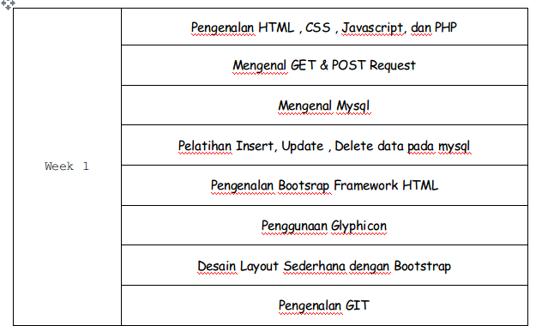
Materi Minggu 1

Slide 4
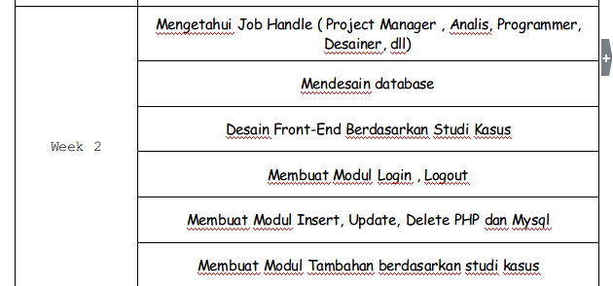
Materi Minggu 2

Slide 5
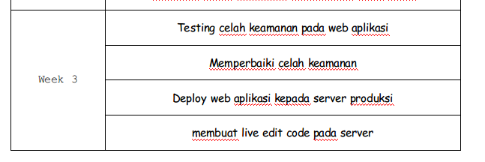
Materi Minggu 3

Slide 6
HTML (Hyper Text Markup Language)
<!DOCTYPE html>
<html>
<head>
<title>Page Title</title>
</head>
<body>
<h1>This is a Heading</h1>
<p>This is a paragraph.</p>
</body>
</html>

Slide 7
HTML stands for Hyper Text Markup Language
HTML describes the structure of Web pages using markup
HTML elements are the building blocks of HTML pages
HTML elements are represented by tags
HTML tags label pieces of content such as "heading", "paragraph", "table", and so on
Browsers do not display the HTML tags, but use them to render the content of the page
Reference : https://www.w3schools.com/html/html_intro.asp

Slide 8
CSS (Cascading Style Sheets)
CSS stands for Cascading Style Sheets
CSS describes how HTML elements are to be displayed on screen, paper, or in other media
CSS saves a lot of work. It can control the layout of multiple web pages all at once
External stylesheets are stored in CSS files
CSS is used to define styles for your web pages, including the design, layout and variations in display for different devices and screen sizes.
Reference : https://www.w3schools.com/css/css_intro.asp

Slide 9
body {
background-color: lightblue;
}
h1 {
color: white;
text-align: center;
}
p {
font-family: verdana;
font-size: 20px;
}

Slide 10
Javascipt

Slide 11
PHP
PHP is an acronym for "PHP: Hypertext Preprocessor"
PHP is a widely-used, open source scripting language
PHP scripts are executed on the server
PHP is free to download and use

Slide 12
What Can PHP Do?
PHP can generate dynamic page content
PHP can create, open, read, write, delete, and close files on the server
PHP can collect form data
PHP can send and receive cookies
PHP can add, delete, modify data in your database
PHP can be used to control user-access
PHP can encrypt data
With PHP you are not limited to output HTML. You can output images, PDF files, and even Flash movies. You can also output any text, such as XHTML and XML.

Slide 13
Why PHP?
PHP runs on various platforms (Windows, Linux, Unix, Mac OS X, etc.)
PHP is compatible with almost all servers used today (Apache, IIS, etc.)
PHP supports a wide range of databases
PHP is free. Download it from the official PHP resource: www.php.net
PHP is easy to learn and runs efficiently on the server side
Reference : https://www.w3schools.com/php/default.asp

Slide 14
Requirement
XAMPP (PHP, MYSQL)
Sublime (optional)

