Slide 1
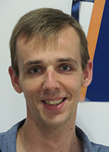
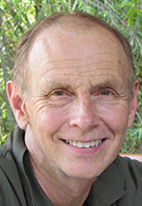
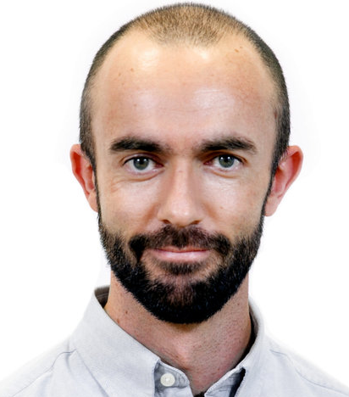



Mutational signature analysis pipelines, machine learning, and benchmarking on synthetic data
Arnoud Boot
arnoud.boot@duke-nus.edu.sg
Duke-NUS Medical School,
Singapore
Steven G Rozen
steverozen@gmail.com
Duke-NUS Medical School,
Singapore
Ferran Muiños
ferran.muinos@irbbarcelona.org
Institute for Research in Biomedicine, Barcelona
Tutorial
11-12 July 2020
1
(Updated 11 July, 9:24 AM EDT)
Notes:
25 minute talk
1

Slide 2
Learning objectives of the course
Understand the biological context of mutational signature analysis
How mutational processes (DNA damage/modification, attempts at repair, DNA synthesis) generate signatures
Common categorizations of mutation types
Prominent mutational processes and their signatures
Understand mutational signature delineation in experimental system
Computational pipeline from sequencing reads to mutational signatures
Pitfalls
Understand mutational signature discovery (“extraction”) by data mining, and understand mutational signature “attribution” – determining which mutational signatures are active in a tumor (or other sample)
Understand how DNA damage, attempts at DNA repair, and DNA synthesis interact with the genomic landscape

Slide 3
Role of mutational signatures in research
Mutational Signatures
Molecular cancer epidemiology
How do mutations cause cancer?
Understanding
of DNA damage and repair
Prevention and screening
Cancer life histories and signature-associated oncogenic pathways
Application
Specific therapeutic opportunities

Slide 4
Role of mutational signatures in research
Discovery
Analysis of large databases
Experimental elucidation
Mutational Signatures
Molecular cancer epidemiology
How do mutations cause cancer?
Understanding
of DNA damage and repair
Prevention and screening
Cancer life histories and signature-associated oncogenic pathways
Application
Specific therapeutic opportunities

Slide 5
Role of mutational signatures in research
Lecture 2
Machine learning and computational analysis in large databases
Lecture 1
Introduction and experimental study of causes of mutational signatures
Discovery
Analysis of large databases
Experimental elucidation
Mutational Signatures
Lecture 3
Differences across the genomic landscape and new understanding
of DNA damage and repair
Molecular cancer epidemiology
How do mutations cause cancer?
Understanding
of DNA damage and repair
Prevention and screening
Cancer life histories and signature-associated oncogenic pathways
Application
Specific therapeutic opportunities

Slide 6
Next, we introduce ourselves

Slide 7
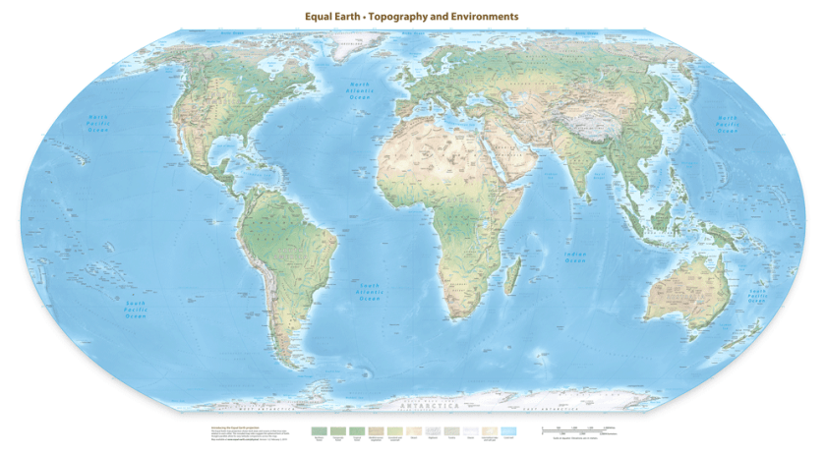
Arnoud Boot
PhD in molecular biology: Genomic instability of thyroid and colorectal cancer.

Slide 8
Arnoud Boot
PhD in molecular biology: Genomic instability of thyroid and colorectal cancer.
Since 2016 part of Steve Rozen’s lab at the Duke-NUS medical school in Singapore.

Slide 9
Arnoud Boot
Interests: Functional genomics; combining bioinformatics tools with wet-lab experiments to study mechanisms underlying tumorigenesis
Mutagenesis
DNA repair and maintenance
Epigenetics
Research contributions to the field of mutational signatures:
First to describe the mutational signatures of:
Cisplatin (Boot et al., Gen.Res, 2018)
Colibactin (Boot et al., Gen.Res, 2020)
TOP2A p.K743N (Boot et al., bioRxiv, 2020)
Also contributed to
Aflatoxin B1 (Huang et al., Gen.Res, 2017)
Aristolochic acid (Ng et al., STM, 2017)
Pan Cancer Analysis of Whole Genomes (Alexandrov et al., Nature, 2020)

Slide 10
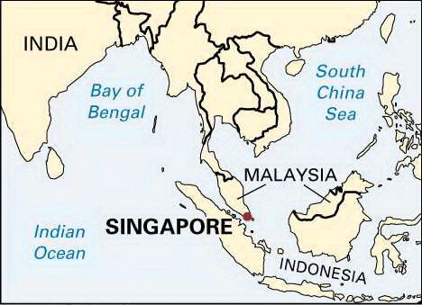
Singapore
Small: 50 km (31 mi) east-west
26 km (16 mi) north-south
5.8 million people
Formerly poor, now rich: per capita GDP > US (purchasing power parity, includes non-citizens)
26 Covid-19 deaths total
http://kids.britannica.com/comptons/art-55105/Singapore
(From CIA World Factbook, https://www.cia.gov/library/publications/the-world-factbook, Nov 2017)
10

Slide 11

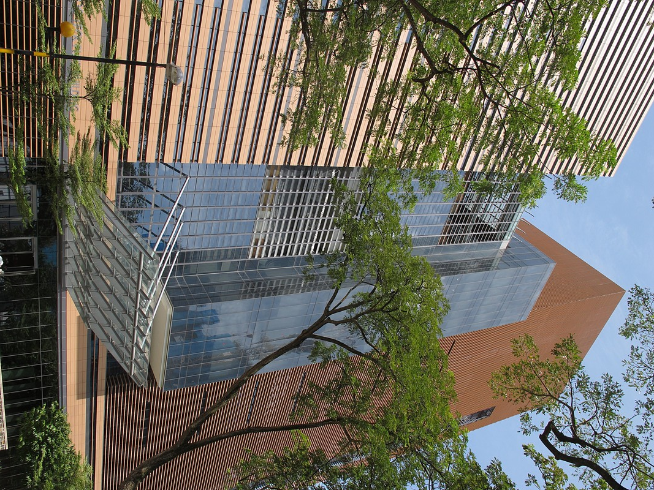
Duke-NUS Medical School
Nonprofit partnership
Duke in North Carolina, USA
National University of Singapore (NUS)
SingHealth, largest public healthcare provider, 3 hospitals, 3,100 beds
60 MDs / year
15 PhD students / year
PhD program in quantitative biology and medicine:
https://www.duke-nus.edu.sg/education/our-programmes/phd/qbm-phd
11

Slide 12
Steve Rozen
Undergrad degree in performing arts
Concluded it wasn’t viable (and not very interesting and I wasn’t very talented)
Got a masters in computer science
Worked on Wall Street for 2 years
Got a PhD in computer science (the dumb way, part time)
Was not willing to relocate for a faculty job in computer science for family reasons, so went to work for Eric Lander at a “genome center”
Helped sequence the human and mouse genomes (small role in huge international effort)
Wrote the Primer3 software and web interface (with Helen Skaletsky), cited by 20,000 papers
12

Slide 13
Steve Rozen
Went to the lab of David Page and did a mix of lab work and bioinformatics for 8 years
Some very high profile genetics publications (Nature, Nature Genetics)
Went to Duke-NUS in 2008, found great collaborators in cancer genomics (Patrick Tan, Bin Teh)
Caught the cancer-resequencing wave: high impact papers on aristolochic acid, gastric cancer, bile duct cancer, …
Last several years heavily involved in mutational signatures, both from data mining and experimental elucidation
Mutational signatures also showed widespread exposure to the carcinogen and nephrotoxin aristolochic acid in multiple cancer types; trying to raise awareness, get more funding, and get more researchers working on this
13

Slide 14
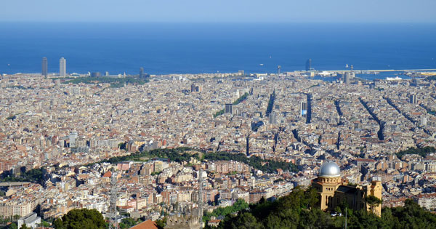

Ferran Muiños
CEST ~ EDT+6
Barcelona, Spain (work)
Sant Pol de Mar (home)
→ 60 km North
14

Slide 15
Ferran Muiños
Undergrad degree in Mathematics
Got a PhD in Mathematics (2011, commutative algebra)
During PhD got involved in private sector as bid writer
Worked as bid consultant and writer for 8 years
Got involved in Bioinformatics Master (2015-2017)
Joined Nuria Lopez-Bigas lab in summer 2016
The lab moved to IRB Barcelona in 2017
15

Slide 16
Ferran Muiños
Research keywords:
computational analysis cancer genomes
mutational heterogeneity in cancer
driver discovery through data mining
Contributor to:
intOGen pipeline (https://intogen.org)
mutational heterogeneity: nucleosomes, ubiquitination, intron-exon
mutational footprint of cancer therapies
Off-topic:
Dancing (balboa, lindy-hop)
16

