Slide 1

How Rofu Thailand's
electricity tariff works
Current PEA tariff structure
and implications for rooftop solar and BESS
Internal briefing | September 2026
Notes:
Purpose: explain the current electricity tariff applied to Rofu Thailand for an internal audience. Visual design follows the supplied Allotrope KEEN reference deck: Keen - Clean Energy Options Analysis_Allotrope 2026.pdf.

Slide 2

Rofu Thailand's utility context
PEA Schedule 4.2
One grid connection
Four transformers supply the factory
Large General Service, time-of-use tariff
500 kVA
Confirmed billing setup
500 kVA
Utility: Provincial Electricity Authority, Phimai branch
1,600 kVA
Voltage: 22-33 kV
630 kVA
Rate code: 4224
3,230 kVA total installed transformer capacity
2025 monthly use: 459-645 MWh | on-peak maximum demand: 1.21-1.38 MW
Internal briefing | September 2026
2
Notes:
Sources: Keen TH Tariff Structure.pdf; PEA invoice for June 2025; RTS Data Collection_KTH_followup_Dec2025 (rebuilt).xlsx; KTH2 Electricity Use.xlsx; email thread Re: [EXTERNAL] Rofu Thailand - Hourly Data Request Letter of Authorization, August-September 2026.

Slide 3

The monthly bill has five building blocks
The utility first calculates usage and capacity charges, then adds VAT
Peak energy
Off-peak + holiday
On-peak demand
Service
Ft adjustment
+
+
+
+
kWh × 4.1839
kWh × 2.6037
max kW × 132.93
THB 312.24
all kWh × Ft
Subtotal
+ 7% VAT
= amount due
A power-factor charge can apply if reactive demand exceeds the tariff allowance.
Internal briefing | September 2026
3
Notes:
Source: Keen TH Tariff Structure.pdf and PEA Schedule 4.2 data embedded in the Thailand tariff implementation. Current project rates: peak THB 4.1839/kWh, off-peak and holiday THB 2.6037/kWh, demand THB 132.93/kW-month, service THB 312.24/month, VAT 7%. Ft varies by announced period. Power-factor charge: THB 56.07/kVAR above the tariff allowance; it is not included in the model outputs because monthly maximum kVAR data were not supplied.

Slide 4

Time-of-use periods determine the energy price
Weekdays
Off-peak
Peak
Off
00:00
09:00
12:00
18:00
22:00
24:00
Saturday, Sunday,
and public holidays
Off-peak for the full day
Why it matters
Solar output overlaps with the higher weekday energy price, but the demand charge depends on one monthly on-peak maximum.
Internal briefing | September 2026
4
Notes:
Source: Keen TH Tariff Structure.pdf and reoptjl/src/thailand/pea_tariff.py. The project applies on-peak to weekday interval end times after 09:00 through 22:00. Saturdays, Sundays, and configured Thai public holidays use off-peak rates all day.

Slide 5

What each charge measures
Charge
Billing basis
What changes the bill
Peak energy
Weekday kWh from 09:00 to 22:00
Lower grid imports during operating hours
Off-peak + holiday
All other kWh
Night, weekend, and holiday grid imports
Demand
Highest on-peak kW in the month
The single interval that sets the monthly peak
Ft adjustment
Ft rate multiplied by all kWh
Total grid energy and the current Ft period
Service and VAT
Fixed monthly fee, then 7% VAT
Service stays fixed, VAT follows the subtotal
Power factor is a conditional charge and requires maximum kVAR data to quantify.
Internal briefing | September 2026
5
Notes:
Source: Keen TH Tariff Structure.pdf; PEA June 2025 invoice; proforma_thailand/defaults/pea_tariff_rates.json. Power factor is described as a conditional charge because monthly maximum kVAR inputs are not available in the current model dataset.

Slide 6

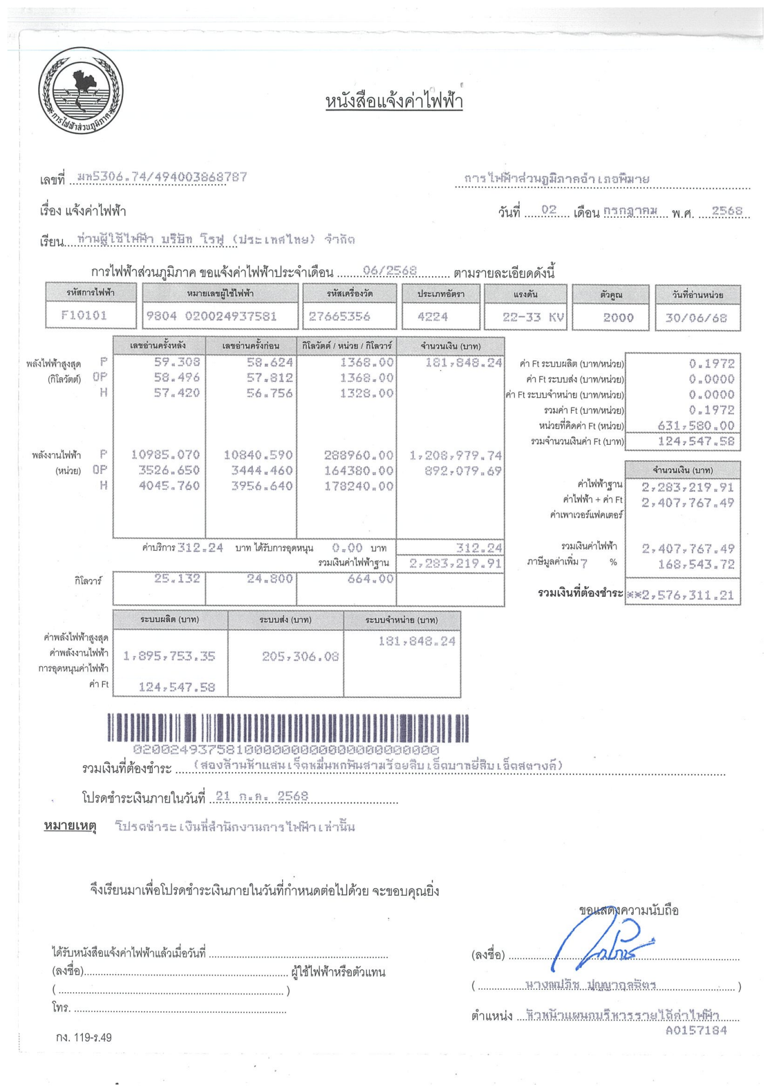
June 2025 bill: THB 2.58 million
Pre-VAT subtotal: THB 2,407,767
631,580 kWh | 1,368 kW on-peak maximum | Ft = THB 0.1972/kWh
50%
37%
Peak energy
Off-peak + holiday
Demand
Ft
THB 1,208,980
THB 892,080
THB 181,848
THB 124,548
Service charge
THB 312
VAT at 7%
THB 168,544
Amount due
THB 2,576,311
Internal briefing | September 2026
6
Notes:
Source: 06. Electricity Bill Jun 2025 KTH2.pdf. Recalculation: peak energy 288,960 kWh x THB 4.1839 = THB 1,208,979.74; off-peak plus holiday energy 342,620 kWh x THB 2.6037 = THB 892,079.69; demand 1,368 kW x THB 132.93 = THB 181,848.24; service THB 312.24; base bill THB 2,283,219.91 on the invoice; Ft 631,580 kWh x THB 0.1972 = THB 124,547.58; subtotal THB 2,407,767.49; VAT THB 168,543.72; amount due THB 2,576,311.21. Component percentages use the pre-VAT subtotal and exclude the negligible service-charge share from the stacked bar.

Slide 7

Rooftop solar avoids energy charges first
How a daytime solar kWh changes the bill
Peak energy
Usually avoided when solar serves the factory during weekday daytime hours
Direct value
Ft adjustment
Avoided on every grid kWh displaced by solar
Direct value
Demand
Avoided only when solar lowers the single monthly on-peak maximum
Conditional
Service charge
Remains on the bill while the grid connection stays active
No change
Surplus export has zero modeled value, so system sizing should prioritize self-consumption.
Internal briefing | September 2026
7
Notes:
Sources: Keen TH Tariff Structure.pdf; corrected KEEN_THAILAND_MEMO.md; Thailand tariff builder and case assumptions. The current case uses no export compensation. Solar can reduce demand charges only when generation coincides with the interval that otherwise sets the month's maximum on-peak kW.

Slide 8

BESS now pays at the confirmed battery price
13-hour weekday peak window
Re-solved 12 Sep 2026
+1.3 pp
09:00
22:00
A battery must shift substantial energy across a long period. At 675 USD/kW that did not pay; at the confirmed 325 USD/kW it does.
incremental grid offset from adding BESS at identical PV
Conservative roof case
The model selects a battery in both cases, neither at a modelling limit, with the battery replaced in year 10 at 100% of install cost. The conclusion has held at three price points.
1,685 kWp PV
222 kW / 367 kWh BESS
32.1% grid offset
Unconstrained roof case
2,847 kWp PV
507 kW / 1,881 kWh BESS
50.4% grid offset
Internal briefing | September 2026
8
Notes:
Source: outputs/thailand_case/rofu_thailand/KEEN_THAILAND_MEMO.md, re-solved 9 Sep 2026 at 500 USD/kWp over 20 years. SUPERSEDES the earlier no-battery finding, which rested on 300 USD/kW plus 250 USD/kWh, i.e. 675 USD/kW for a 1.5 hour system. Keen confirmed 100 USD/kW plus 150 USD/kWh, i.e. 325 USD/kW. Conservative roof case with storage: 1,685 kWp PV, 238 kW / 429 kWh, 31.4% offset, against 30.8% for the same array without storage, so +0.6 pp at identical PV. Unconstrained case: 2,957 kWp PV, 575 kW / 2,378 kWh, 50.9% offset. Do NOT read that against the 41.1% PV-only case as a battery effect: that case also carries 408 kW more PV. Neither battery sits at the 16,000 kWh ceiling, so both are economic choices. Robustness: storage was also selected at 475 USD/kWp over 25 years, so the result survives a dearer array and a shorter life.

Slide 9

Internal diligence items
The roof is the immediate project constraint
The latest site feedback indicates that some roof areas may require reinforcement before PV installation.
01
Structural capacity
Complete an on-site structural assessment and identify reinforcement needs by building.
02
Power factor
Collect monthly maximum kVAR data and confirm whether any excess reactive-demand charge applies.
03
Export and Ft
Keep zero export value in sizing assumptions and retain the Ft period used in each bill comparison.
Internal briefing | September 2026
9
Notes:
Sources: email thread Re: [EXTERNAL] Rofu Thailand - Hourly Data Request Letter of Authorization, September 7, 2026, which reports that an earlier site assessment suggests the existing roof structure may not directly support added PV weight and recommends an on-site assessment; corrected KEEN_THAILAND_MEMO.md; Keen TH Tariff Structure.pdf. The statement that the roof is the immediate constraint is an inference from the roof-limited optimization cases and the latest structural email.

Slide 10

What KEEN should take away
1
The tariff is energy-heavy
Peak and off-peak energy made up 87% of the June 2025 pre-VAT bill.
2
Solar value comes mainly from displaced daytime energy and Ft
Demand savings depend on whether solar output lowers the monthly on-peak maximum.
3
BESS is now economic and belongs in the sizing decision
At the confirmed battery price, with a full-price year-10 replacement, the model selects storage in both cases that permit it. Our earlier no-battery advice stays withdrawn.
4
Structural diligence comes before final sizing
Confirm usable roof capacity, reinforcement cost, and power-factor exposure before contractor comparison.
Internal briefing | September 2026
10
Notes:
Sources: PEA June 2025 invoice calculation; KEEN_THAILAND_MEMO.md re-solved 9 Sep 2026; September 7, 2026 roof-structure email. June 2025 pre-VAT shares: peak energy 50.2%, off-peak and holiday energy 37.1%, demand 7.6%, Ft 5.2%, service 0.01%. Percentages are rounded. Point 3 REVERSES the earlier briefing. Part of the battery value is recovered curtailment, not tariff arbitrage alone: at identical 1,685 kWp arrays, adding storage takes curtailment from 8.6% to 6.3%. That argument does not depend on the peak to off-peak differential holding.

