Slide 1

a = F/m
经典力学→建筑和机械
Classical mechanics
Newtonian mechanics
Dynamics (objects in motion)
Kinematics
Orbital mechanics
Statics (objects in equilibrium)
S₁
S₂
F₀
F_{AB} = F_{BA}
a = g₀=γM/R
F_{m}
M
F = G(m₁m₂)/R²
R
ν

Slide 2
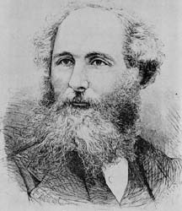
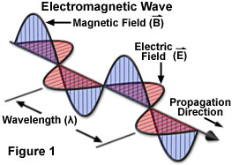
数学
James Maxwell (1831-1879)
电磁场理论
无线电技术
雷达
电磁场与电磁波
微波技术
天线理论

Slide 3
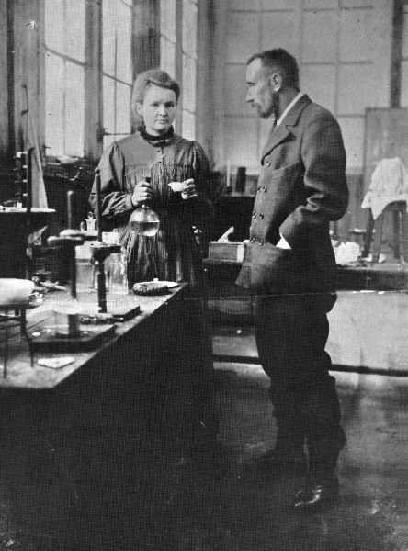
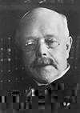
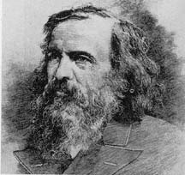
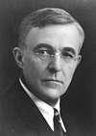

Mendeléev, Dmitri,1834-1907
元素周期表
Curie family, 同位素理论与实践
Walther Hermann Nernst,1864-1941
化学反应理论,热力学第三定理
化学理论
各种化学工业和制药业
Irving Langmuir,1881-1957
表面化学和热离子发射
John Dalton,1766-1844
化学原子理论

Slide 4
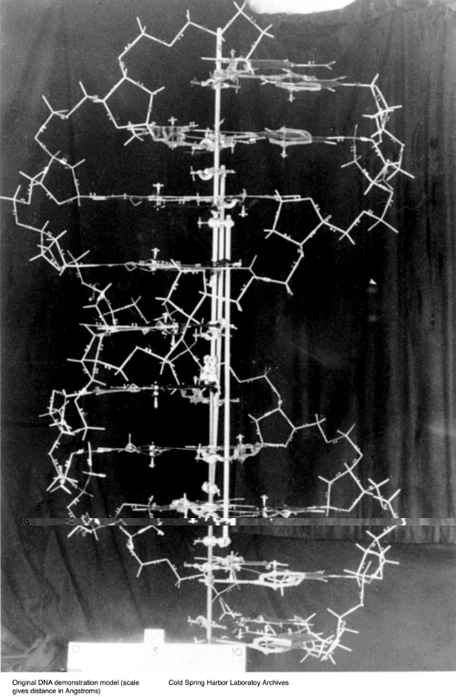
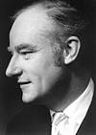
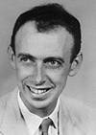
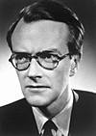
Francis H C Crick
James D Watson
Maurice H F Wilkins
The Nobel Prize in Physiology or Medicine 1962 , "for their discoveries concerning the molecular structure of nucleic acids and its significance for information transfer in living material"
DNA Model
分子遗传学和分子生物学
现代生物技术
基因操纵
医学生物技术
环境生物技术
农业生物技术
能源生物技术
工业生物技术
Original DNA model, 1953

Slide 5
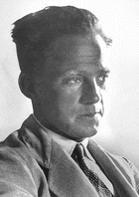
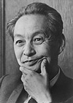
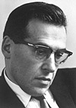
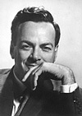
Werner Karl Heisenberg
The father of Quantum mechanics
Sin-Itiro Tomonaga
Julian Schwinger
Richard P. Feynman
The Nobel Prize in Physics 1932, "for the creation of quantum mechanics, the application of which has, inter alia, led to the discovery of the allotropic forms of hydrogen"
The Nobel Prize in Physics 1965 "for their fundamental work in quantum electrodynamics, with deep-ploughing consequences for the physics of elementary particles
微电子学及微电子技术
量子力学
纳米科学与技术

Slide 6
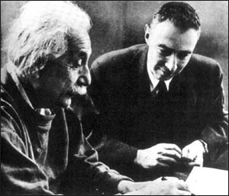
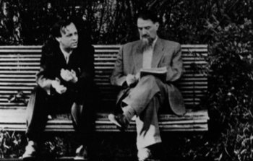
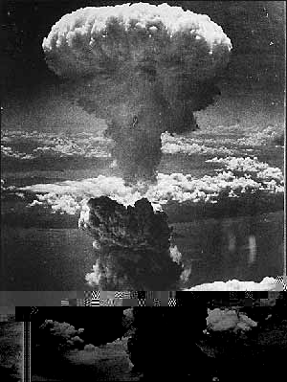
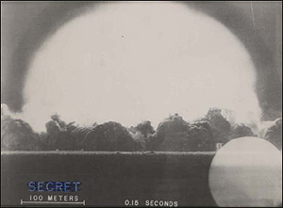
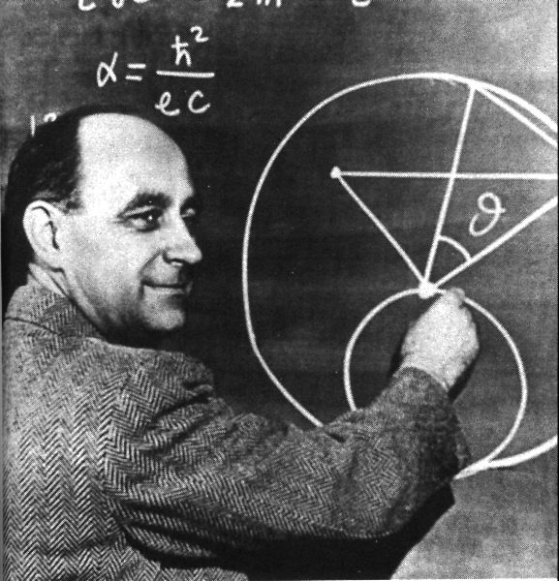
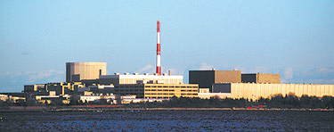
相对论和核物理学
→核能
Andrei Sakharov (l) with Igor Kurchatov (r)
Albert Einstein and Robert Oppenheimer
first warned President Franklin D. Roosevelt of the possibility that Germany could develop a nuclear bomb in August 1939. But the U.S. government didn't launch its own bomb effort, the Manhattan Project, until the summer of 1942. J. Robert Oppenheimer (right) led the team of physicists who designed the atomic bomb at Los Alamos National Laboratory in New Mexico.
This photo was snapped .15 seconds after the world's first atomic bomb exploded on July 16, 1945. It was taken six miles from ground zero.
Millstone Power Station
A dense column of smoke rises 60,000 feet above Nagasaki, Japan, the result of the "Fat Man" atomic bomb dropped on the port city on Aug. 9, 1945. It was the second atomic bomb used in warfare. The first was dropped on Hiroshima, Japan, on Aug. 6, 1945.
Enrico Fermi 1901-1954
Photo: U.S. Department of Defense, National Archives

Slide 7
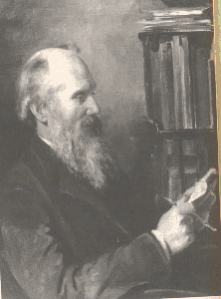
热力学
Thermodynamics
Zeroth law
1st law
2nd law
3th law
发动机
William Thomson, Baron Kelvin, 1824 –1907
was a mathematical physicist who did important work in thermodynamics. In recognition of his achievements, he was in 1892 created Baron Kelvin, of Largs in the County of Ayr, and was commonly known as Lord Kelvin. He was elected a Fellow of the Royal Society in 1851 (serving as its President, 1890 – 1895), was appointed GCVO in 1896, and in 1902 became one of the first members of the Order of Merit as well as a Privy Counsellor. After his death he was buried in Westminster Abbey, London.
热机
制冷机

