Slide 1


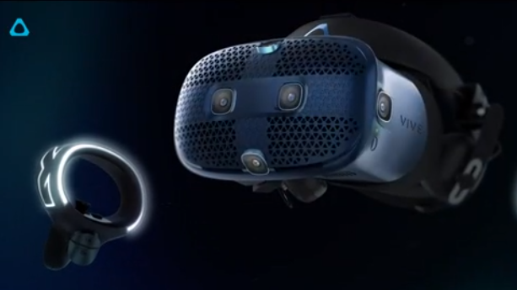
The Design of a circuit solving video game
Konnet Wayne
Department of Engineering and Aviation Sciences
University of Maryland Eastern Shore

Slide 2
oUTLINE
Introduction
Objective
Design Requirement
Design Constraints
Design Approach
Standards
System Diagram
Design Tasks
Team Organization
Timeline
Project Implementation
Conclusion
Acknowledgment
ABET
Question and Answer

Slide 3
Introduction
Virtual Reality for Education and Workforce training
It is evolving
It is effective
It is interactive

Slide 4
Objective
Create a fun and educative game that will help students better understand and solve circuit.

Slide 5
Design Requirement
The Virtual Reality Learning game will be a Shooting game
Players will solve a logic puzzle in order to have an upgrade of their gun
Mystery boxes (weapons, coins, or protection) will be placed in random places for players to find
There will be a total of 12 puzzle
There will be a timer for each scenarios that the player most work with.
Student will learn how to solve parallel and series circuit in two different scenarios
User will search, fight and defeat to be able to find the puzzles to solve
A wizard puts a player into a dimension of horror were there are darkness, fire, and monsters that he/she must defeat. Little do the player know that that is only the beginning. There is new dimension with a different scenario at the end of every other dimension. The player has 20 minutes to fight his/her way out of each scenario while solving circuits until the wizard can be find and defeated.

Slide 6

Design constraints
For the virtual game to work, the software for the game must be downloaded on a laptop that has a WIFI which will then be connected to an HTC VIVE.

Slide 7
Design Approach
Step 1
software
Step 2
Design
Step 3
Script
Step 4
Connect
Step 5
Test

Slide 8

Standards
No Standards

Slide 9
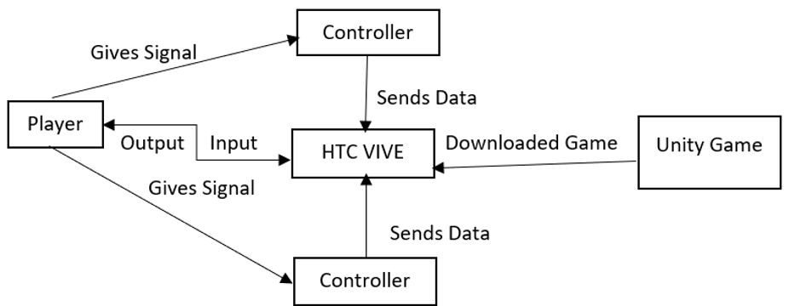
System Diagram ( or Flowchart)

Slide 10
Design Tasks
Task 1: Research
Task 2: Building Design
Task 3: Scenario one: Haunted House Attack
Subtask 1: Environment
Subtask 2: Creature
Subtask 3: Puzzles
Subtask 4: C#
Subtask 5: Assemble
Task 4: Forest Attack
Subtask 1: Environment
Subtask 2: Creature
Subtask 3: Puzzles
Subtask 4: C#
Subtask 5: Assemble
Task 5: Scenario Assemble
Task 6: Test

Slide 11
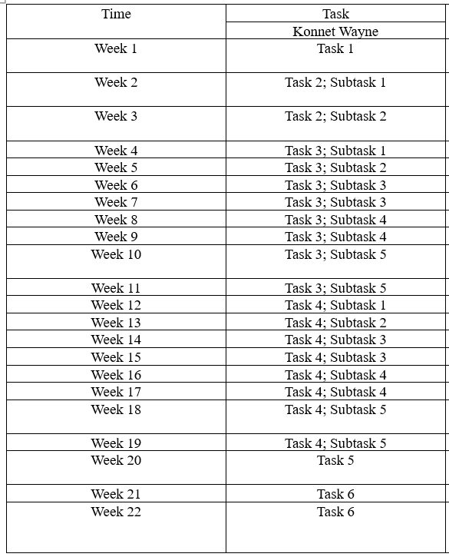
Project Implementation Timeline

Slide 12
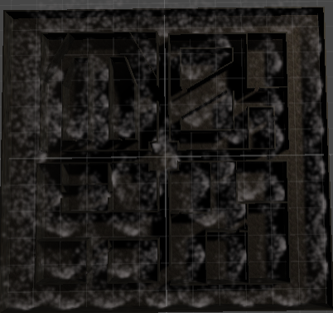
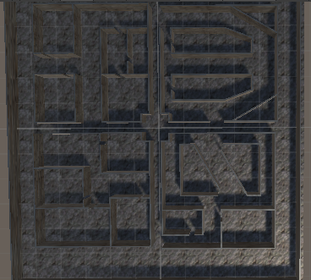
TASK 2

Slide 13
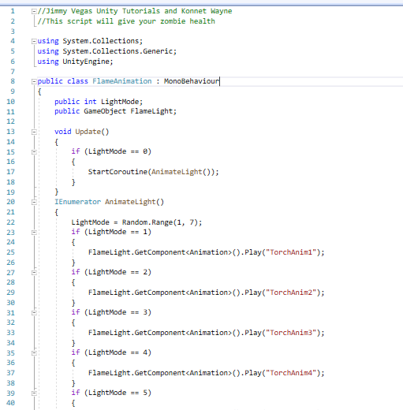
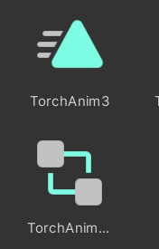
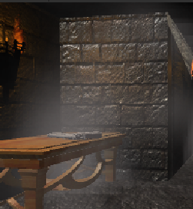
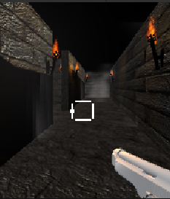
Task 3

Slide 14
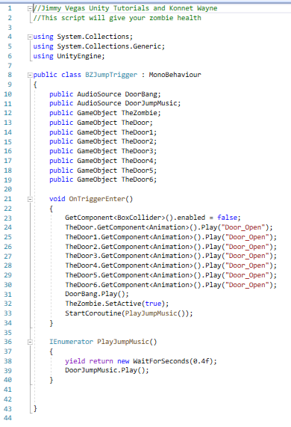
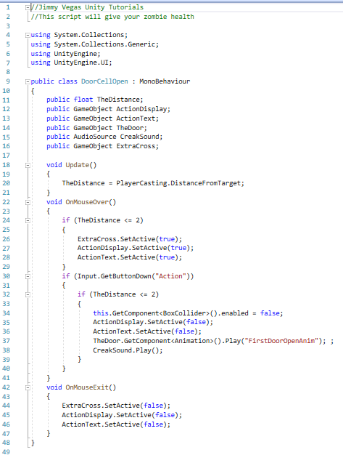
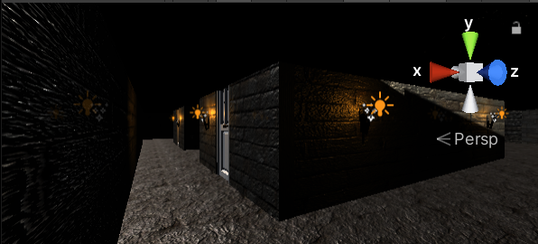
Task 3 Cont.

Slide 15
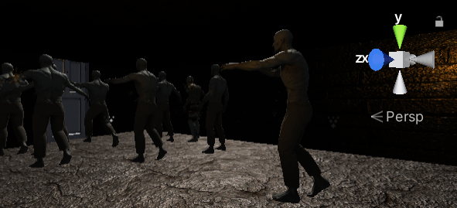
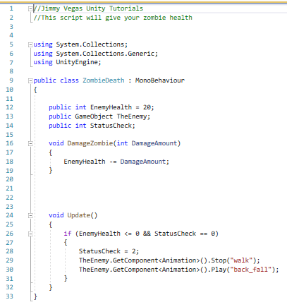
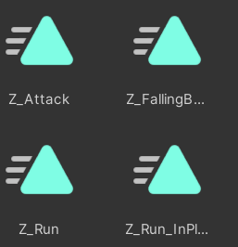
Task 3

Slide 16
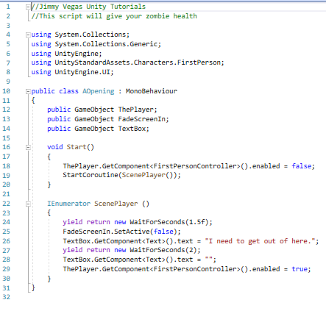
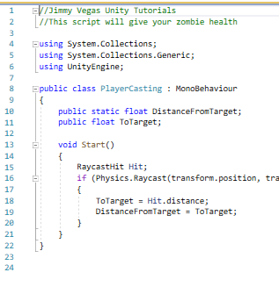
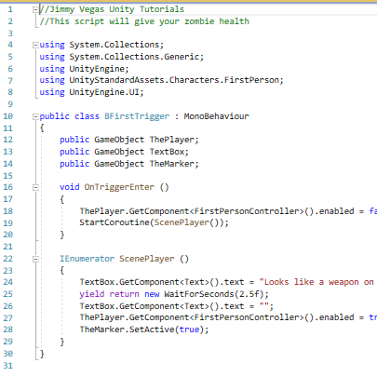
TASK 3 CONT.

Slide 17
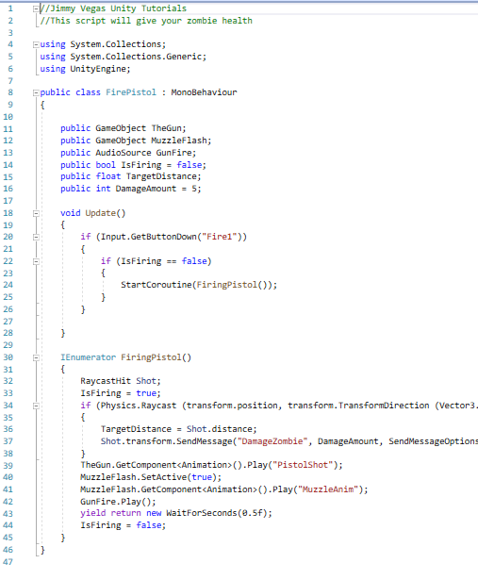
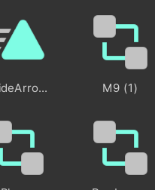
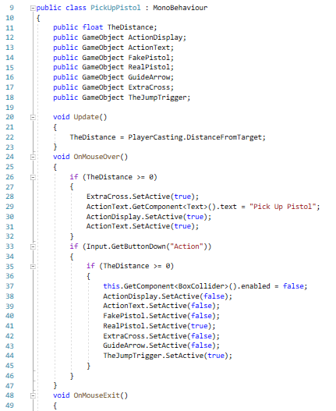
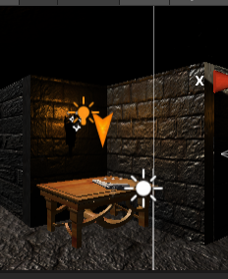
TASK 3 CONT.

Slide 18
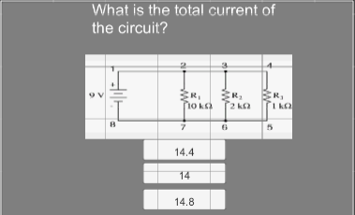
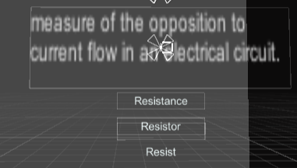
TASK 3 CONT.

Slide 19
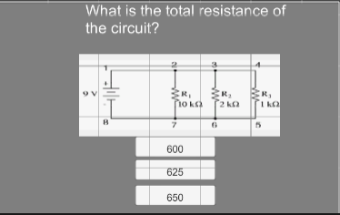
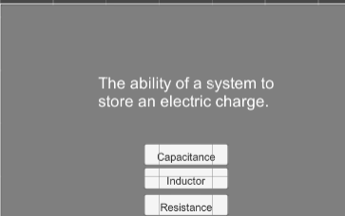
Task 3 Cont.

Slide 20
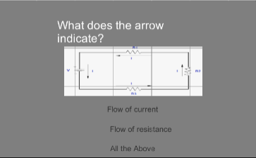
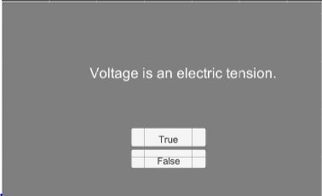
Task 3 cont.

