Slide 1
DEEP MIMO DETECTION
THANOPOULOU KONSTANTINA
1066581 SMHN

Slide 2
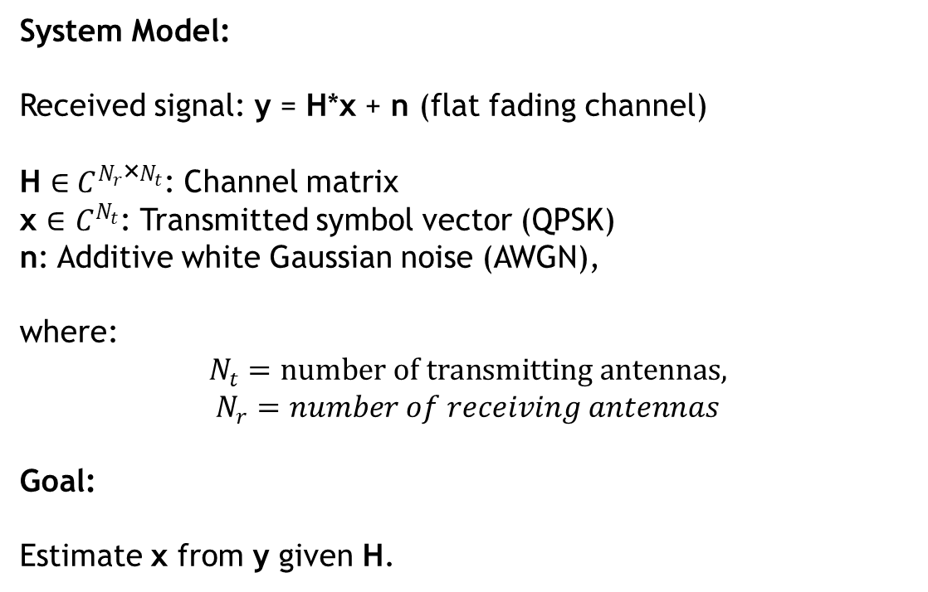
MIMO Detection Problem
System Model:
Received signal: y = H*x + n (flat fading channel)
H ∈${ C}^{N_{r}\text{×}N_{t}}$​: Channel matrix
x ∈ $C^{N_{t}}$: Transmitted symbol vector (QPSK)
n: Additive white Gaussian noise (AWGN),
where:
$$N_{t}=number of transmitting antennas,$$
$$N_{r}=number of receiving antennas$$
Goal:
Estimate x from y given H.
Notes:
4*8 MIMO

Slide 3
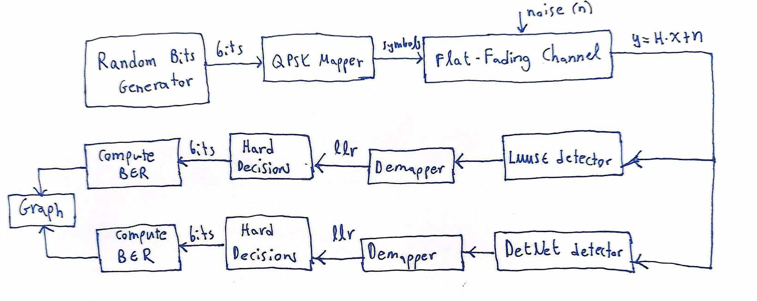
Block Diagram

Slide 4
LMMSE detection flow
(1) Random Bit Generation & Mapping to QPSK symbols & normalization
(2) Pass the symbols through a flat-fading channel ‐ Create a random complex channel H matrix ‐ Add AWGN noise
(3) Pass the received signal y and the channel H to the LMMSE equalizer (to get x_hat)
(4) Get the llr from the demapper used on x_hat
(5) Get the bits of the symbol x_hat by performing hard decision given the llr
(6) Compare the bits detected with the ground truth bits to get bit error rate (BER)

Slide 5
DetNet detection flow
Random Bit Generation & Mapping to QPSK symbols & normalization
Pass the symbols through a flat-fading channel
- Create a random complex channel H matrix
- Add AWGN noise
(3) Real-Valued Conversion to enter values to DetNet detector
(4) Pass the real-valued channel and received signal to the DetNet model (inference).
(5) Turn the estimated x value (x_hat) from real to complex.
(6) Get the llr from the demapper used on x_hat
(7) Get the bits of the symbol x_hat by performing hard decision given the llr.
(8) Compare the bits detected with the ground truth bits to get bit error rate (BER).

Slide 6
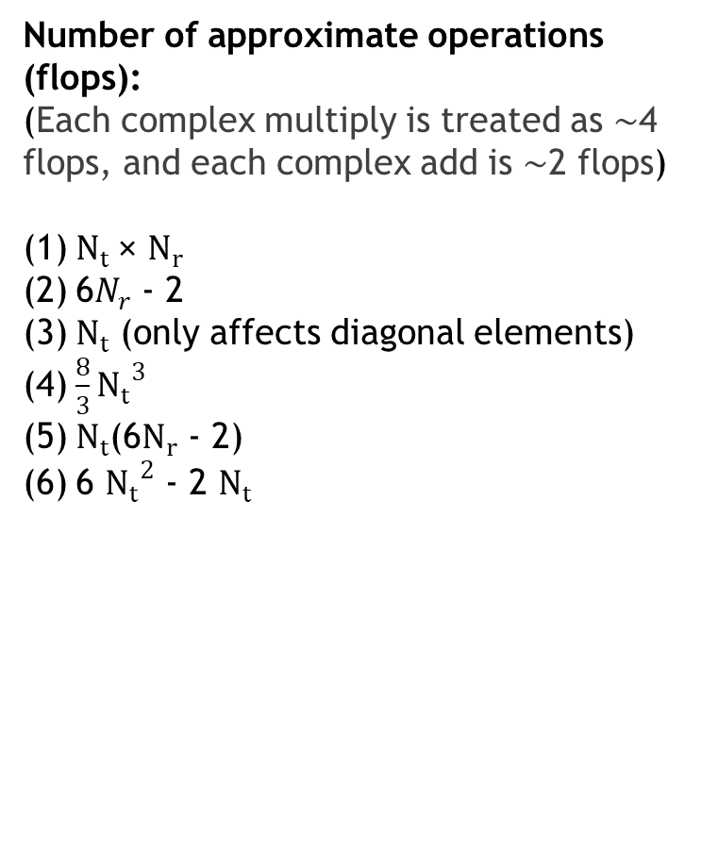
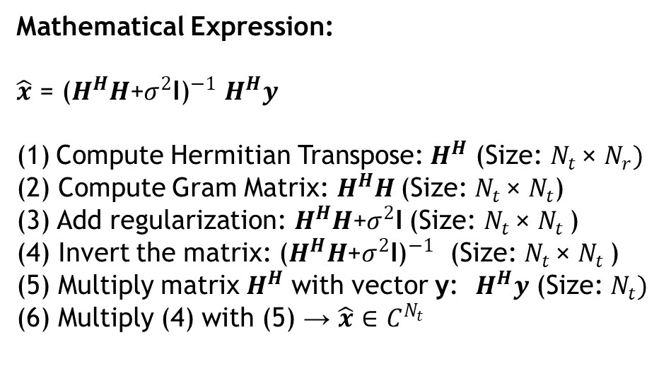
LMMSE Detector – Number of operations
Number of approximate operations (flops):
(Each complex multiply is treated as ∼4 flops, and each complex add is ∼2 flops)
$N_{t}$× $N_{r}$
6$N_{r}$ - 2
$N_{t}$ (only affects diagonal elements)
$\frac{8}{3}{N_{t}}^{3}$
$N_{t}$(6$N_{r}$ - 2)
6 ${N_{t}}^{2}$ - 2 $N_{t}$
Mathematical Expression:
$\hat{x}$ = ${\text{(}H^{H}H\text{+}σ^{2}\text{I}\text{)}}^{−1}$ $H^{H}y$
Compute Hermitian Transpose: $H^{H}$ (Size: $N_{t}$× $N_{r})$
(2) Compute Gram Matrix: $H^{H}H$(Size: $N_{t}$× $N_{t}$​)
(3) Add regularization: $H^{H}H\text{+}σ^{2}\text{I}$ (Size: $N_{t}$× $N_{t}$​)
(4) Invert the matrix: ${\text{(}H^{H}H\text{+}σ^{2}\text{I}\text{)}}^{−1}$ (Size: $N_{t}$× $N_{t}$​)
(5) Multiply matrix $H^{H}$ with vector y: $H^{H}y$ (Size: $N_{t})$
(6) Multiply (4) with (5) → $\hat{x} \text{∈ }C^{N_{t}}$

Slide 7
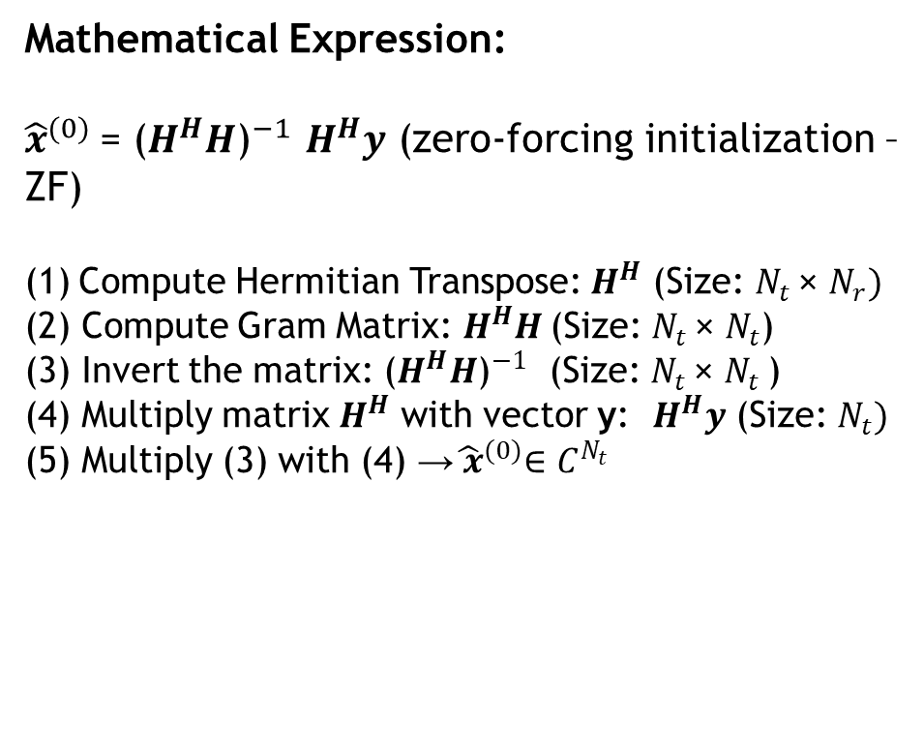
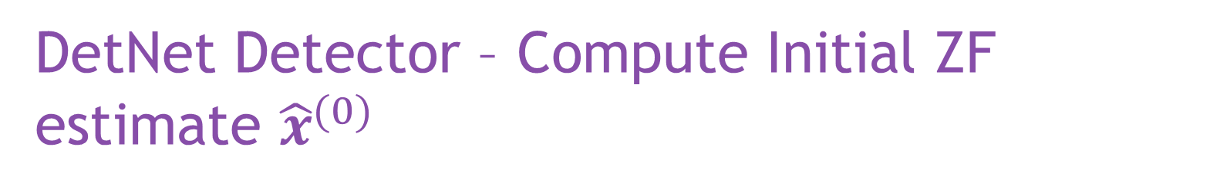

DetNet Detector – Compute Initial ZF estimate ${\hat{x}}^{(0)}$
Mathematical Expression:
${\hat{x}}^{(0)}$= ${\text{(}H^{H}H\text{)}}^{−1}$ $H^{H}y$ (zero-forcing initialization – ZF)
Compute Hermitian Transpose: $H^{H}$ (Size: $N_{t}$× $N_{r})$
(2) Compute Gram Matrix: $H^{H}H$(Size: $N_{t}$× $N_{t}$​)
(3) Invert the matrix: ${\text{(}H^{H}H\text{)}}^{−1}$ (Size: $N_{t}$× $N_{t}$​)
(4) Multiply matrix $H^{H}$ with vector y: $H^{H}y$ (Size: $N_{t})$
(5) Multiply (3) with (4) →${\hat{ x}}^{(0)}\text{∈ }C^{N_{t}}$
Number of approximate operations (flops):
(Each complex multiply is treated as ∼4 flops, and each complex add is ∼2 flops)
$N_{t}$× $N_{r}$
6$N_{r}$ - 2
$\frac{8}{3}{N_{t}}^{3}$
$N_{t}$(6$N_{r}$ - 2)
6 ${N_{t}}^{2}$ - 2 $N_{t}$

Slide 8

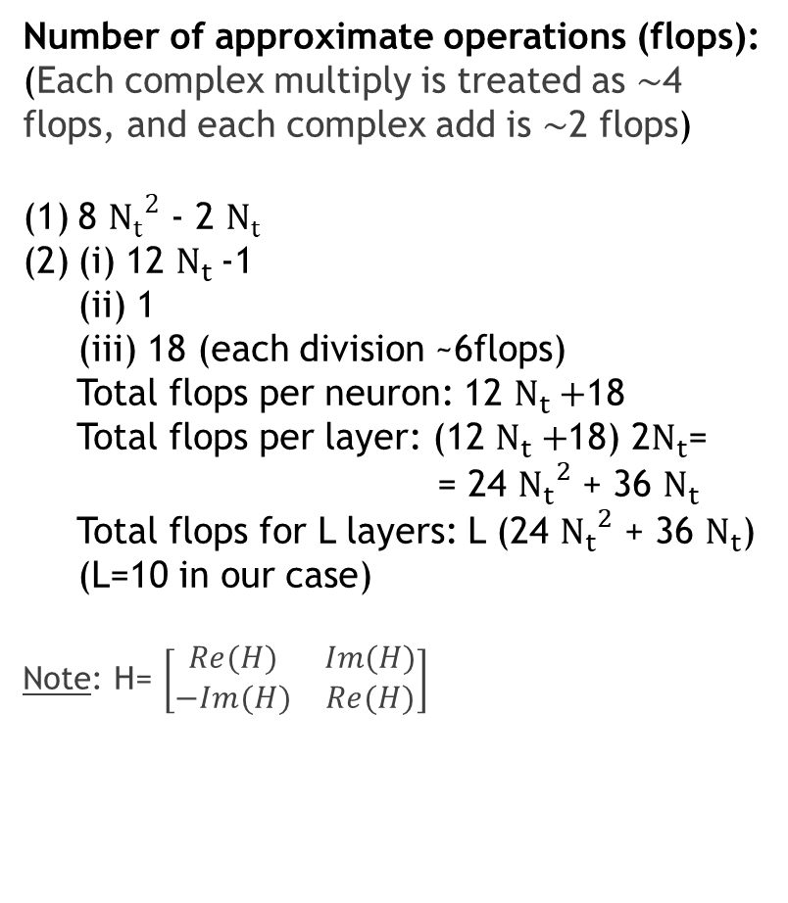
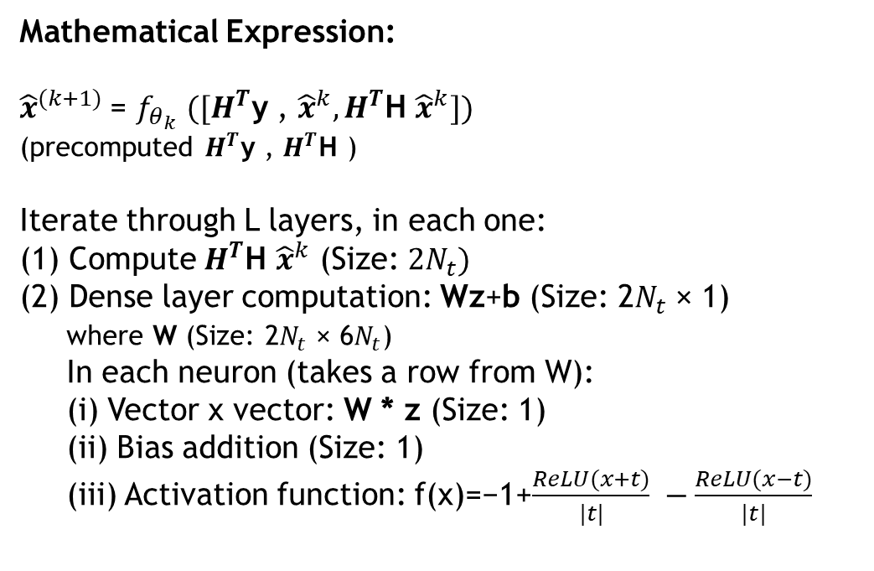
DetNet Detector – Compute ${\hat{x}}^{(k+1)}$
Number of approximate operations (flops):
(Each complex multiply is treated as ∼4 flops, and each complex add is ∼2 flops)
8 ${N_{t}}^{2}$ - 2 $N_{t}$
(i) 12 $N_{t}$-1
(ii) 1
(iii) 18 (each division ~6flops)
Total flops per neuron: 12 $N_{t}+$18
Total flops per layer: (12 $N_{t}+$18) 2$N_{t}$=
= 24 ${N_{t}}^{2}$ + 36 $N_{t}$
Total flops for L layers: L (24 ${N_{t}}^{2}$ + 36 $N_{t}$)
(L=10 in our case)
Note: H= $\left[\begin{matrix}Re(H) & Im(H) \\ −Im(H) & Re(H)\end{matrix}\right]$
Mathematical Expression:
${\hat{x}}^{(k+1)}$= $f_{θ_{k}}$ ${([H}^{T}\text{y}$ , ${\hat{x}}^{k}, H^{T}\text{H}$ ${\hat{x}}^{k}])$
(precomputed $H^{T}\text{y}$ , $H^{T}\text{H}$ )
Iterate through L layers, in each one:
(1) Compute $H^{T}\text{H}$ ${\hat{x}}^{k}$ (Size: ${2N}_{t})$
(2) Dense layer computation: Wz+b (Size: 2$N_{t}$ × 1)
where W (Size: 2$N_{t}$ × 6$N_{t}$)
In each neuron (takes a row from W):
(i) Vector x vector: W * z (Size: 1)
(ii) Bias addition (Size: 1)
(iii) Activation function: f(x)=−1+$\frac{ReLU(x+t)}{|t|} −\frac{ReLU(x−t)}{|t|}$
Notes:
All are converted in real domain inside the DNN, so the dimensions are double the original size

Slide 9
Training
Training Hyperparameters:
Number of Epochs: 50
Steps per Epoch: 150
Batch Size: 2000 per step
Optimizer: Adam with learning rate 0.001
Loss & Regularization:
Per‐layer MSE with a logarithmic weight: log(i) for layer i
SNR Scheduling
First 25 epochs: SNR sampled uniformly between [0,5] dB
Then in the next 25 epochs between [6,10] dB

Slide 10
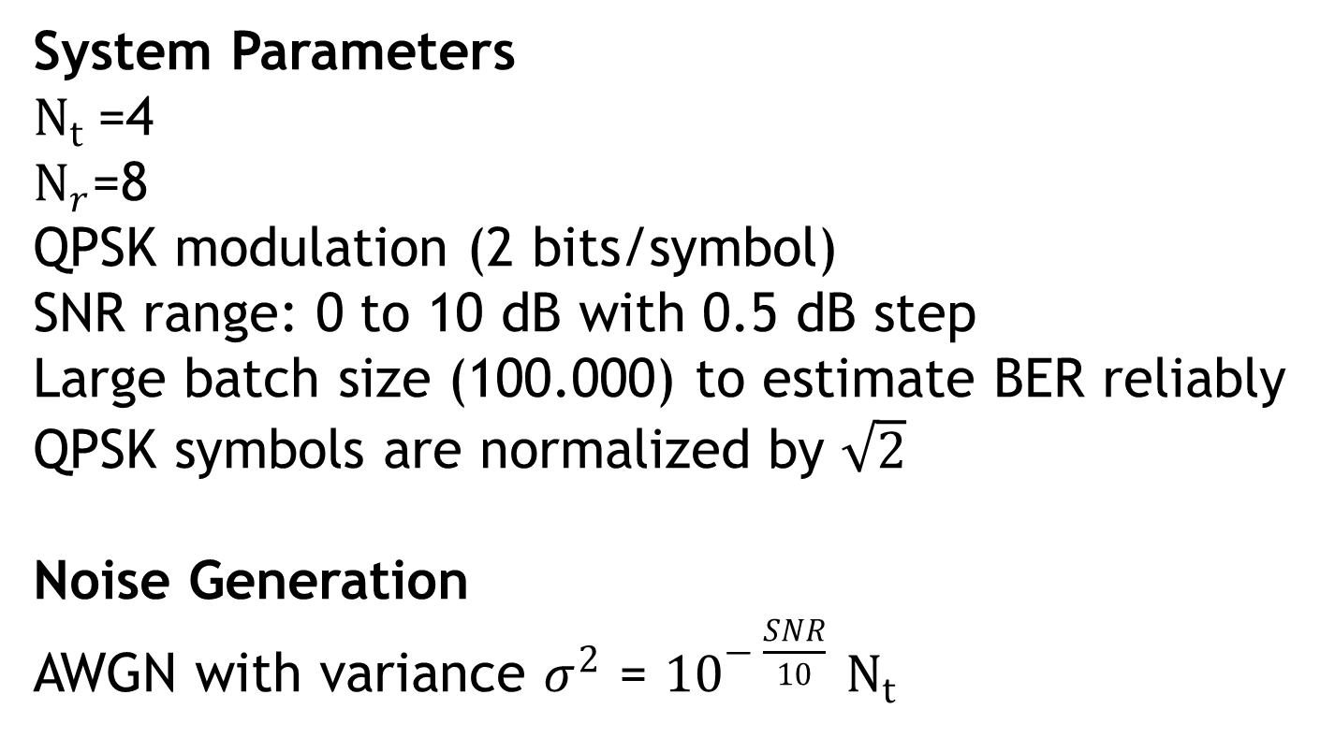
Simulation setup
System Parameters
$N_{t}$=4
$N_{r}$=8
QPSK modulation (2 bits/symbol)
SNR range: 0 to 10 dB with 0.5 dB step
Large batch size (100.000) to estimate BER reliably
QPSK symbols are normalized by $\sqrt{2}$
Noise Generation
AWGN with variance $σ^{2}$ = ${10}^{− \frac{SNR}{10}}$ $N_{t}$

Slide 11
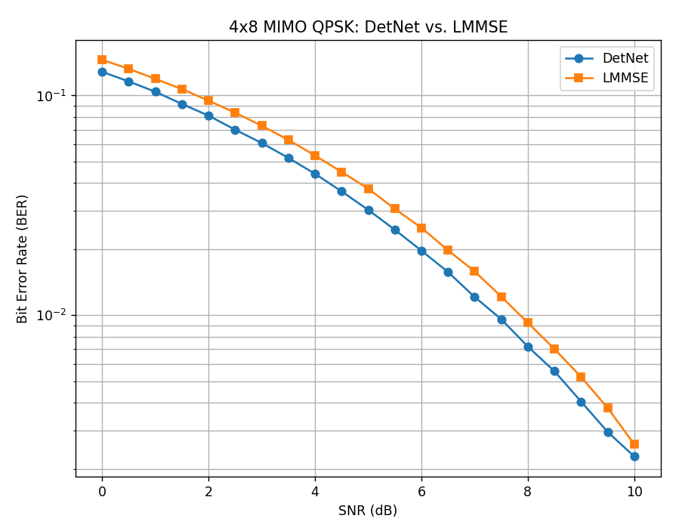
RESULTS

Slide 12
CONCLUSIONS
DetNet provides better BER performance than LMMSE at all SNR levels, despite its higher computational cost.
DetNet requires additional training and implementation complexity, whereas LMMSE is a linear detector with a closed-form solution and no training needed.
DetNet’s scalability is limited by its ZF initialization, which includes a matrix inversion similar to LMMSE. If a more efficient initialization were used, DetNet could scale better for larger MIMO systems.

Slide 13
THANK YOU!
DetNet inspired by:
https://github.com/hello-zhanghao/MIMO_detection_algorithms/blob/master/DetNet.py

