Slide 1

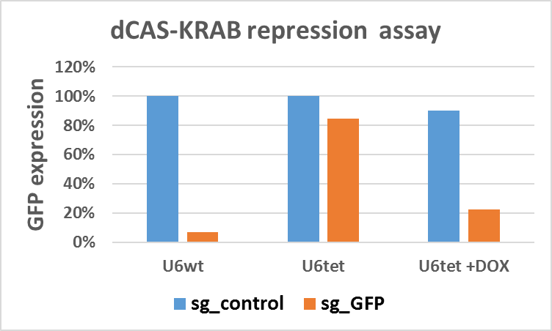
dCAS9-KRAB

Slide 2

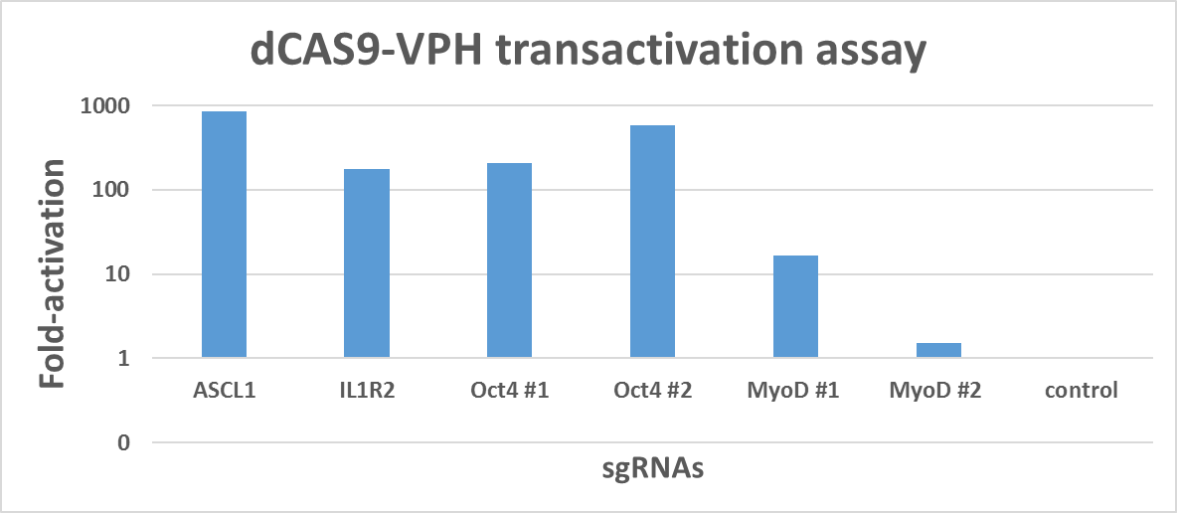
dCAS9-VPH

