Slide 2
CRISPR-KO vs CRISPRa/i
TA
d
CAS9
sgRNA
D10A
NGG
H841A
DNA substrate

Slide 3
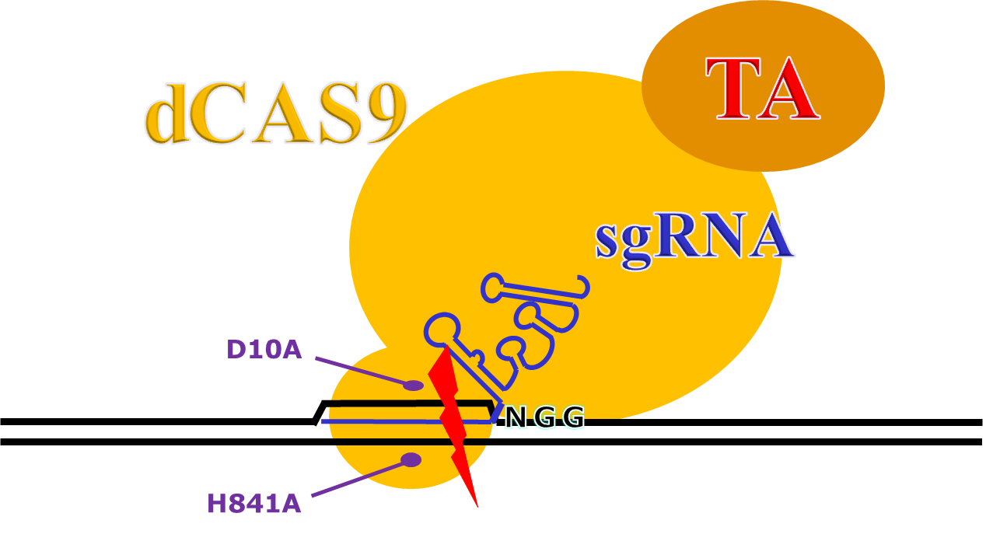
CRISPRi and CRISPRa Variations
KRAB
promoter
Gene X
promoter
Gene X

Slide 4
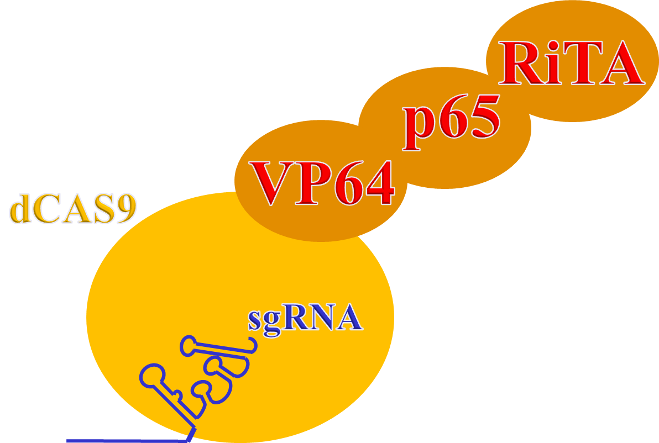
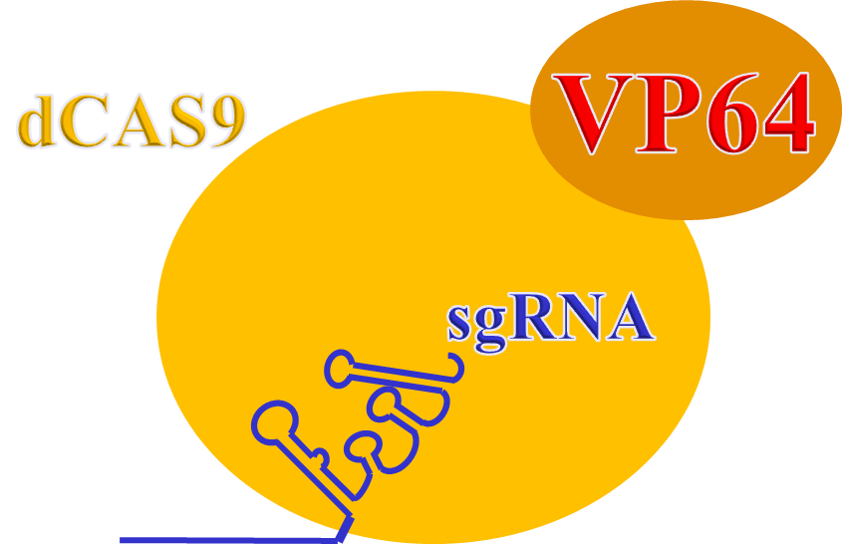
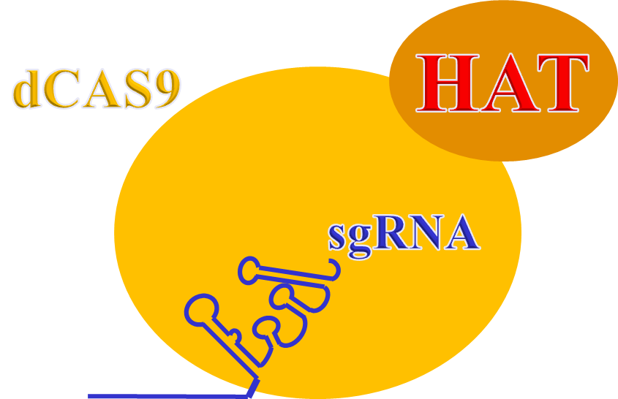
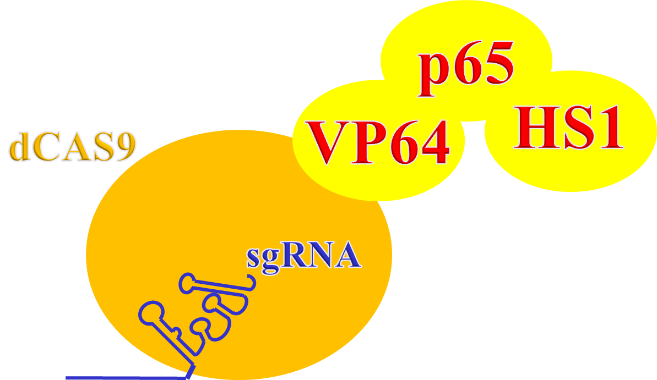
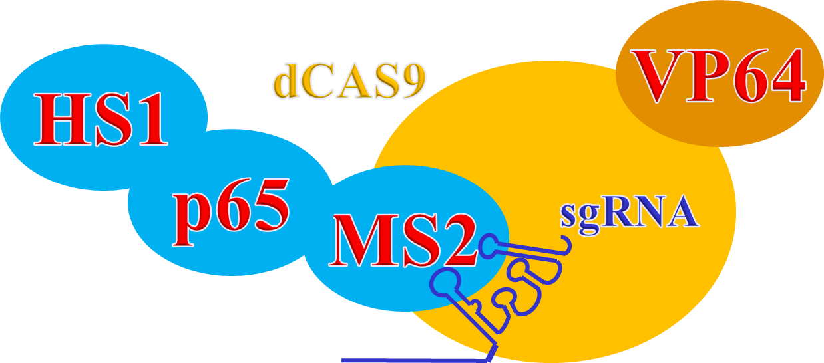
Transcriptional activators
(VPR)
(VPH)
(SAM)

Slide 5
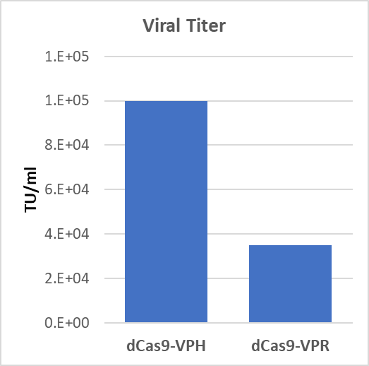
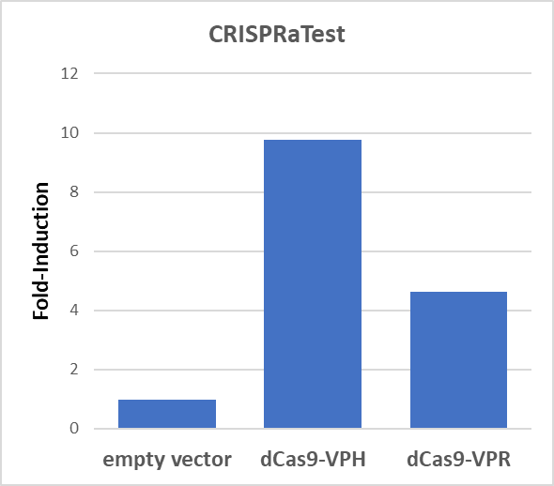
VPH vs VPR

Slide 6
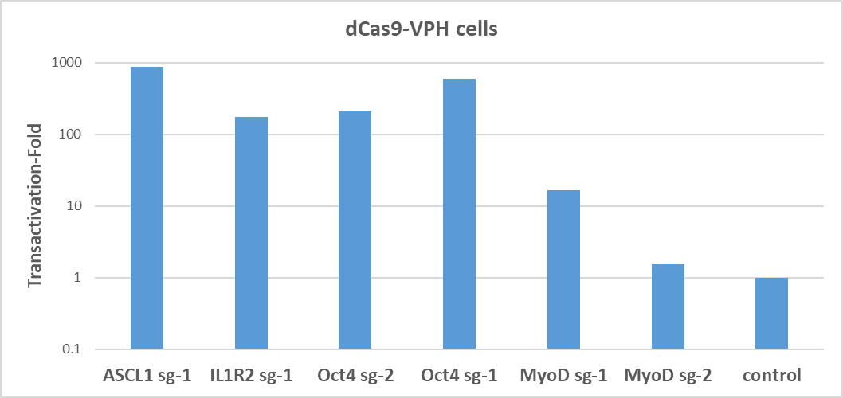
VPH: Transactivation of Endogenous Genes

Slide 7
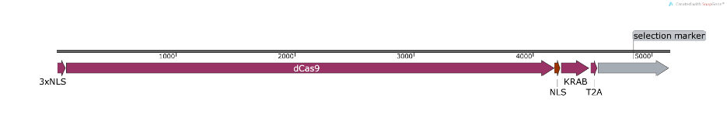
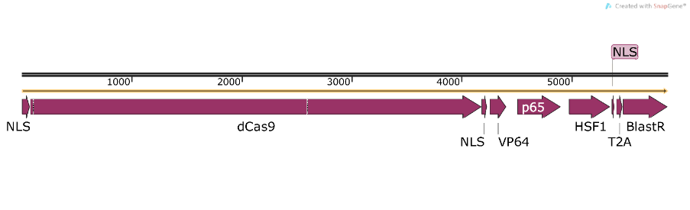
CRISPRi and CRISPRa (Hybrid dCas9)
dCAS9-KRAB
Standard dCas9-inhibitor design.
dCAS9-VPH
We configured our own dCas9-activator using the same elements as the SAM activator, except for the MS2 aptamers, that is expressed all on a single constructs.
Facilitates use for CRISPR screens
Uses a standard sgRNA structure so CRISPRa libraries can also be used with other dCas9-activator variations such as dCas9-VPR
(Likely that CRISPRa screen results may vary somewhat with different activator variations so the ability to swap out dCas-activator variations with same library provides more flexibility for screens.

Slide 8
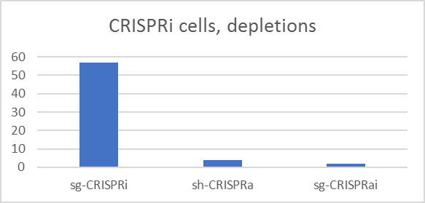
CRISPRi Screens
Screens with dCas9-Krab expressing cells with three different sgRNA designs:
sg-CRISPRi – Weissman sgRNA Designs v2.1 for CRISPRi (eLife 2016;5:e19760)
sg-CRISPRa – Weissman sgRNA Designs v2 CRISPRa (eLife 2016;5:e19760)
sg-CRISPRai – Novel Cellecta test designs

Slide 9
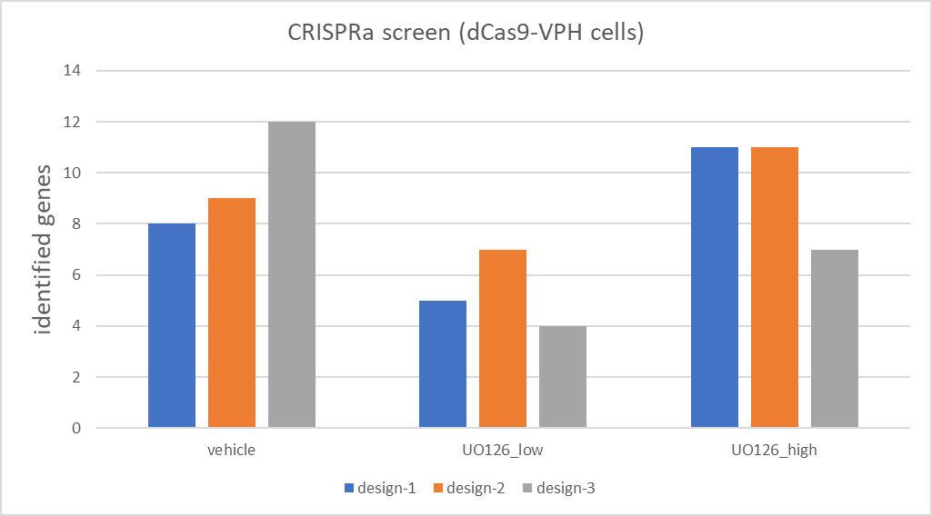
CRISPRa sgRNA Design Testing
Screens with
dCas9-VPH cells expressing cells with three different sgRNA designs:
design-1 – Weissman sgRNA Designs v2.1 for CRISPRi (eLife 2016;5:e19760)
design-2 – Weissman sgRNA Designs CRISPRa v2 (eLife 2016;5:e19760)
design-3 – Novel Cellecta test designs

Slide 10

CRISPR Human Genome-Wide Knock Out Library:
80K Single Module Library
Targets all ~19,000 protein coding human genes
4 sgRNA/gene—selected/designed based on Doench et al., Nature Biotechnology, Jan 2016
Human Genome-Wide CRISPRa and CRISPRi:
106K Single Module libraries
Each express ~106,000 sgRNA targeting almost 19,000 human protein coding genes.
5 sgRNAs designed against promoter region for each gene (Horbeck, et al., eLife 2016;5:e19760 DOI: 10.7554)
CRISPR Mouse Genome-Wide Knock Out Library:
80K Single Module Library
Targets ca. 20,000 protein coding mouse genes
4 sgRNA/gene—designed based on Doench rules and biased to functional domains.
Mouse Genome-Wide CRISPRa and CRISPRi: Single Module libraries
Each express ~109,000 sgRNA sgRNA targeting almost ~20,000 mouse protein coding genes.
5 sgRNAs designed against the promoter region (Horbeck, et al., eLife 2016;5:e19760 DOI: 10.7554)
Custom RNAi and CRISPR Libraries
Service includes design/synthesis and cloning and of the oligos and NGS sequencing to verify representation.
Target any set of genes with any number of shRNAs or sgRNAs per gene.
Choose any of our several vectors or have us clone into one you provide
Ability to design libraries to target non-human genomes—mouse, rat, pig, etc.
HEAT sgRNA designs, standard version, or other customer-defined variations

Slide 11
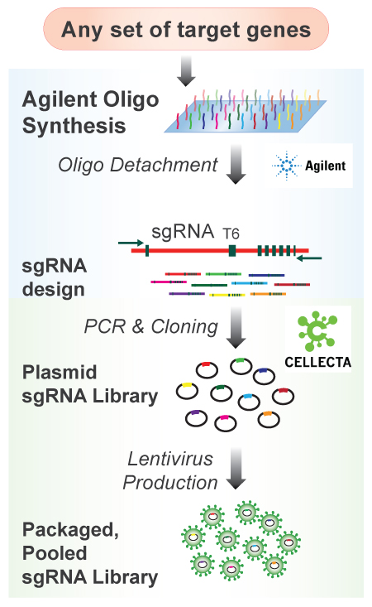
Agilent’s Quality Oligos + Cellecta’s Library Expertise
Give us your gene or guide list and get a fully cloned NGS-verified CRISPR libraries
Have library made with Agilent’s pSGLenti vector, any of a range of Cellecta vectors, or your vector
Packaging options available to you receive a fully QCed library that can directly added to cells to start a screen
Just contact Cellecta and we do the rest…
Design and purchase Agilent guide oligonucleotides
Clone into the vector of your choice
QC library by Sanger Sequencing of individual clones and full NGS analysis
Provide you with 500ug of the plasmid, plus NGS distribution of guide sequences
Option to package library into ready-to-transduce VSV-g lentiviral particles

Slide 12
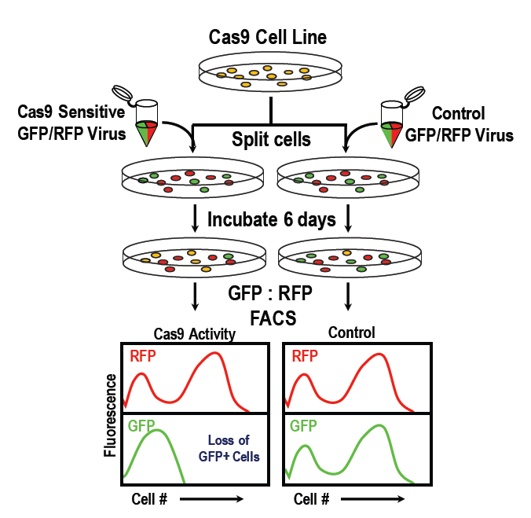
CRISPR-Test Assay Kits
Measure functional activity of
- Cas9 nuclease : CRISPRuTest
- dCas9-activator : CRISPRaTest
- dCas9-repressor : CRISPRiTest
Works with any mammalian cell line in 4-6 days
(original CRISPRtest only works in human cells)
Quantitative FACS-based readouts
Complete kits with ready-to-transduce lentiviral particles
Catalog # | Item Description | Amount | Price
CRUTEST | CRISPRuTest™ Functional Cas9 Nuclease Activity Assay Kit for Any Cell Type (Mammalian) | 1 kit – 10 cells | $ 850
CRATEST | CRISPRaTest™ Functional dCas9-Activator Assay Kit | 1 kit – 20 cells | $ 850
CRITEST | CRISPRiTest™ Functional dCas9-Repressor Assay Kit | 1 kit – 20 cells | $ 850

Slide 13
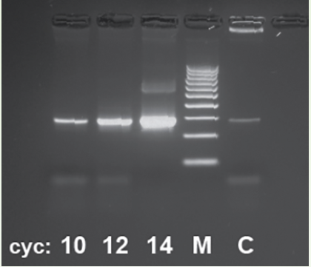
Next-Generation Sequencing (NGS) Library Prep Kits
Kits include all primers and PCR reagents needed to prepare 24 samples for multiplex runs on Illumina NextSeq or HiSeq NGS platforms
Analysis kits available for various CRISPR, RNAi, barcode libraries
All Cellecta Libraries
GeCKO, Brunello, Brie
Other common libraries in same vectors
NGS and Analysis Services still also available
For researchers running their own screens
Includes DNA extraction, amplification, sequencing, and determining guide, shRNA or barcode counts
Catalog # | Item Description | Amount | Price
LNGS-101 | NGS Prep Kit for DECIPHER (shRNA barcoded libraries in pRSI12) | 1 kit – 24 samples | $875
LNGS-102 | NGS Prep Kit for HGW shRNA (barcoded libraries in pRSI16/pRSI17) | 1 kit – 24 samples | $875
LNGS-120 | NGS Prep Kit for KOHGW CRISPR sgRNA (libraries in pRSG16/pRSG17) | 1 kit – 24 samples | $875
LNGS-200 | NGS Prep Kit for CellTracker™ Barcode Libraries (pRSI16/pRSi17) | 1 kit – 24 samples | $875
LNGS-900 | NGS Prep Kit for LentiGuide sgRNA libraries (e.g. GeCKO, Brunello, Brie) | 1 kit – 24 samples | $875
LNGS-905 | NGS Prep Kit for LentiCRISPRv2 sgRNA libraries (e.g. GeCKO single vector, Brunello Kinome) | 1 kit – 24 samples | $875
Sequencing Service (CANA-SQD)
Also available for samples run using GeCKO, Brunello, Brie, and other non-Cellecta CRISPR libraries.

