Slide 1
Mini Defence
Ioannis Konstantakopoulos
Analysis of Niche Communities in ZDF Mediathek

Slide 2

Are there any niche taste communities within ZDF?
Notes:
So my research question is: Are there any niche taste communities within ZDF?

Slide 3
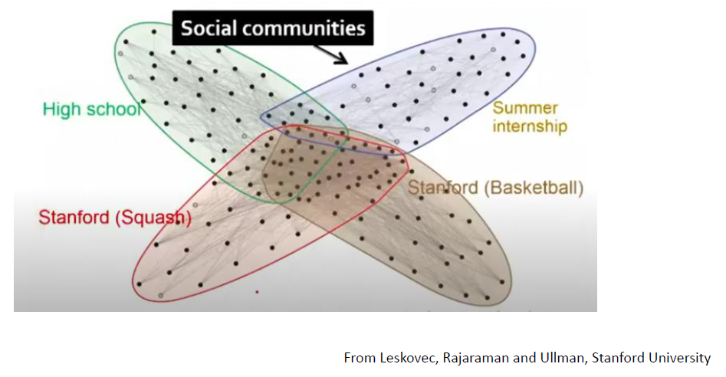
Why this RQ?
Niche communities
Too much information
Cluster in taste communities
Still too broad
Niche communities
Notes:
1) In a site like ZDF where are news from all over Germany the is a lot of content 2)A way to narrow it down is to … 3) But it still too broad, bcs taste communities are still too vague 4) That’s why I am going to find if any niche communities

Slide 4

A niche community is a group of people brought together by a common interest, value, or goal.

Slide 5
Sub-questions - approach
What is a niche taste community?
Can we identify them in the ZDF dataset?
What features do niche taste communities in ZDF have?
Notes:
I will define what a niche taste community is , and answer the question are there any niche communities ? And are there any different niche communities in the dataset? I will try to extract some features that define my niche communities on the given dataset.

Slide 6
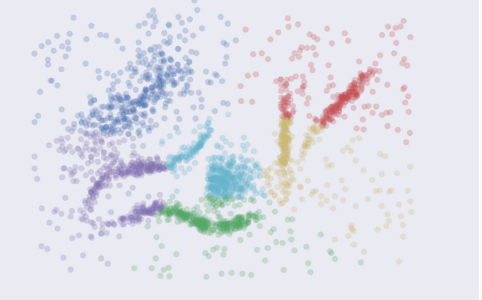
Techniques
K-means
Intuitive parameters
Stability
Performance
Drawback I need to define the number of clusters prior
Notes:
K means is an iterative clustering algorithm that aims to find local maxima in each iteration
Intuitive parameters: If you have a good intuition for how many clusters the dataset your exploring has then great, otherwise you might have a problem. - Stability: Hopefully the clustering is stable for your data. Best to have many runs and check though. - Performance: This is K-Means big win. It’s a simple algorithm and with the right tricks and optimizations can be made exceptionally efficient. There are few algorithms that can compete with K-Means for performance. If you have truly huge data then K-Means might be your only option.

Slide 7
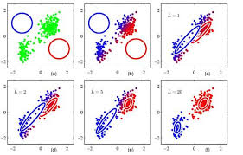
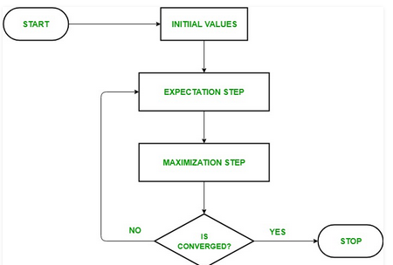
Techniques
Expectation-Maximization
2 steps (E-step, M-step)
Drawbacks: has slow convergence and convergence to the local optima only
Notes:
is an approach for maximum likelihood estimation in the presence of latent variables. Latent variables are the hidden variables which are not directly observed but they can be found through other observed variables
2 steps The first mode attempts to estimate the missing or latent variables, called the estimation-step or E-step. The second mode attempts to optimize the parameters of the model to best explain the data, called the maximization-step or M-step.
It can be used as the basis of unsupervised learning of clusters

Slide 8
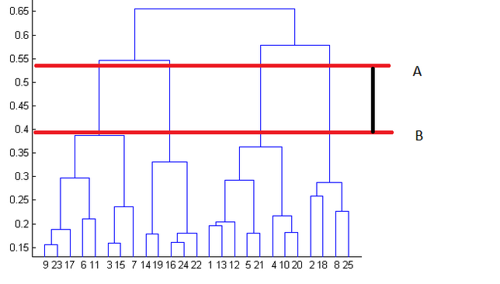
Techniques
Hierarchical Clustering only if the dataset allows it
Intuitive
I don’t need to set the number of clusters prior
Drawback, is slow, its not optimal for big datasets
Notes:
Hierarchical clustering, as the name suggests is an algorithm that builds hierarchy of clusters. This algorithm starts with all the data points assigned to a cluster of their own. Then two nearest clusters are merged into the same cluster. In the end, this algorithm terminates when there is only a single cluster left or can stop at whatever number of clusters you find appropriate in hierarchical clustering by interpreting the dendrogram
because the time complexity of K Means is linear i.e. O(n) while that of hierarchical clustering is quadratic i.e. O(n²).

