Slide 1


CMS Systems Course Introduction
Course Program, Evaluation, Exams, Resources
Svetlin Nakov
Technical Trainer
http://minkov.it
Telerik Software Academy
academy.telerik.com

Slide 2

Table of Contents
The CMS Systems Course Program
Exams and Evaluation
Standard Criteria
Bonuses
Resources for the Course

Slide 3

CMS Systems
The True Web Development

Slide 4

What's Coming Next?
CMS Systems
Continuation of CSS and JavaScript Courses
Lectures twice a week
Practical exam after a month
The course exam?
Converting a sliced HTML and CSS into template for CMS

Slide 5

CMS Systems – Program
What Will We Cover in the Course?

Slide 6


CMS Systems Course Program
CMS Systems Course Intro
Course Program, Exams, Evaluation
Introduction to PHP
Variables, arrays, functions, objects
PHP and databases
Using PHP to work with MySQL

Slide 7
CMS Systems Course Program (2)
WordPress and WordPress theming
What is WordPress?
Installation and configuration
Developing a WordPress theme by given HTML
Development of WordPress plugins
Joomla! and creating Joomla! templates
Installation and
Sitefinity
Installation and configuration
Creating themes

Slide 8





Evaluation
Thank God There Are Bonuses!

Slide 9

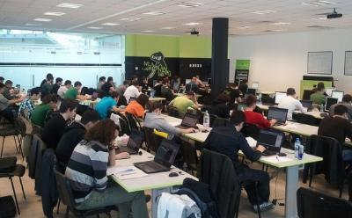
CMS Systems – Evaluation
Evaluation components
Practical project – 60%
Homework – 15%
Homework evaluation – 15%
3 peer reviews per homework
Attendance in class – 10%
Bonuses
Forums activity – bonus up to 15%
Helping the other students – bonus up to 15%

Slide 10

The Trainers

Slide 11
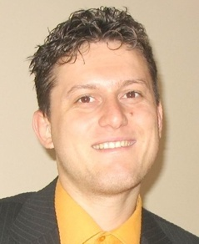
The Trainers
Svetlin Nakov, PhD
Manager Technical Training @ Telerik Software Academy
20 years software development experience
10+ years experience as trainer
Author of 6 books
Speaker at hundreds of events
E-mail: svetlin.nakov [at] telerik.com
Web site / Blog: http://nakov.com

Slide 12
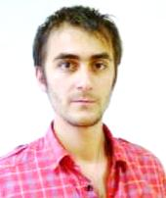
The Trainers (2)
Doncho Minkov
Technical Trainer @ Telerik Software Academy
Contestant in the Informatics competitions
Technical Trainer since 2010
Email: doncho.minkov [at] telerik.com
Blog: http://minkov.it/blog
LinkedIn: http://www.linkedin.com/in/donchominkov

Slide 13
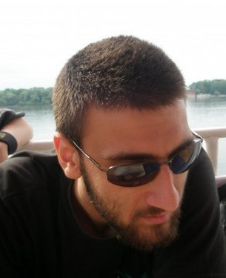
The Trainers (3)
Mario Peshev
Open Source Trainer
WordPress Engineer @ Placester
CTO @ DevriX
Passionate about Open Source stuff and mostly WordPress
Blog: http://devwp.eu/
Twitter: @no_fear_inc
LinkedIn: http://www.linkedin.com/in/mpeshev

Slide 14
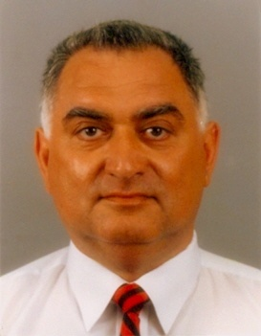
The Trainers (4)
Evgeni Leshtanski
Web design and Joomla! Master
Development of Joomla! templates more than 5 years
Twitter: @Leshtanski
Google Plus: plus.google.com/u/0/116116607784921792903
LinkedIn: http://www.linkedin.com/in/evgeni

Slide 15
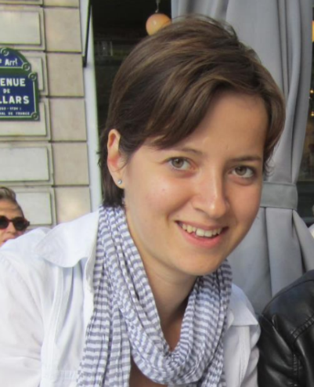
The Trainers (5)
Veronica Milcheva
Software developer @ Telerik
Working on Sitefinity
Twice ImagineCup champion
Email: veronica.milcheva [at] gmail.com
Blog: http://codesecretsbusters.blogspot.com/

Slide 16








Resources
What We Need in Addition to this Course Content?

Slide 17
Course Web Site & Forums
Register for the "Telerik Academy Forums":
Discuss the course exercises with your colleagues
Find solutions for the exercises
Share source code / discuss ideas
The CMS Systems official web site:
forums.academy.telerik.com/web-design-with-html5-css-and-javascript
http://academy.telerik.com/student-courses/web-design-and-ui/cms-systems

Slide 18
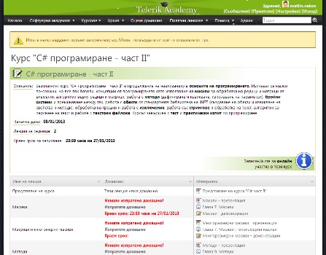
Telerik Integrated Learning System (TILS)
The Telerik Integrated Learning System (TILS)
www.telerikacademy.com
Important resource for all students
Homework submissions
Homework peer reviews
Presence cards with barcode
Reports about your results
telerikacademy.com/Courses/Courses/Details/65

Slide 19


Required Software
Software needed for this course:
Editors
Eclipse (WordPress and Joomla!)
Visual Studio 2012 (Sitefinity)
Sublime Text, Nodepad++, etc…
Servers
WAMP server and/or IIS server

Slide 20



CMS Systems Introduction
http://academy.telerik.com

Slide 21



Free Trainings @ Telerik Academy
Web Design and UI Technologies @ Telerik Academy
html5course.telerik.com
Telerik Software Academy
academy.telerik.com
Telerik Academy @ Facebook
facebook.com/TelerikAcademy
Telerik Software Academy Forums
forums.academy.telerik.com

