Slide 1
From clean code to clean architecture
Konrad Gałczyński
14th May 2020

Slide 2
Agenda
What is clean code?
Handy practices
Clean architecture overview
Questions

Slide 3



What is good software?

Slide 4
Good software is a software which minimizes time needed by user to satisfy his needs.

Slide 5
Clean code architectured in clean way is a code which minimizes time needed by software enginneer to satisfy his needs.

Slide 6
Depend on abstraction – practice I
Impose contract
Decoupling
Dependency inversion
Testability

Slide 7
Favor compsition over inheritance – practice II
 | Composition | Inheritance
Coupling
Reusability
Encapsulation
OCP
Liskov Substitution Principle
Testability

Slide 8
Encapsulate what is changing – practice III
Expose what is needed by client - exception is when you preparing widely used library
Carve out subcomponents with well defined contracts
In case of having problems with testing private methods, extract new class

Slide 9
Clean architecture - purpose
„The primary purpose of architecture is to support the life cycle of the system. Good architecture makes the system easy to understand, easy to develop, easy to maintain, and easy to deploy. The ultimate goal is to minimize the lifetime cost of the system and to maximize programmer productivity.”
Robert C. Martin

Slide 10
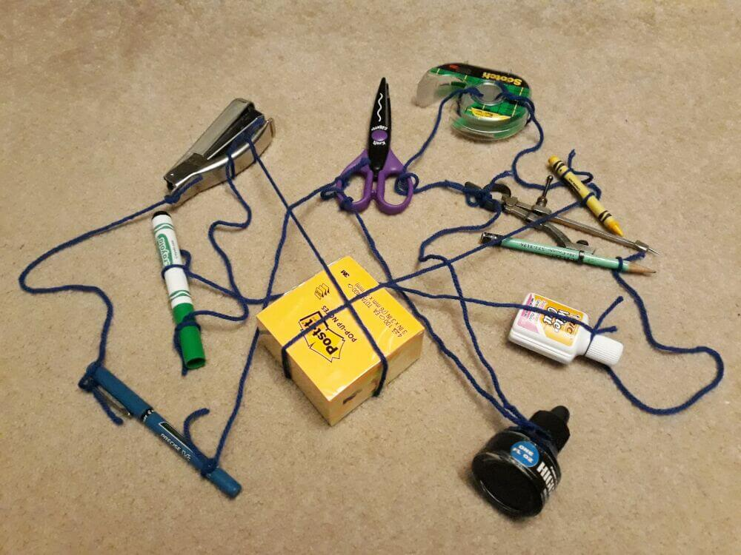
Clean architecture – visualization I

Slide 11
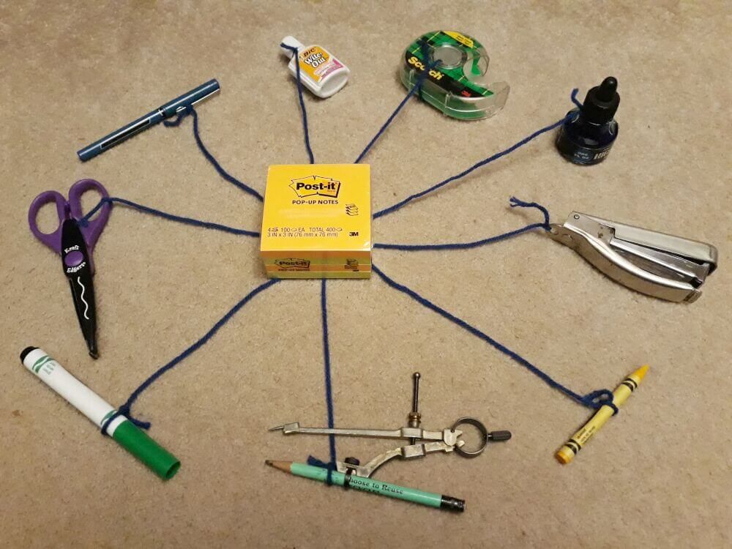
Clean architecture – visualization II

Slide 12
Clean architecture – features
Independent of Frameworks
Testable
Independent of UI
Independent of Database
Independent of any external agency

Slide 13
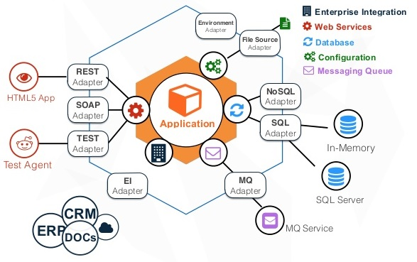
Clean architecture – visualisation III

Slide 14
Thank you!

Slide 15
Resources
https://images-na.ssl-images-amazon.com/images/G/01/gc/designs/livepreview/amazon_drkblue_noto_printfold_v2016_us-main._CB468920742_.png
https://encrypted-tbn0.gstatic.com/images?q=tbn:ANd9GcT3zsc2wmEIINVgMrPJGjIgqL9_vCDsDk8Vo5-er6hWZOvhOwMcdg&s
https://czytio.pl/images/408/maxi/amazon-kindle-10-front.jpg
https://images.ctfassets.net/1es3ne0caaid/4qnEjwkNAIiAmYcms8iKua/5173990eceb6223dc08e6607636dcc48/clean-architecture-ex-1.jpeg
https://images.ctfassets.net/1es3ne0caaid/2Qd2FVYAqIEowM0GySIMyM/5d6acdc87b8149732a6b750fcb09c4b7/clean-architecture-ex-2.jpeg
https://image.slidesharecdn.com/javadev-hexagonalarchitectureforjavaapplications-150202062634-conversion-gate01/95/hexagonal-architecture-for-java-applications-11-638.jpg?cb=1423245064

