Slide 1
From clean code to clean architecture
Konrad Gałczyński
14 May 2020

Slide 2

Agenda
What is clean code?
Handy practices
Clean architecture overview
Questions?

Slide 3



What is good software?

Slide 4
Good software is a software which minimizes time needed by user to satisfy his needs.

Slide 5
Clean code architectured in clean way is a code which minimizes time needed by software enginneer to satisfy his needs.

Slide 6
Depend on abstraction – practice I
impose contract
decoupling
dependency inversion
testability

Slide 7
Favor compsition over inheritance – practice II
 | Composition | Inheritance
Coupling
Reusability
Encapsulation
OCP
Liskov Substitution Principle
testability

Slide 8
Encapsulate what is changing – practice III
expose what is needed by client - exception you preparing widely used library
carve out subcomponents with well defined contract
in case of having problems with testing private methods, extract new class

Slide 9
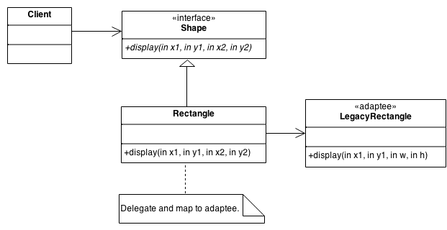
Adapter

Slide 10
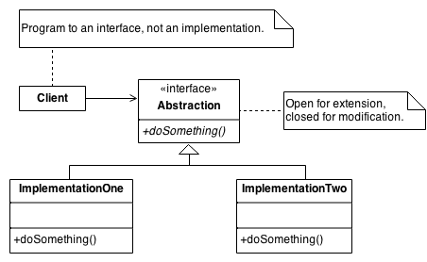
Strategy

Slide 11
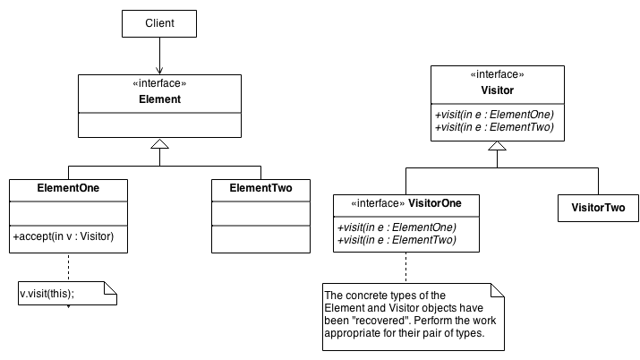
Visitor

Slide 12
Clean architecture - purpose
„The primary purpose of architecture is to support the life cycle of the system. Good architecture makes the system easy to understand, easy to develop, easy to maintain, and easy to deploy. The ultimate goal is to minimize the lifetime cost of the system and to maximize programmer productivity.”
Robert C. Martin

Slide 13
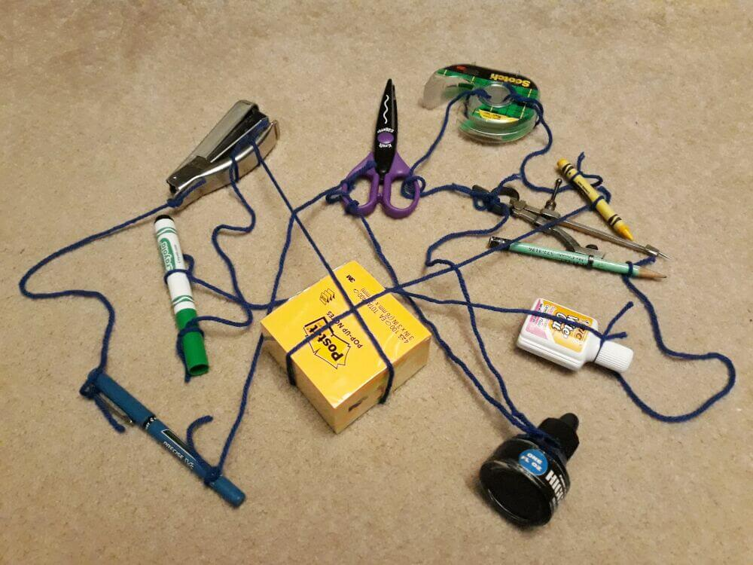
Clean architecture – visualization I

Slide 14
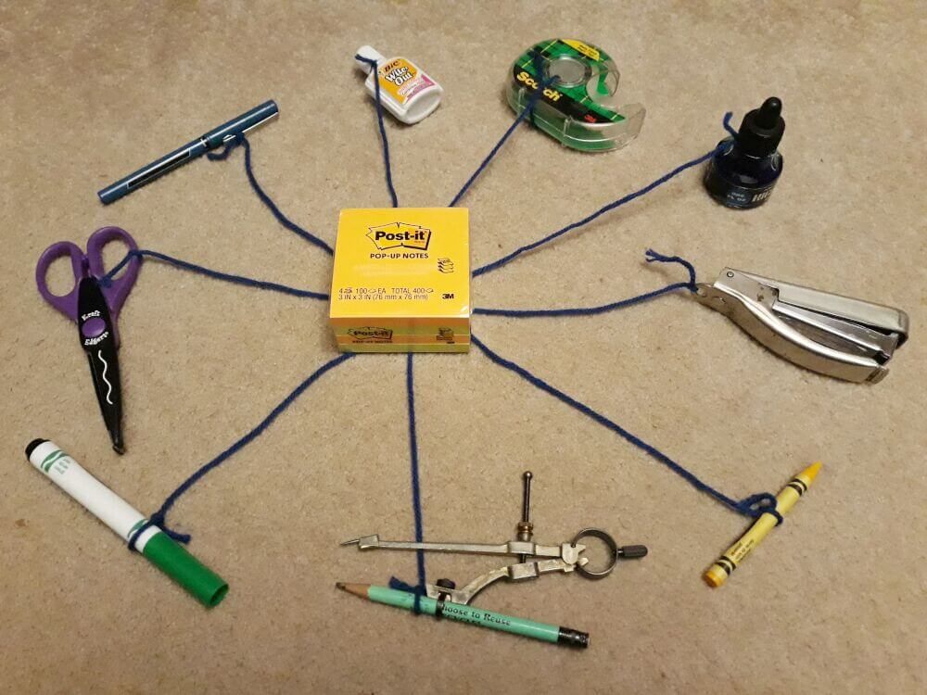
Clean architecture – visualization II

Slide 15
Clean architecture – features
independent of Frameworks
testable
independent of UI
independent of Database
independent of any external agency

Slide 16
Clear architecture - guide
Reuse/Release Equivalence Principle (REP)
Common Closure Principle (CCP)
Common Reuse Principle (CRP)
Acyclic Dependency Principle (ADP)
Stable Dependency Principle (SDP)
Notes:
REP is a component level principle. Reuse refers to a group of reusable classes or modules. Release refers to publishing it with a version number. This principle says that whatever you release should be reusable as a cohesive unit. It shouldn't be a random collection of unrelated classes.
CCP is a component level principle. It says that components should be a collection of classes that change for same reason at the same time. If there are different reasons to change or the classes change at different rates, then the component should be split up. This is basically the same thing as the Single Responsibility Principle above.
CRP is a component level principle. It says that you shouldn't depend on a component that has classes that you don't need. Those components should be split up so that the users don't have to depend on classes that they don't use. This is basically the same thing as Interface Segregation Principle above.
SDP This principle says that dependencies should be in the direction of stability. That is, less stable components should depend on more stable components. This minimizes the effect of change. Some components are intended to be volatile. That's OK, but you shouldn't make stable components depend on them.

Slide 17
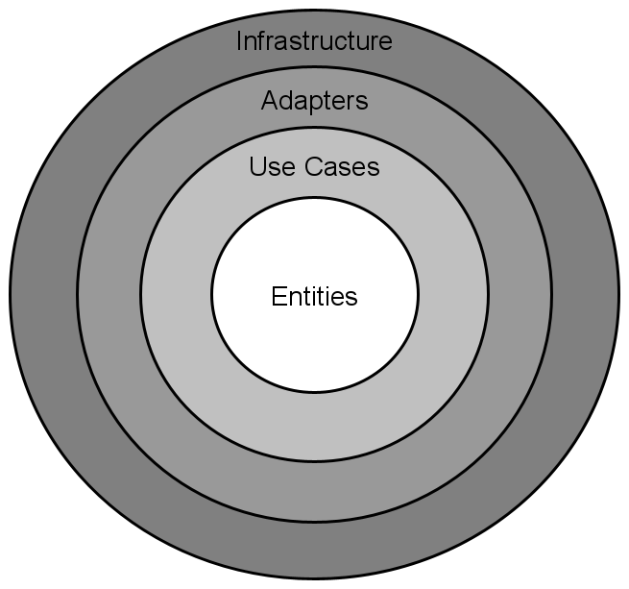
Clean architecture – visualisation III
Notes:
Entities
An entity is a set of related business rules that are critical to the function of the application. In an object oriented programming language the rules for an entity would be grouped together as methods in a class. Even if there were no application, these rules would still exist. For example, charging 10% interest on a loan is a rule that a bank might have. This would be true whether the interest was calculated on paper or using a computer.
Use cases
The use cases are the business rules for a specific application. They tell how to automate the system. This determines the behavior of the app.
The use cases interact with and depend on the entities, but they know nothing about the layers further out. They don't care if it's a web page or an iPhone app. They don't care if the data is stored in the cloud or in a local SQLite database.
Adapters
The adapters, also called interface adapters, are the translators between the domain and the infrastructure. For example, they take input data from the GUI and repackage it in a form that is convenient for the use cases and entities. Then they take the output from the use cases and entities and repackage it in a form that is convenient for displaying in the GUI or saving in a database.
Infrastructure
This layer is where all the I/O components go: the UI, database, frameworks, devices, etc. It's the most volatile layer. Since the things in this layer are so likely to change, they are kept as far away as possible from the more stable domain layers. Because they are kept separate, it's relatively easy make changes or swap one component for another.

Slide 18
Questions?
Thank you!

Slide 19
Resources
https://images-na.ssl-images-amazon.com/images/G/01/gc/designs/livepreview/amazon_drkblue_noto_printfold_v2016_us-main._CB468920742_.png
https://encrypted-tbn0.gstatic.com/images?q=tbn:ANd9GcT3zsc2wmEIINVgMrPJGjIgqL9_vCDsDk8Vo5-er6hWZOvhOwMcdg&s
https://czytio.pl/images/408/maxi/amazon-kindle-10-front.jpg
https://images.ctfassets.net/1es3ne0caaid/4qnEjwkNAIiAmYcms8iKua/5173990eceb6223dc08e6607636dcc48/clean-architecture-ex-1.jpeg
https://images.ctfassets.net/1es3ne0caaid/2Qd2FVYAqIEowM0GySIMyM/5d6acdc87b8149732a6b750fcb09c4b7/clean-architecture-ex-2.jpeg
https://sourcemaking.com/design_patterns/visitor
https://sourcemaking.com/design_patterns/strategy
https://sourcemaking.com/design_patterns/adapter

