Slide 1
Contract distribution and service testing
Konrad Gałczyński
20 Aug 2020

Slide 2

Agenda
Why contract distribution is important
Differrent views on tests
Interface-based contract distribution and testing
DTO-based contract distribution and testing
OpenAPI contract distribution and testing
Special service dependency considerations
Non-REST contract distribution
Questions

Slide 3
WebAPI contract distribution – why?
To have physical coupling between components which are logically coupled
To tell the world what our component is doing and be serious about it

Slide 4
WebAPI contract distribution – how?
Spec-first approach
+ code for both client and server can be generated
+ can be done without writing single line of code
+ is language agnostic
Code-first approach
+ cheaper to start
+ easier to maintain
+ more natural for developers
+ no code is generated
- usually requires bigger effort upfront
- can be done without writing single line of code
- we deal with both written and generated code
no code is generated
is tied to language

Slide 5
Why do we test?
To check if our code behaves as expected
To have better design
To check if performance of codebase is sufficient
To have regression suite
To check if in no memory/thread leaks are present in codebase
Notes:
- Joke about test pyramid when someone is speaking about testing

Slide 6
Why do we test?
Functionality
Performance
CONFIDENCE
Responsiveness
Reliability
No breakage
Notes:
It all about confidence – not about level of testing
Think about how confidence can be achieved and test on appropriate level

Slide 7
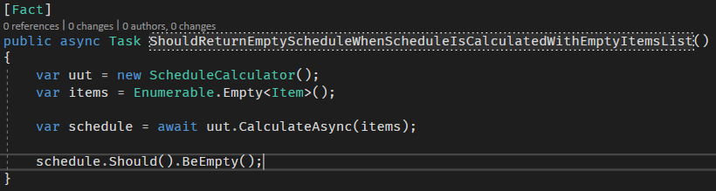
Tests as living specification I

Slide 8
Tests as living specification II
What about coverage?
Line
Path
Behavior?
Mutation testing

Slide 9
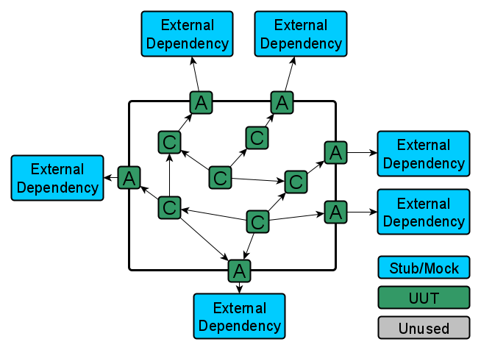
Contract testing for WebAPI

Slide 10
Interface-based contract distribution

Slide 11
DTO-based contract distribution

Slide 12
Contract distribution with OpenAPI spec

Slide 13
Different dependencies considerations

Slide 14
Non-REST contract distribution

Slide 15
Questions?
Thank you!

Slide 16
Resources

