Slide 1
Contract distribution and service testing
Konrad Gałczyński
20 Aug 2020

Slide 2

Agenda
Why contract distribution is important
Differrent views on tests
Interface-based contract distribution and testing
DTO-based contract distribution and testing
OpenAPI contract distribution and testing
Special service dependency considerations
Non-REST contract distribution
Questions

Slide 3

My WebAPI

Slide 4



WebAPI contract distribution – why & how?

Slide 5
WebAPI contract distribution – how I?
Spec-first approach
code for both client and server can be generated
can be done without writing single line of code
is language agnostic
usually requires bigger effort upfront
we deal with both written and generated code

Slide 6
WebAPI contract distribution – how II?
Code-first approach
cheap to start
easy to maintain
more natural for developers
no code is generated
is tied to language

Slide 7
Why do we test?
To check if our code behaves as expected
To have better design
To check if performance of codebase is sufficient
To have regression suite
To check if in no memory/thread leaks are present in codebase
Notes:
- Joke about test pyramid when someone is speaking about testing

Slide 8
Why do we test?
Functionality
Performance
CONFIDENCE
Responsiveness
Reliability
No breakage
Notes:
It all about confidence – not about level of testing
Think about how confidence can be achieved and test on appropriate level

Slide 9
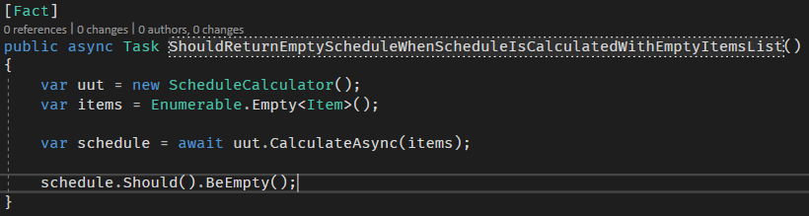
Tests as living specification I

Slide 10
Tests as living specification II
What about coverage?
Line
Path
Behavior?
Mutation testing

Slide 11
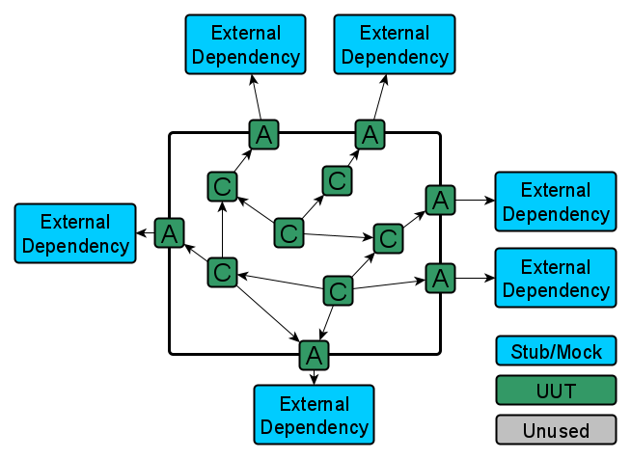
Contract testing for WebAPI

Slide 12
Interface-based contract distribution
https://github.com/reactiveui/refit
No easy way to couple contract with WebAPI implementer
Does not require any changes in WebAPI implementer
Easy to test distributed contract
Distributed as nuget with Refit interface
Very natural and easy from client perspective
Tied to technology

Slide 13
DTO-based contract distribution
https://docs.servicestack.net/netcore
Contract distributed is tightly coupled with contract implementer
Changes in contract implementer are required
ServiceStack is powerfull tool (and complex too)
Easy to test distributed contract
Distributed as nuget with ServiceStack DTOs
Not very natural from client perspective but still fairly easy
Tied to technology

Slide 14
Contract distribution with OpenAPI spec
https://docs.microsoft.com/en-us/aspnet/core/tutorials/web-api-help-pages-using-swagger?view=aspnetcore-3.1
Contract is generated out of code
Requires some changes in contract implementer but they are harmless
Apart from distributing contract we can have preety UI for our WebAPI
Client can be generated out of OpenAPI spec – more complicated than previous approaches
Distributed as json
Technology agnostic – the most flexible solution

Slide 15
Different dependencies considerations

Slide 16
Non-REST contract distribution

Slide 17
Questions?
Thank you!

Slide 18
Resources
https://wallpapercave.com/wp/wp2408553.jpg
https://cdn.windowsreport.com/wp-content/uploads/2019/01/unable-save-word-document-930x620.png
https://upload.wikimedia.org/wikipedia/commons/thumb/d/d3/Mail.svg/1024px-Mail.svg.png
https://i.dailymail.co.uk/1s/2019/09/16/14/18535700-0-image-m-55_1568639490556.jpg

