Slide 1
The operating system for funded work
PROJECTS BY TATOOK
Projects, money and books for NGOs, with a shared record of every grant for the donors who fund them.
Miles Global Softwares · Investor and partner briefing · [Date]
Notes:
Open with the one line: run your organization, share what you choose.

Slide 2
Funded work runs on tools that never agree
Spreadsheets, email approvals and a separate accounting system each hold part of the truth.
Spending drifts
Money is committed before anyone checks the budget or the grant it is charged to.
Duties blur
The same person asks for, approves and pays — exactly what auditors flag.
Donors chase reports
Funders wait for spreadsheets; organizations rebuild the same figures for each one.
Notes:
Back these with interview quotes or survey numbers from your own customer conversations. No statistics are claimed here.

Slide 3
One workspace from the task to the journal entry
THE SOLUTION
Plan the work, approve spending with duties kept apart, buy through quotes and orders, and post to double-entry books in the same step as the payment. Share with each donor only what you switch on.
Notes:
Projects replaces the spreadsheet, the approval email chain and the separate ledger with one record.

Slide 4
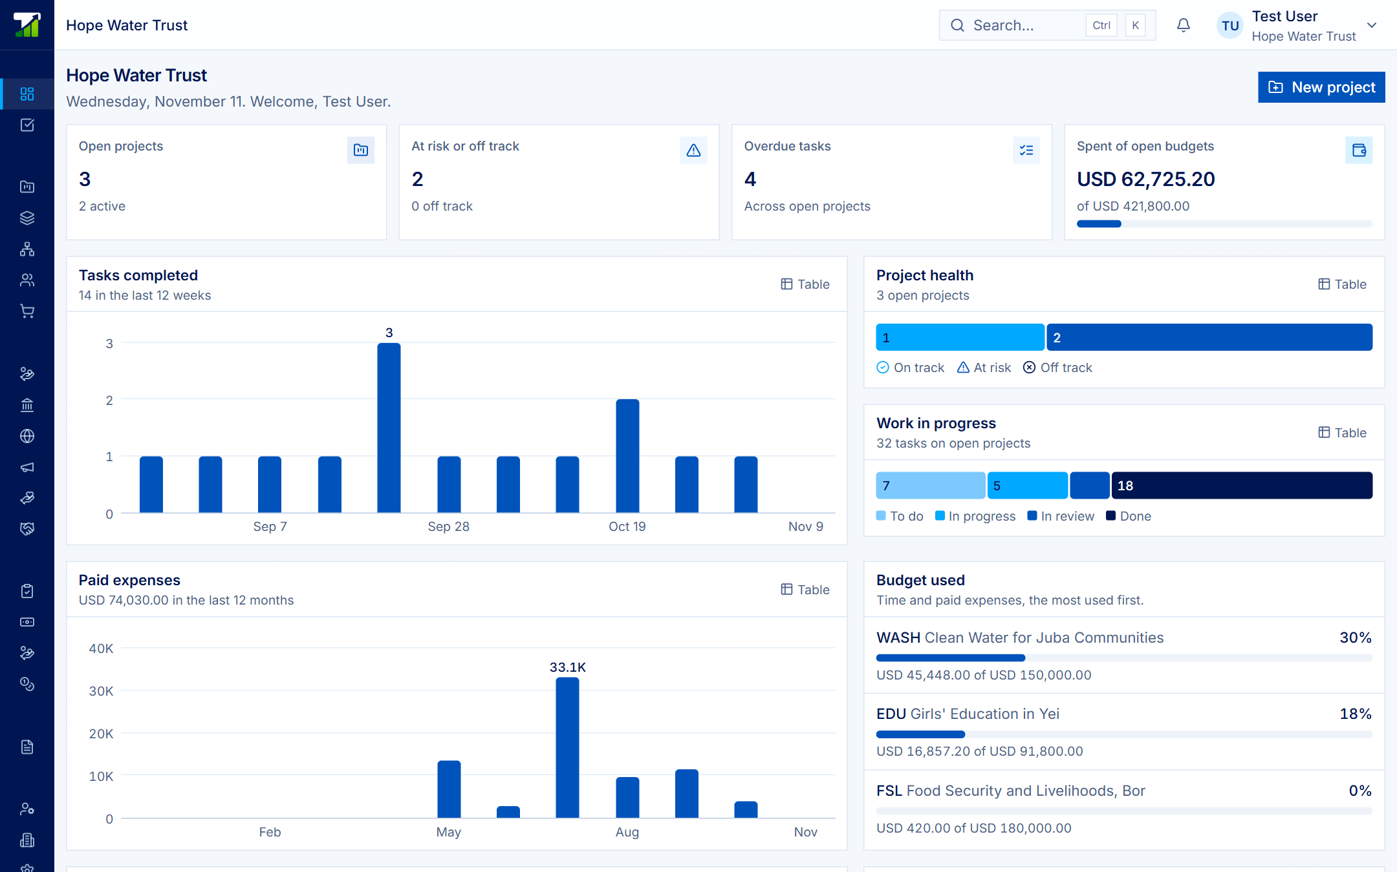
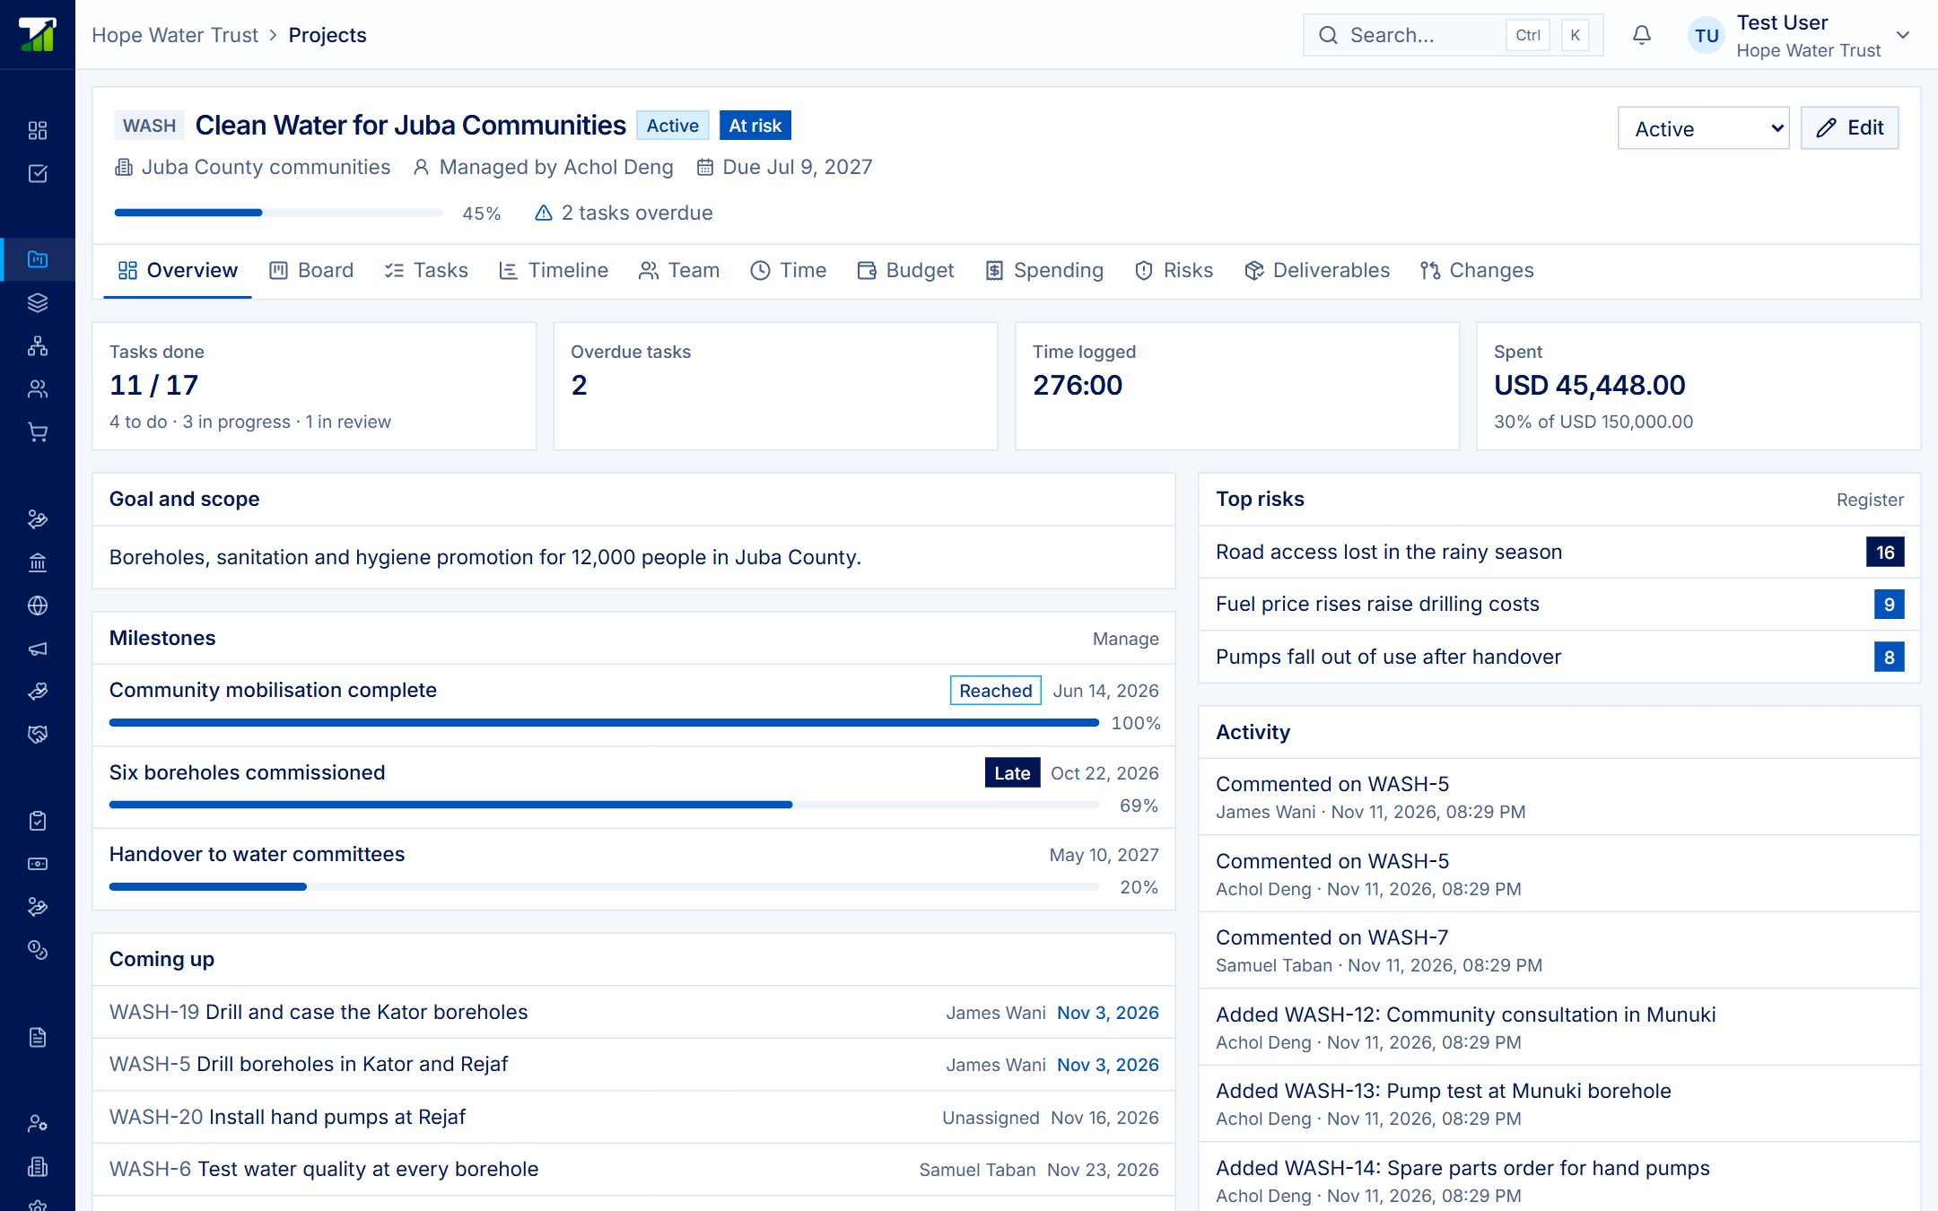
Built and running
Portfolio health, budgets by category, approvals, grants and reports owed — real screens from a demo organization.
Notes:
Both screens are from the working product: the portfolio, and one project with milestones, top risks and activity.

Slide 5
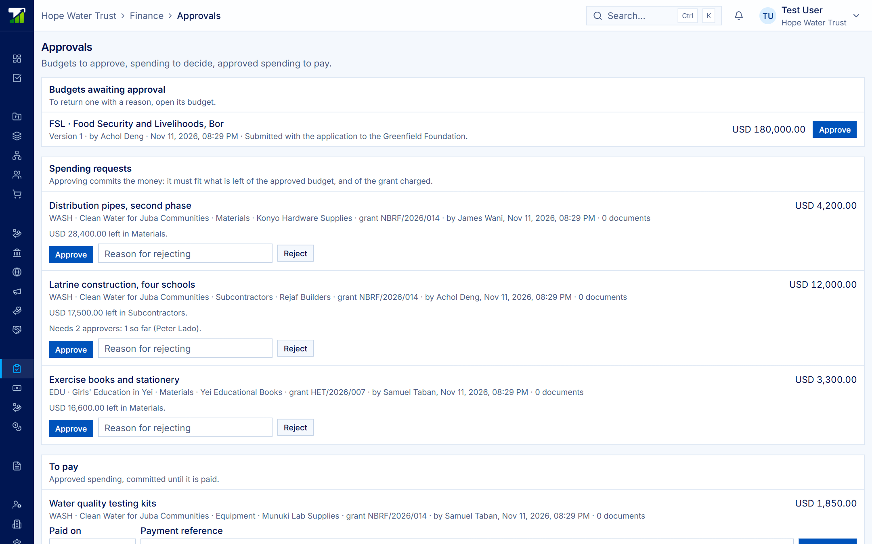
Controls auditors look for, built in
Different hands
Requester never approves or pays.
Checked before committed
Against budget category and grant.
Books can’t disagree
Payment and journal post together.
Notes:
If the books refuse a journal, the payment is refused too. Approved budgets never change, amendments are numbered, and nothing is deleted.

Slide 6
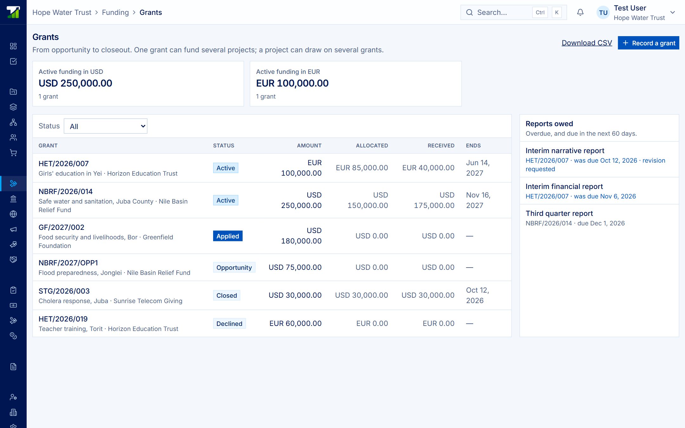
Every grant can bring the other side in
TWO-SIDED BY DESIGN
Donors invite the organizations they fund; organizations invite their funders’ contacts.
Each keeps its own workspace, and the grant connects them.
The organization chooses what each donor sees, switch by switch.
Notes:
This is the growth loop: one donor brings several funded organizations onto the platform, and one organization brings several donors.

Slide 7
What organizations use today
Today’s option | What it does well | What it misses
Spreadsheets and email | Cheap, familiar | No controls, no history, no donor view
Generic task tools | Boards and timelines | No budgets, grants or approvals
Standalone accounting | The ledger | Disconnected from projects and grants
Donor-specific portals | One funder’s reporting | Re-typing for every donor
Projects | Work, money, books, donors | Field data and M&E: on the roadmap
Notes:
Categories rather than named competitors. Add named competitors and pricing from your own research before sharing externally.

Slide 8
Business model: the NGO ERP on Tatook
Projects
Core. Subscription per organization workspace: [$__ / month].
Finance, HR, Payroll
Add-ons. Optional Tatook applications on the same sign-in: [$__ each].
Donor workspace
Funders follow grantees from one dashboard: [pricing to decide].
One account, one sign-in, many organizations; billing runs on the Tatook platform.
Notes:
Projects is listed on the platform as the required application of the NGO ERP, with Finance and Accounting, HR and Payroll as optional add-ons. Fill in the bracketed prices.

Slide 9
Market: start where we work, then grow
[__]
[__]
[__]
Beachhead
NGOs and implementing partners in South Sudan and the region.
East Africa
Donor-funded organizations reporting in several currencies.
Donors
Foundations, agencies and funds that each bring their grantees.
Notes:
Fill each bracket with a sourced count of organizations or annual spend. Do not present invented market sizes.

Slide 10
Where we are
Product built: projects, budgets, spending, procurement, grants, donor workspace
Double-entry books posting from payments
Single sign-on and roles on the Tatook platform
Pharmacy, restaurant and finance products already on the same platform
Pilot numbers
Organizations onboarded: [__]
Grants managed: [__]
Funds tracked: [$__]
Letters of intent: [__]
Notes:
Projects is in beta. Replace the brackets with real pilot figures, or drop the card until there are some.

Slide 11
Roadmap: from finance to impact
Now · built
Projects and tasks
Budgets and approvals
Grants and donors
Accounting
Next · [quarter]
Monitoring and evaluation
KoboToolbox, ODK data
Templates, calendar
Later · [quarter]
People served records
Tenders and contracts
Assistant, integrations
Notes:
Items under Next and Later are planned, not built. Set the quarters to your real plan.

Slide 12
[Raising $__] to bring Projects to [__] organizations
THE ASK
[__%] sales and partner onboarding · [__%] monitoring and evaluation build · [__%] support and implementation
[Founder name] · [contact email] · Miles Global Softwares
Notes:
Pilot partners can be asked for something other than money: a donor willing to invite three grantees is worth naming here.

