Slide 1
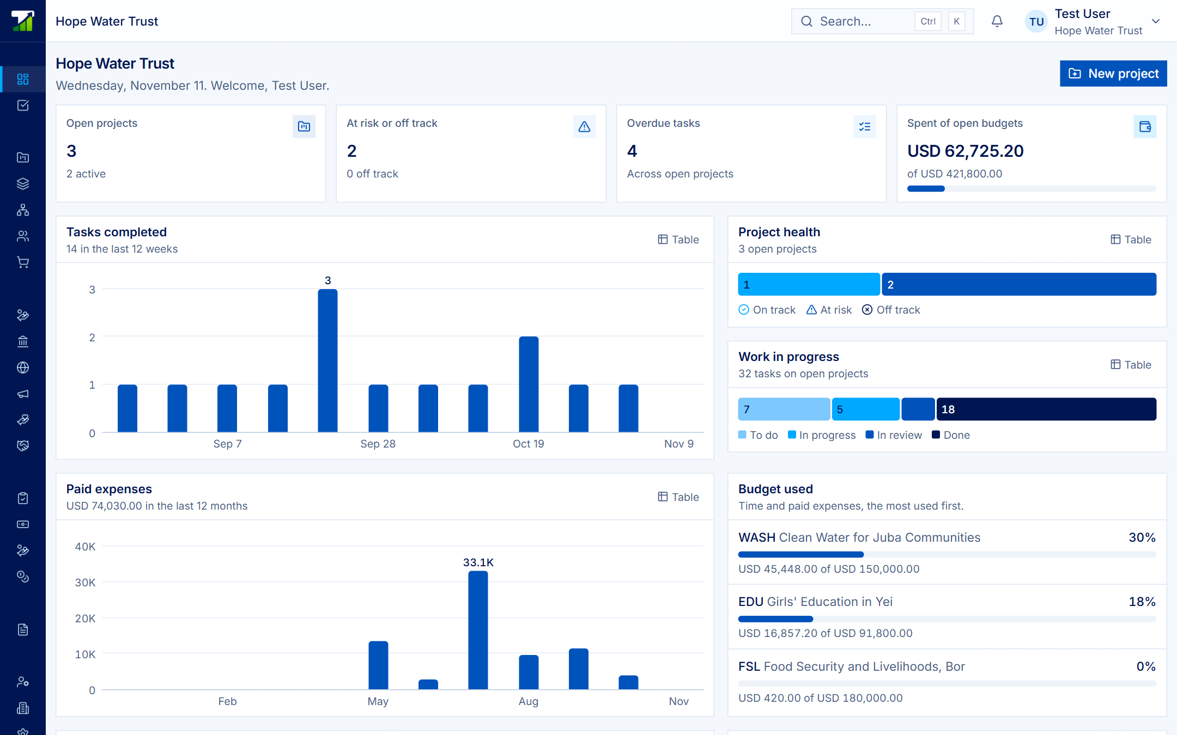
Run your organization. Share what you choose.
TATOOK · PROJECTS
Projects, budgets, spending, grants and the books in one workspace, for NGOs and the donors who fund them.
Product presentation · Miles Global Softwares · November 2026
Notes:
Projects is the project and grant management product on the Tatook platform. This deck walks through what it does, screen by screen, using a demo organization called Hope Water Trust.

Slide 2
One workspace for the work, the money and the books
And a shared record of each grant with whoever funds it. An organization can also use it with no donor at all.
Plan
Projects, tasks, milestones, risks, team and time.
Control
Budgets, spending approvals, procurement and petty cash.
Report
Grants, donor reports and double-entry books that post as you pay.
Notes:
When one organization funds another, a grant is what connects their two workspaces.

Slide 3
Built for both sides of a grant
Delivering organizations
Plan projects, approve spending with duties kept apart, buy through quotes and orders, keep the books.
Funders and donors
One dashboard across every organization funded: grants, payments and reports to accept.
Finance teams
Budgets someone else approves, spending checked before it is committed, books that post on payment.
Project teams
Board, list and timeline, My work, a weekly timesheet, and purchases raised from the project.
Notes:
Four audiences, one product. Donors and delivering organizations each keep their own workspace, members and records.

Slide 4
Everything in one menu
Area | What is in it
Overview | Portfolio, My work, search and notifications
Projects | Projects, Programmes, Spaces and lists, People, Procurement
Funding | Grants, Funders, partnerships with beneficiaries
Finance | Approvals, Commitments, Staff advances, Petty cash, Accounting
Records | Documents with every version kept
Administration | Members, Departments and teams, Roles, Settings, Audit log
Documents, Grants, Procurement and Accounting can each be turned off in Settings. Nothing is deleted.
Notes:
Organizations switch off the parts they do not use, and switching back brings everything back.

Slide 5
Every project, worst health first
PORTFOLIO
Open projects, those at risk, overdue work and spend against open budgets on one page.
Every chart has a Table button for the figures behind it.
Notes:
Home page for the demo organization: three open projects, two at risk, four overdue tasks, and USD 62,725 spent of USD 421,800 in open budgets.

Slide 6
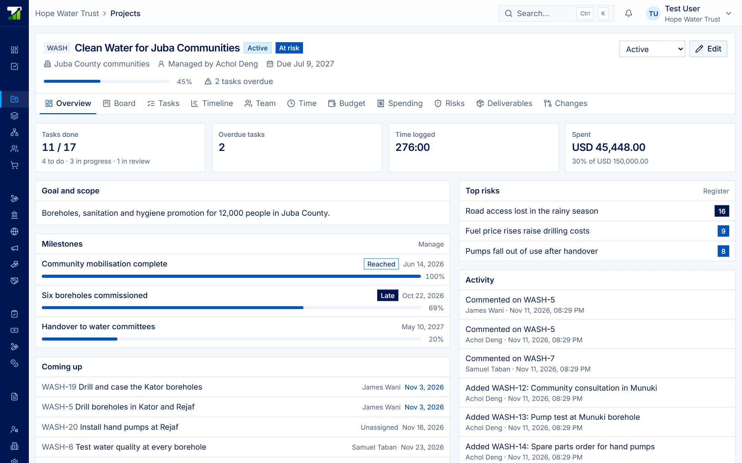
Health is calculated, not guessed
A PROJECT
Off track: past its due date, or over budget.
At risk: progress 20+ points behind time elapsed, overdue tasks, or spend 20+ points ahead of progress.
Progress is weighted by each task’s estimate.
Notes:
Each project has a code that numbers its tasks, a manager, dates, a budget and a status. The 20-point slack can be changed by the organization.

Slide 7
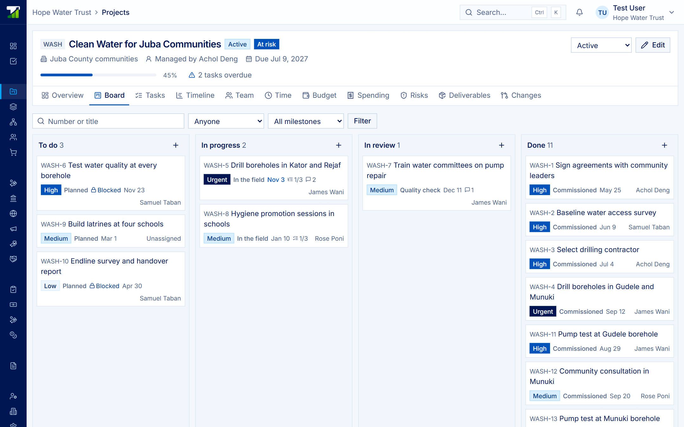
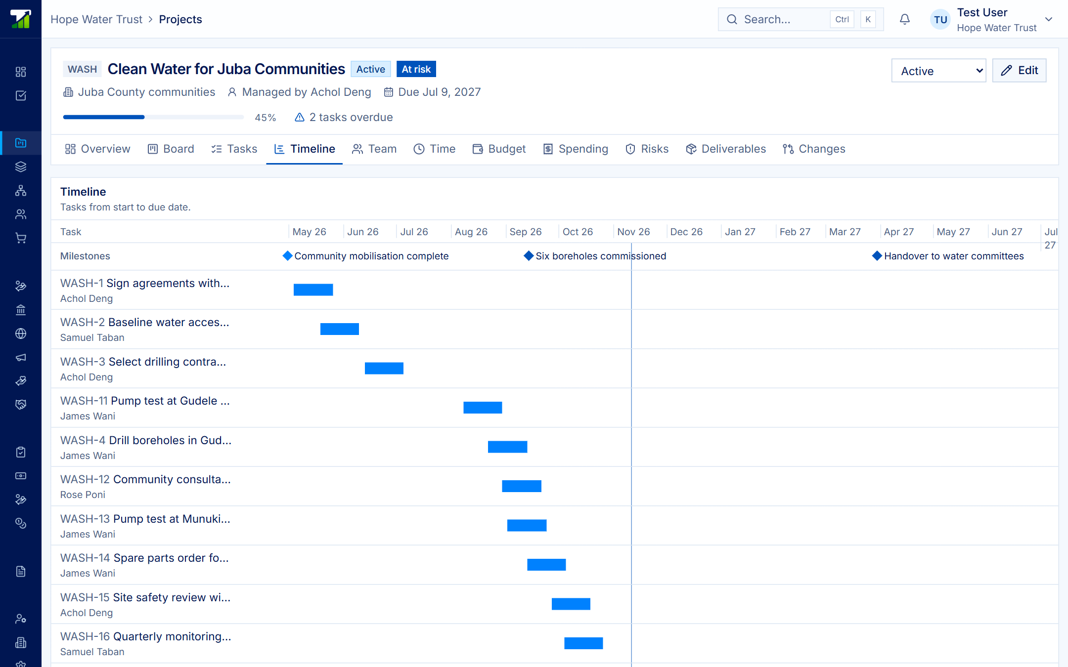
Tasks on a board or a timeline
Tasks are numbered to their project (WASH-12). A task can’t be marked done while one it waits on is open, and circular dependencies are refused.
Notes:
Left: the board, where cards are dragged between columns. Right: the timeline, with milestones as diamonds and a line for today. There is also a list view.

Slide 8
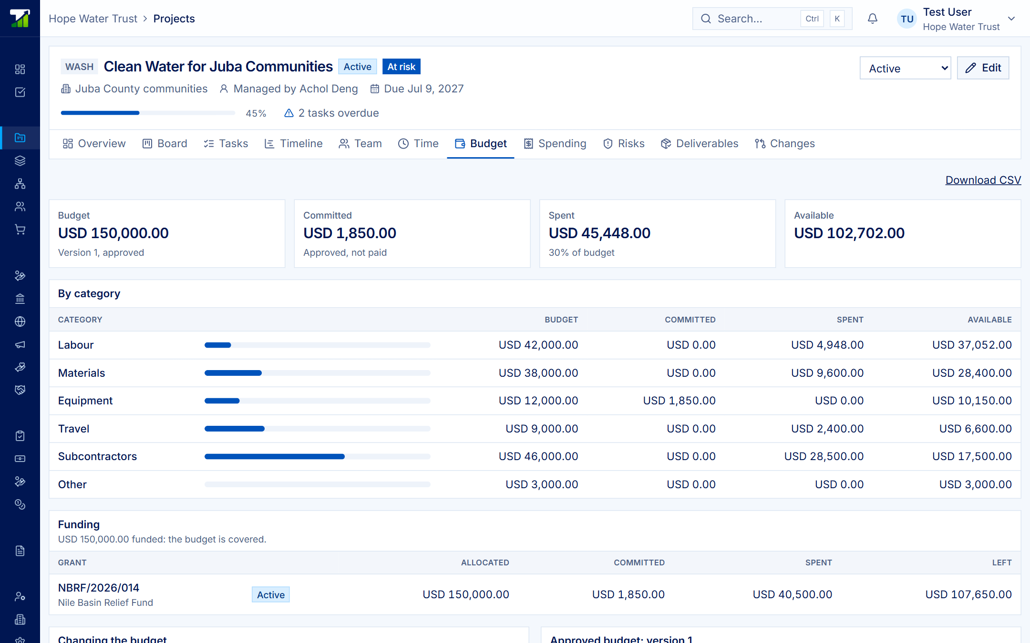
Committed is not spent
BUDGET
Budget, committed, spent and available for each category, and the funding behind it grant by grant.
An approved budget never changes. A revision is a new version that can’t cut below what is committed or spent.
Notes:
Categories are labour, materials, equipment, travel, subcontractors and other. A draft is approved by someone else or returned with a reason.

Slide 9
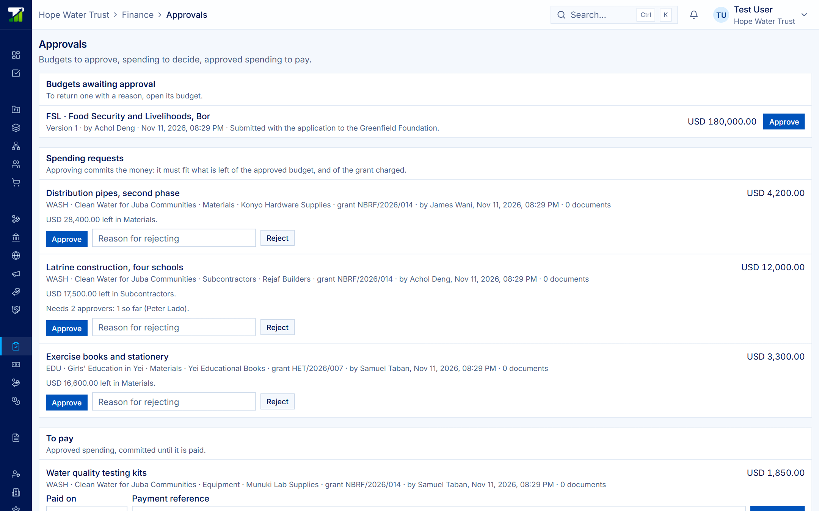
Three hands on every payment
1 · Request
Asked against a budget category and grant, with quotes.
2 · Approve
Someone else commits it if budget and grant allow. 1–3 approvers.
3 · Pay
Finance records the payment; the journal posts with it.
Notes:
The requester never approves or pays their own request; the system enforces it. Rejected, cancelled and voided spending stays on record.

Slide 10
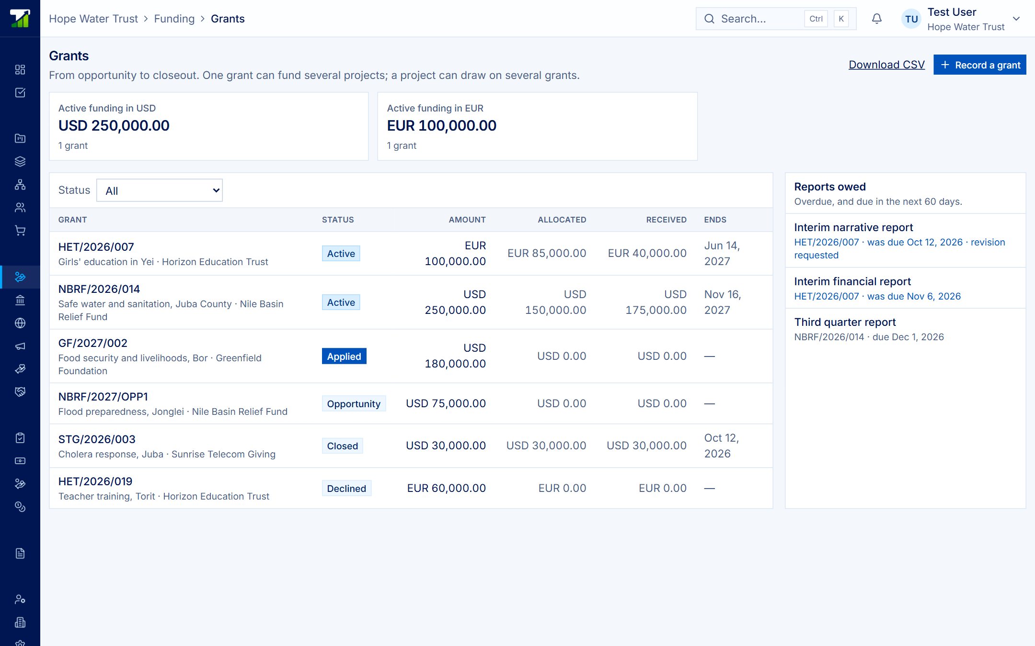
Grants from opportunity to closeout
GRANTS
After the award, changes come only by numbered amendment.
One grant funds several projects, across currencies, with the rate recorded.
A grant closes only when no report is owed.
Notes:
Grant stages: opportunity, applied, active, closed, or declined. Payment schedules and reports owed are tracked on each grant.

Slide 11
The organization decides what each donor sees
One grant and one switch at a time. Every switch is off until someone turns it on.
Can be shared, per grant
Approved budget by category
Paid spending and the committed total
Progress, percent done, milestones
Task number, title, status, dates
Always stays inside
Suppliers and receipts
Who requested or approved
Staff and the cost of people
Risks, internal notes, task assignees
Notes:
Donors see only their own grants, even when an organization has several donors.

Slide 12
The life of a grant
1
Invite
2
Record
3
Choose
The donor invites the organization. Nothing connects until it accepts.
Award, amendments, allocations and payment schedule.
Turn on what to share: budget, spending, progress, tasks.
4
Deliver
5
Report
6
Accept
Tasks move, purchases are approved, payments post to the books.
Reports with due dates and documents, visible once submitted.
The donor accepts or asks for a revision. No report owed: it closes.
Notes:
Steps one to three set the grant up; four to six are the delivery loop. A revision request sends the report back as owed.

Slide 13
Roles that keep duties apart
Role | Can do
Organization Administrator | Everything, plus approvals, grants, settings and the audit log
Project Manager | Everything on projects; drafts budgets, requests spending; sees grants
Team Member | Works tasks, logs own time, requests spending
Viewer | View only
Finance Controller | Approves budgets and spending, records payments, manages grants
Finance Officer | Records payments of approved spending
Funder contact | Their funder’s donor portal only
Notes:
A member can hold more than one role, and the server checks every action again.

Slide 14
What guides the product
Different hands
Whoever asks for money never approves or pays it. The product enforces that.
History stays
Numbered amendments, budgets that never change once approved, spending voided not deleted.
Figures that mean something
Committed kept apart from spent; currencies never added together.
Said plainly
What is not built is marked Planned and listed in one place.
Notes:
Each organization’s records are kept to itself. Every security-relevant change is in the audit log, which the app never edits.

Slide 15
Available today, and what comes next
Available today
Portfolio, projects, programmes
Board, list, timeline, time
Budgets, spending, approvals
Procurement, petty cash, advances
Grants, funders, donor workspace
Double-entry accounting
Documents, roles, audit log
Planned
Monitoring and evaluation
Records of people served
KoboToolbox and ODK field data
Templates and calendar view
Tenders and contracts
An assistant that never approves
Microsoft 365, Google, Slack, Power BI
Notes:
Everything on the right is not in the product today. Naming Microsoft, Google, Slack or Power BI does not imply a partnership.

Slide 16
Set up your organization in an afternoon
GET STARTED
Sign up, create the workspace, invite the team, and record your first project. A donor’s invitation works too, and you can connect later.
yourorganization.milesoftwares.com/projects · [contact email]
Notes:
Close with a demo request. Replace the contact placeholder before sharing.

