Slide 1
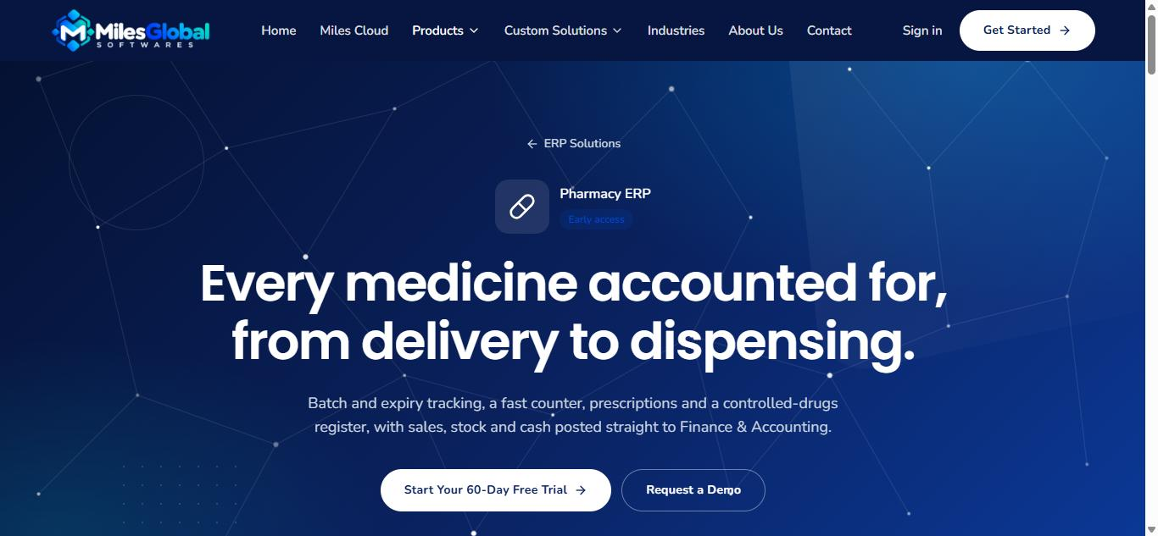
Miles Pharmacy
Every medicine accounted for, from delivery to dispensing.
Pharmacy ERP on Miles Cloud · Product profile
Notes:
Miles Pharmacy is the pharmacy ERP from Miles Global Softwares. It runs on Miles Cloud, so it shares one account, one organization and one set of books with the other Miles products.

Slide 2



Where pharmacies lose money without noticing
Expired stock on the shelf
Prescriptions on paper
Cash that never matches
Batches nobody tracked, found only when a customer or an inspector does.
No record of who checked them, what was dispensed or what is still owed.
Tills counted by hand, with the difference discovered weeks later.
Miles Pharmacy closes these gaps at the counter, in the store room and at month-end.
Notes:
These are the three problems we hear most from pharmacy owners. Every feature that follows answers one of them.

Slide 3









Everything a pharmacy runs on, in one system
Medicines catalogue
Generic and brand names, strength, barcodes; prescription-only and controlled flags.
Batches and expiry
The counter sells the batch that expires first and blocks expired stock.
Quarantine and recalls
Hold a batch back in one step. Recalled stock never sells.
A fast counter
Search or scan; cash, mobile money or card; 80 mm receipts.
Prescriptions
Recorded, verified by a pharmacist, dispensed in part when stock is short.
Controlled drugs register
Every movement of a controlled item, ready for inspection.
Tills and cash-up
Each cashier counts their till; over or short posts to Finance.
Purchasing
Purchase orders, goods received, supplier returns and branch transfers.
Reports
Near-expiry, sales, profitability and cashiers, exportable to CSV.
Notes:
Nine capabilities, all in the product today. Each of the next slides shows one of them in the app.

Slide 4
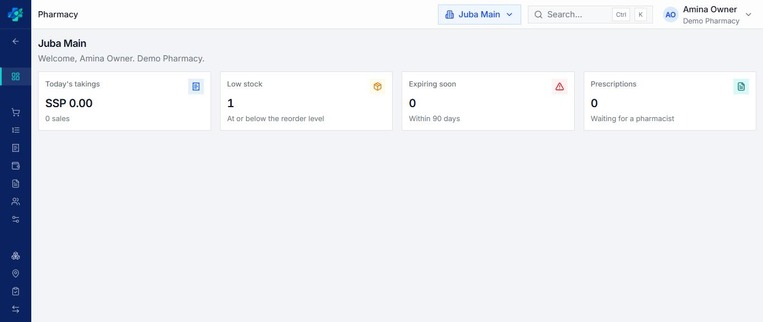
Each branch at a glance
Today's takings
Sales so far today at the branch you are working in.
Low and expiring stock
Medicines at their reorder level, and batches expiring within 90 days.
Prescriptions waiting
Recorded prescriptions still waiting for a pharmacist.
Staff choose their branch once; stock, sales and receipts follow it.
Notes:
The home screen is per branch. Each card links to the list behind it.

Slide 5
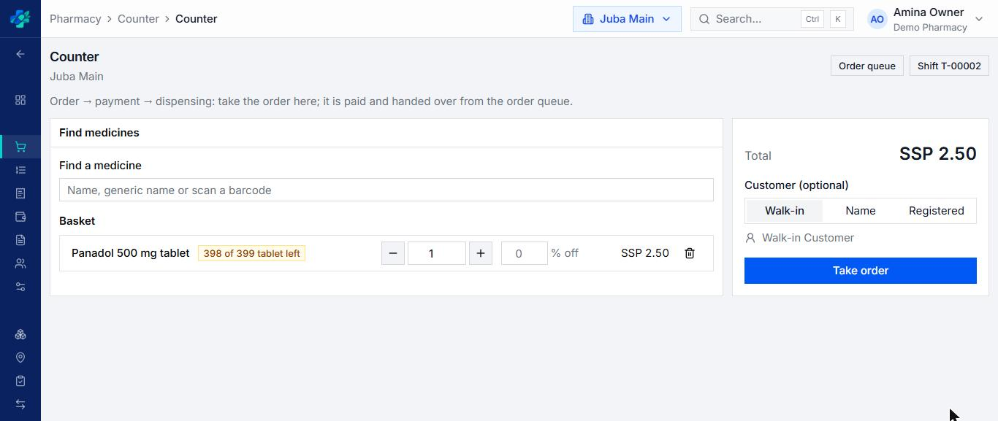

A counter that keeps the queue moving
Search or scan
By brand, generic name or barcode, with stock left shown as you sell.
Order, pay, dispense
Take the order at the counter; it is paid and handed over from the order queue.
Walk-in or registered
Sell to a walk-in, a named customer or a registered account.
Approved discounts, cash, mobile money or card, and an 80 mm receipt.
Notes:
Every sale belongs to the cashier’s open shift, so the till can be reconciled at closing.

Slide 6

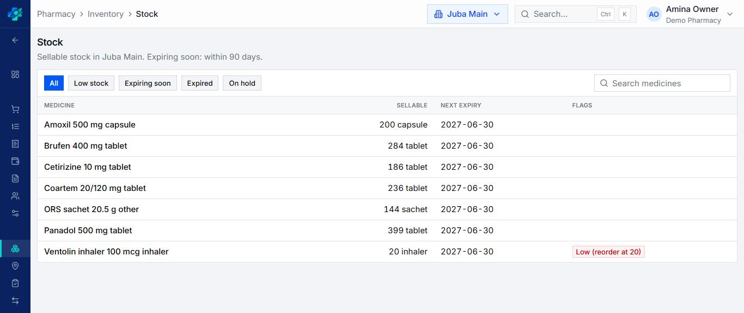
Stock and expiry, branch by branch
One view of the shelf
Sellable stock and the next expiry date for every medicine.
Filters that matter
Low stock, expiring soon, expired and on hold, one click away.
Reorder levels
Medicines at or below their reorder level are flagged.
Each branch keeps its own stock and locations, with transfers between branches.
Notes:
Expiring soon means within 90 days.

Slide 7

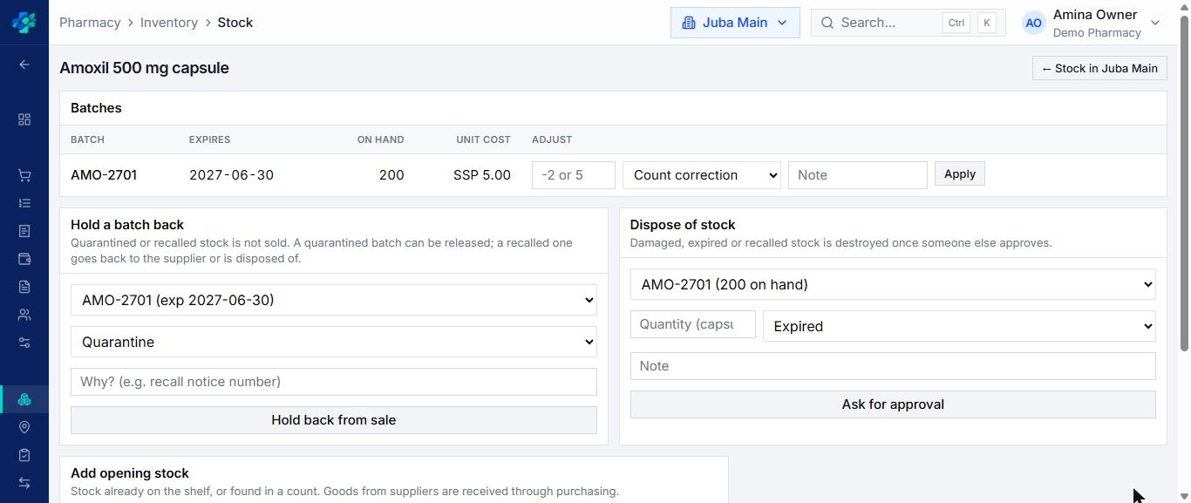
Every batch traced, held back or disposed of
Batch, expiry and cost
Each batch has its number, expiry date, quantity and unit cost.
Quarantine and recall
Hold a batch back from sale in one step, with the reason recorded.
Two people for disposals
Damaged or expired stock is destroyed only after someone else approves.
Corrections are recorded with a reason; stock history is never edited.
Notes:
Separation of duties: the person who asks for a disposal cannot approve it.

Slide 8
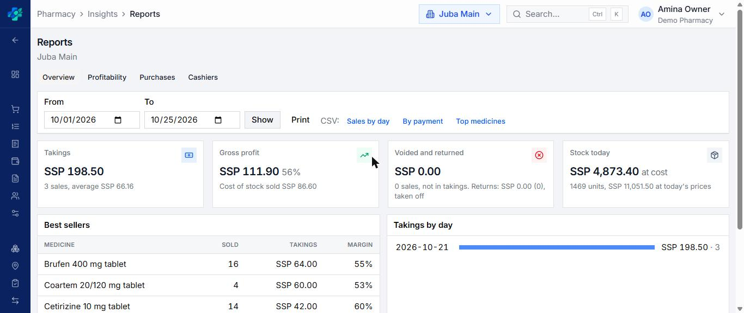
Know what you earn, not just what you sell
Takings and gross profit
Sales, cost of goods and margin for any period.
Best sellers
What sells, how much it brings in and at what margin.
Print or export
Profitability, purchases and cashiers, printable or as CSV.
Figures shown are sample data from a demo workspace.
Notes:
Reports read from the same records as Finance, so the numbers agree with the books.

Slide 9





How a day runs
01
02
03
Receive
Sell and dispense
Close the day
Goods arrive against a purchase order, by batch and expiry. The supplier bill appears in Finance.
The counter picks the batch that expires first and checks prescriptions before dispensing.
Tills are counted. Revenue, cost of goods and cash are already in the ledger.
Finance & Accounting is included: every sale, purchase, return and write-off posts to it on its own.
Notes:
Nobody types a sale or a delivery twice: the pharmacy and Finance share the same records.

Slide 10



Web, desktop and mobile
Web
Desktop
Mobile
Every screen in the browser, at every branch
Your workspace at its own address
Subscription on Miles Cloud
The counter on a Windows PC, with barcode scanners and shortcuts
Keeps selling offline; sales are sent once the connection is back
Standalone single-branch edition, bought once, for no internet at all
Sell, dispense and run a shift on a phone or tablet
Scan barcodes with the camera
Bluetooth receipt printers on Android; prescriptions are never queued offline
Notes:
Desktop sales made offline wait in an outbox and are sent exactly once when the connection returns.

Slide 11



Part of Miles Cloud
Miles Pharmacy runs on Miles Cloud, the platform every Miles product shares. Add Miles Finance, Miles HR or the next application to the same workspace when you are ready.
One sign-in
Google, passkeys and two-step verification, for every Miles app.
Branches and roles
A cashier in one branch sees nothing in another.
Finance & Accounting included
Every Miles Pharmacy workspace comes with its books.
One set of books
Sales, purchases and tills post to Finance & Accounting.
A record of who did what
An append-only audit log; stock entries are reversed, never edited.
Notes:
Miles Cloud is the shared foundation: account, organization, application access, subscriptions and permissions.

Slide 12



Start with a 60-day free trial
No payment details. Your workspace, your branches, your stock.
Miles Pharmacy is in early access today.
milesoftwares.com/erp/pharmacy
Get started: milesoftwares.com/start
Talk to us: milesoftwares.com/contact
Notes:
The trial starts a new workspace with Miles Pharmacy and Finance & Accounting. Custom set-up, data loading and training are available on request.

