Slide 1










Projects
A user and feature guide for NGOs, their teams and their donors
Notes:
This guide explains what the Projects app does, who each part is for, and how the parts connect. Screenshots use made-up demo data for a sample organization, Asaas NGO.

Slide 2
Everything an NGO runs on, in one place
Introduction
Projects replaces scattered spreadsheets, email approvals and separate finance files. Everyone works from one record, and every decision stays on it.
Plan and deliver
Control the money
Answer to funders
Keep the books
Projects, tasks, milestones, team time and risks, with health worked out for you.
Approved budgets, spending requests, a second approver, and recorded payments.
Grants, payment schedules, reports owed, and a private portal for your donors.
Full accounting that picks up project payments and grant receipts by itself.
Plans, money and results, kept honest in one place.
Notes:
The four areas share the same data, so a payment recorded on a project updates its budget and the grant that funds it, and posts to the accounts.

Slide 3





Each person sees what their job needs
Introduction
Team members
Work their tasks, log time and request spending
My work, Board, Spending
Project managers
Run projects, draft budgets, manage risks and the team
Projects, Budget, Risks
Finance staff
Approve budgets and spending, record payments, keep books
Approvals, Accounting
Directors and admins
See the whole organization, invite people and set the rules
Portfolio, Administration
Funders
See only the grants you share, accept reports, write to you
Donor portal
Notes:
Menus only show what a person may use. A team member does not see Funding, Finance or Administration, and a funder sees only the donor portal.

Slide 4

Record it once, and it reaches everything
Introduction
Plan
Budget
Spend
Report
Account
Set up the project, its tasks, team and milestones.
Draft budget lines. Finance approves them.
Request, approve and pay against the budget.
Track each grant, and share progress with funders.
Payments and grant receipts post to the books.
Example: when finance records a payment for twelve hand pumps, the project budget, the grant that paid for them and the accounts all update from that one entry.
Notes:
Each stage feeds the next. Paying an expense updates the project budget and the grant it was charged to, and posts a journal to the accounts.

Slide 5

Join your organization in four steps
Getting started
1
2
3
4
Get your invitation
Set your details
Open your workspace
Protect your account
An administrator emails you a one-time link, valid for a week.
New here? Set your name and password. Already registered? Just sign in.
Your organization has its own web address. Bookmark it.
Turn on two-step sign-in with an authenticator app under Your account.
One account, many organizations. If you work with more than one organization, the same sign-in opens them all, and you switch between them from the menu.
Notes:
Administrators send invitations from Administration, Members. One account can open several organizations.

Slide 6


The menu follows your job
Getting started
Overview
Projects
Funding
Finance
Administration
Portfolio
My work
Projects
Spaces
People
Grants
Funders
Approvals
Accounting
Members
Roles & permissions
Settings
Audit log
Press Ctrl+K anywhere to search projects, tasks, people, spending, grants and funders. Results only include what you have permission to see.
Notes:
Hover over the slim icon rail on the left to open the menu. People only see the sections their role allows.

Slide 7
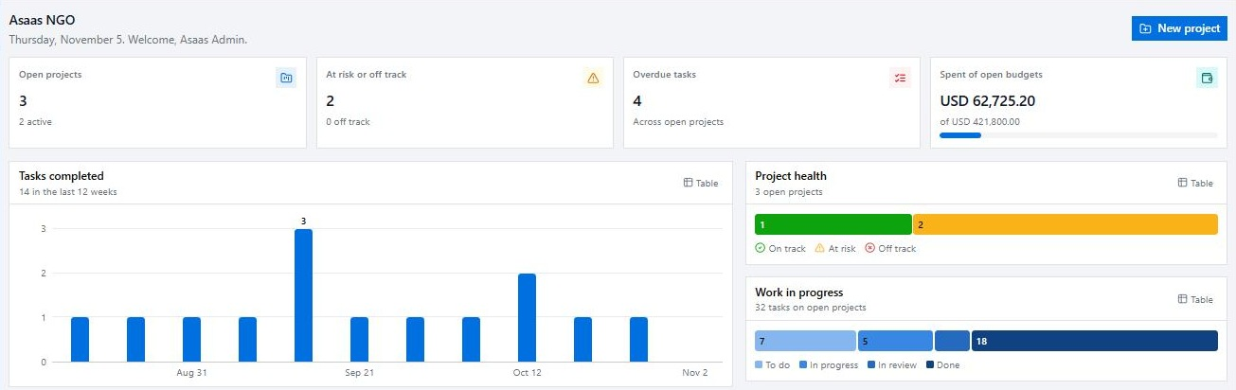
See the whole organization at a glance
Getting started
Headline numbers
Open projects, those at risk, overdue tasks, and spend against budgets.
Trends
Tasks completed each week and expenses paid each month.
Health and workload
How projects are doing, and where work sits. Table shows exact figures.
Notes:
Find it under Overview, Portfolio. Directors, programme leads and finance use this page to see where attention is needed.

Slide 8
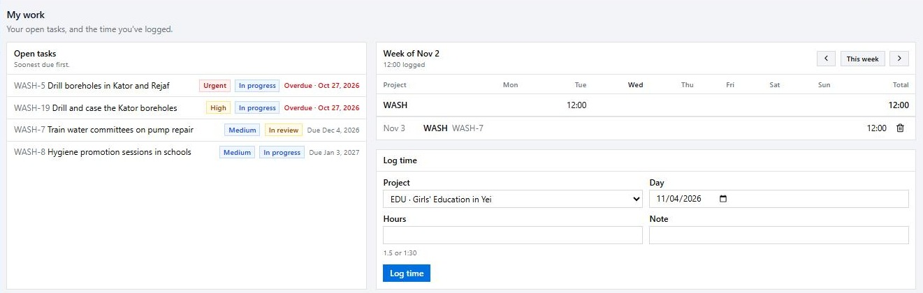
Start each day from your own list
Getting started
Your open tasks
Everything assigned to you, soonest due first, with overdue work in red.
Your week
A timesheet showing the hours you have logged, by project.
Log your time
Pick a project and day, then enter hours as 1.5 or 1:30.
Notes:
Find it under Overview, My work. Logged time is costed at the person's hourly rate, so labour counts toward the project budget.

Slide 9



The app tells you when something needs you
Getting started
Waiting for your decision
Decisions on your requests
Budgets and spending that need your approval.
Spending approved, rejected or paid, and budgets approved or returned.
Your tasks and mentions
What is running late
Tasks assigned to you, and when someone mentions you in a comment.
Overdue tasks you lead, funder reports due soon, and late grant payments.
In the app and by email. Approvals and decisions are emailed straight away, with a daily email of what you have not read. You can turn email off.
Notes:
Approval requests and decisions arrive at once. Reminders and anything unread arrive in the daily email. Anyone can turn email off under Your account; notifications in the app stay on.

Slide 10
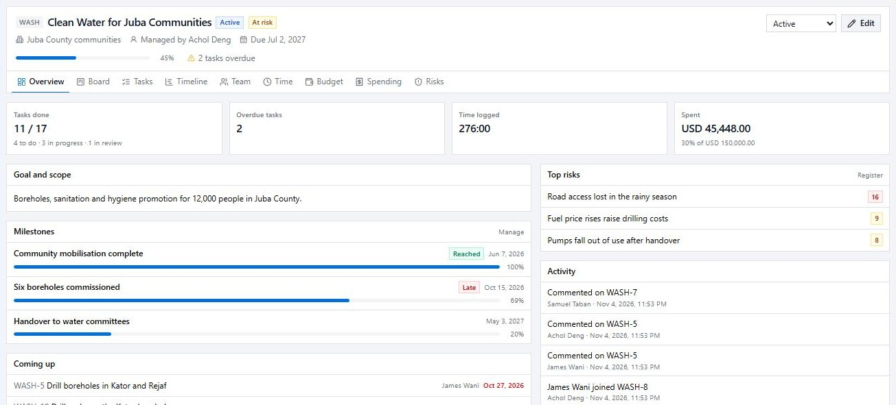

One page for each project
Plan and deliver
Tabs for everything
Board, tasks, timeline, team, time, budget, spending and risks.
Key numbers
Tasks done, overdue tasks, time logged and money spent.
Good to know Each project has a short code that numbers its tasks, so WASH-5 is always easy to find.
Milestones
The big deliverables, and how far each has come.
Notes:
Find it under Projects, then open a project. Top risks and recent activity also appear on the overview.

Slide 11
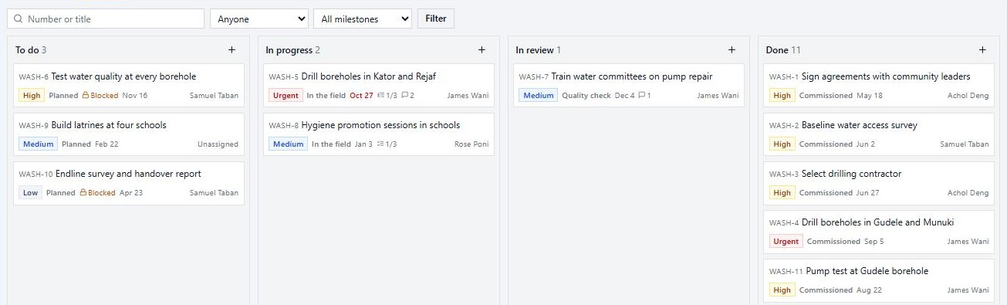
Three views of the same tasks
Plan and deliver
Board
Drag cards across columns. A lock marks a task that is waiting on another.
List
Every task with status, priority, owner and due date. Filter by person or milestone.
Timeline
Bars from start to due date, with milestones and a line marking today.
Notes:
All three views show the same tasks, so nothing needs updating twice. Each list can name its own steps, such as In the field.

Slide 12






A task holds everything about the work
Plan and deliver
Subtasks and checklists
Dependencies
Files
Break work into smaller tasks, or small steps to tick off.
A task can't be finished until the tasks it waits for are done.
Attach PDFs, images and documents, up to 10 MB each.
Comments and mentions
Estimates and time
Owner and helpers
Mention a colleague and they are notified.
Compare the estimate with the hours actually logged.
One person leads the task, and others can be added to it.
Notes:
Open any task from the board or list. Everything about the work stays with it rather than in email threads.

Slide 13




Project health is worked out for you
Plan and deliver
On track
At risk
Off track
Work and spending are moving in line with the time that has passed.
Progress is over 20 points behind the time elapsed
Any task is overdue
Spending is over 20 points ahead of progress
The project is past its due date
Or it has gone over budget
Your organization can change how far a project may slip before it shows At risk. Being past due or over budget always counts as Off track.
Notes:
Administrators can change how many points a project may slip under Administration, Settings. The default is 20 points.

Slide 14


Keep a live risk register
Plan and deliver
5 | 5 | 10 | 15 | 20 | 25
4 | 4 | 8 | 12 | 16 | 20
3 | 3 | 6 | 9 | 12 | 15
2 | 2 | 4 | 6 | 8 | 10
1 | 1 | 2 | 3 | 4 | 5
 | 1 | 2 | 3 | 4 | 5
A simple score
Probability times impact gives 1 to 25. 15 and over is high, and 8 and over is medium.
Probability
A plan for each risk
Record the mitigation, who owns it and when to review it.
Always current
See which risks are open and which are being mitigated. The biggest show on the project page.
Impact
Notes:
Find it on the Risks tab of a project. Project managers add risks. The top risks also appear on the project overview.

Slide 15



Organize the work and the people
Plan and deliver
Where the work lives
Who does the work
Workspace
Team on each project
Everyone's role, share of time, open tasks and hours logged.
Space
Folder
Spot overbooking
See each person's total across all projects. Over 100% means overbooked.
List
Each new project gets its own folder and task list
Parts are archived, not deleted, once nothing is open
Your directory
Members join when they first open the organization. Add contractors by hand.
Notes:
Spaces are under Projects, Spaces. People are under Projects, People. Team allocation is on each project's Team tab.

Slide 16



Two people, every time money moves
Budgets and spending
Request
Requested
Approve
Committed
Pay
Spent
A team member asks to spend, with the supplier and any quotes.
Someone else checks it against the budget. The money is now committed.
Finance records the payment with its date and reference.
No self-approval
Whoever requests spending can never approve or pay it.
Checked first
It must fit what is left in the category and in the grant charged.
Nothing disappears
Rejected, cancelled and voided spending all stay on record.
Notes:
Spent counts paid spending only. Labour comes from time logged, not from expenses. Larger amounts can need up to three approvers, set under Administration, Settings.

Slide 17
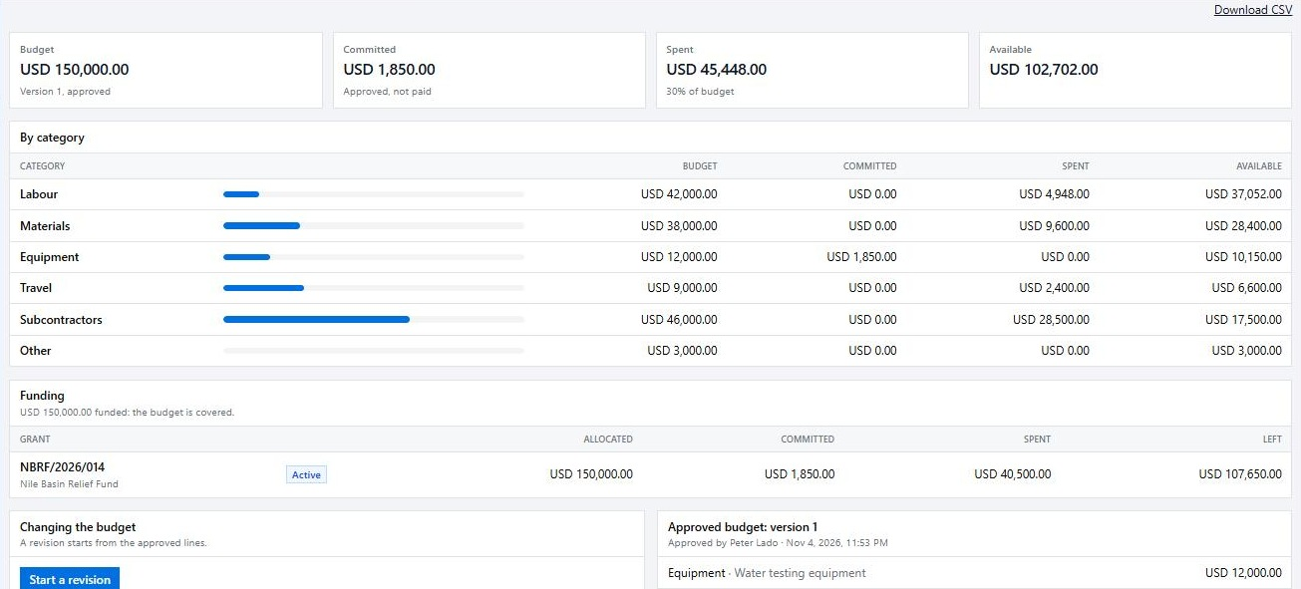
Know what is left, at any moment
Budgets and spending
Four key totals
Budget, committed, spent, and what is still available.
By category
Labour, materials, equipment, travel, subcontractors and other.
Good to know Approved budgets never change. A revision is a new version, and it needs approval to replace the old one.
Funding
Which grants pay for the project, and what each has left.
Notes:
Find it on the Budget tab of a project. Project managers draft budgets and finance controllers approve them. Budgets can be downloaded as CSV.

Slide 18
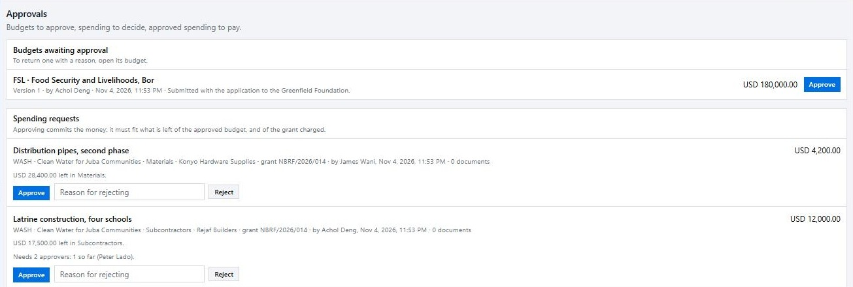
Everything waiting for a decision, on one page
Budgets and spending
Budgets
Submitted budget versions, ready for you to approve.
Spending requests
See what is left in the category, then approve or reject with a reason.
Larger amounts
Big requests can need up to three approvers, all different people.
Notes:
Find it under Finance, Approvals. Approved spending then moves to the To pay list further down the page, ready to record.

Slide 19



Follow each grant from opportunity to closeout
Grants and donors
Opportunity
Applied
Active
Closed
A grant can also end as Declined at the application stage. It stays on record.
Amendments
Funds many projects
Reports owed
After award, the amount and end date change only by a numbered amendment, kept permanently.
One grant can fund several projects, and one project can draw on several grants, across currencies.
See what is overdue or due within 60 days. A grant closes only when no report is owed.
Notes:
Find grants under Funding, Grants. Before the award the amount is your request and can be edited. After the award it changes only by a numbered amendment.

Slide 20
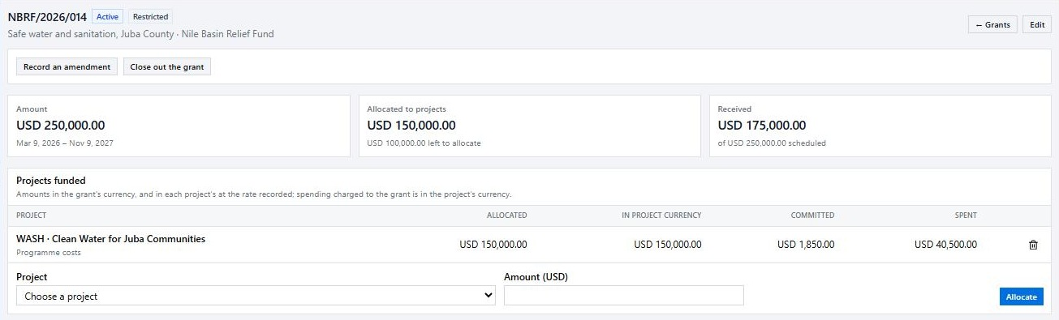
Inside a grant: the award and where it goes
Grants and donors
Allocate to projects
See what each project has committed and spent. Never more than the grant.
Payments
A schedule of expected payments. Marking one received updates the accounts.
Reports to the funder
Each report moves through due, submitted, and accepted or revision requested.
Notes:
Payments and reports sit further down the grant page. A funder directory lives under Funding, Funders, with a named contact for each funder.

Slide 21
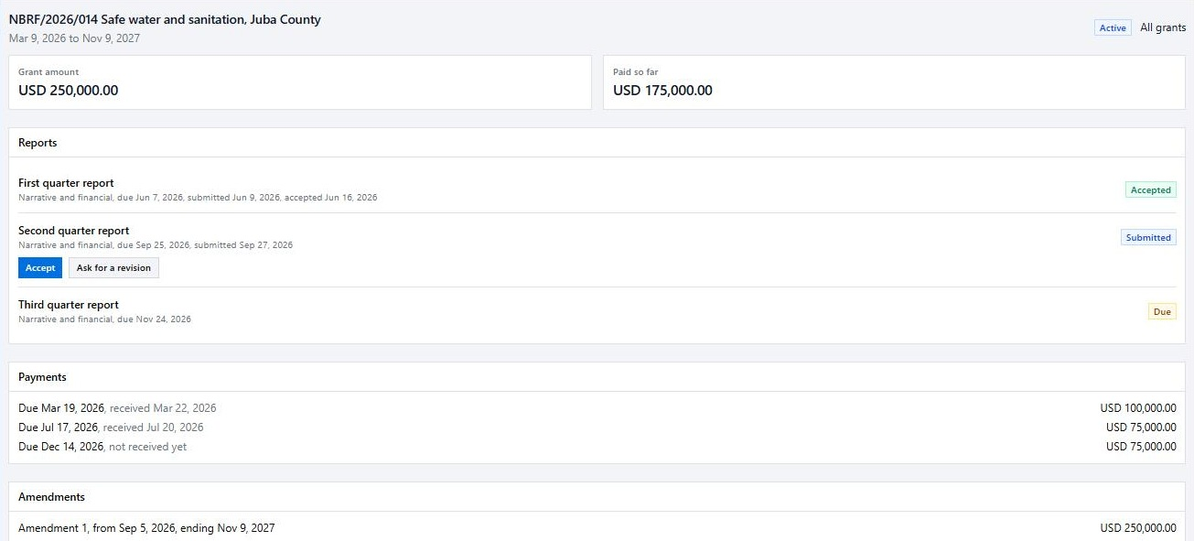
Give funders their own window
Grants and donors
What they see
Grant terms, payments, amendments and reports.
What they can do
Accept a report, ask for a revision, or write to you.
Good to know Nothing reaches a funder until you share that grant. They see the portal and nothing else in your organization.
What you control
Whether to share budget, spending and progress.
Notes:
To share a grant, open it under Funding, Grants, tick Share this grant with the funder, and invite the funder's contacts by email. Spending lists show only what was charged to their own grant.

Slide 22
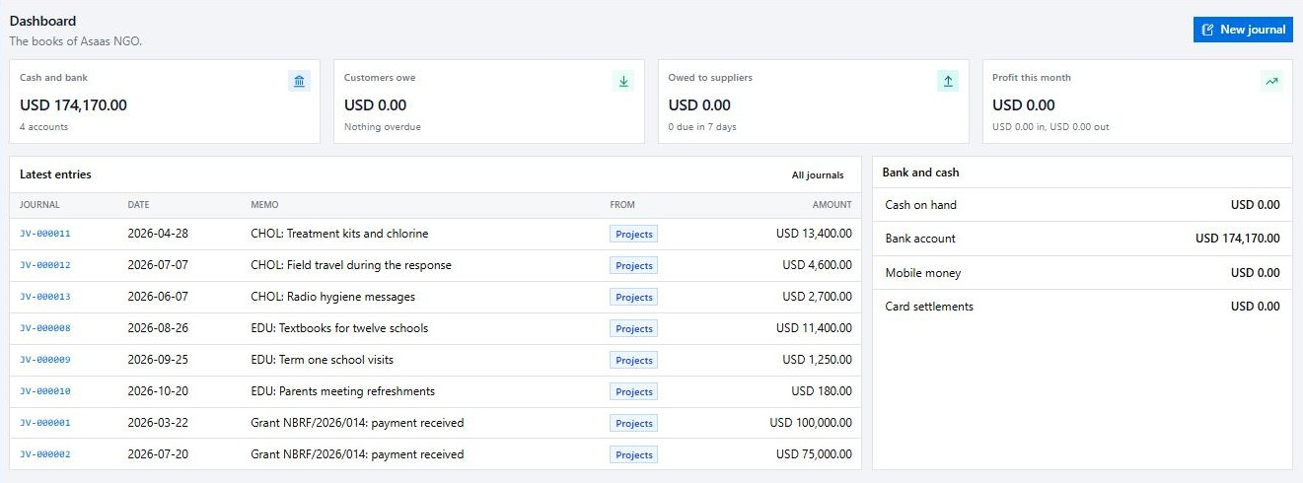
Books that fill in by themselves
Accounting
Key balances
Cash and bank, what customers owe, and what you owe.
Automatic entries
Paid expenses and grant receipts post a journal, tagged Projects.
Good to know Labour, and spending that is approved but not yet paid, do not post to the books.
Your mapping
Choose which account each spending category posts to.
Notes:
Find it under Finance, Accounting. Accountants and bookkeepers work here, and auditors get read-only access. Accounting has its own menu; the arrow at the top of the rail returns to projects.

Slide 23






A complete set of accounting tools
Accounting
General ledger
Payables
Receivables
Banking
Accounts, journals and approvals, recurring journals, periods and closing.
Suppliers, bills and supplier payments.
Invoices you can send as a PDF, and customer payments.
Bank and cash accounts, statement imports, reconciliation and rules.
Fixed assets
Tax
Budgets
Currencies
An asset register with categories, and depreciation runs.
Tax codes and tax returns.
Accounting budgets, cost centres and project tracking.
Several currencies, with exchange rates and revaluation.
Reports: profit and loss, balance sheet, cash flow, ratios, trial balance, general ledger, aged balances, budget against actual.
Notes:
Each area has its own permissions, so a bookkeeper or auditor sees only what their role allows. Reports can be printed or downloaded as CSV.

Slide 24
Nine ready-made roles
Administration and security
Role | What it can do | Area
Organization Administrator | Runs the organization: members, roles, settings and every project | Leadership
Project Manager | Everything on projects, and sees the grants funding them | Delivery
Team Member | Views projects, works tasks, logs own time, requests spending | Delivery
Viewer | Views projects only | Delivery
Finance Controller | Approves budgets and spending, records payments, manages funders and grants | Finance
Finance Officer | Views projects, budgets and grants, and records approved payments | Finance
Accountant | Manages the accounts, journals, bills, invoices, banking and reports | Accounting
Bookkeeper | Day-to-day records: bills, invoices, banking and reconciliation | Accounting
Auditor (read only) | Reads the books and reports, and can change nothing | Accounting
Notes:
Invite people under Administration, Members and tick their roles. One person can hold several roles. The organization owner can do everything. Funder contacts have no role and see only the donor portal.

Slide 25
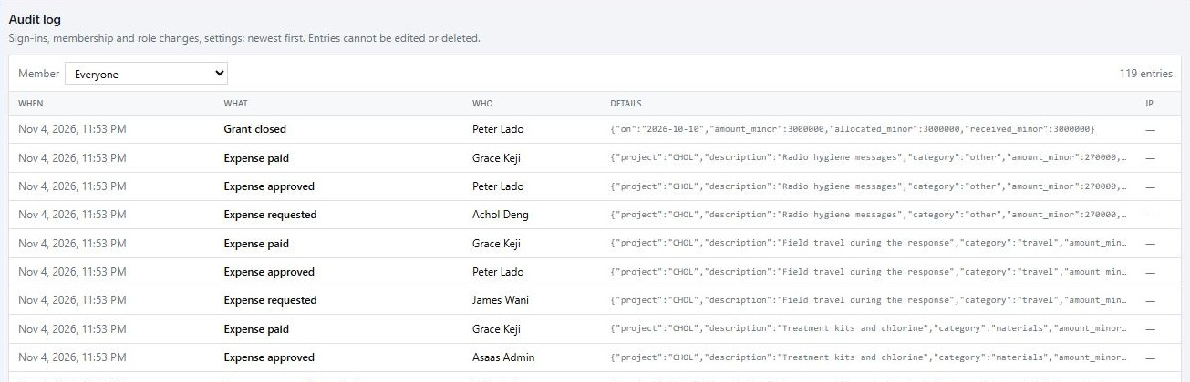
A permanent record of who did what
Administration and security
Everything important
Sign-ins, role changes, approvals, payments, grants and settings.
Tied to a person
Every entry shows who did it and when. Filter by member.
Can't be changed
Entries can't be edited or deleted, so auditors can rely on them.
Notes:
Find it under Administration, Audit log. It is useful during a donor or external audit.

Slide 26



Set your rules and secure your accounts
Administration and security
For your organization
For your account
Your details
Name, country, default currency and time zone.
Two-step sign-in
Add an authenticator code, with one-time recovery codes.
Project health
How far a project may slip before it shows At risk.
Where you are signed in
See your devices, and sign out any you do not recognize.
Spending approvals
From a set amount, require one to three approvers.
Password guessing stopped
After five failed sign-ins in a minute, the address is locked briefly.
Notes:
Organization settings are under Administration, Settings. Personal security is under Your account, opened from your name at the top right of any page.

Slide 27






Protections built into the system
Administration and security
No self-approval
Approved means fixed
Limits are enforced
Nobody approves or pays their own request, and each approver is a different person.
Approved budgets and amendments never change. A change is a new record.
Spending can't exceed the budget left or the grant allocation.
Nothing is erased
Least access
Sharing is your choice
Rejected and voided items stay on record, and the audit log can't be edited.
People only see what their role allows, even in search results.
Funders see only the grants you share, and the details you choose.
Notes:
These rules are enforced by the system itself rather than by policy alone, which is what donors and auditors usually ask about.

Slide 28

STEP 01
Where to go from here
Accept your invitation
Use your link to join your organization's workspace.
STEP 02
Secure your account
New to Projects? Use "Request a demo" on the Projects website to see it with your own team.
Turn on two-step sign-in under Your account.
STEP 03
Need more access? Ask your administrator to adjust your role.
Open My work
See your tasks, and log your first hours.
Notes:
Screenshots in this guide were taken from the demo workspace. Your own workspace will show your organization's data, and may show fewer menu items depending on your role.

