Slide 1

Argument Prediction
Machine Learning & Content Analytics

Slide 2
TABLE OF CONTENTS
01
MISSION
02
TIMEPLAN
03
DATA
04
METHODOLOGY
05
06
07
The business problem and purpose of this project
The timeplan of the execution of this project
The data that were used through the whole project
The process steps & the various models that were explored
RESULTS
The results that were derived from the models
Positive, negative outcomes &comments from the entire project
COMMENTS
TEAM
The team members that executed the project

Slide 3
INSPIRATION
PURPOSE
BENEFICIARIES
01 MISSI0N
Infinite published papers but not all of them produce a scientific argument
Prediction of arguments in paper’s abstract sentences (Claim, Evidence or No Label)
Universities, scientific journals &the Government in order to initially sort the papers that have arguments

Slide 4
02 TIMEPLAN
Paper Annotation
Discussion & assembly
Project Presentation
1ST AUG
30TH SEP
18th OCT
7th AUG
15TH OCT
19TH NOV
Paper Extraction
Model Implementation
Project Delivery

Slide 5

03 DATA
The Sustainable Development Goals (SDGs) or Global Goals are a collection of 17 interlinked goals designed to be a “blueprint to achieve a better and sustainable future for all”. The SDGs were set in 2015 by the United Nations General Assembly and are intended to be achieved by the year 2030

Slide 6
PROCESS
03 DATA
STEP 2
STEP 3
Annotation
Discussion & Corrections
STEP 1
STEP 4
Abstract Extraction
Creation of the final Data set

Slide 7
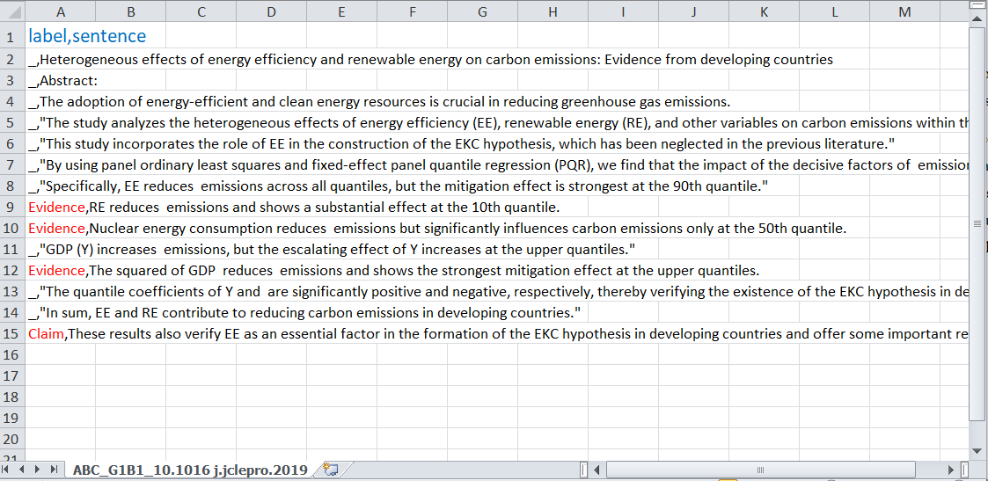
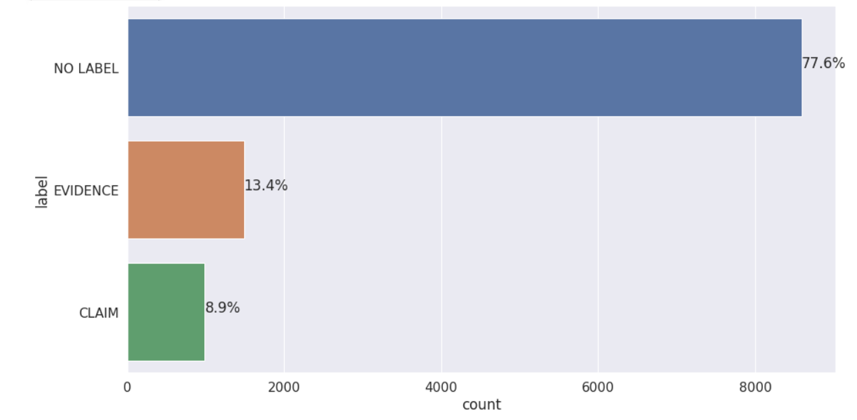
03 DATA
Final data set
Unbalanced data set

Slide 8
04 METHODOLOGY
01
Data cleaning
02
Splitting the data to train and test (80-20)
03
Transformation of the data via the Tokenizer/CountVectorizer
04
Padding of the transformed data (max-end)
05
Transformation of the labels via the OneHotEncoder
06
Creation of class weights based on the size of each class
07
Fit multiple model architectures
08
Search for the best Hyperparameters
09
Evaluation of the best created model

Slide 9
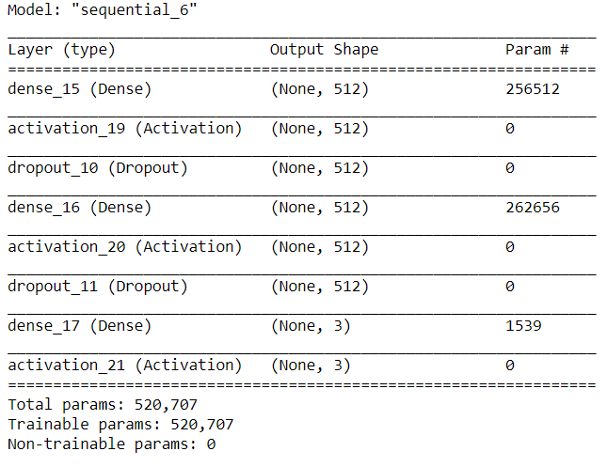
04 METHODOLOGY
MLP model
520,707 params.
Fast execution
RMSprop Optimizer
Early Stopping (3)

Slide 10
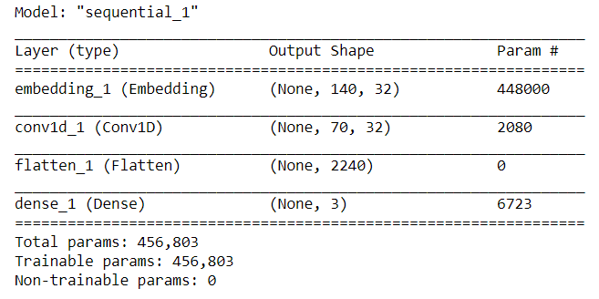
04 METHODOLOGY
CNN model
456,803 params.
Fast execution
Adam Optimizer (lr=0.001)
Callback

Slide 11
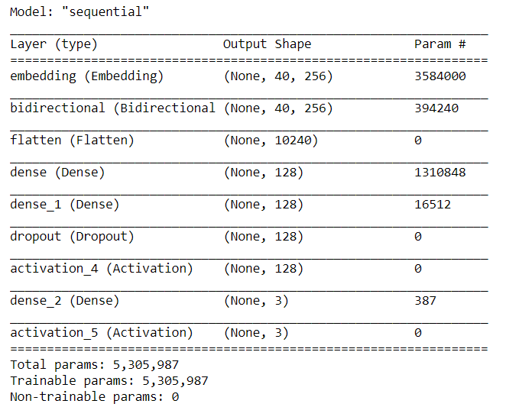
04 METHODOLOGY
LSTM model
5,305,987 params.
Slow execution
Adam Optimizer (lr=0.0005)
Callback

Slide 12
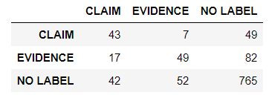
05 RESULTS
MLP model
77 %
Accuracy
 | Precision | Recall | F1-score | Support
Claim | 42% | 43% | 43% | 99
Evidence | 45% | 33% | 38% | 149
No-label | 85% | 89% | 87% | 859

Slide 13
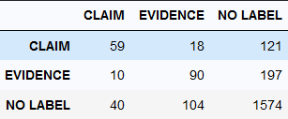
05 RESULTS
CNN model
75 %
Accuracy
 | Precision | Recall | F1-score | Support
Claim | 40% | 35% | 38% | 198
Evidence | 40% | 39% | 39% | 297
No-label | 85% | 86% | 85% | 1718

Slide 14
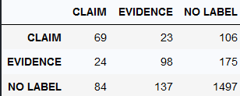
05 RESULTS
LSTM model
75 %
Accuracy
 | Precision | Recall | F1-score | Support
Claim | 39% | 32% | 35% | 198
Evidence | 37% | 35% | 36% | 297
No-label | 84% | 87% | 86% | 1718

Slide 15
05 RESULTS*
73 %
Linear SVC model
Accuracy
 | Precision | Recall | F1-score | Support
Claim | 25% | 37% | 30% | 99
Evidence | 42% | 22% | 29% | 149
No-label | 84% | 86% | 85% | 859

Slide 16
05 RESULTS**
 | Precision | Recall | F1-score
Claim | 41 | 13 | 55
Evidence | 8 | 62 | 88
No-label | 33 | 77 | 867
CNN model
 | Precision | Recall | F1-score | Support
Claim | 50% | 38% | 43% | 109
Evidence | 41% | 39% | 40% | 158
Weighted avg | 45% | 39% | 41% | 267

Slide 17
06 COMMENTS
Positives
Learned a lot of important aspects of Deep Learning and its challenges
Realized the difficulties and the aspects of an entire Deep Learning project
The cooperation between the members of our team was very efficient and harmonic.
The guidance that was provided to our team was very helpful and crucial
The Results of the models provide a certain worth & gain
All models have a somewhat good predictive ability, Sensitivity & Specificity
Negatives
insufficient time given for the project that did not respond to it’s difficulty and complexity
inconsistencies in the TensorFlow library
Small dataset
Comments/Future tasks
Our main concerns regard the annotation phase of the project
Repeat the whole process & especially the annotation phase with more abstracts
Explore if by keeping data from only one scientific field produces a better model
Exploit the usage of pre-trained word embeddings such as Word2Vec, GloVe & SciBert

Slide 18
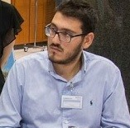


Mikes Manos
Nikolopoulos Filippos
Panagiotatos Konstantinos
07 TEAM
BSc in Mathematics (NKUA)
MSc in Business Analytics (AUEB)
BI Engineer at ImprovIT
BSc in Economics (AUEB)
MSc in Business Analytics (AUEB)
AI Analyst at OTE
M. Eng in Mechanical Engineering (AUTH)
MSc in Business Analytics (AUEB)
BI Engineer at ImprovIT

Slide 19

THANKS!
Do you have any questions?

