Slide 1
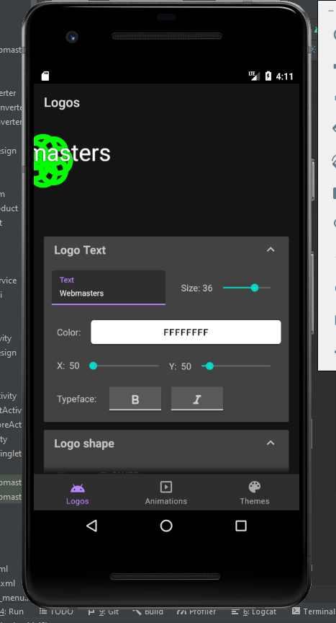
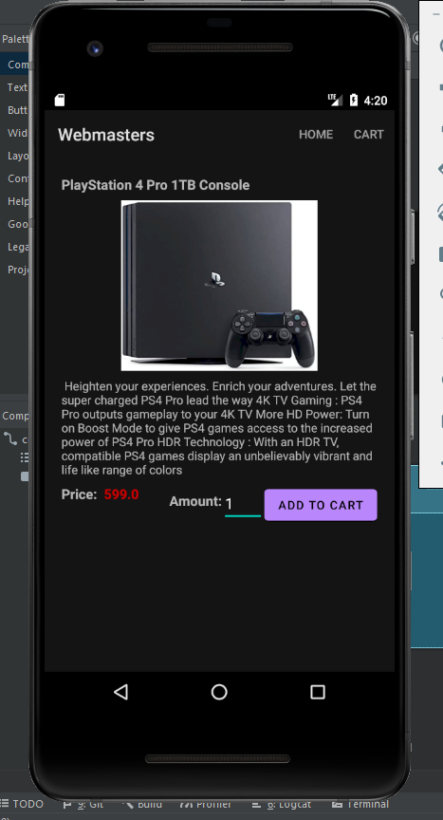
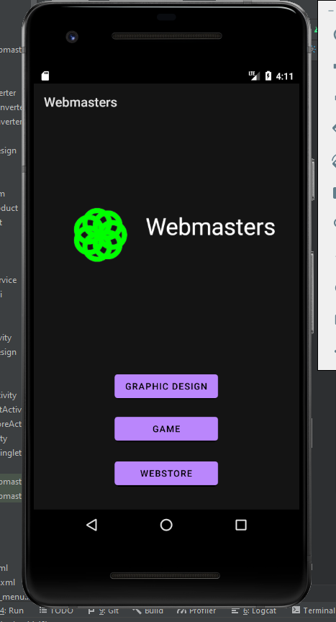
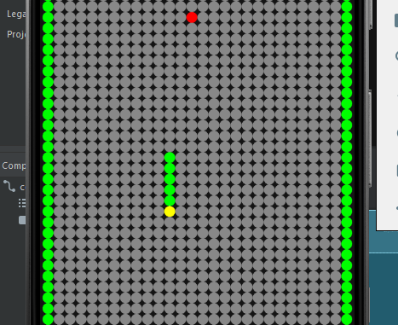
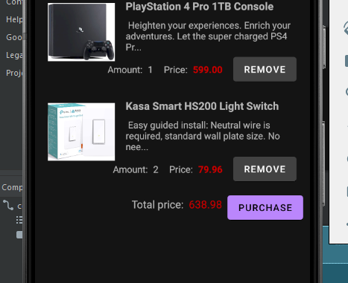
Webmasters
Arttu Rusanen, Jaakko Ikäheimo, Konsta Holm, TVT19KMO
Information Technology, Software Development
Introduction
The main goal of the project was to develop multi-featured mobile application with Android Studio and Firebase representing web-based portfolio.
Objectives
The objectives of this project were to create logo/brand-creation feature, simple snake-game and mobile online-store. Application communicates with Firebase’s firestore database saving user’s settings and session data.
FIGURE 1. Application’s main menu
Methods
Android Studio and IntelliJ IDEA were used mainly for coding and designing the user interface. Google’s mobile application development platform Firebase allowed us to use Cloud Firestore for database access.
The logo editor allows the user to create a logo for themselves based on several different predefined settings and save it to database.
In the game part of application user gets to play the classic snake-game. Due to lack of time additional features of the game were not implemented.
In the online store the user can search products and the application retrieves information from the database and user can add products to the shopping cart.
The product includes different user-interface for all parts of the application, game has its own sub-menus built in it’s main menu.
Results
The end product is a fully functional online portfolio-application. Main problems that came up were the lack of time due to ongoing work-situation. Game could’ve had more functionality in it and more bug-free. Overall product turned out to beclose to what was expected in the beginning. (See Figures 2, 3, 4, 5 below.)
FIGURES 2, 3, 4, 5. The end product consists of different user-interface menus.
Conclusions
Overall successful project, got fully functional mobile application. Time was the biggest obstacle we encountered. Could’ve implemented more features and better user-experience with more time.
References
1. Cloud Firestore:
https://firebase.google.com/docs/firestore
Mobile Application Project
ECTS credits: 6
Date of publication: 2020, Autumn
Instructor: Eino Niemi

