Slide 1
AUDIO DEEPFAKE DETECTION IN SPEECH
A comparison of deep-learning architectures for real-vs-fake speech, with cross-dataset evaluation.
2nd Semester Deep Learning Project
George Nazos MTN2519 | Konstantinos Kaimakis MTN2508
MSc Artificial Intelligence · NSCR Demokritos & UNIPI

Slide 2
MOTIVATION
Why this problem?
Synthetic speech is now near-indistinguishable from real, enabling fraud and disinformation.
The hard part is not in-domain accuracy, it is generalising to unseen generators data.
So we train on one data set (FoR) and test on a completely independent one (ITW).
The test set is class-imbalanced, accuracy alone is misleading so catching fakes is what matters.
31,779
ITW test clips
63% / 37%
real / fake split (imbalanced)
Audio Deepfake Detection — DL project
2

Slide 3
APPROACH
Four architecture families
Family | Input | Idea
MLP | hand-crafted features (MFCC, chroma, contrast, N_MFCC:20, N_FTT:128, HOP:256, N_MEL:128) | classical features + shallow classifier
CNN | mel-spectrogram (SR:16kHz, max_dur: 8.5s, N_FFT:1024 HOP:256, N_MELS:128) | learned 2-D spectral features
RNN / CRNN | mel-spectrogram | temporal modelling, with / without a CNN block
WavLM | raw waveform | self-supervised transformer with a classification head: frozen backbone vs fine-tune
Families 1–3: focused one-axis sweeps (capacity, LR, regularisation).
Family 4: an analysis of how to use a pretrained backbone.
Audio Deepfake Detection — DL project
3

Slide 4
DATA & EVALUATION
Cross-dataset evaluation, leakage control, metrics
Datasets
Class imbalance
FoR (for-norm) for train (53.868 samples) + validation (4.634 samples).
In-the-Wild (31.779 samples) for test only, so results measure true generalisation.
ITW is 63% real / 37% fake. We report per-class precision/recall/F1 and macro-F1, and treat fake-class recall as the operational metric.
Leakage control
Metrics
16 kHz mono, fixed-duration crop/pad. Feature scalers fit on clean training data only. For the WavLM fine tuning, noise augmentation was applied to the train split only.
AUC-ROC (primary), accuracy, macro-F1, per-class P/R/F1.
Audio Deepfake Detection — DL project
4

Slide 5
ARCHITECTURE · SUMMARY TABLE
Baseline configurations
Models | Configuration
MLP baseline | 3 × {Linear(256/128/64) – BN – ReLU – Dropout(0.5)} 1 × {Linear(1) – Sigmoid}
CNN baseline | 3 × {Conv(32/64/128, k=3, p=1) – ReLU – AvgPool2d(k=2) – Dropout(0.5)} 1 × {Linear(128→256) – ReLU – Dropout(0.5)} 1 × {Linear(256→1)}
RNN baseline | 2 × {BiLSTM(128/64, bidirectional) – ReLU – Dropout(0.5)} 1 × {Linear(128→256) – ReLU – Dropout(0.5)} 1 × {Linear(256→1)}
C-RNN baseline | 3 × {Conv(32/64/128, k=3, p=1) – ReLU – AvgPool2d(k=2) – Dropout(0.5)} 2 × {BiLSTM(128/64, bidirectional) – ReLU – Dropout(0.5)} 1 × {Linear(128→256) – ReLU – Dropout(0.5)} 1 × {Linear(256→1)}
The MLP, CNN, RNN, and C-RNN Baseline Network Architectures
Audio Deepfake Detection — DL project
5
AP = AvgPool2d(k=2, s=2) · BN = BatchNorm1d · BiLSTM hidden halves each layer (128→64) · bidirectional output = 2 × hidden

Slide 6
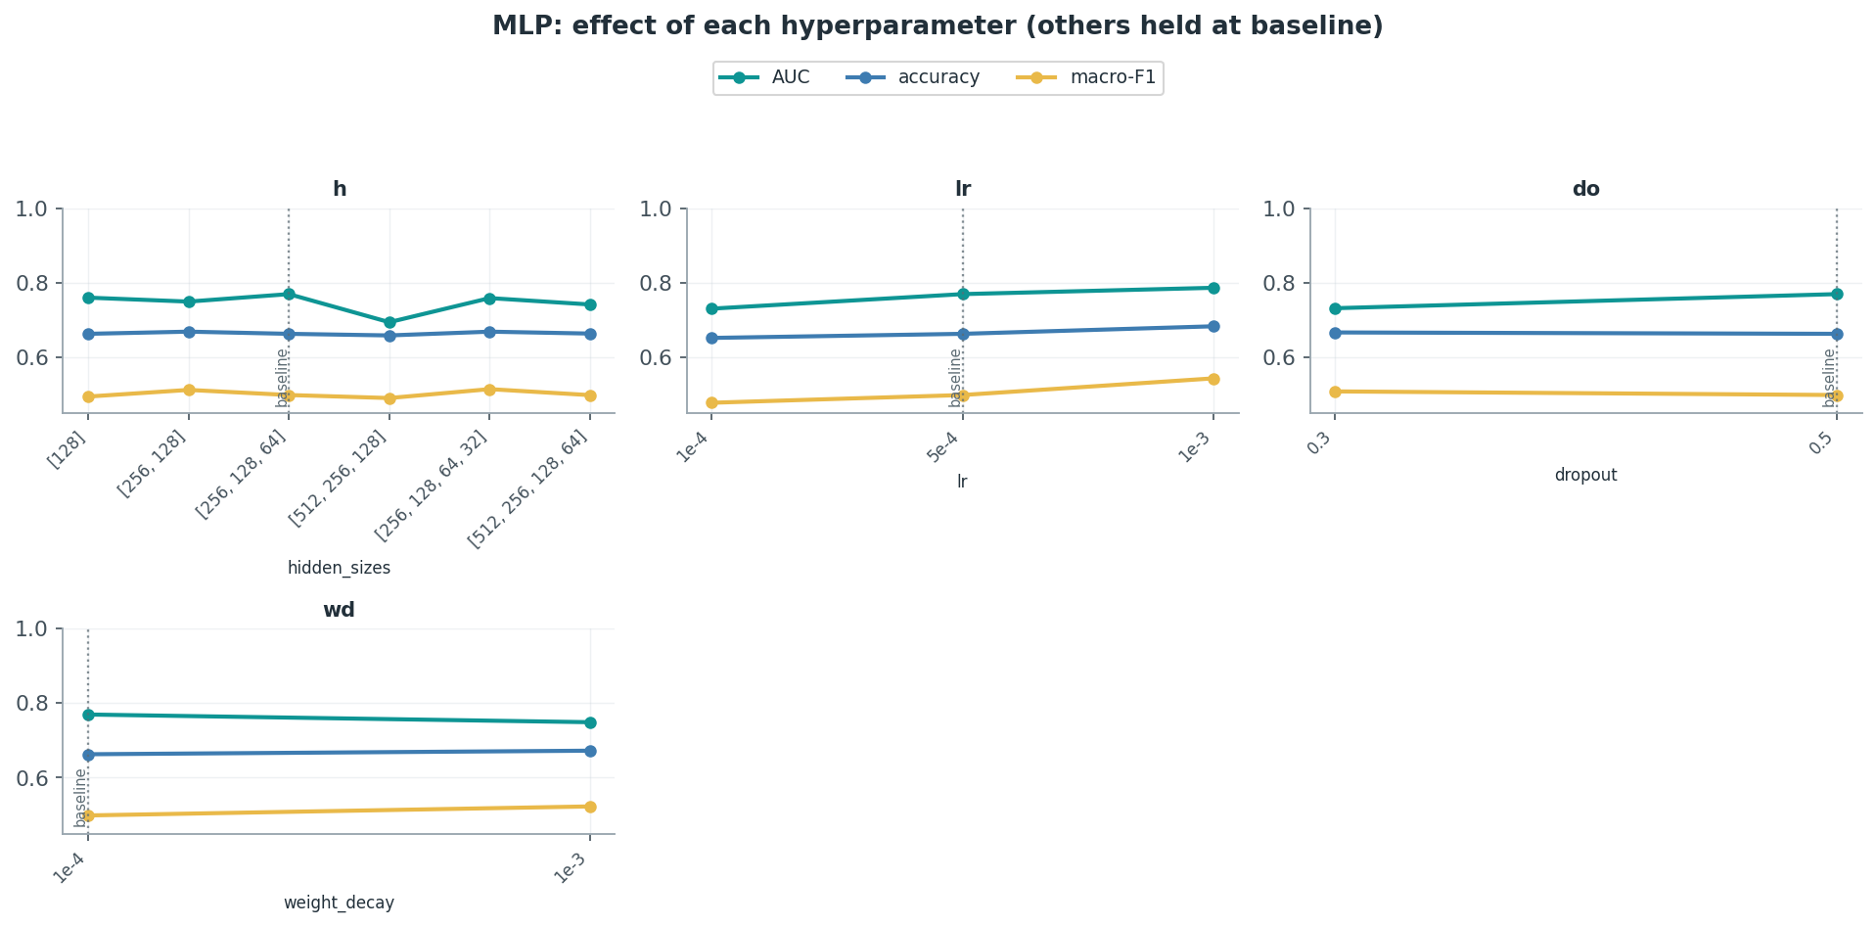
ARCHITECTURE 1 · MLP
Hand-crafted features
Best AUC ≈ 0.79 above chance but the weakest learned model.
More capacity hurts: wide/deep nets overfit FoR and transfer worse.
Learning rate: 1e-3 wins on this low-dim feature space.
The ceiling is the features, not the classifier.
Baseline config
Hidden layers: [256, 128, 64]
Learning rate: 5e-4
Dropout / wd: 0.5 / 1e-4
AUC 0.769 | fake-recall 12%
Best config
Hidden layers: [256, 128, 64]
Learning rate: 1e-3
Dropout / wd: 0.5 / 1e-4
AUC 0.786 | fake-recall 17%
Audio Deepfake Detection — DL project
5

Slide 7
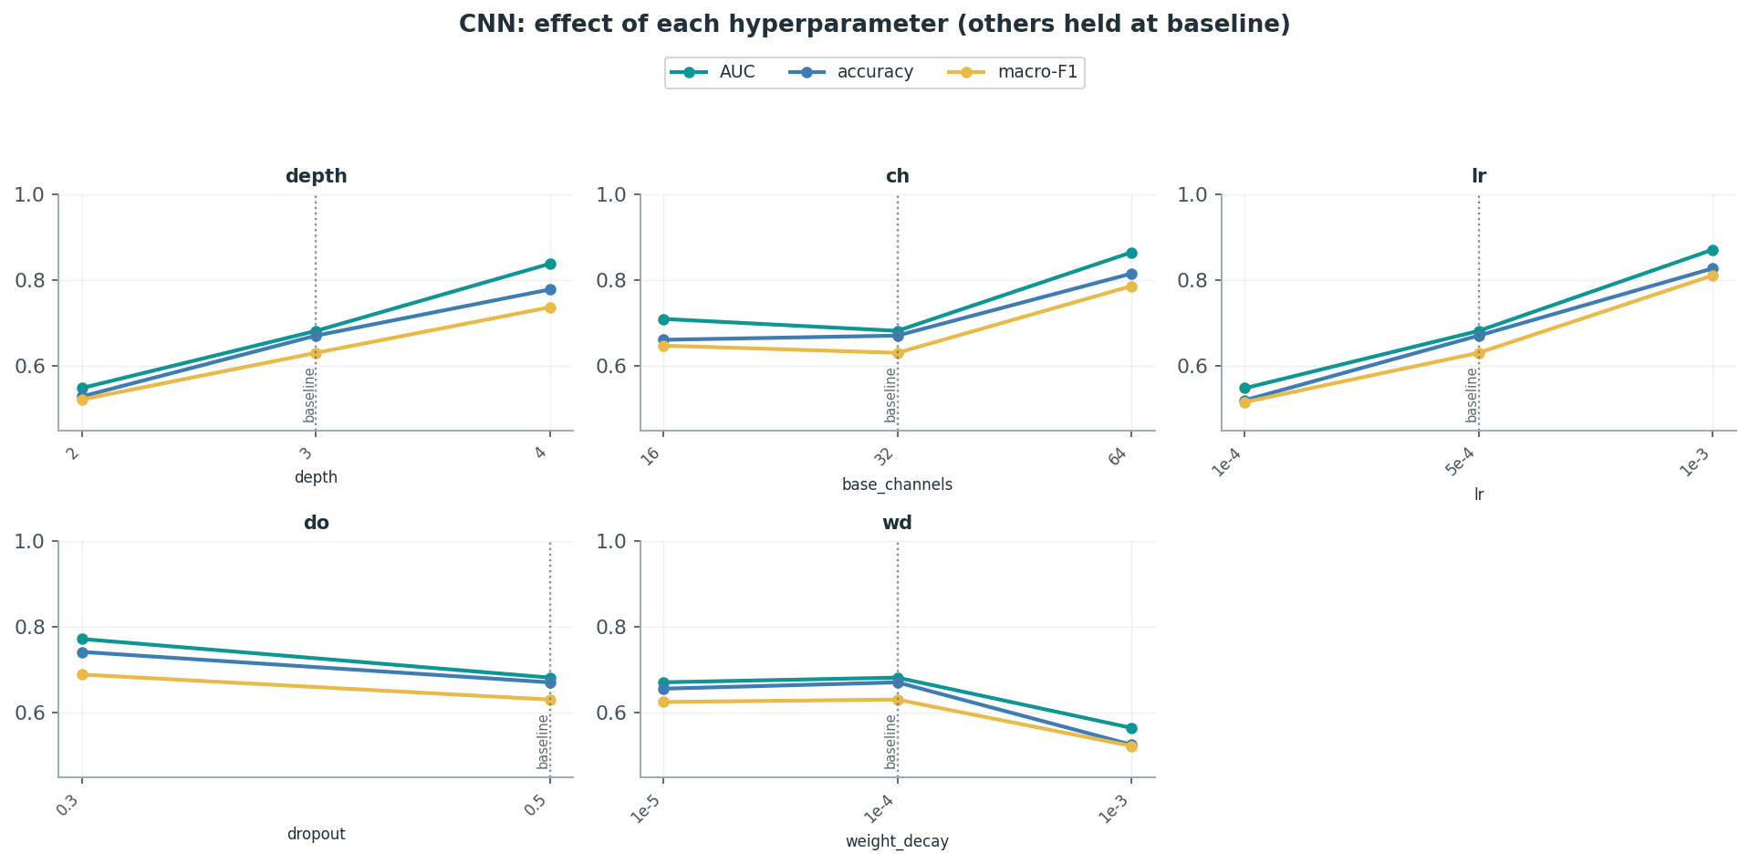
ARCHITECTURE 2 · CNN
Learned spectral features
Best AUC ≈ 0.87 / acc ≈ 0.83, and the best fake recall ≈ 72%.
Depth sweet spot at 3 blocks; 2 collapses, 4 overfits.
Width: 32 channels ideal; 64 adds nothing.
Baseline config
Conv depth / ch: 3 blocks / 32 ch
Learning rate: 5e-4
Dropout / wd: 0.5 / 1e-4
Note: dropout 0.3 beats 0.5 at this lr
AUC 0.681 | fake-recall 46%
Best config
Conv depth / ch: 3 blocks / 32 ch
Learning rate: 1e-3
Dropout / wd: 0.5 / 1e-4
Note: lr×dropout interaction: lr 1e-3 needs do 0.5
AUC 0.870 | fake-recall 72%
Audio Deepfake Detection — DL project
6

Slide 8
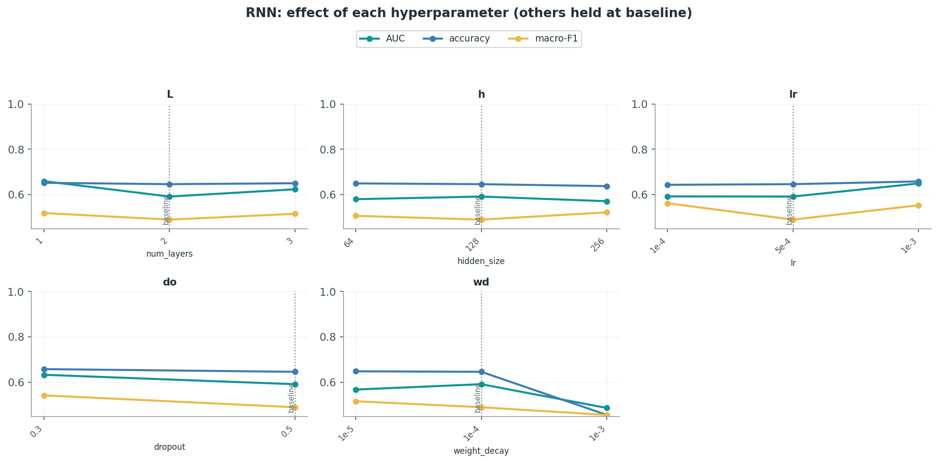
ARCHITECTURE 3 · RNN
Pure BiLSTM
Pure BiLSTM tops out at AUC ≈ 0.66 barely above the MLP.
More layers / wider hidden does not help: it is bottlenecked by representation, not temporal capacity.
Baseline config
BiLSTM layers / h: 2 / 128
Learning rate: 5e-4
Dropout / wd: 0.5 / 1e-4
AUC 0.592 | fake-recall 12%
Best config
BiLSTM layers / h: 1 / 128
Learning rate: 5e-4
Dropout / wd: 0.5 / 1e-4
AUC 0.660 | fake-recall 17%
One-axis sweeps around the baseline config
Audio Deepfake Detection — DL project
8

Slide 9
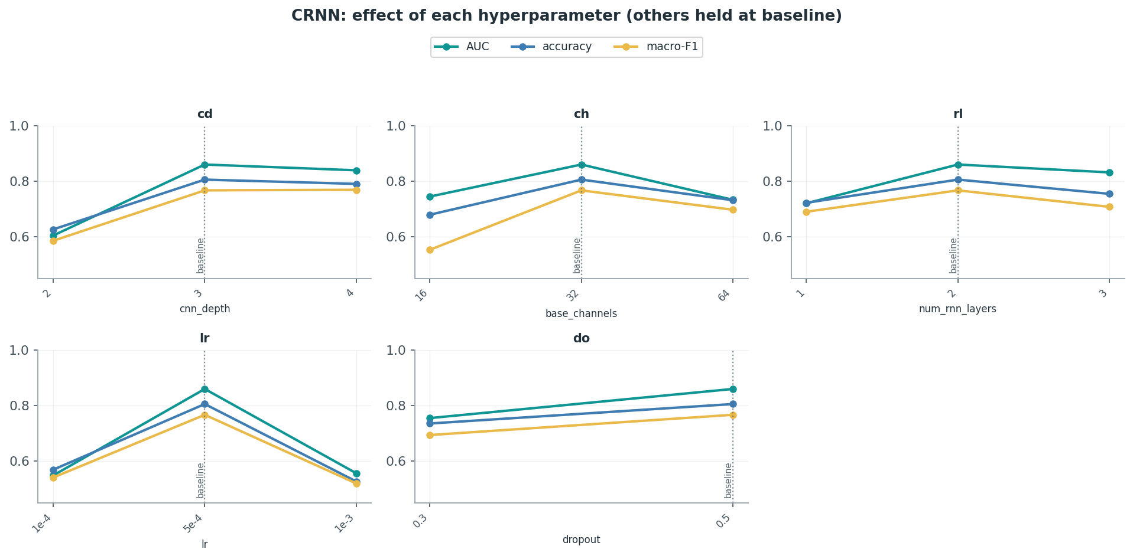
ARCHITECTURE 3 · CRNN
Combining CNN & RNN architectures
CRNN ≈ CNN (AUC ≈ 0.86): the CNN block does the heavy lifting.
Best: conv depth 3, 32 ch, 2 BiLSTM layers, lr 5e-4.
Large LR (1e-3) destabilizes the recurrent part of the model.
Temporal modelling adds little once convolution is present.
RNN 0.66 vs CRNN 0.86
Baseline config
CNN depth / ch: 3 blocks / 32 ch
BiLSTM layers / h: 2 / 128
Learning rate: 5e-4
Dropout / wd: 0.5 / 1e-4
AUC 0.860 | fake-recall 54%
Best config = Baseline
Note: Baseline is the optimum
AUC 0.860 | fake-recall 54%
Audio Deepfake Detection — DL project
7

Slide 10
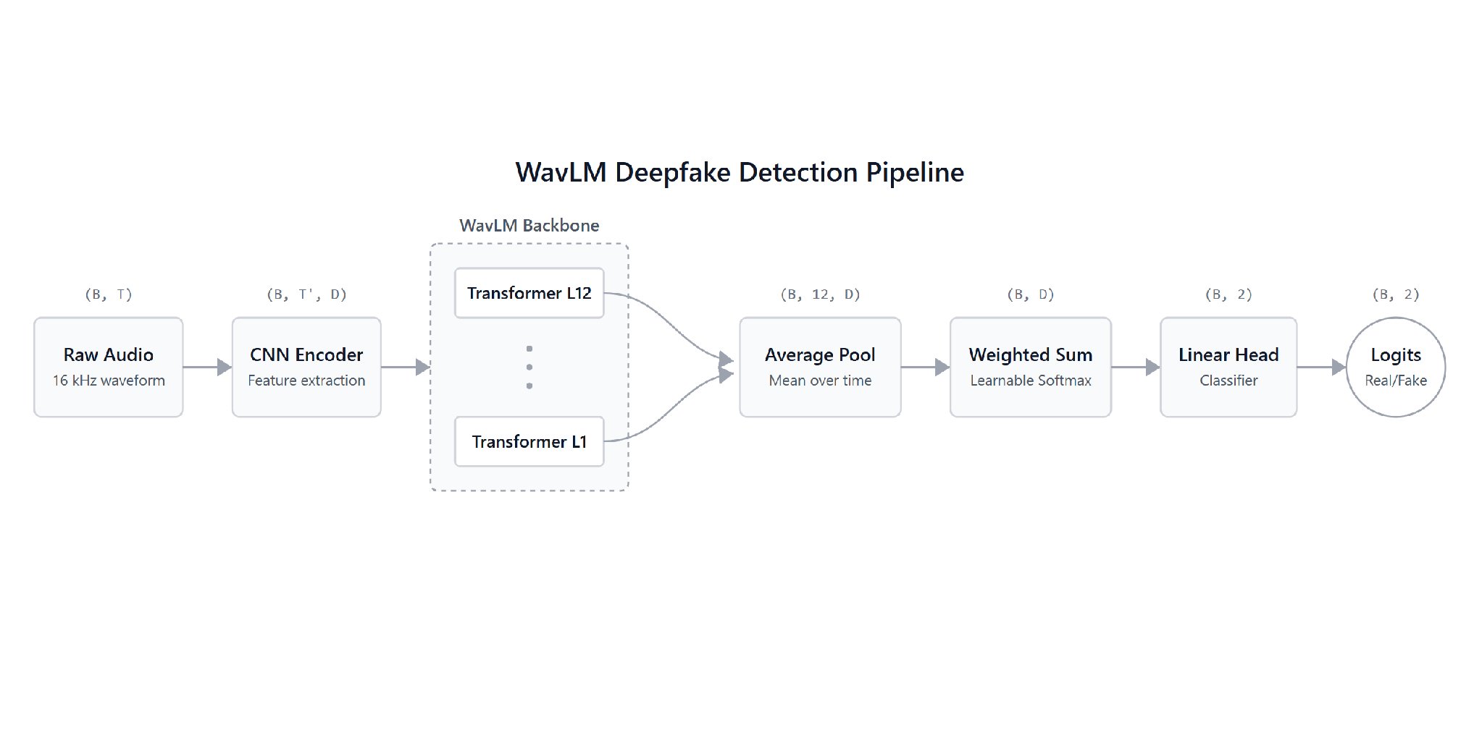
ARCHITECTURE 4 · WAVLM
WAVLM Based Classifier Network
Audio Deepfake Detection — DL project
9

Slide 11
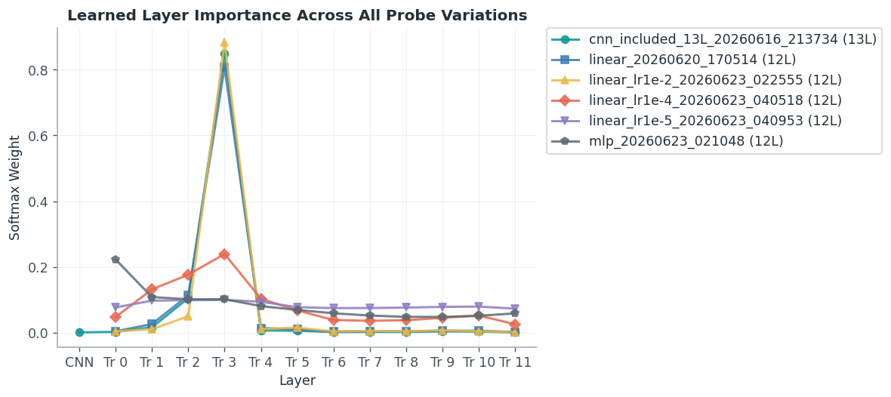
ARCHITECTURE 4 · WAVLM
Pre-trained WavLM Transformer Layer weight distribution
Frozen backbone = weighted sum over hidden layers + linear or MLP head.
~81% of weight on layer 3 of 12, the top layer is nearly ignored.
A 13-layer variant (incl. CNN embedding) agrees — same block.
Frozen backbone config
Aggregation: Softmax-weighted sum, 12 layers
Dominant layer: Layer 3 of 12 (~81% weight)
Trainable params: ~5K
AUC 0.918 | fake-recall 57%
Audio Deepfake Detection — DL project
9

Slide 12
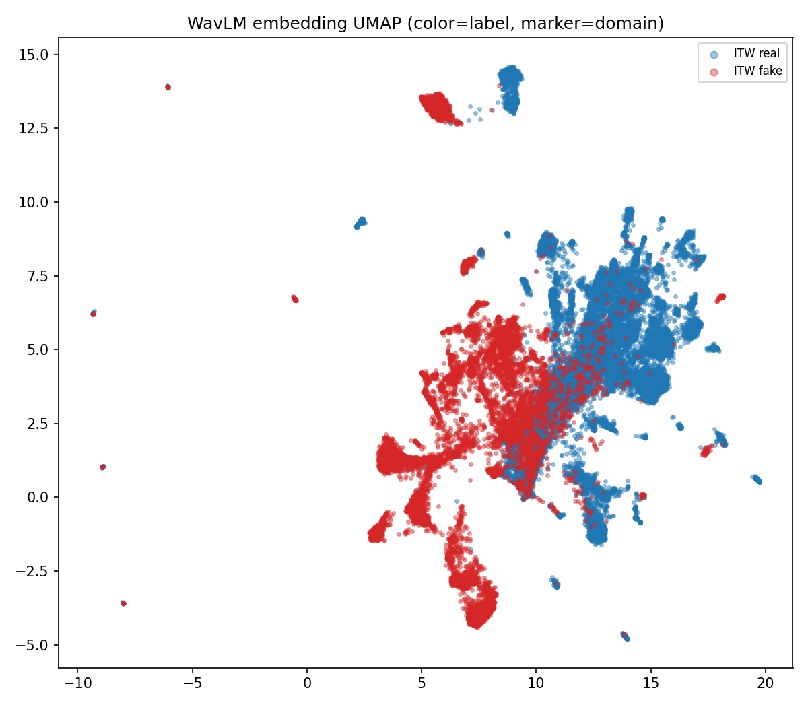
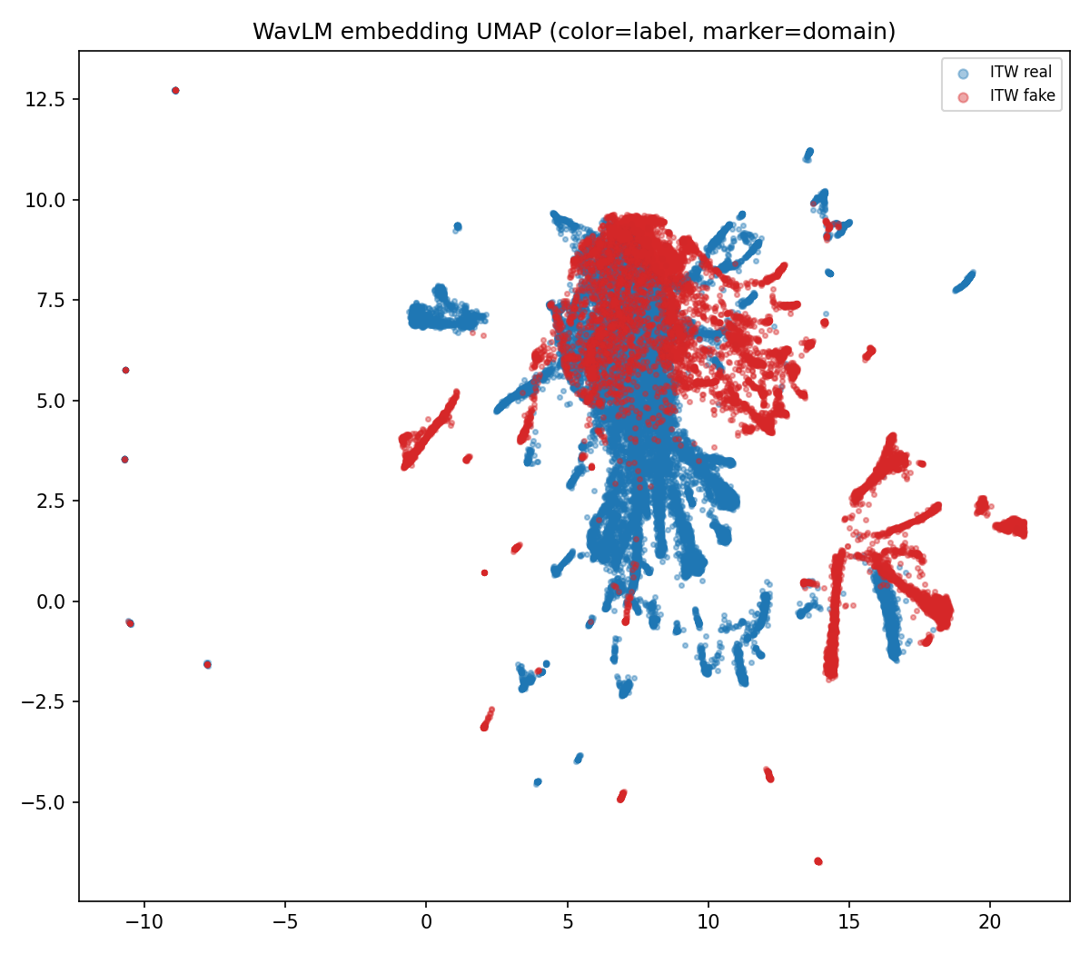
ARCHITECTURE 4 · WAVLM
Embeddings & scores explain the cross-dataset gap
FROZEN backbone
BEST FINE-TUNE
UMAP: ITW points spread across the boundary.
This is exactly why an in-domain threshold under-detects ITW fakes.
Audio Deepfake Detection — DL project
10

Slide 13
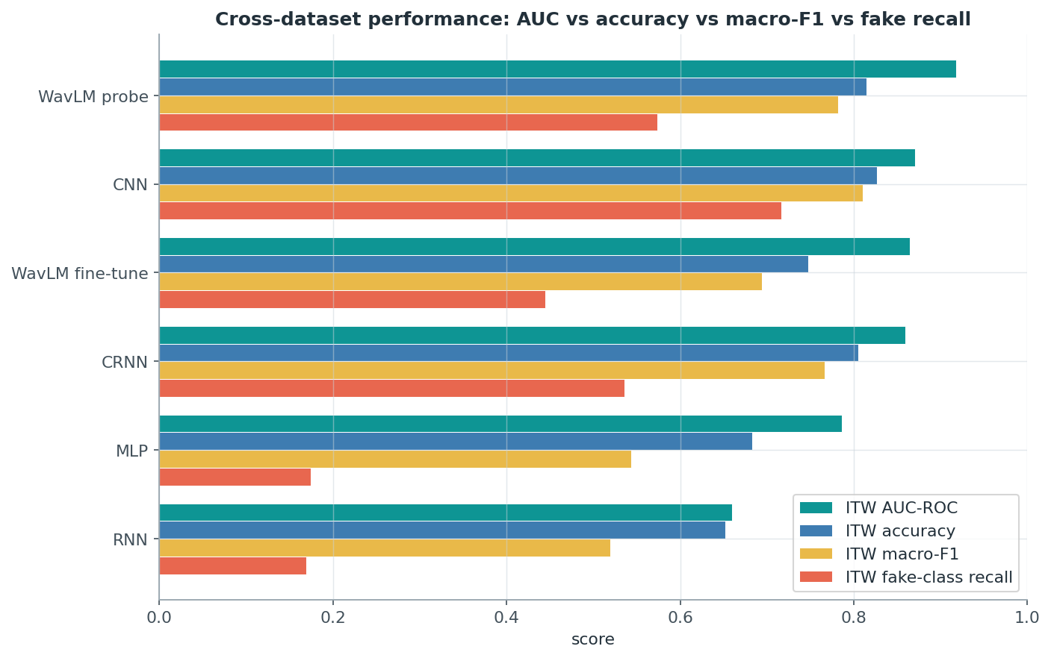
RESULTS
Cross-dataset performance by model
By AUC: WavLM (pre-trained) (0.92) > CNN (0.87) ≈ CRNN (0.86) > WavLM ft (0.86) > MLP (0.79) > RNN (0.66).
Representation learning drives the ranking.
Fine tuning is constrained by the training data.
Both AUC and fake class recall must be considered.
Audio Deepfake Detection — DL project
11

Slide 14
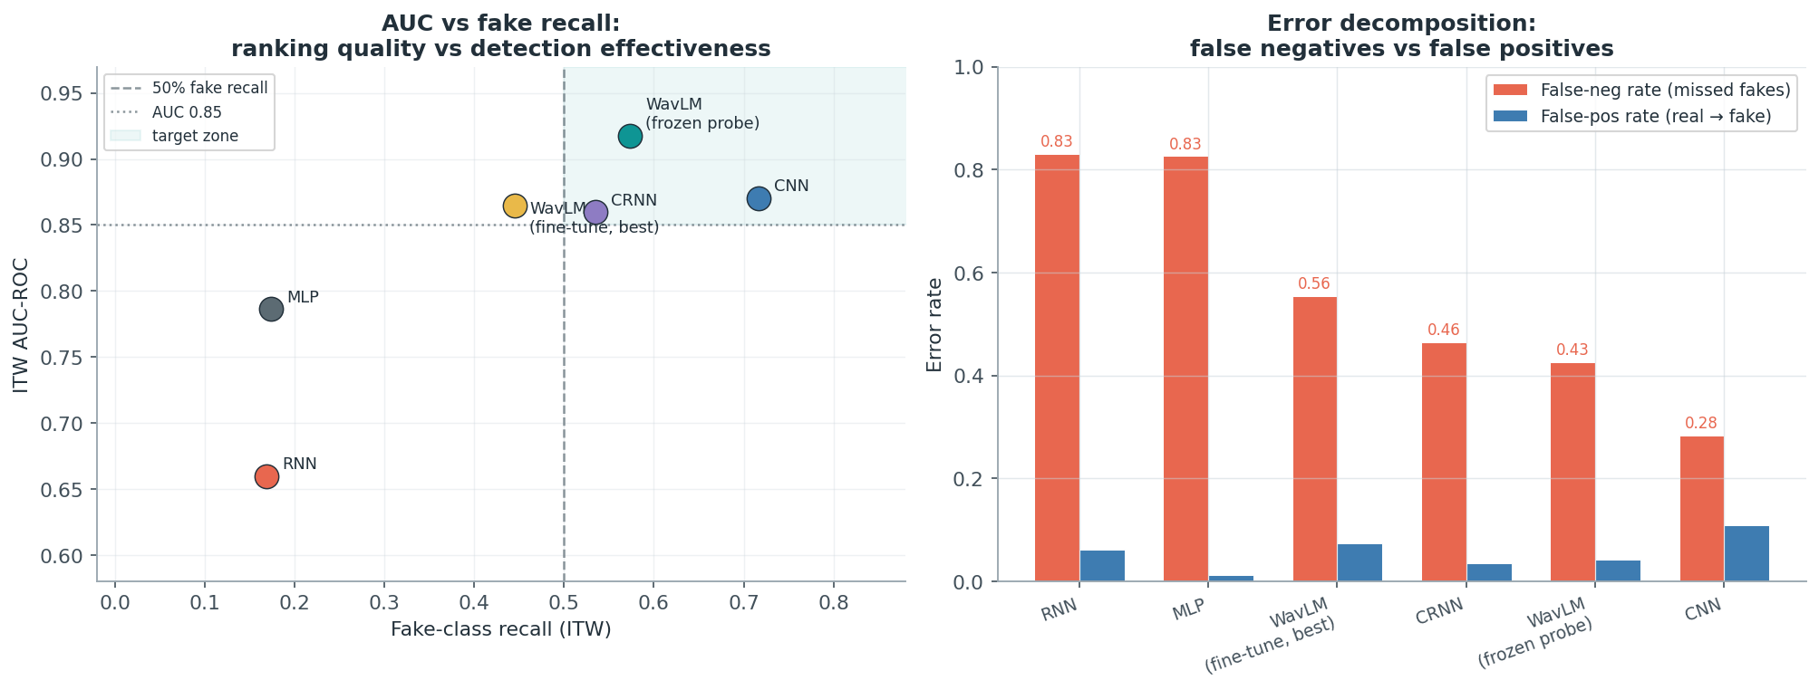
RESULTS · AUC VS FAKE RECALL
Ranking quality vs calibration and where each model errors land
High AUC + low fake-recall at threshold 0.5 = calibration problem, not a modelling failure. Only CNN and WavLM backbone sit in the target zone (top-right).
Audio Deepfake Detection — DL project
12

Slide 15
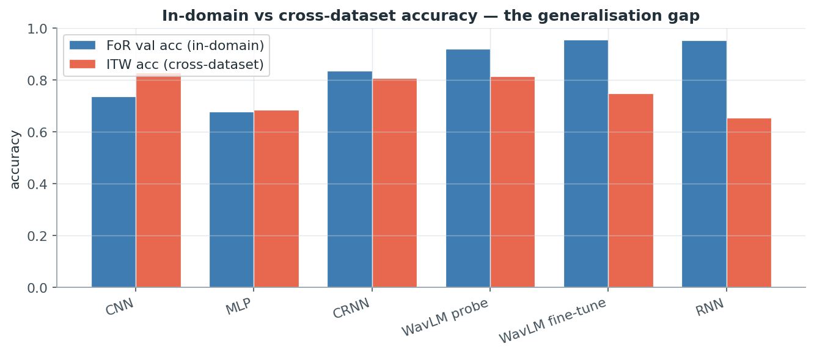
RESULTS · DIAGNOSIS
Architecture Generalisation gap
Fine-tuned WavLM: near-perfect FoR (AUC ~0.99) but the biggest ITW drop.
Frozen backbone transfers best smallest gap, highest ITW.
Under these circumstances, freezing the backbone can beat fine-tuning.
Audio Deepfake Detection — DL project
13

Slide 16
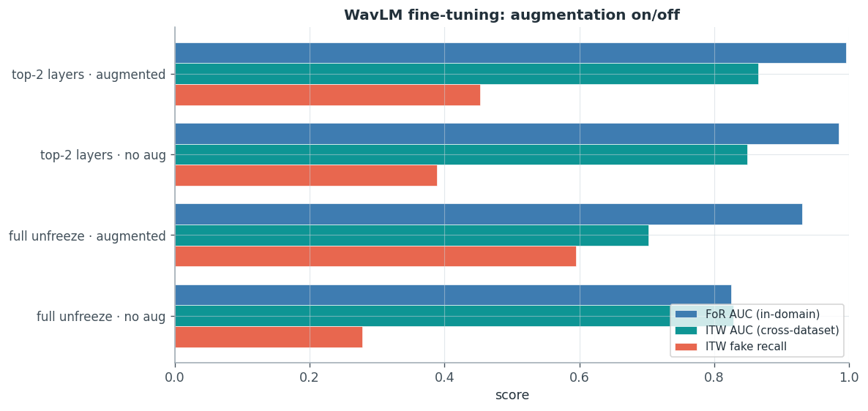
NOISE ROBUSTNESS
Augmentation
Training-side
Online waveform augmentation in the WavLM fine-tune: MUSAN additive noise (0–15 dB SNR), simulated-RIR reverberation, and codec compression — applied to the train split only (no leakage).
Audio Deepfake Detection — DL project
14

Slide 17
Conclusions
Representation learning drives cross-dataset AUC: MLP 0.79 → CNN/CRNN 0.86–0.87 → WavLM 0.92.
MLP/RNN catch only ~17% of fakes despite passable accuracy.
Convolution carries the recurrent path: pure BiLSTM 0.66 vs CRNN 0.86.
Tune capacity & regularisation — don't maximise them; middle settings generalise best.
Under domain shift, freezing the WavLM backbone beats fine-tuning; the cue sits in a mid layer.
Future Evaluations: evaluation-side noise-robustness curves, EER, and multi-seed error bars.
Audio Deepfake Detection — DL project
15

