Slide 1

Business Intelligence & Machine Learning
By Regeneration & Piraeus Bank
Notes:
Alexia

Slide 2
The Essentials of Part I
OLTP DATABASE MIGRATION.
Data warehouse design.
ETL Process Implementation.
Power BI Insights.
Notes:
Alexia

Slide 3
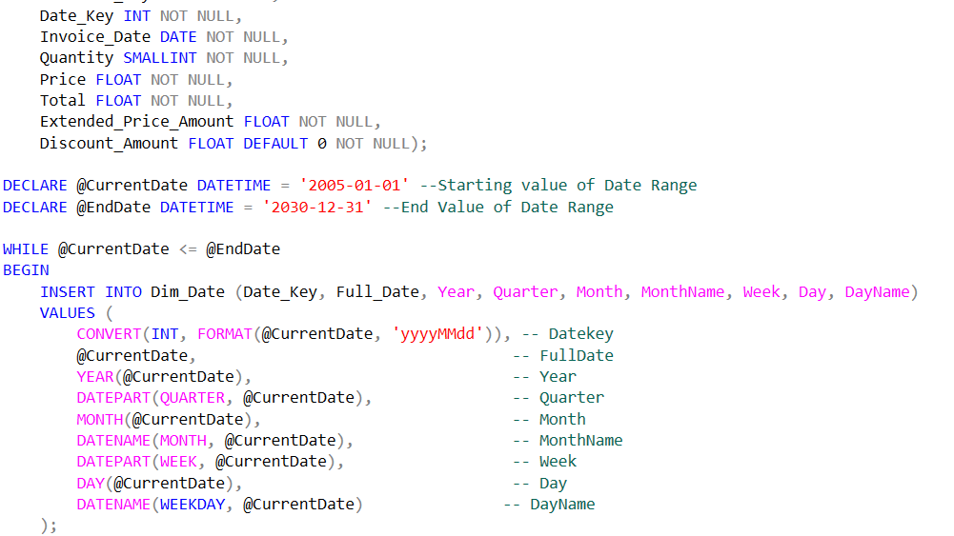
SQL Scripts
To Develop a Staging Area from the OLTP Database.
To Design the ERD Schemas and define the final Star Schema of the Data Warehouse.
To Establish the connections to the main Fact Table.
To Extract, Transform, Load data from the Staging Area into the Data Warehouse.
To Ensure efficient data transfer and query performance.
Notes:
Alexia

Slide 4
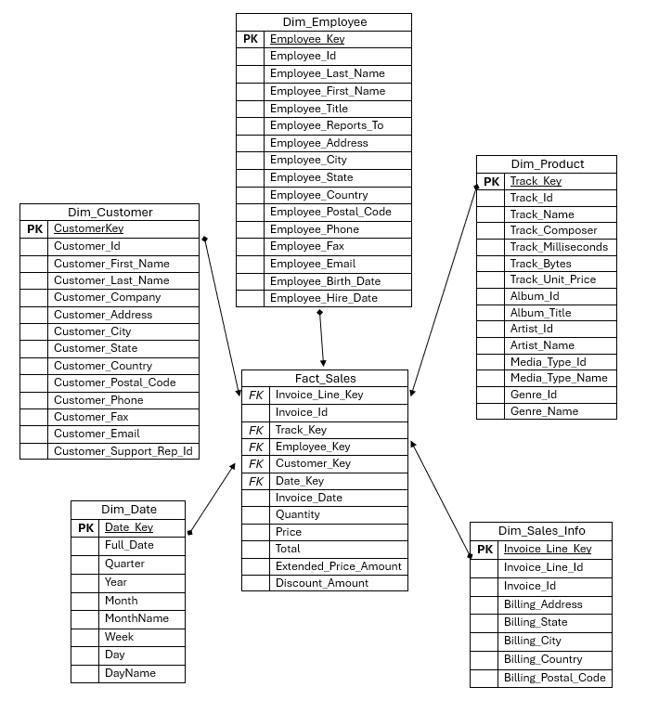
Chinook Data Warehouse
Star Schema
5 Dimension Tables
Main Focus : Fact_Sales
Connections with primary keys
1 to N Cardinality
Notes:
Alexia

Slide 5
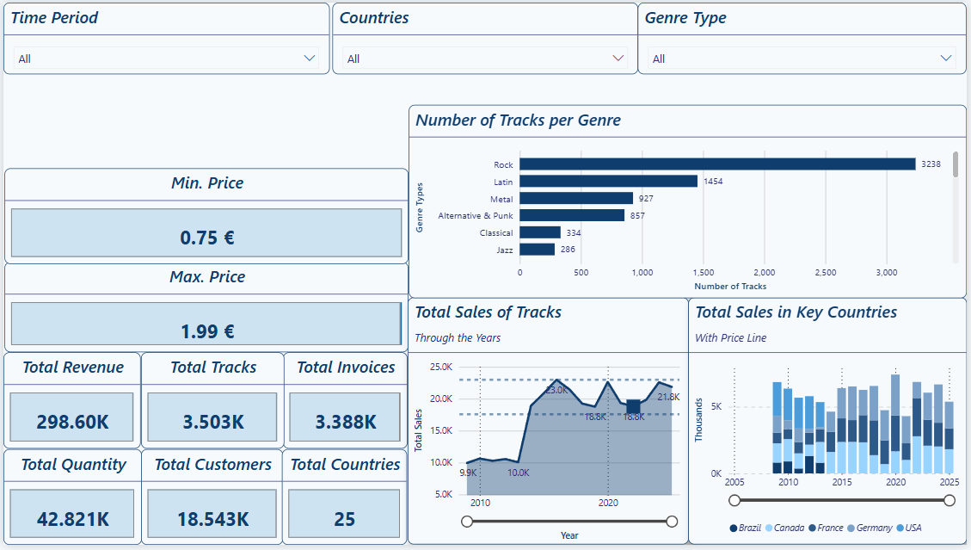
PowerBI Insights
Comments:
Dashboards for a comprehensive analysis
Slicer usage for customized results
Cards to portray key analytics
Variety on Visual Reports
Notes:
Nikos

Slide 6
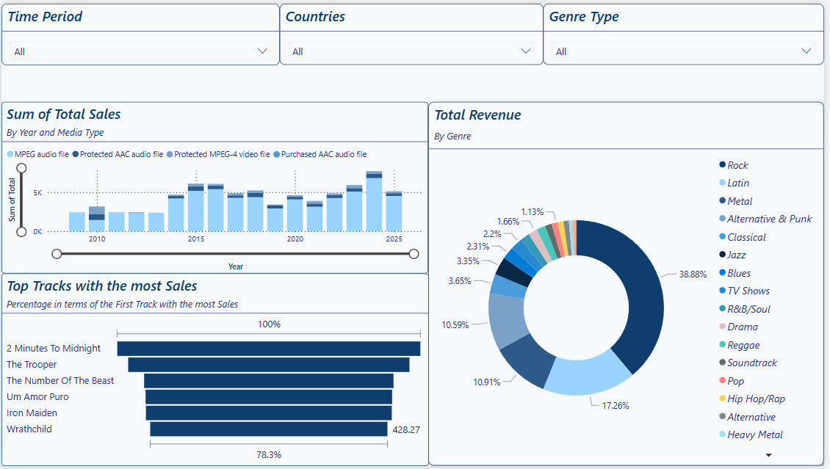
PowerBI Insights
Comments:
Dashboards for a comprehensive analysis
Slicer usage for customized results
Cards to portray key analytics
Variety on Visual Reports
Notes:
Nikos

Slide 7
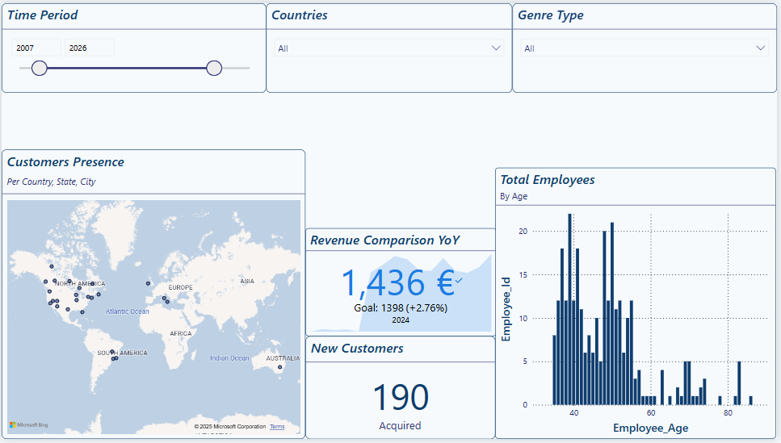
PowerBI Insights
Comments:
Dashboards for a comprehensive analysis
Slicer usage for customized results
Cards to portray key analytics
Variety on Visual Reports
Notes:
Nikos

Slide 8





The Essentials of Part II
Employee sales Performance classification
Preprocessing and Feature Engineering
PERFORMANCE LABELING & ENCODING
Machine Learning Model PIPELINE
EVALUATION Insights and Analysis
Notes:
Giorgos

Slide 9
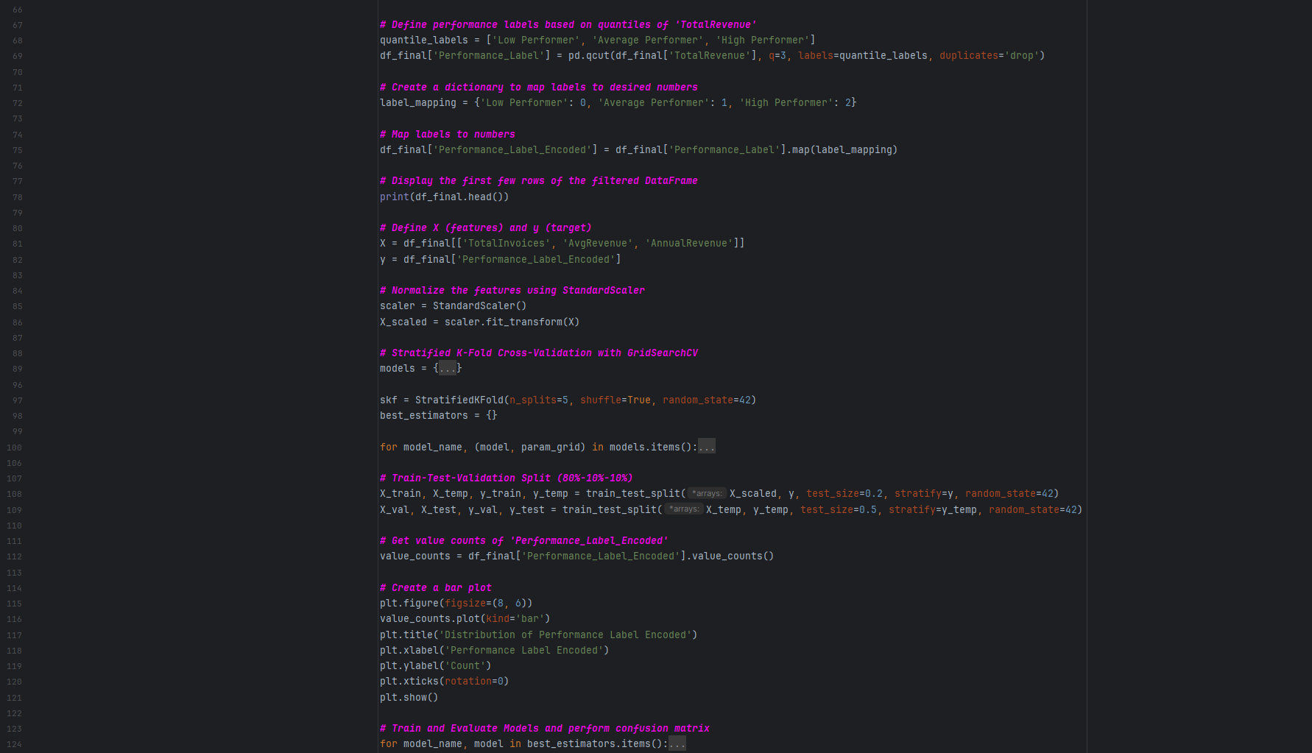
Python Scripts
To Calculate Employee Tenure, Clean Nulls and Remove Outliers.
To Create Correlation Plots and define the final features.
To Establish Performance Labels and Encode them.
To Set Hyperparameters for Optimization, Standardize features and Split the Data Set.
To Train Models, Evaluate Metrics & Predictions and Generate insightful plots
Notes:
Giorgos

Slide 10
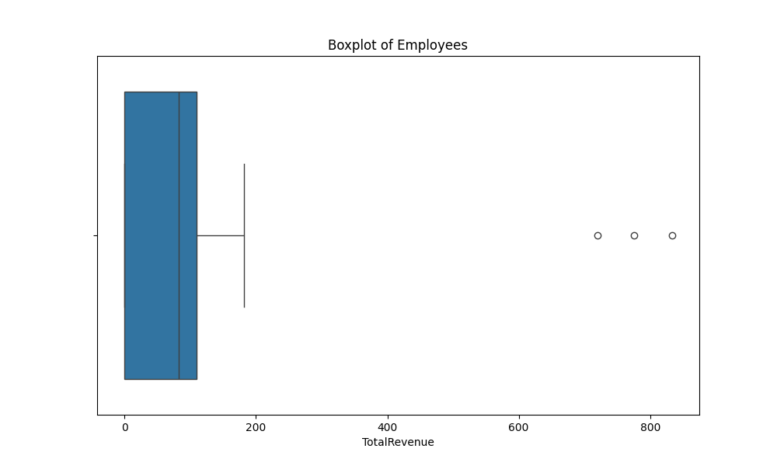
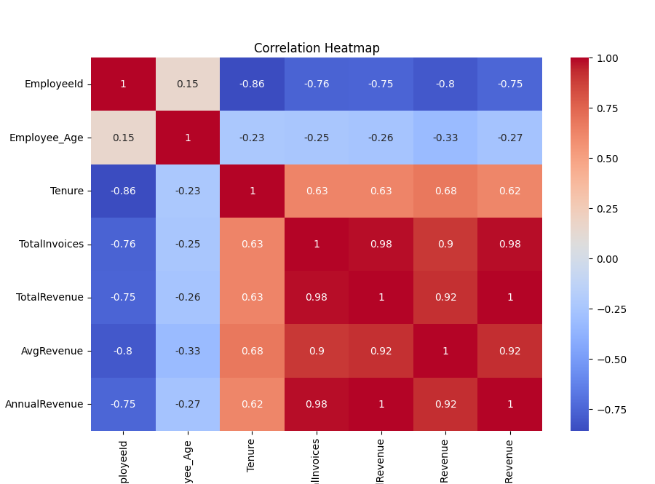
Pre-Processing & Feature Engineering
Comments:
Feature Selection based on High Correlation to the “Total Revenue” such as “Total Invoices”, “Annual Revenue”, “Average Revenue”
Outlier Removal such as salesmen with “Total Revenue” more than 600 and employees who are not salesmen
Sample Cleanup with NA filling and Feature Calculation such as “Tenure” as well as “Annual Revenue”
Notes:
Giorgos

Slide 11
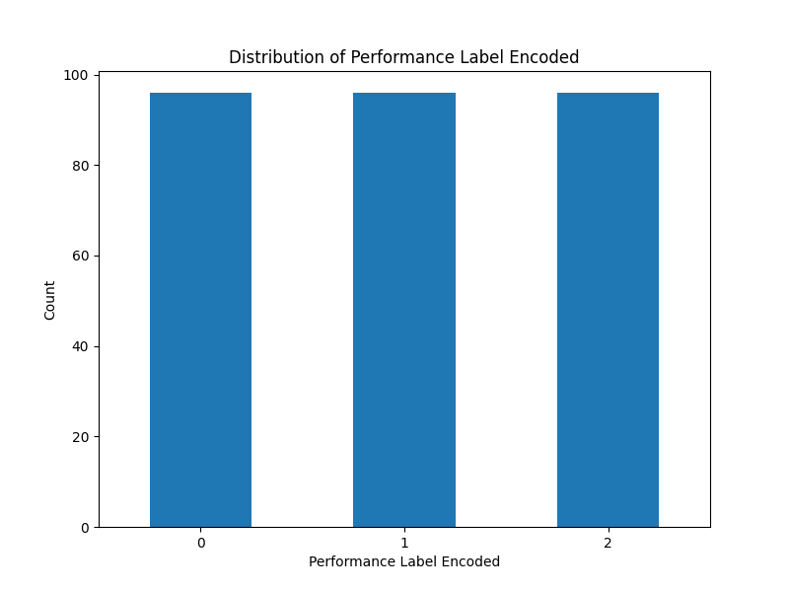
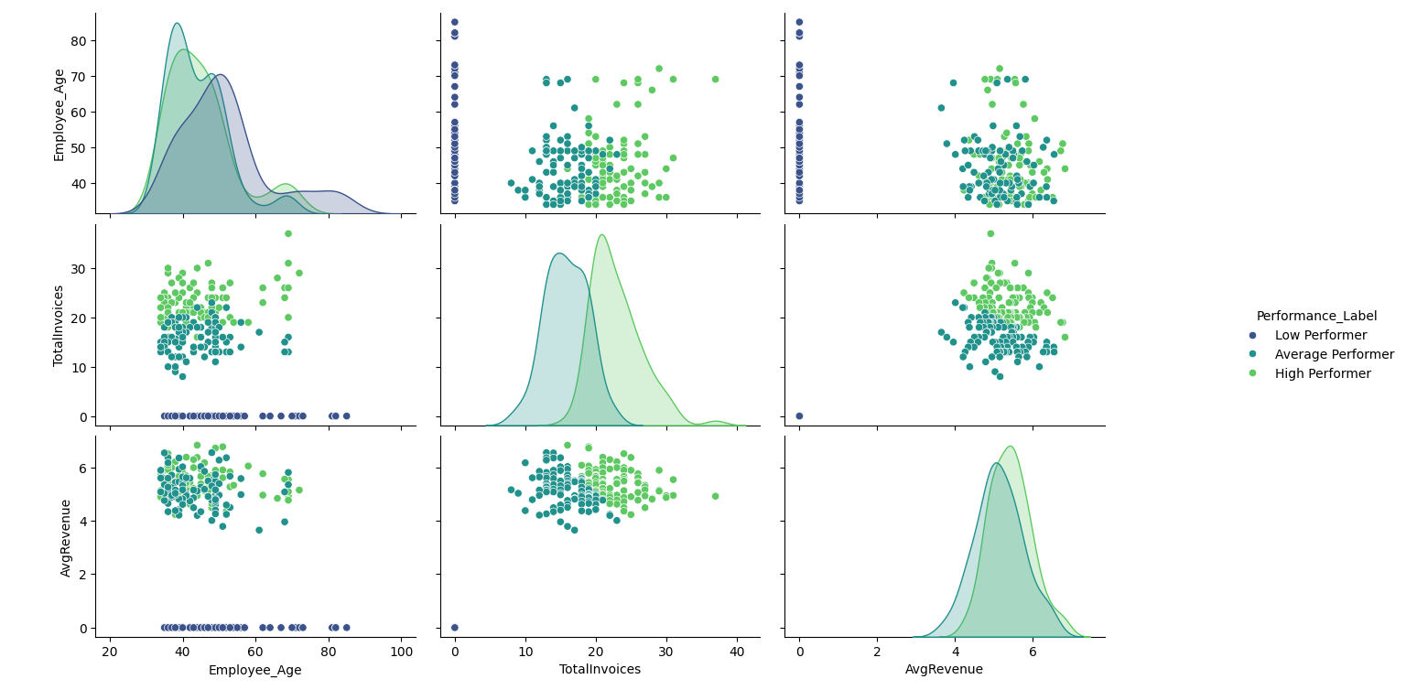
Label Performance & Encoding
Comments:
Labeling based on Performance using Quantiles (High, Average, Low )
Label Encoding manually with Pandas and Label Mapping
Notes:
Giorgos

Slide 12
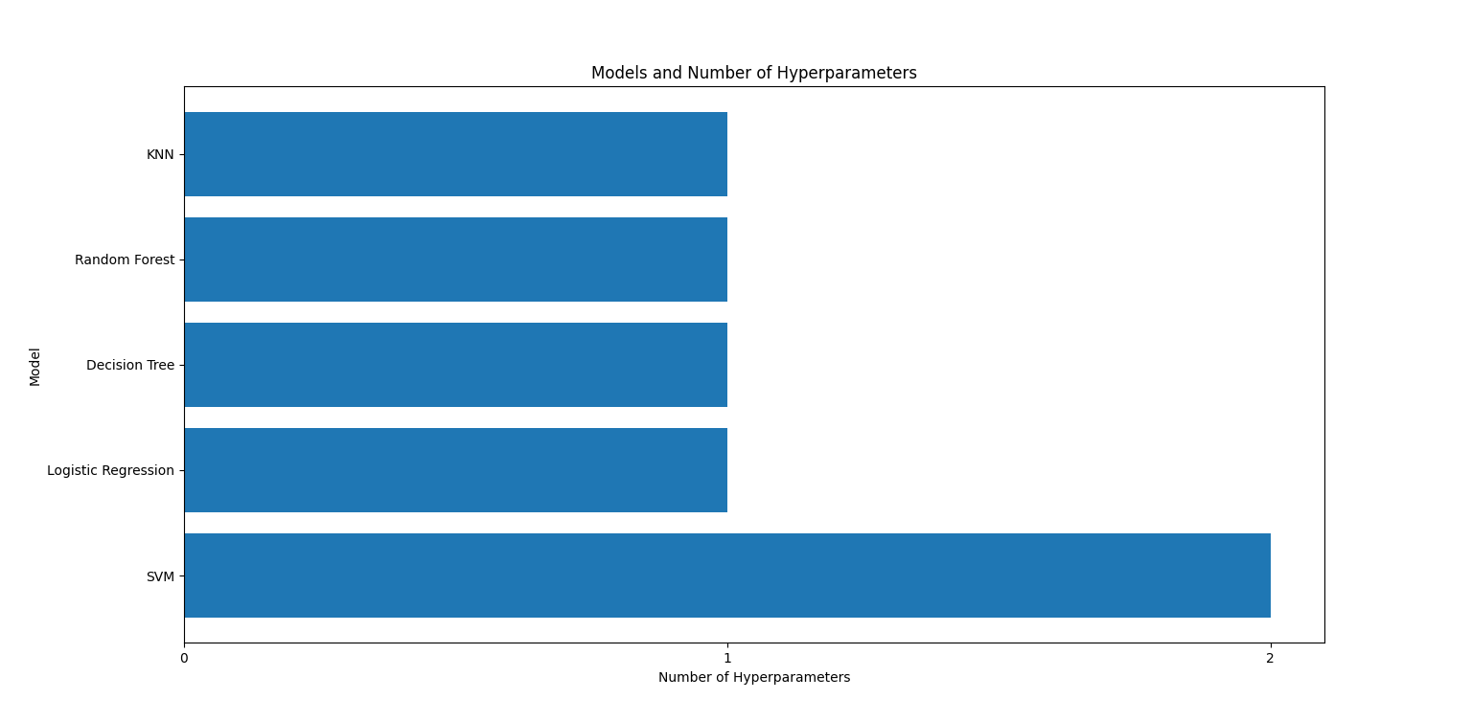
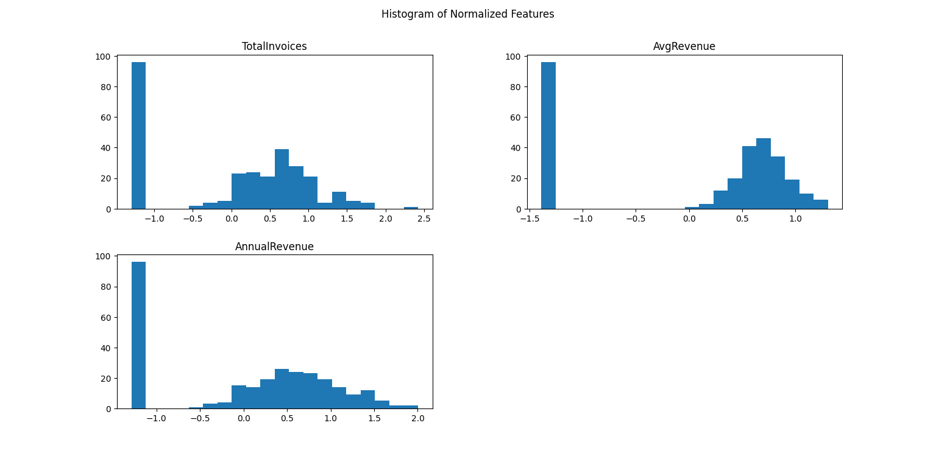
Standardization, Model Selection & Training
Comments:
Feature Scaling of the Training Data with Standard Scaler
Classification Model Selection for the training
Set of Hyperparameters per Model using Stratified K-fold Cross Validation with GridSearch
Notes:
Kons

Slide 13
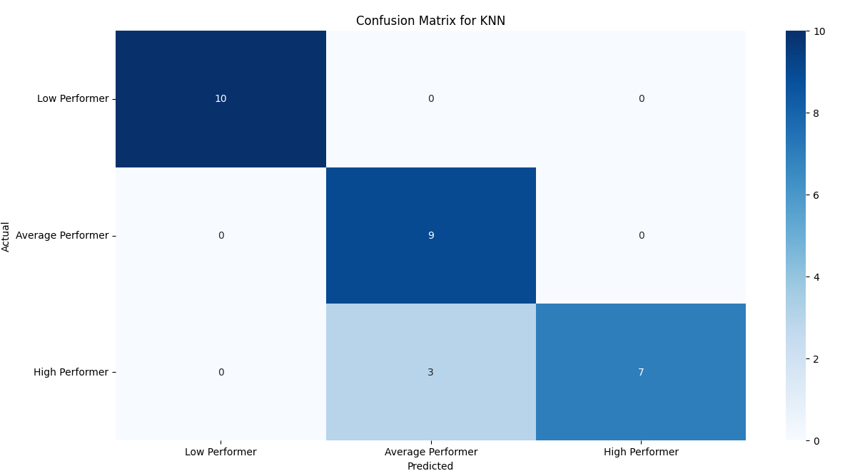
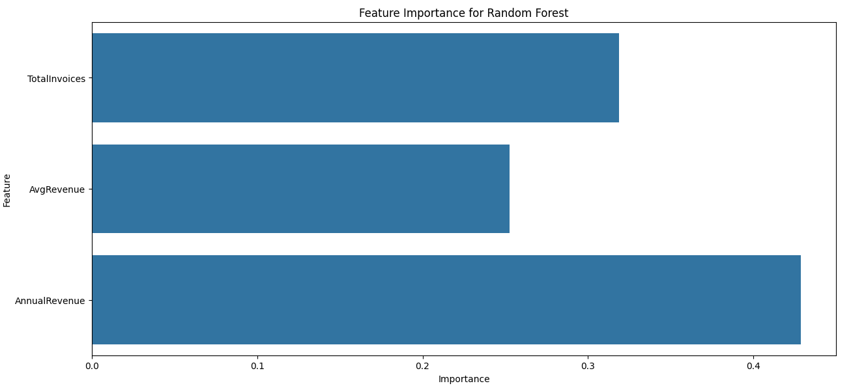
Model Evaluation, Metrics & Confusion Matrix (Part I)
Comments:
Strong results based on the classification report per Model
Metrics achieve over 96% score on Average
Notes:
Kons

Slide 14
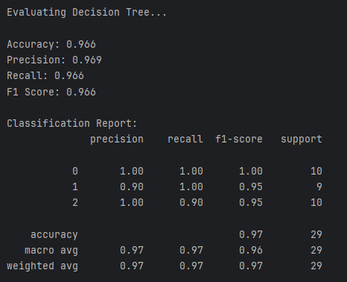
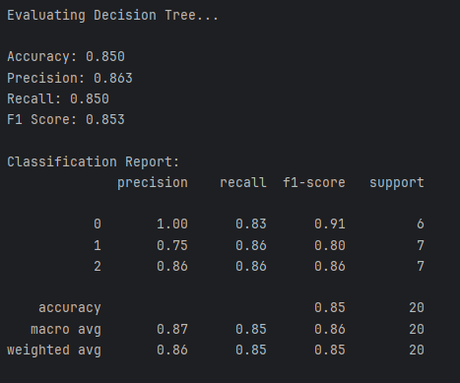
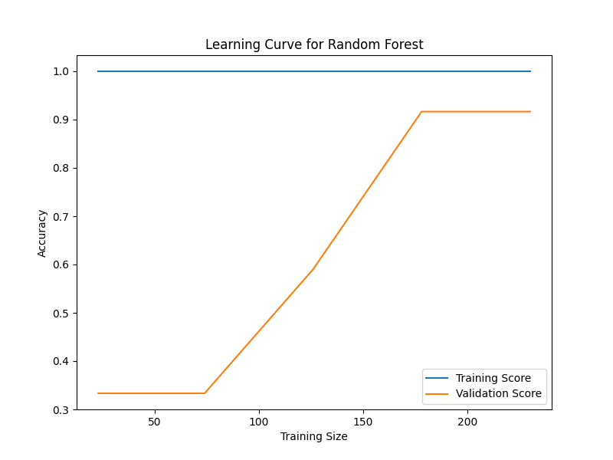
Model Evaluation, Metrics & Confusion Matrix (Part II)
vs
Comments:
Strong results based on the classification report per Model
Metrics achieve over 96% score on Average
Difference between Metrics when we removed all NA values reducing however the Data set size
Notes:
Kons

Slide 15
Project Highlights
Learning Outcomes
End-to-end process of transforming raw data into insights.
Getting Familiar with the Tech Stack
Implementing modern techniques to solve real problems
Tech Stack
GitHub
MS SQL Server
MS Power BI
Python
Challenges Faced
Schema Set up for DW
Feature Engineering
Learning a new coding language with its libraries
Understanding the correct order of the steps for a complete Machine Learning project
Notes:
Kons

Slide 16

Thank you for your attention.
From Our Team:
Alexia Kalliani
Giorgos Petrakis
Konstantinos Gkaravelos
Nikos Antoniou
Notes:
Kons

