Slide 1

Business Intelligence & Machine Learning
By Regeneration & Pireaus Bank
This Photo by Unknown Author is licensed under CC BY-SA-NC

Slide 2
The Essentials of Part I
OLTP DATABASE MIGRATION
Data warehouse design.
ETL Process Implementation.
Power BI Insights.

Slide 3
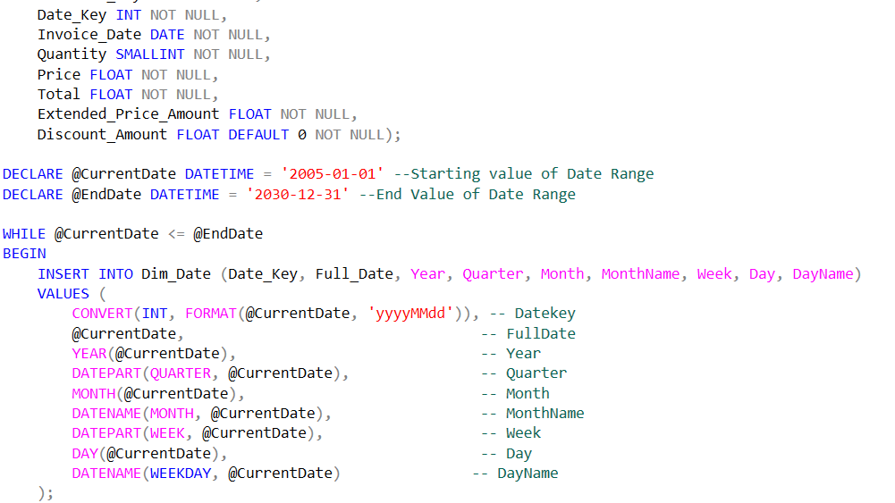
SQL Scripts
To Develop a Staging Area from the OLTP Database (“ChinookStaging”).
To Design the ERD Schemas and define the final Star Schema of the Data Warehouse.
To Establish the connections to the main Fact Table “Dim_Fact_Sales”.
To Extract, Transform, Load data from the Staging Area into the Data Warehouse.
To Ensure efficient data transfer and query performance through optimized SQL operations.

Slide 4
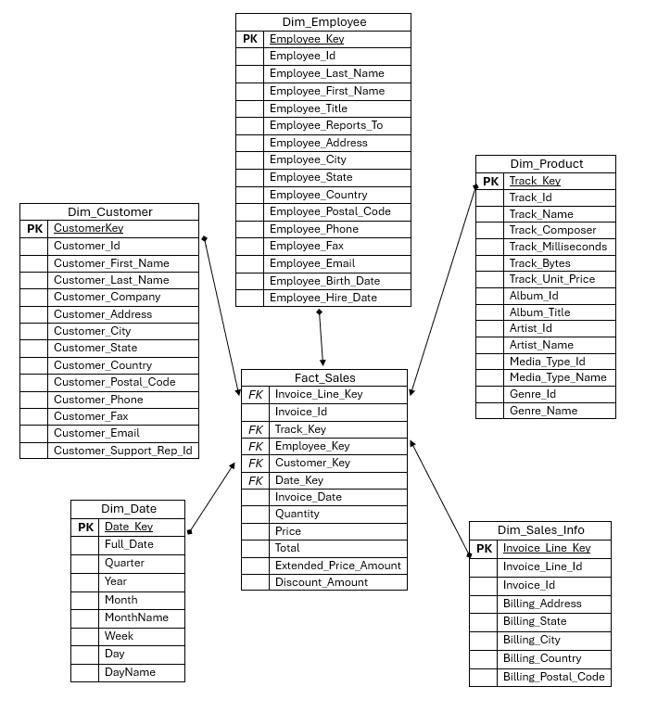
Chinook Data Warehouse
Star Schema
5 Dimension Tables
Main Focus : Fact_Sales
Connections with primary keys

Slide 5
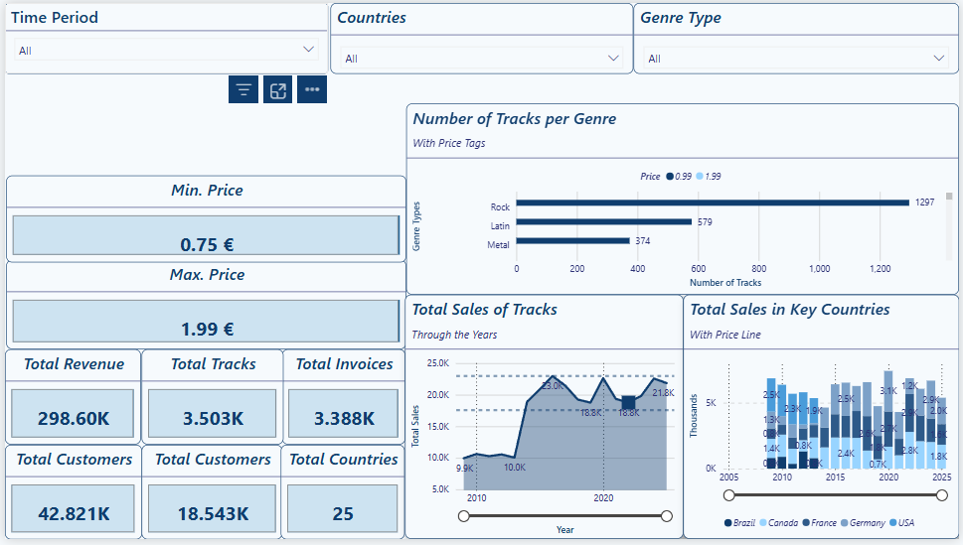
PowerBI Insights
Comments:
Dashboards for a comprehensive analysis
Slicers usage for customized results
Cards to portray key analytics
Variety on Visual Reports

Slide 6
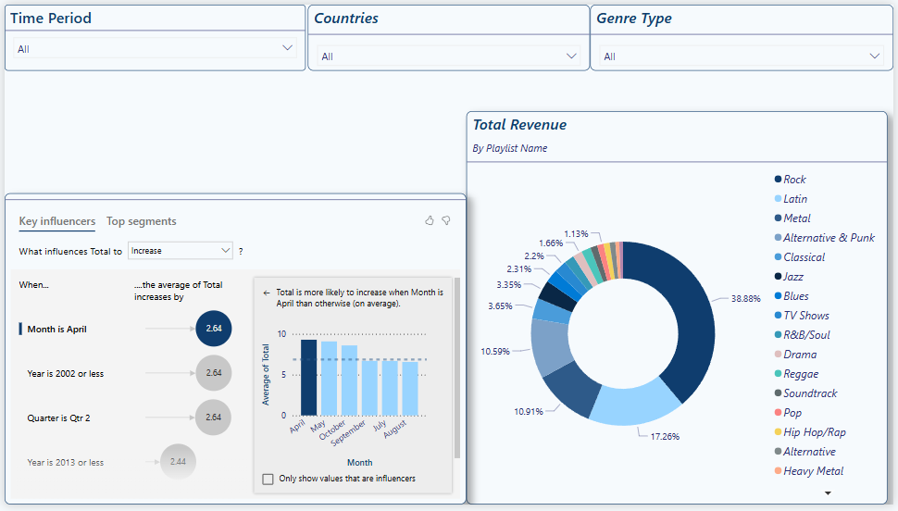
PowerBI Insights
Comments:
Dashboards for a comprehensive analysis
Slicers usage for customized results
Cards to portray key analytics
Variety on Visual Reports

Slide 7
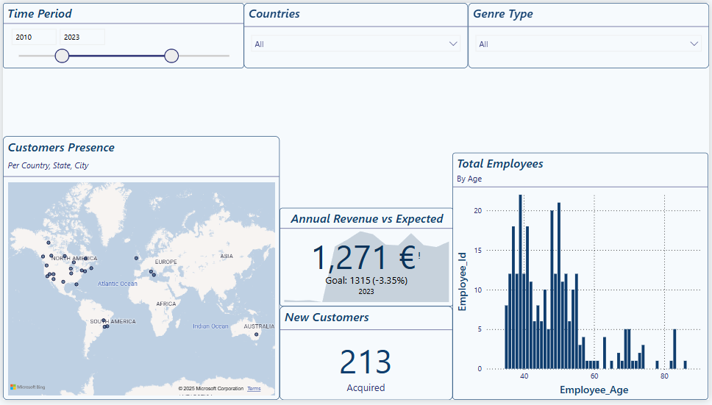
PowerBI Insights
Comments:
Dashboards for a comprehensive analysis
Slicers usage for customized results
Cards to portray key analytics
Variety on Visual Reports

Slide 8





The Essentials of Part II
Employee sales Performance classification
Preprocessing and Feature Engineering
PERFORMANCE LABELING & ENCODING
Machine Learning Model PIPELINE
EVALUATION Insights and Analysis

Slide 9
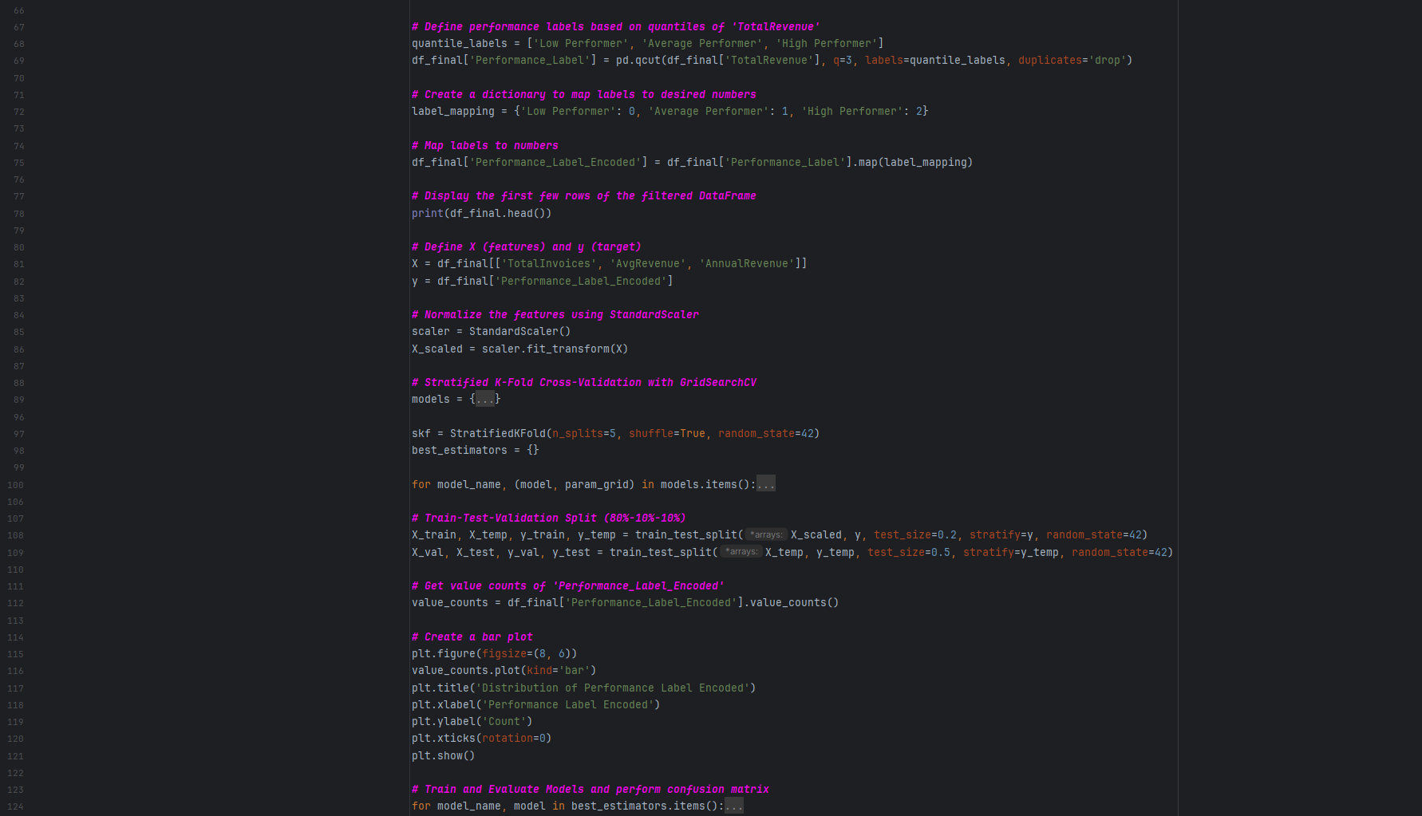
Python Scripts
To Calculate Employee Tenure, clean Nulls and remove Outliers.
To Create Correlation Plots and define the final features.
To Establish Performance Labels and Encode them.
To Set Hyperparameters for Optimization, Normalize features and Split the Data Set.
Ensured efficient data transfer and query performance through optimized SQL operations.

Slide 10
PowerBI Insights
Comments:
Dashboards for a comprehensive analysis
Slicers usage for customized results
Cards to portray key analytics
Variety on Visual Reports

Slide 11
Employee Sales Performance
Pre-Processing Procedure and comments

Slide 12
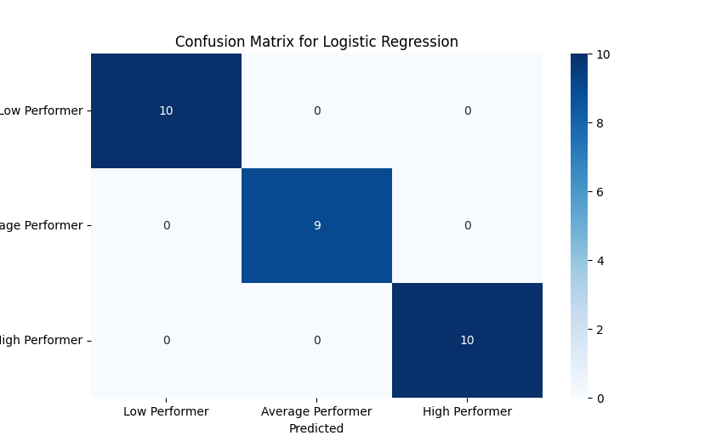


Slide 13
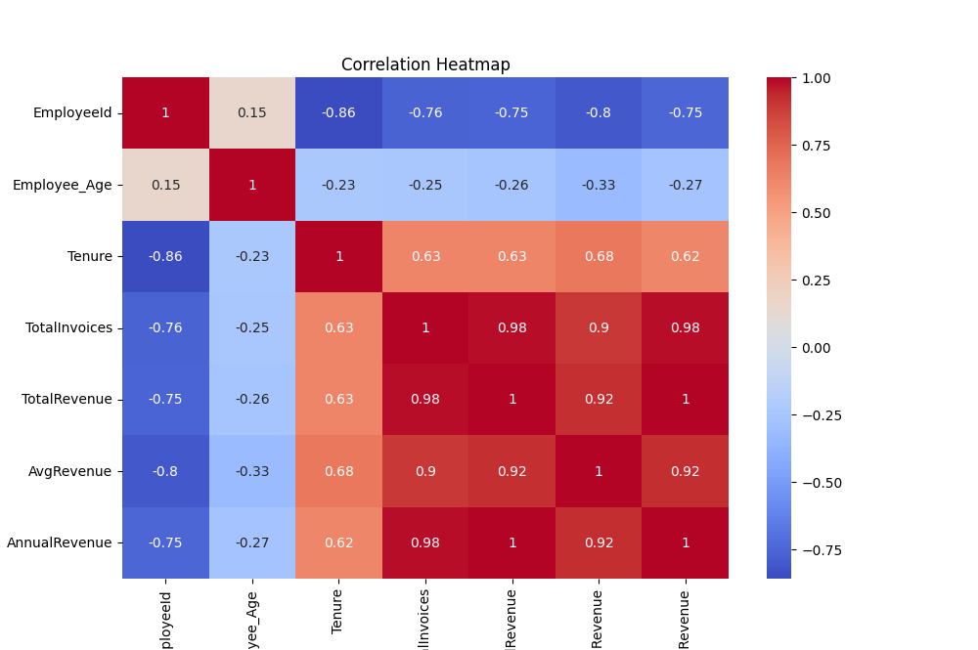

Slide 14
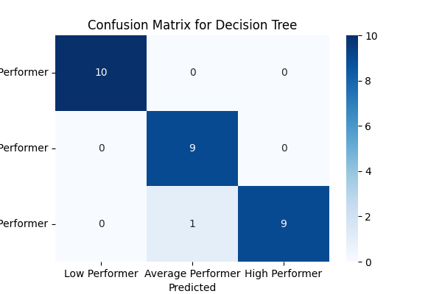
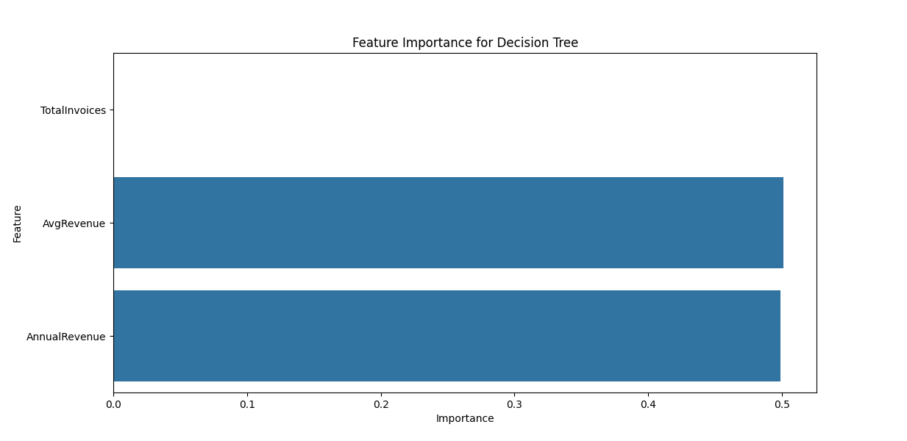
Decision Tree

Slide 15
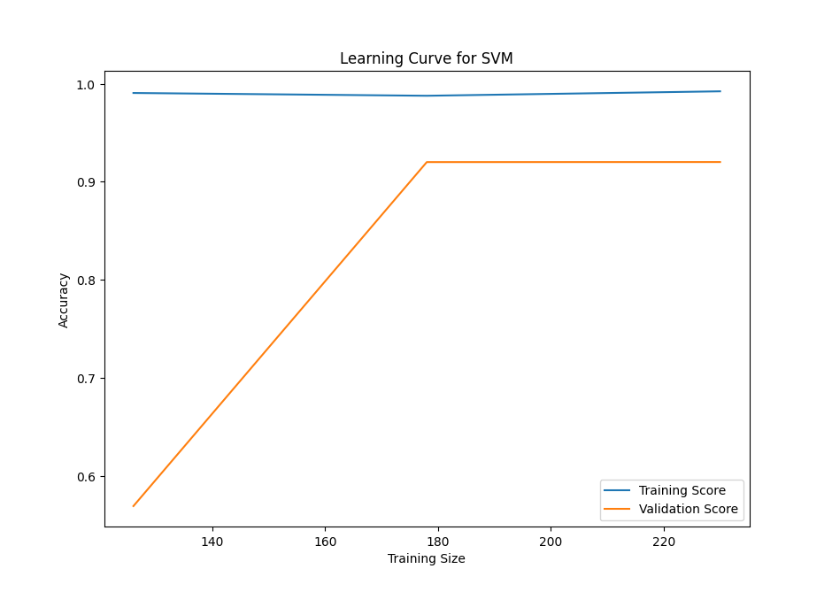
Results of Machine Learning model and comments

Slide 16
Project Highlights
Solutions:

Slide 17
Project Highlights
Learning Outcomes :
SQL, Python, Power BI, Github.
End-to-end process of transforming raw data into insights.

Slide 18

Thank you for your attention.
From Our Team:
Alexia Kalliani
Giorgos Petrakis
Konstantinos Gkaravelos
Nikos Antoniou

