Slide 1

Business Intelligence & Machine Learning
By Regeneration & Pireaus Bank
This Photo by Unknown Author is licensed under CC BY-SA-NC

Slide 2
The Essentials of Part I
Establish SQL Integration.
Design a Star Schema.
ETL Process Implementation.
Create Power BI Insights.

Slide 3
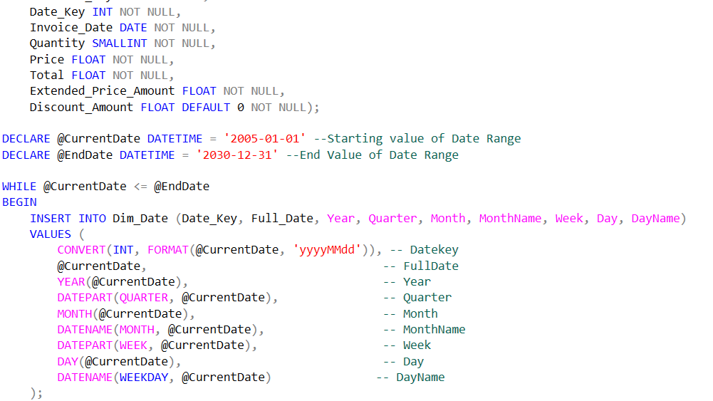
SQL Script
Developed SQL scripts to extract, transform, and load data from the OLTP Chinook database into the Data Warehouse.
Loaded essential tables and transformed raw OLTP data into structured Data Warehouse format for analysis.
Ensured efficient data transfer and query performance through optimized SQL operations.

Slide 4
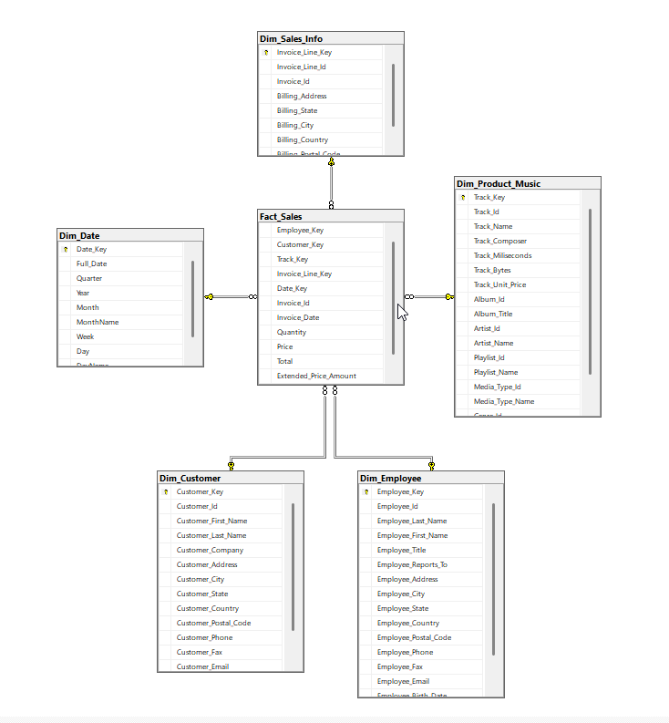
Chinook Data Warehouse
Star Schema
Main Focus : Fact_Sales
Connections with primary keys

Slide 5
PowerBI

Slide 6
Power BI
Photo of a dashboard and comments on the analysis

Slide 7
Power BI
Photo of a dashboard and comments on the analysis

Slide 8
The Essentials of Part II
Employee Performance Classification
Feature Engineering and Data Preparation
Machine Learning Model Development
Performance Insights and Analysis
Visualization and Reporting

Slide 9
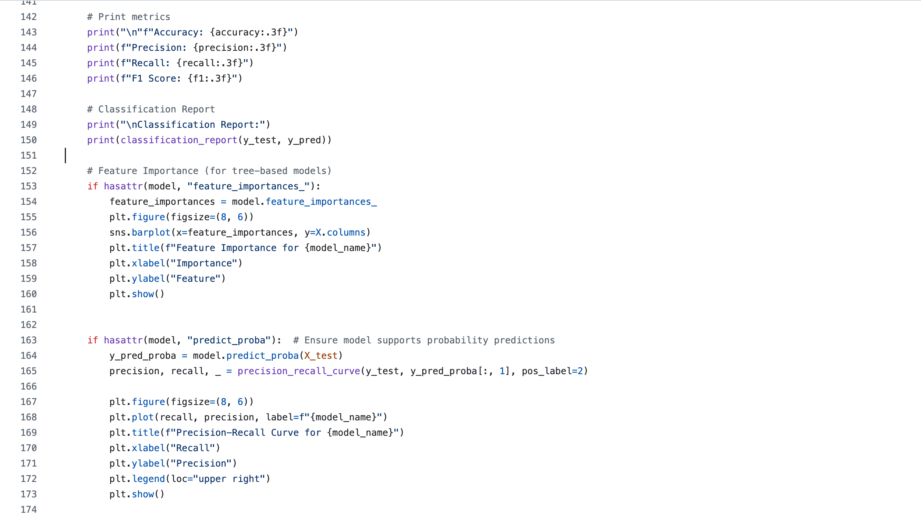
Python

Slide 10
Employee Sales Performance
Pre-Processing Procedure and comments

Slide 11
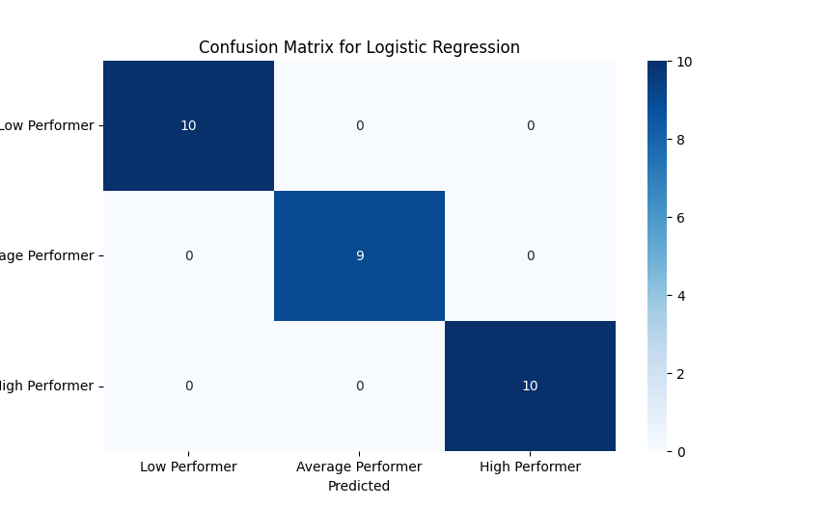


Slide 12
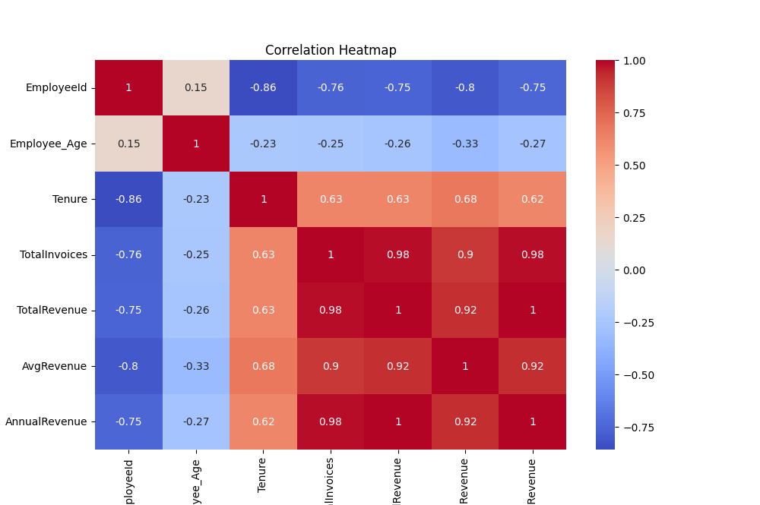

Slide 13
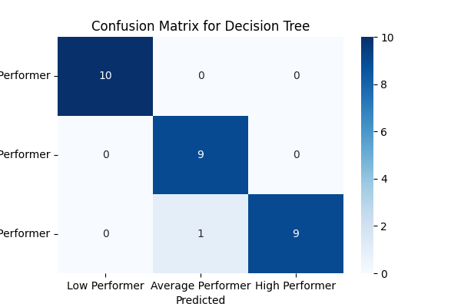
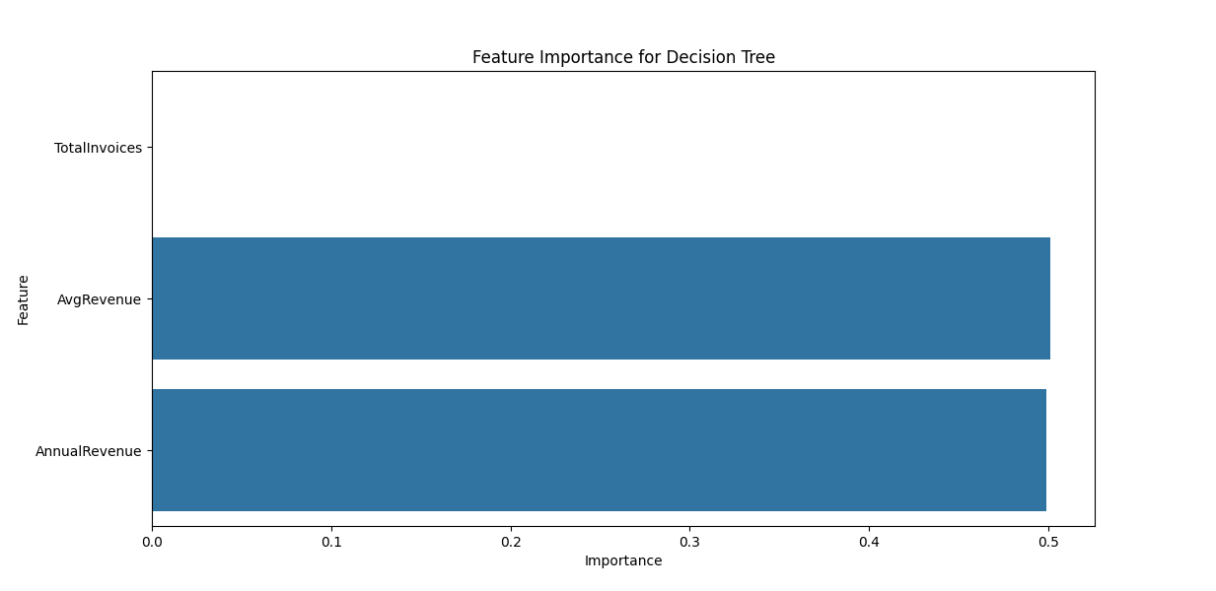
Decision Tree

Slide 14
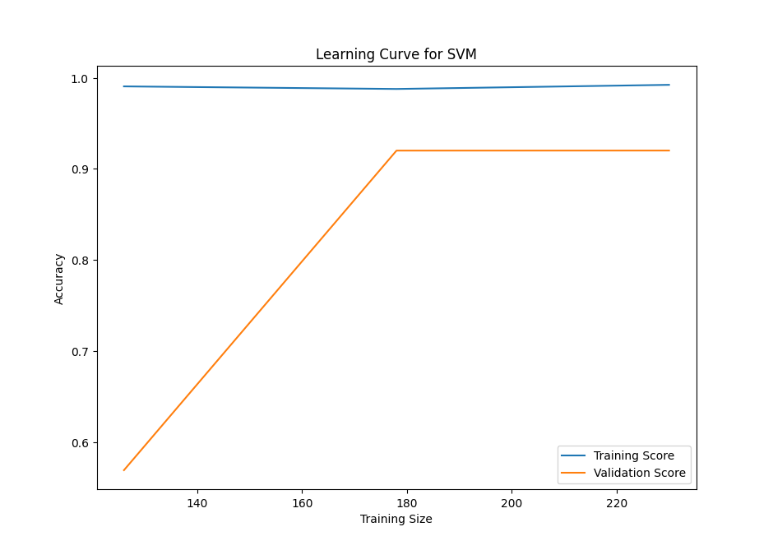
Results of Machine Learning model and comments

Slide 15
Project Highlights
Solutions:

Slide 16
Project Highlights
Learning Outcomes :
SQL, Python, Power BI, Github.
End-to-end process of transforming raw data into insights.

Slide 17

Thank you for your attention.
From Our Team:
Alexia Kalliani
Giorgos Petrakis
Konstantinos Gkaravelos
Nikos Antoniou
This Photo by Unknown Author is licensed under CC BY-SA

