Slide 1

Django Forms
SoftUni Team
Technical Trainers
Software University
https://softuni.bg

Slide 2
Table of Contents
Web Forms
Forms in Django
Django Form Class
Django Form Fields
Built-in Widgets
Django ModelForm Class
ModelForm Options
2

Slide 3
Have a Question?
sli.do
#python-web

Slide 4

Web Forms

Slide 5
Web/HTML Form (1)
It is an online page
Which allows users to enter data
The data is then sent to a server for processing
It mimics a paper document where users fill out particular fields
It may contain text boxes, checkboxes, select options, a submit button, etc.
5

Slide 6
Web/HTML Form (2)
In HTML, forms are enclosed in the <form> tag
GET and POST are the only HTTP methods to use when dealing with forms
<body>
<form action="/your-name/" method="post">
<-- input elements --/>
<-- submit button --/>
</form>
</body>
6

Slide 7

Forms in Django

Slide 8
Django Forms Advantages (1)
Django provides a range of tools and libraries to
Create forms using python code
Support all features of HTML forms in a pythonic way
Simplify and automate vast portions of the process
8

Slide 9
Django Forms Advantages (2)
E.g., the form fields map to HTML form <input> elements
from django import forms
class NameForm(forms.Form):
your_name = forms.CharField(label='Your Name', max_length=50)
<form action="/your-name/" method="post">
<label for="your_name">Your name: </label>
<input type="text" id="your_name" name="your_name" maxlength="50" required>
<input type="submit" value="OK">
</form>
9

Slide 10
Django Forms Handling
Send the form to the user
Populate or Update Form
Create default form
Create form with user data and error messages
No
Yes
Browser requests page with form
Validate Data
Request
Is First Request?
No
Is Data Valid
Redirect Browser to success URL
Perform action
Yes
10

Slide 11
Django Form Class
class Form

Slide 12
The Django Form Class
The Django form
Describes the form fields
Determines how the form works and appears
Perform validation when the form is submitted
12

Slide 13
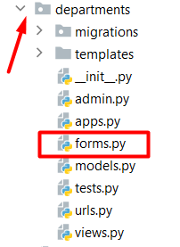
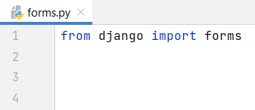
Create a Django Form (1)
First, create a forms.py file in the app directory
Import the forms library
13

Slide 14
Create a Django Form (2)
To create a form:
Inherit from the Form class
Add the form fields
Note: the Form and the Model classes share most field types and some common arguments
from django import forms
class NameForm(forms.Form):
name = forms.CharField()
14

Slide 15
Create a Django Form (3)
Create a view with a corresponding URL path
views.py
from .forms import NameForm
def add_new_name(request):
if request.method == "GET":
form = NameForm()
if request.method == "POST":
form = NameForm(request.POST)
if form.is_valid():
# do something with the data
# redirect to the desired page
return render(request, "index.html", {"form": form})
Generate an empty form
Binds the collected data to the form
Return an empty form or invalid data with errors
Check if the data is valid
15

Slide 16
Flat is Better than Nested
Most of the time, you can use one Form instantiation
views.py
If no post request, generate an empty form
from .forms import NameForm
def add_new_name(request):
form = NameForm(request.POST or None)
if form.is_valid():
# do something with the data
# redirect to the desired page
return render(request, "index.html", {"form": form})
16

Slide 17
Create a Django Form (4)
Create a template with the form
index.html
Cross-Site Request Forgery secure random token
The Django form
<body>
<form method="post">
{% csrf_token %}
{{ form }}
<button type="submit">Add</button>
</form>
</body>
17

Slide 18
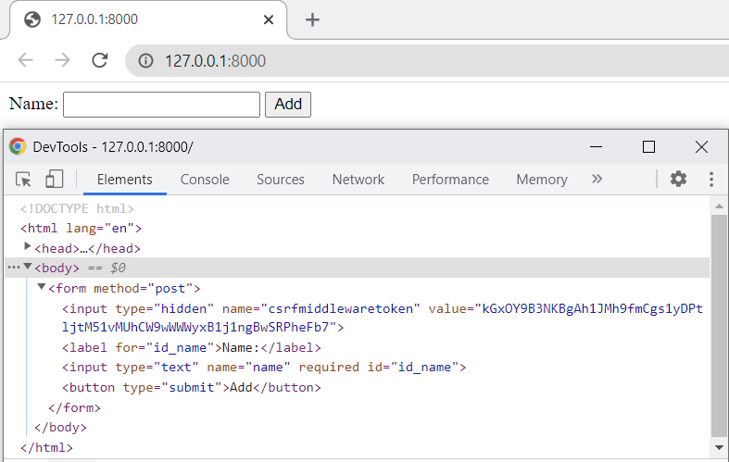
Create a Django Form (5)
Start the development server
18

Slide 19

Django Form Fields

Slide 20
Django Form Fields
The most important part is defining the fields of the form
Each field has custom validation logic
Each field takes some common arguments
Some fields take field-specific arguments
Full list of form fields: https://docs.djangoproject.com/en/4.1/ref/forms/fields/#built-in-field-classes
20

Slide 21
Form Field Arguments (1)
By default, each Field class assumes the value is required
If you pass an empty value, it will raise a ValidationError
You can specify that a field is not required
first_name = forms.CharField(required=False)

Slide 22

Form Field Arguments (2)
You can specify a "human-friendly" label for a field
It is used when the Field is displayed in a form
first_name = forms.CharField(label="Add First Name")

Slide 23

Form Field Arguments (3)
You can display an "empty" form in which a field is initialized to a particular value
The data will be passed into the view when submitted
url_field = forms.URLField(initial='http://')

Slide 24

Form Field Arguments (4)
You can specify a help text for a field
It will be displayed next to the field
first_name = forms.CharField(help_text='Add your first name')
More Field Arguments: https://docs.djangoproject.com/en/4.1/ref/forms/fields/#core-field-arguments

Slide 25

Built-in Widgets

Slide 26
Django Widget
Widgets handle:
Rendering of HTML form input elements
Extraction of raw submitted data
Widgets are assigned to form fields
Each form field has a corresponding widget
To use a different widget for a field, add it as an argument
26

Slide 27

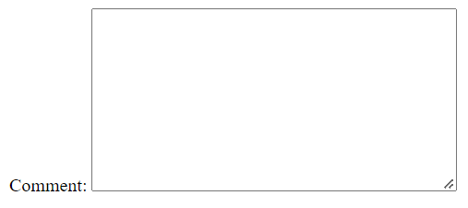
Built-in Widgets (1)
CharField uses TextInput widget by default
Renders as: <input type="text" ...>
You can specify a form that uses a larger Textarea widget
comment = forms.CharField(
widget=forms.Textarea
)
27

Slide 28
Built-in Widgets (2)
NumberInput
HTML input type: "number"
EmailInput
HTML input type: "email"
PasswordInput
HTML input type: "password"
28

Slide 29
Built-in Widgets (3)
URLInput
HTML input type: "url"
DateInput
HTML input type: "text"
DateTimeInput
HTML input type: "text"
More built-in widgets: https://docs.djangoproject.com/en/4.1/ref/forms/widgets/#built-in-widgets
29

Slide 30
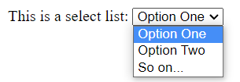


Select, Checkbox and Radio Button (1)
A select list allows you to choose options from a drop-down menu
A checkbox allows you to select options from a list of options
A radio button allows you to select only one option from a list of options
30

Slide 31
Select List Widget
class MyForm(forms.Form): CHOICES = (('Option 1', 'Option 1'),('Option 2', 'Option 2'),) field = forms.ChoiceField(choices=CHOICES)
Select is the default widget for ChoiceField
But can be used in other fields
The same as in the model field
class SelectOptionForm(forms.Form):
CHOICES = (
('1', 'Option One'),
('2', 'Option Two'),
)
choice_field = forms.ChoiceField(choices=CHOICES)
char_field = forms.CharField(widget=forms.Select(choices=CHOICES))
31

Slide 32
Checkbox Widget
CheckboxInput is the default widget for BooleanField
Returns True, if it is checked
Note: to create a checkbox that can be either checked or unchecked, set the attribute required to False
class CheckboxForm(forms.Form):
checkbox_field = forms.BooleanField(required=False)
32

Slide 33
Radio Button Widget
class MyForm(forms.Form): CHOICES = (('Option 1', 'Option 1'),('Option 2', 'Option 2'),) field = forms.ChoiceField(choices=CHOICES)
RadioSelect is similar to the Django Select widget
It can be used on a ChoiceField instead of Select
class RadioButtonForm(forms.Form):
CHOICES = (...)
choices_field = forms.ChoiceField(
choices=CHOICES,
widget=forms.RadioSelect(),
)
char_field = forms.CharField(
widget=forms.RadioSelect(choices=CHOICES),
)
33

Slide 34
Django Widget Attributes
Widgets give you the opportunity to set HTML attributes using Python code
Note: It is not always a good idea to narrow the distinction between the main code logic and the front end
comment = forms.CharField(
widget=forms.Textarea(
attrs={'cols': 80, 'rows': 20,
'class': 'special',
'title': 'Add a comment'}))
34

Slide 35

Django ModelForm Class

Slide 36
The ModelForm Class
In a case of a database-driven app, the forms might overlap with the models
The field types are already defined in the model
Using the ModelForm help to avoid duplicating your model description
This way, the form is automatically created based on a particular model
36

Slide 37
Form vs ModelForm
Form:
Independent of a model
Does not directly interact with models
E.g., search form, contact form, subscription form
ModelForm:
Convert a model into a form
Directly add or edit a model
E.g., registration form, newsletter article form, blog post form

Slide 38
Create a Django Model Form (1)
First, create a model with fields
models.py
from django.db import models
class Name(models.Model):
first_name = models.CharField(max_length=50)
last_name = models. CharField(max_length=50)
38

Slide 39
Create a Django Model Form (2)
To create a form:
Inherit from the ModelForm class
Specify the model you want to create a form for
Add the created model fields
forms.py
from django import forms
from .models import Name
class NameForm(forms.ModelForm):
class Meta:
model = Name
fields = '__all__'
39

Slide 40
Create a Django Model Form (3)
Create a view with a corresponding URL path
views.py
from .forms import NameForm
def add_new_name(request):
if request.method == "GET":
form = NameForm()
if request.method == "POST":
form = NameForm(request.POST)
if form.is_valid():
form.save()
# redirect to the desired page
return render(request, "index.html", {"form": form})
40

Slide 41
Create a Django Model Form (4)
Create a template with the form
index.html
<body>
<form method="post">
{% csrf_token %}
{{ form }}
<button type="submit">Add</button>
</form>
</body>
41

Slide 42
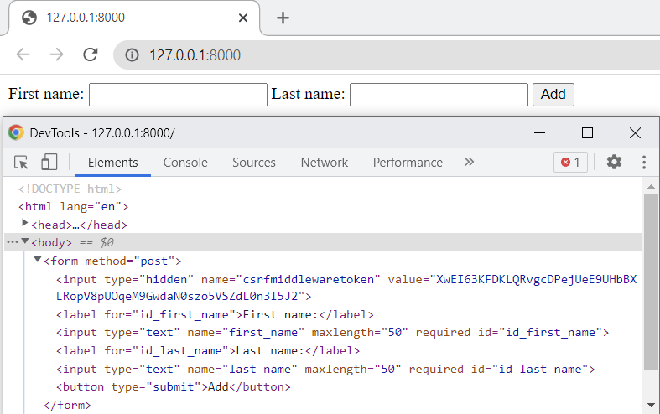
Create a Django Model Form (5)
Start the development server
42

Slide 43
Update a Model using Form (1)
Create an update view with a corresponding URL path
views.py
from .forms import NameForm
from .models import Name
def update_name(request, pk):
name = Name.objects.get_object_or_404(pk=pk)
form = NameForm(request.POST or None, instance=name)
if form.is_valid():
form.save()
# redirect to the desired page
return render(request, 'update.html', {'form': form})
43

Slide 44
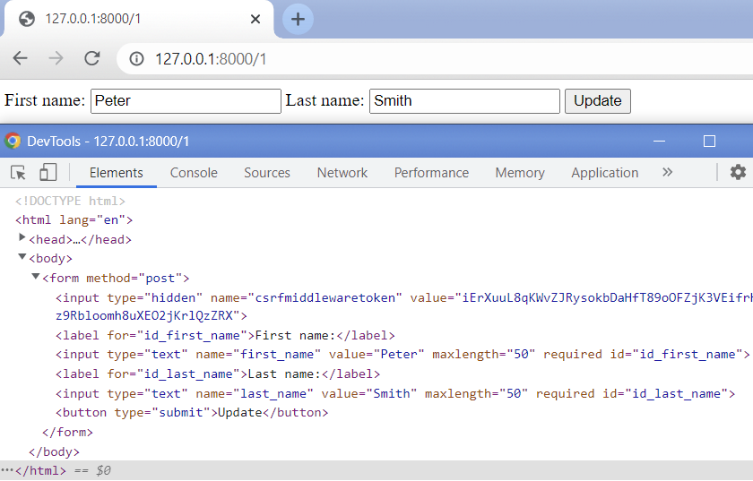
Update a Model using Form (2)
Start the development server
44

Slide 45
ModelForm Options

Slide 46
Class Meta
Like the Model, a ModelForm class has an inner Meta class with predefined options
The Meta options indicate how the form works and appears
A full list of the options can be found in the Django class ModelFormOptions, in its __init__() method
46

Slide 47
Model Option
Each time you configure ModelForm, you must indicate which model to use to generate the form
Its value should be set to the Model class (not instance)
from django import forms
from .models import Name
class NameForm(forms.ModelForm):
class Meta:
model = Name
47

Slide 48
Fields Option
You should set the fields that will be edited in the form
Failure to do so can easily lead to security problems
Set to __all__ to use all model fields
from django import forms
from .models import Name
class NameForm(forms.ModelForm):
class Meta:
model = Name
fields = ['first_name', 'last_name']
48

Slide 49
Exclude Option
Sometimes, it is easier to set which fields to be excluded from the form
from django import forms
from .models import Name
class NameForm(forms.ModelForm):
class Meta:
model = Name
exclude = ['last_name']
49

Slide 50
ModelForm Field Types
Each model field has a corresponding default form field
Model Field | Form Field
CharField | CharField with max_length set
IntegerField | IntegerField
FloatField | FloatField
BooleanField | BooleanField, or NullBooleanField if null=True
ForeignKey | ModelChoiceField
ManyToManyField | ModelMultipleChoiceField
Full table: https://docs.djangoproject.com/en/4.1/topics/forms/modelforms/#field-types
50

Slide 51
Overriding the Default Fields (1)
You have the flexibility of changing the field type for the model
Use the widgets option
A dictionary mapping field names to widget classes/instances
class CommentForm(forms.ModelForm):
class Meta:
...
widgets = {
'comment': Textarea(),
}
51

Slide 52
Overriding the Default Fields (2)
You can specify a different label for a field
Use the labels option
A dictionary mapping field names to strings
class NameForm(forms.ModelForm):
class Meta:
...
labels = {
'first_name': 'Add Your First Name',
}
52

Slide 53
Overriding the Default Fields (3)
You can add a help text for a field
Use the help_texts option
A dictionary mapping field names to strings
class EmailForm(forms.ModelForm):
class Meta:
...
help_texts = {
'email': 'You must supply a valid email address',
}
53

Slide 54

Summary
Use forms when building apps that accept input from their visitors
Each form field has a corresponding Widget
When we want to skip defining the field types of our forms, we use ModelForm
Notes:
54

Slide 55
Questions?
Notes:
55

Slide 56













SoftUni Diamond Partners

Slide 57

Educational Partners

Slide 58
Trainings @ Software University (SoftUni)
Software University – High-Quality Education, Profession and Job for Software Developers
softuni.bg, softuni.org
Software University Foundation
softuni.foundation
Software University @ Facebook
facebook.com/SoftwareUniversity
Software University Forums
forum.softuni.bg
58
Notes:
58

Slide 59

License
This course (slides, examples, demos, exercises, homework, documents, videos, and other assets) is copyrighted content
Unauthorized copy, reproduction, or use is illegal
© SoftUni – https://softuni.org
© Software University – https://softuni.bg
Notes:
59

