Slide 1

Django Forms
SoftUni Team
Technical Trainers
Software University
https://softuni.bg

Slide 2
Table of Contents
Validating Forms in Django
Validation in Forms
Validation in ModelForms
Overriding error messages
Working with Media Files - Demo
2

Slide 3
Have a Question?
sli.do
#python-web

Slide 4

Validating Forms in Django

Slide 5
Django Validators (1)
A validator is a function (or a class) that tries to meet some criteria:
If it does - returns nothing
Otherwise - it raises a ValidationError
validators.py
from django.core.exceptions import ValidationError
def validate_function(value):
# if not valid:
raise ValidationError("Some Error Message")
5

Slide 6
Django Validators (2)
You can reuse validation logic between different types of fields
Also, you can reuse it between
A Model
A Form
A ModelForm
6

Slide 7
Validating Forms
Form validation happens when the data is cleaned
Raises ValidationError and passes the relevant information
Returns the normalized (cleaned) data as a Python object
Each form field has a custom validation logic
7

Slide 8
Form Validators
You can pass additional validators to a Form field
You can use both:
Custom validators
Built-in Django validators
class NameForm(forms.Form):
name = forms.CharField(
validators=[validator_one, validator_two, ...]
)

Slide 9
Built-in Validators (1)
The Django validators module contains a collection of validators for use
from django.core import validators
class NameForm(forms.Form):
name = forms.CharField(
validators=[
validators.MinLengthValidator(2),
validators.MinLengthValidator(50),
])
9

Slide 10
Built-in Validators (2)
EmailValidator
URLValidator
MinValueValidator / MaxValueValidator
MinLengthValidator / MaxLengthValidator
RegexValidator
More built-in validators: https://docs.djangoproject.com/en/4.1/ref/validators/#built-in-validators
10

Slide 11
ModelForm Validators
You can make validation in a ModelForm by:
Validating the Model
Validating the Form

Slide 12
Validating the Model
Pass additional validators to the Model field constructor
class Name(models.Model):
first_name = models.CharField(
max_length=20,
validators=[
validator_one,
validator_two,
...
]
)

Slide 13
Validating the ModelForm
Override the clean() method in the ModelForm class
def clean(self):
super(NameForm, self).clean()
first_name = self.cleaned_data.get('first_name')
if len(first_name) < 2:
self._errors['first_name'] = self.error_class([
'Minimum 2 characters required!'])
return self.cleaned_data

Slide 14
Error Messages in Forms
You can override the default error messages on an existing validator
Each validator has a list of error message keys
Pass in a dictionary with keys and error messages
class NameForm(forms.Form):
name = forms.CharField(
error_messages={
'required': 'Please enter your name'
})

Slide 15
Error Messages in Models
You can directly override the error messages in the model
class UserName(models.Model):
username = models.CharField(
max_length=50,
unique=True,
error_messages={
"unique": "The name is already taken."
})

Slide 16
Error Messages in ModelForms
You can override the error messages in the model form
class Name(models.ModelForm):
class Meta:
...
error_messages = {
'name': {
'max_length': "The name is too long."
}
}

Slide 17

Working with Media Files
Live Demo

Slide 18
What are Media Files?
Media files are pictures, music, audios, videos, and documents
Computer programs or applications can read and work with a digital file after it is encoded during the saving process
For instance, document formats can be read and edited in word-processing programs like Microsoft Word

Slide 19
Most Common Media Files
Photo file formats: JPEG, GIF, TIFF, BMP
Music file formats: AAC, MP3, WAV, WMA, DOLBY DIGITAL, DTS
Other available music file formats: AIFF, ASF, FLAC, ADPCM, DSD, LPCM, OGG
Video file formats: MPEG-1, MPEG-2, MPEG-4, AVI, MOV, AVCHD, H.264, H.265
Other available video formats: DivX and DivX HD, Xvid HD, MKV, RMVB, WMV9, TS/TP/M2T, WMV

Slide 20
Pillow - Python Imaging Library
Python Imaging Library (abbreviated as PIL) (in newer versions known as Pillow) is a free library
It adds support for opening, manipulating, and saving many different image file formats
It is available for Windows, Mac OS X and Linux
Some of the file formats supported are PPM, PNG, JPEG, GIF, TIFF, and BMP

Slide 21
Installing Pillow
To install pillow, we can use the python package manager (pip)
Warnings
Pillow and PIL cannot co-exist in the same environment
Before installing Pillow, please uninstall PIL
pip install pillow

Slide 22
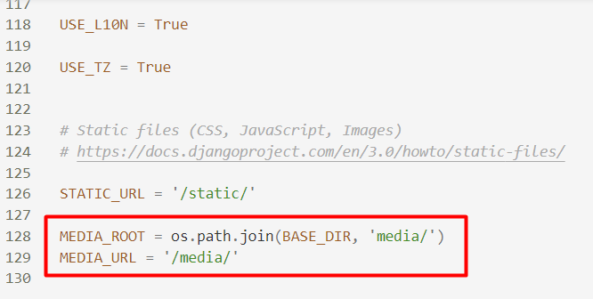
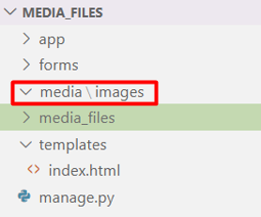
Configure Media Folder
Create a media folder and configure it in the settings.py file

Slide 23
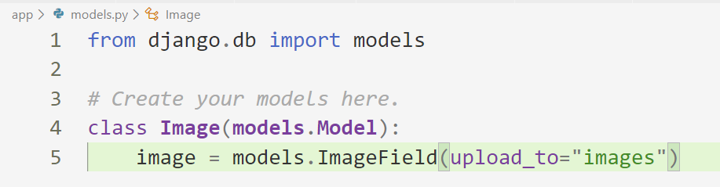
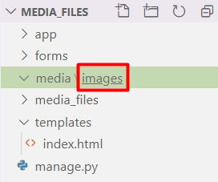
Create Image Field in a Model
Name of the folder where the images will be stored

Slide 24
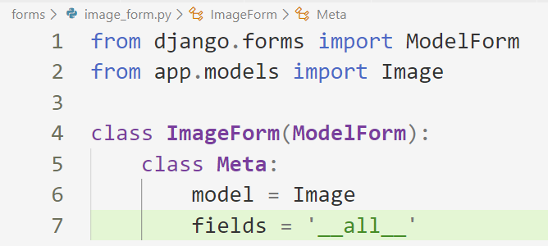
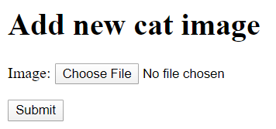
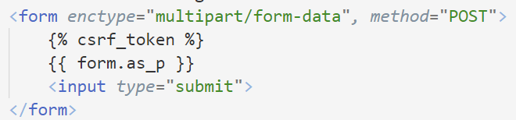
Create a Model Form

Slide 25
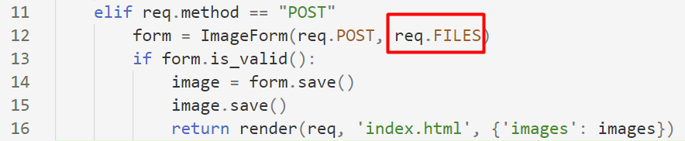
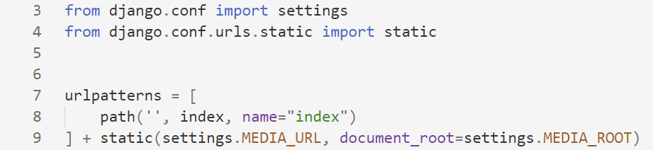
Handling the POST Request
Configure the URLs for media

Slide 26
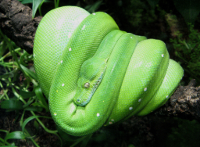
Displaying the Image

Slide 27
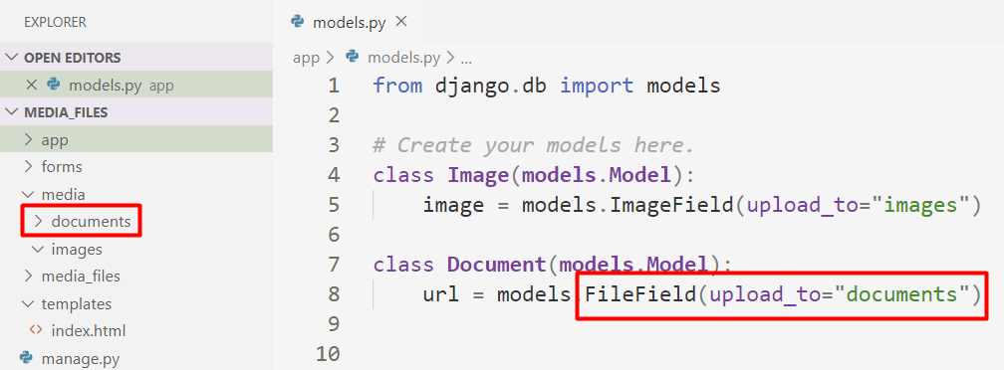
Create Documents Folder

Slide 28
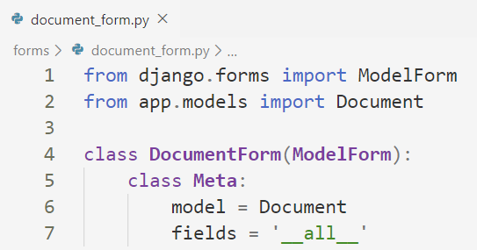
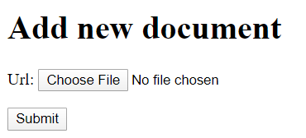
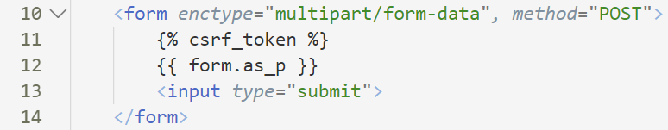
Create Model Form

Slide 29

Summary
We can let Django handle the performance and use the prebuilt Django tools
We can override Django methods, classes, or functions
We can customize the built-in ones
Notes:
29

Slide 30
Questions?
Notes:
30

Slide 31













SoftUni Diamond Partners

Slide 32

Educational Partners

Slide 33
Trainings @ Software University (SoftUni)
Software University – High-Quality Education, Profession and Job for Software Developers
softuni.bg, softuni.org
Software University Foundation
softuni.foundation
Software University @ Facebook
facebook.com/SoftwareUniversity
Software University Forums
forum.softuni.bg
33
Notes:
33

Slide 34

License
This course (slides, examples, demos, exercises, homework, documents, videos, and other assets) is copyrighted content
Unauthorized copy, reproduction, or use is illegal
© SoftUni – https://softuni.org
© Software University – https://softuni.bg
Notes:
34

