Slide 1


Models in Django - Part 2
SoftUni Team
Technical Trainers
Software University
https://softuni.bg

Slide 2
Table of Contents
Working with Model Objects
Reading Data
Filtering Data
Deleting Data
Class Meta
Model Methods
Adding Slugs
2

Slide 3
Have a Question?
sli.do
#python-web

Slide 4

Working with Model Objects
Reading Data

Slide 5
Reading Data from the Database
Use Python code to retrieve data from the database
Use the Manager on the model class
Construct a QuerySet
views.py
Retrieve all objects
def show_all_departments(request)
all_departments = Department.objects.all()
...
context = {"departments": all_departments}
return render(request, 'departments.html', context)

Slide 6
Model Manager
Each model has at least one Manager, and it's called objects by default
Managers are accessible only via model classes rather than from model instances
views.py
def show_all_departments(request)
all_departments = Department.objects
print(all_departments)
# departments.EmployeeNew.objects
print(type(all_departments))
# <class 'django.db.models.manager.Manager'>

Slide 7
QuerySet
QuerySet is a collection of objects from the database
You can work with it without hitting the database
It hits the database when you evaluate the queryset
views.py
def show_all_departments(request)
all_departments = Department.objects.all()
print(all_departments)
# <QuerySet []>
print(type(all_departments))
# <class 'django.db.models.query.QuerySet'>

Slide 8
Working with Model Objects
Filtering Data

Slide 9
Filtering Objects
Return objects that match given parameters
Return objects that do NOT match given parameters
Return only one object that matches your query
employees_aged_35 = Employee.objects.filter(age=35)
# returns a QuerySet with all employees (objects) whose age is 35
employees_not_aged_35 = Employee.objects.exclude(age=35)
# returns a QuerySet with all employees (objects) whose age is NOT 35
employee_with_id_one = Employee.objects.get(id=1)
# returns the employee object with an id equal to 1

Slide 10
Filtering with Shortcut Functions
Get the desired object or raise an HTTP 404
Get the desired queryset (casted to list) or raise an HTTP 404
employee_with_id_one = get_object_or_404(Employee, pk=1)
# try to get an employee with an id of 1;
# if not - raise an Http404 exception;
employees_aged_35 = get_list_or_404(Employee, age=35)
# try to filter a list of employees who are aged 35;
# if the list is empty - raise an Http404 exception;

Slide 11
Adding Filter Conditions
The filtering methods accept key-value paired field lookup parameters
They take the form field__lookuptype=value
Employee.objects.filter(age__lte=35)
# returns a QuerySet with all employees (objects) whose age is less than or equal to 35
SELECT * FROM employees WHERE age <= 35;

Slide 12
Field Lookup Types (1)
To match objects with exactly the given value
To match objects that contain the given value
To match objects that starts-with or ends-with the given value
Employee.objects.filter(job_level="Junior")
Employee.objects.exclude(job_level__exact="Junior") # explicit form
Employee.objects.get(job_level__iexact="Junior") # case-insensitive match
Employee.objects.exclude(job_title__contains="Engineer")
Employee.objects.filter(job_title__icontains="engineer") # case-insensitive
Employee.objects.exclude(job_title__startswith="Senior")
Employee.objects.filter(job_title__endswith="Engineer")

Slide 13
Field Lookup Types (2)
To match objects with a value greater than the given value
To match objects with a value less than the given value
To match objects in a given range (inclusive)
Employee.objects.filter(age__gt=20) # greater than
Employee.objects.exclude(age_gte=20) # greater than or equal to
Employee.objects.filter(age_lt=20) # less than
Employee.objects.exclude(age_lte=20) # less than or equal to
Employee.objects.filter(age__range=(20, 30)) # from 20 to 30 both inclusive

Slide 14
Chaining Filter Conditions
Date/time field lookup types allow chaining additional field lookups
Employee.objects.filter(birth_date__year__gt=1999)
# returns a QuerySet with all employees (objects) who are born after 1999
SELECT * FROM employees WHERE birth_date > '2000-01-01';
More Chained Conditions: https://docs.djangoproject.com/en/4.1/ref/models/querysets/#date

Slide 15
Working with Model Objects
Deleting Data

Slide 16
Deleting Model Object (1)
The delete() method immediately deletes the model object
You should explicitly request the object
The method returns:
The number of objects deleted
The number of deletions per object type
employee = Employee.objects.first()
employee.delete()
# (1, {'departments.Employee': 1})

Slide 17
Deleting Model Object (2)
Delete a single object
Delete multiple objects in a QuerySet
Note: when deleting an object with foreign keys, it will emulate the behavior of the SQL constraint ON DELETE
employee = Employee.objects.get(pk=1)
employee.delete()
employees = Employee.objects.all()
employees.delete()

Slide 18

Class Meta

Slide 19
Class Meta
To insert model metadata in the model, use the inner-class Meta
Adding the class is completely optional
class Employee(models.Model):
...
year_of_employment = models.IntegerField()
class Meta:
ordering = ["-year_of_employment"]
Meta option

Slide 20
Meta Options (1)
You can create an abstract base class to put some common information into other models
The model will not create any database table
class CommonInfo(models.Model):
name = models.CharField(max_length=100)
...
class Meta:
abstract = True
class Employee(CommonInfo):
...

Slide 21
Meta Options (2)
You can generate a default ordering for the object when retrieving data from the model
Note: if you order by a field that is not unique, objects with the same values may appear in a different order
class Employee(models.Model):
...
class Meta:
ordering = ['name', '-years_of_employment']
Ascending order
Descending order

Slide 22
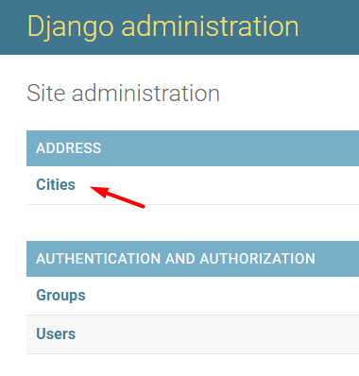
Meta Options (3)
You can give a plural name to your model to be represented correctly in the Django admin site
class City(models.Model):
...
class Meta:
verbose_name_plural = "cities"
More Meta Options: https://docs.djangoproject.com/en/4.1/ref/models/options/

Slide 23

Model Methods

Slide 24
Custom Model Methods
Add functionality on a particular model instance
Keeps business logic in one place
class Employee(models.Model):
...
def years_of_experience:
# returns the years and months of experience

Slide 25
Custom Model Properties
Add managed attributes
Feature of Python
class Employee(models.Model):
...
@property
def full_name:
# returns the full name of an employee

Slide 26
Built-in Model Methods
Each of them have special purpose
class Employee(models.Model):
...
def get_absolute_url(self):
# returns a calculated URL for that object
def __str__(self):
# returns a human-readable representation
More Model Methods: https://docs.djangoproject.com/en/4.1/topics/db/models/#model-methods

Slide 27

Adding Slugs
Live Demo

Slide 28
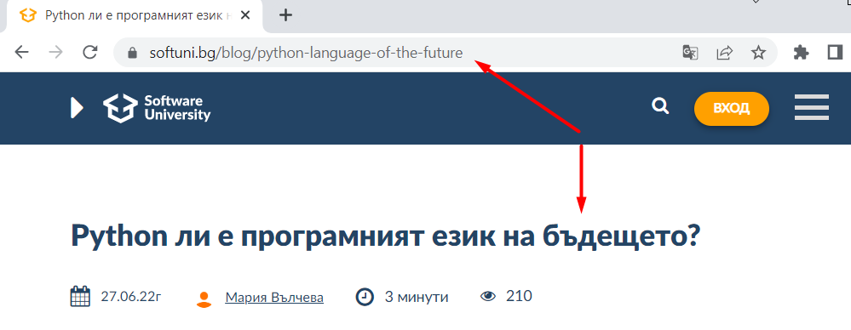
Using Slugs
Slugs are generally used in URLs
It is often used to automatically prepopulate a slug with a value based on another value

Slide 29
Add a SlugField
Define a field where the data of each slug will be stored
Each value should be unique as it is part of an URL
departments/models.py
class Department(models.Model):
name = models.CharField(max_length=100)
...
slug = models.SlugField(unique=True)

Slide 30
Add the URL pattern
The route should be a slug value which will be passed to the view function
departments/urls.py
urlpatterns = [
...
path("<slug:slug>", views.show_department, name="show-dep"),
]

Slide 31
Create the View
Create the view as usual
Try to find to object by the given slug
departments/views.py
def show_department(request, slug):
department = get_object_or_404(Department, slug=slug)
context = {"department": department}
return render(request, "department_details.html", context)

Slide 32
Generate the Path Reference
Define the built-in model method that calculates the absolute URL
Use the reverse() function
Pass the slug value as an argument
departments/models.py
class Department(models.Model):
...
def get_absolute_url(self):
return reverse("show-dep", kwargs={"slug": self.slug})

Slide 33
Add the Slug in the Template
Specify the URL for each model
Use the generated path in the model
dashboard.html
<h1>All Departments</h1>
{% for dep in departments_list %}
<ul>
<li><a href="{{ dep.get_absolute_url }}">{{ dep.name }}</a></li>
</ul>
{% endfor %}

Slide 34
Customize the Admin Site
The slug field should be prepopulated with the value in the name field
departmets/admin.py
class DepartmentAdmin(admin.ModelAdmin):
prepopulated_fields = {"slug": ("name",)}
admin.site.register(Department, DepartmentAdmin)

Slide 35

Live Demo
Live Exercises in Class

Slide 36

Summary
Models allow us to work with data using Python code
Use class Meta to insert "anything that's not a field"
Use model methods to add custom "row-level" functionality to the objects

Slide 37
Questions?
Notes:
37

Slide 38













SoftUni Diamond Partners

Slide 39

Educational Partners

Slide 40

License
This course (slides, examples, demos, exercises, homework, documents, videos, and other assets) is copyrighted content
Unauthorized copy, reproduction, or use is illegal
© SoftUni – https://softuni.org
© Software University – https://softuni.bg
Notes:
40

Slide 41
Trainings @ Software University (SoftUni)
Software University – High-Quality Education, Profession and Job for Software Developers
softuni.bg, softuni.org
Software University Foundation
softuni.foundation
Software University @ Facebook
facebook.com/SoftwareUniversity
Software University Forums
forum.softuni.bg
41
Notes:
41

