Slide 1
Use of GENOPT and BIGBOSOR4 to obtain optimum designs of a double-walled inflatable cylindrical vacuum chamber
David Bushnell, retired
775 Northampton Drive, Palo Alto, CA 94303
bush@sonic.net
November, 2010
Notes:
GENOPT/BIGBOSOR4 is applied to the problem of a perfect elastic cylindrical “shell” the complex inflatable wall of which is a webbed sandwich. The cylindrical “shell” is stabilized by uniform pressure applied between its inner and outer walls. General buckling of the entire cross section of the cylindrical shell and local buckling of some of the individual segments of its complex wall cross section can occur because an external pressure applied outside the outer wall is greater than an internal pressure applied inside the inner wall. The complex wall cross section is prismatic (uniform in the axial direction). It consists of the following segments: outer curved (small cylindrical) segments that bulge outward locally from the average outer radius of the double-walled cylindrical “shell”, inner curved (small cylindrical) segments that bulge inward locally from the average inner radius of the cylindrical “shell”, straight segments oriented in the circumferential direction that connect the ends of the outer curved segments, straight segments oriented in the circumferential direction that connect the ends of the inner curved segments, and webs that connect the inner and outer walls. There are two geometries: one in which the webs are oriented radially and the other in which the webs are slanted, forming a kind of truss. The entire structure consists of segments that act like membranes. The structure is a kind of balloon. The radial distance from the inner wall to the outer wall is the same order as the average radius of the entire cylindrical vacuum chamber. The decision variables of the optimization problem are the radial distance from the inner wall to the outer wall, the radius of curvature of the outer curved membranes, the radius of curvature of the inner curved membranes, and the thicknesses of the various segments that comprise each repeating module of the complex wall. Design constraints are the lowest buckling load factor (whether general buckling or local buckling) and various membrane stress components in each of the segments of the complex wall cross section. The objective is the weight per axial length of the cylindrical vacuum chamber.

Slide 2
Summary
What is GENOPT? (Slides 3 - 16)
What is BIGBOSOR4? (Slide 17)
Geometry, discretization, segments, modules, materials (Slides 18 - 22)
Huge torus/prismatic shell model (Slide 20)
Optimized balloons with truss-like (slanted) webs (Slides 23 - 38)
Optimized balloons with radial webs (Slides 39 - 55)
Conclusions (Slides 56 - 57)

Slide 3

Notes:
ABSTRACT - The purpose of GENOPT (GENeral OPTimization) is to enable an engineer to create a user-friendly system of programs for analyzing and/or optimizing anything. The application of GENOPT is not limited to the field of structural mechanics. GENOPT is designed to handle problems with small data bases, not large finite element models, although it might well be used to provide a user-friendly “shell” within which any analysis could be done. GENOPT is ideal for generating programs for optimizing objects the behavior (stress, buckling, vibration, etc.) of which can be expressed by relatively simple tables or formulas such as those that appear in handbooks, or for optimizing objects the behavior of which has been previously encoded in existing subroutines. The optimizer used in GENOPT, created by Vanderplaats, is called ADS. Two examples are presented, one relatively simple, the other more complex

Slide 4
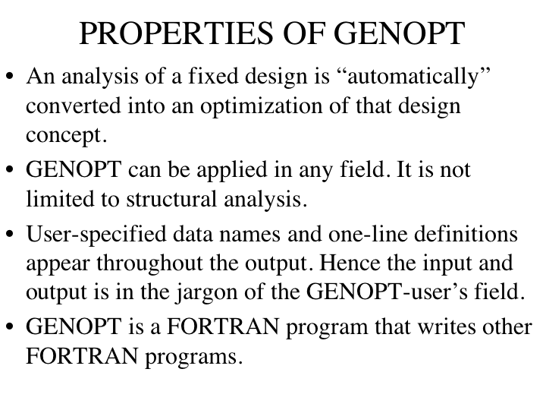

Slide 5
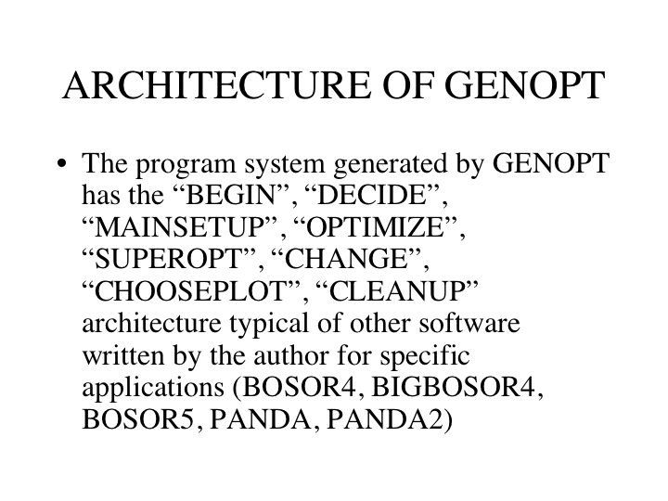

Slide 6
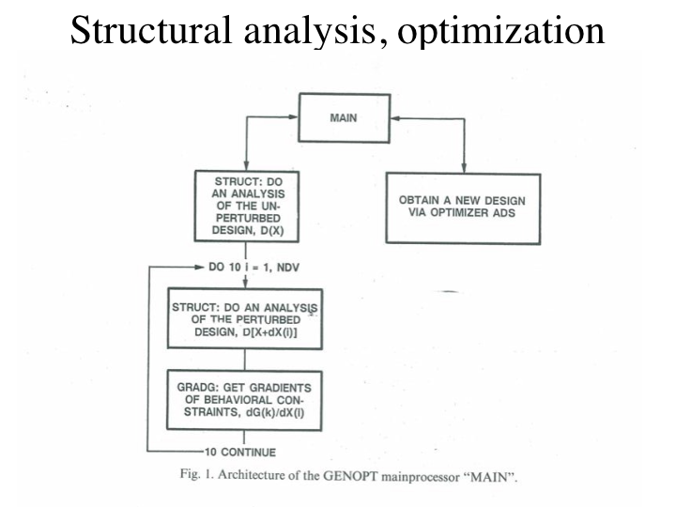
Notes:
The optimization is via ADS, optimization software developed many years ago by Gary Vanderplaats and his colleagues. As shown in this slide, optimization is based on the gradients of the behavioral constraints. The gradients of the behavioral constraints are computed from finite differences between the behavior of the perturbed design and the behavior of the current design.

Slide 7
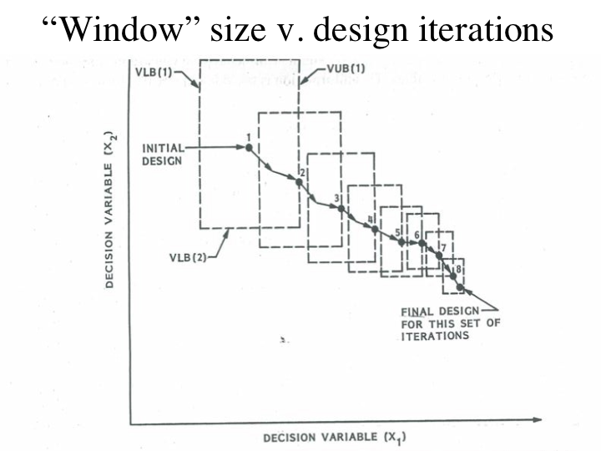
Notes:
The “window” within which the decision variables may move is shrunk with each design iteration following a single execution of the GENOPT processor called “OPTIMIZE”. Therefore, it is necessary to execute OPTIMIZE several times. At the beginning of each new execution of OPTIMIZE the “window” is re-expanded to its original size.
An execution of SUPEROPT consists of many sets, each set consisting of several executions of OPTIMIZE in succession, followed by an execution of the GENOPT processor called “AUTOCHANGE”. AUTOCHANGE obtains a new “starting” design in a random manner mostly consistent with linking and inequality constraints. Hence, one execution of SUPEROPT seeks many different optimum designs, each starting from a different “initial” design. In this way it is expected that the optimum design found at the end of a SUPEROPT execution will be close to a “global” optimum design, since it was found by starting from many different points in design space.

Slide 8
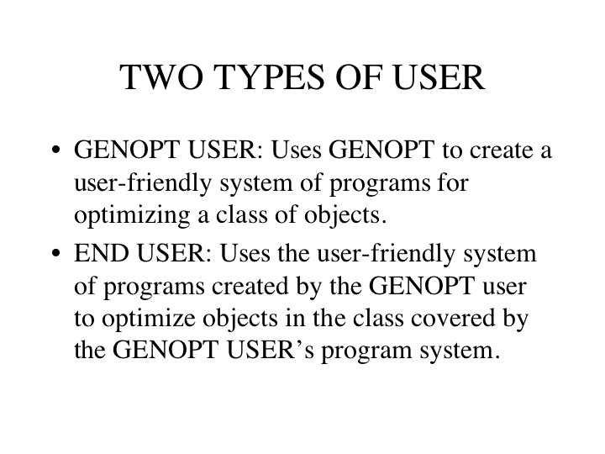

Slide 9
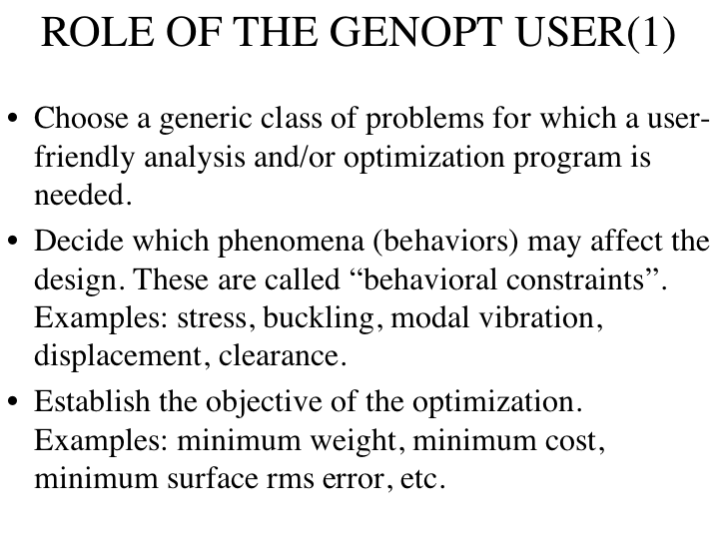

Slide 10
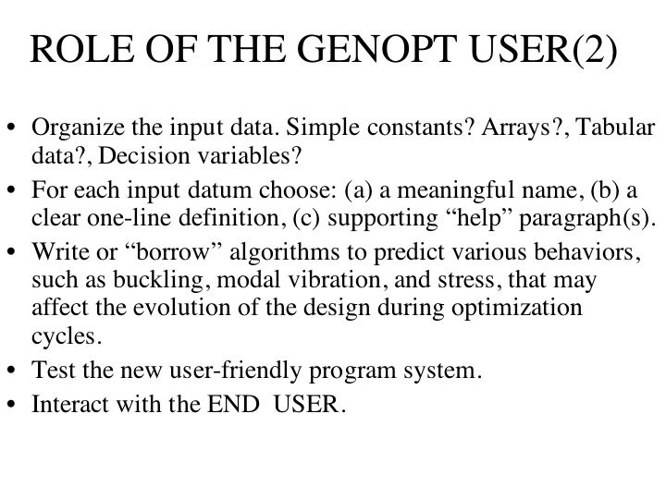

Slide 11
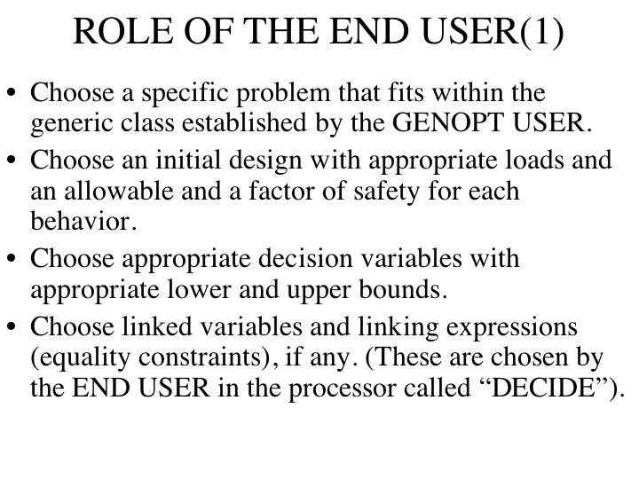

Slide 12
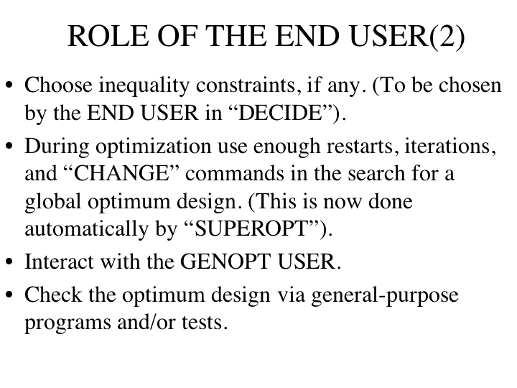

Slide 13
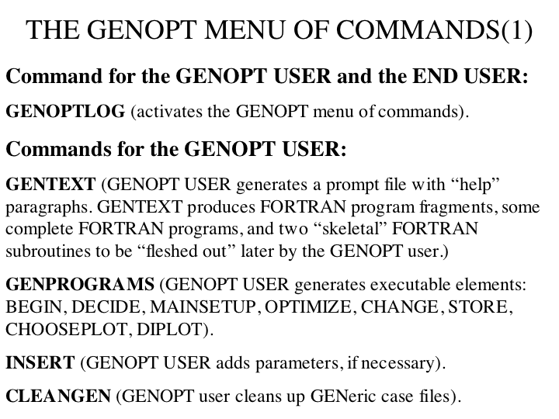

Slide 14
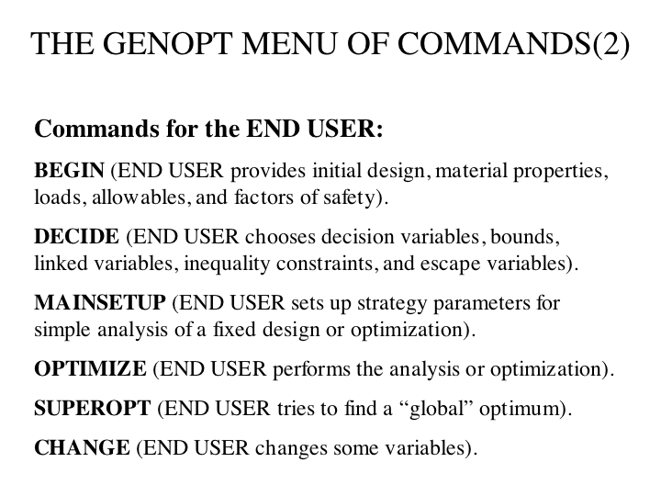

Slide 15
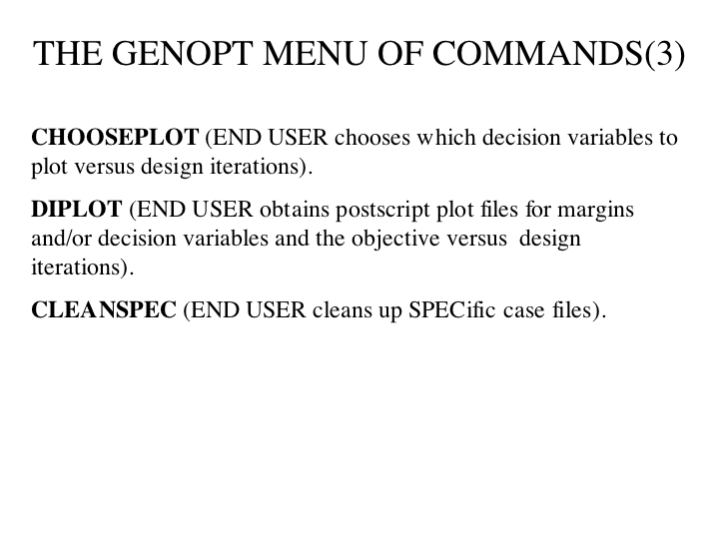

Slide 16
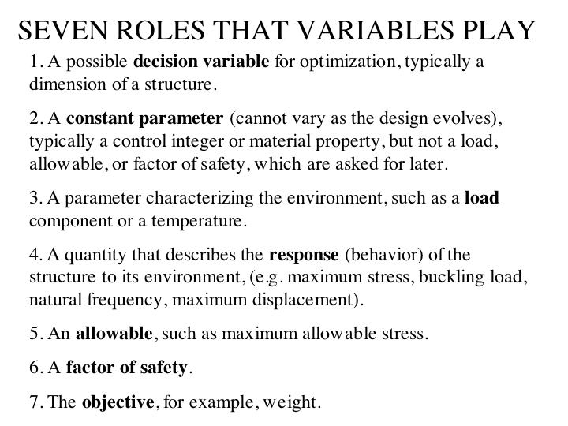

Slide 17
What is BIGBOSOR4?
Stress, buckling and vibration of elastic shells of revolution (BIGBOSOR4=BOSOR4 with more shell segments permitted, up to 295 shell segments as of 2011).
Nonlinear axisymmetric stress analysis
Linear non-axisymmetric stress analysis
Axisymmetric or non-axisymmetric bifurcation buckling
Linear vibration modes of axisymmetrically loaded shell
Multi-segment, branched, ring-stiffened shells of revolution
Various wall constructions
BIGBOSOR4 cannot handle local shell segment transverse shear deformation (t.s.d.) or local shell wall anisotropy or bifurcation buckling with applied in-plane shear loading. Use a factor of safety to compensate for these effects on local buckling.
Notes:
BOSOR4 paper (Computers & Structures, Vol. 4, pp 399 – 435, 1974)
STRESS, STABILITY AND VIBRATION OF COMPLEX, BRANCHED SHELLS OF REVOLUTION
DAVID BUSHNELL, Lockheed Palo Alto Research Laboratory, Palo Alto, California, U.S.A.
ABSTRACT - A comprehensive computer program, designated BOSOR4, for analysis of the stress, stability and vibration of segmented, ring-stiffened, branched shells of revolution and prismatic shells and panels is described. The program performs large deflection axisymmetric stress analysis, small-deflecton nonsymmetric stress analysis, modal vibration analysis with axisymmetric nonlinear prestress included, and buckling analysis with axisymmetric or nonsymmetric prestress. One of the main advantages of the code is the provision for realistic engineering details such as eccentric load paths, internal supports, arbitrary branching conditions, and a library of wall constructions. The program is based on the finite difference energy method which is very rapidly convergent with increasing numbers of mesh points. The organization of the program is briefly described with flow of calculations charted for each of the types of analysis. Overlay charts and core storage requirements are given for the CDC 6600, IBM 370, and UNIVAC 1108 versions of BOSOR4. A large number of cases is included to demonstrate the scope and practicality of the program.
About BOSOR4, etc. (Computers & Structures, Vol. 18, pp 471 – 536, 1984)
COMPUTERIZED ANALYSIS OF SHELLS-GOVERNING EQUATIONS
DAVID BUSHNELL, Applied Mechanics Laboratory, Lockheed Palo Alto Research Laboratory, 3251 Hanover Street, Palo Alto, CA 94304, U.S.A.
ABSTRACT - This paper opens with a general discussion of terms in an energy functional which might be the basis from which equations governing stress, stability, and vibration analyses are derived. The energy expression includes strain energy of the shell and discrete stiffeners, kinetic energy of the shell and stiffeners, constraint conditions with Lagrange multipliers, and other terms arising from the change in direction of applied loads during deformation. Brief discussions are included of the coupling effect between bending and extensional energy needed for the analysis of layered composite shells or elastic-plastic shells, nonlinear terms, and the form that the energy expression takes upon discretization of the structure. A section follows in which the energy formulation for stress, stability, and vibration analyses of an elastic curved beam is given, including thermal effects, moderately large rotations, boundary conditions, and distributed and concentrated loads. The matrix notation and type of discretization are introduced here which will later be used for the analysis of shells of revolution. Terms in the local element stiffness, mass, and load-geometric matrices are derived in terms of nodal point displacements, and it is shown how these local matrices are assembled into global matrices. The purpose of the section is to demonstrate the procedure for derivation of the analogous equations and quantities for shells of revolution or more complex structures. The next section is on elastic shells of revolution. It opens with a summary of what computer programs exist for stress, buckling, and stability analyses of such structures. The assumptions on which these programs are based are listed and the various components of the energy functional, such as strain energy of the shell and discrete rings, are identified and derived in terms of nodal point displacements. Included are a derivation of the constitutive law for anisotropic shell walls and a formulation of nonlinear constraint conditions, which are required for the treatment of segmented or branched shells with meridional discontinuities between segments or branches. Derivations of terms in the global stiffness and load-geometric matrices and the force vector are given, with tables tracing the origin of each term. The computational strategy for calculation of critical bifurcation buckling loads in the presence of prebuckling nonlinearities is given, with an example of buckling under axial compression of a very thin cylinder. This is a simple problem to formulate but a difficult one to solve numerically, owing to the existence of closely spaced eigenvalues corresponding to nonsymmetric buckling at loads close to the load corresponding to nonlinear axisymmetric collapse. A description of various pitfalls encountered in the search for the lowest bifurcation buckling load is given, including estimates of the critical number of circumferential waves in the buckling mode. Computerized formulations and run times are compared for various discretization methods, including finite difference energy models and standard finite element models, with an example showing comparisons of rate of convergence with increasing nodal point density and computer times required to form stiffness matrices. Hybrid bodies of revolution are discussed next. By "hybrid" is meant a body of revolution with both one-dimensionally and two-dimensionally discretized regions. The formulation is particularly useful for the stress, buckling, and vibration analyses of branched shells or ring-stiffened shells in which one is particularly interested in local effects within a distance equal to a shell wall thickness of a branch or ring. An appropriate strategy for the solution of nonlinear problems with simultaneous geometric nonlinearity and path-dependent material properties is described, including the development of the incremental constitutive law for the tangent stiffness method of treatment of elastic-plastic structures. The two-dimensionally discretized regions are modeled with use of 8-node isoparametric quadrilaterals of revolution. Details are presented on the formulation of constraint conditions for compatibility at junctions between rotationally symmetric shell segments (one-dimensionally discretized regions) and solid segments (two-dimensionally discretized regions). The paper closes with a summary of linear equations for general shells. Surface coordinates, the first and second fundamental forms, and the definition of a shell are introduced, and the assumptions corresponding to Love's first approximation are identified. The differences in commonly used or referenced formulations are listed, including differences with regard to kinematic relations, expressions for total strain anywhere in the thickness of the shell wall, and expressions for stress and moment resultants. Comments are offered on which theory is the most suitable for engineering estimates.

Slide 18
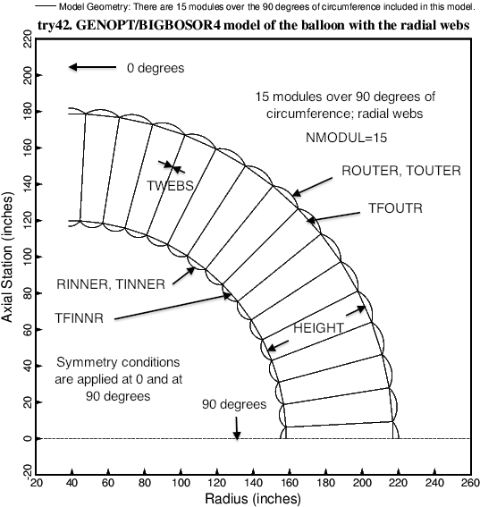
Balloon with radial webs. The 8 decision variable candidates are shown
Notes:
Fig. 1 Cross section of the double wall of the cylindrical vacuum chamber with radial webs. The radius to the inner wall is RADIUS, which is not a decision variable. The decision variable candidates are the distance between the inner and outer walls, HEIGHT, the two radii of curvature, RINNER and ROUTER, and the five thicknesses, TINNER, TOUTER, TFINNR, TFOUTR, and TWEBS. (TWEBS is misspelled: it should be TFWEBS.) The pressure inside the inner wall is PINNER; the pressure outside the outer wall is POUTER; The pressure between the inner and outer walls is PMIDDL. PMIDDL > POUTER > PINNER. Buckling of and stress in this configuration is computed with use of the BIGBOSOR4 computer program. The wall is optimized (minimum weight) with the use of the system of computer programs called “GENOPT/BIGBOSOR4” [2, 6, and 8 – 11].

Slide 19
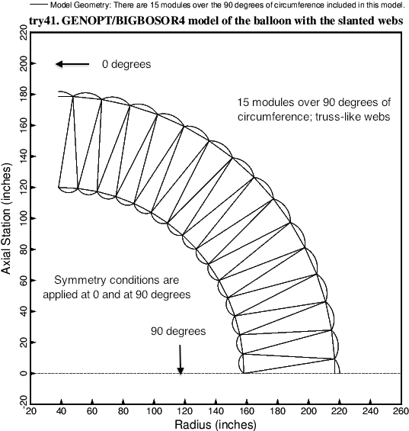
Balloon with truss-like (slanted) webs.
Notes:
Fig. 2 Cross section of the double wall of the cylindrical vacuum chamber with truss-like (slanted) webs. The pressure inside the inner wall is PINNER; the pressure outside the outer wall is POUTER; The pressure between the inner and outer walls is PMIDDL. PMIDDL > POUTER > PINNER. Buckling of and stress in this configuration is computed with use of the BIGBOSOR4 computer program. The wall is optimized (minimum weight) with the use of the system of computer programs called “GENOPT/BIGBOSOR4” [2, 6, and 8 – 11].

Slide 20
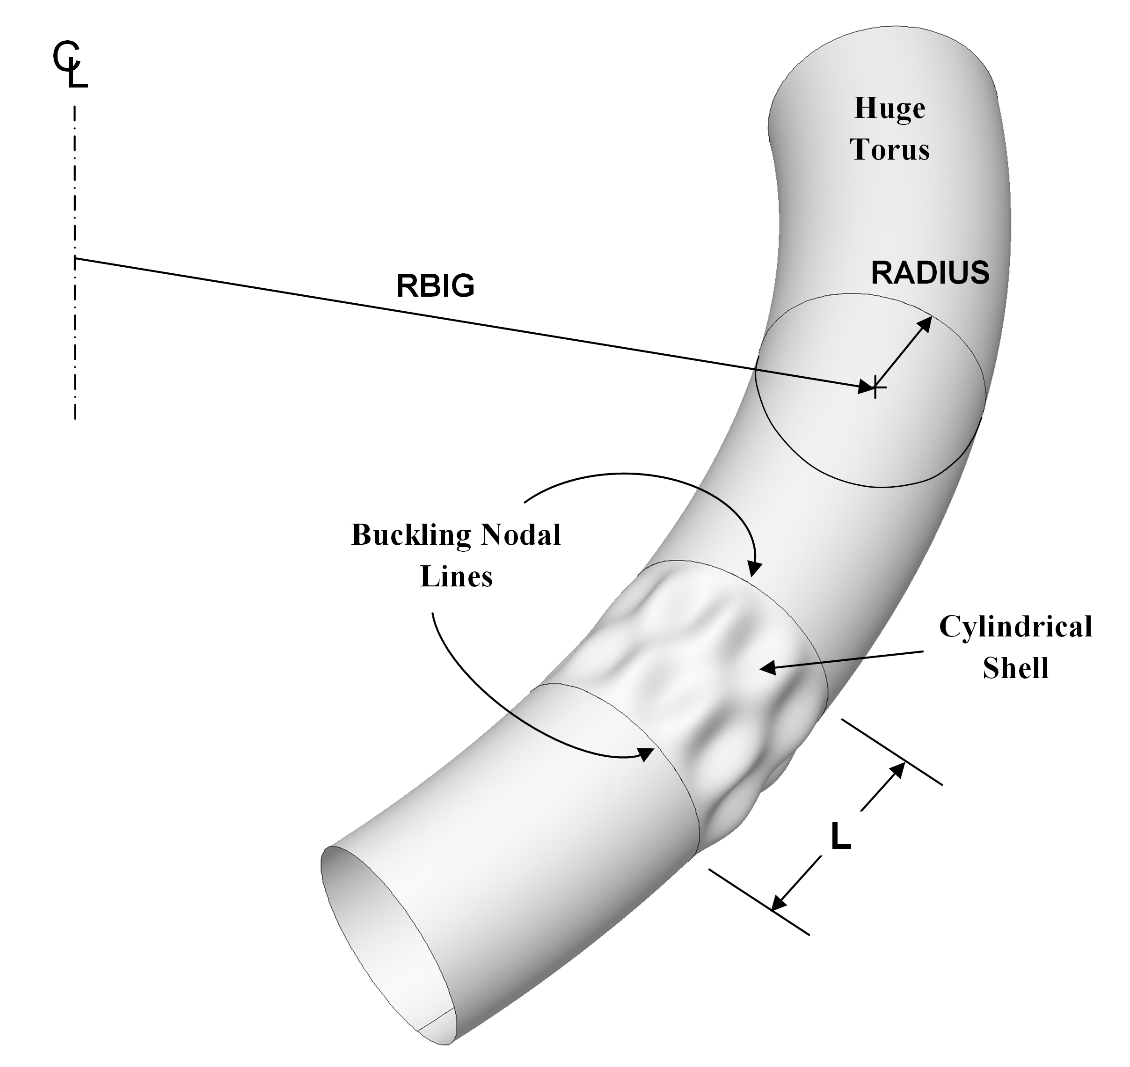
The “huge torus” model of a prismatic shell. Drawing Robert P. Thornburgh
Notes:
Fig. 3 Schematic of a “huge torus” model [7-9]. This figure was created by Robert P. Thornburgh [9]. For most “huge torus” models [7], a good choice of RBIG is RBIG = 100xL/π. The double-walled cylindrical balloons studied here have RADIUS = 120 inches to the inner wall of the double-walled vacuum chamber. For the “true prismatic” shell model the kinematic relationships introduced recently into BIGBOSOR4 [8] correspond essentially to RBIG = infinity. In the “huge torus” [7] and “true prismatic shell” [8] models what is the axial coordinate in the usual model of a cylindrical shell becomes the circumferential coordinate in the “huge torus” model, and what is the circumferential coordinate in the usual model of a cylindrical shell becomes the meridional coordinate in the “huge torus” model. This “trick” of exchanging coordinates makes it possible to analyze prismatic shells as if they were shells of revolution. Hence, the details of the cross section of the double-wall of the balloon are retained, and a shell-of-revolution code such as BIGBOSOR4 can be used to analyze the cylindrical vacuum chamber that is not, in the ordinary sense, a shell of revolution. The wall characteristics need not be smeared, and both local and general buckling modes can be obtained.

Slide 21
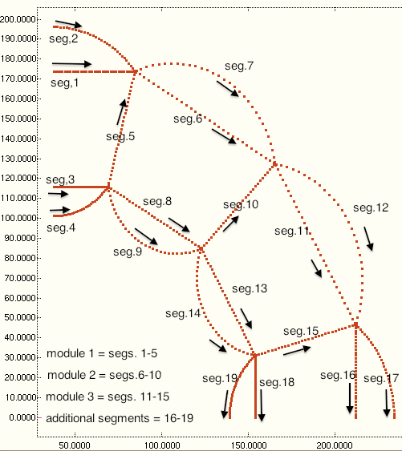
Balloon with radial webs. This crude model has only three modules. “Shell” segment numbering is shown.
Notes:
Fig. 4 The complex wall of the cylindrical vacuum chamber (balloon) consists of a number of modules, NMODUL.
NMODUL is an input quantity that the end user chooses when executing the GENOPT processor, BEGIN. In this crude model of a balloon wall with radial webs NMODUL = 3. The “shell” segment numbering convention and the direction of “travel” along each segment in the BIGBOSOR4 model are displayed here. Each “shell” segment is discretized in the meridional coordinate: 31 nodal points per segment. Variation of the buckling modal displacements in the direction normal to the plane of the paper is trigonometric. Although the computer program, BIGBOSOR4, was created to analyze shells with finite bending stiffness and the segments of the vacuum chamber treated in this paper act more like membranes than like shells, useful predictions are obtained.

Slide 22
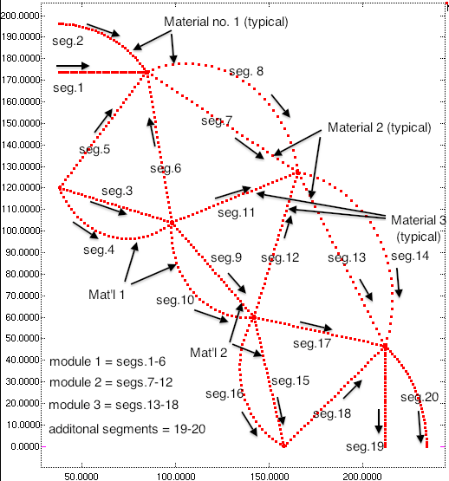
Balloon with truss-like (slanted) webs. This crude model has only three modules. “Shell” segment numbering and material types are shown.
Notes:
Fig. 5 The complex wall of the cylindrical vacuum chamber (balloon) consists of a number of modules, NMODUL.
NMODUL is an input quantity that the end user chooses when executing the GENOPT processor, BEGIN. In this crude model of a balloon wall with truss-like (slanted) webs NMODUL = 3. The “shell” segment numbering convention and the direction of “travel” along each segment in the BIGBOSOR4 model are displayed here. Each “shell” segment is discretized in the meridional coordinate: 31 nodal points per segment. Variation of the buckling modal displacements in the direction normal to the plane of the paper is trigonometric. There are 3 material types in this model and also in the model shown in the previous figure. In the studies reported in this paper all three material types have the same properties. Although the computer program, BIGBOSOR4, was created to analyze shells with finite bending stiffness and the segments of the vacuum chamber treated in this paper act more like membranes than like shells, useful predictions are obtained.

Slide 23
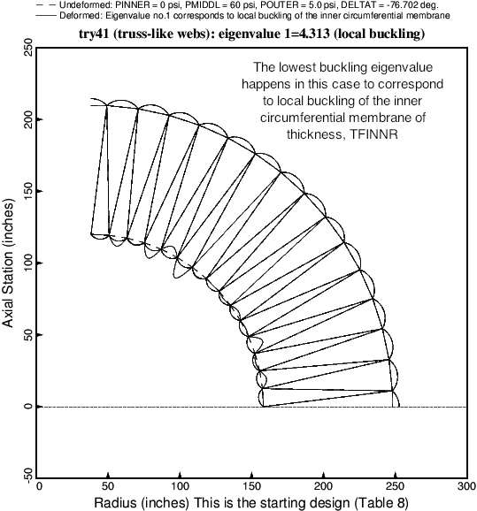
Local buckling of starting design
Notes:
Fig. 6a The critical buckling mode of the starting design of the vacuum chamber with truss-like (slanted) webs and with NMODUL = 15 (15 modules). In every case explored in this paper the lowest local buckling eigenvalue (buckling load factor) corresponds to buckling (wrinkling) of the inner circumferential membrane with thickness, TFINNR. Sometimes, especially for the balloons with radial webs, the critical buckling mode (buckling mode associated with the lowest eigenvalue) corresponds to overall ovalization of the entire cross section of the balloon. See Fig. 23 for example. In all cases there are many, many local buckling eigenvalues clustered very closely. This clustering makes it difficult to find the eigenvalue associated with general buckling, unless that eigenvalue happens to be lower than the lowest local buckling eigenvalue. The starting design listed in Table 8 has HEIGHT = 90 inches, RINNER = 8 inches, ROUTER = 15 inches, and all five thicknesses, TINNER, TOUTER, TFINNR, TFOUTR, TFWEBS = 0.1 inch.

Slide 24
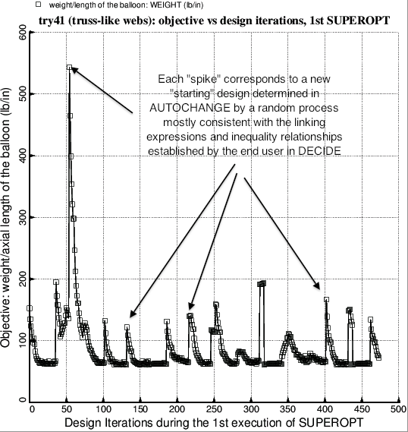
Balloon with truss-like webs: Evolution of the objective during the 1st execution of SUPEROPT
Notes:
Fig. 6b Evolution of the objective (weight/axial length) during the first execution of the GENOPT processor called SUPEROPT. A successful and complete execution of SUPEROPT requires about 20 hours of computer time on the writer’s workstation for the balloon with 15 modules over 90 degrees of circumference (previous figure). In this first execution of SUPEROPT the two radii, RINNER and ROUTER (Fig. 1) are not decision variables (Table 9). The optimum design obtained after the first execution of SUPEROPT is listed in Table 11 and archived with the use of the GENOPT processor called CHANGE (Table 12).

Slide 25
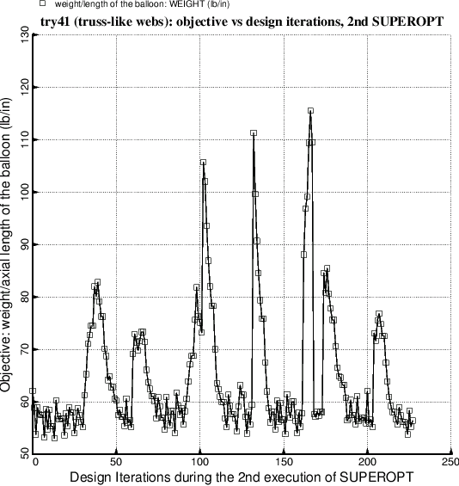
Balloon with truss-like webs: Evolution of the objective during the 2nd execution of SUPEROPT
Notes:
Fig. 7 Evolution of the objective (weight/axial length) during the second execution of the GENOPT processor, SUPEROPT. This 2nd execution of SUPEROPT was terminated on purpose because the writer did not want to wait for several hours for completion of the approximately 470 iterations specified by the GENOPT software. In this 2nd execution of SUPEROPT the two radii, RINNER and ROUTER (Fig. 1) are now decision variables (Table 13). The optimum design obtained after the second execution of SUPEROPT is listed in Table 14 and archived with the use of the GENOPT processor called CHANGE (Table 15).

Slide 26
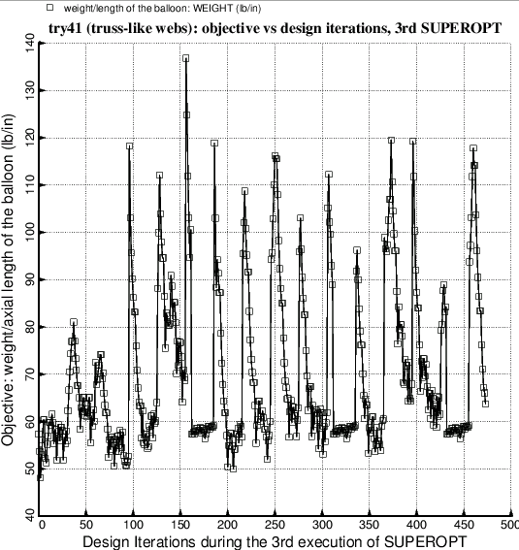
Balloon with truss-like webs: Evolution of the objective during the 3rd execution of SUPEROPT
Notes:
Fig. 8 Evolution of the objective (weight/axial length) during the third execution of the GENOPT processor, SUPEROPT. New lower bounds of the decision variables are specified in the execution of the GENOPT processor called DECIDE before the launch of this third execution of SUPEROPT (Table 16). The optimum design obtained after this third execution of SUPEROPT happens to be the same as that obtained after the second execution of SUPEROPT (Tables 14 and 15). Notice that starting at Design Iterations 155, 305, and 430 there is temporarily less jumpiness of the objective in successive design iterations. This happens because SUPEROPT temporarily resets the move limit of decision variables to a much more restrictive value in order to “close in” on a possibly better optimum design in the immediate neighborhood of whatever optimum has been determined up to that point in the long SUPEROPT process. In this particular case the exploration in the immediate neighborhood in design space did not result in a better optimum design.

Slide 27
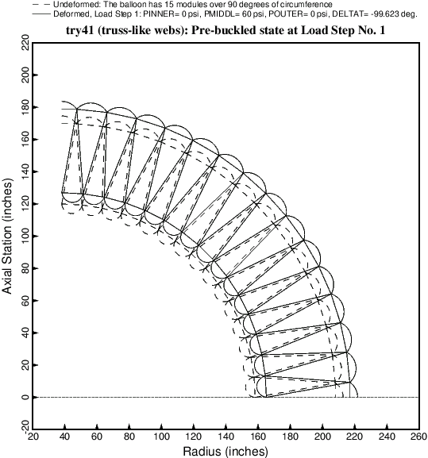
Nonlinear pre-buckled state at Load Step 1:
PINNER = 0, PMIDDL = 60, DELTAT=-99.6 deg.
POUTER
PMIDDL
PINNER
Notes:
Fig. 9 Uniform pre-buckled state of the balloon with truss-like (slanted) webs subjected to the loads in Load Step No. 1, that is, before the outer pressure, POUTER = 15 psi, has been applied. As described in the text the delta-temperature, DELTAT = -99.623, is applied in order to generate the correct pre-buckling axial tension produced by PINNER because the ends of the cavity between the inner and outer walls is assumed to be sealed at the two ends of the cylindrical vacuum chamber. Note: plots of this type, generated via a BIGBOSOR4 input file called “try4.BEHX2”, can no longer be obtained without modifying SUBROUTINE BEHX2 as described in Item 8 of Section 8.

Slide 28
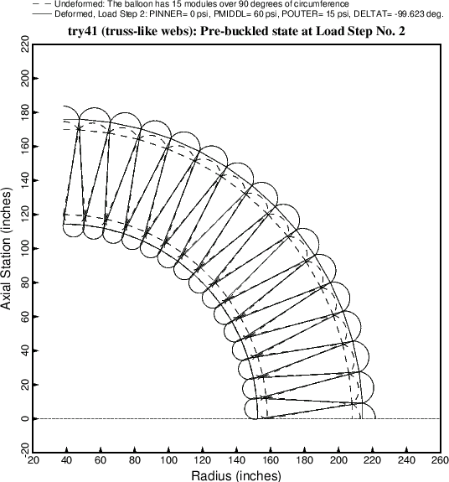
Nonlinear pre-buckled state at Load Step 2:
PINNER = 0, PMIDDL = 60, DELTAT=-99.6 deg., plus POUTER = 15.0 psi
POUTER
PMIDDL
PINNER
Notes:
Fig. 10 Uniform pre-buckled state of the balloon subjected to the loads in Load Step No. 2, that is, after the outer pressure, POUTER, has been applied. In this example POUTER = 15 psi, and the wall cross section has been optimized. The results for POUTER = 15 psi and factor of safety for buckling of 1.0 are listed in Table 17. Note: plots of this type, generated via a BIGBOSOR4 input file called “try4.BEHX2”, can no longer be obtained without modifying SUBROUTINE BEHX2 as described in Item 8 of Section 8.

Slide 29
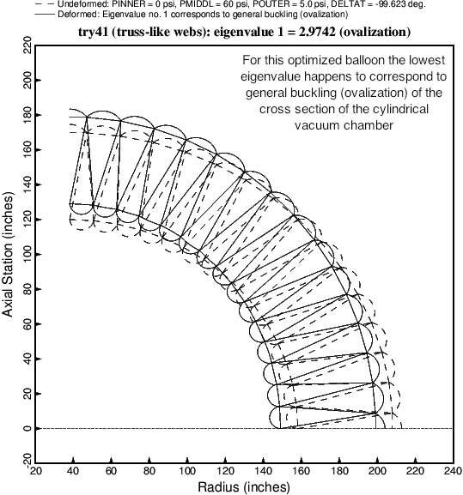
General buckling of the optimized balloon
Notes:
Fig. 11 The critical buckling mode and load factor (eigenvalue) corresponding to the optimized balloon cross section (Table 14). In this case the critical buckling mode, that is, the buckling mode associated with the lowest eigenvalue, happens to correspond to general buckling (ovalization) of the entire cross section of the cylindrical vacuum chamber. The buckling modes corresponding to some slightly higher eigenvalues are displayed in the next three figures.

Slide 30
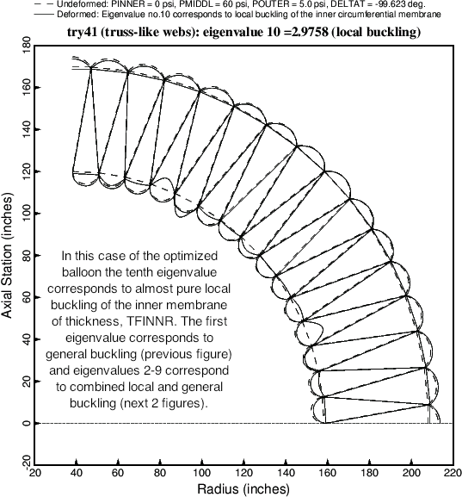
Local buckling of the optimized balloon
Notes:
Fig. 12 The tenth buckling mode and load factor (eigenvalue) corresponding to the optimized balloon cross section (Table 14). The tenth buckling mode is the first mode that is almost entirely local buckling. There is a tiny component of general buckling (ovalization) contained in this tenth buckling mode. The buckling modes corresponding to the second and third eigenvalues are displayed in the next two figures.

Slide 31
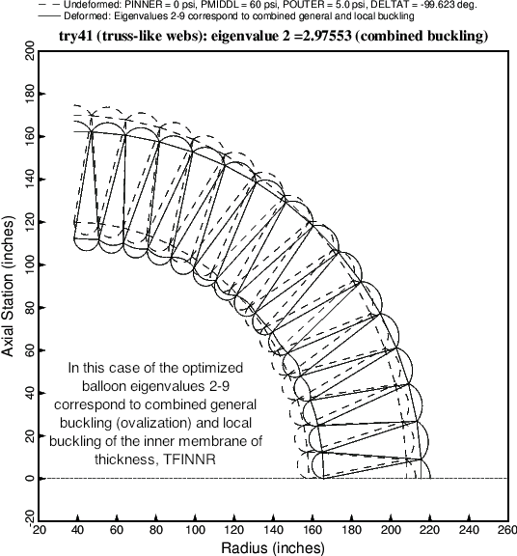
Combined general and local buckling of the optimized balloon
Notes:
Fig. 13 The second buckling mode and load factor (eigenvalue) corresponding to the optimized balloon cross section (Table 14). The second buckling mode is a combination of local and general buckling

Slide 32
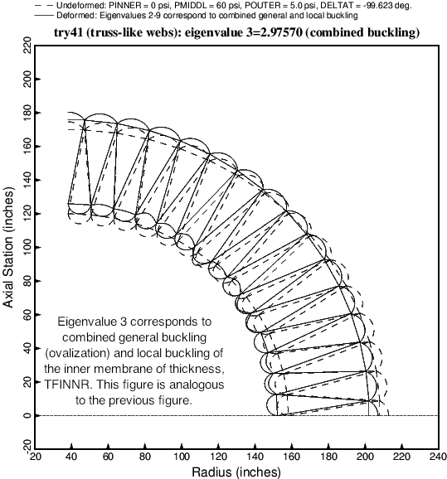
Combined general and local buckling of the optimized balloon
Notes:
Fig. 14 The third buckling mode and load factor (eigenvalue) corresponding to the optimized balloon cross section (Table 14). The third buckling mode, like the second displayed in the previous figure, is a combination of local and general buckling.

Slide 33
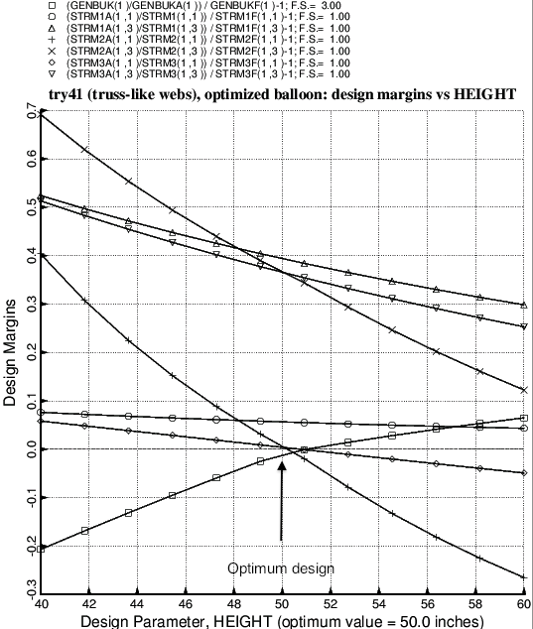
Design sensitivity of optimized balloon with respect to the decision variable, HEIGHT
Notes:
Fig. 15 Design sensitivity analysis of the optimized balloon (Table 14). This figure is produced following an analysis type, ITYPE = 3, in the *.OPT file (input for the GENOPT processor called MAINSETUP). In this case the design sensitivity with respect to the decision variable, HEIGHT, is determined. As is often the case for optimized designs, several design margins are critical (near zero) in the neighborhood of the optimum value of HEIGHT. (HEIGHT is the distance from the inner to outer walls of the balloon, as indicated in Fig. 1.)

Slide 34
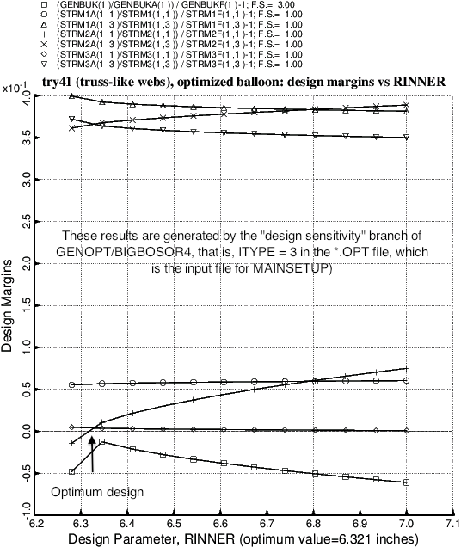
Design sensitivity of optimized balloon with respect to the decision variable, RINNER
Notes:
Fig. 16 Design sensitivity analysis of the optimized balloon (Table 14). This figure is produced following an analysis type, ITYPE = 3, in the *.OPT file (input for the GENOPT processor called MAINSETUP). In this case the design sensitivity with respect to the decision variable, RINNER, is determined. As is often the case for optimized designs, several design margins are critical (near zero) in the neighborhood of the optimum value of RINNER. (RINNER is the radius of curvature of the inner curved membrane in the balloon wall, as indicated in Fig. 1.)

Slide 35
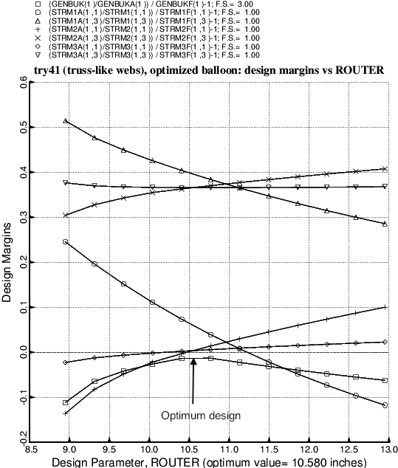
Design sensitivity of optimized balloon with respect to the decision variable, ROUTER
Notes:
Fig. 17 Design sensitivity analysis of the optimized balloon (Table 14). This figure is produced following an analysis type, ITYPE = 3, in the *.OPT file (input for the GENOPT processor called MAINSETUP). In this case the design sensitivity with respect to the decision variable, ROUTER, is determined. As is often the case for optimized designs, several design margins are critical (near zero) in the neighborhood of the optimum value of ROUTER. (ROUTER is the radius of curvature of the outer curved membrane in the balloon wall, as indicated in Fig. 1.)

Slide 36
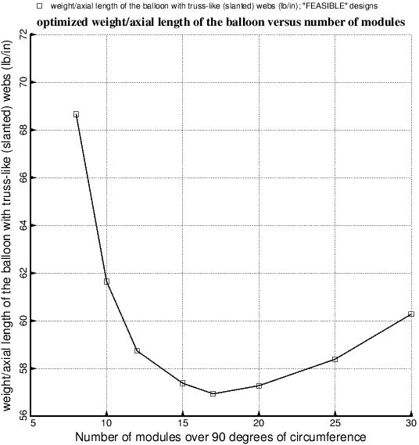
Objective versus number of modules for the balloon with the truss-like (slanted) webs
Notes:
Fig. 18 Optimized weight/axial length as a function of the number, NMODUL, of modules in the model. These results required many days to obtain because the SUPEROPT runs required, especially for the models with 20 or more modules, long execution times on the computer.

Slide 37
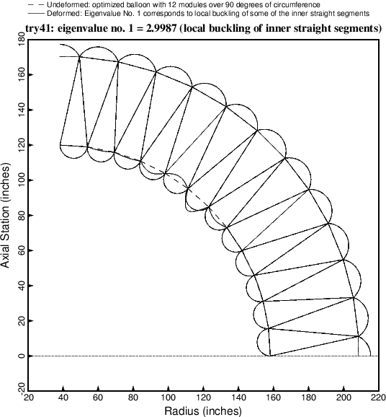
Local buckling of optimized balloon with 12 modules
Notes:
Fig. 19 Critical buckling mode of the optimized balloon with 12 modules over 90 degrees of circumference. In this particular case the critical (lowest) eigenvalue happens to be associated with a local buckling mode

Slide 38
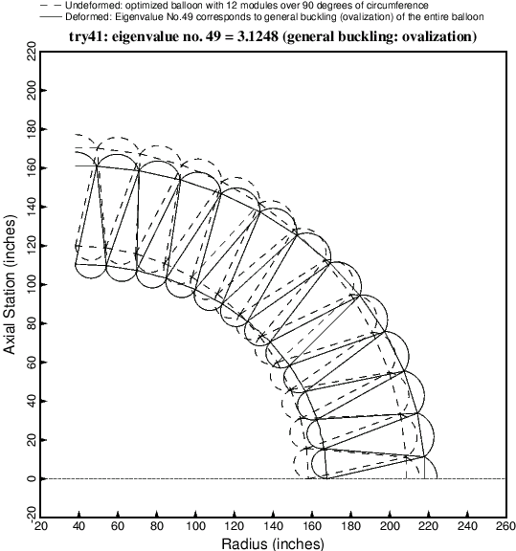
General buckling of optimized balloon with 12 modules
Notes:
Fig. 20 49th buckling mode of the optimized balloon with 12 modules over 90 degrees of circumference. In this particular case the 49th eigenvalue happens to be associated with the general buckling (ovalization) mode.

Slide 39
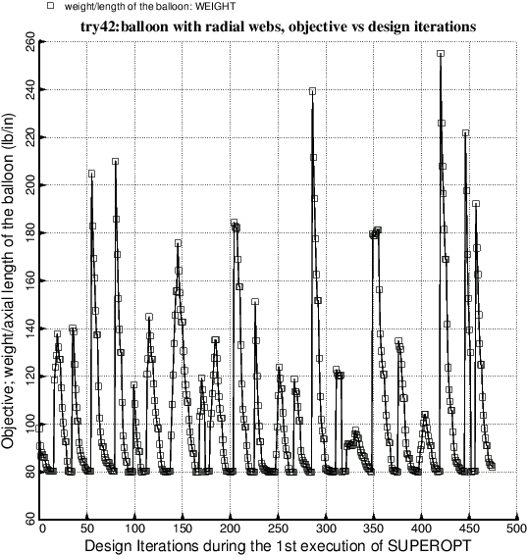
Balloon with radial webs: Evolution of the objective during the 1st execution of SUPEROPT
Notes:
Fig. 21 This figure is analogous to Fig. 6b. Optimization of the balloon with radial webs (Fig.1). There are 15 modules over 90 degrees of circumference. In this first execution of SUPEROPT the radii, RINNER and ROUTER, are not decision variables.

Slide 40
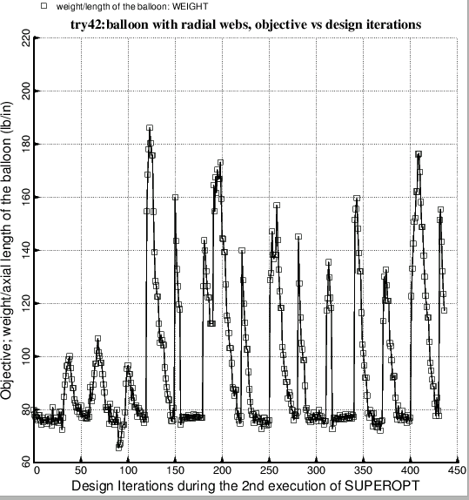
Balloon with radial webs: Evolution of the objective during the 2nd execution of SUPEROPT
Notes:
Fig. 22 This figure is analogous to Fig. 7. Optimization of the balloon with radial webs (Fig.1). In this second execution of SUPEROPT the radii, RINNER and ROUTER, are decision variables.

Slide 41
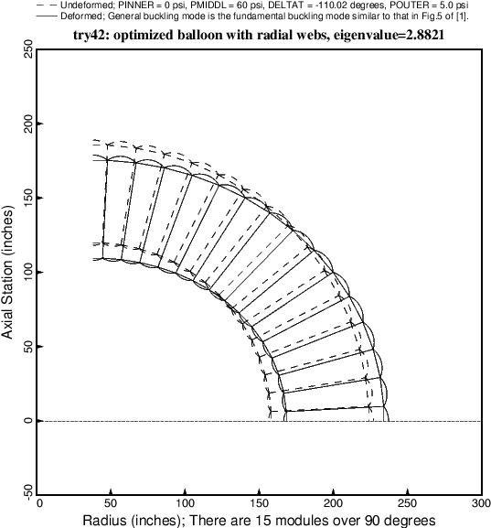
General buckling of the optimized balloon with radial webs
Notes:
Fig. 23 This figure is analogous to Fig. 11. The critical buckling mode corresponds to general buckling (ovalization).
This general buckling mode is similar to the general buckling mode shown in Fig. 5 of [1]. Notice, however, that there is less shearing deformation in the plane of the wall cross section at 45 degrees than exists in Fig. 5 of [1].

Slide 42
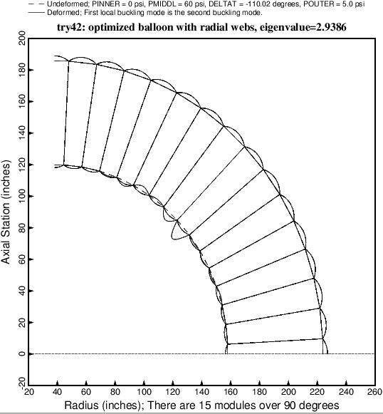
Local buckling of the optimized balloon with radial webs
Notes:
Fig. 24 This figure is analogous to Fig. 12. Local buckling of the optimized balloon with radial webs. At the optimum design the local buckling load factor, 2.9386, which corresponds to eigenvalue no. 2, is fairly close to the general buckling load factor, 2.8821, shown on the previous slide.

Slide 43
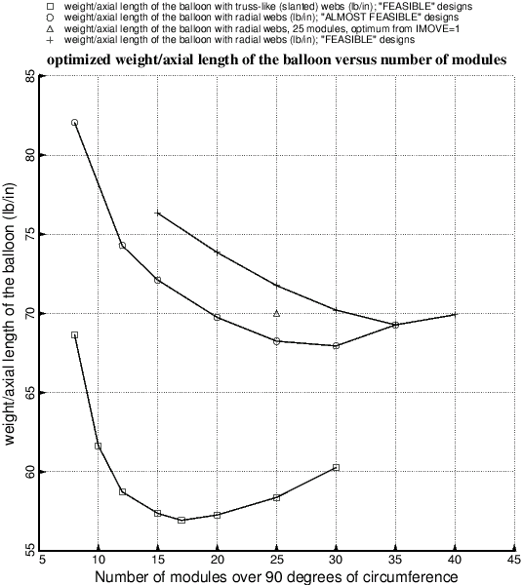
Weight versus number of modules over 90 degrees
Notes:
Fig. 25 Optimized weight of the balloons with the truss-like (slanted) webs (trace no. 1) and optimized weight of the balloons with the radial webs (traces 2,3,4) as functions of the number of modules over 90 degrees of circumference of the cylindrical vacuum chamber. The best design of the balloon with the truss-like webs weighs significantly less than the best design of the balloon with the radial webs. The data points in this figure required about 3 weeks of calendar time to produce because of long computer runs, especially for the designs with more than 15 modules. An “ALMOST FEASIBLE” design is a design in which the most critical margin is greater than –0.05 and less than –0.01. A “FEASIBLE” design is a design in which the most critical margin is greater than –0.01.

Slide 44
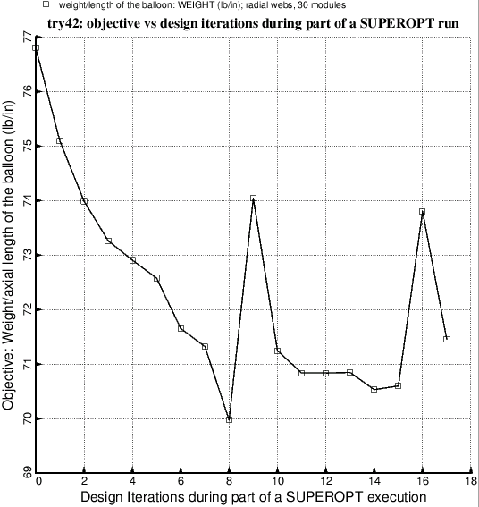
Objective for a partial SUPEROPT run
Notes:
Fig. 26 Optimization of the balloon with radial webs and 30 modules. This execution of SUPEROPT aborted at Design Iteration No. 18 because of failure of convergence of the nonlinear pre-buckling equilibrium solution during Load Step No. 1, for which the applied loads are PINNER, PMIDDL, and DELTAT [the “fixed” (non-eigenvalue) loads]. At the time this run was made SUBROUTINE BEHX1 included only two attempts to solve the nonlinear problem (Try no. 1 and Try no. 2 identified in Item 9 listed in Section 8). Introduction of a third attempt, Try no. 3, solved the problem.

Slide 45
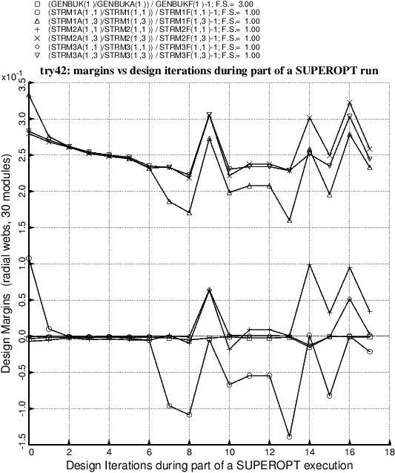
Design margins for a partial SUPEROPT run
Notes:
Fig. 27 Optimization of the balloon with radial webs and 30 modules. This execution of SUPEROPT aborted at Design Iteration No. 18 because of failure of convergence of the nonlinear pre-buckling equilibrium solution during Load Step No. 1, for which the applied loads are PINNER, PMIDDL, and DELTAT [the “fixed” (non-eigenvalue) loads]. At the time this run was made SUBROUTINE BEHX1 included only two attempts to solve the nonlinear problem (Try no. 1 and Try no. 2 identified in Item 9 listed in Section 8). Introduction of a third attempt, Try no. 3, solved the problem.

Slide 46
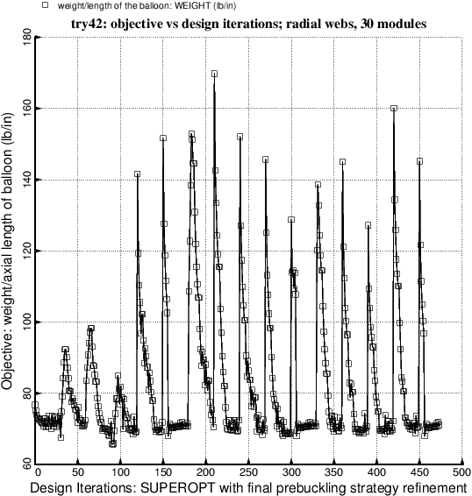
Objective after a successful execution of SUPEROPT
Notes:
Fig. 27b Optimization of the balloon with radial webs and 30 modules after the introduction into SUBROUTINE BEHX1 of Try no. 3 in the strategy to solve the nonlinear pre-buckling equilibrium equations. (See Item 9 listed in Section 8.) This execution of SUPEROPT ran to a normal termination at about 470 design iterations. Compare with Fig. 26.

Slide 47
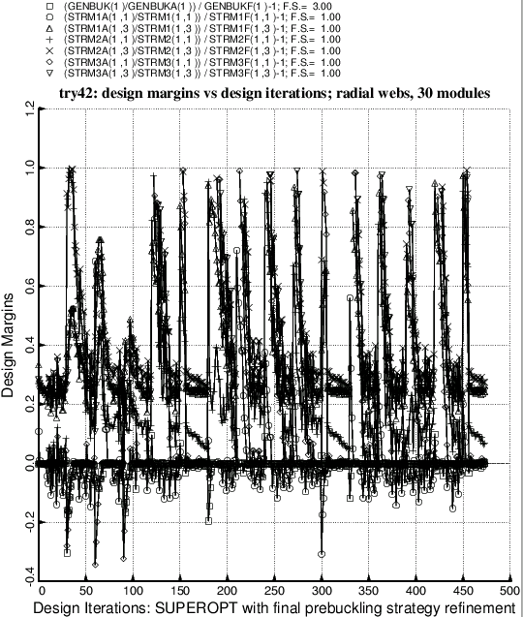
Margins after a successful execution of SUPEROPT
Notes:
Fig. 27c Optimization of the balloon with radial webs and 30 modules after the introduction into SUBROUTINE BEHX1 of Try no. 3 in the strategy to solve the nonlinear pre-buckling equilibrium equations. (See Item 9 listed in Section 8.) This execution of SUPEROPT ran to a normal termination at about 470 design iterations. Compare with Fig. 27. Ordinarily one does not bother with plots of design margins subsequent to a completed execution of SUPEROPT because the plot, containing results from about 470 design iterations, is so messy.

Slide 48
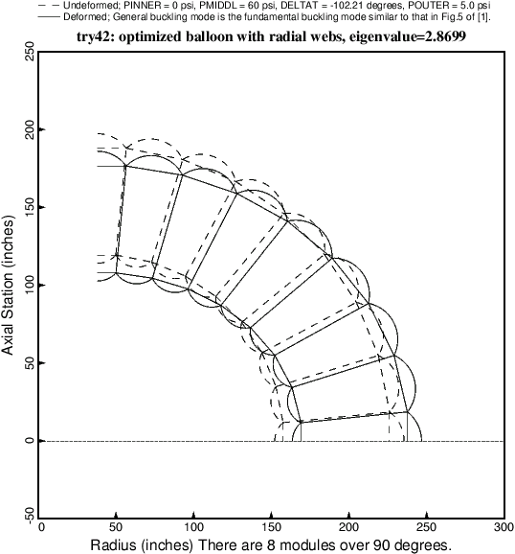
General buckling of balloon with 8 modules
Notes:
Fig. 28 General buckling of the optimized balloon with radial webs and 8 modules.

Slide 49
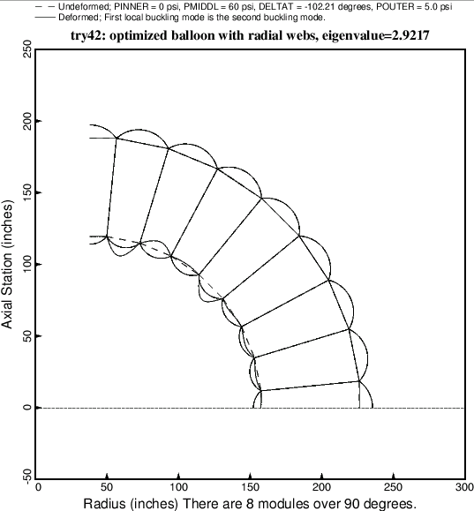
Local buckling of balloon with 8 modules
Notes:
Fig. 29 Local buckling of the optimized balloon with radial webs and 8 modules. This local buckling mode corresponds to eigenvalue no. 2.

Slide 50
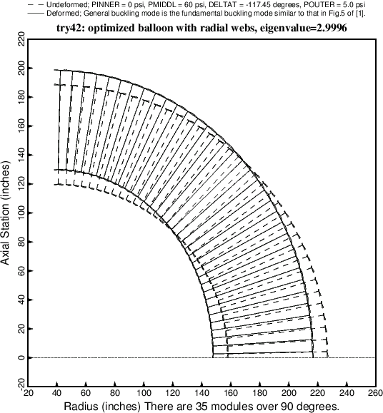
General buckling of balloon with 35 modules
Notes:
Fig. 30 General buckling of the optimized balloon with radial webs and 35 modules.

Slide 51
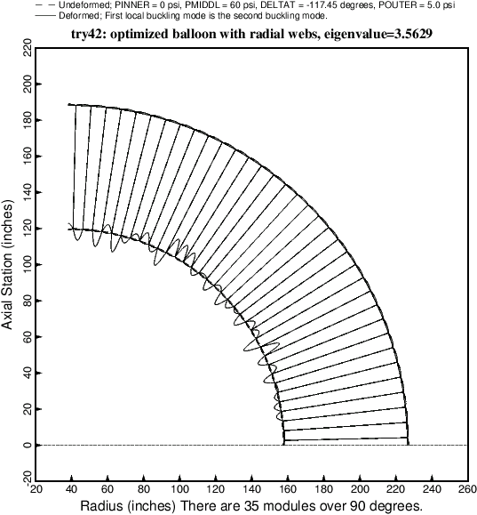
Local buckling of balloon with 35 modules
Notes:
Fig. 31 Local buckling of the optimized balloon with radial webs and 35 modules. This local buckling mode corresponds to eigenvalue no. 2. Eigenvalues 3, 4, 5,,… are all very close to Eigenvalue No. 2 and all of them correspond to buckling of the inner straight segmented membrane of thickness, TFINNR.

Slide 52
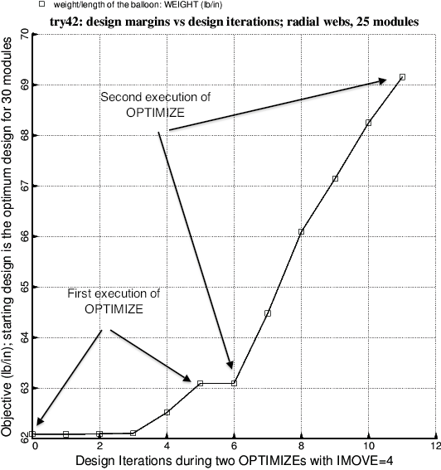
Objective for two executions of OPTIMIZE with IMOVE=4
Notes:
Fig. 32 Optimization of the balloon with the radial webs and 25 modules. The “move limit” index, IMOVE, is set equal to 4, which restricts the change of each decision variable to 2 per cent of its current value during a single optimization cycle. The data points in this plot were obtained via two successive executions of OPTIMIZE by the end user, rather than by a partial execution of SUPEROPT. IMOVE = 4 is more restrictive than IMOVE = 1. IMOVE = 4 is used to close in on a local optimum design in the neighborhood of a previously found optimum obtained with the use of IMOVE = 1. The plots of objective versus design iterations are usually smoother with the use of IMOVE = 4 than with IMOVE = 1, but a less extensive region of design space is explored when IMOVE = 4.

Slide 53
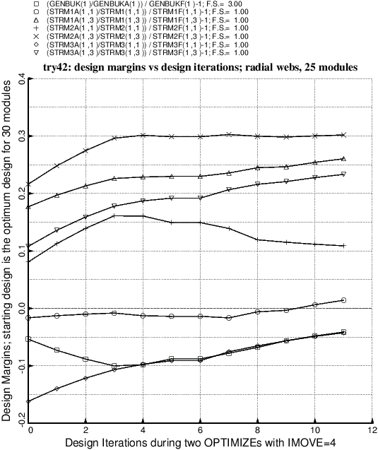
Margins for two executions of OPTIMIZE with IMOVE=4
Notes:
Fig. 33 Optimization of the balloon with the radial webs and 25 modules. The “move limit” index, IMOVE, is set equal to 4, which restricts the change of each decision variable to 2 per cent of its current value during a single optimization cycle. The data points in this plot were obtained via two successive executions of OPTIMIZE by the end user (see the previous figure), rather than by a partial execution of SUPEROPT. IMOVE = 4 is more restrictive than IMOVE = 1. IMOVE = 4 is used to close in on a local optimum design in the neighborhood of a previously found optimum obtained with the use of IMOVE = 1. The plots of design margins versus design iterations are usually smoother with the use of IMOVE = 4 than with IMOVE = 1, but a less extensive region of design space is explored when IMOVE = 4. Compare this figure, generated with IMOVE = 4, with Fig. 27, which was generated from an incomplete SUPEROPT run in which IMOVE=1.

Slide 54
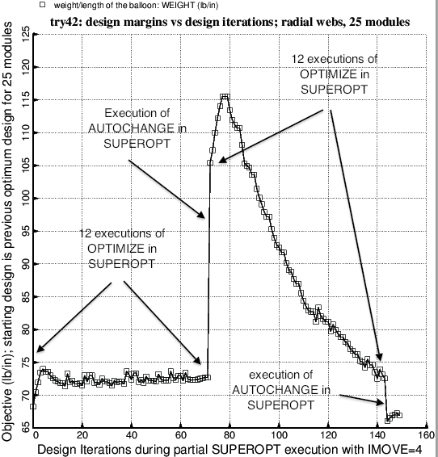
Objective for 2 sets of 12 executions of OPTIMIZE/AUTOCHANGE with IMOVE=4
Notes:
Fig. 34 Results of a SUPEROPT run with IMOVE = 4 and with the end user’s specification that there be 12 executions of OPTIMIZE for each execution of AUTOCHANGE in the “SUPEROPT” context. Note that with IMOVE = 4 many executions of OPTIMIZE are required for re-convergence to a local optimum design (see design iterations 73 – 143). Figure 27b, which was generated with IMOVE = 1, demonstrates that fewer executions of OPTIMIZE are require per execution of AUTOCHANGE for re-convergence to local optimum designs. This characteristic enables much more design space to be explored during an execution of SUPEROPT when IMOVE = 1 than is the case when IMOVE = 4. Ordinarily, SUPEROPT should be executed only with IMOVE = 1.

Slide 55

Margins for 2 sets of 12 executions of OPTIMIZE/AUTOCHANGE with IMOVE=4
Notes:
Fig. 35 Results of a SUPEROPT run with IMOVE = 4 and with the end user’s specification that there be 12 executions of OPTIMIZE for each execution of AUTOCHANGE in the “SUPEROPT” context. (See the previous figure.) Note that with IMOVE = 4 many executions of OPTIMIZE are required for re-convergence to a local optimum design (see design iterations 73 – 143). Figure 27b, which was generated with IMOVE = 1, demonstrates that fewer executions of OPTIMIZE are require per execution of AUTOCHANGE for re-convergence to local optimum designs. This characteristic enables much more design space to be explored during an execution of SUPEROPT when IMOVE = 1 than is the case when IMOVE = 4. Ordinarily, SUPEROPT should be executed only with IMOVE = 1.

Slide 56
Conclusions (1 of 2)
1. The best optimum design of the balloon with truss-like (slanted) webs weights considerably less than the best optimum design of the balloon with the radial webs.
2. For the balloon with truss-like (slanted) webs the lowest buckling eigenvalue sometimes corresponds to local buckling and sometimes corresponds to general buckling (ovalization). In the cases explored here the lowest local buckling mode involves one or more of the straight segments that form the inner membrane of thickness, TFINNR. No other parts of the wall of the balloon buckle locally at a lower local buckling load factor.
3. For the optimized balloons with radial webs the lowest buckling eigenvalue corresponds to general buckling (ovalization) in every case explored in this project.
4. In spite of the fact that the segments of the balloon wall behave like membranes that have no bending stiffness rather than like shells that have a finite bending stiffness, BIGBOSOR4, which is designed to handle segmented shell structures with finite bending stiffness, seems to be capable of solving both the nonlinear pre-buckling phase and the linear bifurcation buckling phase of the analysis.
Notes:
SECTION 13 CONCLUSIONS
1. The best optimum design of the balloon with truss-like (slanted) webs weights considerably less than the best optimum design of the balloon with the radial webs.
2. For the balloon with truss-like (slanted) webs the lowest buckling eigenvalue sometimes corresponds to local buckling and sometimes corresponds to general buckling (ovalization). In the cases explored here the lowest local buckling mode involves one or more of the straight segments that form the inner membrane of thickness, TFINNR. No other parts of the wall of the balloon buckle locally at a lower local buckling load factor.
3. For the balloon with radial webs the lowest buckling eigenvalue corresponds to general buckling (ovalization) in every case explored in this project.
4. In spite of the fact that the segments of the balloon wall behave like membranes that have no bending stiffness rather than like shells that have a finite bending stiffness, BIGBOSOR4, which is designed to handle segmented shell structures with finite bending stiffness, seems to be capable of solving both the nonlinear pre-buckling phase and the linear bifurcation buckling phase of the analysis.
5. A strategy is established by means of which failure of convergence of the nonlinear pre-buckling analysis is minimized.
6. Stress components in the various segments of a module are computed from membrane theory, that is, the stress component is equal to the appropriate stress resultant divided by the thickness of the segment.
7. The capability to analyze and design double-walled cylindrical vacuum chambers (balloons) is established within the GENOPT/BIGBOSOR4 framework. Enough information is provided in this paper and in [2] and in [6 – 11] so that researchers can use GENOPT/BIGBOSOR4 to analyze and design other shell structures of a similar nature.

Slide 57
Conclusions (2 of 2)
5. A strategy is established by means of which failure of convergence of the nonlinear pre-buckling analysis is minimized.
6. Stress components in the various segments of a module are computed from membrane theory, that is, the stress component is equal to the appropriate stress resultant divided by the thickness of the segment. This is an unconservative strategy. An actual balloon fabricated in a configuration that corresponds to an optimized design developed here by GENOPT/BIGBOSOR4 should have reinforced seams at the junctions between segments
7. The capability to analyze and design double-walled cylindrical vacuum chambers (balloons) is established within the GENOPT/BIGBOSOR4 framework. Enough information is provided in this paper and in [2,6] and in [9 – 11] so that researchers can use GENOPT/BIGBOSOR4 to analyze and design other shell structures of a similar nature.

