Slide 1
MINIMUM WEIGHT DESIGN OF IMPERFECT ISOGRID-STIFFENED ELLIPSOIDAL SHELLS UNDER UNIFORM EXTERNAL PRESSURE
  David Bushnell, Fellow, AIAA, Retired
Notes:
See the files, …/genopt/case/torisph/sdm50.report.*/*
MINIMUM WEIGHT DESIGN OF IMPERFECT ISOGRID-STIFFENED ELLIPSOIDAL SHELLS UNDER UNIFORM EXTERNAL PRESSURE
David Bushnell,* Fellow, AIAA, Retired
775 Northampton Drive, Palo Alto, CA 94303
email: bush@sonic.net
ABSTRACT
GENOPT, a program that can be used to optimize anything, and BIGBOSOR4, a program for stress, buckling, and vibration analysis of segmented, branched, stiffened, elastic shells of revolution, are combined to create a capability to optimize a specific kind of shell of revolution: an internally isogrid-stiffened elastic ellipsoidal shell subjected to uniform external pressure. Optimum designs are obtained for isogrid-stiffened and unstiffened axisymmetrically imperfect and perfect titanium 2:1 ellipsoidal shells. The decision variables are the shell skin thickness at several user-selected meridional stations, the height of the isogrid stiffeners at the same meridional stations, the spacing of the isogrid stiffeners (constant over the entire shell), and the thickness of the isogrid stiffeners (also constant over the entire shell). The design constraints involve maximum stress in the isogrid stiffeners, maximum stress in the shell skin, local buckling of an isogrid stiffener, local buckling of the shell skin between isogrid stiffeners, general nonlinear bifurcation buckling, nonlinear axisymmetric collapse, and maximum normal displacement at the apex of the dome. Optimum designs first obtained by GENOPT are subsequently evaluated by the use of STAGS, a general-purpose finite element computer program. It is found that in order to obtain reasonably good agreement between predictions from BIGBOSOR4 and STAGS it is necessary to model the ellipsoidal shell as an "equivalent" ellipsoidal shell consisting of a spherical cap and a series of toroidal shell segments that closely approximates the true ellipsoidal meridional shape. The equivalent ellipsoidal shell is optimized with up to four axisymmetric buckling modal imperfections, each imperfection shape assumed to be present by itself. Computations include both plus and minus axisymmetric buckling modal imperfection shapes. At each design cycle and for the plus and minus version of each axisymmetric imperfection shape the following analyses are conducted: 1. linear general axisymmetric bifurcation buckling analysis (in order to obtain the axisymmetric linear buckling modal imperfection shapes), 2. nonlinear axisymmetric stress analysis at the design pressure, 3. nonlinear axisymmetric collapse analysis, and 4. nonlinear non-axisymmetric bifurcation buckling analysis. For each axisymmetric imperfection shape the design margins include an axisymmetric collapse margin, a general buckling margin, a margin involving the normal displacement of the apex of the shell, and local skin and stiffener stress margins and local skin and stiffener buckling margins within two approximately equal meridional regions of the equivalent ellipsoidal shell. There is generally good agreement of the predictions from STAGS and from BIGBOSOR4 for the elastic behavior of the perfect stiffened and unstiffened optimized shells and for the behavior of the imperfect stiffened optimized shells with axisymmetric buckling modal imperfections. Optimization with the use of only axisymmetric buckling modal imperfections has a disadvantage in the case of the unstiffened imperfect shell under certain conditions: the optimum design of the axisymmetrically imperfect unstiffened shell evolves in such a way that, according to predictions from STAGS, a non-axisymmetric buckling modal imperfection with the same amplitude as an axisymmetric buckling modal imperfection causes collapse of the shell at an external pressure far below the design pressure. This disadvantage is easily overcome if, during optimization cycles, the unstiffened shell wall in the neighborhood of the apex is forced to remain thick enough so that local axisymmetric buckling does not occur primarily at and near the apex but instead occurs primarily in the remainder of the shell. An extensive study of some of the previously optimized elastic shells is conducted with STAGS including elastic-plastic material properties. The effect on collapse pressure of initial imperfections in the form of off-center residual dents produced by load cycles applied before application of the uniform external pressure is determined and compared with the effect on collapse pressure of imperfections in the form of non-axisymmetric and axisymmetric linear buckling modes, especially the non-axisymmetric linear buckling modal imperfection with n=1 circumferential wave, which seems to be the most harmful imperfection shape for optimized externally pressurized ellipsoidal shells. For the optimized unstiffened shell it is found that a residual dent that locally resembles the n=1 linear buckling modal imperfection shape is just as harmful as the entire n=1 linear buckling modal imperfection shape.

Slide 2
Summary of this presentation
1. What is GENOPT? (slides 3 - 19)
2. Statement of the problem to be solved (slides 20-23)
3. Sample input to and output from GENTEXT
a. text created by GENOPT (slides 24 - 35)
b. FORTRAN code by GENOPT (slides 36-50)
4. Seven analyses in subroutine STRUCT (slides 51-59)
5. Design margins of the optimum design (slides 60-64)
6. Optimum designs from GENOPT (slides 65 and 66)
7. Evaluation of optimum design of isogrid-stiffened equivalent ellipsoidal shell by BIGBOSOR4 & STAGS (slides 67-87)
8. Evaluation of optimum designs of unstiffened equivalent ellipsoidal shells by BIGBOSOR4 & STAGS (slides 88 -94)

Slide 3
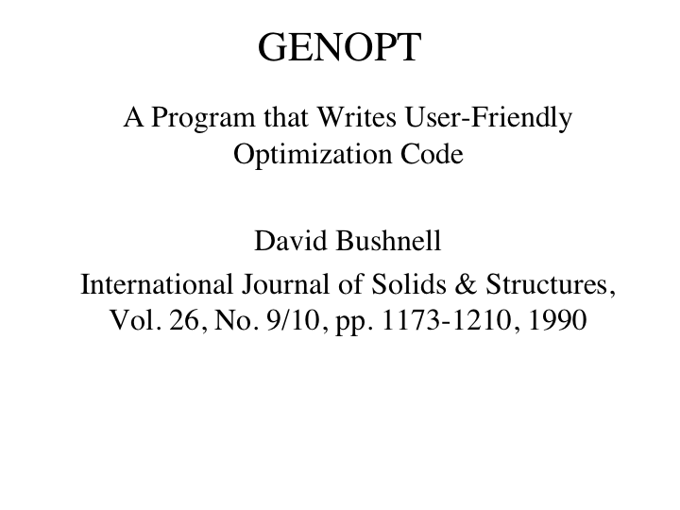
Original GENOPT reference

Slide 4

Abstract of a previous GENOPT talk

Slide 5
List of references about GENOPT
[2] Bushnell, D., "GENOPT--A program that writes user-friendly optimization code", International Journal of Solids and Structures, Vol. 26, No. 9/10, pp. 1173-1210, 1990. The same paper is contained in a bound volume of papers from the International Journal of Solids and Structures published in memory of Professor Charles D. Babcock, formerly with the California Institute of Technology.
[3] Bushnell, D., "SPHERE - Program for minimum weight design of isogrid-stiffened spherical shells under uniform external pressure", LMSC Report F372046, Lockheed Missiles and Space Company, January 15, 1990
[4] Jacoby, J. and Steele, C. R., "Fast optimization of shell structures", Third Air Force/NASA Symposium on Recent Advances in Multidisciplinary Analysis and Optimization, San Francisco, September 24-26, 1990
[6] Bushnell, W. D., "Using GENOPT to minimize the noise of a two-stage RF amplifier", LMSC Report F318422, Lockheed Missiles and Space Company, March 14, 1991
[7] Bushnell, D., "Automated optimum design of shells of revolution with application to ring-stiffened cylindrical shells with wavy walls", AIAA paper 2000-1663, 41st AIAA Structures Meeting, Atlanta, GA, April 2000. Also see Lockheed Martin report, same title, LMMS P525674, November 1999

Slide 6
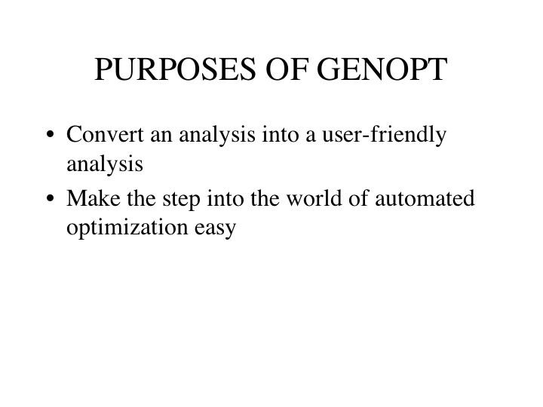

Slide 7
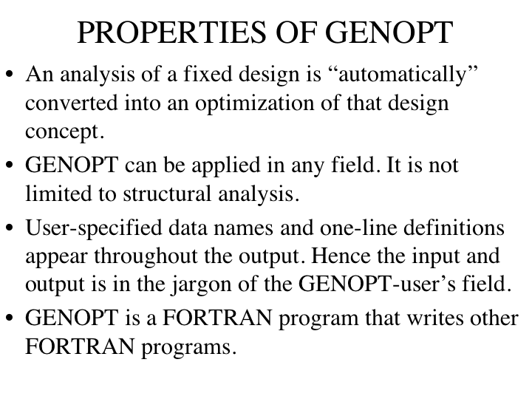

Slide 8
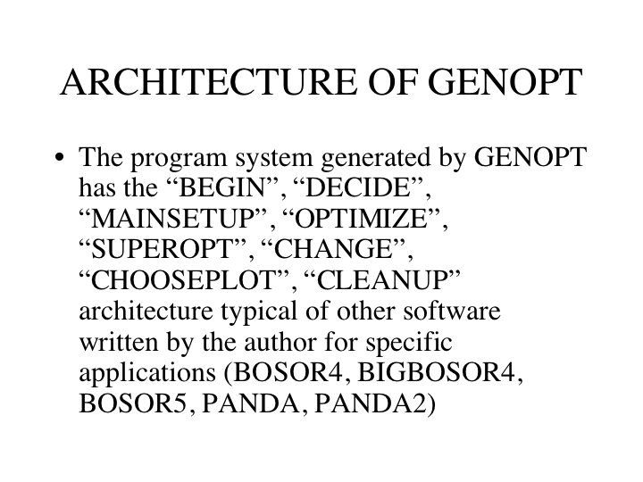

Slide 9
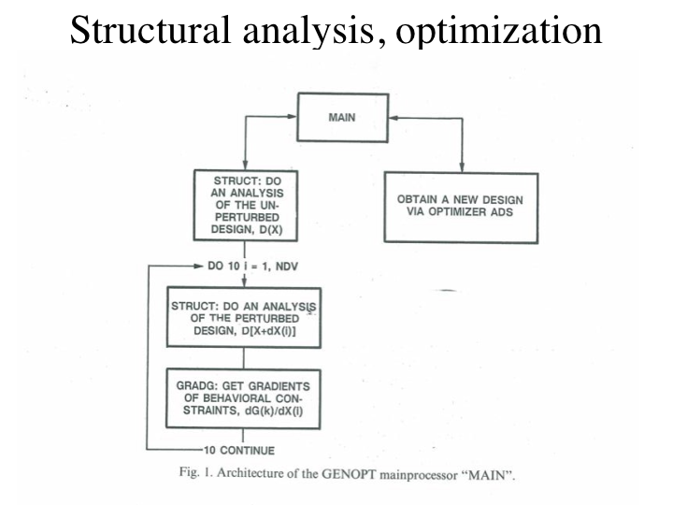

Slide 10
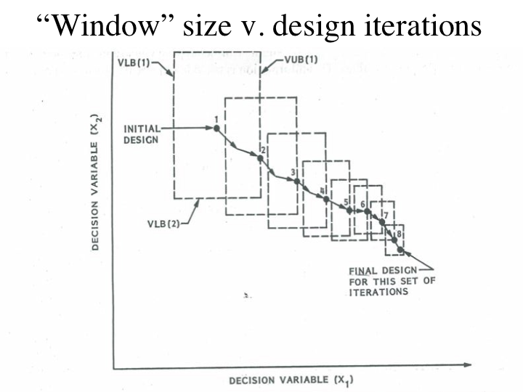
Notes:
The move limits of the decision variables are automatically assigned initial values for the first iteration in an optimization loop initiated by the single command, “OPTIMIZE”, then decreased with each successive iteration for that particular command, “OPTIMIZE”. When the command, “OPTIMIZE” is given a second time the move limits are re-expanded to the same initial values they had at the beginning of the first “OPTIMIZE”, and the same process is repeated, starting from the design obtained at the end of the first “OPTIMIZE”. The author of GENOPT has found that it is best to specify 5 design iterations per “OPTIMIZE”, then execute “OPTIMIZE” many times in succession. Better yet, give the command “SUPEROPT”. “SUPEROPT” is a script that launches a long “batch” computer run that consists of repeated cycles of the following executions:
OPTIMIZE, OPTIMIZE, OPTIMIZE, OPTIMIZE, OPTIMIZE, OPTIMIZE, AUTOCHANGE
OPTIMIZE, OPTIMIZE, OPTIMIZE, OPTIMIZE, OPTIMIZE, OPTIMIZE, AUTOCHANGE
OPTIMIZE, OPTIMIZE, OPTIMIZE, OPTIMIZE, OPTIMIZE, OPTIMIZE, AUTOCHANGE
etc.
until the total number of design iterations since the beginning of the SUPEROPT operation reaches about 470. AUTOCHANGE generates a new non-neighboring “starting” design in a random manner consistent with decision variable bounds, equality constraints, and inequality constraints. The number of “OPTIMIZEs” per AUTOCHANGE is selected by the user. GENOPT keeps track of the best design obtained during SUPEROPT and establishes that best design (not necessarily the last design, of course) as the current design, to be used as a starting design in any further SUPEROPTs or OPTIMIZEs or as the final optimum design if the user decides that there will be no more optimization. See Fig. 3 for a plot of the objective vs design iterations during a single long SUPEROPT run. For successive SUPEROPT runs you must give the following sequence of commands:
SUPEROPT, CHOOSEPLOT, DIPLOT,
SUPEROPT, CHOOSEPLOT, DIPLOT,
SUPEROPT, CHOOSEPLOT, DIPLOT,
etc.

Slide 11
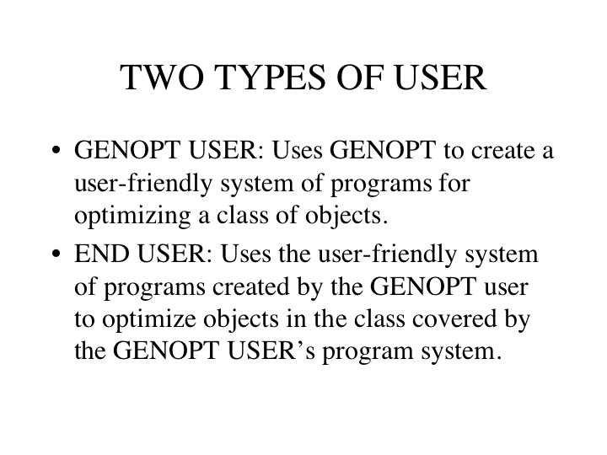

Slide 12
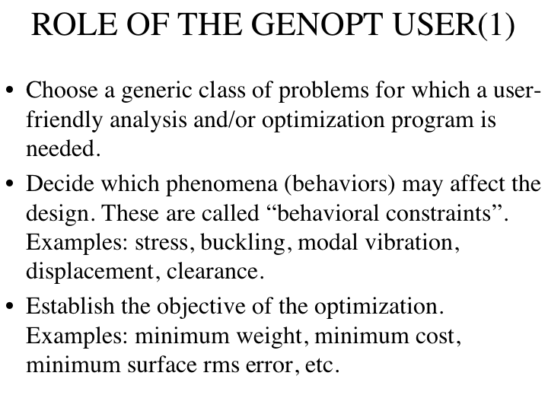

Slide 13
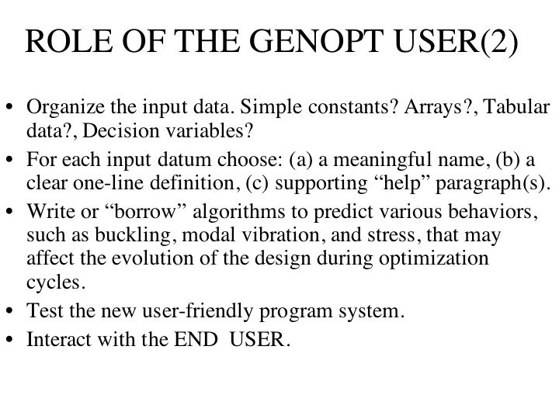

Slide 14
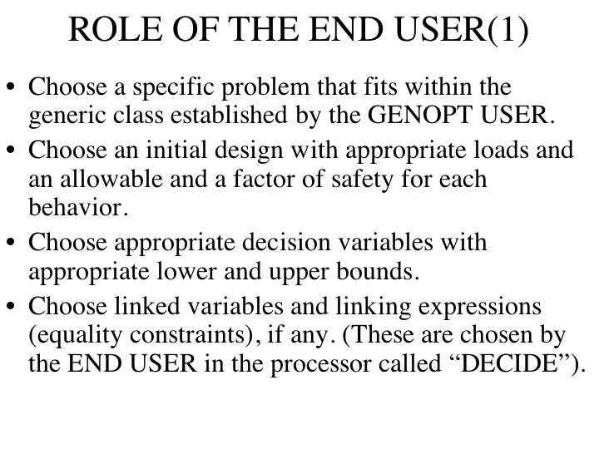

Slide 15
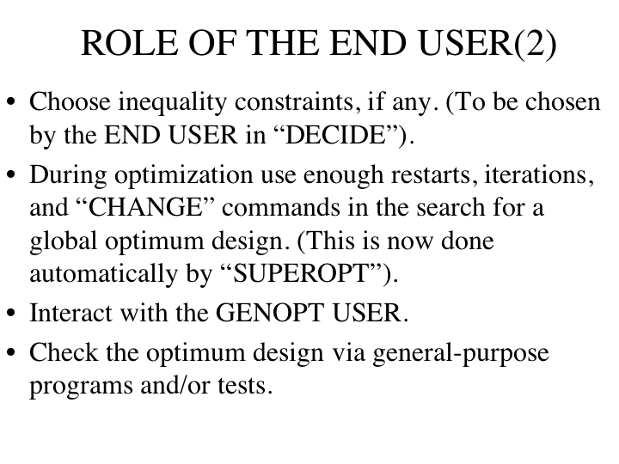

Slide 16
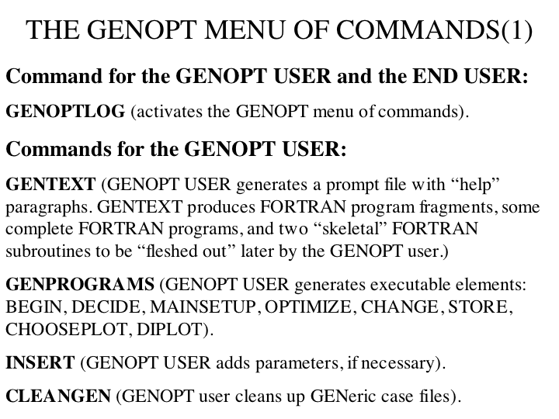

Slide 17
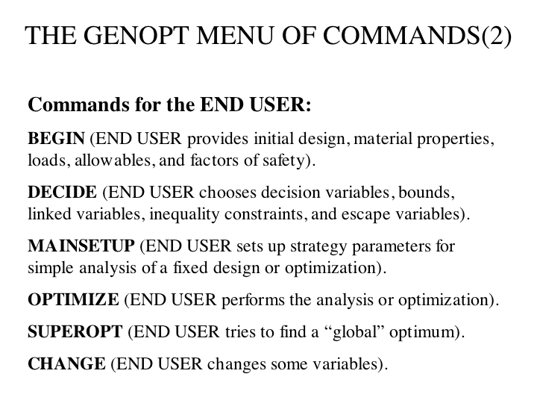

Slide 18
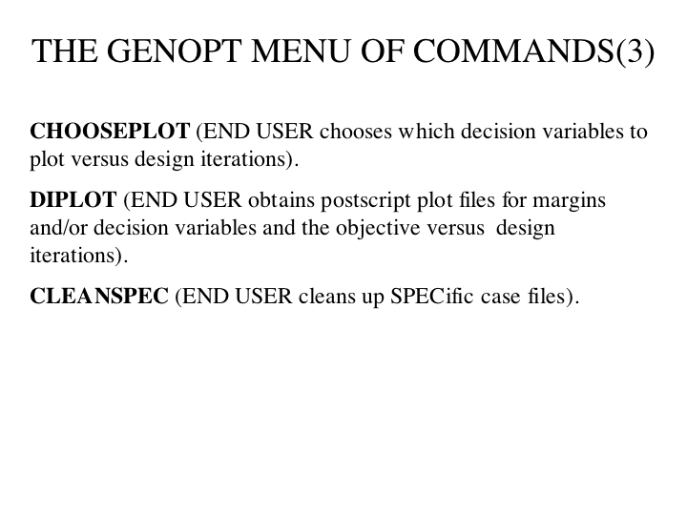

Slide 19
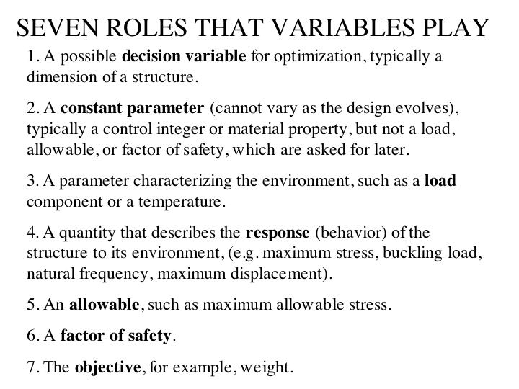

Slide 20
Statement of the problem to be solved
Use GENOPT in connection with BIGBOSOR4 to find the minimum-weight design of internally isogrid-stiffened and unstiffened, externally pressurized elastic metallic imperfect ellipsoidal shells. The shells are axisymmetric and have shell wall thickness and isogrid stiffener height that vary only along the meridian. The shells have axisymmetric buckling modal imperfections. The decision variables of the optimization problem are shell skin thickness and isogrid stiffener height at user-selected callout points along the meridian and isogrid stiffener spacing and rectangular isogrid member thickness. Evaluate the optimized designs with STAGS.
Notes:
MINIMUM WEIGHT DESIGN OF IMPERFECT ISOGRID-STIFFENED ELLIPSOIDAL SHELLS UNDER UNIFORM EXTERNAL PRESSURE
David Bushnell, Fellow, AIAA, Retired
775 Northampton Drive, Palo Alto, CA 94303
email:bush@sonic.net
ABSTRACT OF THE PAPER AND REPORT
GENOPT, a program that can be used to optimize anything, and BIGBOSOR4, a program for stress, buckling, and vibration analysis of segmented, branched, stiffened, elastic shells of revolution, are combined to create a capability to optimize a specific kind of shell of revolution: an internally isogrid-stiffened elastic ellipsoidal shell subjected to uniform external pressure. Optimum designs are obtained for isogrid-stiffened and unstiffened axisymmetrically imperfect and perfect titanium 2:1 ellipsoidal shells. The decision variables are the shell skin thickness at several user-selected meridional stations, the height of the isogrid stiffeners at the same meridional stations, the spacing of the isogrid stiffeners (constant over the entire shell), and the thickness of the isogrid stiffeners (also constant over the entire shell). The design constraints involve maximum stress in the isogrid stiffeners, maximum stress in the shell skin, local buckling of an isogrid stiffener, local buckling of the shell skin between isogrid stiffeners, general nonlinear bifurcation buckling, nonlinear axisymmetric collapse, and maximum normal displacement at the apex of the dome. Optimum designs first obtained by GENOPT are subsequently evaluated by the use of STAGS, a general-purpose finite element computer program. It is found that in order to obtain reasonably good agreement between predictions from BIGBOSOR4 and STAGS it is necessary to model the ellipsoidal shell as an "equivalent" ellipsoidal shell consisting of a spherical cap and a series of toroidal shell segments that closely approximates the true ellipsoidal meridional shape. The equivalent ellipsoidal shell is optimized with up to four axisymmetric buckling modal imperfections, each imperfection shape assumed to be present by itself. Computations include both plus and minus axisymmetric buckling modal imperfection shapes. At each design cycle and for the plus and minus version of each axisymmetric imperfection shape the following analyses are conducted: 1. linear general axisymmetric bifurcation buckling analysis (in order to obtain the axisymmetric linear buckling modal imperfection shapes), 2. nonlinear axisymmetric stress analysis at the design pressure, 3. nonlinear axisymmetric collapse analysis, and 4. nonlinear non-axisymmetric bifurcation buckling analysis. For each axisymmetric imperfection shape the design margins include an axisymmetric collapse margin, a general buckling margin, a margin involving the normal displacement of the apex of the shell, and local skin and stiffener stress margins and local skin and stiffener buckling margins within two approximately equal meridional regions of the equivalent ellipsoidal shell. There is generally good agreement of the predictions from STAGS and from BIGBOSOR4 for the elastic behavior of the perfect stiffened and unstiffened optimized shells and for the behavior of the imperfect stiffened optimized shells with axisymmetric buckling modal imperfections. Optimization with the use of only axisymmetric buckling modal imperfections has a disadvantage in the case of the unstiffened imperfect shell under certain conditions: the optimum design of the axisymmetrically imperfect unstiffened shell evolves in such a way that, according to predictions from STAGS, a non-axisymmetric buckling modal imperfection with the same amplitude as an axisymmetric buckling modal imperfection causes collapse of the shell at an external pressure far below the design pressure. This disadvantage is easily overcome if, during optimization cycles, the unstiffened shell wall in the neighborhood of the apex is forced to remain thick enough so that local axisymmetric buckling does not occur primarily at and near the apex but instead occurs primarily in the remainder of the shell. An extensive study of some of the previously optimized elastic shells is conducted with STAGS including elastic-plastic material properties. The effect on collapse pressure of initial imperfections in the form of off-center residual dents produced by load cycles applied before application of the uniform external pressure is determined and compared with the effect on collapse pressure of imperfections in the form of non-axisymmetric and axisymmetric linear buckling modes, especially the non-axisymmetric linear buckling modal imperfection with n=1 circumferential wave, which seems to be the most harmful imperfection shape for optimized externally pressurized ellipsoidal shells. For the optimized unstiffened shell it is found that a residual dent that locally resembles the n=1 linear buckling modal imperfection shape is just as harmful as the entire n=1 linear buckling modal imperfection shape.

Slide 21
What is BIGBOSOR4?
BOSOR4 [10-12] (or its latest version, BIGBOSOR4 [7]) is a program for the static and dynamic analysis of any shell of revolution. Input files valid for BOSOR4 are also valid for BIGBOSOR4. BIGBOSOR4 is essentially the same as BOSOR4 except that BIGBOSOR4 will solve bigger problems (more shell segments, more degrees of freedom). The shell can be loaded axisymmetrically or non-axisymmetrically by line loads, distributed loads, temperature, and acceleration. BOSOR4 (BIGBOSOR4) computes static equilibrium states, axisymmetric and nonaxisymmetric bifurcation buckling, nonlinear axisymmetric collapse, modal vibration, and linear response to lateral and axial base excitation. In BOSOR4 (BIGBOSOR4) a complex, branched, stiffened elastic shell of revolution is modeled as an assemblage of shell segments or branches, each with its own geometry (flat, conical, cylindrical, spherical, toroidal), loading, wall construction, and linear elastic material properties. Laminated composite wall construction can be handled.
Notes:
See Section 4.1.

Slide 22
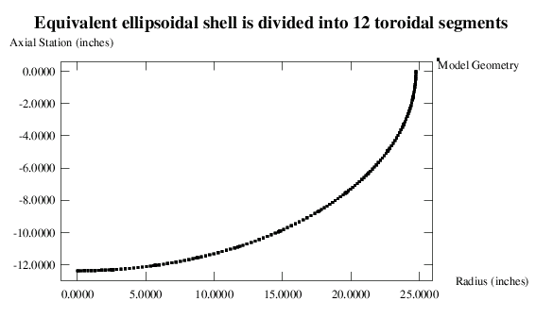
Externally pressurized ellipsoidal shell
Shell wall thickness varies along the meridian. BIGBOSOR4 is used to do the various analyses. ADS is used to do the optimization. Decision variables are shell skin thicknesses and isogrid stiffener heights at several meridional “callout” points.
Notes:
The text within the frame of the plot is not complete. The spacing of the isogrid, SPACNG, and the thickness of an isogrid member, THSTIF, are also decision variables. For the isogrid-stiffened shell there are 28 decision variables:
Thickness of the shell wall at 13 meridional callout points: THKSKN(i), i = 1,13;
Height of the isogrid at the same 13 meridional callout points: HIGHST(i), i = 1,13;
Spacing of the isogrid, constant over the entire shell: SPACNG;
Thickness of an isogrid member, constant over the entire shell: THSTIF.
The callout points are provided by the “end” user and are listed in Table 28.

Slide 23
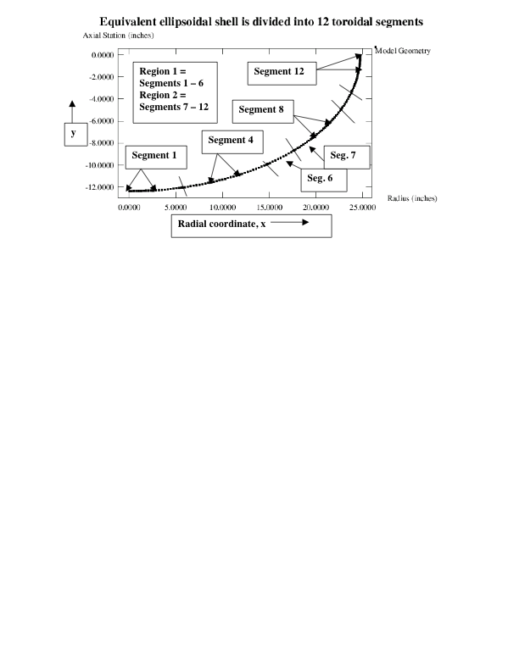
Equivalent ellipsoidal shell of 12 toroidal segments
Notes:
Fig. 2 This is a BIGBOSOR4 model of the EQUIVALENT ellipsoidal shell. The equivalent ellipsoidal shell consists of 12 shell segments: one spherical cap (Segment 1) and 11 toroidal shell segments with end points that fall on the profile of the TRUE ellipsoidal shell and that match as closely as possible the local profile of the TRUE ellipsoidal shell. Finite element “lockup” is avoided because the meridional radius of curvature within each segment of the perfect EQUIVALENT ellipsoidal shell is constant. The (r,z) = (x,y) = (x₃,y₃) = (radius, axial station) location of the center of meridional curvature of each toroidal shell segment is computed as set forth in Table 29. Maximum local shell skin extreme fiber effective stress and minimum local skin buckling load factor and maximum local meridional isogrid member extreme fiber stress and minimum local meridional isogrid member buckling load factor are computed for each of the two regions: Region 1 and Region 2. The corresponding design margins are listed in Tables 31 and 32, for example. The 360-degree STAGS finite element model shown in Fig. a1 of the appendix is analogous to this BIGBOSOR4 model. The 360-degree STAGS finite element model has fewer nodal points along the meridian than the BIGBOSOR4 model shown here.

Slide 24
Interactive GENTEXT session (1)
1 $ Type of prompt: 0="help" paragraph, 1=one-line prompt
npoint $ Name of a variable in the users program (defined below)
2 $ Role of the variable in the users program
1 $ type of variable: 1 =integer, 2 =floating point
n $ Is the variable npoint an array?
number of x-coordinates $ one-line definition of npoint
y $ Do you want to include a "help" paragraph?
The ellipse is simulated by a number of shell segments (try 10)
y $ Any more lines in the "help" paragraph?
each of which has constant meridional curvature (toroidal).
y $ Any more lines in the "help" paragraph?
npoint is the number of x-coordinates corresponding to the
y $ Any more lines in the "help" paragraph?
ends of the toroidal segments that make up the equivalent
y $ Any more lines in the "help" paragraph?
ellipse. You might try to simulate the ellipse by using 10
y $ Any more lines in the "help" paragraph?
toroidal segments. Then the value of npoint would be 11
y $ Any more lines in the "help" paragraph?
npoint includes the apex of the ellipse (x = 0) and the equator
y $ Any more lines in the "help" paragraph?
of the ellipse (x = a, in which a = semimajor axis length).
n $ Any more lines in the "help" paragraph?
Notes:
From Table 3: Portion of the equivellipse.DAT file relating to some Role 1 and Role 2 variables established and defined and explained in “help” paragraphs by the GENOPT user during the first part of interactive “GENTEXT” session. (“equivellipse” is the generic name selected by the GENOPT user for the class of objects to be optimized). After the GENOPT user has completed the “GENTEXT” interactive session the completed equivellipse.DAT file becomes a file that is called equivellipse.INP. See the appendix for a list of equivellipse.INP (Table a1). In the following list in this table the GENOPT user’s responses to the prompting phrases issued by GENOPT are in boldface. The part of the glossary of variables that corresponds to the GENOPT user’s input listed here appears in Table 4, and the part of the prompting file automatically generated by GENOPT during this partial GENTEXT interactive session appears in Table 5. See Table 1 for definitions of “Role of the variable in the users program”.

Slide 25
Interactive GENTEXT session (2)
y $ Any more variables for role types 1 or 2 ? $10
1 $ Type of prompt: 0="help" paragraph, 1=one-line prompt
xinput $ Name of a variable in the users program (defined below)
2 $ Role of the variable in the users program
2 $ type of variable: 1 =integer, 2 =floating point
y $ Is the variable xinput an array?
y $ Do you want to establish new dimensions for xinput ?
1 $ Number of dimensions in the array, xinput
vector element number for xinput
21 $ Max. allowable number of rows NROWS in the array, xinput
x-coordinates for ends of segments $ one-line definition of xinput
y $ Do you want to include a "help" paragraph?
Please make sure to include x = 0 and x = a (equator) when
y $ Any more lines in the "help" paragraph?
you provide values for xinput.
n $ Any more lines in the "help" paragraph?
Notes:
This is from Table 3.

Slide 26
Interactive GENTEXT session (3)
y $ Any more variables for role types 1 or 2 ? $20
1 $ Type of prompt: 0="help" paragraph, 1=one-line prompt
ainput $ Name of a variable in the users program (defined below)
2 $ Role of the variable in the users program
2 $ type of variable: 1 =integer, 2 =floating point
n $ Is the variable ainput an array?
length of semi-major axis $ one-line definition of ainput
y $ Do you want to include a "help" paragraph?
ainput is the maximum "x=dimension" of the ellipse.
y $ Any more lines in the "help" paragraph?
The equation for the ellipse is x^2/a^2 + y^2/b^2 = 1.0
n $ Any more lines in the "help" paragraph?
y $ Any more variables for role types 1 or 2 ? $25
1 $ Type of prompt: 0="help" paragraph, 1=one-line prompt
binput $ Name of a variable in the users program (defined below)
2 $ Role of the variable in the users program
2 $ type of variable: 1 =integer, 2 =floating point
n $ Is the variable binput an array?
length of semi-minor axis of ellipse $ one-line definition of binput
y $ Do you want to include a "help" paragraph?
binput is the y-dimension of the ellipse, the equation for which
y $ Any more lines in the "help" paragraph?
is x^2/a^2 + y^2/b^2 = 1.0.
n $ Any more lines in the "help" paragraph?
Notes:
This is from Table 3.

Slide 27
Interactive GENTEXT session (4)
y $ Any more variables for role types 1 or 2 ? $30
1 $ Type of prompt: 0="help" paragraph, 1=one-line prompt
nodes $ Name of a variable in the users program (defined below)
2 $ Role of the variable in the users program
1 $ type of variable: 1 =integer, 2 =floating point
n $ Is the variable nodes an array?
number of nodal points per segment $ one-line definition of nodes
y $ Do you want to include a "help" paragraph?
If you have about 10 segments, use a number less than 31.
y $ Any more lines in the "help" paragraph?
Use an odd number, greater than or equal to 11
n $ Any more lines in the "help" paragraph?
y $ Any more variables for role types 1 or 2 ? $35
1 $ Type of prompt: 0="help" paragraph, 1=one-line prompt
xlimit $ Name of a variable in the users program (defined below)
2 $ Role of the variable in the users program
2 $ type of variable: 1 =integer, 2 =floating point
n $ Is the variable xlimit an array?
max.x-coordinate for x-coordinate callouts$one-line definition of xlimit
y $ Do you want to include a "help" paragraph?
xlimit has two functions:
y $ Any more lines in the "help" paragraph?
1. a delimiter for the definition of callouts:
Notes:
This is from Table 3.

Slide 28
Interactive GENTEXT session (5)
y $ Any more lines in the "help" paragraph?
for x < xlimit callouts are x-coordinates.
y $ Any more lines in the "help" paragraph?
for x > xlimit callouts are y-coordinates.
y $ Any more lines in the "help" paragraph?
Set xlimit equal to about a/2, where a = length of the
y $ Any more lines in the "help" paragraph?
semi-major axis of the ellipse.
y $ Any more lines in the "help" paragraph?
2. a delimiter for the boundary between Region 1
y $ Any more lines in the "help" paragraph?
and Region 2. Design margins for maximum stress and
y $ Any more lines in the "help" paragraph?
minimum buckling load in the shell skin and in the
y $ Any more lines in the "help" paragraph?
isogrid stiffeners can be computed in two regions,
y $ Any more lines in the "help" paragraph?
Region 1: 0 < x < xlimit, and
y $ Any more lines in the "help" paragraph?
Region 2: xlimit < x < semi-major axis.
n $ Any more lines in the "help" paragraph?
Notes:
This is from Table 3.

Slide 29
Glossary of variables produced automatically by GENOPT corresponding to the GENTEXT interactive input on the previous 5 slides
=========================================================================
ARRAY NUMBER OF PROMPT
? (ROWS,COLS) ROLE NUMBER NAME DEFINITION OF VARIABLE
(equivellipse.PRO)
=========================================================================
n ( 0, 0) 2 10 npoint = number of x-coordinates
n ( 0, 0) 2 15 Ixinpu = vector element number for
xinput in xinput(Ixinpu)
y ( 21, 0) 2 20 xinput = x-coordinates for ends of
segments
n ( 0, 0) 2 25 ainput = length of semi-major axis
n ( 0, 0) 2 30 binput = length of semi-minor axis of
ellipse
n ( 0, 0) 2 35 nodes = number of nodal points per
segment
n ( 0, 0) 2 40 xlimit = max. x-coordinate for
x-coordinate callouts
Notes:
From Table 4: Glossary of variables used in the generic case called "equivellipse" corresponding to the GENOPT user's interactive input to "GENTEXT" listed in Table 3. The complete glossary generated by GENOPT upon the GENOPT user's completion of the entire "GENTEXT" interactive session is listed in Table 2 and forms part of the file, equivellipse.DEF, which is listed in Table a2 in the appendix. (“equivellipse” is the generic name selected by the GENOPT user for the class of objects to be optimized). See Table 1 for definitions of “ROLE”, and see the next table for more on “PROMPT NUMBER” (the partial equivellipse.PRO file).

Slide 30
Glossary of variables produced automatically by GENOPT corresponding to additional GENTEXT interactive input from Table 3
=========================================================================
ARRAY NUMBER OF PROMPT
? (ROWS,COLS) ROLE NUMBER NAME DEFINITION OF VARIABLE
(equivellipse.PRO)
=========================================================================
y ( 21, 0) 1 45 THKSKN = skin thickness at xinput
y ( 21, 0) 1 50 HIGHST = height of isogrid members at
xinput
n ( 0, 0) 1 55 SPACNG = spacing of the isogrid
members
n ( 0, 0) 1 60 THSTIF = thickness of an isogrid
stiffening member
n ( 0, 0) 2 65 THKCYL = thickness of the cylindrical
shell
n ( 0, 0) 2 70 RADCYL = radius of the cylindrical
shell
=========================================================================
Notes:
This is from Table 4.

Slide 31
Prompting file produced automatically by GENOPT corresponding to the GENTEXT interactive input on the previous slides (1)
10.1 number of x-coordinates: npoint
10.2
The ellipse is simulated by a number of shell segments (try 10)
each of which has constant meridional curvature (toroidal).
npoint is the number of x-coordinates corresponding to the
ends of the toroidal segments that make up the equivalent
ellipse. You might try to simulate the ellipse by using 10
toroidal segments. Then the value of npoint would be 11
npoint includes the apex of the ellipse (x = 0) and the equator
of the ellipse (x = a, in which a = semimajor axis length).
15.1 Number Ixinpu of rows in the array xinput: Ixinpu
20.1 x-coordinates for ends of segments: xinput
20.2
Please make sure to include x = 0 and x = a (equator) when
you provide values for xinput.
Notes:
From Table 5: Portion of the prompting file, equivellipse.PRO, generated automatically by "GENTEXT" that corresponds to the GENOPT user's interactive input listed in Table 3. The complete equivellipse.PRO file generated after the GENOPT user completes the "GENTEXT" interactive session is listed in Table 6. The variable names, the one-line definitions of the variables, and the “help” paragraphs, created by the GENOPT user during the GENTEXT interactive session, will be seen by the “end” user. If the GENOPT user has done his or her job well, the program system created by GENOPT (BEGIN, DECIDE, MAINSETUP, OPTIMIZE, CHOOSEPLOT, etc.), that is, the program system for the generic case, “equivellipse”, to be used later by the “end” user for specific cases (such as a specific case called “eqellipse”), will be user-friendly. The numbering (e.g. 10.1) of the one-line prompting phrases and of the “help” paragraphs (e.g. 10.2) is created automatically by GENOPT. The “end” user always sees the one-line prompting phrases (e.g. “number of x-coordinates: npoint”) during his or her interactive input session in “BEGIN”. The “end” user will see the corresponding “help” paragraph if he or she types “h”(elp) in response to the one-line prompting phrase. If there is no “help” paragraph “BEGIN” will respond to the user’s “h” with the phrase, “There is no help.”

Slide 32
Prompting file produced automatically by GENOPT corresponding to the GENTEXT interactive input on the previous slides (2)
25.1 length of semi-major axis: ainput
25.2
ainput is the maximum "x=dimension" of the ellipse.
The equation for the ellipse is x^2/a^2 + y^2/b^2 = 1.0
30.1 length of semi-minor axis of ellipse: binput
30.2
binput is the y-dimension of the ellipse, the equation for which
is x^2/a^2 + y^2/b^2 = 1.0.
35.1 number of nodal points per segment: nodes
35.2
If you have about 10 segments, use a number less than 31.
Use an odd number, greater than or equal to 11
40.1 max. x-coordinate for x-coordinate callouts: xlimit
40.2
Notes:
This is from Table 5.

Slide 33
Prompting file produced automatically by GENOPT corresponding to the GENTEXT interactive input on the previous slides (3)
40.2
xlimit has two functions:
1. a delimiter for the definition of callouts:
for x < xlimit callouts are x-coordinates.
for x > xlimit callouts are y-coordinates.
Set xlimit equal to about a/2, where a = length of the
semi-major axis of the ellipse.
2. a delimiter for the boundary between Region 1
and Region 2, Design margins for maximum stress and
minimum buckling load in the shell skin and in the
isogrid stiffeners can be computed in two regions,
Region 1: 0 < x < xlimit, and
Region 2: xlimit < x < semi-major axis.
Notes:
This is from Table 5.

Slide 34
Prompting file produced automatically by GENOPT corresponding to the GENTEXT interactive input in Table 3 (4)
45.1 skin thickness at xinput: THKSKN
45.2
xinput is the vector of x-coordinate callouts for
thickness of the shell skin and height of the
isogrid stiffeners.
50.1 height of isogrid members at xinput: HIGHST
50.2
xinput is the vector of x-coordinate callouts for
thickness of the shell skin and height of the
isogrid stiffeners.
55.1 spacing of the isogrid members: SPACNG
55.2
SPACNG = altitude of the equilateral triangle between adjacent
isogrid members, measured to middle surfaces of isogrid members.
SPACNG = (length of side of triangle)*sqrt(3)/2.
SPACNG is constant over the entire shell.
Notes:
This is from Table 5.

Slide 35
Prompting file produced automatically by GENOPT corresponding to the GENTEXT interactive input in Table 3 (5)
55.1 spacing of the isogrid members: SPACNG
55.2
SPACNG = altitude of the equilateral triangle between adjacent
isogrid members, measured to middle surfaces of isogrid members.
SPACNG = (length of side of triangle)*sqrt(3)/2.
SPACNG is constant over the entire shell.
60.1 thickness of an isogrid stiffening member: THSTIF
60.2
THSTIF is constant over the entire shell.
65.1 thickness of the cylindrical shell: THKCYL
70.1 radius of the cylindrical shell: RADCYL
====================================================================
The “end” user’s response to prompts in BEGIN (Part of the *.BEG file):
3.000000 $ spacing of the isogrid members: SPACNG
0.1000000 $ thickness of an isogrid stiffening member: THSTIF
0.2000000 $ thickness of the cylindrical shell: THKCYL
24.75000 $ radius of the cylindrical shell: RADCYL
Notes:
From Table 5 and part of Table 35. Table 35= Input file, *.BEG, for the "BEGIN" processor for an imperfect isogrid-stiffened equivalent ellipsoidal shell in which there are two load sets:
Load set 1=+mode 1 and +mode 2 axisymmetric imperfections, one at a time
Load set 2=-mode 1 and -mode 2 axisymmetric imperfections, one at a time
In the directory, /home/progs/genopt/case/torisph, the input file name is "eqellipse.stiffened.BEG". Copy this file to /home/progs/genoptcase and change the case name from "eqellipse.stiffened" to "eqellipse” before processing. The shell has an initial imperfection with amplitude, Wimp= (+ or -) 0.2 inch. (/home/progs = the directory where the GENOPT system is stored on the writer’s computer).

Slide 36
GENOPT automatically generates labeled common blocks
===============================================================
COMMON/FV01/xinput(21),Ixinpu
REAL xinput
COMMON/FV02/ainput,binput,xlimit,SPACNG,THSTIF,THKCYL,RADCYL
REAL ainput,binput,xlimit,SPACNG,THSTIF,THKCYL,RADCYL
COMMON/FV05/THKSKN(21),HIGHST(21)
REAL THKSKN,HIGHST
COMMON/IV01/npoint,nodes,IMODE
INTEGER npoint,nodes,IMODE
================================================================
Notes:
Table 9 Portion of the equivellipse.COM file generated automatically by "GENTEXT" that corresponds to the GENOPT user's input listed in Table 3. GENOPT inserts these labeled
common blocks and variable declarations in all the FORTRAN libraries listed in Table 7. This list forms part of the complete equivellipse.COM file that appears in Table a6 of the
appendix of [26]. The complete equivellipse.COM file exists when the GENOPT user has completed the interactive "GENTEXT" session.

Slide 37
GENOPT automatically generates FORTRAN code(1)
========================================================================
CALL DATUM(IFILE, 10,1,2,npoint , REALL,CHARAC,IOUT,0,0,0,IPROMP)
WRITE(6,'(A)')' '
WRITE(6,'(A)')
1 ' DEFINITION OF THE ROW INDEX OF THE ARRAY, xinput = '
WRITE(6,'(A)')
1 ' vector element number for xinput'
WRITE(6,'(A)')' '
IF (IPROMP.GT.1) THEN
WRITE(IFILE8,'(A)')' '
WRITE(IFILE8,'(A)')
1 ' DEFINITION OF THE ROW INDEX OF THE ARRAY, xinput = '
WRITE(IFILE8,'(A)')
1 ' vector element number for xinput'
WRITE(IFILE8,'(A)')' '
ENDIF
REWIND IFILE
CALL DATUM(IFILE, 15,1,1,Ixinpu ,REALL,CHARAC,IOUT,0,0,0,IPROMP)
=========================================================================
Corresponding to the two “CALL DATUM” statements, we have, from the *.BEG file:
13 $ number of x-coordinates: npoint
13 $ Number Ixinpu of rows in the array xinput: Ixinpu
Notes:
From Table 13: Portion of the equivellipse.NEW file generated automatically by "GENTEXT" that corresponds to the GENOPT user's input listed in Table 3. This list forms part of the
complete equivellipse.NEW file that appears in Table a10 of the appendix of [26]. The complete equivellipse.NEW file exists when the GENOPT user has completed the interactive "GENTEXT” session. This FORTRAN fragment forms part the FORTRAN library,
begin.new, in particular, part of SUBROUTINE INPUT.

Slide 38
GENOPT automatically generates FORTRAN code(2)
IF (Ixinpu .EQ.0) GO TO 16
DO 15 I=1,Ixinpu
REWIND IFILE
CALL DATUM(IFILE, 20,1,2,
1 INT,xinput(I),CHARAC, IOUT,I,0,1,IPROMP)
CALL GETVAR(I,0, xinput(I), IPAR, PAR,WORDP)
15 CONTINUE
16 CONTINUE
CALL DATUM(IFILE, 25,1,2, INT,ainput ,CHARAC,IOUT,0,0,0,IPROMP)
CALL GETVAR(0,0, ainput , IPAR, PAR,WORDP)
CALL DATUM(IFILE, 30,1,2, INT,binput ,CHARAC,IOUT,0,0,0,IPROMP)
CALL GETVAR(0,0, binput , IPAR, PAR,WORDP)
CALL DATUM(IFILE, 35,1,2,nodes , REALL,CHARAC,IOUT,0,0,0,IPROMP)
CALL DATUM(IFILE, 40,1,2, INT,xlimit ,CHARAC,IOUT,0,0,0,IPROMP)
CALL GETVAR(0,0, xlimit , IPAR, PAR,WORDP)
WRITE(6,'(A)')' '
WRITE(6,'(A)')
1 ' DEFINITION OF THE ROW INDEX OF THE ARRAY, THKSKN = '
WRITE(6,'(A)')
1 ' vector element number for xinput'
WRITE(6,'(A)')' '
Notes:
This is from Table 13. The next slide shows entries in the *.BEG file corresponding to the “end” user’s responses to the promptings during the interactive session in “BEGIN” that are generated by the calls to SUBROUTINE DATUM in the FORTRAN fragment reproduced in this slide.

Slide 39
Corresponding to the “CALL DATUM” statements on the previous slide, we have from *.BEG:
0.000000 $ x-coordinates for ends of segments: xinput( 1)
2.554500 $ x-coordinates for ends of segments: xinput( 2)
5.666450 $ x-coordinates for ends of segments: xinput( 3)
8.753630 $ x-coordinates for ends of segments: xinput( 4)
11.79770 $ x-coordinates for ends of segments: xinput( 5)
14.77232 $ x-coordinates for ends of segments: xinput( 6)
17.63477 $ x-coordinates for ends of segments: xinput( 7)
19.63631 $ x-coordinates for ends of segments: xinput( 8)
21.26065 $ x-coordinates for ends of segments: xinput( 9)
22.70426 $ x-coordinates for ends of segments: xinput(10)
23.86535 $ x-coordinates for ends of segments: xinput(11)
24.54286 $ x-coordinates for ends of segments: xinput(12)
24.75000 $ x-coordinates for ends of segments: xinput(13)
24.75000 $ length of semi-major axis: ainput
12.37500 $ length of semi-minor axis of ellipse: binput
11 $ number of nodal points per segment: nodes
17.63477 $ max. x-coordinate for x-coordinate callouts: xlimit
Notes:
From Table 35: Input data for the “BEGIN” processor corresponding to the “CALL DATUM” statements in the FORTRAN fragment listed in the previous slide.

Slide 40
More GENTEXT interactive input, this time for a Role 4,5,6 “bundle”
=========================================================================
y $ Any more variables for role type 4 ? $160
1 $ Type of prompt: 0="help" paragraph, 1=one-line prompt
STFBK1 $ Name of a variable in the users program (defined below)
4 $ Role of the variable in the users program
n $ Do you want to reset the number of columns in STFBK1 ?
buckling load factor, isogrid member,mode 1 $one-line definition,STFBK1
n $ Do you want to include a "help" paragraph?
1 $ Type of prompt: 0="help" paragraph, 1=one-line prompt
STFBK1A $ Name of a variable in the users program (defined below)
5 $ Role of the variable in the users program
allowable for isogrid stiffener buckling (Use 1.)$ definition, STFBK1A
n $ Do you want to include a "help" paragraph?
1 $ Type of prompt: 0="help" paragraph, 1=one-line prompt
STFBK1F $ Name of a variable in the users program (defined below)
6 $ Role of the variable in the users program
factor of safety for isogrid stiffener buckling$ definition, STFBK1F
n $ Do you want to include a "help" paragraph?
2 $ Indicator (1 or 2 or 3) for type of constraint
Notes:
From Table 15: Portion of the equivellipse.DAT file relating to some Role 4, 5, and 6 variables established and defined by the GENOPT user during the interactive GENTEXT session. When the GENOPT user has completed the GENTEXT interactive session the complete equivellipse.DAT file becomes a file that is called equivellipse.INP. See Table a1 of the appendix for a list of equivellipse.INP. The GENOPT user’s responses to the prompts are in bold face in this table. The variable names, the one-line definitions of the variables, and the “help” paragraphs, created by the GENOPT user during the GENTEXT interactive session, will be seen by the “end” user. If the GENOPT user has done his or her job well, the program system created by GENOPT (BEGIN, DECIDE, MAINSETUP, OPTIMIZE, CHOOSEPLOT, etc.), that is, the program system for the generic case, “equivellipse”, to be used later by the “end” user for specific cases (such as a specific case called “eqellipse”), will be user-friendly. Note that the GENOPT user (the writer) did not create any “help” paragraphs here. It would have been better if he had. See Section 3.7 for suggestions for typical “help” paragraphs that the GENOPT user should probably have included. The next slide explains the last prompt in this slide: “Indicator (1 or 2 or 3) for type of constraint”.

Slide 41
Types of design constraints
2 For a feasible design the actual response, BEHAV,
must be greater than the product of the allowable
response, ALLOW, times its factor of safety, FSAFE.
EXAMPLES: (a) buckling load factor must be greater than
the allowable value x the factor of safety
for buckling.
(b) lowest natural frequency must be greater
than the allowable value x the factor of
safety for natural frequency.
For example, a design margin of this type is expressed as:
[(BEHAVIOR)/(ALLOWABLE BEHAVIOR)] /(FACTOR OF SAFETY) - 1
3 For a feasible design the allowable response, ALLOW
must be greater than the product of the actual
response, BEHAV, times its factor of safety, FSAFE. (same
as for INDX = 1). However, the margin has a different form
EXAMPLE: Allowable stress must be greater than the actual
stress x the factor of safety for stress.
For example, a design margin of this type is expressed as:
[(ALLOWABLE BEHAVIOR)/(BEHAVIOR)] /(FACTOR OF SAFETY) - 1
Notes:
From Table 16. This slide explains the last prompt on the previous slide, “Indicator (1 or 2 or 3) for type of constraint”. This list is from Table 16, entitled: Explanation of three types of behavioral constraints corresponding to the prompt in the previous table: "Indicator (1 or 2 or 3) for type of constraint". In the “equivellipse” application of GENOPT only Indicators 2 and 3 are used. See Tables 31 and 32 for typical margins.

Slide 42
FORTRAN code automatically written by GENOPT(1)
DO 170 J=1,JSKNBK1
IF (JSKNBK1.GT.1) THEN
WRITE(6,'(A)')' '
WRITE(6,'(A)')
1 ' DEFINITION OF THE COLUMN INDEX OF THE ARRAY, STFBK1A = '
WRITE(6,'(A)')
1 ' number of regions for computing behavior'
(lines skipped to save space)
ENDIF
WRITE(6,'(A)')' '
WRITE(6,'(A)')
1 ' DEFINITION OF THE ROW INDEX OF THE ARRAY, STFBK1A = '
WRITE(6,'(A)')
1 ' Number of load cases (number of environments) '
(lines skipped to save space)
IF (NCASES .EQ.0) GO TO 171
DO 170 I=1,NCASES
REWIND IFILE
CALL DATUM(IFILE,170,1,1,
1 INT,STFBK1A(I,J),CHARAC,IOUT,I,J,2,IPROMP)
CALL GETVAR(I,J, STFBK1A(I,J),IALLOW,ALLOW,WORDA)
170 CONTINUE
171 CONTINUE
Notes:
This list is from Table 24. This is a part of the equivellipse.NEW file generated automatically by "GENTEXT" that corresponds to the GENOPT user's input listed in Table 15. This list forms part of the complete equivellipse.NEW file that appears in Table a10 of the appendix of [26]. The complete equivellipse.NEW file exists when the GENOPT user has completed the interactive "GENTEXT" session. This FORTRAN fragment forms part the FORTRAN library, begin.new, in particular, part of SUBROUTINE INPUT. This table is analogous to Table 13.

Slide 43
FORTRAN code automatically written by GENOPT(2)
DO 175 J=1,JSKNBK1
IF (JSKNBK1.GT.1) THEN
WRITE(6,'(A)')' '
WRITE(6,'(A)')
1 ' DEFINITION OF THE COLUMN INDEX OF THE ARRAY, STFBK1F = '
WRITE(6,'(A)')
1 ' number of regions for computing behavior'
(lines skipped to save space)
ENDIF
WRITE(6,'(A)')' '
WRITE(6,'(A)')
1 ' DEFINITION OF THE ROW INDEX OF THE ARRAY, STFBK1F = '
WRITE(6,'(A)')
1 ' Number of load cases (number of environments) '
(lines skipped to save space)
IF (NCASES .EQ.0) GO TO 176
DO 175 I=1,NCASES
REWIND IFILE
CALL DATUM(IFILE,170,1,1,
1 INT,STFBK1F(I,J),CHARAC,IOUT,I,J,2,IPROMP)
CALL GETVAR(I,J, STFBK1F(I,J),IALLOW,ALLOW,WORDA)
175 CONTINUE
176 CONTINUE
Notes:
This list is from Table 24.

Slide 44
Input to the BEGIN processor (entries in the *.BEG file) corresponding to the previous two slides
1.000000 $ allowable for isogrid stiffener buckling: STFBK1A( 1, 1)
1.000000 $ allowable for isogrid stiffener buckling: STFBK1A( 2, 1)
1.000000 $ allowable for isogrid stiffener buckling: STFBK1A( 1, 2)
1.000000 $ allowable for isogrid stiffener buckling: STFBK1A( 2, 2)
1.000000 $ factor of safety, isogrid stiffener buckling: STFBK1F(1,1)
1.000000 $ factor of safety, isogrid stiffener buckling: STFBK1F(2,1)
1.000000 $ factor of safety, isogrid stiffener buckling: STFBK1F(1,2)
1.000000 $ factor of safety, isogrid stiffener buckling: STFBK1F(2,2)
In the arrays, STFBK1A(i,j) and STFBK1F(i,j):
i = load set number and j = region number
Notes:
These lines are taken from Table 35, which lists the input data for the entire “BEGIN” interactive session (*.BEG file, in which “*” denotes the “end” user’s name for the specific case). Load Set number 1 corresponds to shells with axisymmetric +mode 1 and +mode 2 linear buckling modal imperfection shapes. Load Set number 2 corresponds to shells with axisymmetric -mode 1 and -mode 2 linear buckling modal imperfection shapes. “Region number” is the region on the shell meridian. See Fig. 2 for the definitions of the two regions used in this work. (Region 1 = Shell segments 1 - 6; Region 2 = Shell segments 7 - 12).

Slide 45
FORTRAN code automatically written by GENOPT(3)
================================================================
C Behavior and constraints generated next for STFBK1:
C STFBK1 = buckling load factor, isogrid member, mode 1
C
IF (JSKNBK1.EQ.0) GO TO 176
IF (NPRINX.GT.0) THEN
IF (JSKNBK1.GT.1) THEN
WRITE(IFILE8,'(1X,A)')' '
WRITE(IFILE8,'(1X,A,$)')' BEHAVIOR OVER J = '
WRITE(IFILE8,'(1X,A)')
1 'number of regions for computing behavior'
ENDIF
ENDIF
DO 175 J=1,JSKNBK1
CALL CONVR2(J,CJX)
PHRASE =
1 'buckling load factor, isogrid member, mode 1'
CALL BLANKX(PHRASE,IENDP4)
IF (IBEHV(4 ).EQ.0) CALL BEHX4
1 (IFILE8,NPRINX,IMODX,IFAST,ILOADX,J,
1 'buckling load factor, isogrid member, mode 1')
Notes:
This list is from Table 20: Portion of the equivellipse.CON file generated automatically by "GENTEXT" that corresponds to the GENOPT user's input listed in Table 15. This list forms part of the complete equivellipse.CON file that appears in Table a12 of the appendix of [26]. The complete equivellipse.CON file exists when the GENOPT user has completed the interactive "GENTEXT" session. This FORTRAN fragment forms part the FORTRAN library,
struct.new, which contains the GENOPT-created skeletal version of SUBROUTINE STRUCT. The complete skeletal version of SUBROUTINE STRUCT is included in Table a14 of the appendix of [26]. See Section 3.7 for more on subroutines BEHXi, construction of design constraints, typical forms which the design margins have, and the meanings of array subscripts.

Slide 46
FORTRAN code automatically written by GENOPT(4)
IF (STFBK1(ILOADX,J).EQ.0.) STFBK1(ILOADX,J) = 1.E+10
IF (STFBK1A(ILOADX,J).EQ.0.) STFBK1A(ILOADX,J) = 1.0
IF (STFBK1F(ILOADX,J).EQ.0.) STFBK1F(ILOADX,J) = 1.0
KCONX = KCONX + 1
CARX(KCONX) =STFBK1(ILOADX,J)
WORDCX= '(STFBK1('//CIX//','//CJX//')/STFBK1A('//CIX//','//CJX//
1 ')) / STFBK1F('//CIX//','//CJX//')'
CALL CONX(STFBK1(ILOADX,J),STFBK1A(ILOADX,J),STFBK1F(ILOADX,J)
1,'buckling load factor, isogrid member, mode 1',
1 'allowable for isogrid stiffener buckling (Use 1.)',
1 'factor of safety for isogrid stiffener buckling',
1 2,INUMTT,IMODX,CONMAX,ICONSX,IPOINC,CONSTX,WORDCX,
1 WORDMX,PCWORD,CPLOTX,ICARX)
IF (IMODX.EQ.0) THEN
CODPHR =
1 ' buckling load factor, isogrid member, mode 1: '
IENDP4 =48
CODNAM ='STFBK1('//CIX//','//CJX//')'
MLET4 =6 + 7
WORDBX(KCONX)= CODPHR(1:IENDP4)//CODNAM(1:MLET4)
IF (NPRINX.GT.0) WRITE(IFILE8,'(I5,6X,G14.7,A,A)')
1 KCONX,CARX(KCONX),CODPHR(1:IENDP4),CODNAM(1:MLET4)
ENDIF
175 CONTINUE
176 CONTINUE
Notes:
This list is from Table 20. This GENOPT-created FORTRAN coding produces the design margin listed on the next slide, the margin that involves the GENOPT-user variables, STFBK1, STFBK1A, STFBK1F. These variables pertain to local buckling of an isogrid member in the presence of a +mode 1 axisymmetric linear buckling modal imperfection shape if ILOADX = 1 and in the presence of a -mode 1 axisymmetric linear buckling modal imperfection shape if ILOADX = 2.

Slide 47
The design margin corresponding to the FORTRAN coding shown in the previous slide
A typical margin with the meanings of the indices, a, b, c, d, e, explained:
a b
5 1.919E+00 (STFBK1(1,1)/STFBK1A(1,1))/STFBK1F(1,1)-1; F.S.= 1.00
c d e c d e c d e
"STFBK" means "Stiffener buckling"
a = "A" means "Allowable value"
b = "F" means "Factor of safety"
c = Imperfection mode number, (1 or 2 in the cases explored here)
d = Load set number (1 or 2 in the cases explored here)
Load set 1 means "use +mode 1 and +mode 2 imperfection shapes"
Load set 2 means "use -mode 1 and -mode 2 imperfection shapes"
e = Region number:
(1 or 2 Region 1 is from the axis of revolution to xlimit,
that is, 0 < x < xlimit.
Region 2 is from xlimit to the equator,
that is, xlimit < x < semi-major axis.)
Notes:
This information is provided in Table 31, which lists the design margins corresponding to Load Set Number 1 for the optimized isogrid-stiffened equivalent ellipsoidal shell. The design margin listed here (Margin Number 5) is computed by the FORTRAN fragment given in the previous slide.

Slide 48
One of the skeletal “behavior” subroutines written by GENOPT(1)
C=DECK BEHX4
SUBROUTINE BEHX4
1 (IFILE,NPRINX,IMODX,IFAST,ILOADX,JCOL,PHRASE)
C
C PURPOSE: OBTAIN buckling load factor, isogrid member, mode 1
C
C YOU MUST WRITE CODE THAT, USING
C THE VARIABLES IN THE LABELLED
C COMMON BLOCKS AS INPUT, ULTIMATELY
C YIELDS THE RESPONSE VARIABLE FOR
C THE ith LOAD CASE, ILOADX:
C
C STFBK1(ILOADX,JCOL)
C
C AS OUTPUT. THE ith CASE REFERS
C TO ith ENVIRONMENT (e.g. load com-
C bination).
C THE jth COLUMN (JCOL)
C INDEX IS DEFINED AS FOLLOWS:
C number of regions for computing behavior
STFBK1 is the behavior that must be computed
Notes:
From Table 25. Portion of the behavior.new file generated automatically by GENTEXT that corresponds to the GENOPT user's input listed in Table 15. The complete behavior.new file, available after the GENOPT user has completed the interactive "GENTEXT" session, is
listed in Table a13 of the appendix of [26]. The behavior.new file created by GENTEXT contains the skeletal version of SUBROUTINES BEHXi, I = 1, 2, 3... In the present application of GENOPT the GENOPT user does not modify these skeletal subroutines, but instead "fleshes out" only SUBROUTINE STRUCT. The file, equivellipse.SUB, contains similar FORTRAN coding as behavior.new after the GENOPT user's completion of the "GENTEXT" interactive session. equivellipse.SUB lacks a copy of the file, equivellipse.DEF and lacks the labeled common blocks generated automatically by “GENTEXT” and added to each BEHXi, i=1,14, in the skeletal behavior.new file. equivellipse.SUB is listed in Table a28 of the appendix of [26].

Slide 49
One of the skeletal “behavior” subroutines written by GENOPT(2)
C DEFINITIONS OF INPUT DATA:
C IMODX = DESIGN CONTROL INTEGER:
C IMODX = 0 MEANS BASELINE DESIGN
C IMODX = 1 MEANS PERTURBED DESIGN
C IFAST = 0 MEANS FEW SHORTCUTS FOR PERTURBED DESIGNS
C IFAST = 1 MEANS MORE SHORTCUTS FOR PERTURBED DESIGNS
C IFILE = FILE FOR OUTPUT LIST:
C NPRINX= OUTPUT CONTROL INTEGER:
C NPRINX=0 MEANS SMALLEST AMOUNT
C NPRINX=1 MEANS MEDIUM AMOUNT
C NPRINX=2 MEANS LOTS OF OUTPUT
C
C ILOADX = ith LOADING COMBINATION
C JCOL = jth column of STFBK1
C JCOL = number of regions for computing behavior
C PHRASE = buckling load factor, isogrid member, mode 1
C
C OUTPUT:
C
C STFBK1(ILOADX,JCOL)
STFBK1 is the behavior that must be computed
Notes:
This is from Table 25.

Slide 50
One of the skeletal “behavior” subroutines written by GENOPT(3)
C
CHARACTER*80 PHRASE
C INSERT ADDITIONAL COMMON BLOCKS:
(lines skipped to save space)
COMMON/FV28/STFBK1(20,10),STFBK1A(20,10),STFBK1F(20,10)
REAL STFBK1,STFBK1A,STFBK1F
COMMON/FV31/SKNST1(20,10),SKNST1A(20,10),SKNST1F(20,10)
REAL SKNST1,SKNST1A,SKNST1F
(lines skipped to save space)
C
C INSERT SUBROUTINE STATEMENTS HERE.
C
C
RETURN
END
This is where the GENOPT user may insert computer code that calculates the “behavior” called STFBK1.
Notes:
From Table 25. The GENOPT user may insert FORTRAN coding after the line that reads:
“INSERT SUBROUTINE STATEMENTS HERE.”
In the “equivellipse” application of GENOPT the GENOPT user “fleshed out” the skeletal version of SUBROUTINE STRUCT instead of “fleshing out” the skeletal “behavior” subroutines, BEHXi, I = 1, 2, 3,… In Ref. [2] Bushnell, D., "GENOPT--A program that writes user-friendly optimization code", International Journal of Solids and Structures, Vol. 26, No. 9/10, pp. 1173-1210, 1990, there is an example in which the skeletal “behavior” subroutines, BEHXi, I = 1, 2, 3, 4, are “fleshed out” by the GENOPT user.

Slide 51
Seven analyses conducted in STRUCT(1)
======================================================================
======== Analysis No. 1 for Load Set No. 1 =========
Start linear axisymmetric bifurcation buckling of perfect shell. The purpose is to get two axisymmetric buckling modal imperfection shapes: mode 1 and mode 2. The applied pressure, p = 0.46 psi, is one thousandth of the design pressure, p = 460 psi, to ensure linearity.
BIGBOSOR4 input file for linear buckling,perfect shell=
eqellipse.ALL1
Input file for SUBROUTINE WALL for STAGS models=
eqellipse.STAGS
Linear buckling eigenvalues from BIGBOSOR4, EGV(i)=
2.8386E+03 3.5262E+03 4.1902E+03 4.3751E+03 5.8141E+03
6.9852E+03 9.0675E+03 1.0883E+04 1.2440E+04 1.3618E+04
Linear axisymmetric buckling pressure of perfect shell= 1.3057E+03
Buckling modal normal displacement w at apex of shell,= 1.0000E+00
Notes:
This list is from Table 30: Analyses performed in SUBROUTINE STRUCT for generation of the behavioral design constraints. This list is abstracted from the file, eqellipse.OPM, which presents results for the optimized isogrid-stiffened equivalent ellipsoidal shell: the design
identified by the heading, “isogrid-stiffened, imperfect” in Table 33. The complete eqellipse.OPM file, called “eqellipse.stiffened.opm4”, is listed in Table a19 of the appendix. “eqellipse” is the “end” user’s specific name for the case that is a member of the generic class called by the GENOPT user: “equivellipse”. The file, eqellipse.ALL1, contains valid input data for a BIGBOSOR4 linear bifurcation buckling run (INDIC = 1).The file, eqellipse.STAGS, is the same as the WALLTHICK.STAGS file described in Table 40 and used in connection with STAGS runs that involve user-written subroutines, WALL.F (Tables a20 - a22 of [26]) or USRFAB.F (Tables a34 - a36 of [26]).

Slide 52
Seven analyses conducted in STRUCT(2)
======== Analysis No. 2 for Load Set No. 1 =========
Start nonlinear axisymmetric stress,+(mode 1) imperfection
BIGBOSOR4 input file for nonlinear stress,+(mode 1) imperfect=
eqellipse.ALL2P
The following quantities are used to generate
behavioral constraint conditions and margins:
Region 1 skin buckling load factor, bskin1= 2.6863E+00
Region 1 stiffener buckling load factor, bstif1= 2.9187E+00
Region 1 skin maximum effective stress, sknmx1= 8.9086E+04
Region 1 stiffener max. effective stress, stfmx1= 8.6190E+04
Region 2 skin buckling load factor, bskin2= 2.6893E+00
Region 2 stiffener buckling load factor, bstif2= 1.5813E+00
Region 2 skin maximum effective stress, sknmx2= 1.0543E+05
Region 2 stiffener max. effective stress, stfmx2= 1.2476E+05
Normal displacement of shell at apex, ENDUV= 2.8842E-01
Notes:
This list is from Table 30. The file, eqellipse.ALL2P, is valid input for a BIGBOSOR4 nonlinear axisymmetric equilibrium run (INDIC = 0) for the shell with a +mode 1 axisymmetric linear buckling imperfection shape. The BIGBOSOR4 input files with an “N” in the suffix, such as, eqellipse.ALL2N, correspond to files generated in the presence of –mode 1 and –mode 2 axisymmetric linear buckling modal imperfection shapes (Load Set 2). The next slide shows the margins that are generated from Analysis No. 2.

Slide 53
Design margins corresponding to Analysis No. 2 on the previous slide
RESULTS FOR LOAD SET NO. 1 (+mode 1 axisymmetric imperfection)
MARGINS CORRESPONDING TO CURRENT DESIGN (F.S.= FACTOR OF SAFETY)
MARGIN CURRENT
NO. VALUE DEFINITION
3 1.686E+00 (SKNBK1(1,1)/SKNBK1A(1,1))/SKNBK1F(1,1)-1; F.S.= 1.00
4 1.689E+00 (SKNBK1(1,2)/SKNBK1A(1,2))/SKNBK1F(1,2)-1; F.S.= 1.00
5 1.919E+00 (STFBK1(1,1)/STFBK1A(1,1))/STFBK1F(1,1)-1; F.S.= 1.00
6 5.813E-01 (STFBK1(1,2)/STFBK1A(1,2))/STFBK1F(1,2)-1; F.S.= 1.00
7 3.470E-01 (SKNST1A(1,1)/SKNST1(1,1))/SKNST1F(1,1)-1; F.S.= 1.00
8 1.382E-01 (SKNST1A(1,2)/SKNST1(1,2))/SKNST1F(1,2)-1; F.S.= 1.00
9 3.923E-01 (STFST1A(1,1)/STFST1(1,1))/STFST1F(1,1)-1; F.S.= 1.00
10 -3.816E-02 (STFST1A(1,2)/STFST1(1,2))/STFST1F(1,2)-1; F.S.= 1.00
11 1.427E+00 (WAPEX1A(1 )/WAPEX1(1 )) / WAPEX1F(1 )-1; F.S.= 1.00
Notes:
This list is taken from Table 31.

Slide 54
Seven analyses conducted in STRUCT(3)
======== Analysis No. 3 for Load Set No. 1 =========
Start nonlinear axisymmetric stress,+(mode 2) imperfection
BIGBOSOR4 input file for nonlinear stress,+(mode 2) imperfect=
eqellipse.ALL4P
The following quantities are used to generate
behavioral constraint conditions and margins:
Region 1 skin buckling load factor, bskin1= 2.9925E+00
Region 1 stiffener buckling load factor, bstif1= 1.8143E+00
Region 1 skin maximum effective stress, sknmx1= 8.3974E+04
Region 1 stiffener max. effective stress, stfmx1= 1.2255E+05
Region 2 skin buckling load factor, bskin2= 3.1488E+00
Region 2 stiffener buckling load factor, bstif2= 1.7200E+00
Region 2 skin maximum effective stress, sknmx2= 1.1438E+05
Region 2 stiffener max. effective stress, stfmx2= 1.2331E+05
Normal displacement of shell at apex, ENDUV= 3.1743E-01
Notes:
This list is from Table 30. The file, eqellipse.ALL4P, is valid input for a BIGBOSOR4 nonlinear axisymmetric equilibrium run (INDIC = 0) for the shell with a +mode 2 axisymmetric linear buckling imperfection shape. The BIGBOSOR4 input files with an “N” in the suffix, such as, eqellipse.ALL4N, correspond to files generated in the presence of –mode 1 and –mode 2 axisymmetric linear buckling modal imperfection shapes (Load Set 2). The next slide shows the margins that are generated from Analysis No. 3.

Slide 55
Design margins corresponding to Analysis No. 3 on the previous slide
RESULTS FOR LOAD SET NO. 1 (+mode 2 axisymmetric imperfection)
MARGINS CORRESPONDING TO CURRENT DESIGN (F.S.= FACTOR OF SAFETY)
MARGIN CURRENT
NO. VALUE DEFINITION
14 1.992E+00 (SKNBK2(1,1)/SKNBK2A(1,1))/SKNBK2F(1,1)-1; F.S.= 1.00
15 2.149E+00 (SKNBK2(1,2)/SKNBK2A(1,2))/SKNBK2F(1,2)-1; F.S.= 1.00
16 8.143E-01 (STFBK2(1,1)/STFBK2A(1,1))/STFBK2F(1,1)-1; F.S.= 1.00
17 7.200E-01 (STFBK2(1,2)/STFBK2A(1,2))/STFBK2F(1,2)-1; F.S.= 1.00
18 4.290E-01 (SKNST2A(1,1)/SKNST2(1,1))/SKNST2F(1,1)-1; F.S.= 1.00
19 4.917E-02 (SKNST2A(1,2)/SKNST2(1,2))/SKNST2F(1,2)-1; F.S.= 1.00
20 -2.078E-02 (STFST2A(1,1)/STFST2(1,1))/STFST2F(1,1)-1; F.S.= 1.00
21 -2.687E-02 (STFST2A(1,2)/STFST2(1,2))/STFST2F(1,2)-1; F.S.= 1.00
22 1.205E+00 (WAPEX2A(1 )/WAPEX2(1 )) / WAPEX2F(1 )-1; F.S.= 1.00
Notes:
This list is taken from Table 32.

Slide 56
Seven analyses conducted in STRUCT(4)
======== Analysis No. 4 for Load Set No. 1 =========
Start nonlinear axisymmetric collpse,+(mode 1) imperfection
BIGBOSOR4 input file, axisymmetric collpse, +mode 1 imperfect=
eqellipse.ALL6P
Pressure multiplier, P, for all load steps=
4.6000E+01 9.2000E+01 1.3800E+02 1.8400E+02 2.3000E+02
2.7600E+02 3.2200E+02 3.6800E+02 4.1400E+02 4.6000E+02
5.0600E+02 5.5200E+02 5.9800E+02 6.4400E+02 6.9000E+02
7.3600E+02 7.8200E+02 8.2800E+02 8.3260E+02 8.3720E+02
8.4180E+02 8.4640E+02 8.5100E+02 8.5560E+02 8.6020E+02
8.6480E+02 8.6940E+02 8.7400E+02 8.7860E+02 8.8320E+02
8.8780E+02 8.8826E+02 8.8872E+02 8.8918E+02 8.8964E+02
8.9010E+02 8.9056E+02 8.9102E+02 8.9148E+02
Collapse pressure with +(mode 1): PSTEP(ISTEP)= 8.9148E+02
The following quantity is used to generate the
behavioral constraint condition and margin:
Collapse pressure with mode 1: CLAPS1(ILOADX)= 8.9148E+02
==================================================================
This analysis produces the following design margin:
1 6.209E-01 (CLAPS1(1 )/CLAPS1A(1 )) / CLAPS1F(1 )-1; F.S.= 1.00
Notes:
This list is from Table 30. The file, eqellipse.ALL6P, is valid input for a BIGBOSOR4 nonlinear axisymmetric equilibrium run (INDIC = 0) for the shell with a +mode 1 axisymmetric linear buckling imperfection shape. The BIGBOSOR4 input files with an “N” in the suffix, such as, eqellipse.ALL6N, correspond to files generated in the presence of –mode 1 and –mode 2 axisymmetric linear buckling modal imperfection shapes (Load Set 2).

Slide 57
Seven analyses conducted in STRUCT(5)
======== Analysis No. 5 for Load Set No. 1 =========
Start nonlinear axisymmetric collpse,+(mode 2) imperfection
BIGBOSOR4 input file, axisymmetric collpse, +mode 2 imperfect=
eqellipse.ALL7P
Pressure multiplier, P, for all load steps=
4.6000E+01 9.2000E+01 1.3800E+02 1.8400E+02 2.3000E+02
2.7600E+02 3.2200E+02 3.6800E+02 4.1400E+02 4.6000E+02
5.0600E+02 5.5200E+02 5.9800E+02 6.4400E+02 6.9000E+02
7.3600E+02 7.8200E+02 8.2800E+02 8.7400E+02 9.2000E+02
Collapse pressure with +(mode 2): PSTEP(ISTEP)= 9.2000E+02
The following quantity is used to generate the
behavioral constraint condition and margin:
Collapse pressure with mode 2: CLAPS2(ILOADX)= 9.2000E+02
==================================================================
This analysis produces the following design margin:
12 6.727E-01 (CLAPS2(1 )/CLAPS2A(1 )) / CLAPS2F(1 )-1; F.S.= 1.00
Notes:
This list is from Table 30. The file, eqellipse.ALL7P, is valid input for a BIGBOSOR4 nonlinear axisymmetric equilibrium run (INDIC = 0) for the shell with a +mode 2 axisymmetric linear buckling imperfection shape. The BIGBOSOR4 input files with an “N” in the suffix, such as, eqellipse.ALL7N, correspond to files generated in the presence of –mode 1 and –mode 2 axisymmetric linear buckling modal imperfection shapes (Load Set 2). In this example the shell does NOT collapse at an external pressure below 920 psi, which was arbitrarily set by the GENOPT user in SUBROUTINE STRUCT as the maximum pressure to be applied during the collapse analysis.

Slide 58
Seven analyses conducted in STRUCT(6)
======== Analysis No. 6 for Load Set No. 1 =========
Start nonlinear bifurcation buckling,+(mode 1) imperfection
BIGBOSOR4 input file, bifurcation buckling, +(mode 1) imperf.=
eqellipse.ALL8P
Overall buckling, +(mode 1) imperfection shape;
Applied pressure, PMAX = 4.6000E+02
Nonlinear bifurcation buckling pressure,
BUCPRSP(circ.waves)=1.1908E+03(2)
General bifurcation buckling load factor, GENBK1(ILOADX)=2.5888E+00
====================================================================
This analysis produces the following design margin:
2 1.589E+00 (GENBK1(1 )/GENBK1A(1 )) / GENBK1F(1 )-1; F.S.= 1.00
Notes:
This list is from Table 30. The file, eqellipse.ALL8P, is valid input for a BIGBOSOR4 nonlinear bifurcation buckling run (INDIC = 1) for the shell with a +mode 1 axisymmetric linear buckling imperfection shape. The BIGBOSOR4 input files with an “N” in the suffix, such as, eqellipse.ALL8N, correspond to files generated in the presence of –mode 1 and –mode 2 axisymmetric linear buckling modal imperfection shapes (Load Set 2).

Slide 59
Seven analyses conducted in STRUCT(7)
======== Analysis No. 7 for Load Set No. 1 =========
Start nonlinear bifurcation buckling,+(mode 2) imperfection
BIGBOSOR4 input file, bifurcation buckling, +(mode 2) imperf.=
eqellipse.ALL9P
Overall buckling, +(mode 2) imperfection shape;
Applied pressure, PMAX = 4.6000E+02
Nonlinear bifurcation buckling pressure,
BUCPRSP(circ.waves)=1.2336E+03(2)
General bifurcation buckling load factor, GENBK2(ILOADX)=2.6818E+00
====================================================================
This analysis produces the following design margin:
13 1.682E+00 (GENBK2(1 )/GENBK2A(1 )) / GENBK2F(1 )-1; F.S.= 1.00
Notes:
This list is from Table 30. The file, eqellipse.ALL9P, is valid input for a BIGBOSOR4 nonlinear bifurcation buckling run (INDIC = 1) for the shell with a +mode 2 axisymmetric linear buckling imperfection shape. The BIGBOSOR4 input files with an “N” in the suffix, such as, eqellipse.ALL9N, correspond to files generated in the presence of –mode 1 and –mode 2 axisymmetric linear buckling modal imperfection shapes (Load Set 2).
To be especially noted in this and in the previous 6 slides:
The file names in large font, such as eqellipse.ALL6P, etc. (in general *.ALL*) are valid input files for BIGBOSOR4 (or BOSOR4). Any of these *.ALL* files can be used as input
to BIGBOSOR4 (or BOSOR4) in independent BIGBOSOR4 executions to produce results corresponding to the type of analysis under which they were created. For example, after completion of a GENOPT mainprocessor run (command = “OPTIMIZE” and only with analysis type, ITYPE = 2 in the *.OPT file), corresponding to Analysis No. 1 the user can copy the eqellipse.ALL1 file from the directory where the user is running GENOPT to a different directory where he or she wants to run BIGBOSOR4 (or BOSOR4), for example:
cp …/genoptcase/eqellipse.ALL1 …/bigbosor4case/eqellipse.ALL
The user then types the commands: bigbosor4log and bigbosorall with the use of the file, eqellipse.ALL, as the input data. In this way one can obtain bigbosor4 type output and plots. The eqellipse.ALL1 file used in the example just given contains input data for Analysis No. 1 (linear axisymmetric bifurcation buckling of perfect shell). After the execution of bigbosorall, one can then type bosorplot to obtain plots such as those
shown in Figs. 4 and 5. Any of the other *.ALL* files works the same way.
The file, eqellipse.STAGS, is the same as the WALLTHICK.STAGS file, such as that listed in Table a23. WALLTHICK.STAGS must be used as input data for any STAGS models that require the user-written SUBROUTINE WALL (Tables a20 – a22 of [26]) or the user-written SUBROUTINE USRFAB (Tables a34 – a36 of [26]). (See Table a36 in the appendix of this paper, for example).

Slide 60
Optimized isogrid-stiffened imperfect shell:
Margins for Load Set 1 (1)
=========================================================================
A typical margin with the meanings of the indices, a, b, c, d, e, explained:
a b
5 1.919E+00 (STFBK1(1,1)/STFBK1A(1,1))/STFBK1F(1,1)-1; F.S.= 1.00
c d e c d e c d e
"STFBK" means "Stiffener buckling"
a = "A" means "Allowable value"
b = "F" means "Factor of safety"
c = Imperfection mode number, (1 or 2 in the cases explored here)
d = Load set number (1 or 2 in the cases explored here)
Load set 1 means "use +mode 1 and +mode 2 imperfection shapes"
Load set 2 means "use -mode 1 and -mode 2 imperfection shapes"
e = Region number:
(1 or 2 Region 1 is from the axis of revolution to xlimit,
that is, 0 < x < xlimit.
Region 2 is from xlimit to the equator,
that is, xlimit < x < semi-major axis.)
Notes:
This list is from Table 31: Optimized imperfect isogrid-stiffened equivalent elliposidal
shell. Design margins from Load Set 1 (+mode 1 and +mode 2 imperfection
shapes) corresponding to the design optimized with the use of only mode 1
and mode 2 imperfection shapes. These margins are developed via the seven
analyses of the type listed in the previous table.

Slide 61
Optimized isogrid-stiffened imperfect shell:
Margins for Load Set 1 (2)
RESULTS FOR LOAD SET NO. 1 (+mode 1 axisymmetric imperfection)
MARGINS CORRESPONDING TO CURRENT DESIGN (F.S.= FACTOR OF SAFETY)
MARGIN CURRENT
NO. VALUE DEFINITION
1 6.209E-01 (CLAPS1(1 )/CLAPS1A(1 )) / CLAPS1F(1 )-1; F.S.= 1.00
2 1.589E+00 (GENBK1(1 )/GENBK1A(1 )) / GENBK1F(1 )-1; F.S.= 1.00
3 1.686E+00 (SKNBK1(1,1)/SKNBK1A(1,1))/SKNBK1F(1,1)-1; F.S.= 1.00
4 1.689E+00 (SKNBK1(1,2)/SKNBK1A(1,2))/SKNBK1F(1,2)-1; F.S.= 1.00
5 1.919E+00 (STFBK1(1,1)/STFBK1A(1,1))/STFBK1F(1,1)-1; F.S.= 1.00
6 5.813E-01 (STFBK1(1,2)/STFBK1A(1,2))/STFBK1F(1,2)-1; F.S.= 1.00
7 3.470E-01 (SKNST1A(1,1)/SKNST1(1,1))/SKNST1F(1,1)-1; F.S.= 1.00
8 1.382E-01 (SKNST1A(1,2)/SKNST1(1,2))/SKNST1F(1,2)-1; F.S.= 1.00
9 3.923E-01 (STFST1A(1,1)/STFST1(1,1))/STFST1F(1,1)-1; F.S.= 1.00
10 -3.816E-02 (STFST1A(1,2)/STFST1(1,2))/STFST1F(1,2)-1; F.S.= 1.00
11 1.427E+00 (WAPEX1A(1 )/WAPEX1(1 )) / WAPEX1F(1 )-1; F.S.= 1.00
Notes:
This list is from Table 31. Critical and nearly critical margins are Margin numbers 8 and 10.

Slide 62
Optimized isogrid-stiffened imperfect shell:
Margins for Load Set 1 (3)
RESULTS FOR LOAD SET NO. 1 (+mode 2 axisymmetric imperfection)
MARGINS CORRESPONDING TO CURRENT DESIGN (F.S.= FACTOR OF SAFETY)
MARGIN CURRENT
NO. VALUE DEFINITION
12 6.727E-01 (CLAPS2(1 )/CLAPS2A(1 )) / CLAPS2F(1 )-1; F.S.= 1.00
13 1.682E+00 (GENBK2(1 )/GENBK2A(1 )) / GENBK2F(1 )-1; F.S.= 1.00
14 1.992E+00 (SKNBK2(1,1)/SKNBK2A(1,1))/SKNBK2F(1,1)-1; F.S.= 1.00
15 2.149E+00 (SKNBK2(1,2)/SKNBK2A(1,2))/SKNBK2F(1,2)-1; F.S.= 1.00
16 8.143E-01 (STFBK2(1,1)/STFBK2A(1,1))/STFBK2F(1,1)-1; F.S.= 1.00
17 7.200E-01 (STFBK2(1,2)/STFBK2A(1,2))/STFBK2F(1,2)-1; F.S.= 1.00
18 4.290E-01 (SKNST2A(1,1)/SKNST2(1,1))/SKNST2F(1,1)-1; F.S.= 1.00
19 4.917E-02 (SKNST2A(1,2)/SKNST2(1,2))/SKNST2F(1,2)-1; F.S.= 1.00
20 -2.078E-02 (STFST2A(1,1)/STFST2(1,1))/STFST2F(1,1)-1; F.S.= 1.00
21 -2.687E-02 (STFST2A(1,2)/STFST2(1,2))/STFST2F(1,2)-1; F.S.= 1.00
22 1.205E+00 (WAPEX2A(1 )/WAPEX2(1 )) / WAPEX2F(1 )-1; F.S.= 1.00
========================================================================
Notes:
This list is from Table 31. Critical and nearly critical margins are Margin numbers 19 - 21.

Slide 63
Optimized isogrid-stiffened imperfect shell:
Margins for Load Set 2 (1)
RESULTS FOR LOAD SET NO. 2 (-mode 1 axisymmetric imperfection)
MARGINS CORRESPONDING TO CURRENT DESIGN (F.S.= FACTOR OF SAFETY)
MARGIN CURRENT
NO. VALUE DEFINITION
1 2.455E-02 (CLAPS1(2 )/CLAPS1A(2 )) / CLAPS1F(2 )-1; F.S.= 1.00
2 5.860E-01 (GENBK1(2 )/GENBK1A(2 )) / GENBK1F(2 )-1; F.S.= 1.00
3 2.168E+00 (SKNBK1(2,1)/SKNBK1A(2,1))/SKNBK1F(2,1)-1; F.S.= 1.00
4 2.298E+00 (SKNBK1(2,2)/SKNBK1A(2,2))/SKNBK1F(2,2)-1; F.S.= 1.00
5 1.477E-01 (STFBK1(2,1)/STFBK1A(2,1))/STFBK1F(2,1)-1; F.S.= 1.00
6 3.683E-01 (STFBK1(2,2)/STFBK1A(2,2))/STFBK1F(2,2)-1; F.S.= 1.00
7 -4.325E-03 (SKNST1A(2,1)/SKNST1(2,1))/SKNST1F(2,1)-1; F.S.= 1.00
8 4.979E-02 (SKNST1A(2,2)/SKNST1(2,2))/SKNST1F(2,2)-1; F.S.= 1.00
9 2.005E-02 (STFST1A(2,1)/STFST1(2,1))/STFST1F(2,1)-1; F.S.= 1.00
10 -1.268E-02 (STFST1A(2,2)/STFST1(2,2))/STFST1F(2,2)-1; F.S.= 1.00
11 3.043E-01 (WAPEX1A(2 )/WAPEX1(2 )) / WAPEX1F(2 )-1; F.S.= 1.00
Notes:
This list is from Table 32: Optimized imperfect isogrid-stiffened equivalent elliposidal
shell. Design margins from Load Set 2 (-mode 1 and -mode 2 imperfection
shapes) corresponding to the design optimized with the use of only mode 1
and mode 2 imperfection shapes. These margins are developed via the seven
analyses of the type listed in Table 30. Critical and nearly critical margins are Margin numbers 1, 5, 7-10.

Slide 64
Optimized isogrid-stiffened imperfect shell:
Margins for Load Set 2 (2)
RESULTS FOR LOAD SET NO. 2 (-mode 2 axisymmetric imperfection)
MARGINS CORRESPONDING TO CURRENT DESIGN (F.S.= FACTOR OF SAFETY)
MARGIN CURRENT
NO. VALUE DEFINITION
12 6.727E-01 (CLAPS2(2 )/CLAPS2A(2 )) / CLAPS2F(2 )-1; F.S.= 1.00
13 1.151E+00 (GENBK2(2 )/GENBK2A(2 )) / GENBK2F(2 )-1; F.S.= 1.00
14 1.790E+00 (SKNBK2(2,1)/SKNBK2A(2,1))/SKNBK2F(2,1)-1; F.S.= 1.00
15 1.791E+00 (SKNBK2(2,2)/SKNBK2A(2,2))/SKNBK2F(2,2)-1; F.S.= 1.00
16 7.854E-02 (STFBK2(2,1)/STFBK2A(2,1))/STFBK2F(2,1)-1; F.S.= 1.00
17 1.232E+00 (STFBK2(2,2)/STFBK2A(2,2))/STFBK2F(2,2)-1; F.S.= 1.00
18 1.558E-01 (SKNST2A(2,1)/SKNST2(2,1))/SKNST2F(2,1)-1; F.S.= 1.00
19 1.423E-01 (SKNST2A(2,2)/SKNST2(2,2))/SKNST2F(2,2)-1; F.S.= 1.00
20 -1.639E-02 (STFST2A(2,1)/STFST2(2,1))/STFST2F(2,1)-1; F.S.= 1.00
21 -3.856E-02 (STFST2A(2,2)/STFST2(2,2))/STFST2F(2,2)-1; F.S.= 1.00
22 5.771E-01 (WAPEX2A(2 )/WAPEX2(2 )) / WAPEX2F(2 )-1; F.S.= 1.00 =======================================================================
Notes:
This list is from Table 32. Critical and nearly critical margins are Margin numbers 16 and 18-21.

Slide 65
Run stream to produce optimum design
================================================================
COMMAND PURPOSE OF THE COMMAND FILES
input output
(PART 1 First generate results from GENOPT...)
begin establish the starting design *.BEG *.OPB
decide choose decision variables, bounds *.DEC *.OPD
mainsetup choose analysis type, strategy *.OPT -----
superopt 96-hour "batch" run. *.OPT *.OPP
five OPTIMIZEs per AUTOCHANGE
chooseplot choose what to plot vs design *.CPL -----
iterations.
diplot get plot file, *.5.ps various *.5.ps
superopt 96-hour "batch" run. *.OPT *.OPP
five OPTIMIZEs per AUTOCHANGE
chooseplot choose what to plot vs design *.CPL -----
iterations.
diplot get plot file, *.5.ps various *.5.ps
===================================================================
Notes:
From Table 39: Run stream to produce the results for the imperfect, isogrid-stiffened equivalent ellipsoidal shell, which is the case called "eqellipse.stiffened" in the directory,
/home/progs/genopt/case/torisph. The GENOPT case is run in the directory, /home/progs/genoptcase. (/home/progs = the directory where the GENOPT system is stored on the writer’s computer).

Slide 66
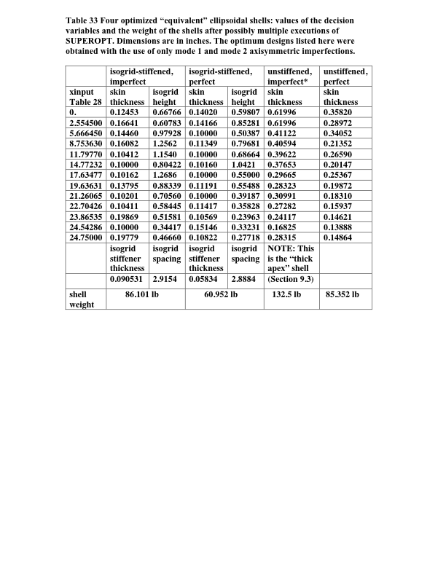
Optimum designs from GENOPT
Notes:
Table 33 Four optimized “equivalent” ellipsoidal shells: values of the decision variables and the weight of the shells after possibly multiple executions of SUPEROPT. Dimensions are in inches. The optimum designs listed here were obtained with the use of only mode 1 and mode 2 axisymmetric imperfections. NOTE: The column headed, “unstiffened, imperfect” lists the “thick apex” optimum design developed in Section 9.3, in which the lower bound of the shell wall thickness in the neighborhood of the apex of the shell is set equal to 0.6 inches, a much higher lower bound than that used (0.1 inch) for the shell skin thickness for the other three optmum designs listed here.

Slide 67
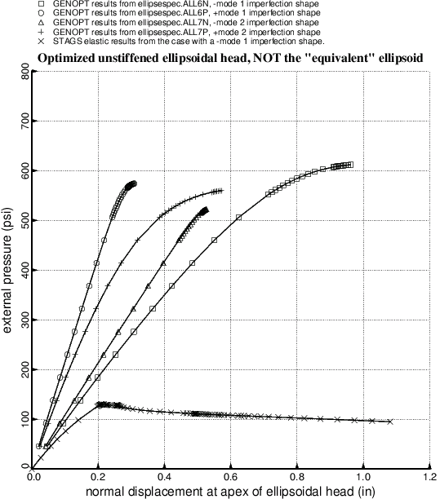
Load-deflection curves for an optimized unstiffened “true” ellipsoidal shell
BIGBOSOR4 results
STAGS results
Notes:
Fig. 1 Load-apex-deflection curves for an optimized, unstiffened, axisymmetrically imperfect, TRUE ellipsoidal shell under uniform external pressure. The “mode 1” and “mode 2” imperfection shapes are the first and second axisymmetric buckling modes of the perfect shell. The curves labeled “GENOPT” are obtained from BIGBOSOR4. The STAGS prediction is from a finite element model similar to that displayed in Fig. 6. The “GENOPT” predictions of maximum load-bearing capability are much higher than that from STAGS because of “finite element lockup” in the BIGBOSOR4 model. “Lockup” is avoided by representation of the TRUE ellipsoidal profile by an EQUIVALENT ellipsoidal profile such as that shown in the next figure, in which the meridional radius of curvature is constant within any one shell segment.

Slide 68
12-segment BIGBOSOR4 model of the equivalent ellipsoidal shell
Notes:
Fig. 2 This is a BIGBOSOR4 model of the EQUIVALENT ellipsoidal shell. The equivalent ellipsoidal shell consists of 12 shell segments: one spherical cap (Segment 1) and 11 toroidal shell segments with end points that fall on the profile of the TRUE ellipsoidal shell and that match as closely as possible the local profile of the TRUE ellipsoidal shell. Finite element “lockup” is avoided because the meridional radius of curvature within each segment of the perfect EQUIVALENT ellipsoidal shell is constant. The (r,z) = (x,y) = (x₃,y₃) = (radius, axial station) location of the center of meridional curvature of each toroidal shell segment is computed as set forth in Table 29. Maximum local shell skin extreme fiber effective stress and minimum local skin buckling load factor and maximum local meridional isogrid member extreme fiber stress and minimum local meridional isogrid member buckling load factor are computed for each of the two regions: Region 1 and Region 2. The corresponding design margins are listed in Tables 31 and 32, for example. The 360-degree STAGS finite element model shown in Fig. a1 of the appendix is analogous to this BIGBOSOR4 model. The 360-degree STAGS finite element model has fewer nodal points along the meridian than the BIGBOSOR4 model shown here.

Slide 69
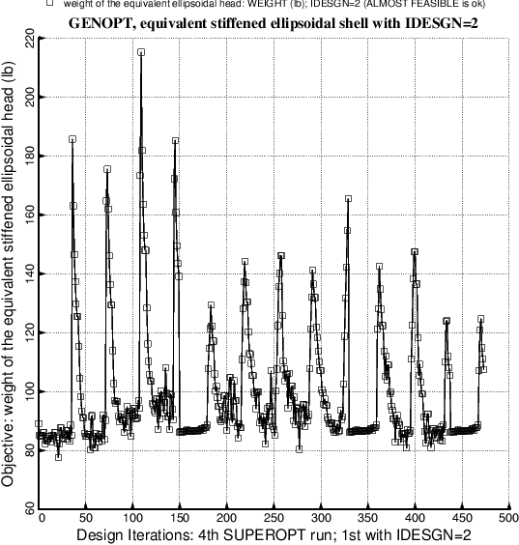
Evolution of the objective during an execution of SUPEROPT
Each “spike” is a new starting design obtained in a random fashion as described in [15]. The three “quiet” regions starting at about Iterations 150, 330, and 440 are caused by a temporary reduction in the move limit of the decision variables, as explained in Section 8.1.2.
Notes:
Fig. 3 Objective vs design iterations for the isogrid-stiffened imperfect shell for the last of a series of four executions of the GENOPT processor called SUPEROPT. Each “spike” in the plot corresponds to a new starting design, obtained randomly as described in [15]. The presence of the three “dense”, “quiet” regions starting approximately at Iteration Numbers 150, 325, and 440, is explained in Section 9 on p. 10 of [24] and in sub-section 8.1.2 of this paper. The purpose of these “quiet” regions, within which the move limits of the decision variables are severely restricted, is to close in on a possibly better optimum design in the neighborhood of the “best” design determined previous to that iteration at which the “quiet” region begins. At the end of each “quiet” region the move limits of the decision variables are re-expanded to their values used during the “non-quiet” design iterations, that is, during most of the SUPEROPT process, during which in this example the objective is rather “jumpy” from design iteration to iteration. The starting design before the first SUPEROPT is listed in Table 35.

Slide 70
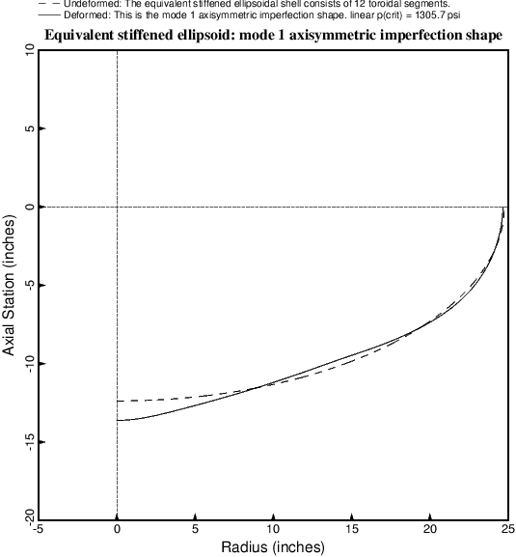
Axisymmetric “+mode 1” buckling modal imperfection from BIGBOSOR4
Optimized isogrid-stiffened equivalent ellipsoidal shell
Notes:
Fig. 4 First axisymmetric linear bifurcation buckling mode shape of the optimized isogrid-stiffened shell as computed by BIGBOSOR4. The corresponding linear bifurcation buckling pressure according to BIGBOSOR4 is p(crit) = 1305.7 psi. The program STAGS obtains a linear bifurcation buckling pressure of 1304.1 psi for this shell. (See Fig. 6). This axisymmetric mode, predicted by BIGBOSOR4, corresponds to the lowest eigenvalue in the STAGS model, as listed in Table 41. Compare with Fig. 6. This axisymmetric buckling mode is what is called in GENOPT jargon “mode 1”. Plus and minus versions of “mode 1” are used as initial axisymmetric imperfection shapes in computations of the local skin and stiffener stresses and buckling load factors, axisymmetric collapse loads, and general nonlinear bifurcation buckling load factors.

Slide 71
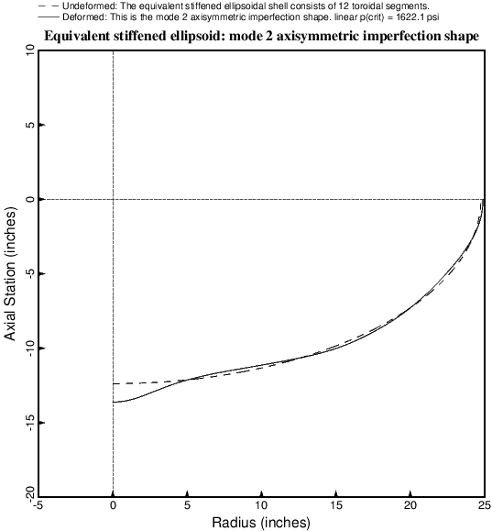
Axisymmetric “+mode 2” buckling modal imperfection from BIGBOSOR4
Optimized isogrid-stiffened equivalent ellipsoidal shell
Notes:
Fig. 5 Second axisymmetric bifurcation buckling mode shape of the optimized isogrid-stiffened shell as computed by BIGBOSOR4. The corresponding linear bifurcation buckling pressure according to BIGBOSOR4 is p(crit) = 1622.1 psi. The program STAGS obtains a linear bifurcation buckling pressure of 1612.3 psi for this second axisymmetric mode predicted by BIGBOSOR4. (See Fig. 9). In the STAGS model the second axisymmetric mode corresponds to the sixth eigenvalue, as listed in Table 41, following four non-axisymmetric modes, two of which are displayed in Figs. 7 and 8. Compare with Fig. 9. This axisymmetric buckling mode is what is called in GENOPT jargon “mode 2”. Plus and minus versions of “mode 2” are used as initial axisymmetric imperfection shapes in computations of the local skin and stiffener stresses and buckling load factors, axisymmetric collapse loads, and general nonlinear bifurcation buckling load factors.

Slide 72
What is STAGS?
STAGS [20 – 23] is a finite element code for the general-purpose nonlinear analysis of stiffened shell structures of arbitrary shape and complexity. Its capabilities include stress, stability, vibration, and transient analyses with both material and geometric nonlinearities permitted in all analysis types. A large rotation algorithm that is independent of the finite element library has been incorporated into STAGS. Solution control in nonlinear problems includes specification of load levels or use of the advanced Riks-Crisfield path parameter that enables traversal of limit points into the post-buckling regime. Two load systems with different histories (Load Sets A and B) can be defined and controlled separately during the solution process. Imperfections can be generated by superposition of several buckling modes determined from previous STAGS analyses of a given case. “Shell units” can be modeled with minimal user input as individual substructures in which the analytic geometry is represented exactly. Complex structures can be assembled from multiple relatively simple shell units.
Notes:
See Section 4.2.

Slide 73
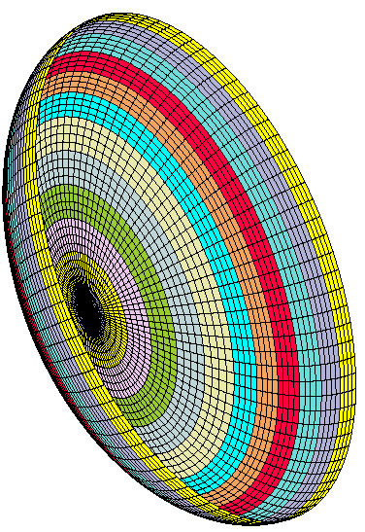
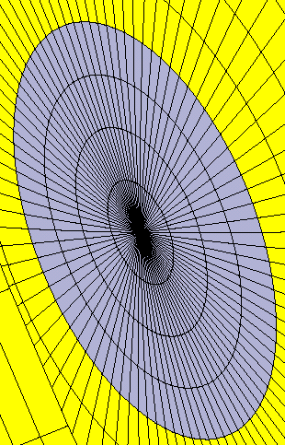
360-degree STAGS model of equivalent ellipsoidal shell
This STAGS model has 12 shell units. Each shell unit corresponds to the same part of the shell as each shell segment in the BIGBOSOR4 model.
Notes:
From Fig. a1 STAGS 360-degree model of the equivalent ellipsoidal shell with a spherical cap (shell unit 1) and 11 toroidal segments (shell units 2 – 12). Each of the twelve axisymmetric STAGS shell units is shown in a different color. This model is analogous to the BIGBOSOR4 model displayed in Fig. 2. The elongated shape of the 410 finite elements nearest the pole causes early lack of convergence in nonlinear cases that involve elastic-plastic mat’l. STAGS results in Figs. 6 – 168 are based on this 360-degree model.

Slide 74
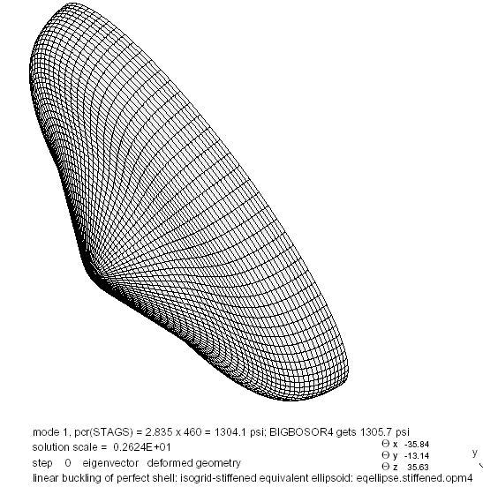
Linear buckling mode from STAGS
360-degree STAGS model. This buckling mode is analogous to the BIGBOSOR4 “mode 1” axisymmetric imperfection shape.
Notes:
Fig. 6 Fundamental linear bifurcation buckling mode of the optimized isogrid-stiffened equivalent ellipsoidal shell according to the STAGS program. The STAGS finite element model is shown in Fig. a1 of the appendix. Compare with the BIGBOSOR4 prediction in Fig. 4. The axisymmetric buckling mode analogous to this one but computed by BIGBOSOR4 (Fig. 4) is what is called in GENOPT jargon “mode 1”. Plus and minus versions of this STAGS linear bifurcation buckling mode are used as initial imperfection shapes in STAGS computations of the local skin and stiffener stresses and buckling load factors, collapse loads, and general nonlinear bifurcation buckling load factors of the optimized isogrid-stiffened shell. Compare with the 10-degree “slice” model in Fig. 36. Compare with the 180-degree STAGS “soccerball” model in Fig. 257 of [26].

Slide 75
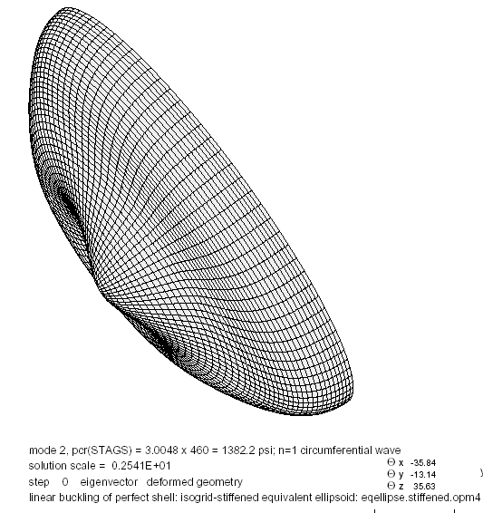
Linear buckling mode from STAGS
360-degree STAGS model. This is the most harmful imperfection shape. (n=1 circumferential wave).
Notes:
Fig. 7 Second linear bifurcation buckling mode of the optimized isogrid-stiffened equivalent ellipsoidal shell according to the STAGS program. This non-axisymmetric (n=1 circumferential wave) mode is the first of a pair of modes with exactly the same eigenvalue. The second non-axisymmetric mode in the pair is the same as the above except that the buckling mode is oriented differently circumferentially. This STAGS linear bifurcation buckling mode is used as an initial imperfection shape with amplitude, Wimp = 0.2 inch, to compute the nonlinear load-apex-deflection curve with upside-down triangles plotted as the seventh trace in Fig. 17. Compare with the 180-degree STAGS “soccerball” model in Fig. 258. Shells of revolution with imperfections with this non-axisymmetric shape cannot be handled by BIGBOSOR4. Therefore, GENOPT optimization occurs in the presence of only axisymmetric buckling modal imperfections.

Slide 76
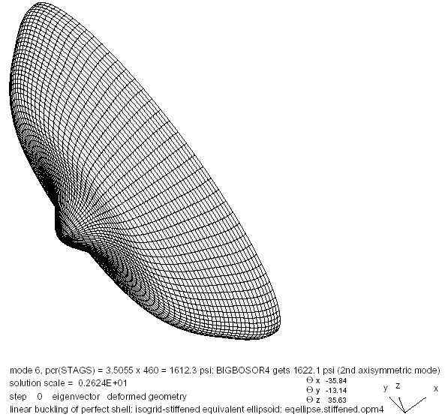
Linear buckling mode from STAGS
360-degree STAGS model. This buckling mode is analogous to the BIGBOSOR4 “mode 2” axisymmetric imperfection shape.
Notes:
Fig. 9 Sixth linear bifurcation buckling mode of the optimized isogrid-stiffened equivalent ellipsoidal shell according to the STAGS program. Compare with the BIGBOSOR4 prediction in Fig. 5. The axisymmetric buckling mode analogous to this one but computed by BIGBOSOR4 (Fig. 5) is what is called in GENOPT jargon “mode 2”. Plus and minus versions of this STAGS linear bifurcation buckling mode are used as initial imperfection shapes in STAGS computations of the local skin and stiffener stresses and buckling load factors, collapse loads, and general nonlinear bifurcation buckling load factors. Compare with the 10-degree “slice” model in Fig. 37. Compare with the 180-degree STAGS “soccerball” model in Fig. 260 of [26].

Slide 77
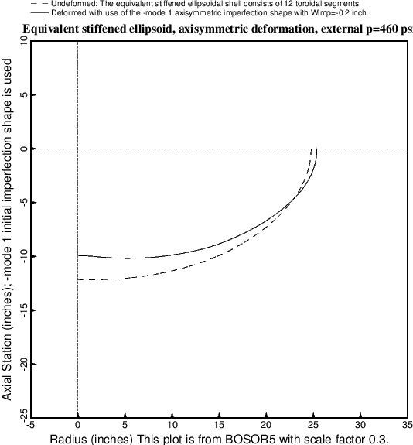
Axisymmetric deformation of optimized isogrid-stiffened shell with a -mode 1 buckling modal imperfection shape
Notes:
Fig. 14 BIGBOSOR4 prediction of axisymmetric deformation of the optimized imperfect isogrid-stiffened equivalent ellipsoidal shell with an axisymmetric –mode 1 linear bifurcation buckling modal imperfection shape with amplitude, Wimp = –0.2 inches. The applied external pressure is the design pressure, p = 460 psi. The shape of the buckling modal imperfection is the negative of that displayed in Fig. 4. The maximum stresses and local buckling load factors of skin and meridionally oriented isogrid members computed by BIGBOSOR4 and associated with this deformation pattern are listed for each shell segment in Table 44. The –mode 1 imperfection shape is the most critical with respect to axisymmetric collapse of the shell, as demonstrated in Fig. 16. Compare with Fig. 82 in [26], which pertains to the optimized unstiffened equivalent ellipsoidal shell.

Slide 78
Some BIGBOSOR4 stresses from the axisymmetric deformation shown in the previous slide (1)
Local skin and smeared stiffener buckling and stress, Seg. 1
Skin buckling load factor, BUCMIN=3.9282E+00 at pt. 2
Smeared stringer/isogrid buckling load factor,BUCMNS=5.4718E+00 at pt.13
Smeared ring buckling load factor, BUCMNR=1.0000E+17 at pt.13
Smeared stringer/isogrid maximum eff. stress, STFMXS=1.0224E+05 at pt. 2
Smeared ring maximum effective stress, STFMXR=0.0000E+00 at pt. 0
Shell skin maximum effective stress, SKNMAX=1.2052E+05 at pt. 3
Local skin and smeared stiffener buckling and stress, Seg. 5
Skin buckling load factor, BUCMIN=3.1685E+00 at pt. 1
Smeared stringer/isogrid buckling load factor,BUCMNS=1.3509E+00 at pt.10
Smeared ring buckling load factor, BUCMNR=1.0000E+17 at pt.13
Smeared stringer/isogrid maximum eff. stress, STFMXS=1.1764E+05 at pt.13
Smeared ring maximum effective stress, STFMXR=0.0000E+00 at pt. 0
Shell skin maximum effective stress, SKNMAX=7.5150E+04 at pt. 1
Local skin and smeared stiffener buckling and stress, Seg. 6
Skin buckling load factor, BUCMIN=3.2980E+00 at pt. 4
Smeared stringer/isogrid buckling load factor,BUCMNS=1.3683E+00 at pt. 2
Smeared ring buckling load factor, BUCMNR=1.0000E+17 at pt.13
Smeared stringer/isogrid maximum eff. stress, STFMXS=1.1803E+05 at pt. 1
Smeared ring maximum effective stress, STFMXR=0.0000E+00 at pt. 0
Shell skin maximum effective stress, SKNMAX=6.7917E+04 at pt.12
Notes:
This list is from Table 44: Output from SUBROUTINE STRUCT in GENOPT for local buckling and effective stress in the shell skin and in the meridionally oriented isogrid stiffener for the optimized imperfect isogrid-stiffened equivalent ellipsoidal shell with an axisymmetric
-mode 1 buckling modal imperfection with amplitude, Wimp = -0.2 inch. The applied external pressure is the design pressure, p = 460 psi. These are predictions from BIGBOSOR4. This file has been edited a bit to get each line in the actual GENOPT output to fit on a single line in this table. For a list of the actual and complete eqellipse.OPM file produced by GENOPT see Table a19 in the appendix. Critical and nearly critical stresses are listed in bold face. The locations of the shell segments are indicated in Fig. 2.

Slide 79
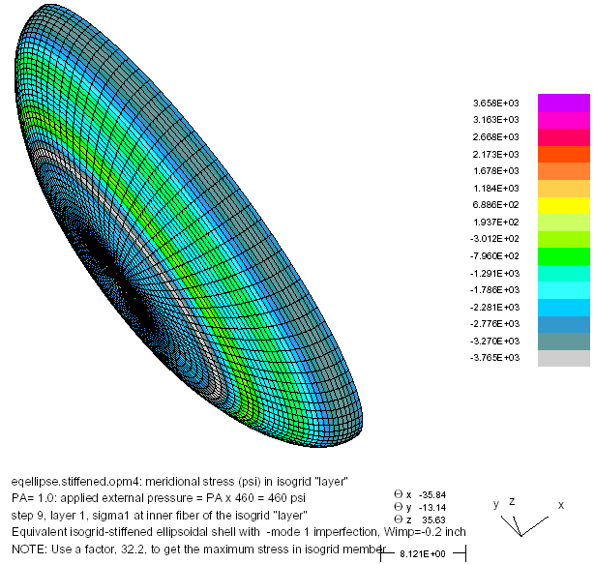
Effective stress at the inner fiber of the isogrid layer in the STAGS model at the design pressure, p=460 psi.
Maximum meridional stress, – 3765 x 32.2 psi, is at the junction between shell units 5 and 6, which agrees with the BIGBOSOR4 prediction listed in Table 44.
Multiply STAGS values by 32.2 to get actual stress in the isogrid material: (SPACNG/THSTIF=32.2)
Notes:
Fig. 28 STAGS prediction of the inner fiber meridional stress sigma1 (psi) in the isogrid “layer” of the optimized –mode 1 imperfect isogrid-stiffened equivalent ellipsoidal shell subjected to the external design pressure, p = 460 psi. To obtain actual stress multiply the values in the key by 32.2 (isogrid spacing/thickness). Then compare with STFMXS in Table 44. Compare with the 10-degree “slice” model in Fig. 43.

Slide 80
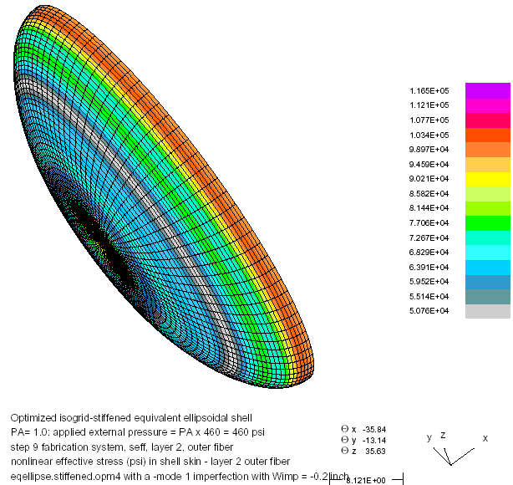
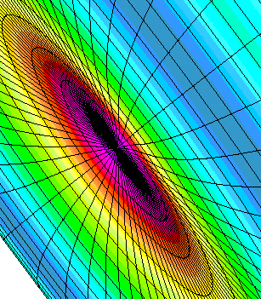
Effective stress at the outer fiber of the shell skin layer in the STAGS model at the design pressure, p=460 psi
–mode 1 imperfection
Maximum effective stress is at the pole and equals 116500 psi. BIGBOSOR4 predicts 120520 psi there.
Notes:
Fig. 31 Optimized isogrid-stiffened equivalent ellipsoidal shell at the external design pressure, p = 460 psi. STAGS prediction of outer fiber effective stress in the skin with a –mode 1 imperfection. Compare with the Table 44 prediction at Seg. 1: SKNMAX=120520 psi.

Slide 81
More BIGBOSOR4 stresses from the axisymmetric deformation shown previously (2)
Local skin and smeared stiffener buckling and stress, Seg. 11
Skin buckling load factor, BUCMIN=4.8340E+00 at pt.13
Smeared stringer/isogrid buckling load factor,BUCMNS=3.9044E+00 at pt. 1
Smeared ring buckling load factor, BUCMNR=1.0000E+17 at pt.13
Smeared stringer/isogrid maximum eff. stress, STFMXS=1.1834E+05 at pt.11
Smeared ring maximum effective stress, STFMXR=0.0000E+00 at pt. 0
Shell skin maximum effective stress, SKNMAX=1.1430E+05 at pt.13
Local skin and smeared stiffener buckling and stress, Seg. 12
Skin buckling load factor, BUCMIN=4.8370E+00 at pt. 1
Smeared stringer/isogrid buckling load factor,BUCMNS=4.4899E+00 at pt.13
Smeared ring buckling load factor, BUCMNR=1.0000E+17 at pt.13
Smeared stringer/isogrid maximum eff. stress, STFMXS=1.2154E+05 at pt. 4
Smeared ring maximum effective stress, STFMXR=0.0000E+00 at pt. 0
Shell skin maximum effective stress, SKNMAX=1.1431E+05 at pt. 1
Notes:
From Table 44: More stresses in the optimized isogrid-stiffened shell with a -mode 1 axisymmetric linear buckling modal imperfection shape loaded by the design external pressure, p = 460 psi.

Slide 82
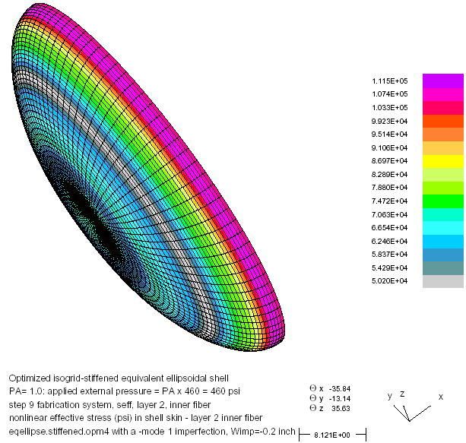
Effective stress at the inner fiber of the shell skin layer in the STAGS model at the design pressure, p=460 psi
–mode 1 imperfection
Maximum effective stress is at the junction of shell units 11 and 12 and equals 111500 psi. BIGBOSOR4 predicts 114300 psi there.
Notes:
Fig. 30 STAGS prediction of inner fiber effective stress seff (psi) in the skin of the optimized imperfect isogrid-stiffened equivalent ellipsoidal shell with an axisymmetric –mode 1 linear buckling modal imperfection (negative of the mode displayed in Figs. 6 and 11) with amplitude, Wimp = -0.2 inch and subjected to the external design pressure, p = 460 psi. Compare with the GENOPT (BIGBOSOR4) prediction of effective stress, SKNMAX = 114310 psi, which occurs at the same meridional location, as listed in Table 44. The maximum effective stress at the pole occurs at the outer fiber and is shown in the next figure. NOTE: The BIGBOSOR4 prediction, listed in Table 44 for the –mode 1 imperfection, only gives the maximum value of the extreme fiber effective stress in each shell segment, not both the maximum inner fiber effective stress and maximum outer fiber effective stress.

Slide 83
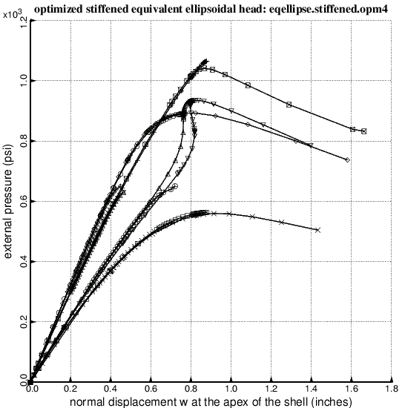
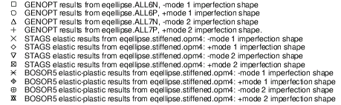
Axisymmetric collapse from BIGBOSOR4, STAGS, BOSOR5
Notes:
Fig. 16 Axisymmetric collapse of the optimized axisymmetrically imperfect isogrid-stiffened equivalent ellipsoidal shell under uniform external pressure from BIGBOSOR4 (elastic material), STAGS (elastic material) and BOSOR5 (elastic-plastic material). Compare with Fig. 83 of [26], which pertains to the optimized unstiffened shell. Compare trace 5 with results plotted in Fig. 254 for several STAGS models.

Slide 84
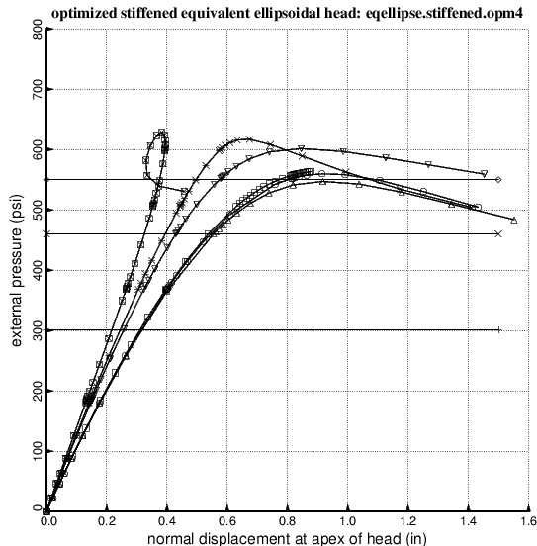
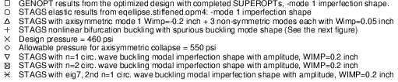
Axisymmetric and non-axisymmetric elastic collapse
Shells of revolution with imperfections with non-axisymmetric shapes cannot be handled by BIGBOSOR4. Therefore, GENOPT optimization occurs in the presence of only axisymmetric buckling modal imperfections.
Notes:
Fig. 17 Axisymmetric and non-axisymmetric collapse of optimized imperfect isogrid-stiffened equivalent ellipsoidal shells. The linear bifurcation buckling modal imperfection shapes corresponding to non-axisymmetric collapse (the last three traces) are displayed in Figs. 7, 8, and 10. In this case the –mode 1 (axisymmetric) buckling modal imperfection is predicted to be more harmful than the non-axisymmetric buckling modal imperfections with shapes given in Figs. 7, 8 and 10. This does not hold for the optimized unstiffened imperfect shell, as seen in Fig. 94. Compare with Fig. 254.

Slide 85
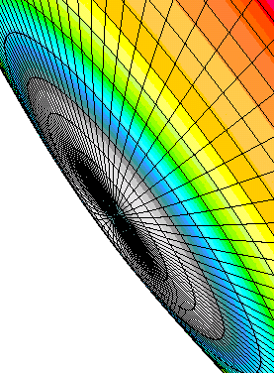
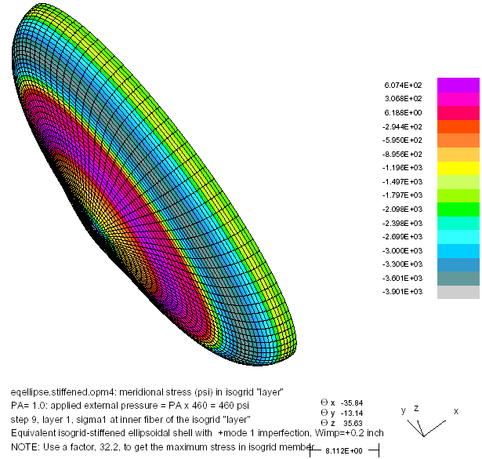
Stress distribution in the inner fiber of the isogrid “layer” from the STAGS model of the optimized isogrid-stiffened shell at p = 460 psi.
Multiply STAGS value by 32.2 to get actual stress in the isogrid material: (SPACNG/THSTIF=32.2)
+mode 1 imperfection shape
Notes:
Fig. 20 STAGS prediction of the inner fiber meridional stress sigma1 (psi) in the isogrid “layer” of the optimized +mode 1 imperfect isogrid-stiffened equivalent ellipsoidal shell subjected to the external design pressure, p = 460 psi. Compare with STFMXS in Table 42. Compare with the 10-degree “slice” model in Fig. 39 of [26].

Slide 86
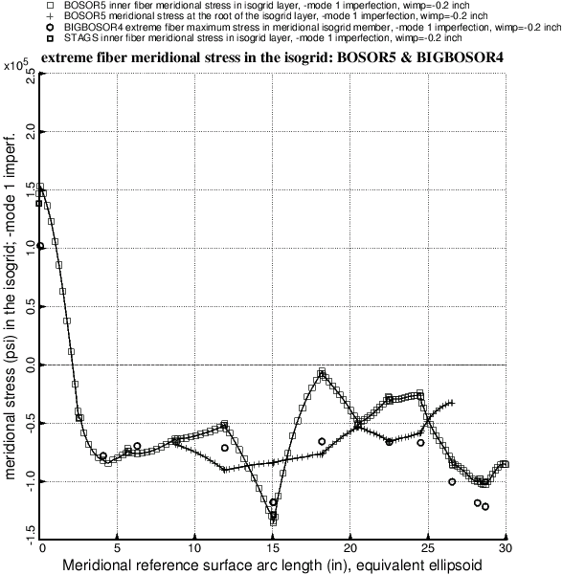
Comparison of meridional stress at the inner fiber of the isogrid layer from BIGBOSOR4, BOSOR5 and STAGS
-mode 1 imperfection shape
At the pole (meridional reference surface arc length = 0) the STAGS and BOSOR5 predictions, for perfect agreement with the BIGBOSOR4 prediction, would have to be [1/(1-nu)] x (the BIGBOSOR4 prediction), in which nu=Poisson ratio = 1/3 for an isogrid configuration. See Eqs.(7-9).
Notes:
Fig. 47 Comparison of extreme fiber meridional stress distribution in the isogrid “layer” from BOSOR5 (elastic material), BIGBOSOR4, and STAGS for the optimized imperfect isogrid-stiffened equivalent ellipsoidal shell with a –mode 1 imperfection with amplitude, Wimp = -0.2 inch. The applied external pressure is the design pressure, p = 460 psi. BOSOR5 and STAGS agree because in both applications the isogrid “layer” is treated as an elastic isotropic layer with smeared stiffeners and Poisson’s ratio, nu = 1/3. In the BIGBOSOR4 application the same “smeared” model is used to compute the 6 x 6 constitutive matrix, C_{ij}, but the extreme fiber stress in the isogrid “layer” is calculated as if the most critical isogrid member is oriented in the meridional coordinate direction. The extreme fiber stress in that meridionally oriented member is obtained as described in Table 27 and in Eq.(8). NOTE: The BIGBOSOR4 prediction, listed in Table 44 for the –mode 1 imperfection, only gives the maximum extreme fiber stress in each shell segment, not both the maximum inner fiber stress and maximum outer fiber stress.

Slide 87
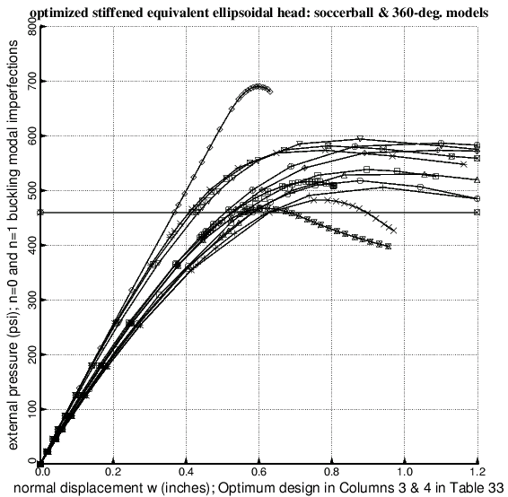
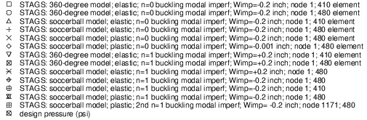
Axisymmetric and non-axisymmetric elastic collapse
The n=0 traces all correspond to a –mode 1 axisym-metric imperfection.
Notes:
Fig. 254 Axisymmetric and non-axisymmetric collapse of optimized almost perfect (trace 6) and imperfect isogrid-stiffened equivalent ellipsoidal shells. The optimum design, listed in columns 2 and 3 of Table 33, was obtained with linear axisymmetric (n=0) buckling modal imperfections with amplitude, Wimp = 0.2 inch. For the 180-degree “soccerball” model the linear bifurcation buckling modal imperfection shape corresponding to axisymmetric (n=0) collapse (the first 6 traces) is shown in Fig. 257 of [26]. The linear bifurcation buckling modal imperfection shapes corresponding to non-axisymmetric (n=1) collapse (the last 7 traces) are displayed in Figs. 258 and 262. For the 360-degree models the linear bifurcation buckling modal imperfection shapes are shown for n=0 in Fig. 6 and for n=1 in Figs. 7 and 10. Compare this figure with Fig. 17.

Slide 88
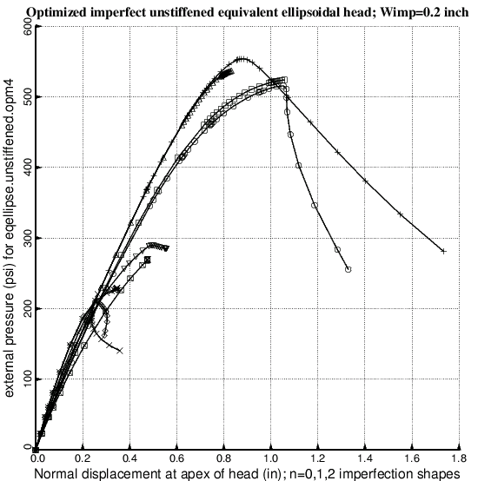
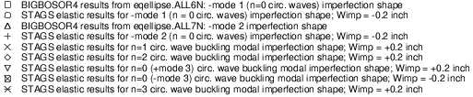
Collapse of optimized unstiffened imperfect equivalent ellipsoidal shell with buckling modal imperfections
NOTE: The lower bound of the shell wall thicknesses in the neighborhood of the apex was set equal to 0.1 inch during optimization cycles. These results correspond to the optimum design listed in the column headed “unstiffened, imperfect” in the version of Table 33 listed in [26] (the long report), not to the optimum design listed in the version of Table 33 given in this paper.
Notes:
Fig. 94 Nonlinear elastic load-deflection curves for the optimized imperfect unstiffened equivalent ellipsoidal shell from BIGBOSOR4 (axisymmetric deformation) and from STAGS (both axisymmetric and non-axisymmetric deformation). The most significant point to be emphasized with regard to this figure is that the pressure-carrying capability of the shell, which is optimized with regard to mode 1 and mode 2 axisymmetric imperfections (BIGBOSOR4 models in Figs. 74 and 75), is much more sensitive to non-axisymmetric imperfections (buckling modal imperfections with n = 1 and n = 2 circumferential waves) with the same amplitude, Wimp = 0.2 inch. The optimized unstiffened shell is therefore under-designed. Compare with the results for the “thick apex” optimized unstiffened shells plotted in Figs. 161 of [26] and 237.

Slide 89
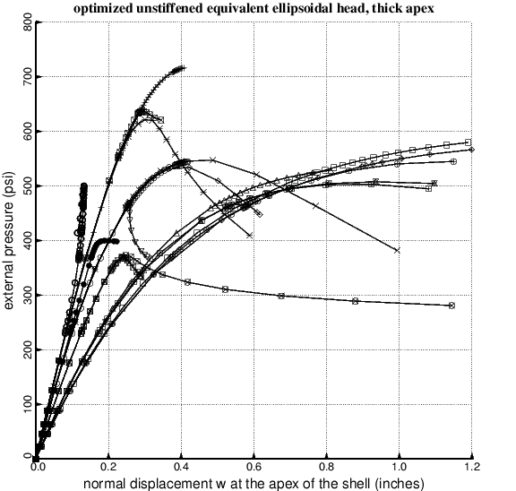
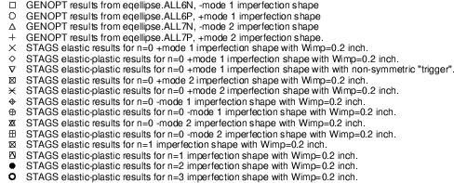
Collapse of optimized unstiffened imperfect equivalent ellipsoidal shell with buckling modal imperfections. Lower bound of t(apex)=0.4 in
NOTE: The lower bound of the shell wall thicknesses in the neighborhood of the apex was set equal to 0.4 inch during optimization cycles.
Notes:
Fig. 161 Optimized unstiffened equivalent ellipsoidal shell with thick apex, t(apex)=0.4 inch; Wimp=0.2 inch; the optimum design is listed in Table 78 of [26]. Load-displacement curves for various buckling modal imperfection shapes. Amplitude of each buckling modal imperfection, Wimp = 0.2 inch. Compare with Fig. 94 (previous slide). This optimized unstiffened “thick-apex” imperfect shell is still under-designed, but much less so than the unstiffened imperfect shell the optimum design of which generates the results shown in the previous slide.

Slide 90
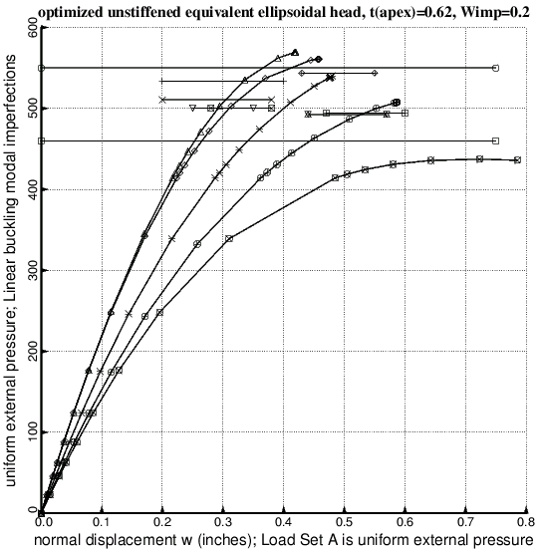
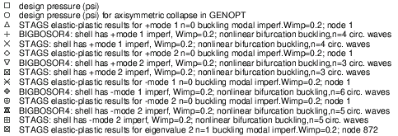
Collapse of optimized unstiffened imperfect equivalent ellipsoidal shell with buckling modal imperfections. Lower bound of t(apex)=0.6 in
NOTE: The lower bound of the shell wall thicknesses in the neighborhood of the apex was set equal to 0.6 inch during optimization cycles.
Notes:
Fig. 237 Optimized unstiffened equivalent ellipsoidal shell with thick apex, t(apex)=0.61996 inch; Wimp=0.2 inch; the optimum design is listed in Table 93 of [26]. STAGS elastic-plastic load-displacement curves and nonlinear bifurcation buckling loads and BIGBOSOR4 elastic nonlinear bifurcation buckling loads for various buckling modal imperfection shapes. Amplitude of each buckling modal imperfection, Wimp = 0.2 inch. Compare with Fig. 161 of [26], for which the optimum design is listed in Table 78 of [26], and compare with Figs. 209 and 211 of [26], for which Wimp=0.1 and optimum design is listed in Table 89 of [26].

Slide 91
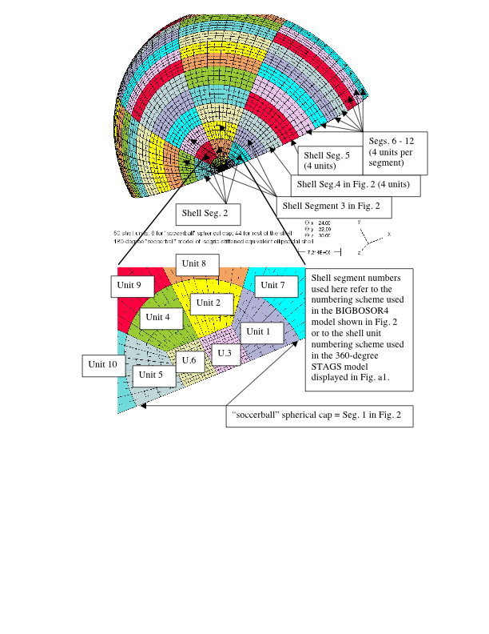
STAGS “soccerball” model of equivalent ellipsoidal shell
Notes:
Fig. a2 180-degree STAGS “soccerball” model of the equivalent ellipsoidal shell, showing the numbering of the STAGS shell units within the six-shell-unit “soccerball” spherical cap, which corresponds to Shell Segment No. 1 in Fig. 2. The units just outside the “soccerball” cap are Units 7, 8, 9, and 10, increasing unit numbers counterclockwise (Fig. a3 of [26]). The entire STAGS 180-degree “soccerball” model of the equivalent ellipsoidal shell is then built up of 10 additional ranks of 4 shell units each, each 4-shell-unit rank corresponding to one of the BIGBOSOR4 shell segments depicted in Fig. 2.

Slide 92
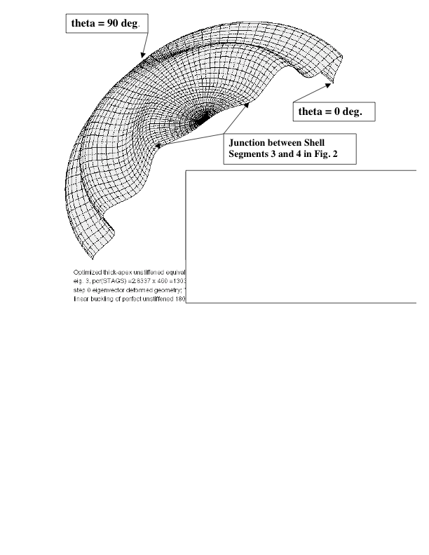
Linear buckling with n=1 circumferential wave of optimized unstiffened imperfect equivalent ellipsoidal shell. Lower bound of t(apex)=0.4 in
Residual dents are produced by a Load Set B which consists of a group of normal inward-directed concentrated loads or imposed normal inward-directed displacements that are distributed as cos(theta) and applied along the circumference at the junction between Shell Segments 3 and 4 from theta = 0 to 90 degrees.
Notes:
Fig. 190 of [26] Linear buckling mode from STAGS 180-degree “crude” soccerball model that corresponds to the third eigenvalue for the optimized unstiffened equivalent ellipsoidal shell with the thick apex with t(apex) = 0.4 inch; the optimum design is listed in Table 78 of [26]. Compare this “crude” 180-degree “soccerball” model with the more refined “soccerball” model displayed in Fig. 179 of [26]. This is the linear buckling modal imperfection shape (with amplitude, Wimp = 0.2 inch) that leads to the load-deflection curve identified as the fourth trace in Fig. 188 and the mode of collapse under uniform pressure shown in Fig. 192 of [26]. Shells of revolution with imperfections with this non-axisymmetric shape cannot be handled by BIGBOSOR4. Therefore, GENOPT optimization occurs in the presence of only axisymmetric buckling modal imperfections.

Slide 93
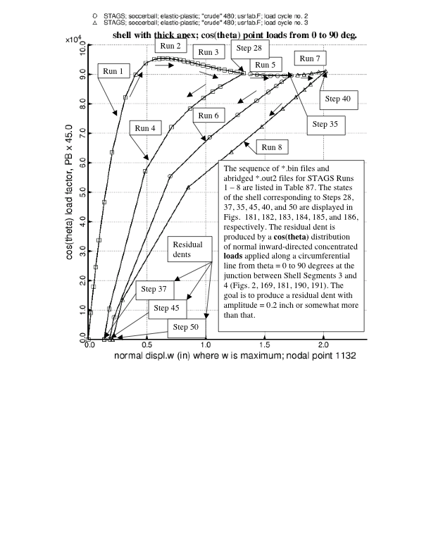
Use of STAGS to produce off-center “cos(theta)” residual dents of various depths. t(apex) = 0.4 inch
Notes:
Fig. 180 Optimized unstiffened equivalent ellipsoidal shell with thick apex, t(apex)=0.4 inch; Wimp=0.2 inch; the optimum design is listed in Table 78. Shown here are three load cycles for load set B (load factor PB) that produce residual dents of three different depths. The load set B consists of a number of normal concentrated loads applied along the junction of shell segments 3 and 4 that has a cos(theta) circumferential distribution from theta = 0 to 90 degrees. (Figs. 2, 169, 190, 191; See Shell units 11 and 12 listed in Table a40, except that the input datum, LT, in Load Set B is +1 instead of -1). This “cos(theta)” loading produces a more harmful dent than that produced by a pressure applied to a single finite element, as is demonstrated in Fig. 188. Compare with Fig. 175.

Slide 94

Collapse of optimized unstiffened imperfect equivalent ellipsoidal shell with n=1 buckling modal imperfection and with residual dents. Lower bound of t(apex)=0.4 in
Residual dents for traces 2 and 3 are produced by a Load Set B which consists of a group of normal inward-directed concentrated loads that are distributed as cos(theta) and applied along the circumference at the junction between Shell Segments 3 and 4 (Figs. 2 and a2) from circumferential coordinate theta = 0 to 90 degrees.
Notes:
Fig. 188 Elastic-plastic analysis of the optimized unstiffened equivalent ellipsoidal shell with the thick apex with t(apex) = 0.4 inch; Wimp=0.2 inch; the optimum design is listed in Table 78 of [26]. Collapse of the imperfect shell with three different kinds of imperfections. trace 1= imperfection is a residual dent caused by a single concentrated load (Fig. 171 of [26]); traces 2 and 3 = imperfections are residual dents caused by a “cos(theta)” distribution of concentrated loads along a circumferential line from theta = 0 to 90 degrees (Figs. 184 and 186 of [26]), and trace 4 = a linear buckling modal imperfection with n=1 circumferential wave (Fig. 190 of [26]). Notice the similarity between traces 2 and 4. These two curves differ mostly by a horizontal shift of w= 0.2 inch, which represents the depth of the residual dent created by the “cos(theta)” distribution of concentrated loads. The “cos(theta)” residual dent is just as harmful as the n=1 buckling modal imperfection.

Slide 95
Conclusions (1)
  1. GENOPT can be used in combination with BIGBOSOR4 to obtain minimum-weight designs of imperfect isogrid-stiffened equivalent ellipsoidal shells under external pressure provided that the imperfection shapes are axisymmetric.
  2. Unstiffened imperfect shells should be optimized with relatively high lower bounds set on the thicknesses of the shell wall in the neighborhood of the shell apex.
  3. The “worst” imperfections are non-axisymmetric linear buckling modal imperfections with n=1 circumferential wave.
  5. Off-center residual dents produced by a single normal inward-directed concentrated load are significantly less harmful than off-center “cos(theta)” residual dents.
Notes:
11.0 CONCLUSIONS
1. GENOPT can be used in combination with BIGBOSOR4 to obtain minimum-weight designs of isogrid-stiffened or unstiffened perfect or imperfect ellipsoidal shells provided that the “equivalent” ellipsoid model (Table 29, Fig. 2) is used and provided that the imperfection shapes are axisymmetric.
2. Unstiffened imperfect shells should be optimized with relatively high lower bounds set on the thicknesses of the shell wall in the neighborhood of the shell apex (Table 77 of [26]). In the case of the unstiffened, imperfect shell, if the lower bound of the wall thickness in the neighborhood of the shell apex is set too low the thickness distribution in the neighborhood of the shell apex evolves during optimization cycles in a way that essentially isolates the apex from the remainder of the shell. This produces optimum designs the collapse pressures of which are especially sensitive to non-axisymmetric imperfection shapes, a type of imperfection that cannot be modeled with BIGBOSOR4 and therefore cannot be accommodated during the GENOPT optimization process.
3. It is generally found from STAGS models that for optimized shells the “worst” imperfections are non-axisymmetric linear buckling modal imperfections with n=1 circumferential wave (Figs. 94, 109, 161, 176, 209, 211, 237 and 254 of [26] and Figs. 94, 161, and 254 here).
4. For the optimized unstiffened imperfect shell it is found that imperfections in the form of off-center residual dents produced by a distribution of normal inward-directed concentrated loads that vary as the cos(theta) over a circumferential line from circumferential coordinate, theta = 0 to 90 degrees applied at a radius from the axis of revolution that corresponds to the first pronounced “valley” or “ridge” in the non-axisymmetric linear buckling mode shape with n=1 circumferential wave are approximately as harmful as the n=1 linear buckling modal imperfection shapes (Figs. 188, 190, 205, 211, 217, 232, 237, 241 in [26] and Figs. 148 and 188 here).
5. Off-center residual dents produced by a single normal inward-directed concentrated load are significantly less harmful than off-center “cos(theta)” residual dents (Figs. 176, 188, 200 in [26] and Figs. 148 and 188 here).
6. A STAGS “soccerball” model (Figs. 169, a2 – a13 in [26] and Fig. a2 here) of the optimized shells is better than a 360-degree STAGS model based on polar coordinates (Fig. a1) because the STAGS 480 finite element, which fails when used for nonlinear analysis in connection with the 360-degree model, works well when used in connection with the “soccerball” model, which has no singularity at the apex of the shell. Also, spurious buckling modes such as that shown in Figs 18 and 19 of [26] are avoided when the STAGS “soccerball” model is used.
7. The STAGS user should rely on user-written SUBROUTINE USRFAB rather than on user-written SUBROUTINE WALL for providing wall properties that vary within a shell unit (Fig. 175 in [26]).
8. Sections 3.0 – 6.0 of this paper contain enough detail about how GENOPT works so that the reader can use it as a guide for setting up user-friendly optimization software for other structural or even non-structural applications.
9. The material about STAGS models in [26] is extensive enough so that the reader should be able to set up other STAGS models without too much trouble.

Slide 96
Conclusions (2)
  6. A STAGS “soccerball” model of the optimized shells is better than a 360-degree STAGS model based on polar coordinates.
  8. Sections 3.0 – 6.0 of this paper contain enough detail about how GENOPT works so that the reader can use it as a guide for setting up user-friendly optimization software for other structural or even non-structural applications.
  9. The material about STAGS models in [26] is extensive enough so that the reader should be able to set up other STAGS models without too much trouble.
Notes:
More conclusions.

