Slide 1
MINIMUM WEIGHT DESIGN OF IMPERFECT ISOGRID-STIFFENED ELLIPSOIDAL SHELLS UNDER UNIFORM EXTERNAL PRESSURE
  David Bushnell, Fellow, AIAA, Retired
Notes:
See the files, …/genopt/case/torisph/sdm50.report.*/*
MINIMUM WEIGHT DESIGN OF IMPERFECT ISOGRID-STIFFENED ELLIPSOIDAL SHELLS UNDER UNIFORM EXTERNAL PRESSURE
David Bushnell,* Fellow, AIAA, Retired
775 Northampton Drive, Palo Alto, CA 94303
email: bush@sonic.net
ABSTRACT
GENOPT, a program that can be used to optimize anything, and BIGBOSOR4, a program for stress, buckling, and vibration analysis of segmented, branched, stiffened, elastic shells of revolution, are combined to create a capability to optimize a specific kind of shell of revolution: an internally isogrid-stiffened elastic ellipsoidal shell subjected to uniform external pressure. Optimum designs are obtained for isogrid-stiffened and unstiffened axisymmetrically imperfect and perfect titanium 2:1 ellipsoidal shells. The decision variables are the shell skin thickness at several user-selected meridional stations, the height of the isogrid stiffeners at the same meridional stations, the spacing of the isogrid stiffeners (constant over the entire shell), and the thickness of the isogrid stiffeners (also constant over the entire shell). The design constraints involve maximum stress in the isogrid stiffeners, maximum stress in the shell skin, local buckling of an isogrid stiffener, local buckling of the shell skin between isogrid stiffeners, general nonlinear bifurcation buckling, nonlinear axisymmetric collapse, and maximum normal displacement at the apex of the dome. Optimum designs first obtained by GENOPT are subsequently evaluated by the use of STAGS, a general-purpose finite element computer program. It is found that in order to obtain reasonably good agreement between predictions from BIGBOSOR4 and STAGS it is necessary to model the ellipsoidal shell as an "equivalent" ellipsoidal shell consisting of a spherical cap and a series of toroidal shell segments that closely approximates the true ellipsoidal meridional shape. The equivalent ellipsoidal shell is optimized with up to four axisymmetric buckling modal imperfections, each imperfection shape assumed to be present by itself. Computations include both plus and minus axisymmetric buckling modal imperfection shapes. At each design cycle and for the plus and minus version of each axisymmetric imperfection shape the following analyses are conducted: 1. linear general axisymmetric bifurcation buckling analysis (in order to obtain the axisymmetric linear buckling modal imperfection shapes), 2. nonlinear axisymmetric stress analysis at the design pressure, 3. nonlinear axisymmetric collapse analysis, and 4. nonlinear non-axisymmetric bifurcation buckling analysis. For each axisymmetric imperfection shape the design margins include an axisymmetric collapse margin, a general buckling margin, a margin involving the normal displacement of the apex of the shell, and local skin and stiffener stress margins and local skin and stiffener buckling margins within two approximately equal meridional regions of the equivalent ellipsoidal shell. There is generally good agreement of the predictions from STAGS and from BIGBOSOR4 for the elastic behavior of the perfect stiffened and unstiffened optimized shells and for the behavior of the imperfect stiffened optimized shells with axisymmetric buckling modal imperfections. Optimization with the use of only axisymmetric buckling modal imperfections has a disadvantage in the case of the unstiffened imperfect shell under certain conditions: the optimum design of the axisymmetrically imperfect unstiffened shell evolves in such a way that, according to predictions from STAGS, a non-axisymmetric buckling modal imperfection with the same amplitude as an axisymmetric buckling modal imperfection causes collapse of the shell at an external pressure far below the design pressure. This disadvantage is easily overcome if, during optimization cycles, the unstiffened shell wall in the neighborhood of the apex is forced to remain thick enough so that local axisymmetric buckling does not occur primarily at and near the apex but instead occurs primarily in the remainder of the shell. An extensive study of some of the previously optimized elastic shells is conducted with STAGS including elastic-plastic material properties. The effect on collapse pressure of initial imperfections in the form of off-center residual dents produced by load cycles applied before application of the uniform external pressure is determined and compared with the effect on collapse pressure of imperfections in the form of non-axisymmetric and axisymmetric linear buckling modes, especially the non-axisymmetric linear buckling modal imperfection with n=1 circumferential wave, which seems to be the most harmful imperfection shape for optimized externally pressurized ellipsoidal shells. For the optimized unstiffened shell it is found that a residual dent that locally resembles the n=1 linear buckling modal imperfection shape is just as harmful as the entire n=1 linear buckling modal imperfection shape.

Slide 2
Summary of this presentation
1. What is GENOPT? (Slides 3 - 16)
2. Statement of the problem to be solved (Slides 17-19)
3. Seven analyses for each design (Slide 20)
4. Sample input to and output from GENTEXT (21 - 34)
a. text created by GENOPT
b. FORTRAN code by GENOPT
5. Run stream to produce an optimum design (Slide 35)
6. Design margins of the optimum design (Slides 36 - 39)
7. Optimum designs from GENOPT (Slides 40, 41)
8. Evaluation of optimum designs of isogrid-stiffened and unstiffened equivalent ellipsoidal shell by BIGBOSOR4 & STAGS (Slides 42 - 55)
9. Conclusions (Slides 56, 57)

Slide 3
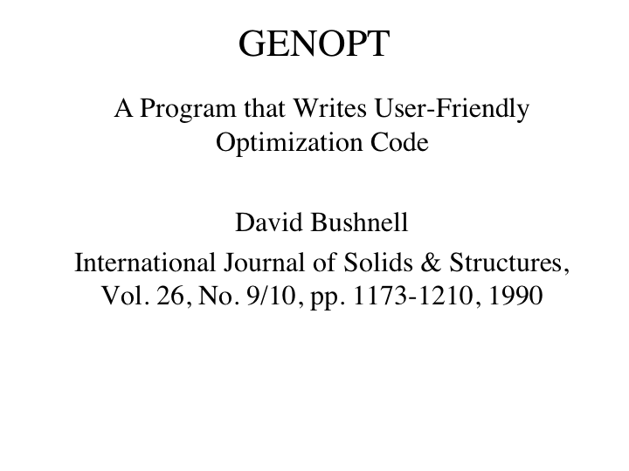
Original GENOPT reference

Slide 4
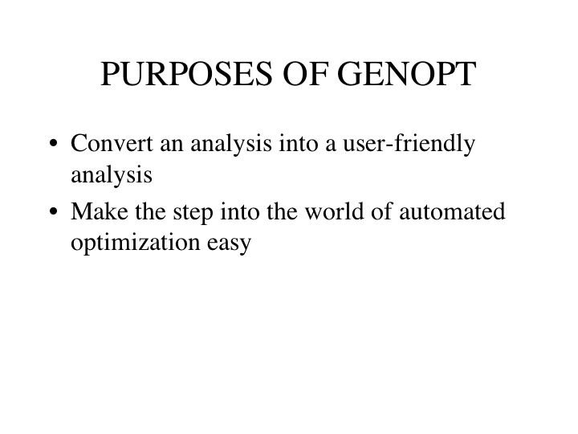

Slide 5
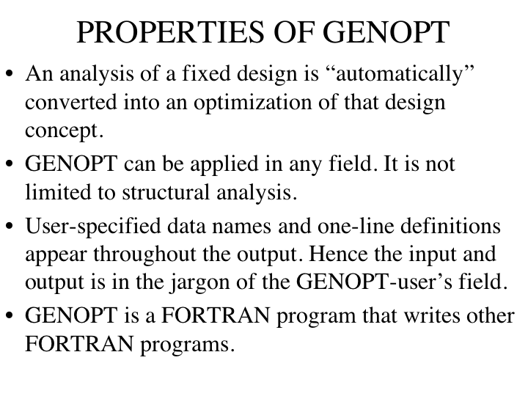

Slide 6
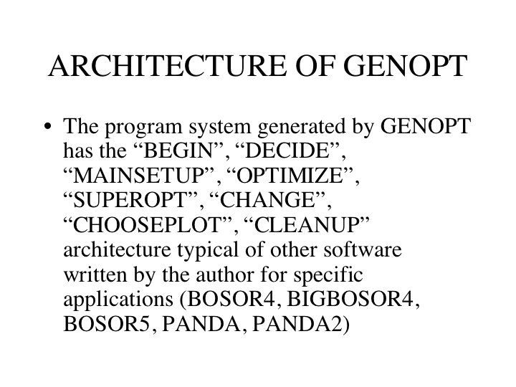

Slide 7
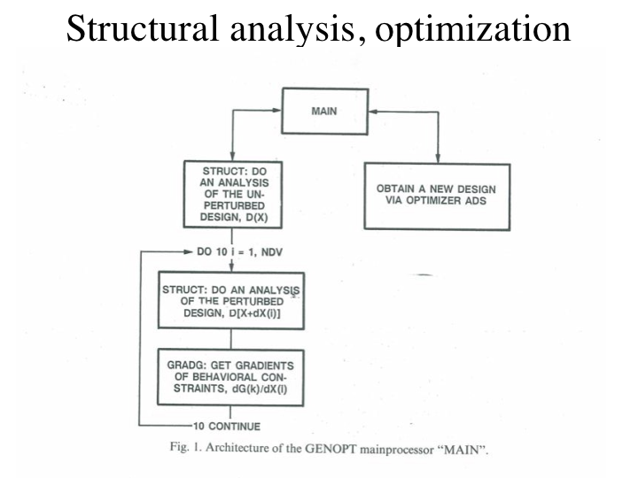

Slide 8
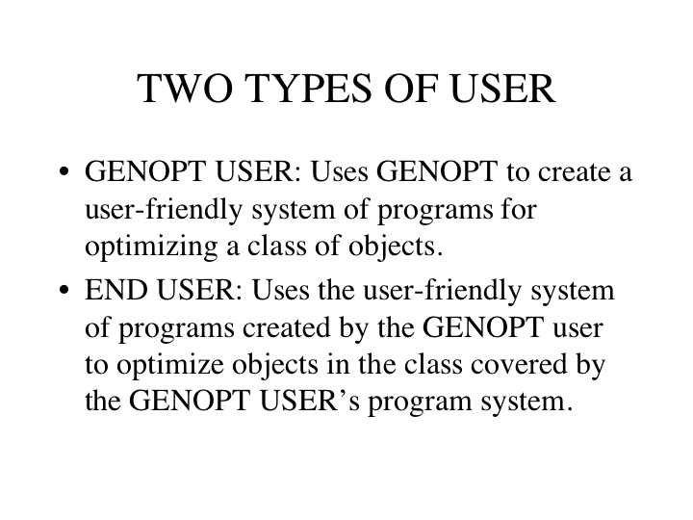

Slide 9
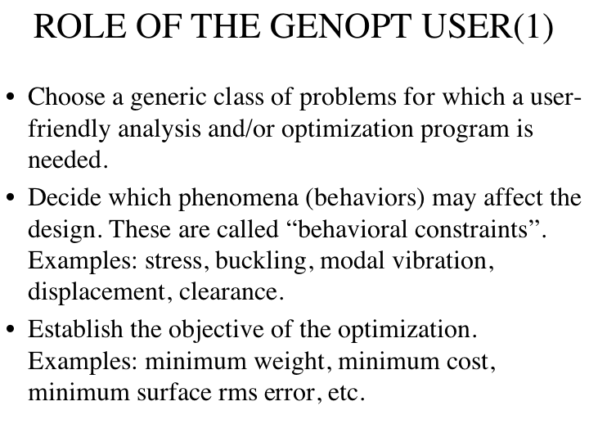

Slide 10
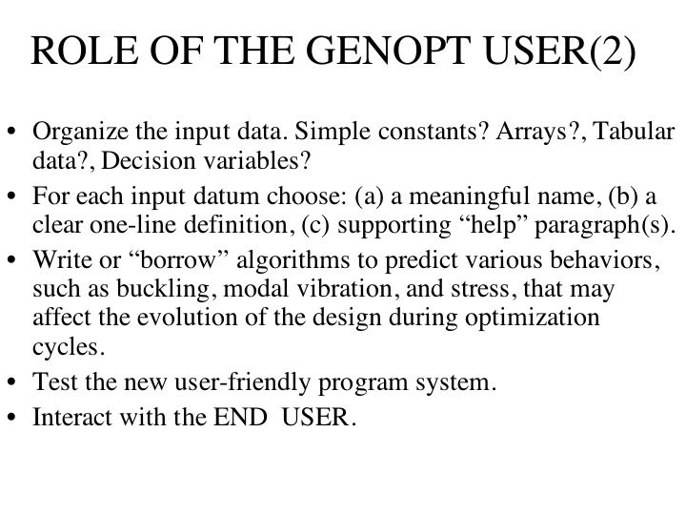

Slide 11
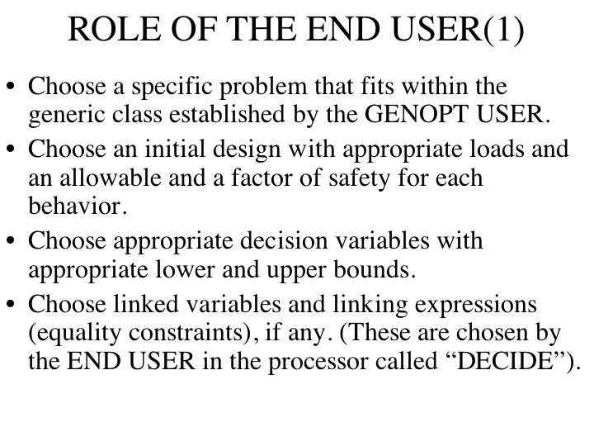

Slide 12
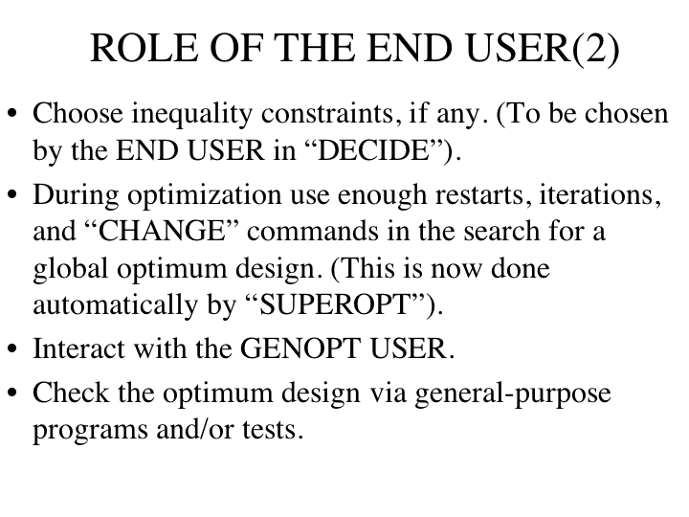

Slide 13
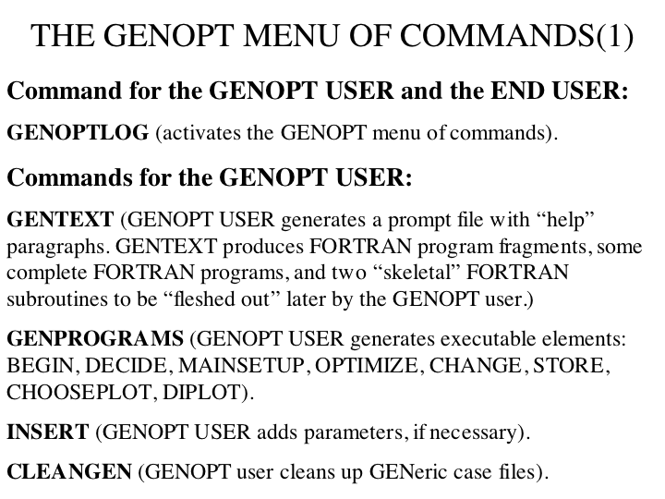

Slide 14
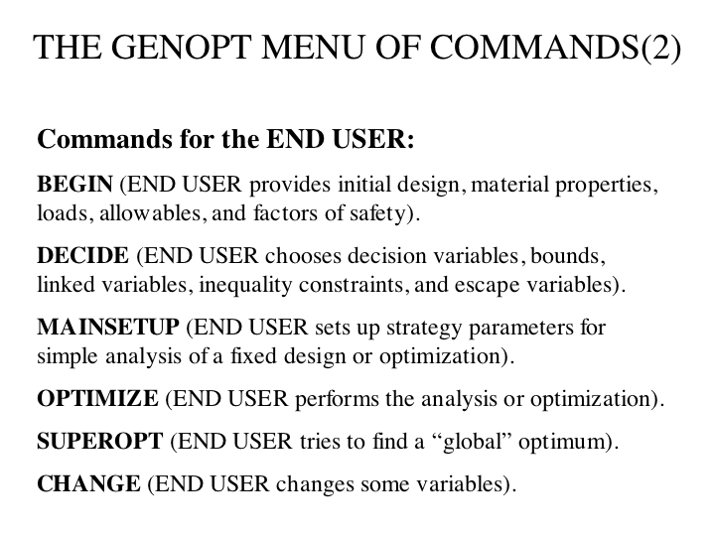

Slide 15
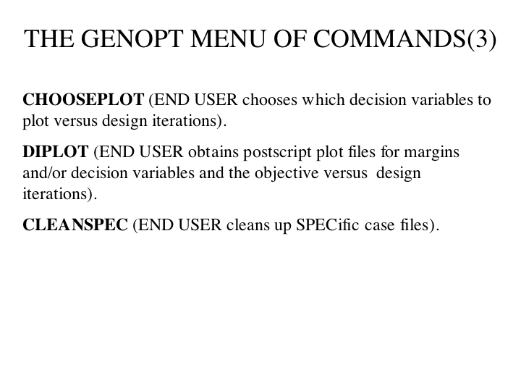

Slide 16
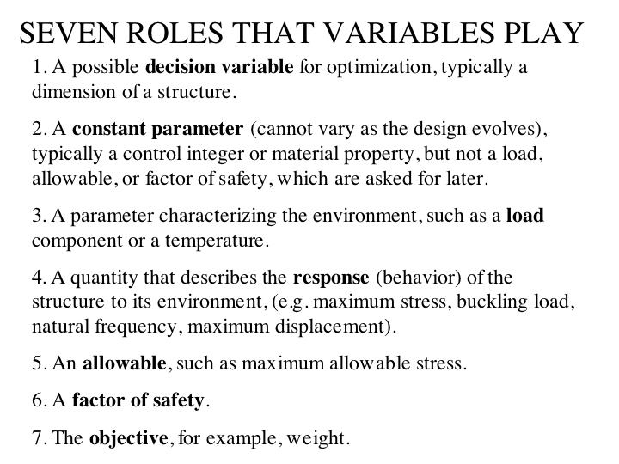

Slide 17
Statement of the problem to be solved
Use GENOPT in connection with BIGBOSOR4 to find the minimum-weight design of internally isogrid-stiffened and unstiffened, externally pressurized elastic metallic imperfect ellipsoidal shells. The shells are axisymmetric and have shell wall thickness and isogrid stiffener height that vary only along the meridian. The shells have axisymmetric buckling modal imperfections. The decision variables of the optimization problem are shell skin thickness and isogrid stiffener height at user-selected callout points along the meridian and isogrid stiffener spacing and rectangular isogrid member thickness. Evaluate the optimized designs with STAGS.
Notes:
MINIMUM WEIGHT DESIGN OF IMPERFECT ISOGRID-STIFFENED ELLIPSOIDAL SHELLS UNDER UNIFORM EXTERNAL PRESSURE
David Bushnell, Fellow, AIAA, Retired
775 Northampton Drive, Palo Alto, CA 94303
email:bush@sonic.net
ABSTRACT OF THE PAPER AND REPORT
GENOPT, a program that can be used to optimize anything, and BIGBOSOR4, a program for stress, buckling, and vibration analysis of segmented, branched, stiffened, elastic shells of revolution, are combined to create a capability to optimize a specific kind of shell of revolution: an internally isogrid-stiffened elastic ellipsoidal shell subjected to uniform external pressure. Optimum designs are obtained for isogrid-stiffened and unstiffened axisymmetrically imperfect and perfect titanium 2:1 ellipsoidal shells. The decision variables are the shell skin thickness at several user-selected meridional stations, the height of the isogrid stiffeners at the same meridional stations, the spacing of the isogrid stiffeners (constant over the entire shell), and the thickness of the isogrid stiffeners (also constant over the entire shell). The design constraints involve maximum stress in the isogrid stiffeners, maximum stress in the shell skin, local buckling of an isogrid stiffener, local buckling of the shell skin between isogrid stiffeners, general nonlinear bifurcation buckling, nonlinear axisymmetric collapse, and maximum normal displacement at the apex of the dome. Optimum designs first obtained by GENOPT are subsequently evaluated by the use of STAGS, a general-purpose finite element computer program. It is found that in order to obtain reasonably good agreement between predictions from BIGBOSOR4 and STAGS it is necessary to model the ellipsoidal shell as an "equivalent" ellipsoidal shell consisting of a spherical cap and a series of toroidal shell segments that closely approximates the true ellipsoidal meridional shape. The equivalent ellipsoidal shell is optimized with up to four axisymmetric buckling modal imperfections, each imperfection shape assumed to be present by itself. Computations include both plus and minus axisymmetric buckling modal imperfection shapes. At each design cycle and for the plus and minus version of each axisymmetric imperfection shape the following analyses are conducted: 1. linear general axisymmetric bifurcation buckling analysis (in order to obtain the axisymmetric linear buckling modal imperfection shapes), 2. nonlinear axisymmetric stress analysis at the design pressure, 3. nonlinear axisymmetric collapse analysis, and 4. nonlinear non-axisymmetric bifurcation buckling analysis. For each axisymmetric imperfection shape the design margins include an axisymmetric collapse margin, a general buckling margin, a margin involving the normal displacement of the apex of the shell, and local skin and stiffener stress margins and local skin and stiffener buckling margins within two approximately equal meridional regions of the equivalent ellipsoidal shell. There is generally good agreement of the predictions from STAGS and from BIGBOSOR4 for the elastic behavior of the perfect stiffened and unstiffened optimized shells and for the behavior of the imperfect stiffened optimized shells with axisymmetric buckling modal imperfections. Optimization with the use of only axisymmetric buckling modal imperfections has a disadvantage in the case of the unstiffened imperfect shell under certain conditions: the optimum design of the axisymmetrically imperfect unstiffened shell evolves in such a way that, according to predictions from STAGS, a non-axisymmetric buckling modal imperfection with the same amplitude as an axisymmetric buckling modal imperfection causes collapse of the shell at an external pressure far below the design pressure. This disadvantage is easily overcome if, during optimization cycles, the unstiffened shell wall in the neighborhood of the apex is forced to remain thick enough so that local axisymmetric buckling does not occur primarily at and near the apex but instead occurs primarily in the remainder of the shell. An extensive study of some of the previously optimized elastic shells is conducted with STAGS including elastic-plastic material properties. The effect on collapse pressure of initial imperfections in the form of off-center residual dents produced by load cycles applied before application of the uniform external pressure is determined and compared with the effect on collapse pressure of imperfections in the form of non-axisymmetric and axisymmetric linear buckling modes, especially the non-axisymmetric linear buckling modal imperfection with n=1 circumferential wave, which seems to be the most harmful imperfection shape for optimized externally pressurized ellipsoidal shells. For the optimized unstiffened shell it is found that a residual dent that locally resembles the n=1 linear buckling modal imperfection shape is just as harmful as the entire n=1 linear buckling modal imperfection shape.

Slide 18
What is BIGBOSOR4?
BOSOR4 [10-12] (or its latest version, BIGBOSOR4 [7]) is a program for the static and dynamic analysis of any shell of revolution. Input files valid for BOSOR4 are also valid for BIGBOSOR4. BIGBOSOR4 is essentially the same as BOSOR4 except that BIGBOSOR4 will solve bigger problems (more shell segments, more degrees of freedom). The shell can be loaded axisymmetrically or non-axisymmetrically by line loads, distributed loads, temperature, and acceleration. BOSOR4 (BIGBOSOR4) computes static equilibrium states, axisymmetric and nonaxisymmetric bifurcation buckling, nonlinear axisymmetric collapse, modal vibration, and linear response to lateral and axial base excitation. In BOSOR4 (BIGBOSOR4) a complex, branched, stiffened elastic shell of revolution is modeled as an assemblage of shell segments or branches, each with its own geometry (flat, conical, cylindrical, spherical, toroidal), loading, wall construction, and linear elastic material properties. Laminated composite wall construction can be handled.
Notes:
See Section 4.1.

Slide 19
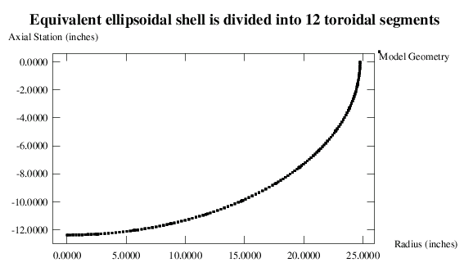
Externally pressurized ellipsoidal shell
Shell wall thickness varies along the meridian. BIGBOSOR4 is used to do the various analyses. ADS is used to do the optimization. Decision variables are shell skin thicknesses and isogrid stiffener heights at several meridional “callout” points.
Notes:
The text within the frame of the plot is not complete. The spacing of the isogrid, SPACNG, and the thickness of an isogrid member, THSTIF, are also decision variables. For the isogrid-stiffened shell there are 28 decision variables:
Thickness of the shell wall at 13 meridional callout points: THKSKN(i), i = 1,13;
Height of the isogrid at the same 13 meridional callout points: HIGHST(i), i = 1,13;
Spacing of the isogrid, constant over the entire shell: SPACNG;
Thickness of an isogrid member, constant over the entire shell: THSTIF.
The callout points are provided by the “end” user and are listed in Table 28.

Slide 20
Externally pressurized ellipsoidal shell
Analyses performed:
1. Linear axisymmetric buckling (to get imperfection shapes)
2 and 3 Nonlinear axisymmetric analyses at design pressure to get local skin and stiffener buckling and stress in 2 regions for shell with mode 1 and mode 2 imperfection shapes
4 and 5. Nonlinear axisymmetric collapse analysis for shell with mode 1 and mode 2 imperfection shapes
6 and 7. Nonlinear nonaxisymmetric bifurcation buckling of axisymmetrically deformed shell for shell with mode 1 and mode 2 imperfection shapes
Region 2
Region 1
Notes:
Region 1 = shell segments 1 - 6. (0. < x < 17.634 inches)
Region 2 = shell segments 7 - 12. (17.634 < x < 24.75 inches)
+mode 1 and +mode 2 imperfection shapes are in Load Set 1
-mode 1 and -mode 2 imperfection shapes are in Load Set 2.

Slide 21
Interactive GENTEXT session (3)
y $ Any more variables for role types 1 or 2 ? $20
1 $ Type of prompt: 0="help" paragraph, 1=one-line prompt
ainput $ Name of a variable in the users program (defined below)
2 $ Role of the variable in the users program
2 $ type of variable: 1 =integer, 2 =floating point
n $ Is the variable ainput an array?
length of semi-major axis $ one-line definition of ainput
y $ Do you want to include a "help" paragraph?
ainput is the maximum "x=dimension" of the ellipse.
y $ Any more lines in the "help" paragraph?
The equation for the ellipse is x^2/a^2 + y^2/b^2 = 1.0
n $ Any more lines in the "help" paragraph?
y $ Any more variables for role types 1 or 2 ? $25
1 $ Type of prompt: 0="help" paragraph, 1=one-line prompt
binput $ Name of a variable in the users program (defined below)
2 $ Role of the variable in the users program
2 $ type of variable: 1 =integer, 2 =floating point
n $ Is the variable binput an array?
length of semi-minor axis of ellipse $ one-line definition of binput
y $ Do you want to include a "help" paragraph?
binput is the y-dimension of the ellipse, the equation for which
y $ Any more lines in the "help" paragraph?
is x^2/a^2 + y^2/b^2 = 1.0.
n $ Any more lines in the "help" paragraph?
Notes:
This is from Table 3.

Slide 22
Glossary of variables produced automatically by GENOPT corresponding to the GENTEXT interactive input on the previous 5 slides
=========================================================================
ARRAY NUMBER OF PROMPT
? (ROWS,COLS) ROLE NUMBER NAME DEFINITION OF VARIABLE
(equivellipse.PRO)
=========================================================================
n ( 0, 0) 2 10 npoint = number of x-coordinates
n ( 0, 0) 2 15 Ixinpu = vector element number for
xinput in xinput(Ixinpu)
y ( 21, 0) 2 20 xinput = x-coordinates for ends of
segments
n ( 0, 0) 2 25 ainput = length of semi-major axis
n ( 0, 0) 2 30 binput = length of semi-minor axis
of the ellipse
n ( 0, 0) 2 35 nodes = number of nodal points per
segment
n ( 0, 0) 2 40 xlimit = max. x-coordinate for
x-coordinate callouts
Notes:
From Table 4: Glossary of variables used in the generic case called "equivellipse" corresponding to the GENOPT user's interactive input to "GENTEXT" listed in Table 3. The complete glossary generated by GENOPT upon the GENOPT user's completion of the entire "GENTEXT" interactive session is listed in Table 2 and forms part of the file, equivellipse.DEF, which is listed in Table a2 in the appendix. (“equivellipse” is the generic name selected by the GENOPT user for the class of objects to be optimized). See Table 1 for definitions of “ROLE”, and see the next table for more on “PROMPT NUMBER” (the partial equivellipse.PRO file).

Slide 23
Prompting file produced automatically by GENOPT corresponding to the GENTEXT interactive input on the previous slides (2)
25.1 length of semi-major axis: ainput
25.2
ainput is the maximum "x=dimension" of the ellipse.
The equation for the ellipse is x^2/a^2 + y^2/b^2 = 1.0
30.1 length of semi-minor axis of ellipse: binput
30.2
binput is the y-dimension of the ellipse, the equation for
which is x^2/a^2 + y^2/b^2 = 1.0.
35.1 number of nodal points per segment: nodes
35.2
If you have about 10 segments, use a number less than 31.
Use an odd number, greater than or equal to 11
40.1 max. x-coordinate for x-coordinate callouts: xlimit
40.2
Notes:
This is from Table 5.

Slide 24
GENOPT automatically generates labeled common blocks
===============================================================
COMMON/FV01/xinput(21),Ixinpu
REAL xinput
COMMON/FV02/ainput,binput,xlimit,SPACNG,THSTIF,THKCYL,RADCYL
REAL ainput,binput,xlimit,SPACNG,THSTIF,THKCYL,RADCYL
COMMON/FV05/THKSKN(21),HIGHST(21)
REAL THKSKN,HIGHST
COMMON/IV01/npoint,nodes,IMODE
INTEGER npoint,nodes,IMODE
================================================================
Notes:
Table 9 Portion of the equivellipse.COM file generated automatically by "GENTEXT" that corresponds to the GENOPT user's input listed in Table 3. GENOPT inserts these labeled
common blocks and variable declarations in all the FORTRAN libraries listed in Table 7. This list forms part of the complete equivellipse.COM file that appears in Table a6 of the
appendix of [26]. The complete equivellipse.COM file exists when the GENOPT user has completed the interactive "GENTEXT" session.

Slide 25
GENOPT automatically generates FORTRAN code(2)
IF (Ixinpu .EQ.0) GO TO 16
DO 15 I=1,Ixinpu
REWIND IFILE
CALL DATUM(IFILE, 20,1,2,
1 INT,xinput(I),CHARAC, IOUT,I,0,1,IPROMP)
CALL GETVAR(I,0, xinput(I), IPAR, PAR,WORDP)
15 CONTINUE
16 CONTINUE
CALL DATUM(IFILE, 25,1,2,INT,ainput,CHARAC,IOUT,0,0,0,IPROMP)
CALL GETVAR(0,0, ainput, IPAR, PAR,WORDP)
CALL DATUM(IFILE, 30,1,2,INT,binput,CHARAC,IOUT,0,0,0,IPROMP)
CALL GETVAR(0,0, binput, IPAR, PAR,WORDP)
CALL DATUM(IFILE, 35,1,2,nodes , REALL,CHARAC,IOUT,0,0,0,IPROMP)
CALL DATUM(IFILE, 40,1,2, INT,xlimit ,CHARAC,IOUT,0,0,0,IPROMP)
CALL GETVAR(0,0, xlimit , IPAR, PAR,WORDP)
WRITE(6,'(A)')' '
WRITE(6,'(A)')
1 ' DEFINITION OF THE ROW INDEX OF THE ARRAY, THKSKN = '
WRITE(6,'(A)')
1 ' vector element number for xinput'
WRITE(6,'(A)')' '
Notes:
This is from Table 13. The next slide shows entries in the *.BEG file corresponding to the “end” user’s responses to the promptings during the interactive session in “BEGIN” that are generated by the calls to SUBROUTINE DATUM in the FORTRAN fragment reproduced in this slide.

Slide 26
Corresponding to the “CALL DATUM” statements on the previous slide, we have from *.BEG:
0.000000 $ x-coordinates for ends of segments: xinput( 1)
2.554500 $ x-coordinates for ends of segments: xinput( 2)
5.666450 $ x-coordinates for ends of segments: xinput( 3)
8.753630 $ x-coordinates for ends of segments: xinput( 4)
11.79770 $ x-coordinates for ends of segments: xinput( 5)
14.77232 $ x-coordinates for ends of segments: xinput( 6)
17.63477 $ x-coordinates for ends of segments: xinput( 7)
19.63631 $ x-coordinates for ends of segments: xinput( 8)
21.26065 $ x-coordinates for ends of segments: xinput( 9)
22.70426 $ x-coordinates for ends of segments: xinput(10)
23.86535 $ x-coordinates for ends of segments: xinput(11)
24.54286 $ x-coordinates for ends of segments: xinput(12)
24.75000 $ x-coordinates for ends of segments: xinput(13)
24.75000 $ length of semi-major axis: ainput
12.37500 $ length of semi-minor axis of ellipse: binput
11 $ number of nodal points per segment: nodes
17.63477 $ max. x-coordinate for x-coordinate callouts: xlimit
Notes:
From Table 35: Input data for the “BEGIN” processor corresponding to the “CALL DATUM” statements in the FORTRAN fragment listed in the previous slide.

Slide 27
More GENTEXT interactive input, this time for a Role 4,5,6 “bundle”
=========================================================================
y $ Any more variables for role type 4 ? $160
1 $ Type of prompt: 0="help" paragraph, 1=one-line prompt
STFBK1 $ Name of a variable in the users program (defined below)
4 $ Role of the variable in the users program
n $ Do you want to reset the number of columns in STFBK1 ?
buckling load factor, isogrid member,mode 1 $one-line definition,STFBK1
n $ Do you want to include a "help" paragraph?
1 $ Type of prompt: 0="help" paragraph, 1=one-line prompt
STFBK1A $ Name of a variable in the users program (defined below)
5 $ Role of the variable in the users program
allowable for isogrid stiffener buckling (Use 1.)$ definition, STFBK1A
n $ Do you want to include a "help" paragraph?
1 $ Type of prompt: 0="help" paragraph, 1=one-line prompt
STFBK1F $ Name of a variable in the users program (defined below)
6 $ Role of the variable in the users program
factor of safety for isogrid stiffener buckling$ definition, STFBK1F
n $ Do you want to include a "help" paragraph?
2 $ Indicator (1 or 2 or 3) for type of constraint
Notes:
From Table 15: Portion of the equivellipse.DAT file relating to some Role 4, 5, and 6 variables established and defined by the GENOPT user during the interactive GENTEXT session. When the GENOPT user has completed the GENTEXT interactive session the complete equivellipse.DAT file becomes a file that is called equivellipse.INP. See Table a1 of the appendix for a list of equivellipse.INP. The GENOPT user’s responses to the prompts are in bold face in this table. The variable names, the one-line definitions of the variables, and the “help” paragraphs, created by the GENOPT user during the GENTEXT interactive session, will be seen by the “end” user. If the GENOPT user has done his or her job well, the program system created by GENOPT (BEGIN, DECIDE, MAINSETUP, OPTIMIZE, CHOOSEPLOT, etc.), that is, the program system for the generic case, “equivellipse”, to be used later by the “end” user for specific cases (such as a specific case called “eqellipse”), will be user-friendly. Note that the GENOPT user (the writer) did not create any “help” paragraphs here. It would have been better if he had. See Section 3.7 for suggestions for typical “help” paragraphs that the GENOPT user should probably have included. The next slide explains the last prompt in this slide: “Indicator (1 or 2 or 3) for type of constraint”.

Slide 28
Types of design constraints
2 For a feasible design the actual response, BEHAV,
must be greater than the product of the allowable
response, ALLOW, times its factor of safety, FSAFE.
EXAMPLES: (a) buckling load factor must be greater than
the allowable value x the factor of safety
for buckling.
(b) lowest natural frequency must be greater
than the allowable value x the factor of
safety for natural frequency.
For example, a design margin of this type is expressed as:
[(BEHAVIOR)/(ALLOWABLE BEHAVIOR)] /(FACTOR OF SAFETY) - 1
3 For a feasible design the allowable response, ALLOW
must be greater than the product of the actual
response, BEHAV, times its factor of safety, FSAFE. (same
as for INDX = 1). However, the margin has a different form
EXAMPLE: Allowable stress must be greater than the actual
stress x the factor of safety for stress.
For example, a design margin of this type is expressed as:
[(ALLOWABLE BEHAVIOR)/(BEHAVIOR)] /(FACTOR OF SAFETY) - 1
Notes:
From Table 16. This slide explains the last prompt on the previous slide, “Indicator (1 or 2 or 3) for type of constraint”. This list is from Table 16, entitled: Explanation of three types of behavioral constraints corresponding to the prompt in the previous table: "Indicator (1 or 2 or 3) for type of constraint". In the “equivellipse” application of GENOPT only Indicators 2 and 3 are used. See Tables 31 and 32 for typical margins.

Slide 29
FORTRAN code automatically written by GENOPT(3)
================================================================
C Behavior and constraints generated next for STFBK1:
C STFBK1 = buckling load factor, isogrid member, mode 1
C
IF (JSKNBK1.EQ.0) GO TO 176
IF (NPRINX.GT.0) THEN
IF (JSKNBK1.GT.1) THEN
WRITE(IFILE8,'(1X,A)')' '
WRITE(IFILE8,'(1X,A,$)')' BEHAVIOR OVER J = '
WRITE(IFILE8,'(1X,A)')
1 'number of regions for computing behavior'
ENDIF
ENDIF
DO 175 J=1,JSKNBK1
CALL CONVR2(J,CJX)
PHRASE =
1 'buckling load factor, isogrid member, mode 1'
CALL BLANKX(PHRASE,IENDP4)
IF (IBEHV(4 ).EQ.0) CALL BEHX4
1 (IFILE8,NPRINX,IMODX,IFAST,ILOADX,J,
1 'buckling load factor, isogrid member, mode 1')
Notes:
This list is from Table 20: Portion of the equivellipse.CON file generated automatically by "GENTEXT" that corresponds to the GENOPT user's input listed in Table 15. This list forms part of the complete equivellipse.CON file that appears in Table a12 of the appendix of [26]. The complete equivellipse.CON file exists when the GENOPT user has completed the interactive "GENTEXT" session. This FORTRAN fragment forms part the FORTRAN library,
struct.new, which contains the GENOPT-created skeletal version of SUBROUTINE STRUCT. The complete skeletal version of SUBROUTINE STRUCT is included in Table a14 of the appendix of [26]. See Section 3.7 for more on subroutines BEHXi, construction of design constraints, typical forms which the design margins have, and the meanings of array subscripts.

Slide 30
FORTRAN code automatically written by GENOPT(4)
IF (STFBK1(ILOADX,J).EQ.0.) STFBK1(ILOADX,J) = 1.E+10
IF (STFBK1A(ILOADX,J).EQ.0.) STFBK1A(ILOADX,J) = 1.0
IF (STFBK1F(ILOADX,J).EQ.0.) STFBK1F(ILOADX,J) = 1.0
KCONX = KCONX + 1
CARX(KCONX) =STFBK1(ILOADX,J)
WORDCX= '(STFBK1('//CIX//','//CJX//')/STFBK1A('//CIX//','//CJX//
1 ')) / STFBK1F('//CIX//','//CJX//')'
CALL CONX(STFBK1(ILOADX,J),STFBK1A(ILOADX,J),
1 STFBK1F(ILOADX,J)
1,'buckling load factor, isogrid member, mode 1',
1 'allowable for isogrid stiffener buckling (Use 1.)',
1 'factor of safety for isogrid stiffener buckling',
1 2,INUMTT,IMODX,CONMAX,ICONSX,IPOINC,CONSTX,WORDCX,
1 WORDMX,PCWORD,CPLOTX,ICARX)
IF (IMODX.EQ.0) THEN
CODPHR =
1 ' buckling load factor, isogrid member, mode 1: '
IENDP4 =48
CODNAM ='STFBK1('//CIX//','//CJX//')'
MLET4 =6 + 7
WORDBX(KCONX)= CODPHR(1:IENDP4)//CODNAM(1:MLET4)
IF (NPRINX.GT.0) WRITE(IFILE8,'(I5,6X,G14.7,A,A)')
1 KCONX,CARX(KCONX),CODPHR(1:IENDP4),CODNAM(1:MLET4)
ENDIF
175 CONTINUE
176 CONTINUE
Notes:
This list is from Table 20. This GENOPT-created FORTRAN coding produces the design margin listed on the next slide, the margin that involves the GENOPT-user variables, STFBK1, STFBK1A, STFBK1F. These variables pertain to local buckling of an isogrid member in the presence of a +mode 1 axisymmetric linear buckling modal imperfection shape if ILOADX = 1 and in the presence of a -mode 1 axisymmetric linear buckling modal imperfection shape if ILOADX = 2.

Slide 31
The design margin corresponding to the FORTRAN coding shown in the previous slide
A typical margin with the meanings of the indices, a, b, c, d, e, explained:
a b
5 1.919E+00 (STFBK1(1,1)/STFBK1A(1,1))/STFBK1F(1,1)-1; F.S.= 1.00
c d e c d e c d e
"STFBK" means "Stiffener buckling"
a = "A" means "Allowable value"
b = "F" means "Factor of safety"
c = Imperfection mode number, (1 or 2 in the cases explored here)
d = Load set number (1 or 2 in the cases explored here)
Load set 1 means "use +mode 1 and +mode 2 imperfection shapes"
Load set 2 means "use -mode 1 and -mode 2 imperfection shapes"
e = Region number:
(1 or 2 Region 1 is from the axis of revolution to xlimit,
that is, 0 < x < xlimit.
Region 2 is from xlimit to the equator,
that is, xlimit < x < semi-major axis.)
Notes:
This information is provided in Table 31, which lists the design margins corresponding to Load Set Number 1 for the optimized isogrid-stiffened equivalent ellipsoidal shell. The design margin listed here (Margin Number 5) is computed by the FORTRAN fragment given in the previous slide.

Slide 32
One of the skeletal “behavior” subroutines written by GENOPT(1)
C=DECK BEHX4
SUBROUTINE BEHX4
1 (IFILE,NPRINX,IMODX,IFAST,ILOADX,JCOL,PHRASE)
C
C PURPOSE: OBTAIN buckling load factor, isogrid member, mode 1
C
C YOU MUST WRITE CODE THAT, USING
C THE VARIABLES IN THE LABELLED
C COMMON BLOCKS AS INPUT, ULTIMATELY
C YIELDS THE RESPONSE VARIABLE FOR
C THE ith LOAD CASE, ILOADX:
C
C STFBK1(ILOADX,JCOL)
C
C AS OUTPUT. THE ith CASE REFERS
C TO ith ENVIRONMENT (e.g. load com-
C bination).
C THE jth COLUMN (JCOL)
C INDEX IS DEFINED AS FOLLOWS:
C number of regions for computing behavior
STFBK1 is the behavior that must be computed
Notes:
From Table 25. Portion of the behavior.new file generated automatically by GENTEXT that corresponds to the GENOPT user's input listed in Table 15. The complete behavior.new file, available after the GENOPT user has completed the interactive "GENTEXT" session, is
listed in Table a13 of the appendix of [26]. The behavior.new file created by GENTEXT contains the skeletal version of SUBROUTINES BEHXi, I = 1, 2, 3... In the present application of GENOPT the GENOPT user does not modify these skeletal subroutines, but instead "fleshes out" only SUBROUTINE STRUCT. The file, equivellipse.SUB, contains similar FORTRAN coding as behavior.new after the GENOPT user's completion of the "GENTEXT" interactive session. equivellipse.SUB lacks a copy of the file, equivellipse.DEF and lacks the labeled common blocks generated automatically by “GENTEXT” and added to each BEHXi, i=1,14, in the skeletal behavior.new file. equivellipse.SUB is listed in Table a28 of the appendix of [26].

Slide 33
One of the skeletal “behavior” subroutines written by GENOPT(2)
C DEFINITIONS OF INPUT DATA:
C IMODX = DESIGN CONTROL INTEGER:
C IMODX = 0 MEANS BASELINE DESIGN
C IMODX = 1 MEANS PERTURBED DESIGN
C IFAST = 0 MEANS FEW SHORTCUTS FOR PERTURBED DESIGNS
C IFAST = 1 MEANS MORE SHORTCUTS FOR PERTURBED DESIGNS
C IFILE = FILE FOR OUTPUT LIST:
C NPRINX= OUTPUT CONTROL INTEGER:
C NPRINX=0 MEANS SMALLEST AMOUNT
C NPRINX=1 MEANS MEDIUM AMOUNT
C NPRINX=2 MEANS LOTS OF OUTPUT
C
C ILOADX = ith LOADING COMBINATION
C JCOL = jth column of STFBK1
C JCOL = number of regions for computing behavior
C PHRASE = buckling load factor, isogrid member, mode 1
C
C OUTPUT:
C
C STFBK1(ILOADX,JCOL)
STFBK1 is the behavior that must be computed
Notes:
This is from Table 25.

Slide 34
One of the skeletal “behavior” subroutines written by GENOPT(3)
C
CHARACTER*80 PHRASE
C INSERT ADDITIONAL COMMON BLOCKS:
(lines skipped to save space)
COMMON/FV28/STFBK1(20,10),STFBK1A(20,10),STFBK1F(20,10)
REAL STFBK1,STFBK1A,STFBK1F
COMMON/FV31/SKNST1(20,10),SKNST1A(20,10),SKNST1F(20,10)
REAL SKNST1,SKNST1A,SKNST1F
(lines skipped to save space)
C
C INSERT SUBROUTINE STATEMENTS HERE.
C
C
RETURN
END
This is where the GENOPT user may insert computer code that calculates the “behavior” called STFBK1.
Notes:
From Table 25. The GENOPT user may insert FORTRAN coding after the line that reads:
“INSERT SUBROUTINE STATEMENTS HERE.”
In the “equivellipse” application of GENOPT the GENOPT user “fleshed out” the skeletal version of SUBROUTINE STRUCT instead of “fleshing out” the skeletal “behavior” subroutines, BEHXi, I = 1, 2, 3,… In Ref. [2] Bushnell, D., "GENOPT--A program that writes user-friendly optimization code", International Journal of Solids and Structures, Vol. 26, No. 9/10, pp. 1173-1210, 1990, there is an example in which the skeletal “behavior” subroutines, BEHXi, I = 1, 2, 3, 4, are “fleshed out” by the GENOPT user.

Slide 35
Run stream to produce optimum design
================================================================
COMMAND PURPOSE OF THE COMMAND FILES
input output
begin establish the starting design *.BEG *.OPB
decide choose decision variables, bounds *.DEC *.OPD
mainsetup choose analysis type, strategy *.OPT -----
superopt 96-hour "batch" run. *.OPT *.OPP
five OPTIMIZEs per AUTOCHANGE
chooseplot choose what to plot vs design *.CPL -----
iterations.
diplot get plot file, *.5.ps various *.5.ps
superopt 96-hour "batch" run. *.OPT *.OPP
five OPTIMIZEs per AUTOCHANGE
chooseplot choose what to plot vs design *.CPL -----
iterations.
diplot get plot file, *.5.ps various *.5.ps
===================================================================
Notes:
From Table 39: Run stream to produce the results for the imperfect, isogrid-stiffened equivalent ellipsoidal shell, which is the case called "eqellipse.stiffened" in the directory,
/home/progs/genopt/case/torisph. The GENOPT case is run in the directory, /home/progs/genoptcase. (/home/progs = the directory where the GENOPT system is stored on the writer’s computer).

Slide 36
Optimized isogrid-stiffened imperfect shell:
Margins for Load Set 1 (2)
RESULTS FOR LOAD SET NO. 1 (+mode 1 axisymmetric imperfection)
MARGINS CORRESPONDING TO CURRENT DESIGN (F.S.= FACTOR OF SAFETY)
MARGIN CURRENT
NO. VALUE DEFINITION
1 6.209E-01 (CLAPS1(1 )/CLAPS1A(1 )) / CLAPS1F(1 )-1; F.S.= 1.00
2 1.589E+00 (GENBK1(1 )/GENBK1A(1 )) / GENBK1F(1 )-1; F.S.= 1.00
3 1.686E+00 (SKNBK1(1,1)/SKNBK1A(1,1))/SKNBK1F(1,1)-1; F.S.= 1.00
4 1.689E+00 (SKNBK1(1,2)/SKNBK1A(1,2))/SKNBK1F(1,2)-1; F.S.= 1.00
5 1.919E+00 (STFBK1(1,1)/STFBK1A(1,1))/STFBK1F(1,1)-1; F.S.= 1.00
6 5.813E-01 (STFBK1(1,2)/STFBK1A(1,2))/STFBK1F(1,2)-1; F.S.= 1.00
7 3.470E-01 (SKNST1A(1,1)/SKNST1(1,1))/SKNST1F(1,1)-1; F.S.= 1.00
8 1.382E-01 (SKNST1A(1,2)/SKNST1(1,2))/SKNST1F(1,2)-1; F.S.= 1.00
9 3.923E-01 (STFST1A(1,1)/STFST1(1,1))/STFST1F(1,1)-1; F.S.= 1.00
10 -3.816E-02 (STFST1A(1,2)/STFST1(1,2))/STFST1F(1,2)-1; F.S.= 1.00
11 1.427E+00 (WAPEX1A(1 )/WAPEX1(1 )) / WAPEX1F(1 )-1; F.S.= 1.00
Notes:
This list is from Table 31. Critical and nearly critical margins are Margin numbers 8 and 10.

Slide 37
Optimized isogrid-stiffened imperfect shell:
Margins for Load Set 1 (3)
RESULTS FOR LOAD SET NO. 1 (+mode 2 axisymmetric imperfection)
MARGINS CORRESPONDING TO CURRENT DESIGN (F.S.= FACTOR OF SAFETY)
MARGIN CURRENT
NO. VALUE DEFINITION
12 6.727E-01 (CLAPS2(1 )/CLAPS2A(1 )) / CLAPS2F(1 )-1; F.S.= 1.00
13 1.682E+00 (GENBK2(1 )/GENBK2A(1 )) / GENBK2F(1 )-1; F.S.= 1.00
14 1.992E+00 (SKNBK2(1,1)/SKNBK2A(1,1))/SKNBK2F(1,1)-1; F.S.= 1.00
15 2.149E+00 (SKNBK2(1,2)/SKNBK2A(1,2))/SKNBK2F(1,2)-1; F.S.= 1.00
16 8.143E-01 (STFBK2(1,1)/STFBK2A(1,1))/STFBK2F(1,1)-1; F.S.= 1.00
17 7.200E-01 (STFBK2(1,2)/STFBK2A(1,2))/STFBK2F(1,2)-1; F.S.= 1.00
18 4.290E-01 (SKNST2A(1,1)/SKNST2(1,1))/SKNST2F(1,1)-1; F.S.= 1.00
19 4.917E-02 (SKNST2A(1,2)/SKNST2(1,2))/SKNST2F(1,2)-1; F.S.= 1.00
20 -2.078E-02 (STFST2A(1,1)/STFST2(1,1))/STFST2F(1,1)-1; F.S.= 1.00
21 -2.687E-02 (STFST2A(1,2)/STFST2(1,2))/STFST2F(1,2)-1; F.S.= 1.00
22 1.205E+00 (WAPEX2A(1 )/WAPEX2(1 )) / WAPEX2F(1 )-1; F.S.= 1.00
========================================================================
Notes:
This list is from Table 31. Critical and nearly critical margins are Margin numbers 19 - 21.

Slide 38
Optimized isogrid-stiffened imperfect shell:
Margins for Load Set 2 (1)
RESULTS FOR LOAD SET NO. 2 (-mode 1 axisymmetric imperfection)
MARGINS CORRESPONDING TO CURRENT DESIGN (F.S.= FACTOR OF SAFETY)
MARGIN CURRENT
NO. VALUE DEFINITION
1 2.455E-02 (CLAPS1(2 )/CLAPS1A(2 )) / CLAPS1F(2 )-1; F.S.= 1.00
2 5.860E-01 (GENBK1(2 )/GENBK1A(2 )) / GENBK1F(2 )-1; F.S.= 1.00
3 2.168E+00 (SKNBK1(2,1)/SKNBK1A(2,1))/SKNBK1F(2,1)-1; F.S.= 1.00
4 2.298E+00 (SKNBK1(2,2)/SKNBK1A(2,2))/SKNBK1F(2,2)-1; F.S.= 1.00
5 1.477E-01 (STFBK1(2,1)/STFBK1A(2,1))/STFBK1F(2,1)-1; F.S.= 1.00
6 3.683E-01 (STFBK1(2,2)/STFBK1A(2,2))/STFBK1F(2,2)-1; F.S.= 1.00
7 -4.325E-03 (SKNST1A(2,1)/SKNST1(2,1))/SKNST1F(2,1)-1; F.S.= 1.00
8 4.979E-02 (SKNST1A(2,2)/SKNST1(2,2))/SKNST1F(2,2)-1; F.S.= 1.00
9 2.005E-02 (STFST1A(2,1)/STFST1(2,1))/STFST1F(2,1)-1; F.S.= 1.00
10 -1.268E-02 (STFST1A(2,2)/STFST1(2,2))/STFST1F(2,2)-1; F.S.= 1.00
11 3.043E-01 (WAPEX1A(2 )/WAPEX1(2 )) / WAPEX1F(2 )-1; F.S.= 1.00
Notes:
This list is from Table 32: Optimized imperfect isogrid-stiffened equivalent elliposidal
shell. Design margins from Load Set 2 (-mode 1 and -mode 2 imperfection
shapes) corresponding to the design optimized with the use of only mode 1
and mode 2 imperfection shapes. These margins are developed via the seven
analyses of the type listed in Table 30. Critical and nearly critical margins are Margin numbers 1, 5, 7-10.

Slide 39
Optimized isogrid-stiffened imperfect shell:
Margins for Load Set 2 (2)
RESULTS FOR LOAD SET NO. 2 (-mode 2 axisymmetric imperfection)
MARGINS CORRESPONDING TO CURRENT DESIGN (F.S.= FACTOR OF SAFETY)
MARGIN CURRENT
NO. VALUE DEFINITION
12 6.727E-01 (CLAPS2(2 )/CLAPS2A(2 )) / CLAPS2F(2 )-1; F.S.= 1.00
13 1.151E+00 (GENBK2(2 )/GENBK2A(2 )) / GENBK2F(2 )-1; F.S.= 1.00
14 1.790E+00 (SKNBK2(2,1)/SKNBK2A(2,1))/SKNBK2F(2,1)-1; F.S.= 1.00
15 1.791E+00 (SKNBK2(2,2)/SKNBK2A(2,2))/SKNBK2F(2,2)-1; F.S.= 1.00
16 7.854E-02 (STFBK2(2,1)/STFBK2A(2,1))/STFBK2F(2,1)-1; F.S.= 1.00
17 1.232E+00 (STFBK2(2,2)/STFBK2A(2,2))/STFBK2F(2,2)-1; F.S.= 1.00
18 1.558E-01 (SKNST2A(2,1)/SKNST2(2,1))/SKNST2F(2,1)-1; F.S.= 1.00
19 1.423E-01 (SKNST2A(2,2)/SKNST2(2,2))/SKNST2F(2,2)-1; F.S.= 1.00
20 -1.639E-02 (STFST2A(2,1)/STFST2(2,1))/STFST2F(2,1)-1; F.S.= 1.00
21 -3.856E-02 (STFST2A(2,2)/STFST2(2,2))/STFST2F(2,2)-1; F.S.= 1.00
22 5.771E-01 (WAPEX2A(2 )/WAPEX2(2 )) / WAPEX2F(2 )-1; F.S.= 1.00 =======================================================================
Notes:
This list is from Table 32. Critical and nearly critical margins are Margin numbers 16 and 18-21.

Slide 40
Optimum designs from GENOPT
Notes:
Table 33 Four optimized “equivalent” ellipsoidal shells: values of the decision variables and the weight of the shells after possibly multiple executions of SUPEROPT. Dimensions are in inches. The optimum designs listed here were obtained with the use of only mode 1 and mode 2 axisymmetric imperfections. NOTE: The column headed, “unstiffened, imperfect” lists the “thick apex” optimum design developed in Section 9.3, in which the lower bound of the shell wall thickness in the neighborhood of the apex of the shell is set equal to 0.6 inches, a much higher lower bound than that used (0.1 inch) for the shell skin thickness for the other three optmum designs listed here.

Slide 41
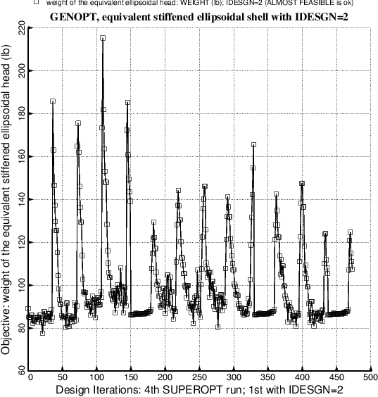
Evolution of the objective during an execution of SUPEROPT
Each “spike” is a new starting design obtained in a random fashion as described in [15]. The three “quiet” regions starting at about Iterations 150, 330, and 440 are caused by a temporary reduction in the move limit of the decision variables, as explained in Section 8.1.2.
Notes:
Fig. 3 Objective vs design iterations for the isogrid-stiffened imperfect shell for the last of a series of four executions of the GENOPT processor called SUPEROPT. Each “spike” in the plot corresponds to a new starting design, obtained randomly as described in [15]. The presence of the three “dense”, “quiet” regions starting approximately at Iteration Numbers 150, 325, and 440, is explained in Section 9 on p. 10 of [24] and in sub-section 8.1.2 of this paper. The purpose of these “quiet” regions, within which the move limits of the decision variables are severely restricted, is to close in on a possibly better optimum design in the neighborhood of the “best” design determined previous to that iteration at which the “quiet” region begins. At the end of each “quiet” region the move limits of the decision variables are re-expanded to their values used during the “non-quiet” design iterations, that is, during most of the SUPEROPT process, during which in this example the objective is rather “jumpy” from design iteration to iteration. The starting design before the first SUPEROPT is listed in Table 35.

Slide 42
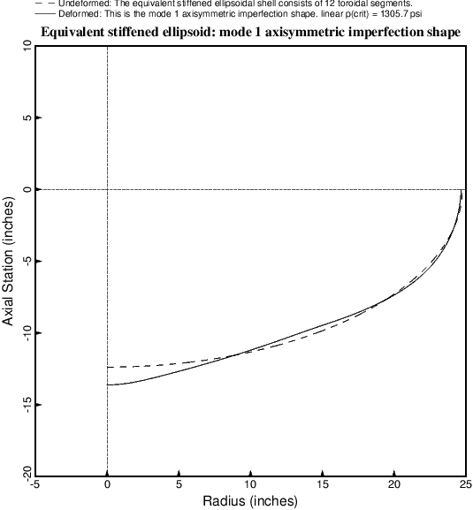
Axisymmetric “+mode 1” buckling modal imperfection from BIGBOSOR4
Optimized isogrid-stiffened equivalent ellipsoidal shell
Notes:
Fig. 4 First axisymmetric linear bifurcation buckling mode shape of the optimized isogrid-stiffened shell as computed by BIGBOSOR4. The corresponding linear bifurcation buckling pressure according to BIGBOSOR4 is p(crit) = 1305.7 psi. The program STAGS obtains a linear bifurcation buckling pressure of 1304.1 psi for this shell. (See Fig. 6). This axisymmetric mode, predicted by BIGBOSOR4, corresponds to the lowest eigenvalue in the STAGS model, as listed in Table 41. Compare with Fig. 6. This axisymmetric buckling mode is what is called in GENOPT jargon “mode 1”. Plus and minus versions of “mode 1” are used as initial axisymmetric imperfection shapes in computations of the local skin and stiffener stresses and buckling load factors, axisymmetric collapse loads, and general nonlinear bifurcation buckling load factors.

Slide 43
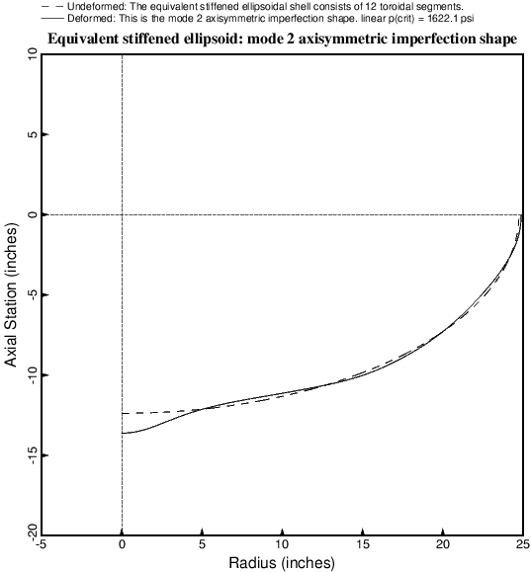
Axisymmetric “+mode 2” buckling modal imperfection from BIGBOSOR4
Optimized isogrid-stiffened equivalent ellipsoidal shell
Notes:
Fig. 5 Second axisymmetric bifurcation buckling mode shape of the optimized isogrid-stiffened shell as computed by BIGBOSOR4. The corresponding linear bifurcation buckling pressure according to BIGBOSOR4 is p(crit) = 1622.1 psi. The program STAGS obtains a linear bifurcation buckling pressure of 1612.3 psi for this second axisymmetric mode predicted by BIGBOSOR4. (See Fig. 9). In the STAGS model the second axisymmetric mode corresponds to the sixth eigenvalue, as listed in Table 41, following four non-axisymmetric modes, two of which are displayed in Figs. 7 and 8. Compare with Fig. 9. This axisymmetric buckling mode is what is called in GENOPT jargon “mode 2”. Plus and minus versions of “mode 2” are used as initial axisymmetric imperfection shapes in computations of the local skin and stiffener stresses and buckling load factors, axisymmetric collapse loads, and general nonlinear bifurcation buckling load factors.

Slide 44
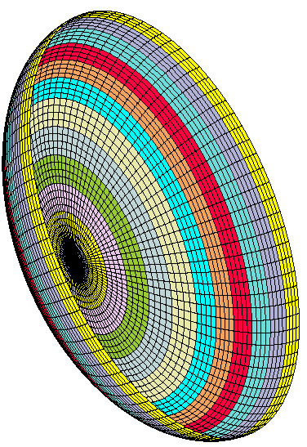
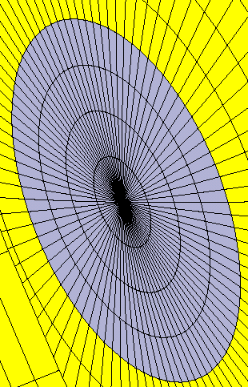
360-degree STAGS model of equivalent ellipsoidal shell
This STAGS model has 12 shell units. Each shell unit corresponds to the same part of the shell as each shell segment in the BIGBOSOR4 model.
Notes:
From Fig. a1 STAGS 360-degree model of the equivalent ellipsoidal shell with a spherical cap (shell unit 1) and 11 toroidal segments (shell units 2 – 12). Each of the twelve axisymmetric STAGS shell units is shown in a different color. This model is analogous to the BIGBOSOR4 model displayed in Fig. 2. The elongated shape of the 410 finite elements nearest the pole causes early lack of convergence in nonlinear cases that involve elastic-plastic mat’l. STAGS results in Figs. 6 – 168 are based on this 360-degree model.

Slide 45
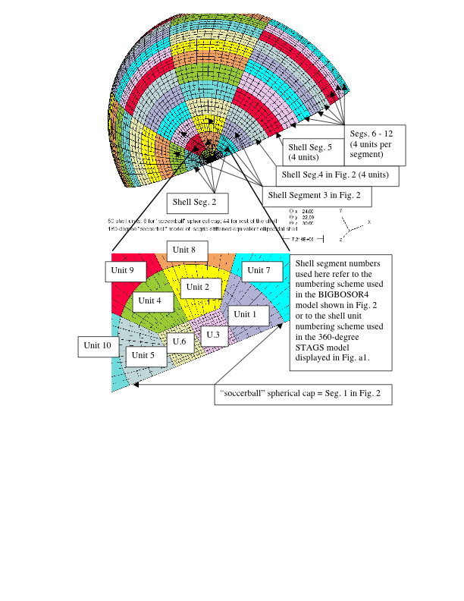
STAGS “soccerball” model of dome
Notes:
The STAGS “soccerball” model is more reliable than the simpler model shown on the previous slide. There are no numberical difficulties assoicated with the pole.

Slide 46
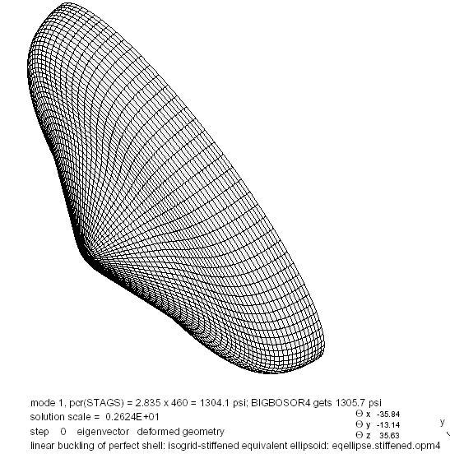
Linear buckling mode from STAGS
360-degree STAGS model. This buckling mode is analogous to the BIGBOSOR4 “mode 1” axisymmetric imperfection shape.
Notes:
Fig. 6 Fundamental linear bifurcation buckling mode of the optimized isogrid-stiffened equivalent ellipsoidal shell according to the STAGS program. The STAGS finite element model is shown in Fig. a1 of the appendix. Compare with the BIGBOSOR4 prediction in Fig. 4. The axisymmetric buckling mode analogous to this one but computed by BIGBOSOR4 (Fig. 4) is what is called in GENOPT jargon “mode 1”. Plus and minus versions of this STAGS linear bifurcation buckling mode are used as initial imperfection shapes in STAGS computations of the local skin and stiffener stresses and buckling load factors, collapse loads, and general nonlinear bifurcation buckling load factors of the optimized isogrid-stiffened shell. Compare with the 10-degree “slice” model in Fig. 36. Compare with the 180-degree STAGS “soccerball” model in Fig. 257 of [26].

Slide 47
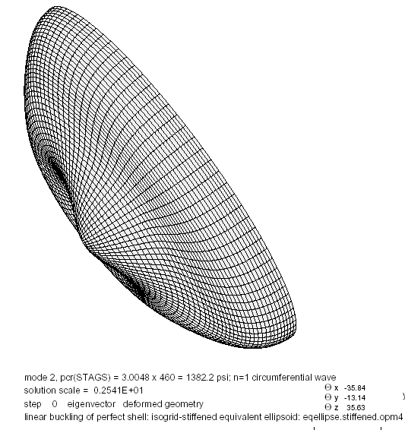
Linear buckling mode from STAGS
360-degree STAGS model. This is the most harmful imperfection shape. (n=1 circumferential wave).
Notes:
Fig. 7 Second linear bifurcation buckling mode of the optimized isogrid-stiffened equivalent ellipsoidal shell according to the STAGS program. This non-axisymmetric (n=1 circumferential wave) mode is the first of a pair of modes with exactly the same eigenvalue. The second non-axisymmetric mode in the pair is the same as the above except that the buckling mode is oriented differently circumferentially. This STAGS linear bifurcation buckling mode is used as an initial imperfection shape with amplitude, Wimp = 0.2 inch, to compute the nonlinear load-apex-deflection curve with upside-down triangles plotted as the seventh trace in Fig. 17. Compare with the 180-degree STAGS “soccerball” model in Fig. 258. Shells of revolution with imperfections with this non-axisymmetric shape cannot be handled by BIGBOSOR4. Therefore, GENOPT optimization occurs in the presence of only axisymmetric buckling modal imperfections.

Slide 48
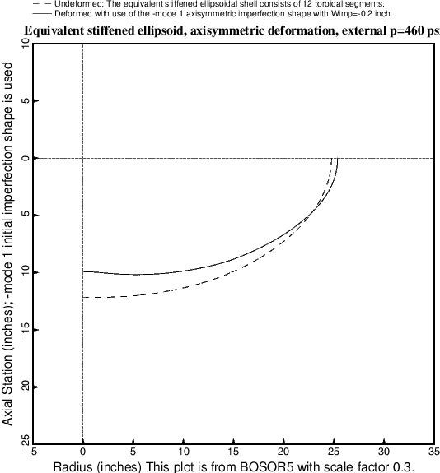
Axisymmetric deformation of optimized isogrid-stiffened shell with a -mode 1 buckling modal imperfection shape
Notes:
Fig. 14 BIGBOSOR4 prediction of axisymmetric deformation of the optimized imperfect isogrid-stiffened equivalent ellipsoidal shell with an axisymmetric –mode 1 linear bifurcation buckling modal imperfection shape with amplitude, Wimp = –0.2 inches. The applied external pressure is the design pressure, p = 460 psi. The shape of the buckling modal imperfection is the negative of that displayed in Fig. 4. The maximum stresses and local buckling load factors of skin and meridionally oriented isogrid members computed by BIGBOSOR4 and associated with this deformation pattern are listed for each shell segment in Table 44. The –mode 1 imperfection shape is the most critical with respect to axisymmetric collapse of the shell, as demonstrated in Fig. 16. Compare with Fig. 82 in [26], which pertains to the optimized unstiffened equivalent ellipsoidal shell.

Slide 49
Some BIGBOSOR4 stresses from the axisymmetric deformation shown in the previous slide (1)
Local skin and smeared stiffener buckling and stress, Seg. 1
Skin buckling load factor, BUCMIN=3.9282E+00 at pt. 2
Smeared stringer/isogrid buckling load factor,BUCMNS=5.4718E+00 at pt.13
Smeared ring buckling load factor, BUCMNR=1.0000E+17 at pt.13
Smeared stringer/isogrid maximum eff. stress, STFMXS=1.0224E+05 at pt. 2
Smeared ring maximum effective stress, STFMXR=0.0000E+00 at pt. 0
Shell skin maximum effective stress, SKNMAX=1.2052E+05 at pt. 3
Local skin and smeared stiffener buckling and stress, Seg. 5
Skin buckling load factor, BUCMIN=3.1685E+00 at pt. 1
Smeared stringer/isogrid buckling load factor,BUCMNS=1.3509E+00 at pt.10
Smeared ring buckling load factor, BUCMNR=1.0000E+17 at pt.13
Smeared stringer/isogrid maximum eff. stress, STFMXS=1.1764E+05 at pt.13
Smeared ring maximum effective stress, STFMXR=0.0000E+00 at pt. 0
Shell skin maximum effective stress, SKNMAX=7.5150E+04 at pt. 1
Local skin and smeared stiffener buckling and stress, Seg. 6
Skin buckling load factor, BUCMIN=3.2980E+00 at pt. 4
Smeared stringer/isogrid buckling load factor,BUCMNS=1.3683E+00 at pt. 2
Smeared ring buckling load factor, BUCMNR=1.0000E+17 at pt.13
Smeared stringer/isogrid maximum eff. stress, STFMXS=1.1803E+05 at pt. 1
Smeared ring maximum effective stress, STFMXR=0.0000E+00 at pt. 0
Shell skin maximum effective stress, SKNMAX=6.7917E+04 at pt.12
Notes:
This list is from Table 44: Output from SUBROUTINE STRUCT in GENOPT for local buckling and effective stress in the shell skin and in the meridionally oriented isogrid stiffener for the optimized imperfect isogrid-stiffened equivalent ellipsoidal shell with an axisymmetric
-mode 1 buckling modal imperfection with amplitude, Wimp = -0.2 inch. The applied external pressure is the design pressure, p = 460 psi. These are predictions from BIGBOSOR4. This file has been edited a bit to get each line in the actual GENOPT output to fit on a single line in this table. For a list of the actual and complete eqellipse.OPM file produced by GENOPT see Table a19 in the appendix. Critical and nearly critical stresses are listed in bold face. The locations of the shell segments are indicated in Fig. 2.

Slide 50
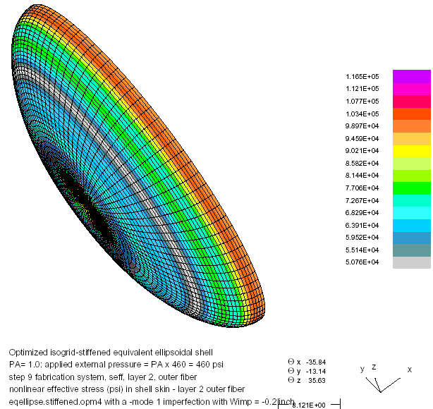
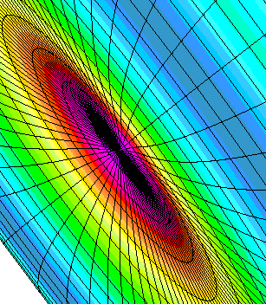
Effective stress at the outer fiber of the shell skin layer in the STAGS model at the design pressure, p=460 psi
–mode 1 imperfection
Maximum effective stress is at the pole and equals 116500 psi. BIGBOSOR4 predicts 120520 psi there.
Notes:
Fig. 31 Optimized isogrid-stiffened equivalent ellipsoidal shell at the external design pressure, p = 460 psi. STAGS prediction of outer fiber effective stress in the skin with a –mode 1 imperfection. Compare with the Table 44 prediction at Seg. 1: SKNMAX=120520 psi.

Slide 51
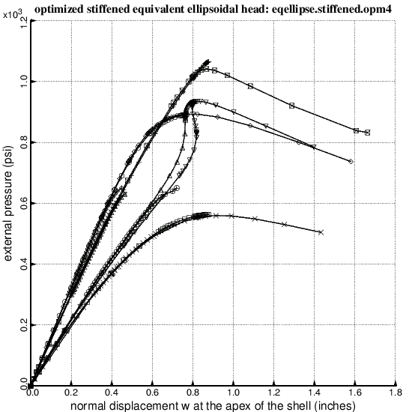
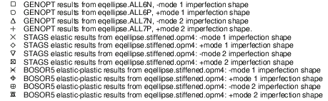
Axisymmetric collapse from BIGBOSOR4, STAGS, BOSOR5
+mode 2 imperf.
+mode 1 imperf.
-mode 2 imperf.
-mode 1 imperf.
Notes:
Fig. 16 Axisymmetric collapse of the optimized axisymmetrically imperfect isogrid-stiffened equivalent ellipsoidal shell under uniform external pressure from BIGBOSOR4 (elastic material), STAGS (elastic material) and BOSOR5 (elastic-plastic material). Compare with Fig. 83 of [26], which pertains to the optimized unstiffened shell. Compare trace 5 with results plotted in Fig. 254 for several STAGS models.

Slide 52
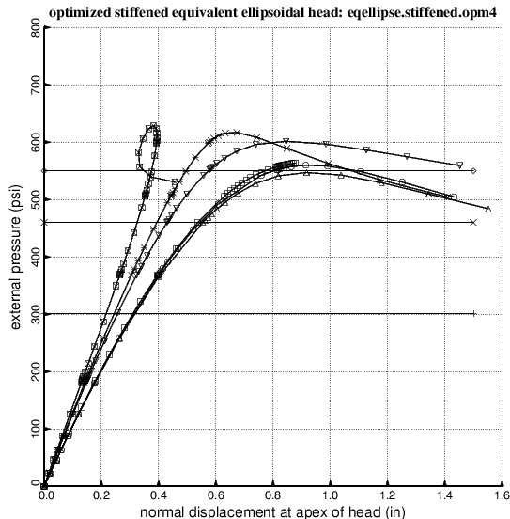
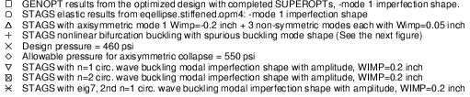
Axisymmetric and non-axisymmetric elastic collapse
Shells of revolution with imperfections with non-axisymmetric shapes cannot be handled by BIGBOSOR4. Therefore, GENOPT optimization occurs in the presence of only axisymmetric buckling modal imperfections.
n =2 circ. wave imperf.
n =1 circ. wave imperf.
n =1 circ. wave imperf.
n =0 circ. wave imperf.
Notes:
Fig. 17 Axisymmetric and non-axisymmetric collapse of optimized imperfect isogrid-stiffened equivalent ellipsoidal shells. The linear bifurcation buckling modal imperfection shapes corresponding to non-axisymmetric collapse (the last three traces) are displayed in Figs. 7, 8, and 10. In this case the –mode 1 (axisymmetric) buckling modal imperfection is predicted to be more harmful than the non-axisymmetric buckling modal imperfections with shapes given in Figs. 7, 8 and 10. This does not hold for the optimized unstiffened imperfect shell, as seen in Fig. 94. Compare with Fig. 254.

Slide 53
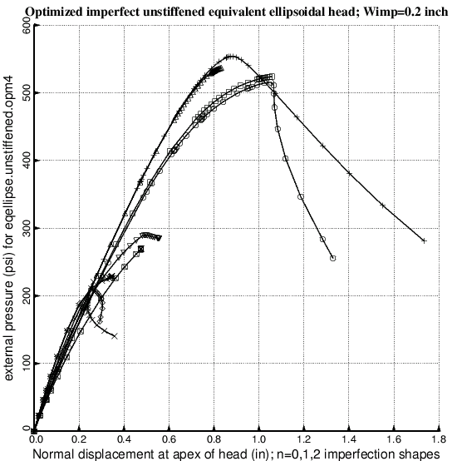
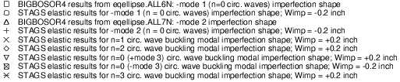
Collapse of optimized unstiffened imperfect equivalent ellipsoidal shell with buckling modal imperfections
NOTE: The lower bound of the shell wall thicknesses in the neighborhood of the apex was set equal to 0.1 inch during optimization cycles. These results correspond to the optimum design listed in the column headed “unstiffened, imperfect” in the version of Table 33 listed in [26] (the long report), not to the optimum design listed in the version of Table 33 given in this paper.
Notes:
Fig. 94 Nonlinear elastic load-deflection curves for the optimized imperfect unstiffened equivalent ellipsoidal shell from BIGBOSOR4 (axisymmetric deformation) and from STAGS (both axisymmetric and non-axisymmetric deformation). The most significant point to be emphasized with regard to this figure is that the pressure-carrying capability of the shell, which is optimized with regard to mode 1 and mode 2 axisymmetric imperfections (BIGBOSOR4 models in Figs. 74 and 75), is much more sensitive to non-axisymmetric imperfections (buckling modal imperfections with n = 1 and n = 2 circumferential waves) with the same amplitude, Wimp = 0.2 inch. The optimized unstiffened shell is therefore under-designed. Compare with the results for the “thick apex” optimized unstiffened shells plotted in Figs. 161 of [26] and 237.

Slide 54
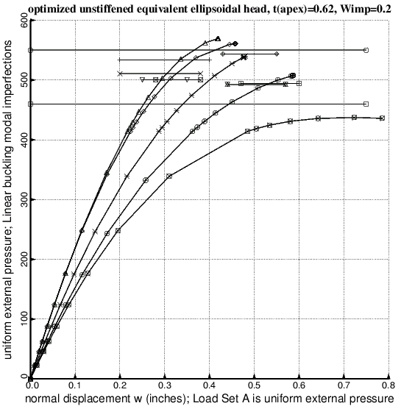
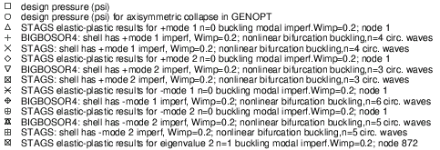
Collapse of optimized unstiffened imperfect equivalent ellipsoidal shell with buckling modal imperfections. Lower bound of t(apex)=0.6 in
NOTE: The lower bound of the shell wall thicknesses in the neighborhood of the apex was set equal to 0.6 inch during optimization cycles.
Notes:
Fig. 237 Optimized unstiffened equivalent ellipsoidal shell with thick apex, t(apex)=0.61996 inch; Wimp=0.2 inch; the optimum design is listed in Table 93 of [26]. STAGS elastic-plastic load-displacement curves and nonlinear bifurcation buckling loads and BIGBOSOR4 elastic nonlinear bifurcation buckling loads for various buckling modal imperfection shapes. Amplitude of each buckling modal imperfection, Wimp = 0.2 inch. Compare with Fig. 161 of [26], for which the optimum design is listed in Table 78 of [26], and compare with Figs. 209 and 211 of [26], for which Wimp=0.1 and optimum design is listed in Table 89 of [26].

Slide 55
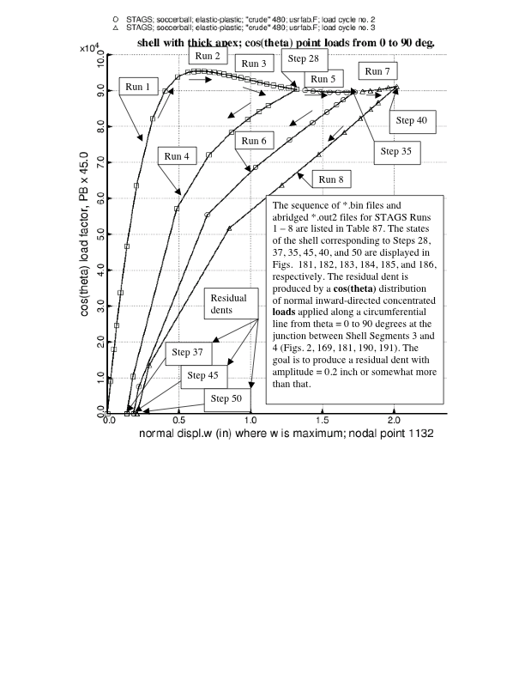
Use of STAGS to produce off-center “cos(theta)” residual dents of various depths. t(apex) = 0.4 inch
Notes:
Fig. 180 Optimized unstiffened equivalent ellipsoidal shell with thick apex, t(apex)=0.4 inch; Wimp=0.2 inch; the optimum design is listed in Table 78. Shown here are three load cycles for load set B (load factor PB) that produce residual dents of three different depths. The load set B consists of a number of normal concentrated loads applied along the junction of shell segments 3 and 4 that has a cos(theta) circumferential distribution from theta = 0 to 90 degrees. (Figs. 2, 169, 190, 191; See Shell units 11 and 12 listed in Table a40, except that the input datum, LT, in Load Set B is +1 instead of -1). This “cos(theta)” loading produces a more harmful dent than that produced by a pressure applied to a single finite element, as is demonstrated in Fig. 188. Compare with Fig. 175.

Slide 56
Conclusions (1)
  1. GENOPT can be used in combination with BIGBOSOR4 to obtain minimum-weight designs of imperfect isogrid-stiffened equivalent ellipsoidal shells under external pressure provided that the imperfection shapes are axisymmetric.
  2. Unstiffened imperfect shells should be optimized with relatively high lower bounds set on the thicknesses of the shell wall in the neighborhood of the shell apex.
  3. The “worst” imperfections are non-axisymmetric linear buckling modal imperfections with n=1 circumferential wave.
  5. Off-center residual dents produced by a single normal inward-directed concentrated load are significantly less harmful than off-center “cos(theta)” residual dents.
Notes:
11.0 CONCLUSIONS
1. GENOPT can be used in combination with BIGBOSOR4 to obtain minimum-weight designs of isogrid-stiffened or unstiffened perfect or imperfect ellipsoidal shells provided that the “equivalent” ellipsoid model (Table 29, Fig. 2) is used and provided that the imperfection shapes are axisymmetric.
2. Unstiffened imperfect shells should be optimized with relatively high lower bounds set on the thicknesses of the shell wall in the neighborhood of the shell apex (Table 77 of [26]). In the case of the unstiffened, imperfect shell, if the lower bound of the wall thickness in the neighborhood of the shell apex is set too low the thickness distribution in the neighborhood of the shell apex evolves during optimization cycles in a way that essentially isolates the apex from the remainder of the shell. This produces optimum designs the collapse pressures of which are especially sensitive to non-axisymmetric imperfection shapes, a type of imperfection that cannot be modeled with BIGBOSOR4 and therefore cannot be accommodated during the GENOPT optimization process.
3. It is generally found from STAGS models that for optimized shells the “worst” imperfections are non-axisymmetric linear buckling modal imperfections with n=1 circumferential wave (Figs. 94, 109, 161, 176, 209, 211, 237 and 254 of [26] and Figs. 94, 161, and 254 here).
4. For the optimized unstiffened imperfect shell it is found that imperfections in the form of off-center residual dents produced by a distribution of normal inward-directed concentrated loads that vary as the cos(theta) over a circumferential line from circumferential coordinate, theta = 0 to 90 degrees applied at a radius from the axis of revolution that corresponds to the first pronounced “valley” or “ridge” in the non-axisymmetric linear buckling mode shape with n=1 circumferential wave are approximately as harmful as the n=1 linear buckling modal imperfection shapes (Figs. 188, 190, 205, 211, 217, 232, 237, 241 in [26] and Figs. 148 and 188 here).
5. Off-center residual dents produced by a single normal inward-directed concentrated load are significantly less harmful than off-center “cos(theta)” residual dents (Figs. 176, 188, 200 in [26] and Figs. 148 and 188 here).
6. A STAGS “soccerball” model (Figs. 169, a2 – a13 in [26] and Fig. a2 here) of the optimized shells is better than a 360-degree STAGS model based on polar coordinates (Fig. a1) because the STAGS 480 finite element, which fails when used for nonlinear analysis in connection with the 360-degree model, works well when used in connection with the “soccerball” model, which has no singularity at the apex of the shell. Also, spurious buckling modes such as that shown in Figs 18 and 19 of [26] are avoided when the STAGS “soccerball” model is used.
7. The STAGS user should rely on user-written SUBROUTINE USRFAB rather than on user-written SUBROUTINE WALL for providing wall properties that vary within a shell unit (Fig. 175 in [26]).
8. Sections 3.0 – 6.0 of this paper contain enough detail about how GENOPT works so that the reader can use it as a guide for setting up user-friendly optimization software for other structural or even non-structural applications.
9. The material about STAGS models in [26] is extensive enough so that the reader should be able to set up other STAGS models without too much trouble.

Slide 57
Conclusions (2)
  6. A STAGS “soccerball” model of the optimized shells is better than a 360-degree STAGS model based on polar coordinates.
  8. Sections 3.0 – 6.0 of this paper contain enough detail about how GENOPT works so that the reader can use it as a guide for setting up user-friendly optimization software for other structural or even non-structural applications.
  9. The material about STAGS models in [26] is extensive enough so that the reader should be able to set up other STAGS models without too much trouble.
Notes:
More conclusions.

