Slide 1
MODE JUMPING
AIAA Paper-97-1141
AIAA 38th SDM Meeting, 1997
Notes:
REFERENCE:
Bushnell, David, Rankin, Charles C., and Riks, Eduard, “Optimization of stiffened panels in which mode jumping is accounted for”, AIAA Paper 97-1141, 38th AIAA Structures, Structural Dynamics and Materials Conference, April 1997

Slide 2
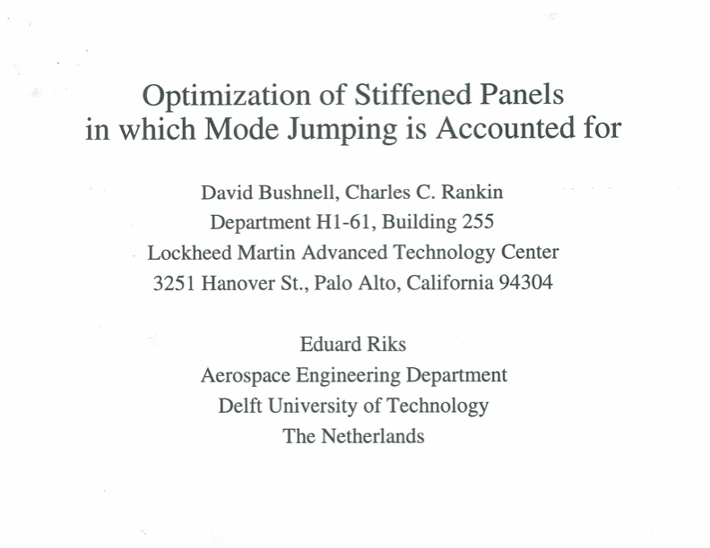
Notes:
REFERENCE:
Bushnell, David, Rankin, Charles C., and Riks, Eduard, “Optimization of stiffened panels in which mode jumping is accounted for”, AIAA Paper 97-1141, 38th AIAA Structures, Structural Dynamics and Materials Conference, April 1997
ABSTRACT: PANDA2 is a computer program for the minimum weight design of stiffened composite, flat or cylindrical, perfect or imperfect panels and shells subject to multiple sets of combined in-plane loads, normal pressure, edge moments and temperature. STAGS is a general-purpose nonlinear finite element code that is specifically designed to analyze especially difficult stability problems in shell structures. Weight optimization of stiffened panels can be particularly troublesome when local buckling is allowed to occur in the pre-collapse state. For these systems, designs may be affected by interaction between local modes, a mechanism that manifests itself as mode jumping and is difficult to characterize. In this paper we describe how in PANDA2 mode jumping is detected and suppressed in optimized panels. Two axially compressed blade stiffened panels optimized by PANDA2 for service in the far post-buckling regime were numerically tested by STAGS. Mode jumping was permitted to occur below the design load in the first panel and suppressed in the second. Results obtained by STAGS are in reasonably good agreement with predictions by PANDA2. The first panel optimized by PANDA2 under the condition that mode jumping is not considered exhibits mode jumping well below the design load according to STAGS. Application of STAGS to this panel reveals that even though the mode jump involves little change in potential energy it generates large amplitude oscillating stresses in the panel skin with significant stress reversal that might well cause fatigue in a metallic panel and delamination in a laminated composite panel. The oscillating stresses are caused by post-local-buckling lobes in the panel skin that move to and fro along the panel axis immediately after initiation of the mode jump. The second panel optimized by PANDA2 in the presence of a constraint that prevents mode jumping at a load below the design load is significantly heavier than the first panel, but mode jumping according to STAGS does not occur until a load well above the design load.

Slide 3
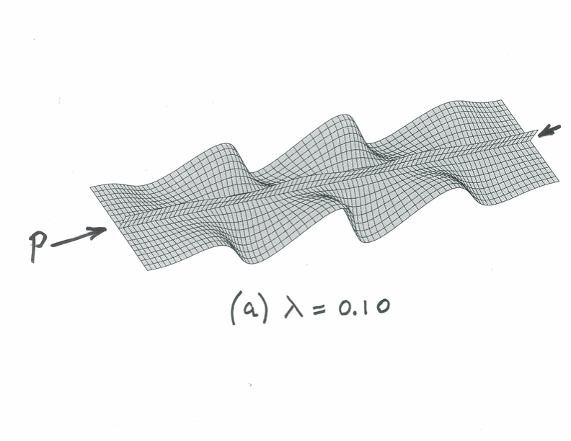
STAGS model of one module of the axially compressed stiffened panel designed for service in the far post-buckling regime. Panel has 10 modules.
Linear buckling mode shape
Buckling load factor
Notes:
Axially compressed blade-stiffened flat panel designed for service in the far post-local buckling regime. The blade-stiffened panel was optimized with use of PANDA2. This slide shows a STAGS model of a single panel module of the panel previously optimized by PANDA2. In the PANDA2 model there are 10 modules. The panel is 50 inches long, 100 inches wide, and the rectangular axial stiffeners are spaced 10 inches apart, a dimension that is fixed during optimization cycles in this particular case. The decision variables in the optimization cycles are panel skin thickness, stiffener thickness, and stiffener height. The local buckling load factor is to be no less than one tenth of the general buckling load factor. The applied axial resultant, N_{x}, is -5000 lb/in (axial compression). The material of the panel is steel. This slide of the one-module STAGS model shows the linear bifurcation buckling mode shape and load factor, lambda = 0.1 for the panel previously optimized by PANDA2. Linear buckling of the optimized panel occurs at one tenth of the design load, PA(design load) = 1.0, that is, the local buckling load factor, lambda = 0.10. Note that there are six axial halfwaves in the linear bifurcation buckling mode, according to STAGS. This mode shape is used as an initial imperfection in subsequent nonlinear static and dynamic STAGS analyses of this panel.
REFERENCES:
Bushnell, D., “PANDA2 - program for minimum weight design of stiffened, composite, locally buckled panels”, Computers & Structures, Vol. 25, pp. 469-605, 1987
Almroth, B. O. and Brogan, F. A., “The STAGS computer code”, NASA CR-2950, NASA Langley Research Center, Hampton, VA, 1978
Rankin C. C., Stehlin, P., and Brogan, F. A., “Enhancements to the STAGS computer code”, NASA CR-4000, NASA Langley Research Cventer, Hampton, CA, 1986
Rankin, C. C., “Application of linear finite elements to finite strain using corotation”, AIAA Paper 2006-1751, 47th AIAA Structures, Structural Dynamics and Materials Conference, May 2006
Riks, E., Rankin, C. C., and Brogan, F. A., “On the solution of mode jumping phenomena in thin walled shell structures”, First ASCE/ASM/SES Mechanics Conference, Charlottesville, VA, June 6-9, 1993; in: Computer Methods in Applied Mechanics and Engineering, Vol. 136, 1996

Slide 4
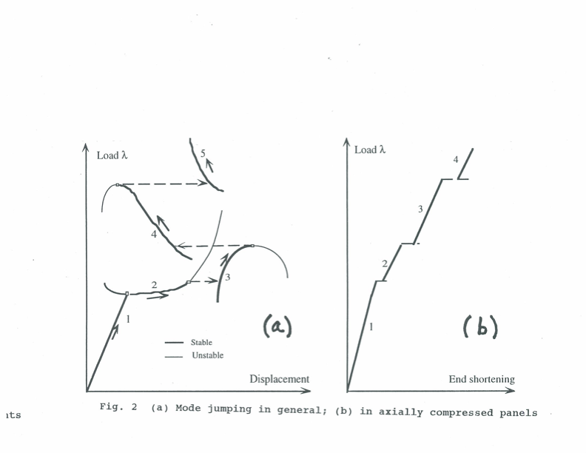
Mode jumping phenomenon
Notes:
What is “mode jumping”?
(a) Schematic of mode jumping in a general case. The fundamental equilibrium branch No. 1 corresponds to the pre-buckled state; branch No. 2 represents growth of the fundamental (critical) local buckling mode, such as that shown in the previous slide, in the initial post-buckling regime; branch numbers. 3, 4, and 5 represent growth of higher local buckling modes arising from the prior locally post-buckled state of the panel. Mode jumps occur between branches 2 and 3, 3 and 4, and 4 and 5.
(b) Schematic of mode jumping in the special case of an axially compressed plate. (Note, there is an error in the plot: There should be no jump, that is, no horizontal discontinuity, between branch 1 and branch 2. Branch 1 and 2 should intersect at the fundamental local bifurcation buckling load.)

Slide 5
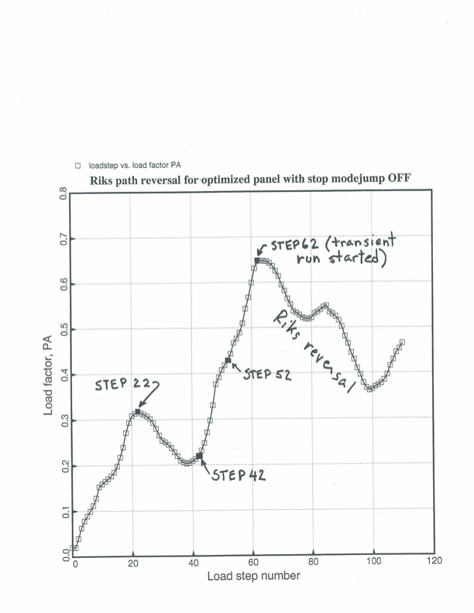
Nonlinear equilibrium: load v step
Nonlinear equilibrium: load factor v. load step number from the STAGS one-module model. This panel was optimized by PANDA2 with the “stop modejump” switch turned OFF (PANEL I)
See next slide for the state of the panel at load steps 22, 42, 52, and 62.
Notes:
A plot of load factor v. load step number for the STAGS nonlinear static analysis of an imperfect panel previously optimized by PANDA2 with the “stop modejump” switch turned off, that is, for a panel optimized with the phenomenon of mode jumping disregarded (PANEL I). The imperfection shape is the linear bifurcation buckling mode shown on the first slide. The STAGS nonlinear static analysis continued successfully up to Step 62. Beyond that step, STAGS was unable to find any stable static nonlinear equilibrium states at higher load levels. In order to determine what happens for load factors higher than about PA = 0.65 (65 per cent of the design load, PA = 1.0), it was necessary to perform a nonlinear dynamic analysis with STAGS. The static nonlinear equilibrium states of the panel at load steps 22, 42, 52 and 62 are shown in the next slide. NOTE: Whether or not dynamic mode jumping occurs between load steps 22 and 42 depends in a test on whether end shortening is controlled or applied load is controlled. If the load is controlled there would, during a test of the panel, be a dynamic snap at load step 22 over to a stable state between load step 42 and load step 52 (actually, a jump to a state between load step 46 and 47).

Slide 6
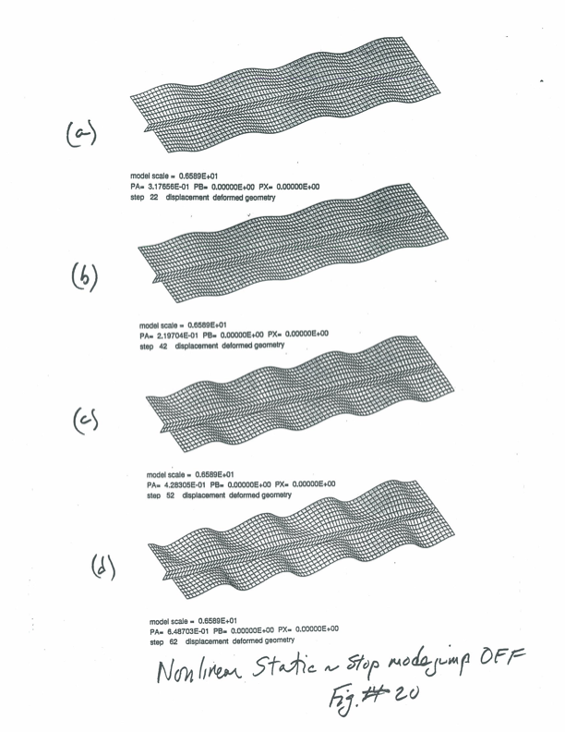
Post-buckled panel
Post-buckled state of the panel optimized by PANDA2 with the “stop modejump” switch turned off. Prediction is from the STAGS one-module model at 4 load factors, PA
Step 22. PA=0.318
Step 42. PA=0.220
Step 52. PA=0.428
Step 62. PA=0.649
Notes:
Static nonlinear equilibrium states from STAGS of the initially imperfect panel at the 4 load steps: 22, 42, 52, and 62, indicated in the previous slide. Note that there are about 7 axial half-waves at Load Step 22, which is already one more axial half-wave than exists in the linear bifurcation buckling mode shown in the first slide. Hence, already at Load Step 22 there has been one change in the post-local buckling mode of deformation. In this particular case this mode change occurred without any abrupt “mode jumping”, that is, without any dynamic behavior. At load steps 42, 52, and 62 there exist 8 axial half-waves in the local post-buckling shape. An additional axial half-wave has been generated without the need to perform any nonlinear dynamic STAGS analysis. Whether or not dynamic mode jumping occurs between load steps 22 and 42 depends in a test on whether end shortening is controlled or applied load is controlled. If the load is controlled there would, during a test of the panel, be a dynamic snap at load step 22 over to a stable state between load step 42 and load step 52 (actually, a jump to a state between load step 46 and 47; see the previous slide).

Slide 7
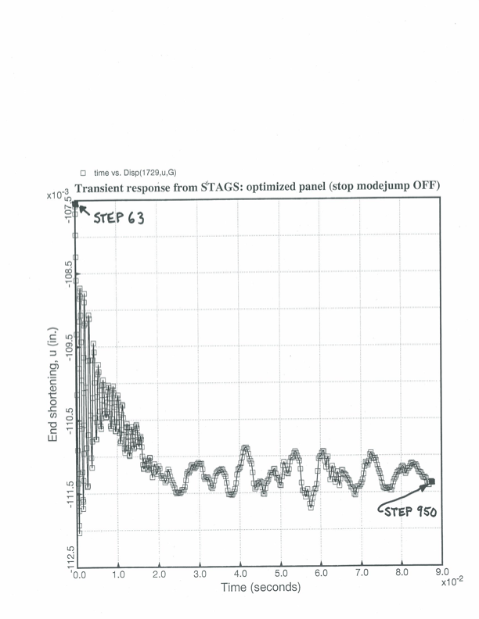
Dynamic response starting at 62
Dynamic response of the one-module STAGS model of the axially compressed, stiffened plate starting at Load Step 63
Notes:
This slide shows the results of a STAGS nonlinear dynamic run starting from the previously determined nonlinear static equilibrium state determined at Load Step 62 in the previous slide. In the STAGS input the load is set at a level about one per cent higher than that at Load Step 62 in the previous slide, a damping factor is assigned, and an initial time step is assigned. The results from STAGS shown here indicate dynamic behavior the amplitude of which diminishes rapidly at first and is assumed to converge adequately to a stable static equilibrium state when step 950 has been reached. The next couple of slides show what happens during this interval of time, Time = 0 to Time = 0.087 seconds.

Slide 8
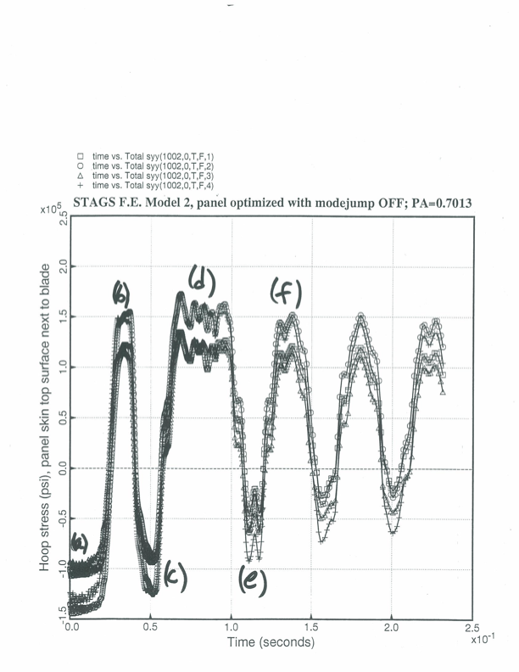
Stress in top surface of panel skin next to the stiffener v. time
Stress: top surface of the panel skin next to the stiffener v. time
States of the panel at a, b, c, d, e, f are shown on the next slide.
Notes:
This slide shows “hoop” stress, that is stress in the panel skin normal to the axial stiffener, at the top surface of the skin adjacent to the blade stiffener v. time at a particular axial location where the maximum “hoop” stress occurs during the nonlinear dynamic STAGS run. Note that there are significant oscillations of this hoop stress, oscillations that could well cause fracture due to elastic-plastic low-cycle fatigue in a steel panel or delamination in a similar panel fabricated of laminated composite material. The next slide shows the state of the panel at times (a), (b), (c), (d), (e), and (f).

Slide 9
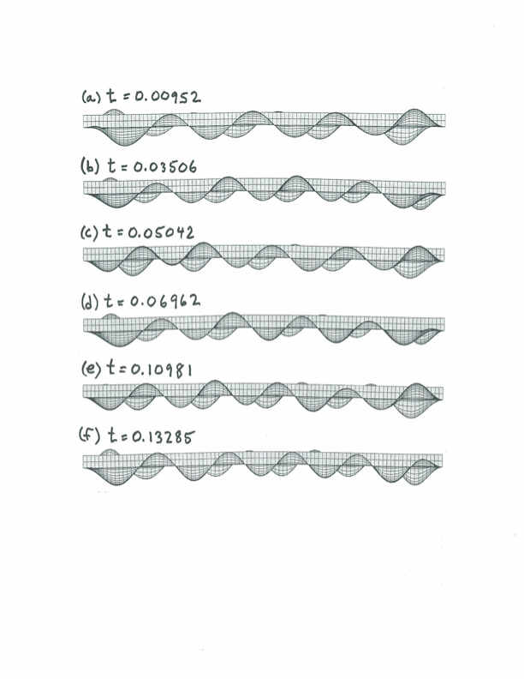
Dynamic state of the panel at 6 time steps
Dynamic state of the panel at the 6 time steps shown on the previous slide
Notes:
This slide shows the dynamic states of the locally post-buckled panel at the six times indicated in the previous slide. Here we are viewing the panel edge-on. The local axial waves occur in the panel skin. At time (a) there exist 8 axial half-waves; at time (b) there exist 9 axial half-waves; at time (c) there exist 10 axial half-waves; at time (d) there exist 9 axial half-waves; and at times (e) and (f) there exist 10 axial half-waves. The peaks of the axial half-waves shift along the axis of the panel during the nonlinear dynamic STAGS run. This shifting of the peaks of the deformation along the axis of the panel is what causes the cycling of the maximum “hoop” stress shown in the previous slide.

Slide 10
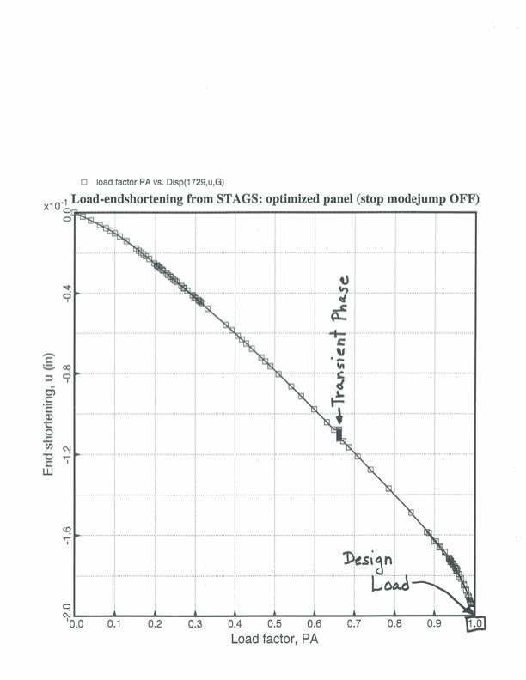
Nonlinear load-endshortening curve showing transient phase, 2nd static phase and collapse
NOTE: This panel was optimized by PANDA2 with the “stop modejump” switch turned OFF. Note that mode jumping occurs well below the design load.
Nonlinear load-end-shortening curve showing initial static phase of the STAGS analysis, transient phase, post-transient static phase, and final collapse of the stiffened panel.
Notes:
This slide shows the load-end-shortening curve obtained from the complete sequence of STAGS runs for the panel previously optimized by PANDA2 with the “stop modejump” switch turned off, that is, with mode jumping disregarded in the PANDA2 analysis (PANEL I). The transient phase described in the previous three slides that occurs at load factor PA = 0.67 (approximately) is indicated. After the dynamic phase of the analysis has been completed and a new stable nonlinear static equilibrium state is established at PA = 0.67, a new nonlinear static analysis is initiated. Static loading continues until STAGS indicates that static collapse occurs at close to the design load, PA = 1.0.

Slide 11
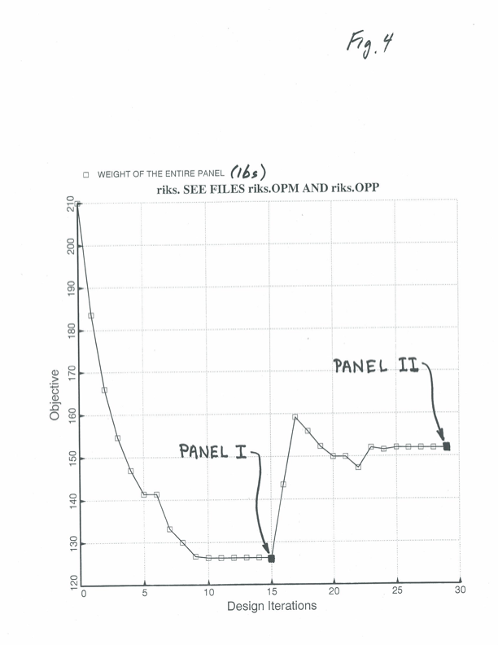
Optimization cycles with modejump switch off, then on
PANDA2 optimization cycles with the “stop modejump” switch first turned OFF (PANEL I), then turned ON (PANEL II)
Notes:
This slide, generated by PANDA2, shows the objective (weight of the stiffened panel) as a function of design iteration. Optimization cycles are first executed with the “stop modejump” switch turned OFF (mode jumping ignored in the PANDA2 analysis). The optimized panel at design iteration number 15 is called “PANEL I”. The previous STAGS results shown here pertain to PANEL I. Then optimization cycles are continued with the “stop modejump” switch turned ON (mode jumping accounted for in the PANDA2 analysis). The PANEL II skin is significantly thicker than that for PANEL I [t_{skin}(PANEL II) = 0.075 inch; t_{skin}(PANEL I) = 0.057 inch; stringer thickness and height are approximately the same for both PANEL II and PANEL I in this particular case.]

Slide 12
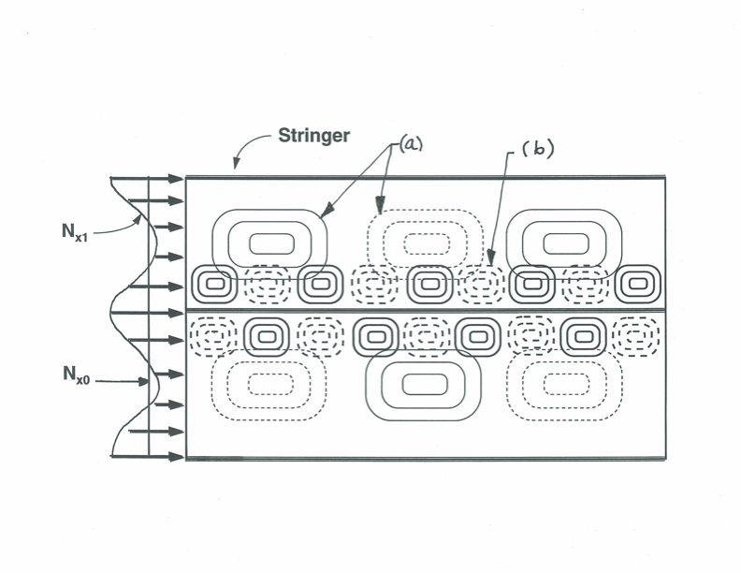
Model used in PANDA2 for secondary buckling
Model used in PANDA2 for secondary buckling, that is, mode jumping: (a) = primary buckling and post-buckling mode; (b) = secondary buckling mode.
Notes:
This slide demonstrates the PANDA2 model for mode jumping. The initial buckling mode (a) has three axial half-waves in this schematic. Before local buckling occurs the width-wise distribution of axial compression, N_{x0}, in the panel skin is uniform. In the locally post-buckled state the distribution of axial compression, N_{x1}, in the panel skin varies over the width of the panel, having its highest values in the neighborhood of each stiffener where the amplitude of the local post-buckling deformation of the panel skin is minimum. PANDA2 computes bifurcation buckling of the locally post-buckled panel skin under N_{x1} with the assumption that the skin of the panel remains undeformed. A typical bifurcation buckling mode under the axial load, N_{x1}, is shown as the pattern (b), which in this schematic has 9 axial half-waves. Mode jumping is held to occur when the eigenvalue corresponding to the pattern (b) equals zero. This is a questionable model, but PANDA2 and STAGS results for this particular example, both with the “stop modejump” switch OFF and ON, agree reasonably well. More numerical testing of the PANDA2 model is needed.

Slide 13
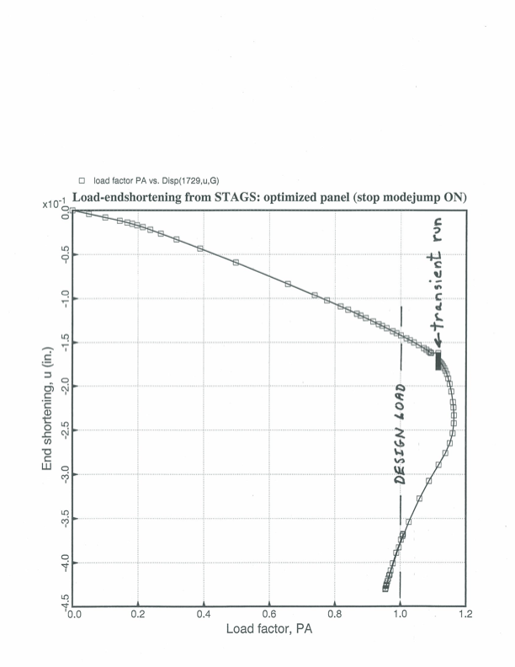
Nonlinear load-end-shortening curve with the modejump switch turned on
Nonlinear load-end-shortening curve for the stiffened panel optimized by PANDA2 with the modejump switch turned ON. The optimized panel is heavier than that optimized with modejump OFF, but note that, unlike the “modejump OFF” panel, the first mode jump in this panel occurs well above the design load, which corresponds to load factor PA = 1.0
Notes:
This slide is analogous to that shown three slides ago: a load-end-shortening curve from STAGS corresponding to the PANEL II design, that is, the design obtained by PANDA2 with the “stop modejump” switch turned ON. PANEL II is significantly heavier than PANEL I, as shown two slides ago, but PANEL II exhibits no mode jumping below the design load, PA = 1.0. Mode jumping in PANEL II occurs at a load factor, PA = 1.12.

