Slide 1
Statistic learning

Slide 2
Plan:
What is Data Science?
Examples
Linear regression

Slide 3
“Essentially, all models are wrong, but some are useful”
George Box

Slide 4


Who is Data Scientist?

Slide 5
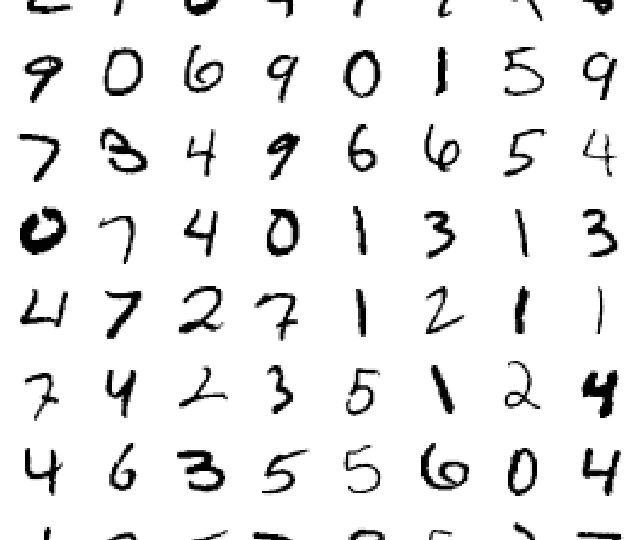
Image recognition
(mnist dataset)

Slide 6
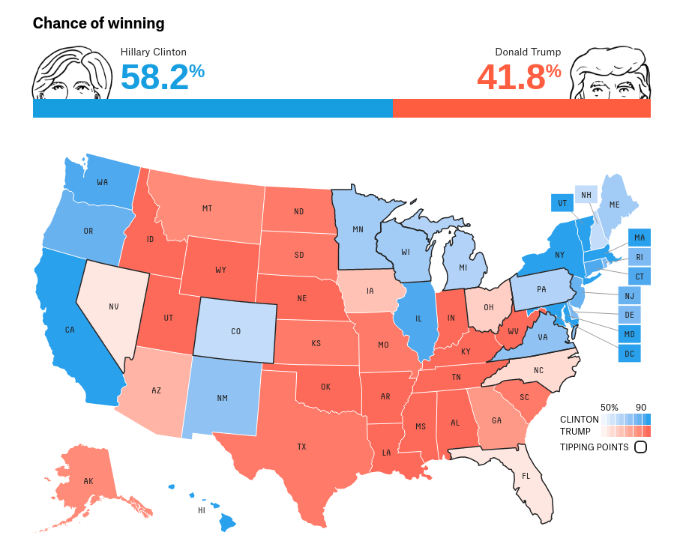
FiveThirtyEight
Election predictions

Slide 7
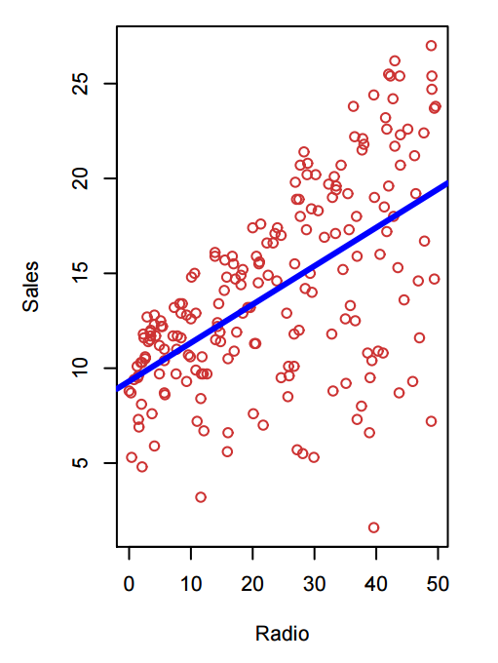
What is Statistical Learning and Data Science?
Shown are Sales vs TV, Radio and Newspaper, with a blue linear-regression line fit separately to each. Can we predict Sales using these three? Perhaps we can do better using a model
Sales ≈ f(TV, Radio, Newspaper)

Slide 8
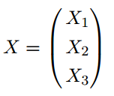
Here Sales is a response or target that we wish to predict. We generically refer to the response as Y . TV is a feature, or input, or predictor; we name it X1. Likewise name Radio as X2, and so on. We can refer to the input vector collectively as:
Now we write our model as Y = f(X) + e where e captures measurement errors and other discrepancies.

Slide 9
What is f(X) good for?
With a good f we can make predictions of Y at new points X = x.
We can understand which components of X = (X1, X2, . . . , Xp) are important in explaining Y , and which are irrelevant. e.g. Seniority and Years of Education have a big impact on Income, but Marital Status typically does not.
Depending on the complexity of f, we may be able to understand how each component Xj of X affects Y .

Slide 10
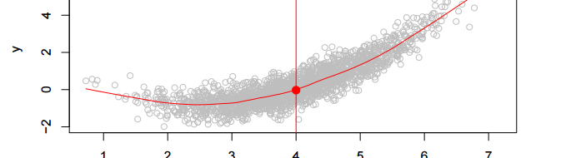
Is there an ideal f(X)?
In particular, what is a good value for f(X) at any selected value of X, say X = 4? There can be many Y values at X = 4. A good value is
f(4) = E(Y |X = 4) E(Y |X = 4)
means expected value (average) of Y given X = 4. This ideal f(x) = E(Y |X = x) is called the regression function.

Slide 11

Regression function f(x)
Is also defined for vector X f(x) = f(x1, x2, x3) = E(Y |X1 = x1, X2 = x2, X3 = x3)
Is the ideal or optimal predictor of Y with regard to mean-squared prediction error: f(x) = E(Y |X = x) is the function that minimizes E[(Y − g(X))^2 |X = x] over all functions g at all points X = x
e = Y − f(x) is the irreducible error — i.e. even if we knew f(x), we would still make errors in prediction, since at each X = x there is typically a distribution of possible Y values
For any estimate ˆf(x) of f(x), we have

Slide 12

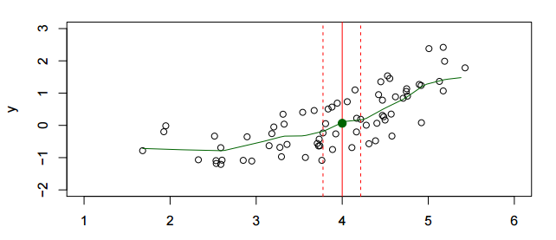
How to estimate f
We have few if any data points with X = 4 exactly
So we cannot compute E(Y |X = x)
But, , where N (x) is some neighborhood of x
Nearest neighbor averaging can be pretty good for small p — i.e. p ≤ 4 and large-ish N.

Slide 13
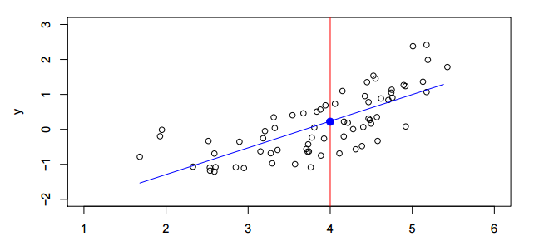
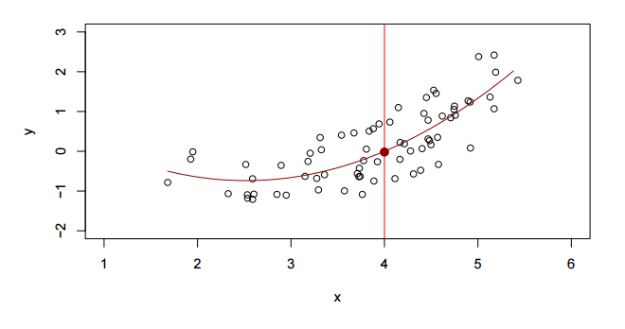
Parametric and structured models
The linear model is an important example of a parametric model:
fL = b0 + b1*X fq = b0 + b1*X +b2*X^2

Slide 14

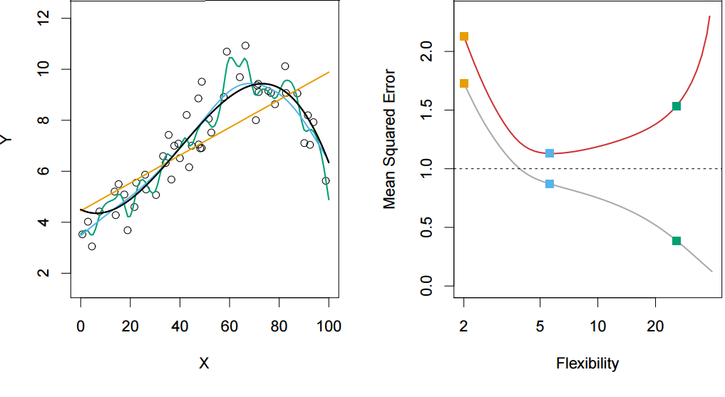
Assessing Model Accuracy
Squared Prediction Error

Slide 15
Thank you!
Questions?

Slide 16
Links:
http://scikit-learn.org/stable/
https://lagunita.stanford.edu
http://www-bcf.usc.edu/~gareth/ISL/
http://statsmodels.sourceforge.net/

