Slide 1
Scrum
<Konstantin Starodubenko>

Slide 2



Scrum origins
Jeff Sutherland
  Initial scrums at Easel Corp in 1993
  IDX and 500+ people doing Scrum
Ken Schwaber
  ADM
  Scrum presented at OOPSLA 95 with Sutherland
  Author of three books on Scrum
Mike Beedle
  Scrum patterns in PLOPD4
Ken Schwaber and Mike Cohn
  Co-founded Scrum Alliance in 2002, initially within the Agile Alliance

Slide 3
Scrum has been used by:
Microsoft
Yahoo
Google
Electronic Arts
High Moon Studios
Lockheed Martin
Philips
Siemens
Nokia
Capital One
BBC
Intuit
Intuit
Nielsen Media
First American Real Estate
BMC Software
Ipswitch
John Deere
Lexis Nexis
Sabre
Salesforce.com
Time Warner
Turner Broadcasting
Oce

Slide 4
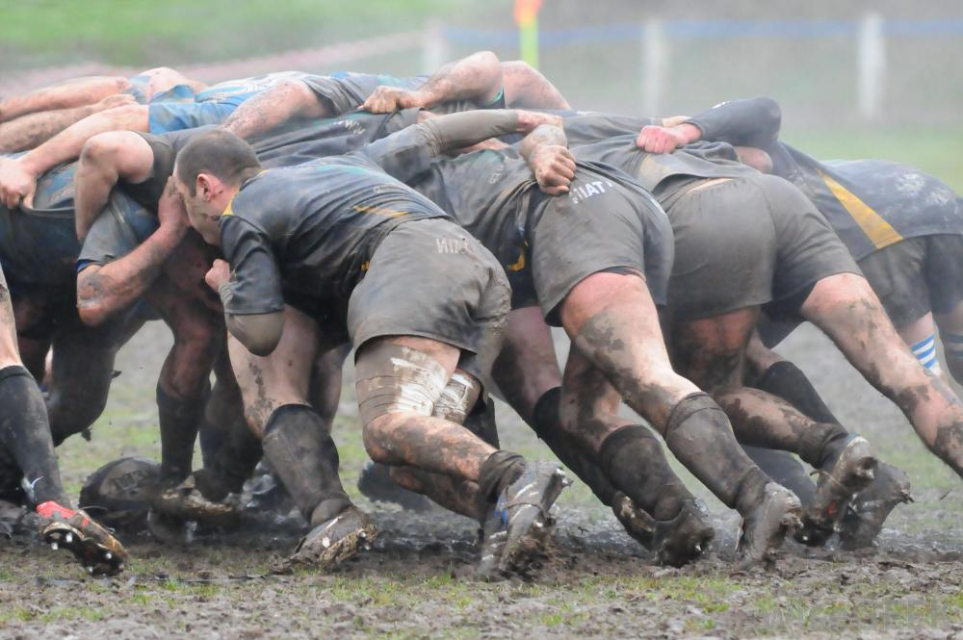
Scrum is a sports term that came to us from rugby, and is a figure that players form before the game begins.

Slide 5
Sprints
Scrum projects make progress in a series of “sprints”
  Analogous to Extreme Programming iterations
Typical duration is 2–4 weeks or a calendar month at most
A constant duration leads to a better rhythm
Product is designed, coded, and tested during the sprint

Slide 6

Scrum framework
Roles
Product owner
ScrumMaster
Team
Ceremonies
Sprint planning
Sprint review
Sprint retrospective
Daily scrum meeting
Artifacts
Product backlog
Sprint backlog
Burndown charts

Slide 7
Scrum framework
Roles
Product owner
ScrumMaster
Team
Ceremonies
Sprint planning
Sprint review
Sprint retrospective
Daily scrum meeting
Artifacts
Product backlog
Sprint backlog
Burndown charts

Slide 8

Product owner
Define the features of the product
Decide on release date and content
Be responsible for the profitability of the product (ROI)
Prioritize features according to market value
Adjust features and priority every iteration, as needed
Accept or reject work results

Slide 9

The ScrumMaster
Represents management to the project
Responsible for enacting Scrum values and practices
Removes impediments
Ensure that the team is fully functional and productive
Enable close cooperation across all roles and functions
Shield the team from external interferences

Slide 10





The team
Typically 5-9 people
Cross-functional:
  Programmers, testers, user experience designers, etc.
Members should be full-time
    May be exceptions (e.g., database administrator)

Slide 11
The team
Teams are self-organizing
  Ideally, no titles but rarely a possibility
Membership should change only between sprints

Slide 12
Scrum framework
Roles
Product owner
ScrumMaster
Team
Ceremonies
Sprint planning
Sprint review
Sprint retrospective
Daily scrum meeting
Artifacts
Product backlog
Sprint backlog
Burndown charts

Slide 13

Sprint planning
Team selects items from the product backlog they can commit to completing
Sprint backlog is created
  Tasks are identified and each is estimated (1-16 hours)
  Collaboratively, not done alone by the ScrumMaster
High-level design is considered
As a vacation planner, I want to see photos of the hotels.
Code the middle tier (8 hours)
Code the user interface (4)
Write test fixtures (4)
Code the foo class (6)
Update performance tests (4)

Slide 14
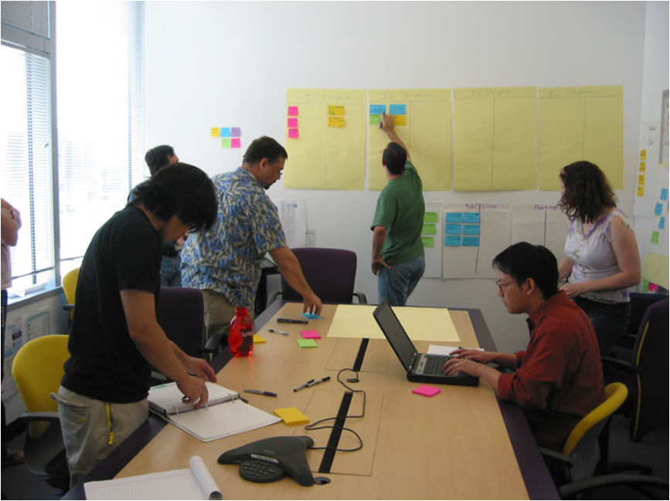
The daily scrum
Parameters
  Daily
  15-minutes
  Stand-up
Not for problem solving
  Whole world is invited
  Only team members, ScrumMaster, product owner, can talk
Helps avoid other unnecessary meetings

Slide 15


Everyone answers 3 questions
1
What did you do yesterday?
2
What will you do today?
3
Is anything in your way?
These are not status for the ScrumMaster
  They are commitments in front of peers

Slide 16
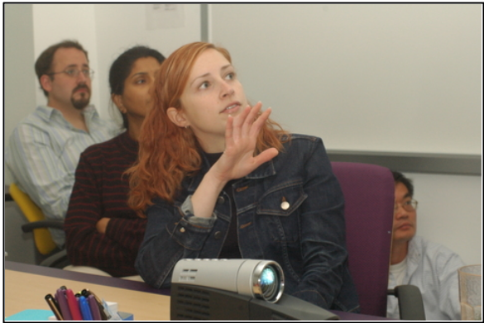
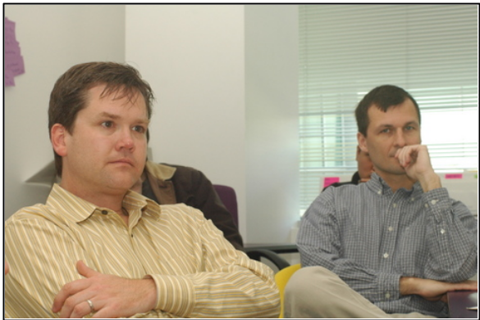
The sprint review
Team presents what it accomplished during the sprint
Typically takes the form of a demo of new features or underlying architecture
Informal
  2-hour prep time rule
  No slides
Whole team participates
Invite the world

Slide 17
Sprint retrospective
Periodically take a look at what is and is not working
Typically 15–30 minutes
Done after every sprint
Whole team participates
  ScrumMaster
  Product owner
  Team
  Possibly customers and others

Slide 18
Scrum framework
Roles
Product owner
ScrumMaster
Team
Ceremonies
Sprint planning
Sprint review
Sprint retrospective
Daily scrum meeting
Artifacts
Product backlog
Sprint backlog
Burndown charts

Slide 19

Product backlog
The requirements
A list of all desired work on the project
Ideally expressed such that each item has value to the users or customers of the product
Prioritized by the product owner
Reprioritized at the start of each sprint
This is the product backlog

Slide 20
A sample product backlog
Backlog item | Estimate
Allow a guest to make a reservation | 3
As a guest, I want to cancel a reservation. | 5
As a guest, I want to change the dates of a reservation. | 3
As a hotel employee, I can run RevPAR reports (revenue-per-available-room) | 8
Improve exception handling | 8
... | 30
... | 50

Slide 21
The sprint goal
A short statement of what the work will be focused on during the sprint
Life Sciences
Support features necessary for population genetics studies.
Database Application
Make the application run on SQL Server in addition to Oracle.
Financial services
Support more technical indicators than company ABC with real-time, streaming data.

Slide 22
Managing the sprint backlog
Individuals sign up for work of their own choosing
  Work is never assigned
Estimated work remaining is updated daily

Slide 23
Managing the sprint backlog
Any team member can add, delete or change the sprint backlog
Work for the sprint emerges
If work is unclear, define a sprint backlog item with a larger amount of time and break it down later
Update work remaining as more becomes known

Slide 24
A sprint backlog
Tasks
Mon
Tues
Wed
Thur
Fri
Code the user interface
8
4
8
Code the middle tier
16
12
10
4
Test the middle tier
8
16
16
11
8
Write online help
12
Write the foo class
8
8
8
8
8
Add error logging
8
4

Slide 25
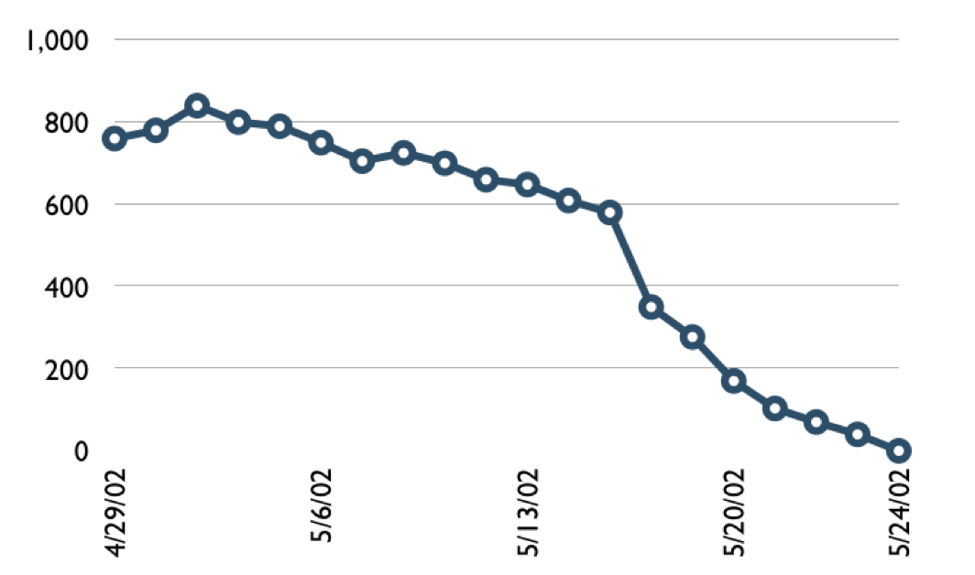

A sprint burndown chart
Hours

Slide 26
Tasks
Mon
Tues
Wed
Thur
Fri
Code the user interface
8
4
8
Code the middle tier
16
12
10
7
Test the middle tier
8
16
16
11
8
Write online help
12
50
40
30
Hours
20
10
0
Mon
Tue
Wed
Thu
Fri

Slide 27
Scalability
Typical individual team is 7 ± 2 people
  Scalability comes from teams of teams
Factors in scaling
  Type of application
  Team size
  Team dispersion
  Project duration
Scrum has been used on multiple 500+ person projects

Slide 28






Scaling through the Scrum of scrums

Slide 29
Scrum of scrums of scrums

Slide 30
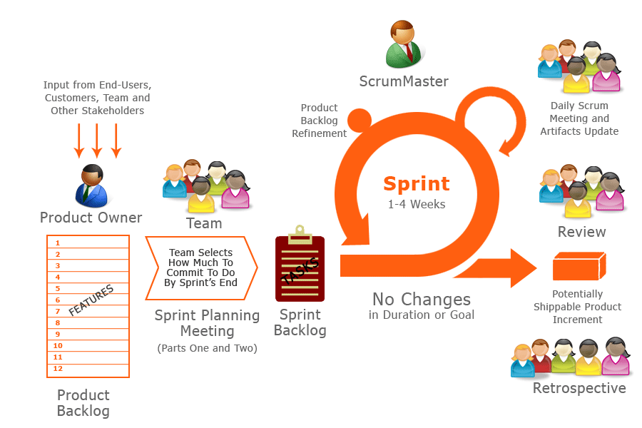
Putting it all together

