Slide 1

Team “SHADDA-BI-BORAN”
presents

Slide 2
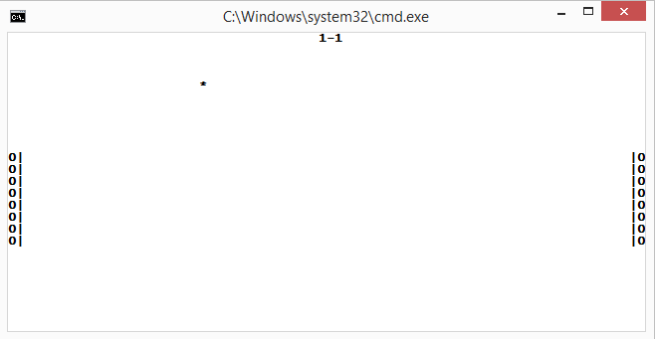
Live Demo!

Slide 3
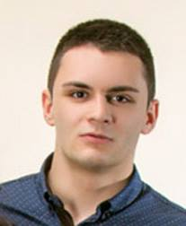

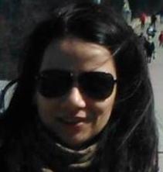
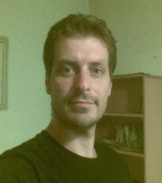
Team members :
Contribution :
Konstantin Yanchev -
25 %
Peter Borisov -
25 %
Tatyana Miteva -
25 %
Slavi Zekov -
25 %

Slide 4

Thanks for your attention.

