Slide 1
ESE 5017 Spatial Statistics Fall, 2022
Welcome !
Instructor: Xiuyu Liang
TA: Yunqiu Zhou
Time: Mon. and Wed. in even weeks
Place: 一教503

Slide 2
The French engineer Georges Matheron coined the word geostatistique, inspired by the clear meaning and success of the older terms geochemistry and geophysics in which the prefix geo- was added to the name of some classical body of knowledge to denote an application of such knowledge to the modeling and understanding of processes of interest in earth sciences and technology (Matheron, 1962, p. 22; Journel and Huijbregts, 1978, p. vi). Therefore, this course can also be named as:
Spatial Statistics
Geostatistics

Slide 3
Introduction
1. Why do we study spatial statistics?
2. What is spatial statistics?
3. Basic Concepts & Procedure in
spatial statistics
4. Introduction to the Book and Data Sets
Reading Assignment
This ppt
Forward and Chpt. 1 of the textbook

Slide 4
1. Why do we study Spatial Statistics?
It is often difficult and expensive to collect field dada as a scientist or engineer in order to answer scientific or engineering questions;
Therefore, one must make the best use of available data to estimate needed parameters.

Slide 5
Data is not sufficient and we thus must fill in the gaps
Because most surface and subsurface environments are complex, even a plethora of data is not sufficient to resolve with accuracy:
e.g., the distribution of the properties that govern the rates of flow, the rates of transport and transformation of contaminants, or the distribution of concentrations in water and soil.
The professionals who analyze the data must fill in the gaps using their understanding，
e.g., of the geologic environment and of the flow, transport, or fate mechanisms that govern the distribution of contaminants.

Slide 6
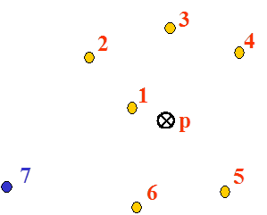
EX: Given seven observed values, how do you estimate the value at p ?

Slide 7
Can point 7 get more weight than 5 ?

Slide 8
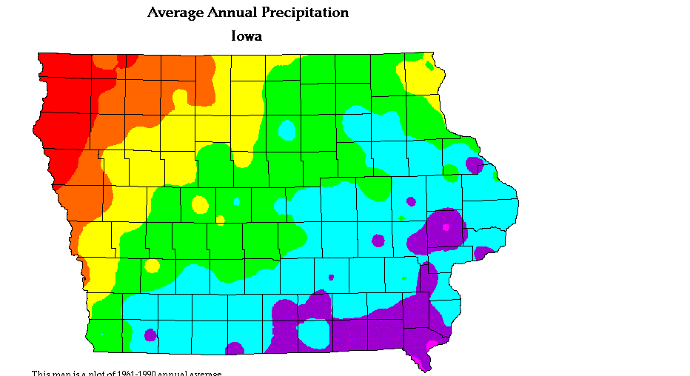
Yes, it can. For example, estimating rainfall at P with 7 rain gauges.
Varies spatially with a mean of 34 inches.

Slide 9
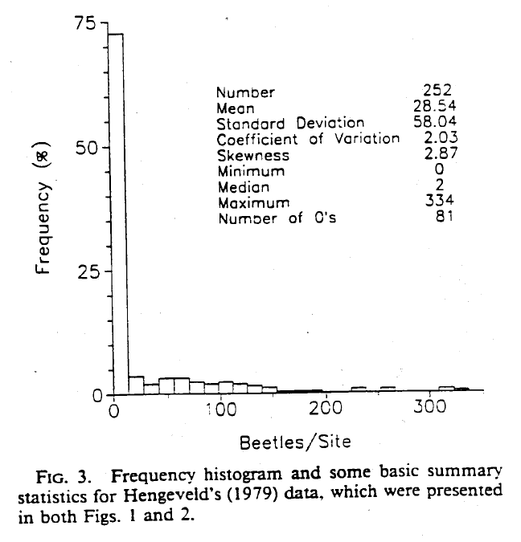
Two data sets have similar statistics

Slide 10
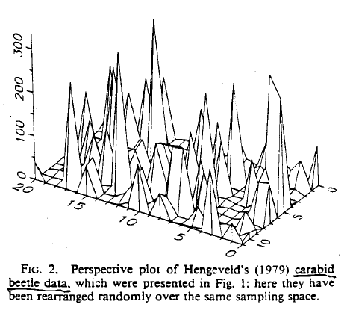
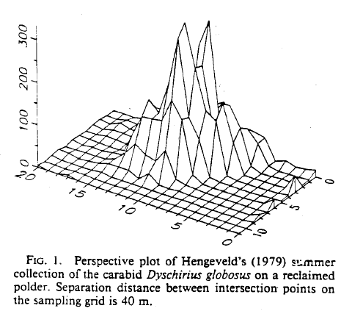
Their spatial distributions are quite different
Can you make a good estimation without knowing the spatial distribution？

Slide 11
Let’s come back to the example
Estimating rainfall (or air temperature or chemical concentration or water table) at an unsampled point (p) using measured data at surrounding points.
The questions we may ask are:
What are the methods you’d use ?
What are the advantages and
disadvantages of the methods?
How do you improve?

Slide 12
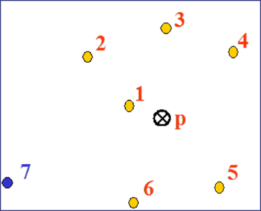
Conventional or classical statistical methods
A common method assigns weights to the measurements or observations at surrounding points. It is reasonable to evolve an interpolation procedure which weight point #1 (the nearest point) higher than any other farthest points;
A whole range of methods can be produced to decide on the weights, mostly based on the distance (and possibly direction) of the sample from the point being estimated, e.g.,
• Linear interpretation
• Inverse distance
These are based on random, independent variables which assume zero continuity and allow for no extension of each data value.

Slide 13
Problems with these methods
1. Which weighting factors are the best (e.g., 1/d or 1/d² ) ?
2. How far do we go in including points?
3. How reliable are the estimates?
4. Can we expect the same method to be equally valid on all cases, e.g., water, soils or aquifers ?
Most importantly,
5. How to consider spatial continuity, correlation or similarity of the variable concerned?
6. How to quantify estimation errors?

Slide 14
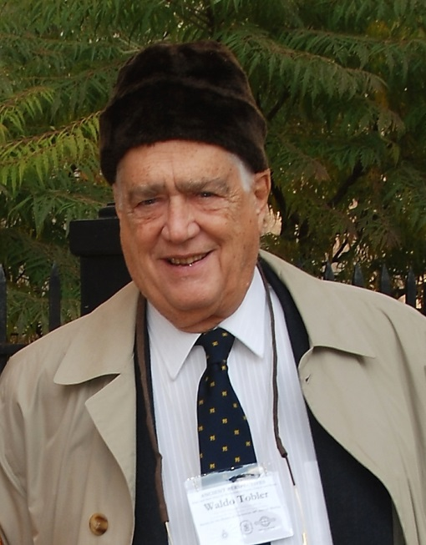
Spatial Continuity
The so-called "first law of geography“: “everything is related to everything else, but near things are more related than distant things” by Waldo Tobler
Most spatial data exhibit what is known as spatial continuity, the notion that sites close together are more likely to have similar data values than sites far apart. As it is on this premise that spatial statistical methods are based, it is of interest to examine methods of assessing the degree of spatial continuity in a given data set.
Waldo Tobler (born 1930) is an American-Swiss geographer, cartographer, Professor Emeritus at the University of California, Santa Barbara.

Slide 15
Spatial statistics deals with these problems by considering SIMILARITY between samples
In reality, many variables in earth and environmental sciences are spatially correlated or similar, i.e.,
• Ground elevations
• Rainfall, air temperature, wind speed
• Water table, hydraulic conductivity, chemical
concentrations
• Thickness of a formation, fracture density and openings
Can you give an example in your areas of interests?

Slide 16
It is unfortunate…
“ most classical statistical methods make no use of the spatial information in earth science data sets. Spatial statistics offers a way of describing the spatial continuity that is an essential feature of many natural phenomena and provide adaptations of classical regression techniques to take advantage of this continuity.” (Isaaks & Srivastava, 1989)

Slide 17
2. What is Spatial Statistics?
• Spatial statistics is based on statistics but also integrate spatial similarity or continuity or correlation of data and mathematical theories such as correlation functions, random fields, and fractals.
• It is used to analyze location-dependent data and then build a one, two or three dimensional models based on the data and interpretation.

Slide 18
2. What is Spatial Statistics? (cont.)
• The particular relationship expressing the extent of the similarity, correlation, or continuity, is measured in a function called the variogram (or semi-variogram) function, or simply the variogram.
• The spatial statistical process can be simplified as a two-step procedure.
The first is the calculation of the experimental variogram and fitting a model to it. This is perhaps the most important step.
The next step is the kriging process. Kriging is a moving average technique which uses the variogram parameters to obtain the relationship between the data points.

Slide 19
2. What is Spatial statistics? (cont.)
• Spatial statistics is concerned with spatial data. That is, each data value is associated with a location in space and there is at least an implied connection between the location and the data value.
• Let x₁, x₂, ....,x_{n} be points in 1, 2 or 3 dimensional space and Z(x₁), Z(x₂),..., Z(x_{n}) denote observed values at these locations.
• Now suppose that x₀ is a location that is not "sampled". The objective then is to estimate/predict the value Z(x₀).
• Traditionally, there are two ways to do this; one is deterministic and the second is stochastic or statistical.
Deterministic methods treat Z(x₁), Z(x₂),..., Z(x_{n}) and Z(x₀) as the values of an analytical function with no uncertainty (an example of a deterministic variable would be the speed of a falling object).

Slide 20
The statistical or stochastic approaches
• Treat Z(x₁), Z(x₂),..., Z(x_{n}) and Z(x₀) as being the values of random variables.
If the joint distribution of these random variables were known then the "best" estimator (best meaning unbiased and having minimal variance of the estimation error) would be the conditional expectation of Z(x₀) given the values of the other random variables.
However the data consists of only one observation or one realization of the random variables Z(x₁), Z(x₂),..., Z(x_{n}) and none of the random variable Z(x₀). Hence it is not possible to estimate or model this distribution using standard ways of modeling or fitting probability distributions.

Slide 21
Regionalized Variables
• With a spatial statistical method Z(x₁), Z(x₂),..., Z(x_{n}) and Z(x₀) are treated as so-called regionalized variables that is a variable between a deterministic variable and random variable.
• What does this mean? It means that the variable is neither totally known without uncertainty nor totally random without any clue (the clue is similarity, continuity, or correlation).

Slide 22
More specifically,
• Spatial statistics is a branch of applied statistics developed by George Matheron of the Centre de Morophologie Mathematicque in Fontainebleau, France (1960s).
• A unique aspect of spatial statistics is the use of regionalized variables which are variables that fall between random variables and completely deterministic variables.
• Typical regionalized variables are functions describing variables that have geographic distributions (e.g. elevation of ground surface).

Slide 23
Regionalized variables
• Unlike random variables, regionalized variables exhibit spatial continuity; however, the change in the variable is so complex that they cannot be described by any deterministic function.
• Furthermore, although regionalized variables are spatially continuous, it is not always possible to sample every location. Therefore, unknown values must be estimated from data taken at specific locations that can be sampled.
• The size, shape, orientation, and spatial arrangement of these samples constitute the support of the regionalized variables and influence the capability to predict the unknown samples.

Slide 24
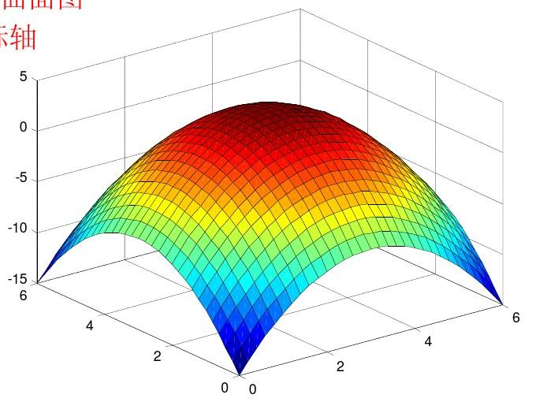
A regionalized variable
A random variable
A deterministic variable
(抛物面）

Slide 25
3. Procedure and Basic Concepts in spatial statistic analyses

Slide 26
Procedure in spatial statistic analysis
In brief, spatial statistical analysis usually has the following steps:
Step 1. Collect a data set over a space or area;
Step 2. Describe data and check for errors;
Step 3. Estimating the form of the regionalized variable (i.e., the spatial similarity between the samples) or calculate the sample variogram;
Step 4. Fit a theoretical model to the sample variogram;
Step 5. Estimate the variable with Kriging.

Slide 27
Basic Concepts in spatial statistics
Variogram
Similarity among data points can be
measured by the covariance between
the samples or by their correlation
Spatial statistical theory uses the variogram (which is similar to covariance) to express the degree of relationship (similarity) between points.

Slide 28
Variogram a function quantifying the spatial continuity
Basic concepts in spatial statistics
Let’s look at the ‘difference in elevation’ between samples and at the same time try to describe these differences as a function of the distance between them and use that in describing the similarity between samples: This is the basic concept of Variogram.
Variogram has been applied in many fields
Environmental Sciences & Engineering
Hydrology, Geology, Geography, Urban studies, Anthropology
Atmospheric Sciences, Biology, Ecology,

Slide 29

Variogram (γ )
A variogram is defined as
where,
z(x) is the measurement of the variable taken at location x;
z(x+h) is another measurement taken h interval away;
N(h) is the total number of the data pairs at separation h.

Slide 30
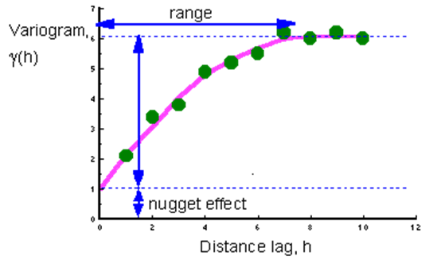
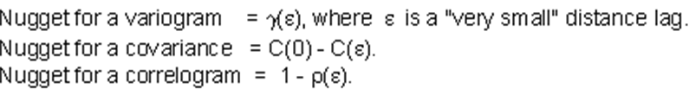
Typical Variogram

Slide 31
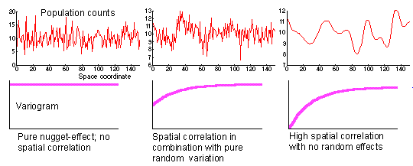
Examples of Variogram
Examples of one-dimensional spatial distributions with different nugget effects and corresponding variograms:

Slide 32
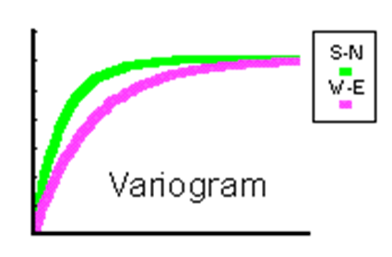
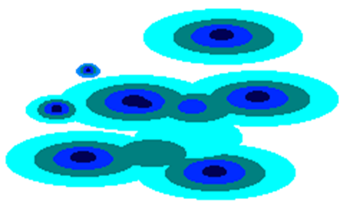
Anisotropy
Different spatial relationships in different directions
Example: A variogram with anisotropy and corresponding spatial pattern:

Slide 33
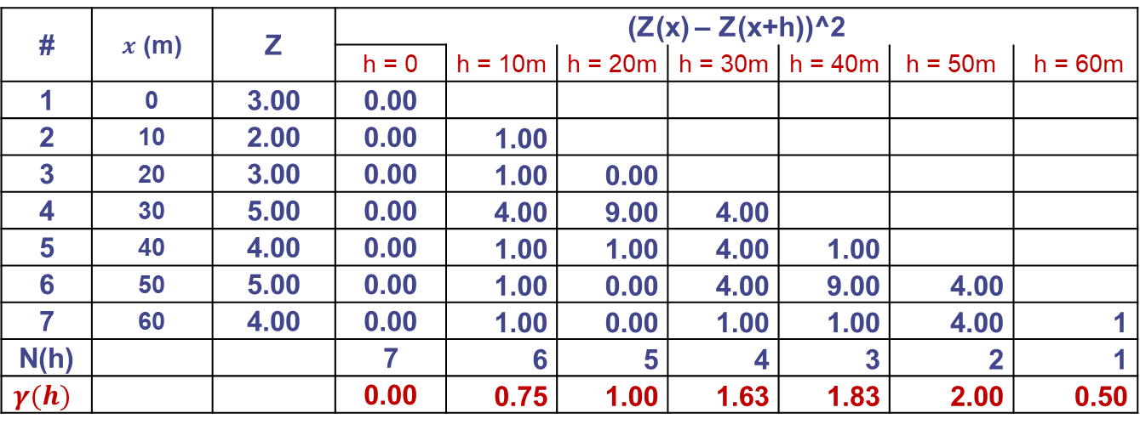
Example: Calculate variogram for the following data set along a cross section. The distance between nearby wells is 10 m.
# | 1 | 2 | 3 | 4 | 5 | 6 | 7
z | 3 | 2 | 3 | 5 | 4 | 5 | 4
# | $x$ (m) | Z | (Z(x) – Z(x+h))^2
 |  |  | h = 0 | h = 10m | h = 20m | h = 30m | h = 40m | h = 50m | h = 60m
1 | 0 | 3.00 | 0.00
2 | 10 | 2.00 | 0.00 | 1.00
3 | 20 | 3.00 | 0.00 | 1.00 | 0.00
4 | 30 | 5.00 | 0.00 | 4.00 | 9.00 | 4.00
5 | 40 | 4.00 | 0.00 | 1.00 | 1.00 | 4.00 | 1.00
6 | 50 | 5.00 | 0.00 | 1.00 | 0.00 | 4.00 | 9.00 | 4.00
7 | 60 | 4.00 | 0.00 | 1.00 | 0.00 | 1.00 | 1.00 | 4.00 | 1
N(h) |  |  | 7 | 6 | 5 | 4 | 3 | 2 | 1
$$γ(h)$$ |  |  | 0.00 | 0.75 | 1.00 | 1.63 | 1.83 | 2.00 | 0.50

Slide 34
Sample variogram

Slide 35
Note:
• The variogram is a measure of how variables change as the separation distance increases. The underlying principle is that two observations closer together are more similar than two observations farther apart.
• Because the underlying processes of the data often have preferred orientations, values may change more quickly in one direction than another. As such, the variogram is a function of direction.
• A smaller distance yields a smaller variogram and a larger distance results in a larger variogram.
• The variogram = 0 at h = 0.
• The range is the greatest distance over which the value at a point on the surface is related to the value at another point (neighborhood).

Slide 36
Examples of Variogram Models
• Linear model
• Exponential model
• Spherical model

Slide 37
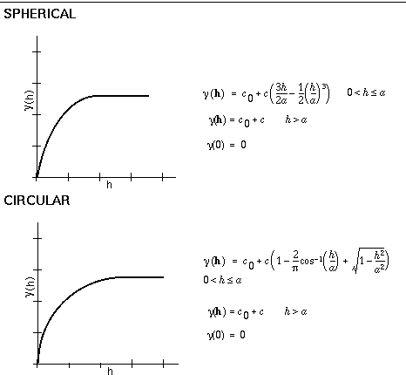
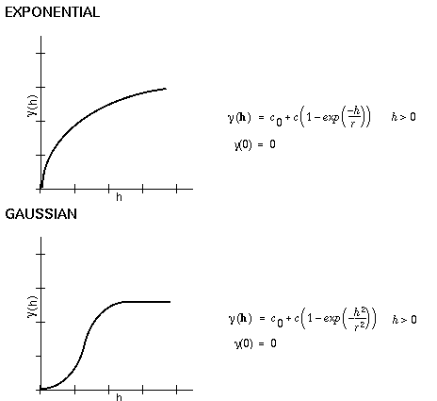
Examples of Variogram Models

Slide 38
Kriging Estimator (BLUE)
• Kriging is named after a South African engineer, D. G. Krige who used the moving average first.
• Kriging estimates is also called BLUE
What does BLUE mean ?

Slide 39
Kriging Estimator (BLUE)
• Kriging is named after a South African engineer, D. G. Krige who used the moving average first.
• Kriging estimates is also called BLUE (Best Linear Unbiased Estimates)
Best: minimizes variance
Linear: can be expressed as the sum of factors
Unbiased: expects a zero error

Slide 40
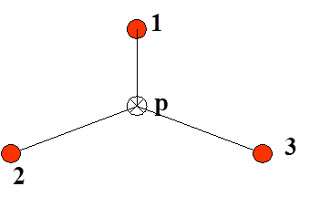
Kriging Estimator (BLUE)
• Formulation of Kriging
Given: 3 points of known elevation;
Estimate: the elevation of point (p), Z_{e}(p), using a weighted average of the known samples:

Slide 41
1) The Linear Estimator
such that
W₁+ W₂+ W₃ = 1
This is called linear estimator, and if the weights sum to 1 we call it unbiased linear estimator (remember if all weight are the same we will end up with the mean of all samples).
For simplicity let us consider the following situation:
Z_{e}(p) = Z₁ that is all weights, except W₁, equal zeros.
This estimated value will most likely differ from the actual value at point p, Z_{a}(p), and this difference is called the estimation error:

Slide 42


2) Minimize the variance of the estimation error
The estimate and estimation error depend on the weights chosen.
Ideally, kriging tries to choose the optimal weights that produce the minimum estimation error.
i.e., kriging minimize the estimation variance with respect to weights, i.e.,
i =1 to n (n is 3 in our example)

Slide 43
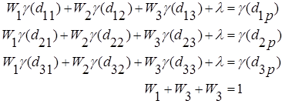
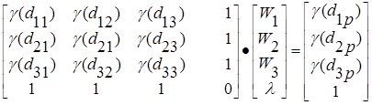
3) Kriging Equation
After the differentiation with respect to W1, W2, W3, the following set of equation is obtained:
Separating these equations into matrix form yields
Solving above system of linear equation, we obtain the coefficients Ws and then the estimation variance is given by

Slide 44
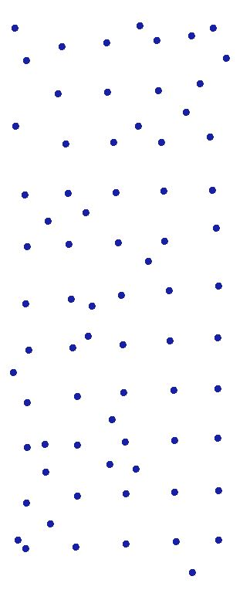
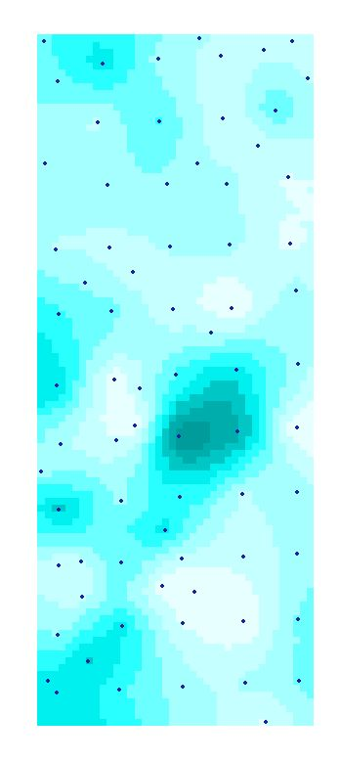
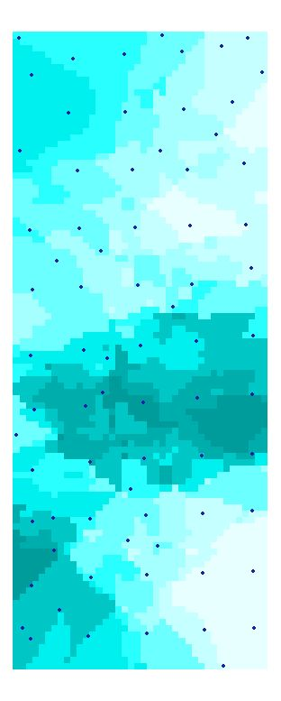
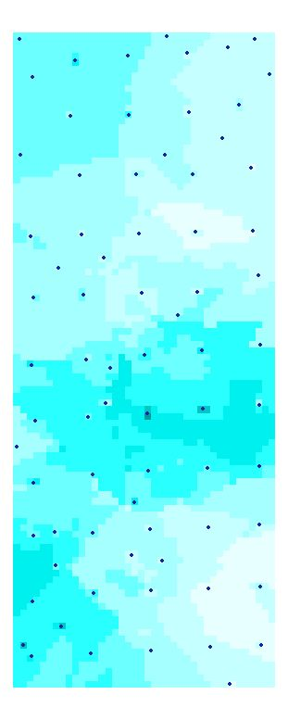
Examples of Kriging
Universal
Exponential
Circular

Slide 45
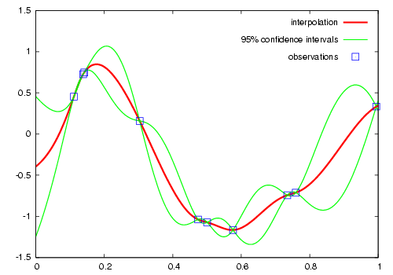
Kriging honors the measurements

Slide 46
4. Introduction to the book and data sets
• This book is not heavily mathematical;
• The book is built around a series of case studies on a real data set;
• The sample data set with which the case studies were performed is in fact a subset of a much large, completely known data set (the exhaustive data set). Therefore, throughout the case studies we will have access to the correct answers.

Slide 47
The Exhaustive Data Set
• The data set is derived from a digital elevation model from the Walker Lake area in Nevada in western US (Figure 1.1);
• A data set consists of 3 variables measured at each of 78,000 points on 1m x 1m grid over a rectangular area of 260m x 300m which was produced from the original digital elevation model;
• There are three variables:
The first two variables, V and U, are continuous and their values range from 0 to several thousands and
the third variable, T, is discrete and its value is either 1 or 2;

Slide 48
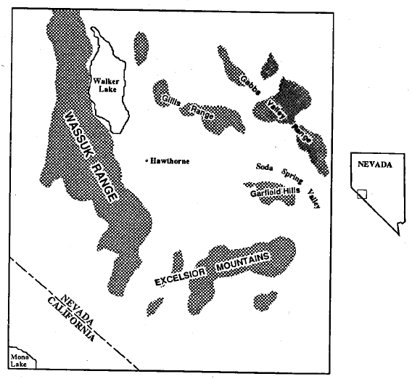
The location map for the 78000 V and U values (The Exhaustive Data Set)
The data set is derived from a digital elevation model (DEM) from the western US, the Walker Lake area in Nevada.

Slide 49
The continuous variables (V and U)
could be:
• concentration of some pollutant
• thickness of a geological horizon
• soil moisture content
• aquifer permeability
• rainfall measurements
• air temperature
• wind speed
• the diameters of trees
Can you think another variable in your areas of interests?

Slide 50
The discrete variable (T)
can be viewed as a number that assigns each point to one of two possible categories or type 1 and type 2, e.g.,
• color difference
• different species
• different rock types
• different soil lithology
• the presence or absence of a particular element in water, soil, or air sample

Slide 51
The Sample Data Set
• The sample data set is a subset of the exhaustive data set;
• It has 470 sample points
Using the 470 data points we will address the following problems:
• The description of the important features of the data.
• The estimation of an average value over a large area.
• The estimation of an unknown value at a particular location.
• The estimation of an average value over small areas.
• The use of the available sampling to check the performance
of an estimation methodology.
• The use of sample values of one variable to improve the
estimation of another variable.
• The assessment of the uncertainty of our various estimates.

Slide 52
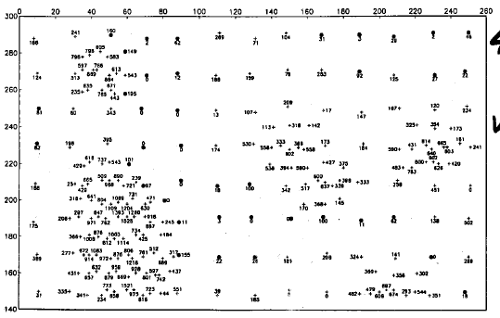
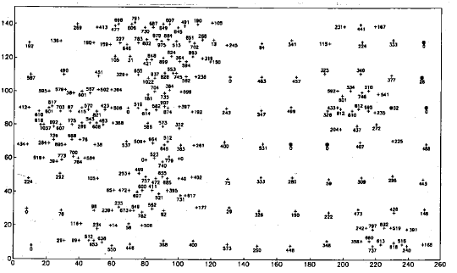
A posting of 470 V values in the sample data set
300
0
260

Slide 53
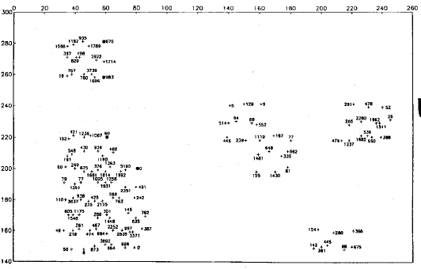
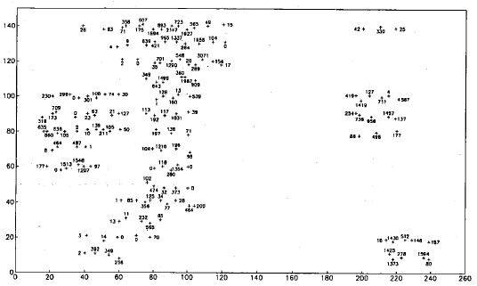
300
A posting of 275 U values in the sample data set
0
260

Slide 54
The Sampling History (Very important to know!)
1st campaign: sampled V at 20 x 20 m² and got (13 * 15=) 195 data points for V;
2nd campaign: Each of the original 195 samples whose V value > 500 ppm was surrounded by 8 extra samples for both V and U on roughly 10 x 10 m² grid and got 150 data points for V and U;
3rd campaign: added two more samples for V and U to those points with V > 500 ppm and got 125 data points for V and U;
So, in the sample data set:
# of data points for V is: 195+150+125 = 470
# of data points for U is: 150+125 = 275

Slide 55
Summary
It is often difficult and expensive to collect field dada. One must make the best use of available data to estimate the needed parameters. Data is not sufficient and we thus must fill in the gaps.
Most variables we are dealing with in environmental and earth sciences are spatially dependent and correlated. However, classical statistical methods make no use of the spatial information in these data sets.
Spatial statistics offers a way of describing the spatial continuity with so-called regionalized variable, variogram, kriging estimator, etc.

Slide 56
Thanks！

