Slide 1

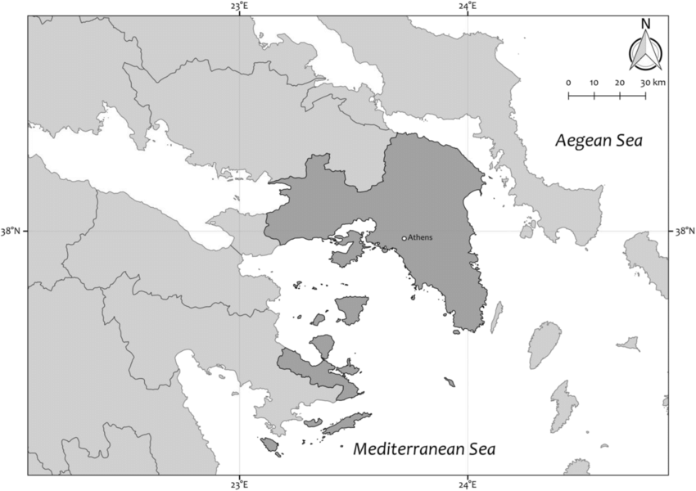
Applied Data Science Capstone
by
Finding the best place to open a restaurant in Attika, Greece
Konstantinos Anathreptakis
June, 2021

Slide 2
Introduction
Background: Explore Attica neighborhoods Latitude and Longitude data in order to find the best place to open a restaurant.
Problems: Which locations restaurants are the most frequently venues. Which Neighborhoods exhibit the same characteristics based on venues.
Interest: Businesses in the food industry as well advertising companies. Knowledge of the location with the most frequently restaurants venues.

Slide 3
Data acquisition and cleaning
Data sources : Data was obtained from the web and Foursquare. The initial dataset was downloaded from (https://simplemaps.com/data/gr-cities).
Data cleaning: Data downloaded in csv file from the web and cleaned and then combined into dataframe.
Features: The number neighborhoods in Attika are 82. Number o features will be 198, as the number of venues. Data will be downloaded form Foursquare API.

Slide 4
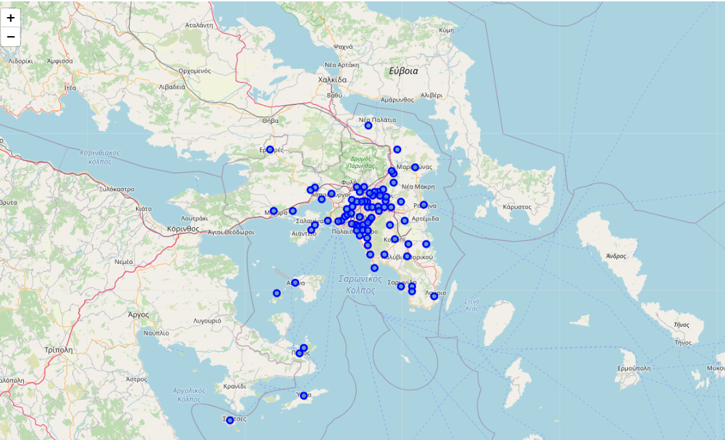
Exploratory Data Analysis – Visualization Map with locations

Slide 5
Exploratory Data Analysis –Neighborhood with top 10 venues
Neighborhood | 1st Most Common Venue | 2nd Most Common Venue | 3rd Most Common Venue | 4th Most Common Venue | 5th Most Common Venue | 6th Most Common Venue | 7th Most Common Venue | 8th Most Common Venue | 9th Most Common Venue | 10th Most Common Venue
Acharnes | Café | Mobile Phone Shop | Supermarket | Creperie | Souvlaki Shop | Taverna | Seafood Restaurant | Plaza | Cosmetics Shop | Dance Studio
Agia Paraskevi | Bakery | Pharmacy | Pizza Place | Clothing Store | Café | Plaza | Baby Store | Cosmetics Shop | Coffee Shop | Furniture / Home Store
Agia Varvara | Grocery Store | Fish Taverna | Café | Optical Shop | Greek Restaurant | Restaurant | Bakery | Bus Stop | Fast Food Restaurant | Betting Shop
Agkistri | Hotel | Nightclub | Hotel Bar | Cocktail Bar | Harbor / Marina | Café | Greek Restaurant | Women's Store | Farmers Market | Food & Drink Shop
Aigaleo | Café | Bar | Meze Restaurant | Coffee Shop | Burger Joint | Souvlaki Shop | Mobile Phone Shop | Donut Shop | Bakery | Snack Place

Slide 6
Exploratory Data Analysis – Number of restaurants in every Neighborhood (top 10)
Neighborhood | Number_of_Restraurants
ydra | 21
Nea Filadelfeia | 19
Argyroupoli | 17
Kaisariani | 15
Chalandri | 15
Palaia Fokaia | 14
Ilioupoli | 14
Melissia | 12
Aigina | 12
alimos | 12
Number_of_Restraurants: Venues containing the words Restaurant, Taverna and Souvlaki

Slide 7
Exploratory Data Analysis – Which Boroughs contain restaurant in top 3 venues
Neighborhood | 1st Most Common Venue
Dafni | Greek Restaurant
Elefsina | Cretan Restaurant
Kalyvia Thorikou | Taverna
Koropi | Meze Restaurant
Mandra | Taverna
Melissia | Greek Restaurant
Oropos | Greek Restaurant
Palaia Fokaia | Seafood Restaurant
Porto Rafti | Fish Taverna
Zografos | Greek Restaurant
agios Dimitrios | Souvlaki Shop
ydra | Greek Restaurant
Neighborhood | 2nd Most Common Venue
Agia Varvara | Fish Taverna
Aigina | Greek Restaurant
Chaidari | Greek Restaurant
Dafni | Meze Restaurant
Galatas | Greek Restaurant
Galatsi | Greek Restaurant
Gerakas | Grilled Meat Restaurant
Ilioupoli | Meze Restaurant
Kaisariani | Meze Restaurant
Kallithea | Souvlaki Shop
Kalyvia Thorikou | Greek Restaurant
Kifisia | Japanese Restaurant
Megara | Grilled Meat Restaurant
Moschato | Greek Restaurant
Nea Filadelfeia | Souvlaki Shop
Nea Peramos | Greek Restaurant
Paiania | Greek Restaurant
Palaia Fokaia | Greek Restaurant
Peristeri | Souvlaki Shop
Petroupoli | Greek Restaurant
Piraeus | Souvlaki Shop
Porto Rafti | Greek Restaurant
alimos | Greek Restaurant
Neighborhood | 3rd Most Common Venue
Aigaleo | Meze Restaurant
Anavyssos | Greek Restaurant
Argyroupoli | Souvlaki Shop
Ilioupoli | Kebab Restaurant
Kalyvia Thorikou | Souvlaki Shop
Kapandriti | Seafood Restaurant
Kitsi | Greek Restaurant
Mandra | Souvlaki Shop
Metamorfosi | Greek Restaurant
Nea Filadelfeia | Meze Restaurant
Perama | Meze Restaurant
Saronida | Seafood Restaurant
Vyronas | Souvlaki Shop
Zefyri | Souvlaki Shop
agios Stefanos | Souvlaki Shop

Slide 8
Clustering model
Clustering: Is a type of unsupervised machine learning that is used to organize data points into similar groups called clusters.
Method: K-means is an algorithm that repeatedly partitions observations into a fixed number, k, of non-overlapping clusters
Parameters: In this project we assume that k is 5. The number of features for the Clustering algorithm will be 198.

Slide 9
Clusters
Cluster 1
Agia Paraskevi | Kalyvia Thorikou | Pefki | agios Dimitrios
Agia Varvara | Keratsini | Perama | agios Stefanos
Agkistri | Kifisia | Peristeri | alimos
Argyroupoli | Kitsi | Piraeus | ano Liosia
Athens | Koropi | Poros | anoixi
Chalandri | Mandra | Porto Rafti | ilion
Cholargos | Marathonas | Psychiko | Kallithea
Dafni | Marousi | Rafina | Palaia Fokaia
Dionysos | Megara | Saronida | agioi Anargyroi
Elefsina | Melissia | Spata | Kaisariani
Erythres | Metamorfosi | Voula | Ntrafi
Gerakas | Nea Filadelfeia | Vouliagmeni | Zografos
Glyfada | Nea Ionia | Vrilissia
Ilioupoli | Nea Smyrni | Zefyri
Cluster 2
Mobile Phone Shop | Kapandriti | Paiania | Galatas
Aigaleo | Korydallos | Palaio Faliro | Galatsi
Aigina | Kythira | Petroupoli | Irakleio
Anavyssos | Lykovrysi | Vyronas | Moschato
Aspropyrgos | Magoula | ydra | Nea Peramos
Chaidari | Markopoulo | Nikaia
Mobile Phone Shop | Kapandriti | Paiania
Cluster 3
Lavrio
Cluster 4
Spetses
Cluster 5
Oropos

Slide 10
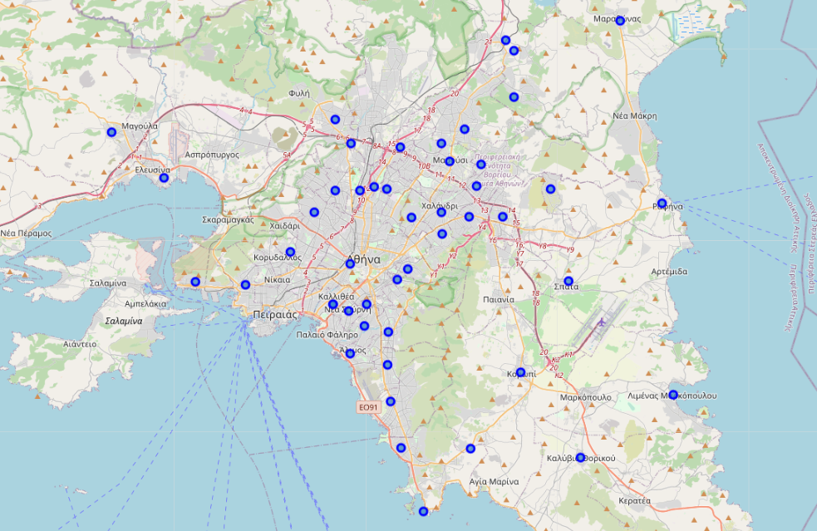
Map Visualization Cluster 1

Slide 11
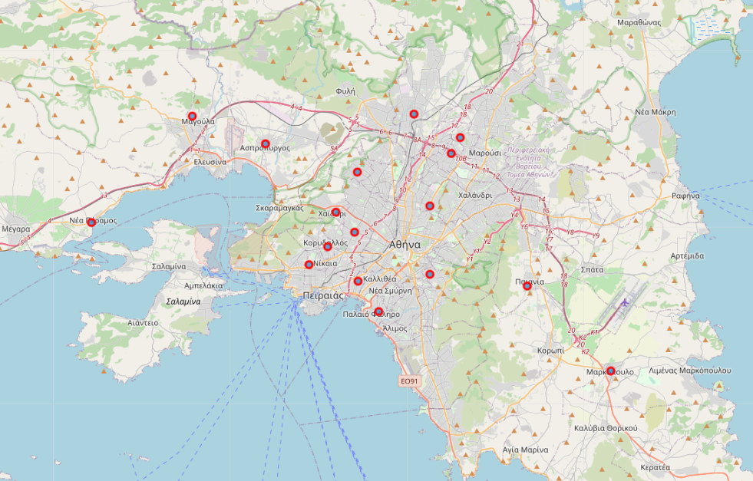
Map Visualization Cluster 2

Slide 12
Conclusion and future directions
Identify locations which restaurants is the most frequently venue in order to aid stakeholders find the best place to open a new restaurant.
Clustering locations into 5 categories in order to know in which area a franchise will open restaurants in order to satisfy all kind of Neighborhood clusters.
There is place for future development of this project, as we can add more variables such as economic development, demographic data and financial data about the potential customer in each Neighborhood.

