Slide 1
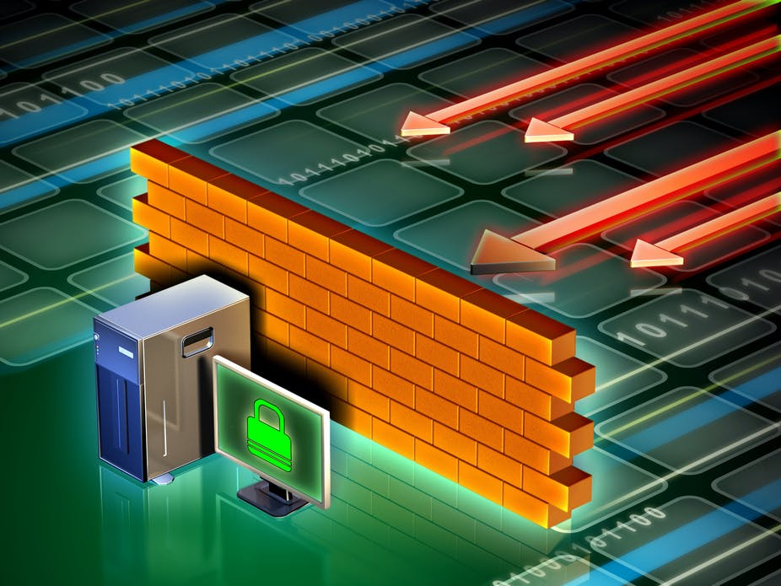
Firewalls
How they work
and how to bypass them

Slide 2
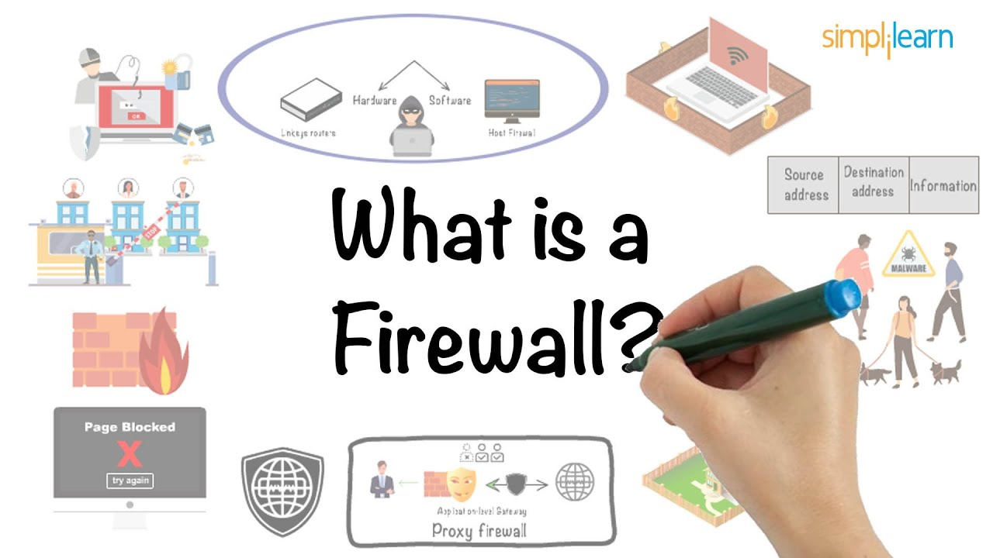

Slide 3

Definition
A firewall is a network security device that monitors incoming and outgoing network traffic and permits or blocks data packets based on a set of security rules.

Slide 4
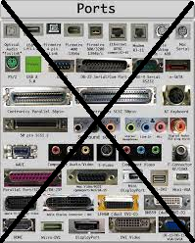
One step Back... Ports?
In computer networking a port is a communication endpoint. There are 65 535 ports on a computer network for any given IP. Whenever we open a connection to the internet, we open a port to receive and transmit data.
If I open google on a browser and view the lower level, the browser opens a new random unused port (ex. 54265) to communicate with google’s server (on port 443).

Slide 5
So How Does A Firewall Work?
Firewalls carefully analyze incoming traffic based on pre-established rules and filter traffic coming from unsecured or suspicious sources to prevent attacks. Firewalls guard traffic at a computer’s entry point, which is where information is exchanged with external devices.

Slide 6
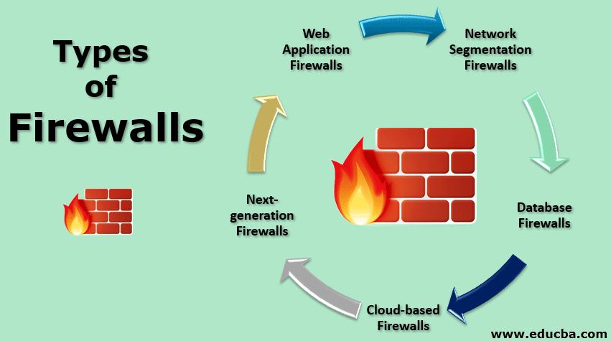

Slide 7
Packet Filtering Firewalls
Stateful
Stateless
Remember previous packets as they examine new ones
Have context knowledge
More Secure
Examine Packets Independently of one another
Lack context
Less Secure
Ultimately Packet Filtering Firewalls provide very basic protection and they both lack context of what the packet may do at the application level.

Slide 8
Next Generation Firewalls (NGFW)
NGFW are considered the go-to solution for firewalls nowadays. They provide old traditional firewall functionality such as packet filtering in addition to more features and mechanisms. They can inspect encrypted traffic, perform deep packet inspection, contain built-in IPS and antivirus, and more...

Slide 9
WAF or Proxy Firewalls
This type of firewall sits in between the two communicating systems at the 7th OSI layer (Application level). They use both packet filtering techniques and deep packet inspection to detect malicious traffic. They work for high level protocols (HTTP, ftp, etc...)

Slide 10
NAT Firewalls
They allow multiple devices with independent network addresses to connect to the internet using a single IP address, keeping individual IP addresses hidden.

Slide 11
Stateful MultiLayer Inspection Firewalls
SMLI filter packets at the network, transport, and application layers, comparing them against known trusted packets. They allow a packet to pass only if they pass every single layer individually. The firewall examines the packets to determine the state of the communication to ensure that all of the communication is taking place with trusted sources

Slide 12
Unified Threat Management Firewalls
Like the NGFW firewall it comes with a lot of security features such as antispam, content filtering, web filtering, antivirus. This firewall comes as hardware and is less customizable than NGFW but it is used heavily on businesses that want the easy way out.

Slide 13
Cloud Firewalls
Cloud Firewalls are software-based, cloud deployed network devices, built to stop or mitigate unwanted access to private networks. As a new technology, they are designed for modern business needs, and sit within online application environments.

Slide 14
Threat Focused NGFW
Basically a NGFW on steroids...

Slide 15
Circuit Level Firewalls
A circuit-filtering firewall (also called a circuit-level gateway) works at the transport and session layers of the OSI model. It can examine the TCP handshake information that is sent between computers to verify that a session request is legitimate.

