Slide 1
Python Task - Airbnb
KONSTANTINOS PETRIDIS

Slide 2
PART A – Data Cleaning
Overiew: Loaded Listings, Calendar, and Reviews datasets. Conducted initial shape validation (.shape) and missing value audits.
Formatting: formatting symbols ($, ,, %) from price and rate columns, converting text fields into float64 to prevent corrupted financial metrics.
Imputation Strategy: Applied placeholder values ("Unknown") for text columns and utilized Mode Imputation (most frequent value) for operational metrics like host_response_time.
Outlier Mitigation: Capped minimum and maximum booking nights at 365 using .clip() to neutralize unrealistic placeholder inputs (e.g., 999 nights) set by hosts.

Slide 3
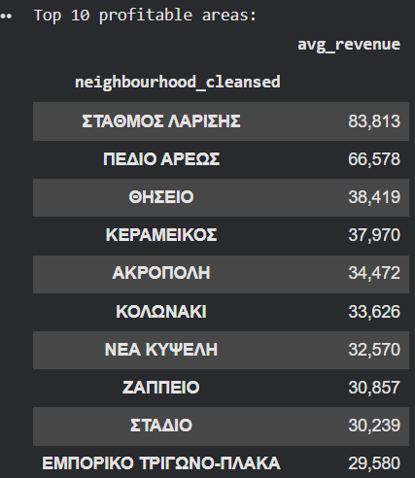
QUESTION - 1 Most Profitable Areas in Greece
Methodology: Isolated actual bookings (available == 'f') from the calendar, calculated total revenue per listing, and aggregated the mean earnings by geographical sector (neighbourhood_cleansed).
Key Finding: Identified and ranked the Top 10 premium neighborhoods yielding the highest average revenue.

Slide 4
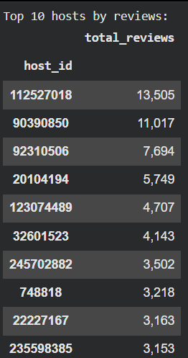
QUESTION - 2 Top Hosts by Review Volume
Methodology: Aggregated total review counts at the listing_id level in the Reviews dataset, then seamlessly linked them to the Listings table to compute cumulative engagement per individual host_id.
Key Finding: Uncovered the Top 10 most active hosts based on overall customer review counts.

Slide 5
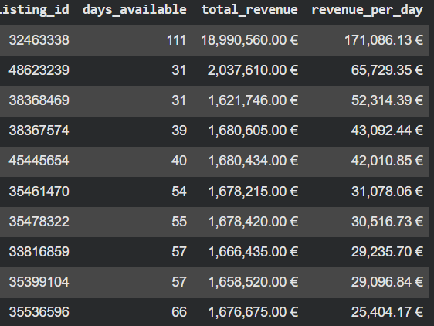
QUESTION - 3 Pricing Strategy Efficiency
Methodology: Developed a specialized performance metric:
Revenue per Day Available.
Utilized np.where() to handle structural division-by-zero anomalies for properties with zero recorded availability
Key Finding:Top 10 listings with the highest earnings for each day they are active

