Slide 1
Calorie Labeling, Health Behavior and BMI

Slide 2
Research Question / Policy
The policy was implemented from New York Department of Health and Mental Hygiene in 2008 to raise the concerns regarding the rising trend of the BMI across the State.
How does a calorie labeling policy inform consumers better and impact their BMI?
Similar Researches were conducted on the specific policy.
”Chain Restaurant Calorie Posting Laws, Obesity and Consumer Welfare”, estimating a significant decrease by 0.2 kg/m^2.

Slide 3
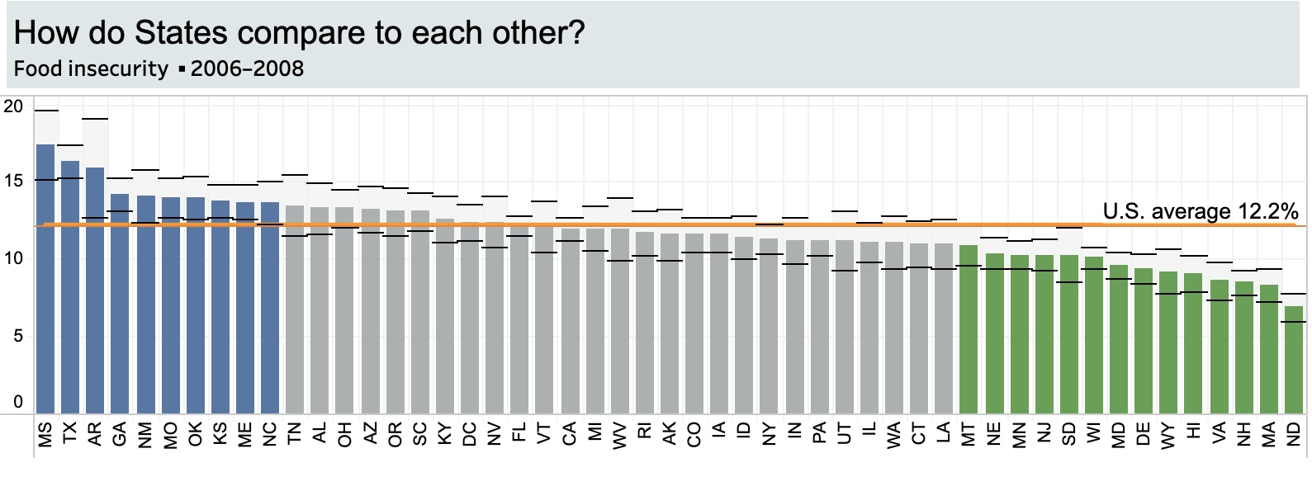
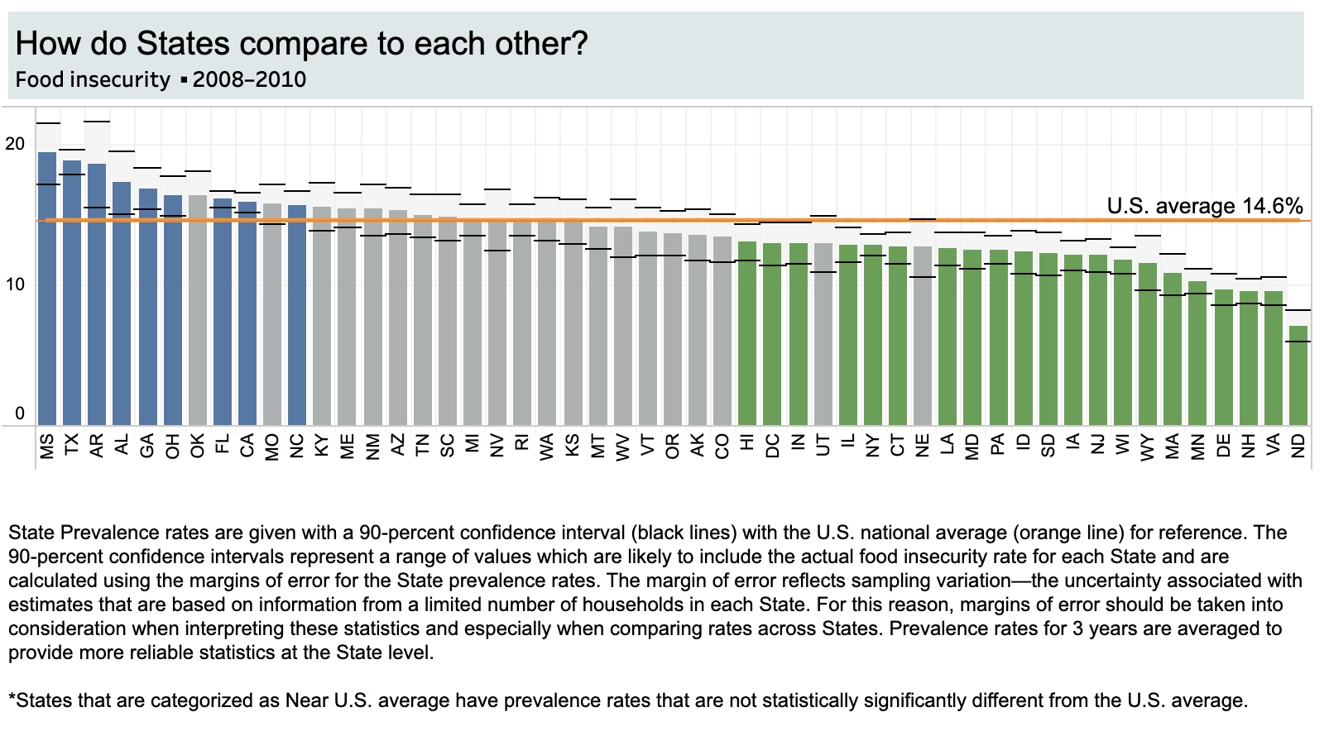

Slide 4
Data /Variables
I combined microdata for the health status, frequency of french-fries consumption, state and year dummies along with the average BMI of each state. Final dataset consists of n= 9,323 observations.
Constructed a “fry-overload” as the ratio of BMI over the frequent of fries’ consumption.

Slide 5
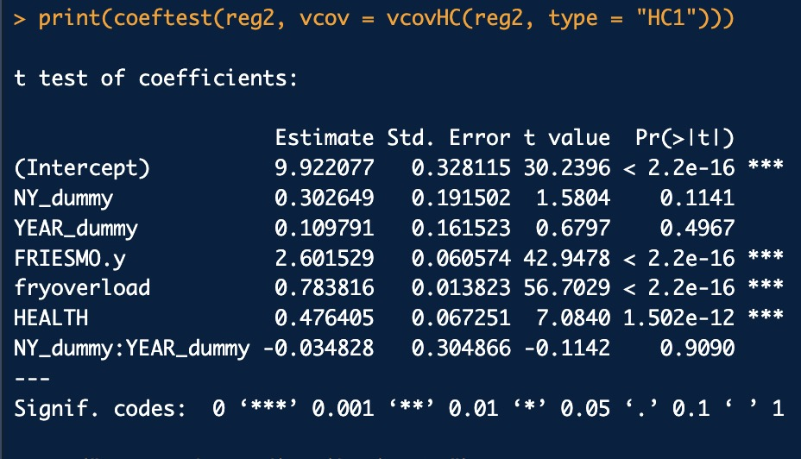
Regressions
Main Result:
Insignificant policy effect.
But,
Health status and eating habits have statistically significant effects.

Slide 6
