Slide 2
From IoT Devices to Time-Series Insights (TSI) (Part 2: Prepare and send the data to the cloud)
Subtitle or speaker name
Konstantinos Barmpas – Imperial College London
PhD Candidate, M.Eng.
Microsoft Learn Student Ambassador – Beta Level

Slide 3
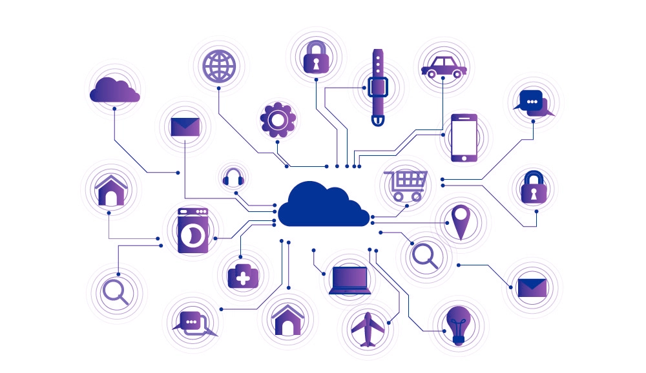
Internet of Things (IoT)
The Internet of Things describes the network of devices that are connected and allow data exchange
Source 1: https://en.wikipedia.org/wiki/Internet_of_things
Source 2: www.e-zigurat.com

Slide 4
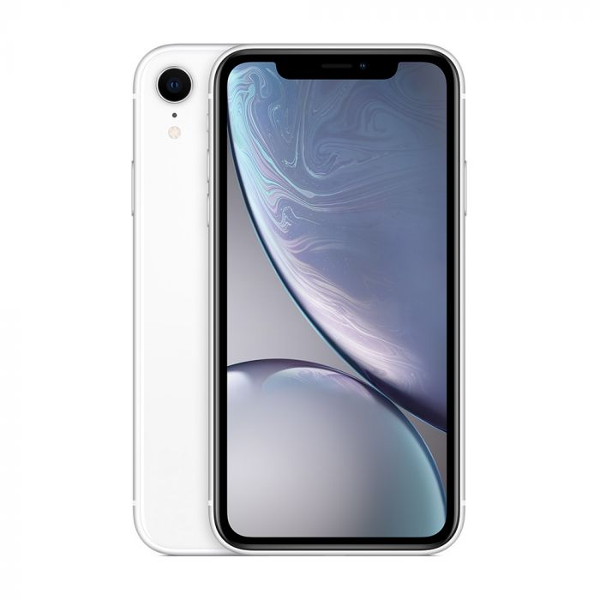
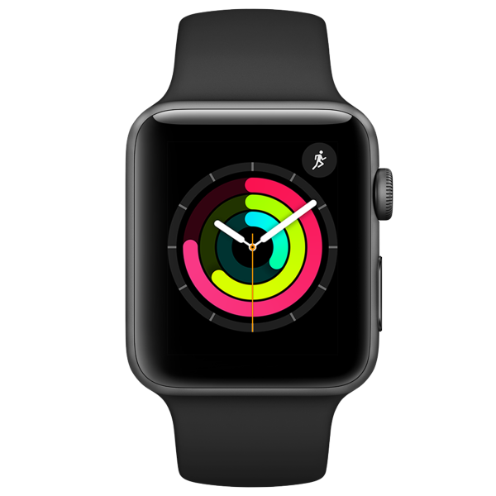
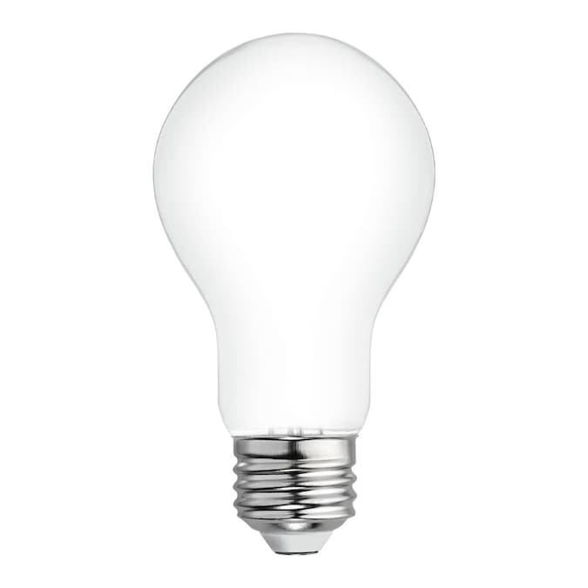
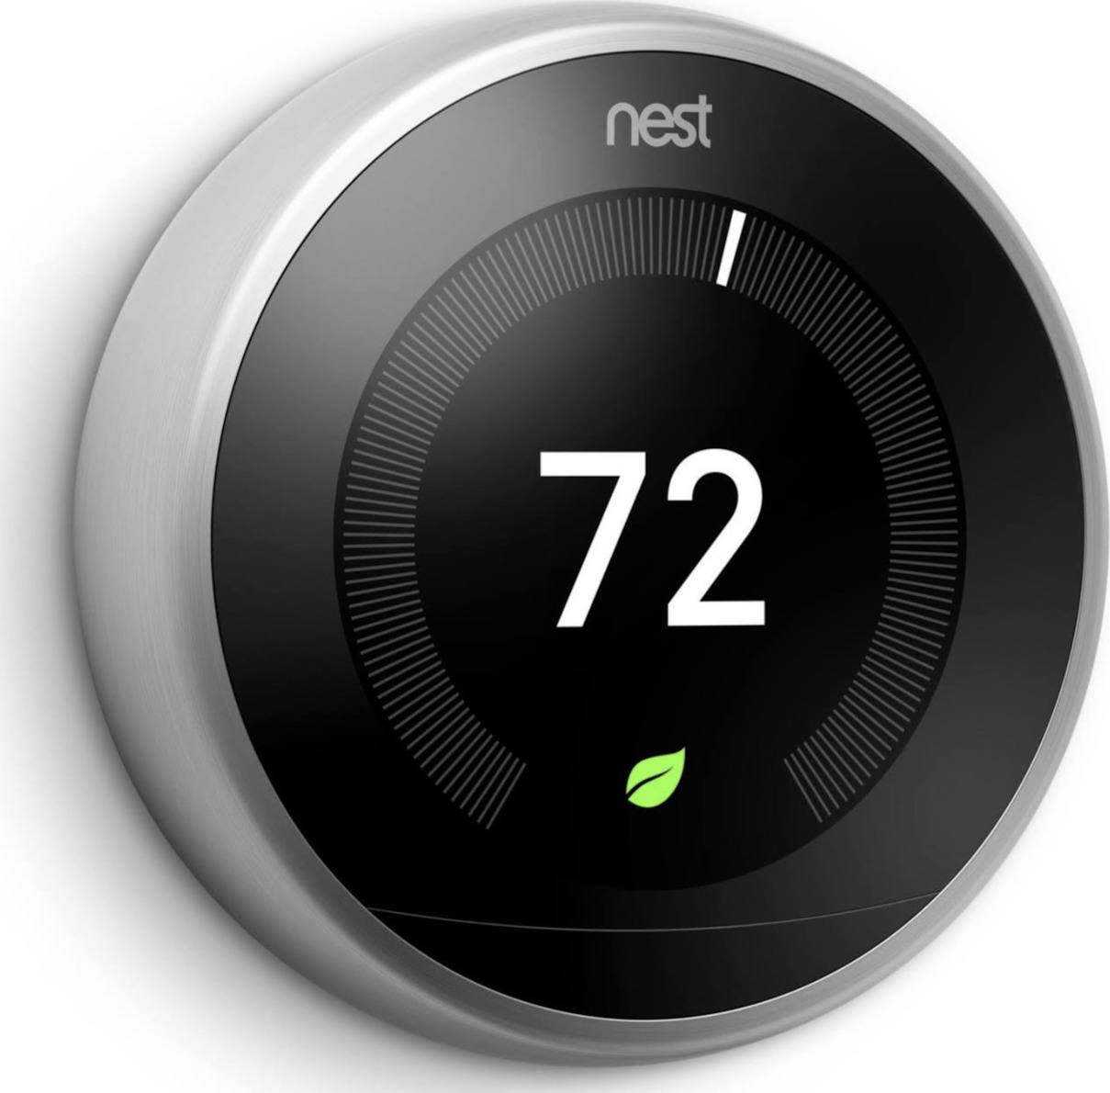
Sources: Apple, Nest

Slide 5
How big is IoT ?
“Tech analyst company IDC predicts that in total there will be 41.6 billion connected IoT devices by 2025, or "things." ”
- Zdnet

Slide 6
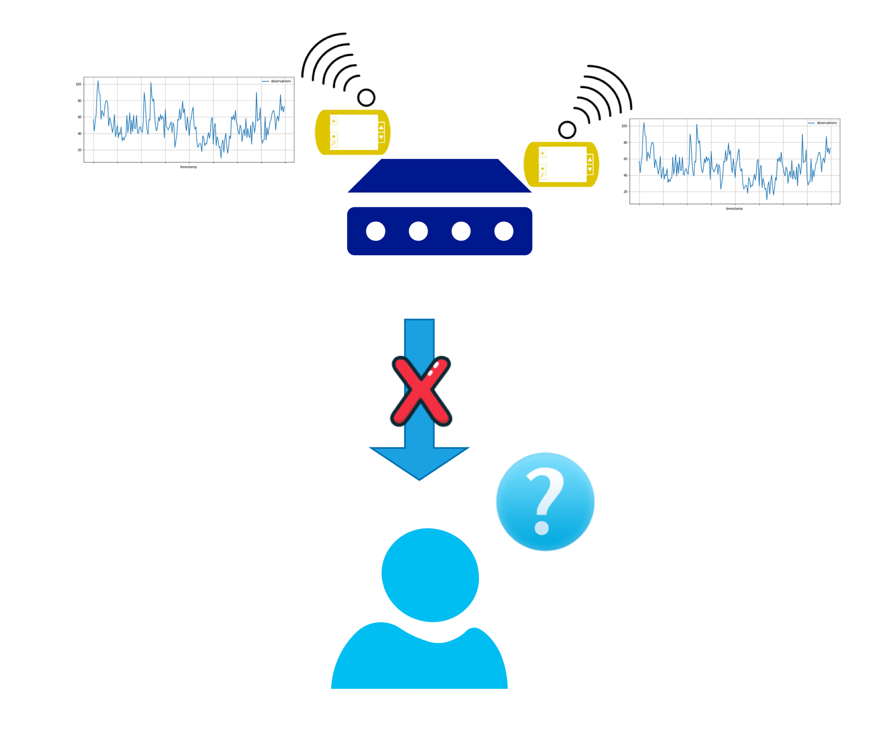
IoT Devices with Timeseries Data

Slide 7

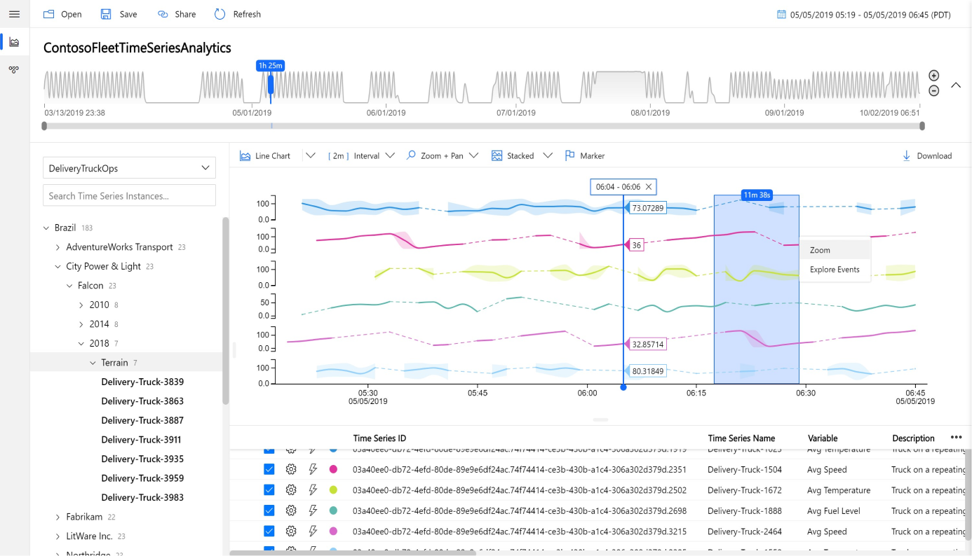
Time-Series Insights (TSI)
TSI provides access to data via an amazing dashboard
Source : Microsoft Azure

Slide 8
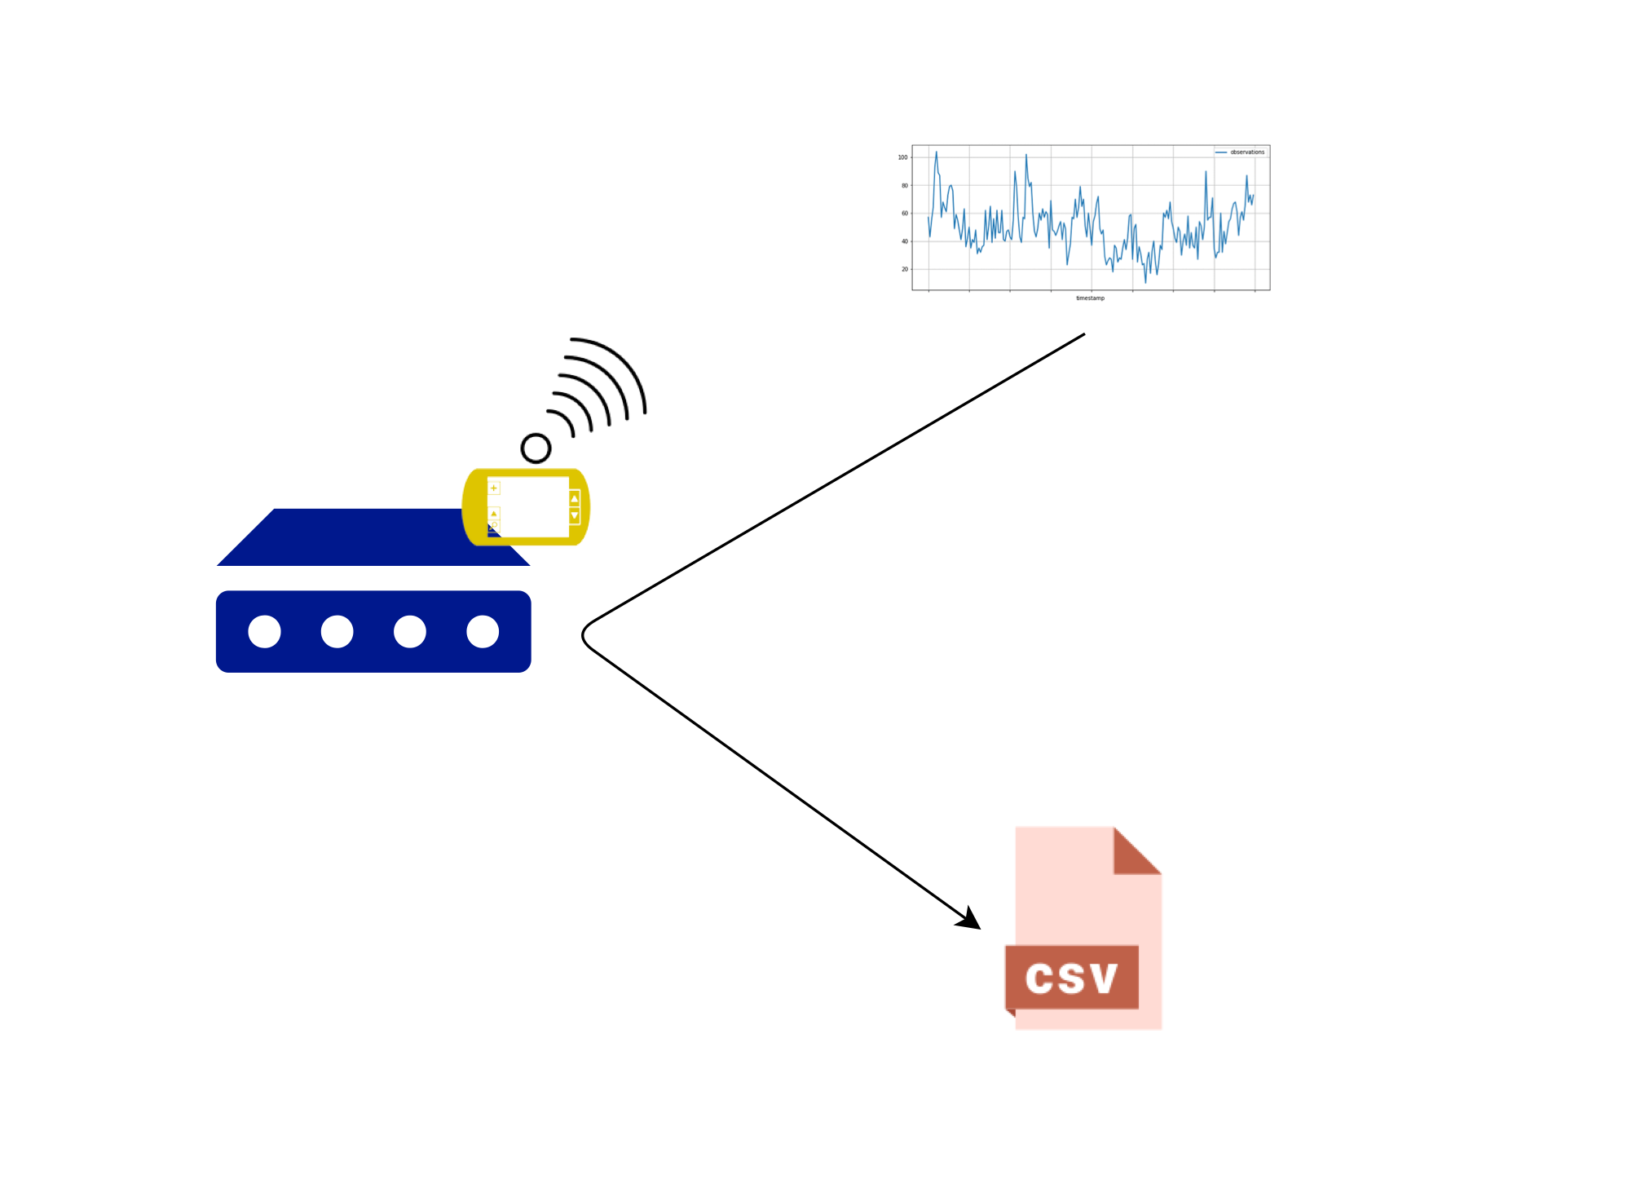
Our Test Case
Two devices and each device has a temperature sensor
Each device calculates a temperature monthly mean and stores it locally

Slide 9
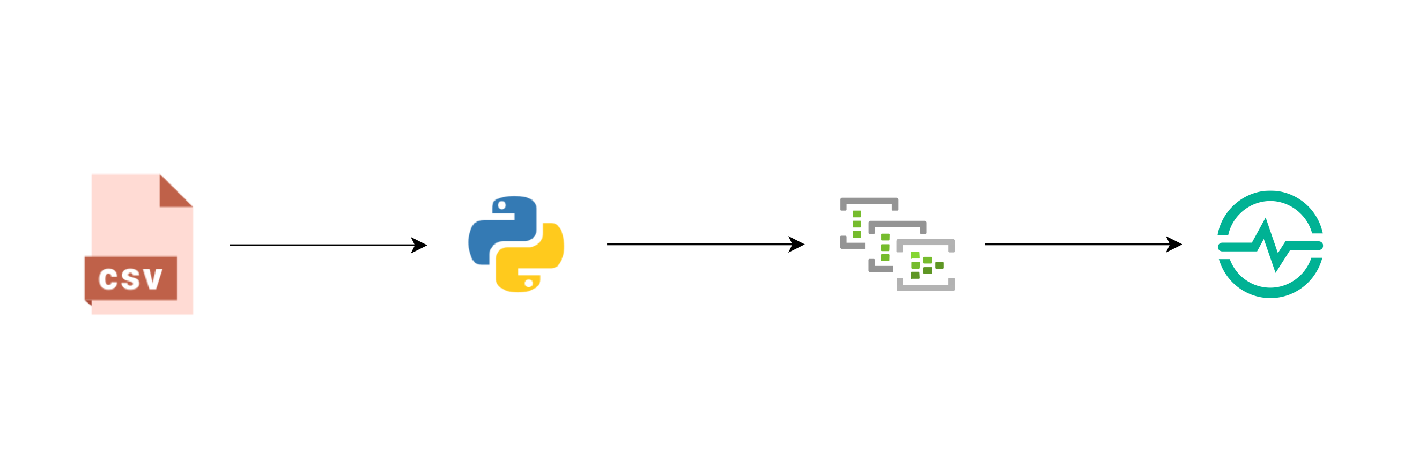
Our Previous Map

Slide 10
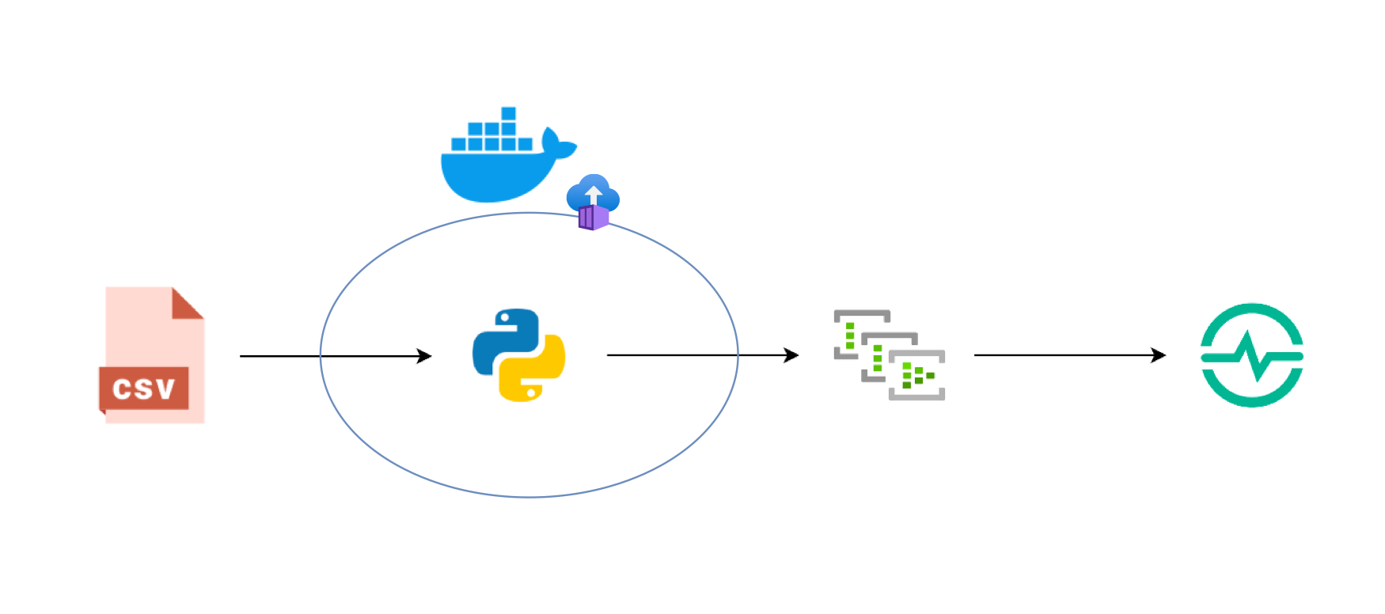
Our Map

Slide 11
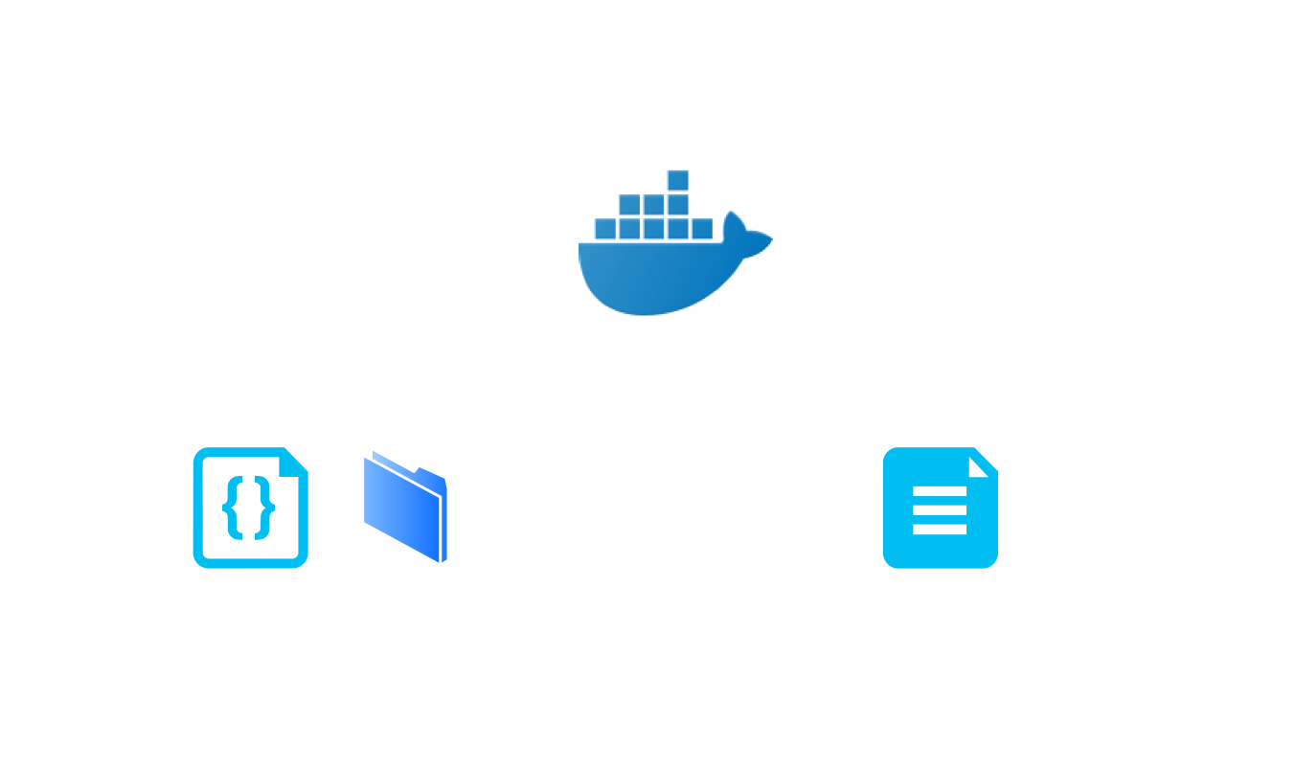
Docker
“Docker is an open platform for developing, shipping, and running applications.
Docker enables you to separate your applications from your infrastructure so you can deliver software quickly.”
DATA
DOCKERFILE
Source: https://docs.docker.com/get-started/overview/

Slide 12
Demo / Hands-On

Slide 13
Our Map

Slide 14



Speaker: Konstantinos Barmpas
Connect with me: https://www.linkedin.com/in/konstantinos-barmpas/
Follow me: @ntinosbarmpas
@KonstantinosBarmpas
The code and slides of this tutorial will be released here on my GitHub account

Slide 15
Thank you !

