Slide 2
From IoT Devices to Time-Series Insights (TSI)
Subtitle or speaker name
Konstantinos Barmpas – Imperial College London
PhD Candidate, M.Eng.
Microsoft Learn Student Ambassador – Alpha Level

Slide 3
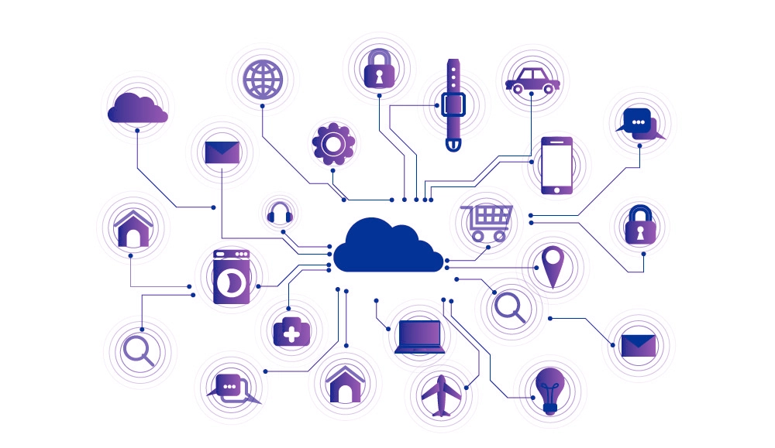
Internet of Things (IoT)
The Internet of Things describes the network of devices that are connected and allow data exchange
Source 1: https://en.wikipedia.org/wiki/Internet_of_things
Source 2: www.e-zigurat.com

Slide 4
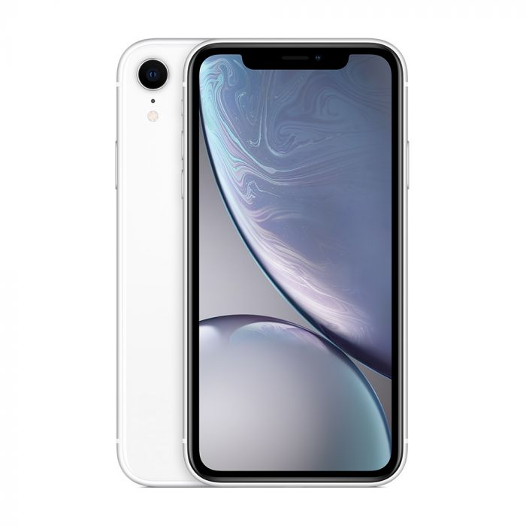
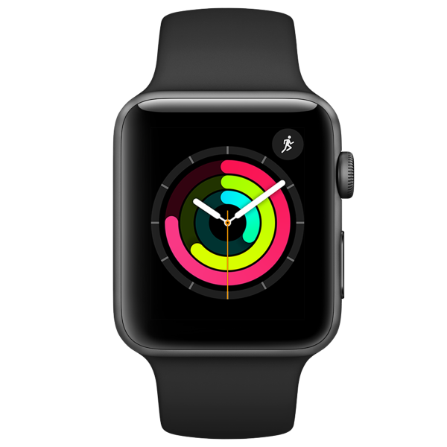
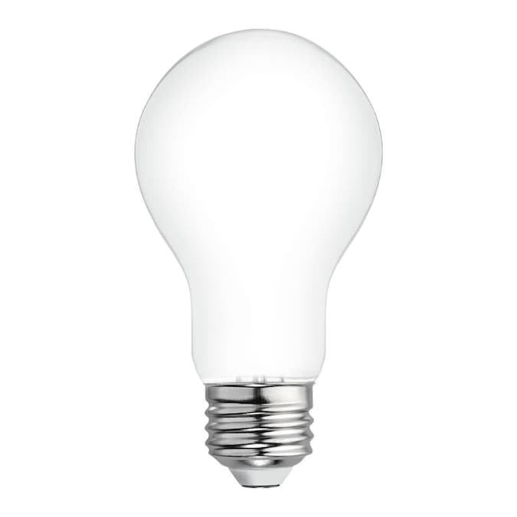
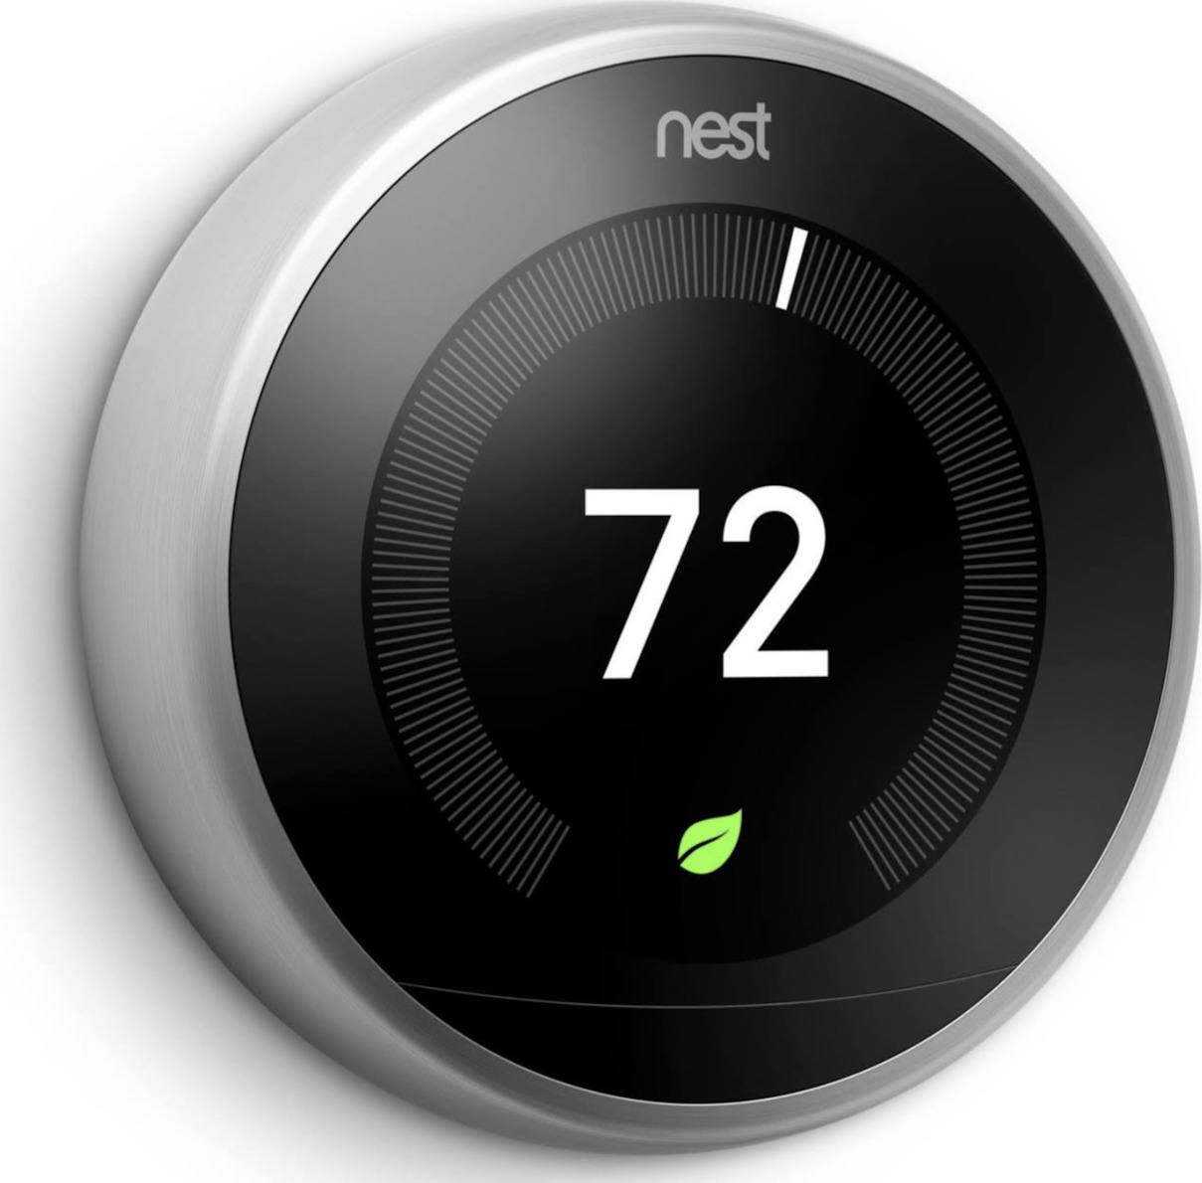
Sources: Apple, Nest

Slide 5
How big is IoT ?
“Tech analyst company IDC predicts that in total there will be 41.6 billion connected IoT devices by 2025, or "things." ”
- Zdnet

Slide 6
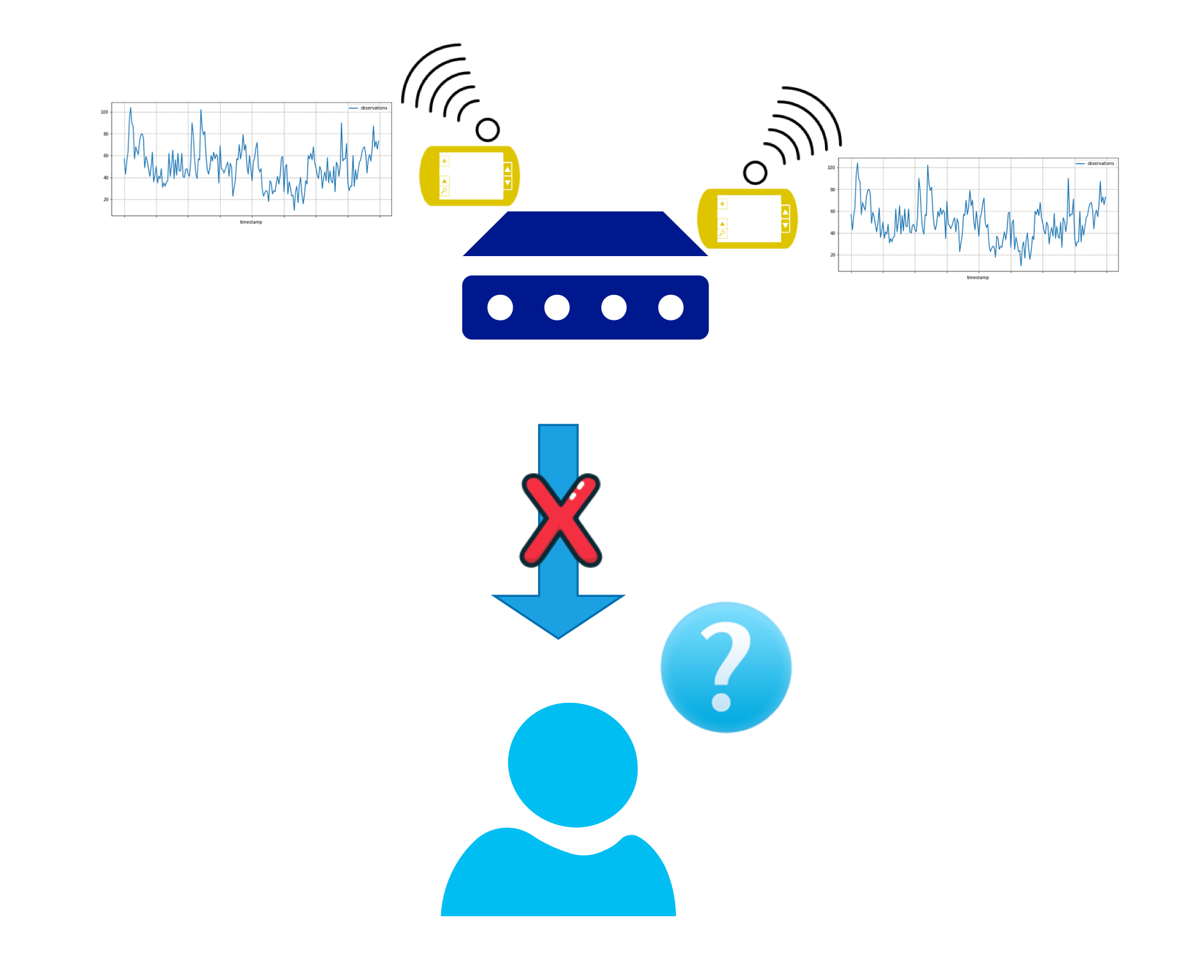
IoT Devices with Timeseries Data

Slide 7

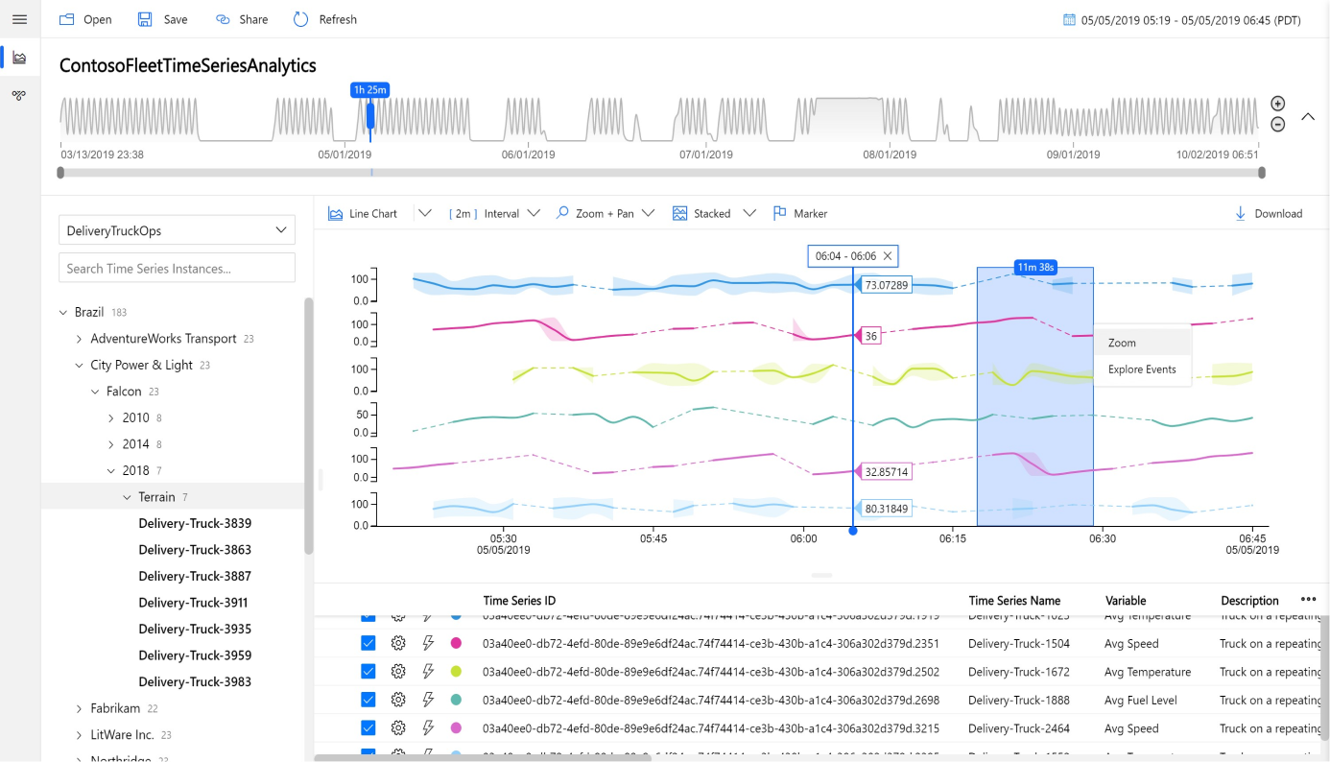
Time-Series Insights (TSI)
TSI provides access to data via an amazing dashboard
Source : Microsoft Azure

Slide 8
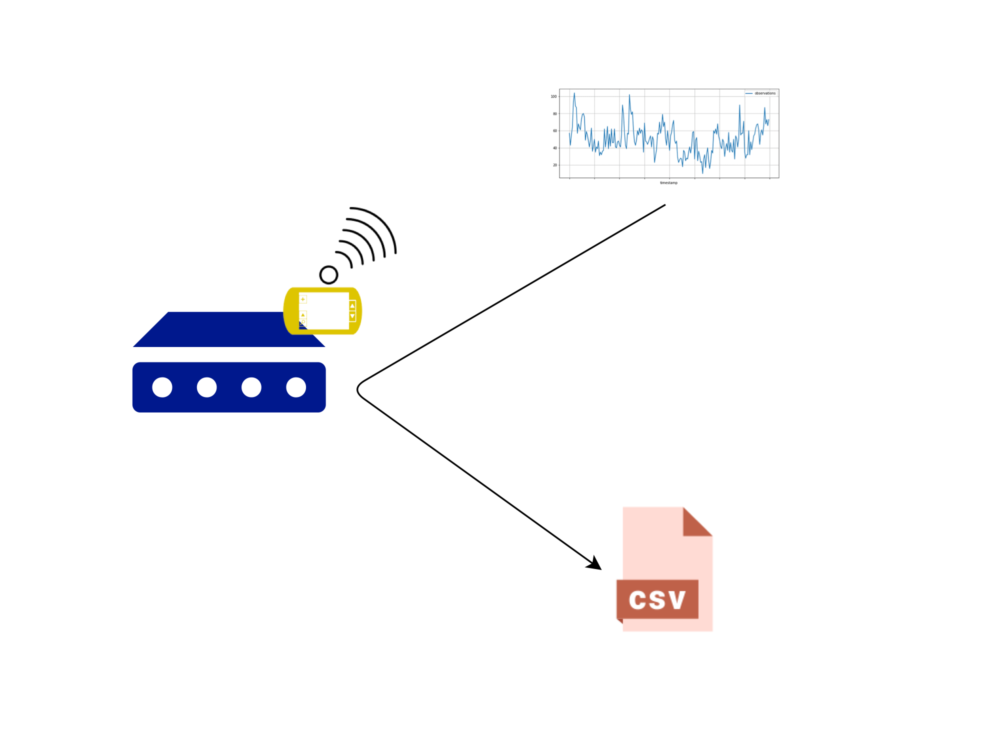
Our Test Case
Two devices and each device has a temperature sensor
Each device calculates a temperature monthly mean and stores it locally

Slide 9
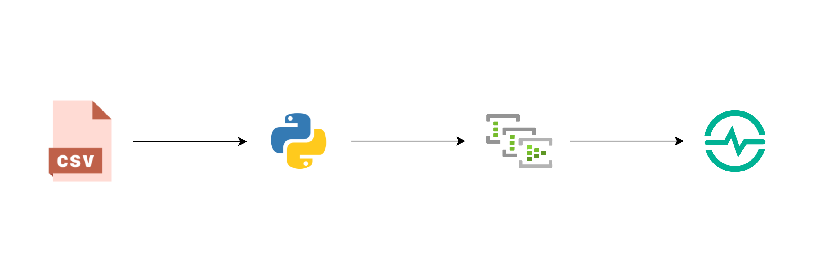
Our Map

Slide 10
Demo / Hands-On

Slide 11
Our Map

Slide 12



Speaker: Konstantinos Barmpas
Connect with me: https://www.linkedin.com/in/konstantinos-barmpas/
Follow me: @ntinosbarmpas
@KonstantinosBarmpas
The code and slides of this tutorial will be released here on my GitHub account

Slide 13
Thank you !

