Slide 1
Machine learning algorithms for financial fraud detection
Kωνσταντίνος Μπενέκος
Σύμβουλος καθηγητής: Μ. Τζαγακαράκης
27/09/2024
Κωνσταντίνος Μπενέκος
ML algorithms for financial fraud detection

Slide 2
Introduction
Background of the study
The growing challenge of credit card fraud
Credit card fraud is increasing due to growing digital dependence as well as the boom in e-commerce experienced over the lase couple of years.
Common fraud techniques include identity theft, document fabrication and more.
Traditional fraud prevention struggle to keep up due to:
Sheer volume of transactions
Constantly evolving fraud patterns
Need for data-driven approaches to detect and adapt to new fraud types.
Κωνσταντίνος Μπενέκος
ML algorithms for financial fraud detection

Slide 3
Introduction
Background of the study
Credit card fraud statistics
The U.S. Federal Trade Commission (FTC) reported 460,000 cases in 2023, This represents a 53% increase compared to 2019; it also ranked as the top identity theft complaint (FTC, 2023).
Data leakage risks: Yu and He (2021) highlight widespread data vulnerability, with incidents like Facebook’s 2018 breach exposing 87 million users' data and 50% of leaks in 2014 occurring in the business sector.
Financial impact in Europe: In 2021, Card-not-present fraud in the euro area amounted to 1.28 billion euros (European Central Bank, 2021).
Κωνσταντίνος Μπενέκος
ML algorithms for financial fraud detection

Slide 4
Introduction
Background of the study
Machine Learning for credit card fraud detection
The main objective of this study is to examine the performance three distinct machine learning techniques in detecting fraudulent credit card transactions.
Aim:
Provide insight into accuracy and overall effectiveness of each technique.
Highlight strengths and weaknesses of each technique.
Techniques in Question:
Random Forest
Logistic regression
Support Vector Machines
Κωνσταντίνος Μπενέκος
ML algorithms for financial fraud detection

Slide 5
Introduction
Background of the study
Formulation of Research Questions
How effective are the proposed techniques at detecting fraudulent credit card transactions in real world data set?
What are their strengths and limitations?
What are the difficulties in terms of handling highly imbalanced fraud datasets, and how do we overcome them?
ML algorithms for financial fraud detection

Slide 6
Introduction
Background of the study
Importance of the Investigation
For financial institutions:
Fraud detection saves resources and protects reputation.
Need for efficient and cost-effective fraud prevention.
For customers:
Enhanced security and trust in online transactions.
Contributions to research:
Insight into applying machine learning to real-world fraud data.
Potential to develop reliable, robust fraud detection systems.
Κωνσταντίνος Μπενέκος
ML algorithms for financial fraud detection

Slide 7
Review of Literature
Definitions of credit card fraud
Definitions of credit card fraud
“When an unauthorized person uses a credit card for personal use without the approval or knowledge of the card owner and the card issuer doesn’t have a clue of what the card is being used for.“(Azhan 2020).
"When an individual uses another individuals’ credit card for personal reasons while the owner of the card and the card issuer are not aware of the fact that the card is being used. Further, the individual using the card has no connection with the cardholder or issuer, and has no intention of either contacting the owner of the card or making repayments for the purchases made.“(Bhatla, Prabhu and Dua 2003).
Κωνσταντίνος Μπενέκος
ML algorithms for financial fraud detection

Slide 8
Review of Literature
Summary of recent work
Related literature
Sadineni (2020), explores the use of machine learning techniques like Random Forest, Decision Trees, SVM, and Logistic Regression for detecting fraudulent credit card transactions. The analysis highlights Random Forest achieving 99.21% accuracy, with other models also performing well, demonstrating the effectiveness of these methods in identifying fraudulent transactions.
Mohari et al. (2021) demonstrated that machine learning techniques effectively combat rising fraud cases by adapting to evolving fraud methods and handling large transaction volumes. Their study found that the Local Outlier Factor achieved the highest accuracy among ten techniques tested.
Κωνσταντίνος Μπενέκος
ML algorithms for financial fraud detection

Slide 9
Review of Literature
Common issues
Common issues
The most common issues prevailing throughout most of the common literature stem from the data
Highly imbalanced, leads to bias.
Unavailability of good data sets.
Κωνσταντίνος Μπενέκος
ML algorithms for financial fraud detection

Slide 10
Methodology
Data
Dataset
Source: Dataset obtained from Kaggle, capturing transactions by European cardholders over two days in September 2013.
Size: 287,807 transactions, with 492 fraudulent (0.172%).
Feature:
30 numerical features (V1-V28 derived from PCA, along with "Time" and "Amount").
Class: Binary variable indicating transaction legitimacy (0 = non-fraudulent, 1 = fraudulent).
Κωνσταντίνος Μπενέκος
ML algorithms for financial fraud detection

Slide 11
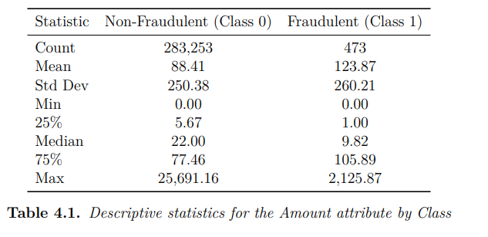
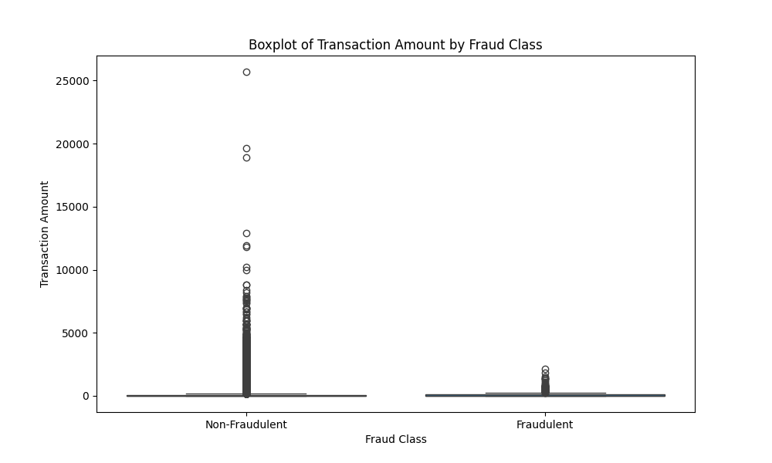
Methodology
Data
Descriptive statistics
Fraudulent transactions tend to have lower amounts despite a higher mean due to the few high-value transactions.
Box-plot confirms that non-fraudulent transactions typically involve larger amounts(more “extreme” outliers).
Κωνσταντίνος Μπενέκος
ML algorithms for financial fraud detection

Slide 12
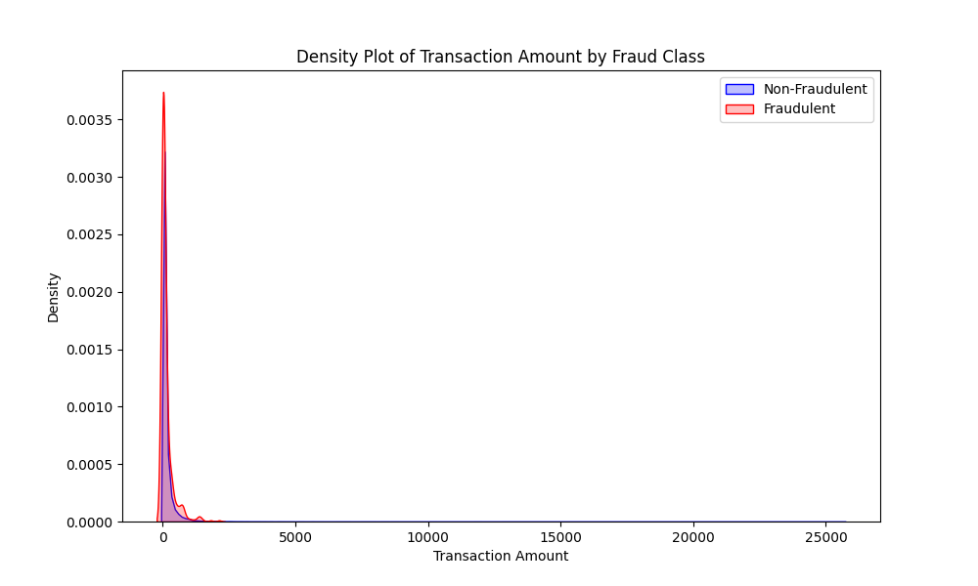
Methodology
Data
Distribution of the data
Yet, it is important to note that, the density plot reveals that both classes exhibit similar patterns, with both tending to involve lower amounts more frequently.
Κωνσταντίνος Μπενέκος
ML algorithms for financial fraud detection

Slide 13
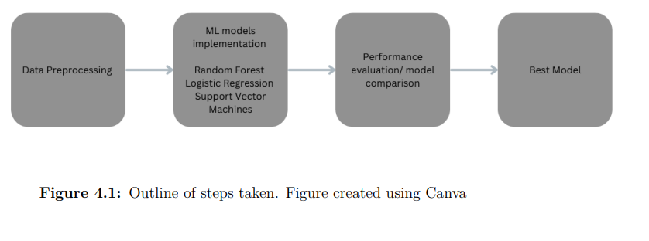
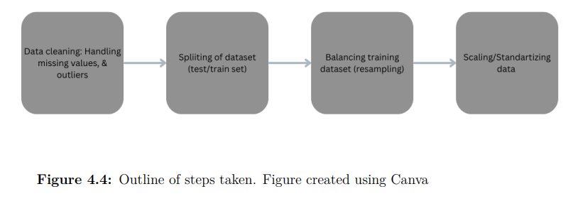
Methodology
Preprocessing
Outline of steps
Data cleaning:
No missing values in dataset
Outliers identified using the Inter Quantile Range(IQR) technique.
Only outlier in feature “Amount” were deleted.
Splitting of dataset:
80% of the data is allocated for training, while the remaining 20% is used for testing.
Stratified sampling to ensure class distribution the same in train/test data as in the original data.
Balancing:
To address the issue of our highly unbalanced dataset, we created ten balanced subsets by sampling the majority class to match the minority class size, ensuring diverse representation within each subset.
We trained separate models on each subset and aggregated predictions through majority voting, leveraging insights from all subsets for a more robust evaluation of performance.
Feature scaling:
Normalization of independent variables using StandartScaler, which centers data at a mean of zero and stdv of one.
This scaling prevents bias in machine learning algorithms that arises from features with larger ranges, ensuring all features contribute equally to the model.
Each subset of data is scaled independently, and the test data is scaled based on parameters derived from the training data.
Κωνσταντίνος Μπενέκος
ML algorithms for financial fraud detection

Slide 14
Methodology
Models
Models
Random Forest:
Popular machine learning algorithm for fraud detection, comprising multiple decision trees that collectively make predictions based on majority voting.
Strengths: no need for feature selection and quick training, also, effectively preventing overfitting by creating distinct decision trees.
Weaknesses: sensitivity to diverse data values and attributes with multiple values.
Our implementation utilizes the RandomForestClassifier from the Scikit-learn library in Python, with the default number of trees set to 100.
Logistic Regression:
Straightforward technique for both classification and regression, utilizing a sigmoid function to estimate the probability of outputs as either binomial or multinomial.
It assigns inputs to predefined categories, predicting a binary response (0 or 1) based on the relationship between independent and dependent variables.
The main advantages include transparency (avoiding the "black-box" problem) and no assumptions about class distributions, while its primary disadvantage is the assumption of a linear relationship between inputs and outputs.
Support Vector Machines:
aims to find the optimal hyperplane that separates data into two classes (fraud/non-fraud), maximizing the distance between the nearest data points (support vectors) and the hyperplane.
The SVM model is trained on historical data to identify this optimal boundary, classifying new transactions based on which side of the hyperplane they fall.
Advantages include effective handling of structured and high-dimensional data while minimizing the risk of overfitting; however, SVMs require significant computational resources, especially with larger datasets.
Κωνσταντίνος Μπενέκος
ML algorithms for financial fraud detection

Slide 15
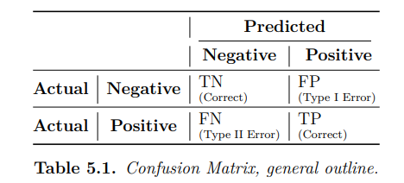
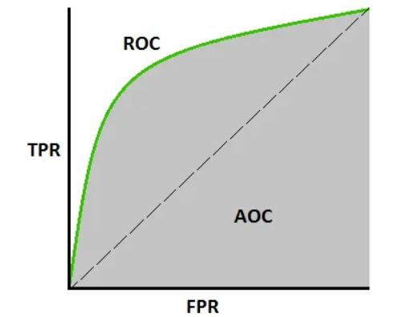
Methodology
Evaluation
Evaluation
Quality Metrics:
Accuracy: (T N + T P)/(T P + F P + F N + T N)
Recall: TP/(TP+FN)
Precision: TP/(TP+FP)
F1 score: 2*[(Recall*Precision)/(Recall+Precision)
Roc-Auc score
Business Relevance: We analyze model relevance in a business context, drawing insights from similar studies and expert reviews, ranking models based on interpretability, accuracy, and real-world applicability.
Κωνσταντίνος Μπενέκος
ML algorithms for financial fraud detection

Slide 16
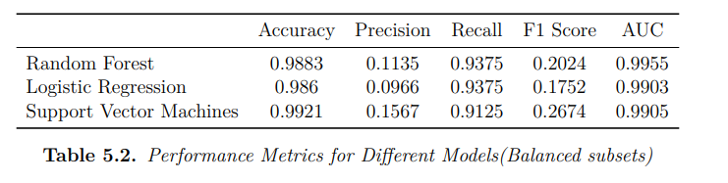
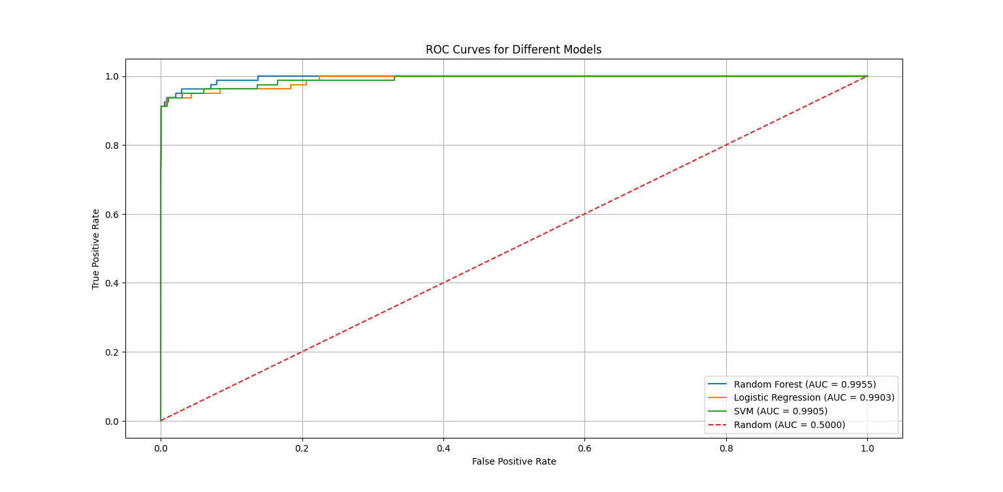
Results
Quantitative evaluation of models trained on balanced data subsets
Model Comparison
Random Forest:
Strong performance in recall and AUC, but low precision due to many false positives.
Logistic Regression:
Good overall metrics, but like Random Forest, suffers from low precision and high false positives.
Support Vector Machines:
Best accuracy, better precision than others, but still prone to false positives.
Conclusion:
All models are effective in detecting fraud but tend to overpredict fraud, likely due to the balanced training set not reflecting real-world data distribution.
Κωνσταντίνος Μπενέκος
ML algorithms for financial fraud detection

Slide 17
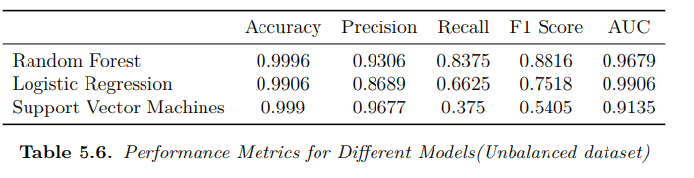
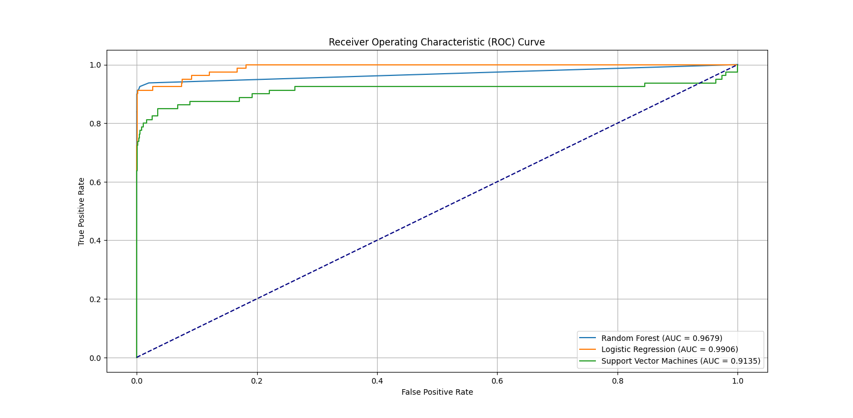
Results
Quantitative evaluation of models trained on unbalanced data
Impact of unbalanced data
Accuracy:
Increases for all models; Random Forest and SVM show the largest gains.
Precision:
Significant improvement, across the board, indicating prior sensitivity to class imbalance.
Recall trade-off:
Recall decreases across models; SVM sees the largest drop (37.5%), but Random Forest remains decent (83.75%).
AUC:
Slight AUC declines for Random Forest and SVM; Logistic regression maintains a strong AUC of 99.06%.
Overall conclusion:
Models perform better on unbalanced data, with significant gains in precision outweighing the slight drop in recall. AUC remains solid across the board, with logistic regression showing the best stability.
Κωνσταντίνος Μπενέκος
ML algorithms for financial fraud detection

Slide 18
Results
Business context
Business context evaluation
Balanced vs unbalanced training data:
Unbalanced data training yields better results, addressing low precision issues from balanced data training.
Misclassifying legitimate transactions as fraudulent incurs significant financial and reputational costs.
Random Forest shows highest accuracy in confusion matrix metrics, yet ROC-AUC score indicated logistic regression as the best performer in terms of class separability.
SVM:
High computational cost and time consumption hinder its real-world applicability.
Timeliness is crucial in fraud detection; slower models increase potential losses from fraud.
Logistic Regression:
High transparency: Coefficients provide clear insight into feature influence on classifications.
Critical for high-stakes fraud detection, ensuring the rationale behind decisions can be understood and justified.
Κωνσταντίνος Μπενέκος
ML algorithms for financial fraud detection

Slide 19
Conclusions
Overall conclusion
Conclusion
Study Objectives:
Evaluated Random Forest, Logistic Regression, and SVM for detecting fraudulent credit card transactions.
Examine the effects of proposed balancing technique on the results of the aforementioned models.
Findings:
Resampling methods led to oversensitivity in predicting the positive-fraud class.
Random Forest excelled in some metrics but was outperformed by Logistic Regression in ROC-AUC score, the key metric of interest.
Logistic Regression demonstrated strong overall performance and exceptional transparency, essential for understanding fraud detection outcomes.
Overall recommendations:
Using raw, unbalanced training data produces better results, taking everything into consideration.
Logistic Regression is deemed the most suitable model for credit card fraud prediction in this dataset, considering real-world applicability and handling of unbalanced data.
Κωνσταντίνος Μπενέκος
ML algorithms for financial fraud detection

Slide 20
Conclusions
Recommendations for future research
Research Gaps & Recommendations
Data availability:
Limited access to public datasets; our dataset features are PCA-transformed with no detailed information, hindering interpretation of factors associated with fraud.
Resampling:
The current balancing method led to low precision in model predictions.
Future recommendations:
Future studies should explore advanced resampling techniques, such as SMOTE, to address data imbalance and improve predictive accuracy.
Κωνσταντίνος Μπενέκος
ML algorithms for financial fraud detection

Slide 21
Machine learning algorithms for financial fraud detection
Thank you!
Κωνσταντίνος Μπενέκος
ML algorithms for financial fraud detection

