Slide 1


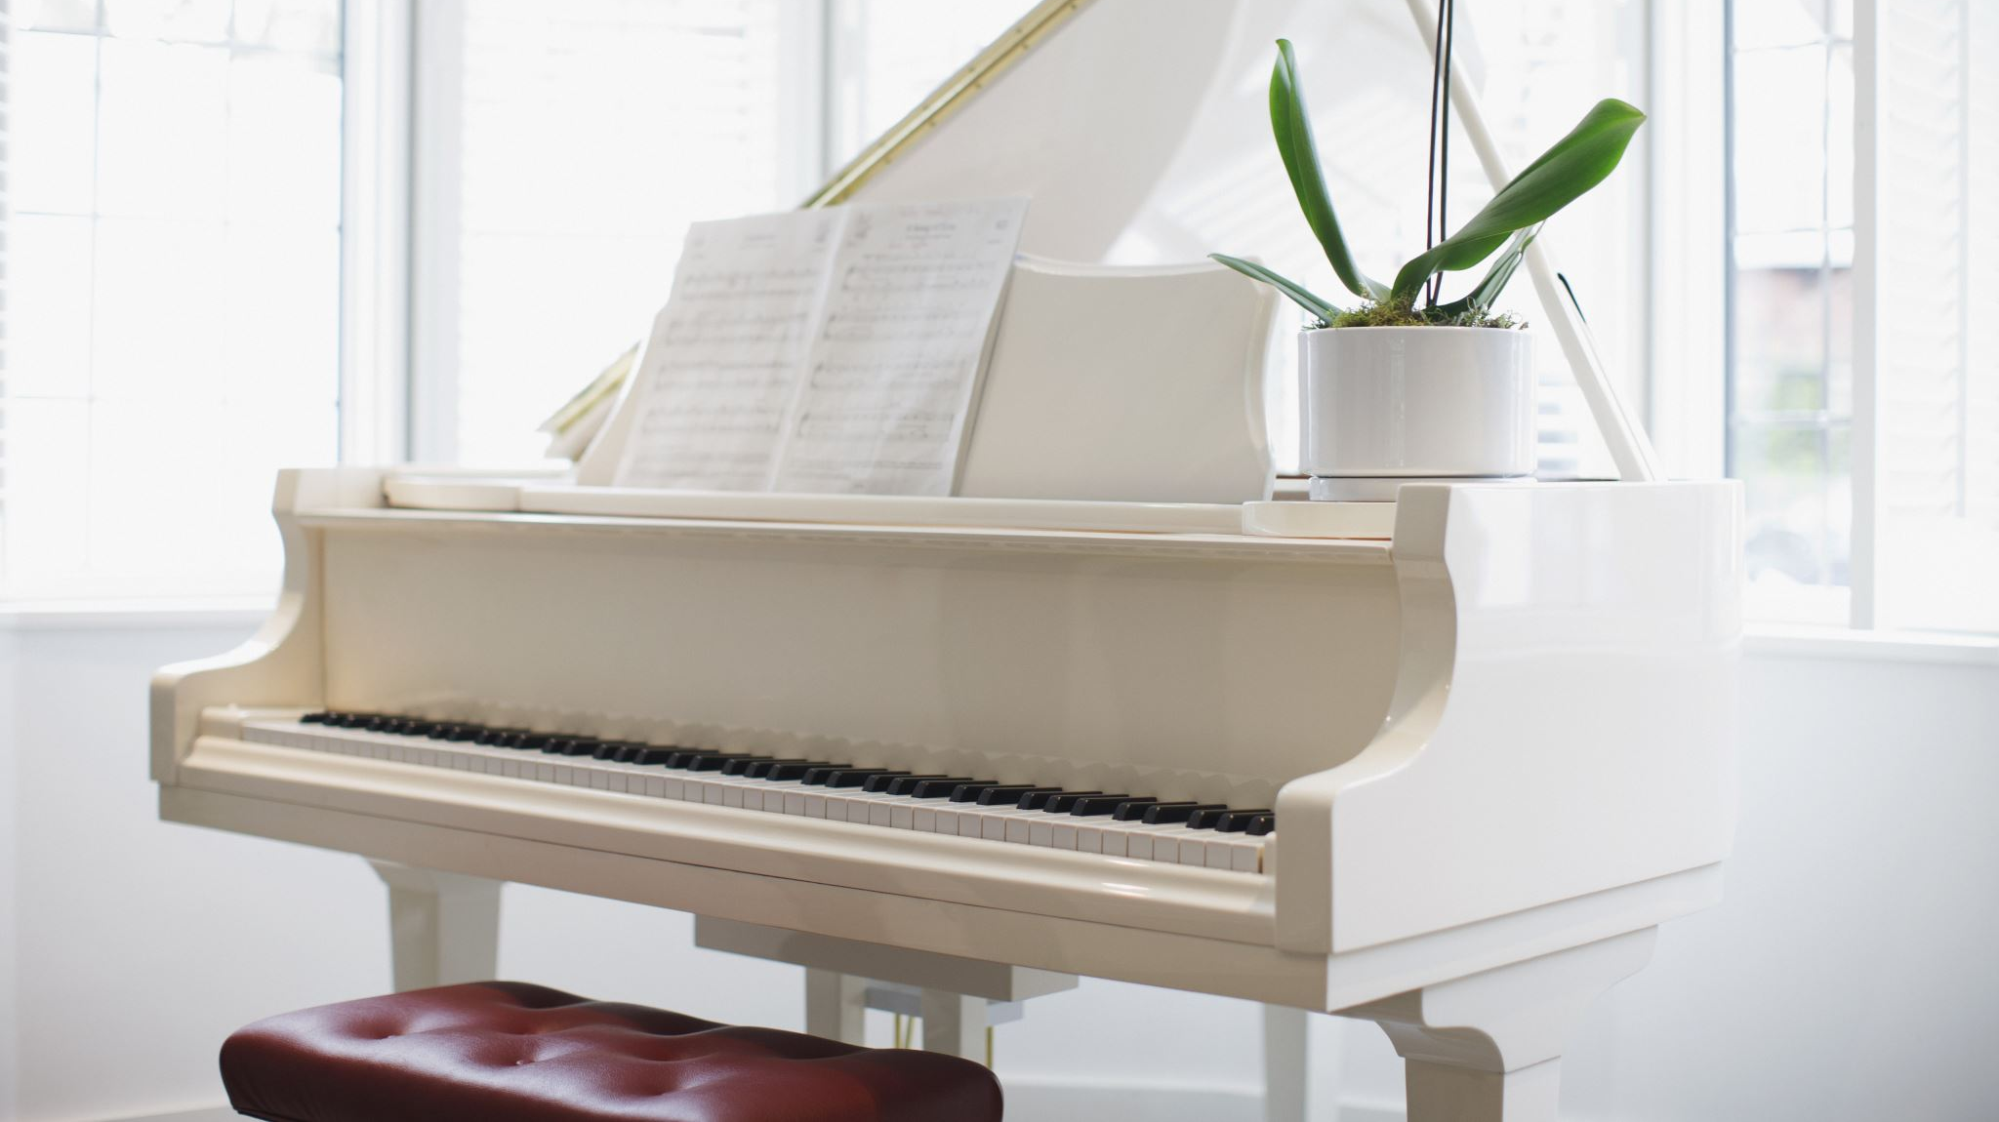
Classical Composer Recognition using Machine Learning
Name of the GitHub repository: "ClassicalComposerRecoginition“
By Konstantinos chaldaiopoulos

Slide 2

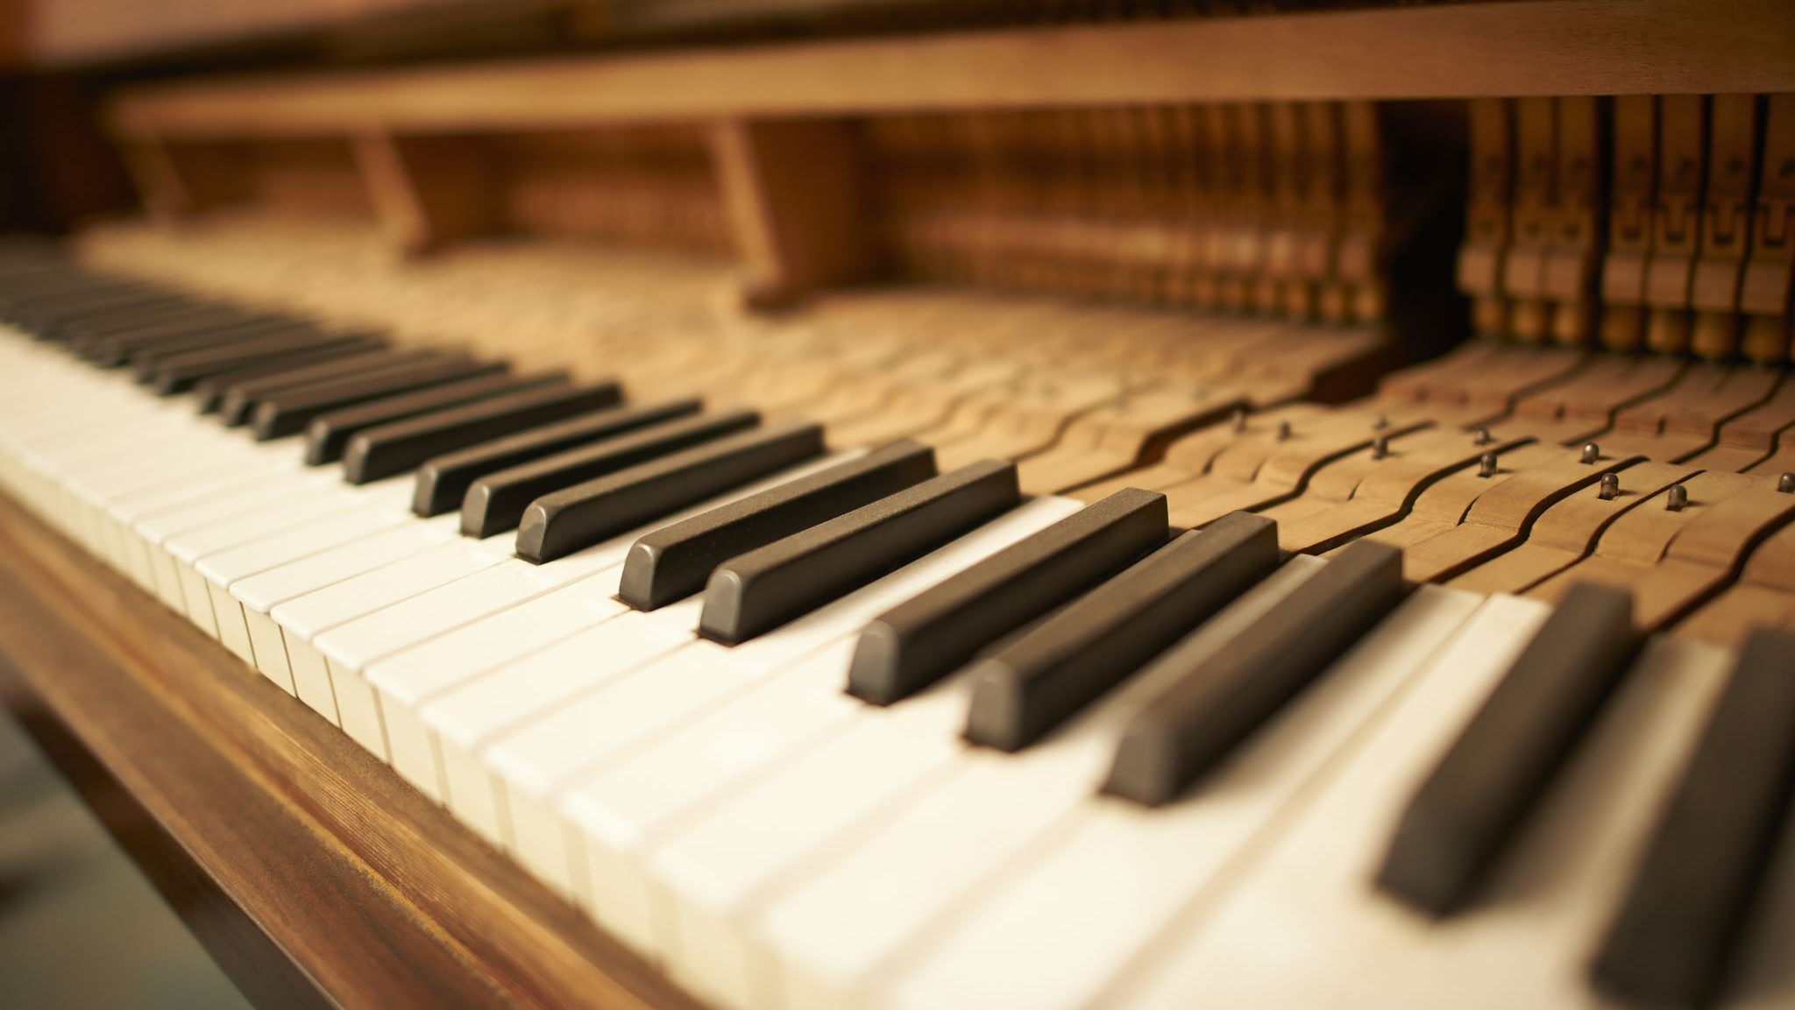
Description
The goal of this project is to train a machine learning model to recognize classical composers on unseen data.
Four classical composers – Beethoven, Mozart, Schubert, Schumann.
Two folders each (Piano-Symphonies) with 1000-7 second wav files inside for both.

Slide 3
Feature extraction using pyaudioanalysis
In the Classical Composer Recognition project, feature extraction was performed on audio files using the pyAudioAnalysis library.
The pyAudioAnalysis library offers a variety of feature extraction functions, including MidTermFeatures, which was used in this project.
The MidTermFeatures function computes a set of 64 short-term features for each audio file, including statistics such as mean and standard deviation, as well as delta features.
In addition to the short-term features, beat extraction is also performed, which is important for tasks such as tempo induction and beat tracking.

Slide 4
Feature extraction using pyaudioanalysis
The extracted features are then normalized by subtracting the mean and dividing by the standard deviation, which is a common preprocessing step in machine learning.
The normalized features for each folder and composer are stored in a pandas DataFrame and exported to a CSV file for use in training a machine learning model.
The files are then combined to create training and testing files like Piano.csv and Piano-testing.csv
Testing datasets were created for each composer in order to test how accurate is the process of training on each composer separately.

Slide 5
Training process
Load the training data and test data.
Select the top N features using a classifier of your choice.
Drop the label columns from the training and test data to use as the features and target.
Fit a classifier using one of several options (SVM, Logistic Regression, Random Forest, KNN, Neural Network, or Naive Bayes) on the training data and selected features.
Perform 10-fold shuffle split cross-validation on the training data to evaluate the performance of the classifier.
Print the mean f1 score, the sigma f1, and the confidence of the 10-fold shuffle split cross-validation.

Slide 6
Testing process
Predict the class labels for test data using the chosen classifier from the previous step.
Calculate the accuracy of the predicted labels.
Calculate the F1 score of the model using the true labels of the test data and the predicted labels.
Print the F1 score and accuracy of the model.

Slide 7
Results
Between the piano and the symphonies files the most accurate model was the piano model with an accuracy of 40% using a Recursive Feature Elimination algorithm and an SVC classifier and training with an MLP.
The most correctly predicted composer in the Piano files was Schubert(>50%) and the least correctly predicted was Mozart(25%).
Most misclassifications of Mozart and Schubert in the Piano Files and in symphonies files were for Beethoven.
The Symphonies models were less significant. The best model accuracy in the test data was the Random Forest Classifier using all features. Less significant result with 32% accuracy but not insignificant.

Slide 8
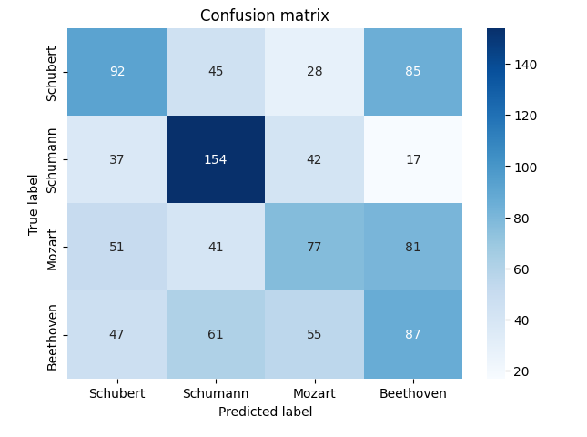
Confusion matrix Piano

Slide 9
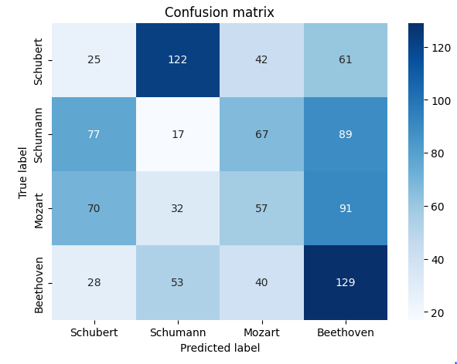
Confusion matrix Symphonies

Slide 10

Thank you!

