Slide 1
Pix2Pix GAN for Saliency Detection: An Investigation into Fixation Prediction.
Konstantinos Chaldaiopoulos - MTN 2220
Teacher: Giannakopoulos Theodoros
Course: Deep Learning
University of Piraeus
Digital Systems - NCSR Democritus

Slide 2
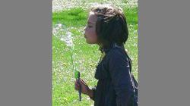
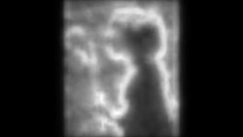
Understanding Visual Saliency
Understanding visual saliency: how humans focus attention on different areas of an image.
Goal: Develop algorithms that mimic or predict human attention mechanism and identify salient parts of an image.
Pix2Pix GAN chosen for exceptional performance in domain translation and potential to capture human visual perception. Example of such prediction :

Slide 3
Introduction to Pix2Pix GAN
Pix2Pix GAN consists of two main parts: a generator and a discriminator
The generator , usually with a U-Net architecture transforms an input image into an output image
The discriminator in Pix2Pix is a PatchGAN, which classifies whether each patch in an image is real or fake
During training, the generator creates realistic output images to fool the discriminator. The discriminator classifies each patch of the output image as real or fake.
The adversarial relationship between the generator and the discriminator pushes the network to generate more realistic output

Slide 4
Introduction to U-Net Architecture
U-Net architecture is specifically designed for biomedical image segmentation, widely adopted for similar tasks
Key feature of U-Net is the use of skip connections, which help retain spatial information
U – Net architecture is used as the generator architecture in our pix2pix GAN.

Slide 5
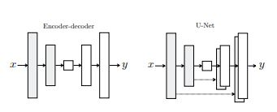
Comparing Traditional Encoder-Decoder and U-Net Architectures
"Basic Encoder-Decoder architectures lose spatial information during encoding"
"U-Net overcomes this by using skip connections to retain and utilize spatial information for more accurate output"

Slide 6
Introduction to PatchGAN
PatchGAN focuses on generating and discriminating image patches, capturing details and local structures in images.
It operates at multiple scales, using multiple discriminators to capture both global and local image features.
PatchGAN is applied to various image-to-image translation tasks including our task.

Slide 7
Typical U-net architecture in pix2pix GANs
Input size: 256x256
Encoder: C64-C128-C256-C512-C512-C512-C512-C512
Decoder: CD512-CD1024-CD1024-C1024-C1024-C512-C256-C128
Leaky ReLU activation function with slope 0.2
Batch normalization except for the first layer
Dropout layers (0.5) after batch normalization and ReLU
Convolutional layers with 4x4 spatial filters and stride 2
Decoder size is double the encoder size for skip connections
Last layer with Tanh activation function

Slide 8
Typical PatchGAN architecture in pix2pix GANs
Input size 256x256
Images upscaled to 286x286 and randomly cropped back to size for jitter
Architecture: C64-C128-C256-C512
Leaky ReLU activation function with slope 0.2
Batch normalization except for the first layer
Last layer maps to a 1-dimensional output with Sigmoid function
Produces a 30x30 feature map (70x70 patch in input image)

Slide 9
Our architecture for U - Net
U-Net architecture with slight modifications
Input size: 250x140
Images interpolated to 256x144 for easier model architecture in input
Output images converted back to 250x140
Encoder: C64-C128-C256-C512-C1024
Decoder: C1024-C2042-C1024-C512-C256-C128
Instance normalization instead of batch normalization
ReLU activation function with slope 0.2
Kernel size 3 and padding 1 in the bottleneck layer of decoder
No use of dropout layers

Slide 10
Our architecture for PatchGan
Input size: 250x140
Again, the images are interpolated in the input and output
Architecture: C128-C256-C512-C1024
Instance normalization instead of batch normalization
Binary cross-entropy loss with logits function (no sigmoid activation)
Efficient for our task

Slide 11
Training Details
Utilized U-Net generator and Patch-GAN discriminator
Custom weights initialization strategy: Convolution layers set to normal distribution (mean: 0.0, std: 0.02)
Goal: Optimize Binary Cross-Entropy with Logits (GAN loss) and L1 loss
GAN loss: Discriminator's ability to distinguish real and generated images
L1 loss: Preserve structural features of real images in generated images
L1 loss scaled by a factor of 100 (lambda_L1) for balance

Slide 12
Training Process
Multiple epochs processing pairs of original images and saliency maps
Adam optimizer used with learning rate: 0.00001, betas: (0.5, 0.999)
Generator creates 'fake' image from real image during each iteration
Generator loss: GAN loss + L1 loss (scaled)
Discriminator loss: Average of losses for real and fake images
Losses used to optimize weights of Generator and Discriminator

Slide 13
Monitoring and Evaluation
Losses for Generator and Discriminator tracked and displayed every 500 iterations
Helps identify potential issues and assess training progress
State of Generator preserved by saving model parameters at the end of each epoch
Output images generated at different stages of training analyzed
Allows analysis of Generator's performance evolution over time
Numerical convergence doesn't guarantee optimal visual results
Human judgment crucial in selecting the most visually satisfying model

Slide 14
Training Time and Hardware
Training time: ~1 hour for 100 epochs
Utilized NVIDIA A100 Tensor Core GPU

Slide 15

Evaluation: Normalized Scanpath Saliency (NSS)
NSS score: 1.41
Compared to minimum human baseline of 1.54
Not as high as state-of-the-art models (e.g., CEDNS with 2.39 on CAT2000 dataset)
PatchGan architecture (C64-C128-C256-C512) resulted in lower NSS score (1.37)
NSS score indicates significant performance and potential of our model

Slide 16
Visual Evaluation:
Results showcase model's performance and quality
Images exhibit strong likeness to real salient maps
Successful highlighting of areas of interest for human attention
Qualitatively pleasing saliency maps capturing human visual interest

Slide 17
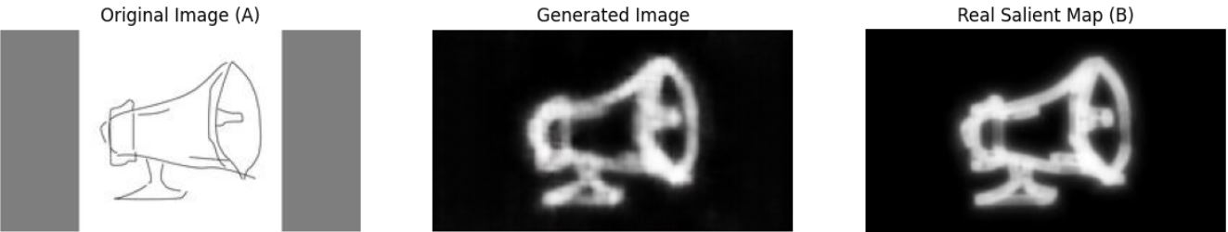
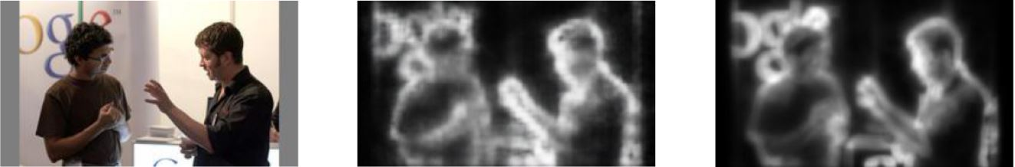
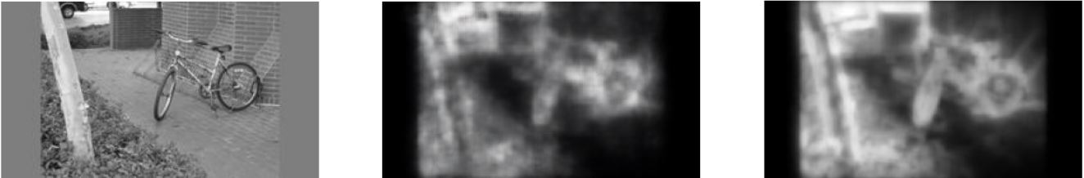
Visual Evaluation Results

Slide 18

Conclusions
Pix2pix GAN shows promise in image fixation prediction and saliency map generation
Falls short compared to state-of-the-art models like CEDNS with an NSS score of 2.39.
Further improvements can be made by exploring different architectures

Slide 19

Thank You!
Konstantinos Chaldaiopoulos
kostaschaldaio@gmail.com

