Slide 1
Violence Detection in Movies
A Multimodal Approach
Konstantinos Chaldaiopoulos
Natalia Koliou

Slide 2
The Multimodal Incentive
Growing need for regulation: As video content volume grows, effective ways to detect violent videos are crucial.
Improving accuracy of detection: Multimodal violence detection frameworks could potentially improve content understanding, leading to improved violence detection.
Comparative analysis: By comparing single and multimodal detection methods, we can better understand the benefits and potential pitfalls of each approach.
Understanding of Fusion Techniques: Studying early and late fusion techniques in multimodal violence detection allows us to enhance our knowledge on data integration, which may be beneficial for future work in related domains.

Slide 3
Modalities & Techniques
Visual: A Deep learning framework blending AlexNet and SqueezeNet with ConvLSTM, enhancing the visual detection accuracy. This architecture was first detailed in "Detecting Violence in Video Based on Deep Features Fusion Technique".
Audio: Features extracted using PyAudioAnalysis. PyAudioAnalysis is a library for audio analysis, segmentation and visualization.
Text: Utilization of DistilBERT, a smaller variant of BERT was deployed for text feature extraction.
GOAL: To study single and combined modalities, aiming to better understand the challenges associated with violence detection in videos.

Slide 4
Image Violence Detection
(1/2)
Step 1 - Frame Extraction:
The video is divided into 20 segments, from which 20 key frames with the highest difference are selected, optimizing data processing.
Step 2 - Feature Extraction:
Leverage the pre-trained AlexNet and SqueezeNet models, both trained on ImageNet, for deep feature extraction from each frame.
AlexNet: A CNN with five convolutional layers and three fully connected layers.
SqueezeNet: An efficient network with fewer parameters, offering comparable performance.
Step 3 - Advanced Processing:
The features extracted by AlexNet and SqueezeNet are fed into separate ConvLSTM models. These ConvLSTMs, designed to handle spatial data, capture both spatial and temporal dependencies within the video data.

Slide 5
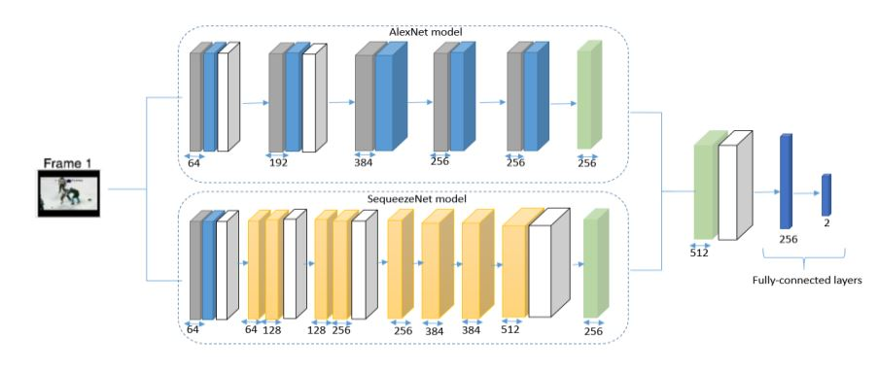
Image Violence Detection
(2/2)
Step 4 - Feature Fusion:
The outputs from the two ConvLSTMs are fused. This fusion captures a broader spectrum of features, enhancing model robustness.
Step 5 - Classification:
The fused ConvLSTM output is passed through a softmax layer to yield the probability of the video being categorized as violent or non-violent.

Slide 6
Audio Violence Detection
(1/3)
Audio Extraction:
MoviePy library used to extract audio from movie dataset.
pyAudioAnalysis library for computing audio features.
Feature Extraction:
Midterm features chosen for comprehensive representation.
Midterm window size 1 ∙ fs with step 1 ∙ fs ∙ 0.5 (50% overlap).
Short window size 0.05 ∙ fs with step 0.05 ∙ fs ∙ 0.5 (50% overlap).
Metric for Midterm Features is the Standard Deviation.
Captures variability and dispersion of audio characteristics.
Crucial for distinguishing violence from non-violence videos as it provides sensitivity to variations in sound.

Slide 7
Audio Violence Detection
(2/3)
Audio Classifier:
We employ a Support Vector Machine (SVM) classifier by initializing our model with the "svm" parameter.
Feature Selection:
SelectKBest method is utilized to choose the k=7 best audio features.
Retaining the most relevant features strengthens the classifier's relationship with the target variable.
Focusing on key features reduces noise and irrelevant information, enhancing overall efficiency.
Hyperparameter Fine-Tuning:
GridSearchCV method is used for exploring various hyperparameter combinations.

Slide 8
Audio Violence Detection
(3/3)
2-fold cross-validation evaluates the effectiveness of different hyperparameters.
Best hyperparameters are determined based on cross-validation results, leading to improved accuracy and generalization.
Kernel: [Linear, RBF, Poly]
Regularization Parameter C: [0.1, 0.5, 1, 2, 5, 10, 20]
Gamma: [Scale, Auto]
Feature Scaling:
Scaling is found unnecessary for the SVM classifier's performance.
The scaling parameter is set to None during the classifier's initialization.

Slide 9
Text Violence Detection
(1/3)
Text Extraction:
Use the Whisper Automatic Speech Recognition (ASR) system by OpenAI.
Whisper transcribes spoken dialogues and monologues from videos into texts.
Whisper's specialized English language training ensures reliable transcriptions for our English-language movie dataset.
Embeddings Extraction:
Use DistilBERT, a lightweight variant of BERT, for feature extraction on the transcribed texts.
DistilBERT's tokenizer converts the texts into numerical representations suitable for the model.
The model's self-attention mechanisms generate BERT embeddings that capture contextual meaning.

Slide 10
Text Violence Detection
(2/3)
Text Classifier:
We employ a Support Vector Machine (SVM) classifier by initializing our model with the "svm" parameter.
Feature Selection:
SelectKBest method is utilized to choose the k=10 best audio features.
Retaining the most relevant features strengthens the classifier's relationship with the target variable.
Focusing on key features reduces noise and irrelevant information, enhancing overall efficiency.
Hyperparameter Fine-Tuning:
GridSearchCV method is used for exploring various hyperparameter combinations.

Slide 11
Text Violence Detection
(3/3)
2-fold cross-validation evaluates the effectiveness of different hyperparameters.
Best hyperparameters are determined based on cross-validation results, leading to improved accuracy and generalization.
Kernel: [Linear, RBF, Poly]
Regularization Parameter C: [0.1, 0.5, 1, 2, 5, 10, 20]
Gamma: [Scale, Auto]
Feature Scaling:
Scaling is found unnecessary for the SVM classifier's performance.
The scaling parameter is set to None during the classifier's initialization.

Slide 12
Early Fusion
Preprocessed audio and text data using autoencoders for dimensionality change.
Performed early fusion by combining processed audio and text data with image data through concatenation along the feature dimension and then passing them through an autoencoder.
We observed that text overfitted the data and we left it out of the early fusion procedure.
Generated final output predictions using a fully connected layer, with probabilities obtained through a softmax function.

Slide 13

Late Fusion
(1/3)
Weight Calculation:
The set of modalities is denoted by M = $\{m_{1}, m_{2}, ..., m_{n}\}$ where $m_{i}$ represents each modality (e.g., audio, text, image).
Each modality is associated with a validation accuracy, denoted by $V = \{V_{1}, V_{2}, ..., V_{n}\}$.
The weight $w_{i}$ for the i-th modality is calculated as follows:
$$w_{i} =\frac{V_{i}}{\sum_{k=1}^{n}{V_{k}}}$$

Slide 14


Late Fusion
(2/3)
Fused Confidence Vector:
Let ${\tilde{T}}_{i}$ be the test confidences for each modality, denoted as a vector of confidence scores: ${\tilde{T}}_{i}=[T_{i0}, T_{i1}, ..., T_{i(c−1)}], 1≤i≤n$, where c is the total number of classes.
The fused confidence vector F̃ is obtained as follows: $\tilde{F}=\sum_{k=1}^{n}{(w_{k}∙{\tilde{T}}_{k})}$.
Class Label Prediction:
To obtain the predicted class label $k_{pred}$, we use the argmax function on the fused confidence vector $\tilde{F}$:
$$k_{pred}=argmax\left(\tilde{F}\right) such that 0≤k_{pred}≤c−1$$

Slide 15


Late Fusion
(3/3)
Accuracy Calculation:
The accuracy of the late fusion model is calculated by comparing the predicted class labels $k_{pred}$ with the true labels $k_{true}$ for N test samples.
We define the indicator function I(a, b) as follows:
$$I\left(a, b\right)=\left\{\begin{aligned}1, if a = b \\ 0, otherwise\end{aligned}\right.$$
The accuracy of the late fusion model is given by:
$${acc}_{LF}=\frac{1}{N}∙\sum_{s=1}^{N}{I\left(k_{pred(s)}, k_{true(s)}\right)}$$

Slide 16
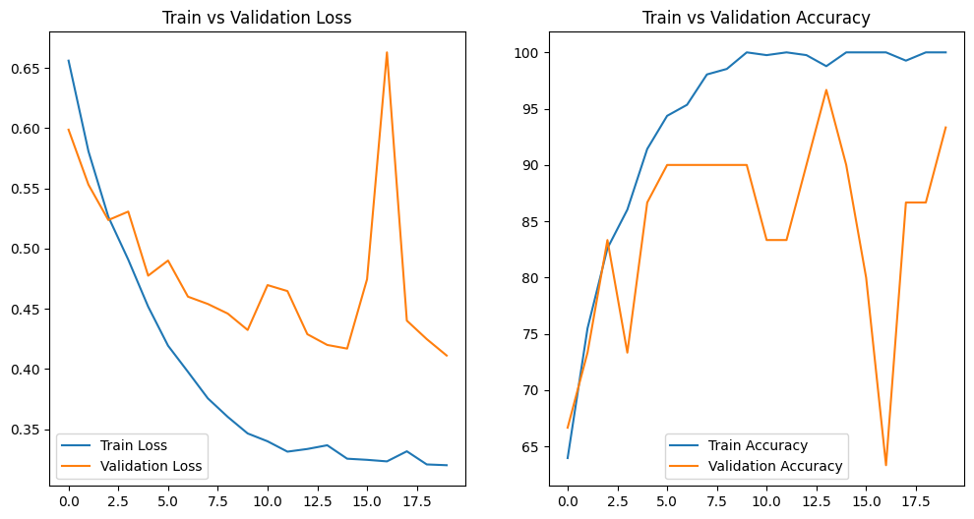
Results – Image Detection
The model has shown significant improvement over the course of the training period. Starting with a validation accuracy of 70% in the first epoch, it has managed to reach a peak accuracy of 96.67% .
The test accuracy achieved was 76.67% suggesting that the model's generalization ability is a little bit lower than what was shown in the validation accuracy but still reasonably high.

Slide 17
Results – Audio Detection
Audio Classifier Performance:
Validation Accuracy: 70%
Test Accuracy: 70%
Able to distinguish between violent and non-violent audio samples with a 70% accuracy on our dataset.
Promising Approach:
SVM Classifier with seven selected Audio Features using PyAudioAnalysis.
Achieved satisfactory results in classifying audio samples based on their violence content.

Slide 18
Results – Text Detection
Audio Classifier Performance:
Validation Accuracy: 76,7%
Test Accuracy: 76,7 %
Able to distinguish between violent and non-violent audio samples with a 76,7% accuracy on our dataset.
Outperformed the audio classifier with higher validation and test accuracies (0.7667 vs. 0.7).
Promising Approach:
SVM classifier with ten selected Text Embeddings.
Text-based features seem to carry more discriminative power in this dataset, likely due to the nature of violence-related text descriptions.

Slide 19
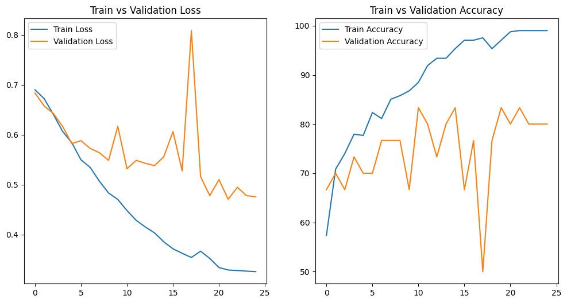
Results – Early Fusion
The model demonstrated robust generalization capabilities, achieving peak validation accuracy of 83.33%.
Despite the complexity of the task and the multimodal nature of the data, the model maintained a robust test accuracy of 80%.
The image-only model reached a validation accuracy of 96%, demonstrating a strong fit to the validation data. However, when it came to the test data, the accuracy dropped to 76.67%, indicating some loss of generalizability.

Slide 20
Results – Late Fusion
Late Fusion:
The late fusion accuracy for our classification task is 0.63.
In comparison, early fusion achieved a significantly higher test accuracy of 80%.
This indicates that early fusion, which combines audio and text data at the input level, outperformed the late fusion approach.
“Early fusion proves more suitable for this classification task,
possibly due to its ability to capture more meaningful patterns
and relationships between different modalities”

Slide 21
Conclusion
Single modalities showed promising results .
Late fusion of modalities decreased our accuracy of the model.
Early fusion was successful for audio and image only, making generalization easier in test data. We removed text from early fusion due to overfitting.
For future work, an effective way to incorporate text data could be found in early fusion that prevents overfitting.

Slide 22
Any Questions?

Slide 23
Thank you!
Konstantinos Chaldaiopoulos
Natalia Koliou

