Slide 1
REVERSE IMAGE SEARCH
Eirini Anagnou
Konstantinos Giorgas
topwear
bottomwear
Mercury is the closest planet to the Sun
shoes

Slide 2
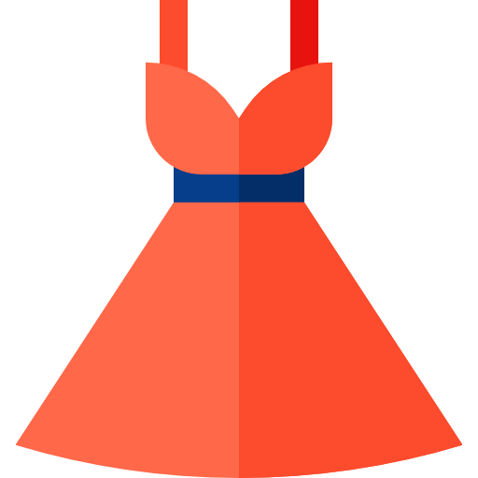
THE IDEA BEHIND THE PROJECT
Users describe clothes differently than marketeers and often find it hard to express in certain keywords
#belted
#formal
#a-line
#red
#long
#pink
#dress
#with-straps
#slim
#midi

Slide 3

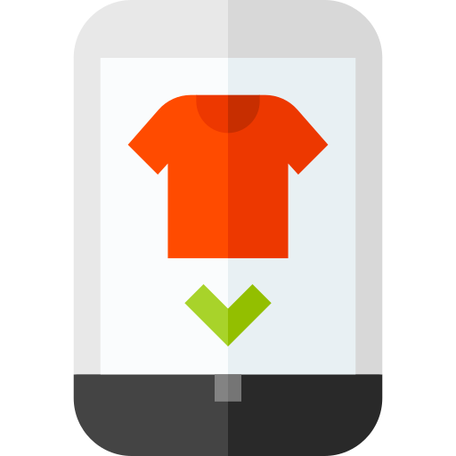



OUR SCOPE TO THE PROBLEM
A user can search directly by inputting an image of a desired cloth and not by typing keywords.

Slide 4

DATASET
The dataset we used consist of 34931 labeled clothing images:
Topwear: 15402 images
Shoes: 7343 images
Bags: 3055 images
Bottomwear: 2694 images
Watches: 2542 images
Innerwear: 1808 images
Jewelry: 1079 images
Eyewear: 1073 images
Socks: 698 images

Slide 5


CONVOLUTIONAL NEURAL NETWORK MODEL
feature extraction layers
flattening layers
“SHOES”
2D Convolutional Layer
[543.23, 0, 0, …, 1002.2, 0,0]
Max Pooling Layer
Flattening Layer
Dense Fully Connected Layer
Dropout Layer

Slide 6
Validation Accuracy
Validation Loss
TRAINING THE MODEL
92.61%
26.04%
Training Accuracy
Training Loss
Venus has a beautiful name, but it’s terribly hot
Venus has a beautiful name, but it’s terribly hot
88.03%
48.36%
Summary stats after 50 epochs

Slide 7

MONGODB CLUSTER
apparel = document
{
_id: <An object id automatically allocated by mongo>,
Category: <The category id of 1 out of the 9 possible categories>,
id: <The id of the image>,
vector:[<The array of 64 numbers describing the apparel>]
}

Slide 8











IMAGE REPOSITORY
4567
3454
679
0987
7856
3956
5678
9475
1476
9384

Slide 9

ORCHESTRATION
returns:
image id
image vector
query based on category
inputs clothing image
image vector
KNN
outputs the 10 most similar clothes
sends the ids of the 10 nearest neighbours (most similar images)
fetches the corresponding images

Slide 10




01
03
IMPROVEMENTS
02
04
Reinforcement learning to improve the model based on user clicks
Combine user data to improve recommendations
Object detection and more diverse training data to improve model performance
Style transfer capabilities to recommend matching outfits

Slide 11
THANKS!
Does anyone have any questions?

