Slide 1

5 Shop: The Used Phones Database
Konstantinos Kalamaras

Slide 2
GOALS OF THE PROJECT
Create a Database of used phones for all budgets and purposes
Warn customers about possible malfunctions, based on statistics
Offer possible solutions based on malfunction type and estimate potential service fee

Slide 3
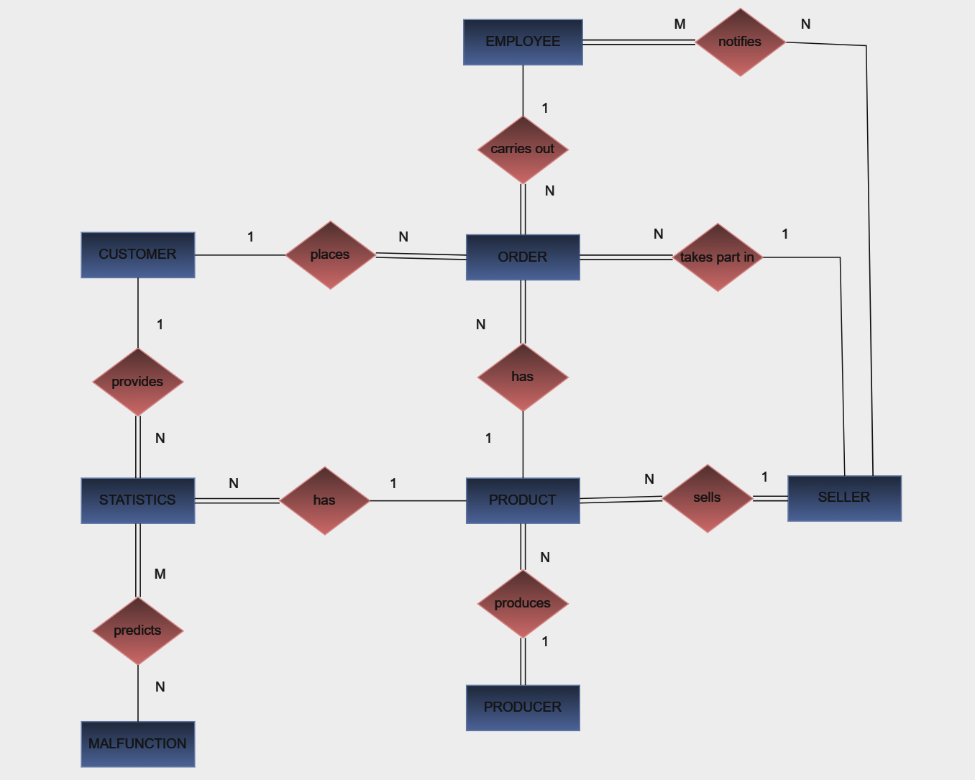
OVERVIEW

Slide 4
POSSIBLE ISSUES AND FUTURE EXPANSION
Issues:
Might provide poor statistics in its early days , due to lack of data
May not provide to customers all the available phones in the market
Add more specialized suggestions
Expand with phone accesories
Expansion:

Slide 5
THANK YOU FOR THE ATTENTION!

