Slide 1

Used Phones Database
Konstantinos Kalamaras

Slide 2
THE PRODUCT
COST SAVINGS
AWARENESS
SERVICE
Compares items from many sellers and helps customer choose the cheapest one.
Warns customers about possible malfunctions, based on statistics.
Offers possible solutions based on malfunction type and estimates potential service fee.
EQUAL OPPORTUNITIES
STATISTICS
Gives opportunities to individual sellers and not only conventional shops.
Provides user with various use statistics , based on user feedback.

Slide 3




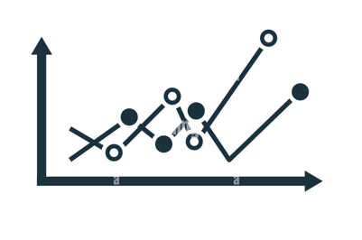


OVERVIEW
PRODUCT
ORDER
CUSTOMER
SELLER
STATISTICS
PRODUCER
MALFUNCTION

Slide 4
THANK YOU FOR YOUR ATTENTION!

