Slide 1
Probability of default ML classifier
By Razmik Sargsyan, Constantinos Papaandrea

Slide 2
The importance of banks and the value of credit appraising models
Adverse selection is a type of market failure caused by asymmetric information existing prior to a transaction. It occurs when one party possesses private information about a fundamental characteristic—such as risk profile—that the other party cannot observe.

Slide 3
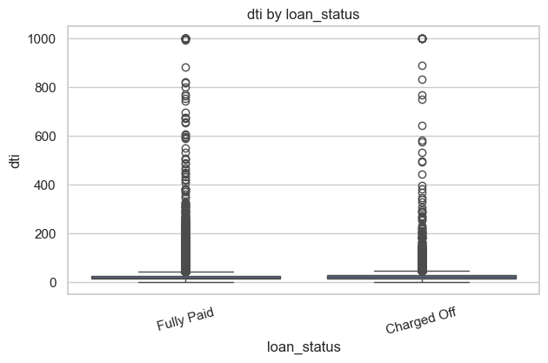
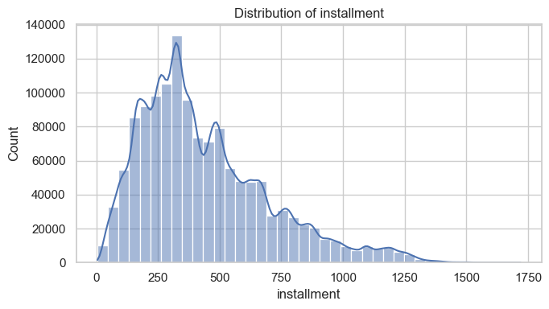
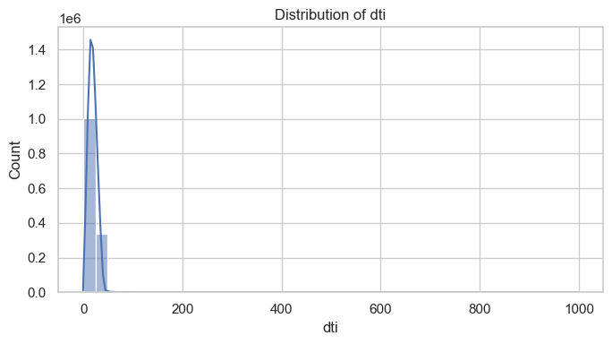
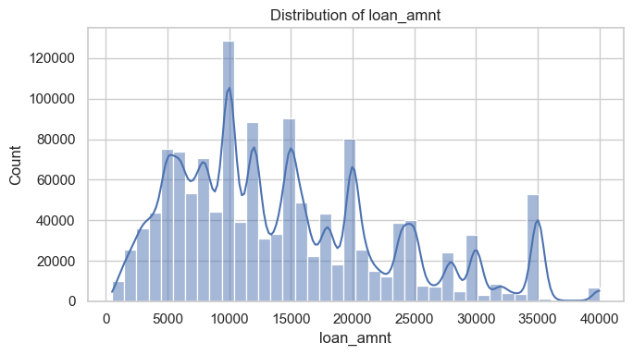
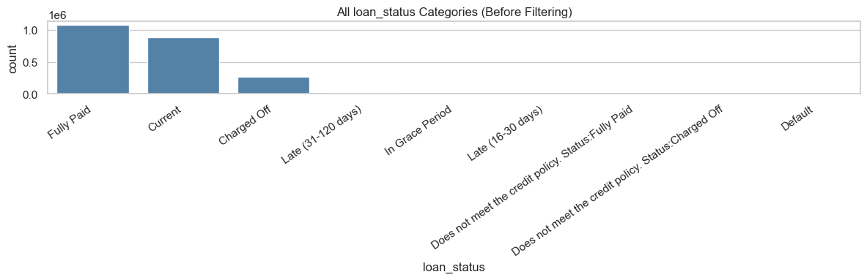
Exploratory Data Analysis (EDA)

Slide 4
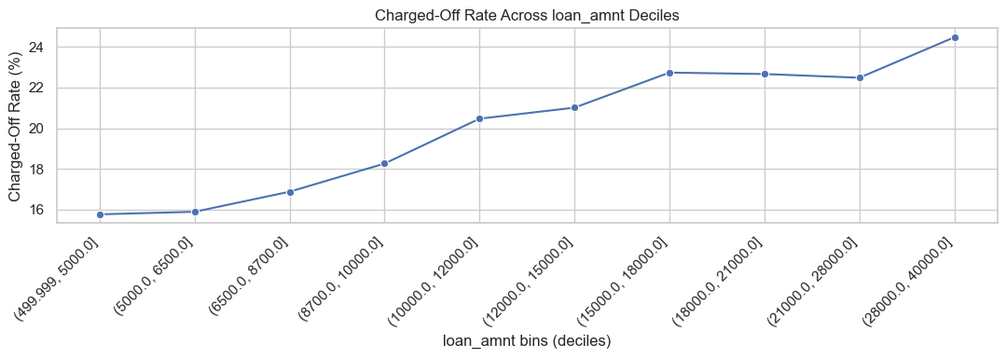
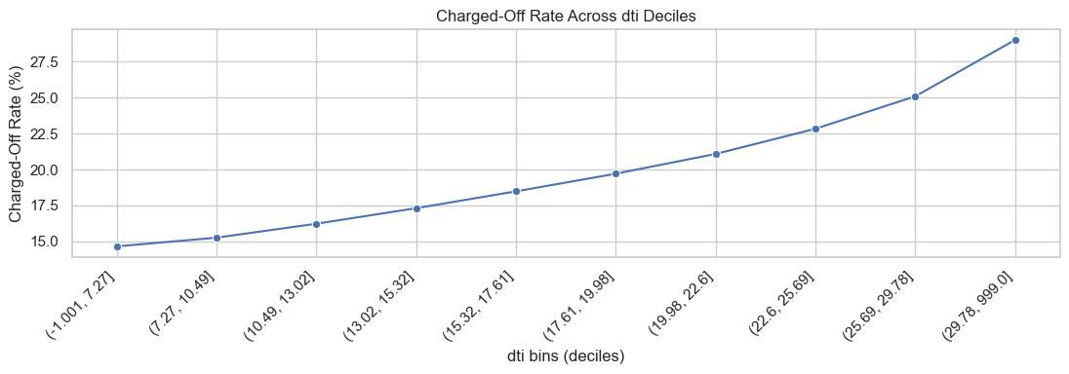
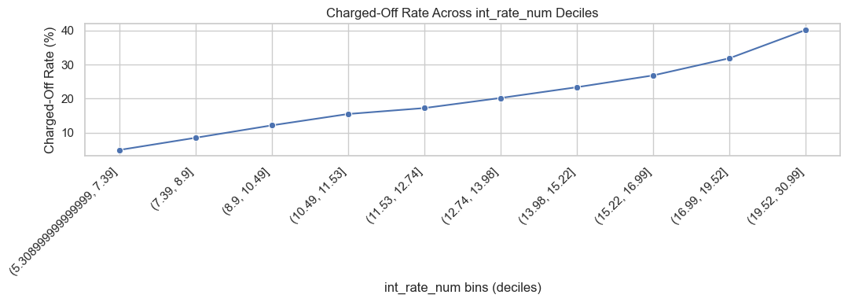
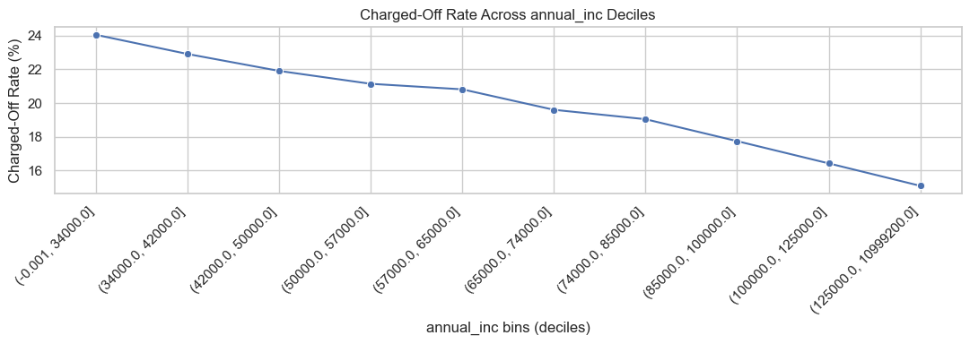
Exploratory Data Analysis (EDA) Charged-Off

Slide 5
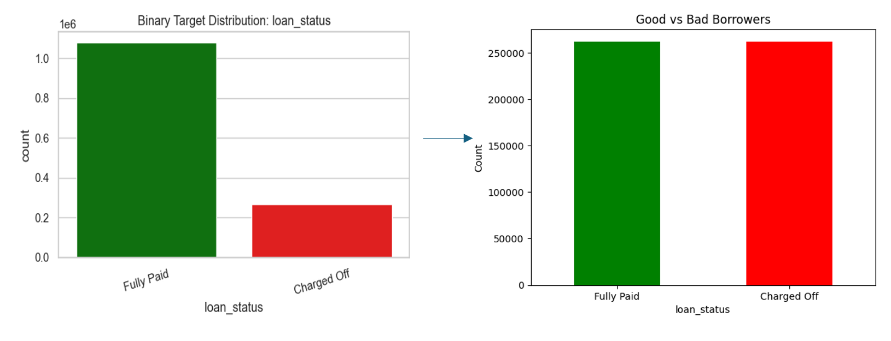
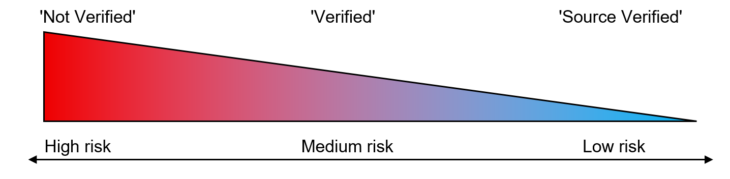
Data pre-processing techniques
Encoding
Data pre-processing techniques
Under-sampling
Wherever it was possible to establish ordinal relationship we used ordinal encoding
However not all categorical variables had ordinal relationships. An example of such feature can be the “purpose”.

Slide 6
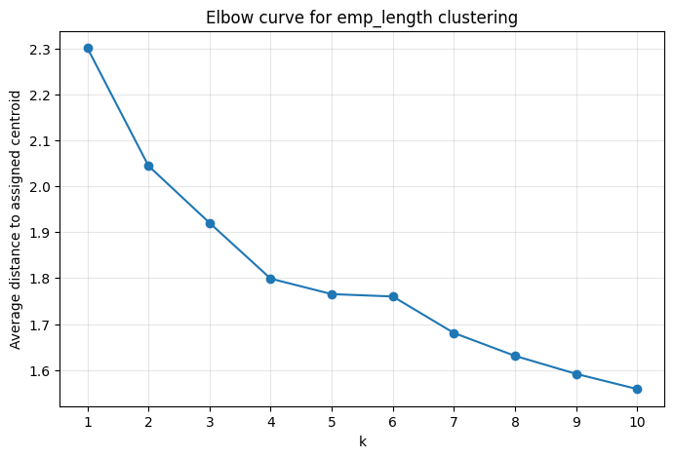
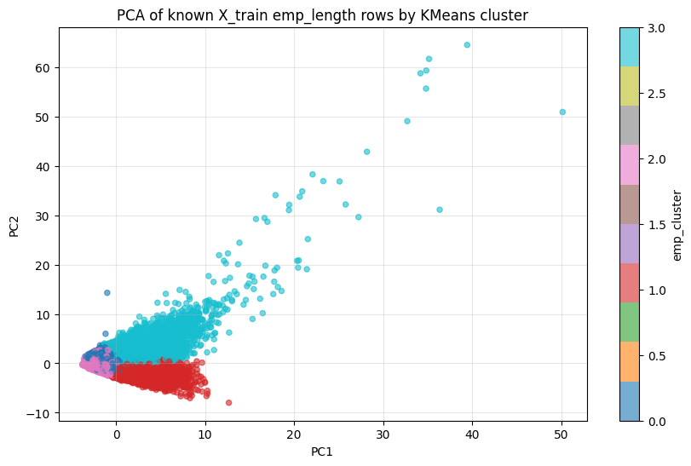
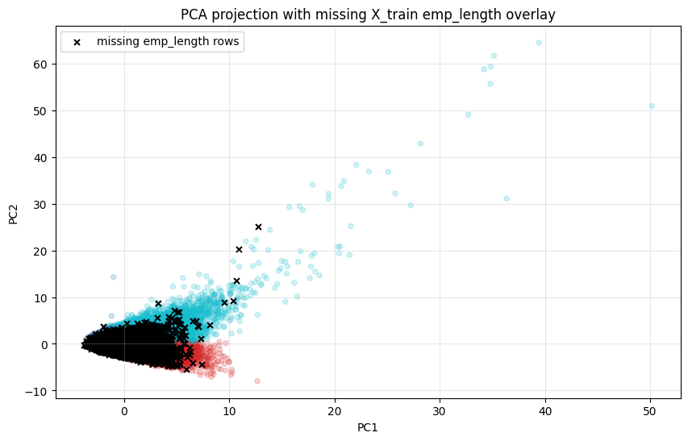
Employment length clustering
Missing employment length values were filled with clustering based on similar financial profiles, and only originally missing entries were updated.

Slide 7
Data pre-processing techniques

Slide 8
Data pre-processing techniques
The paradox of two zero’s
Open_acc_6m
2
5
4
NaN
1
Open_acc_6m
2
5
4
0
1
mths_since_last_delinq
2
0
4
NaN
1
mths_since_last_delinq
2
0
4
0
1
mths_since | was_NaN
2 | 0
0 | 0
4 | 0
0 | 1
1 | 0

Slide 9
Data pre-processing techniques
The paradox of two zero’s
Open_acc_6m
2
5
4
NaN
1
Open_acc_6m
2
5
4
0
1
mths_since_last_delinq
2
0
4
NaN
1
mths_since | was_NaN
2 | 0
0 | 0
4 | 0
0 | 1
1 | 0
mths_since_last_delinq
2
5
4
0
1

Slide 10
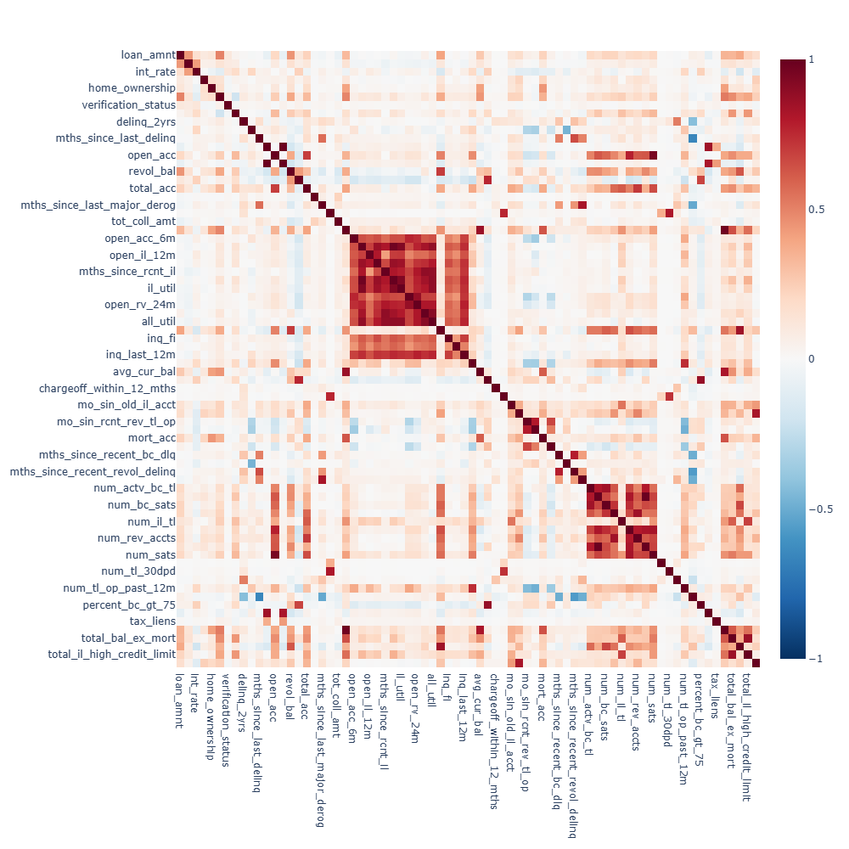
Data pre-processing techniques
The paradox of two zero’s
Open_acc_6m
2
5
4
NaN
1
Open_acc_6m
2
5
4
0
1
mths_since_last_delinq
2
0
4
NaN
1
mths_since | was_NaN
2 | 0
0 | 0
4 | 0
0 | 1
1 | 0
mths_since_last_delinq
2
5
4
0
1

Slide 11
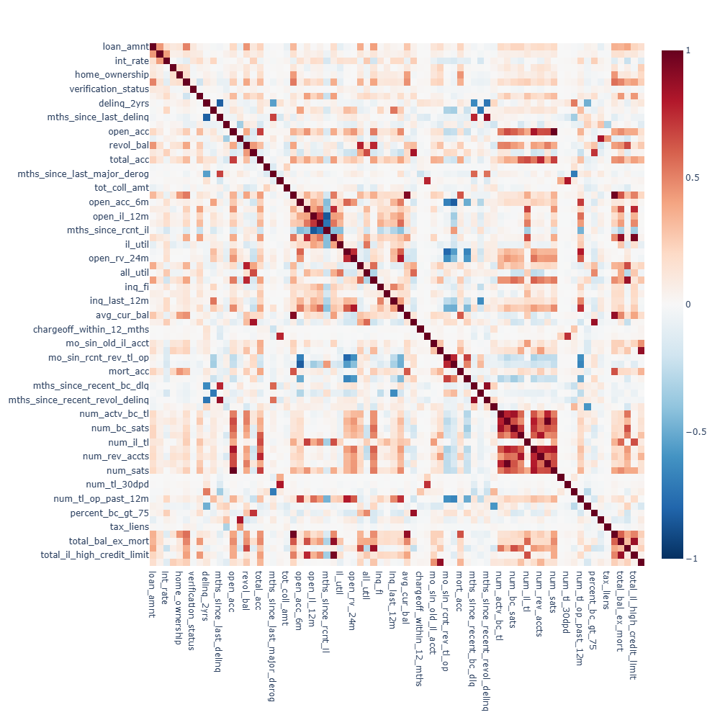
Data pre-processing techniques
The paradox of two zero’s
Open_acc_6m
2
5
4
NaN
1
Open_acc_6m
2
5
4
0
1
mths_since_last_delinq
2
0
4
NaN
1
mths_since | was_NaN
2 | 0
0 | 0
4 | 0
0 | 1
1 | 0
mths_since_last_delinq
2
5
4
0
1

Slide 12
Data pre-processing techniques
The paradox of two zero’s
Open_acc_6m
2
5
4
NaN
1
Open_acc_6m
2
5
4
0
1
mths_since_last_delinq
2
0
4
NaN
1
mths_since_last_delinq
2
0
4
999
1
mths_since | was_NaN
2 | 0
0 | 0
4 | 0
0 | 1
1 | 0

Slide 13
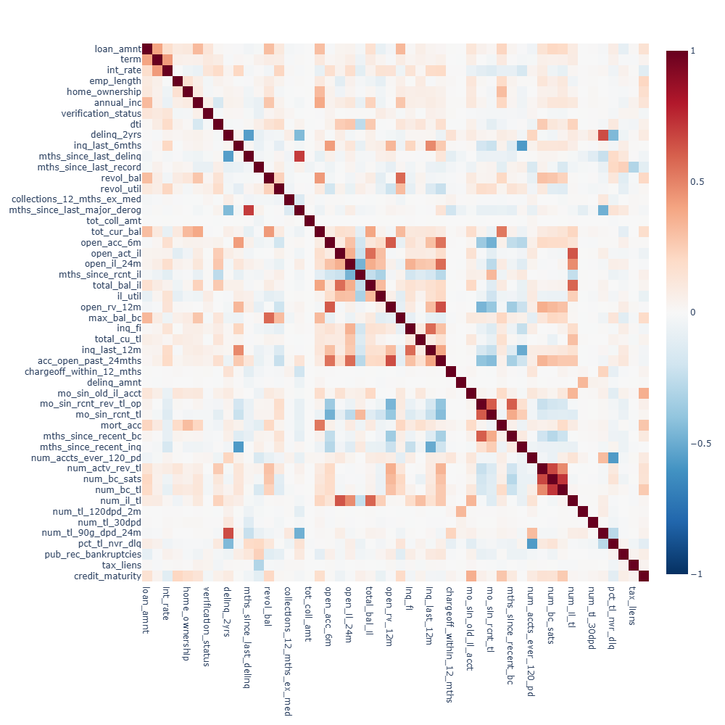
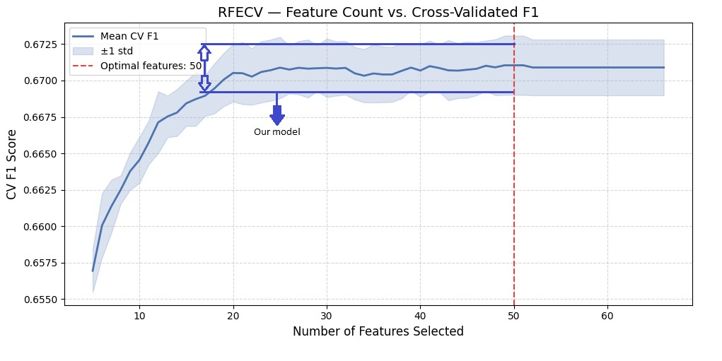
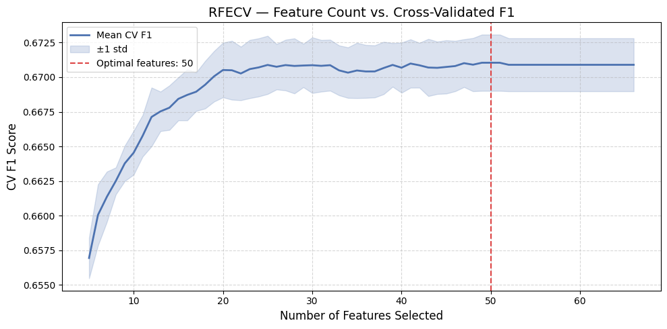
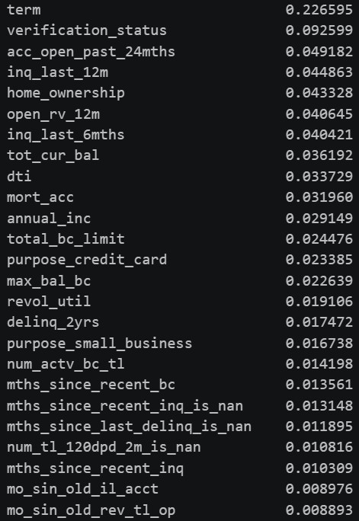
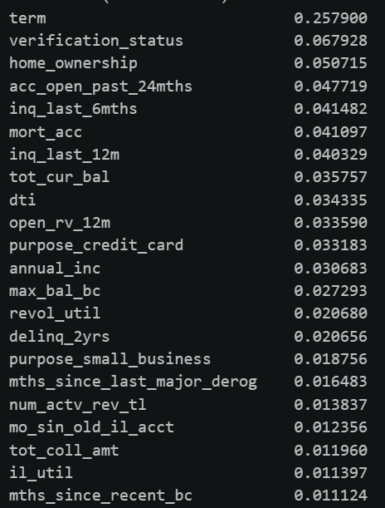
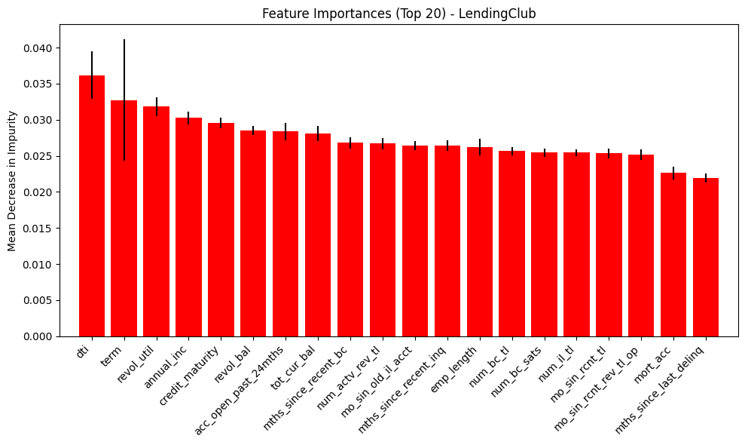
Feature selection identified a stable core of important predictors
some differences reflected preprocessing choices and model-specific selection behavior.
Future selection

Slide 14
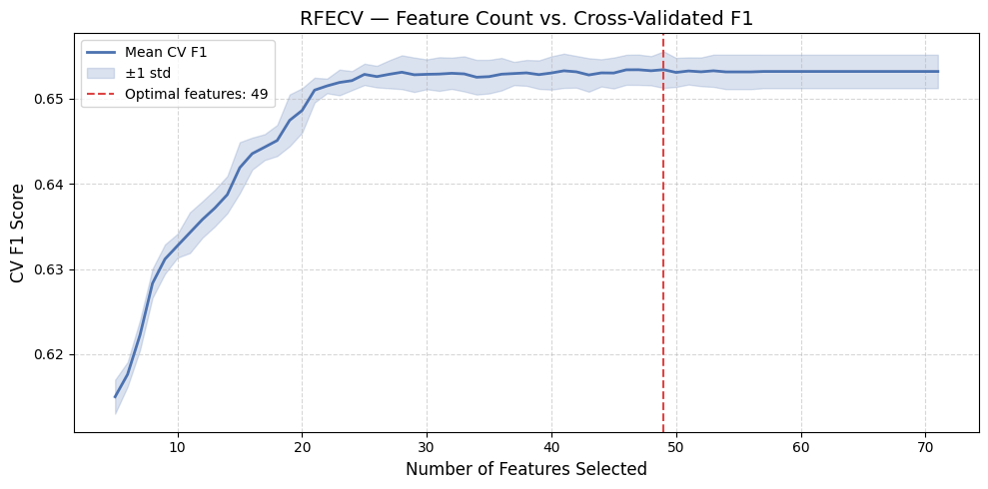
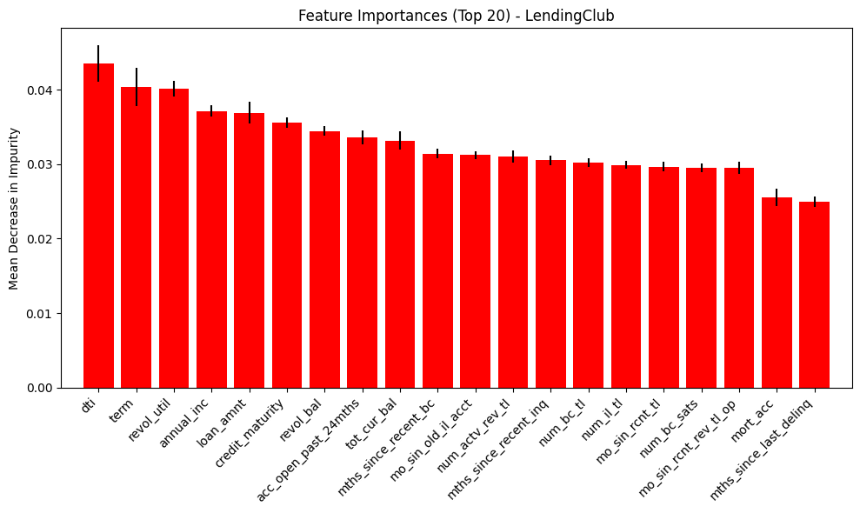
Feature selection identified a stable core of important predictors
some differences reflected preprocessing choices and model-specific selection behavior.
Future selection

Slide 15
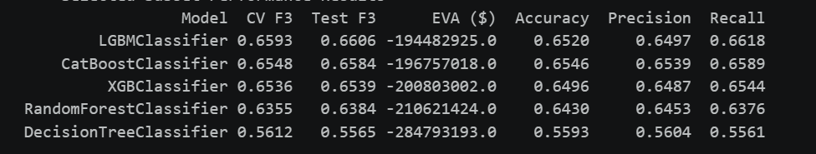
Classification technique used and results
Bounded by our tree dataset we used 5 tree-based ML techniques identifying LGBMClassifier as best performing one. Important to note that due to the fact that we used only tree-based models we did not scale or normalize data as these models can handle extreme values naturally.
Custom Evaluation Metric
The metric we create to simulate a banks profit works following the below algorithm:
Profit = TN (Loan * Rate) – FN (Loan * Recovery Ratio) – Opportunity Cost (Total Capital * Risk Free Rate)
Recovery rate – The amount of money a bank can get per 1$ of bad loan by selling it to debt collecting agencies.
Risk free rate – The amount of interest the bank could earn if it had loaned the capital to a risk-free entity like the government instead of a borrower.

Slide 16
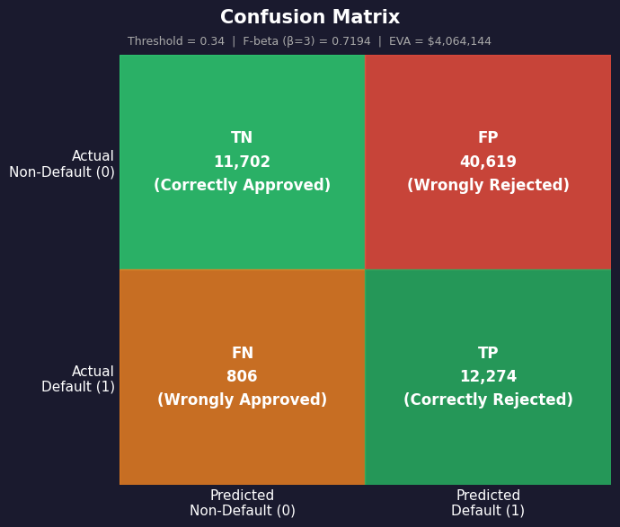
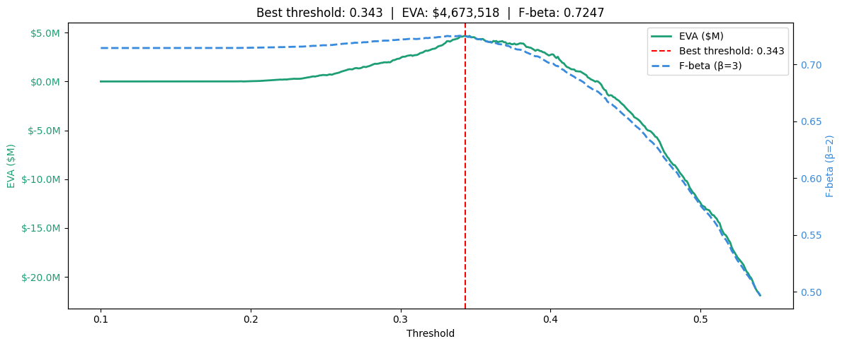
Final Results
The confusion matrix shows that the model achieves a balanced trade-off between identifying defaults and avoiding unnecessary rejections. Since our objective places more weight on catching risky borrowers, the F-beta score confirms that the model performs well under a recall-oriented evaluation criterion

Slide 17
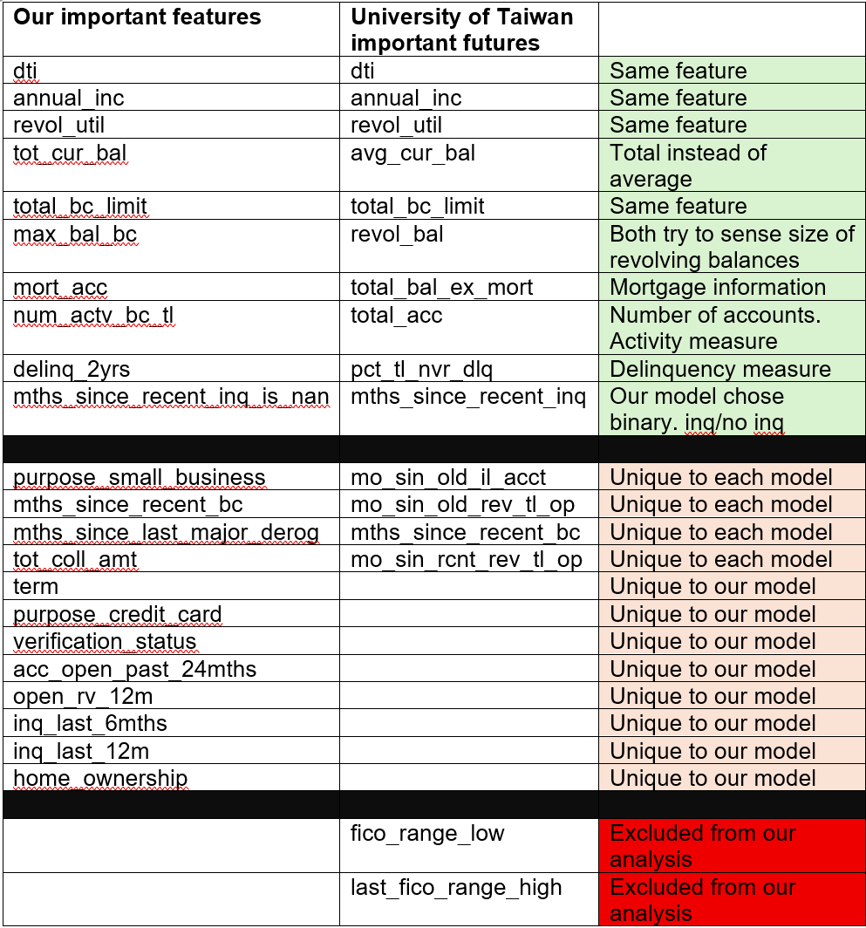
Results and comparison with other literature
Our important features largely align with prior literature, with differences mostly coming from proxy selection and dataset-specific modeling choices

Slide 18

Interpretation of results for experts in the field
The resulting model uses well known ratios and information that the financial industry commonly uses. Information dti, home ownership, verification status, annual income, delinquency or derogatory history are information all banks now require. Furthermore, out profitability metric shows that there is room for improvement and ML models do provide valuable addition to the existing bank measure.
Limitations
Endogeneity of Interest Rates
Risk appetite and economic conditions
Survivorship bias and bias dataset

Slide 19
Thank you for your attention

Slide 20
Data pre-processing techniques (missing data/multicoliniarity, encoding, scaling and normalization balancing of dataset )
The paradox of two zero’s
Open_acc_6m
2
5
4
NaN
1
Open_acc_6m
2
5
4
0
1
mths_since_last_delinq
2
0
4
NaN
1
mths_since | was_NaN
2 | 0
0 | 0
4 | 0
0 | 1
1 | 0
mths_since_last_delinq
2
5
4
0
1

